Slide 1
DNA Cleanup with SPRI Beads
Laboratory Module
Notes:
Organization logos will be included in the video’s outro animation

Slide 2
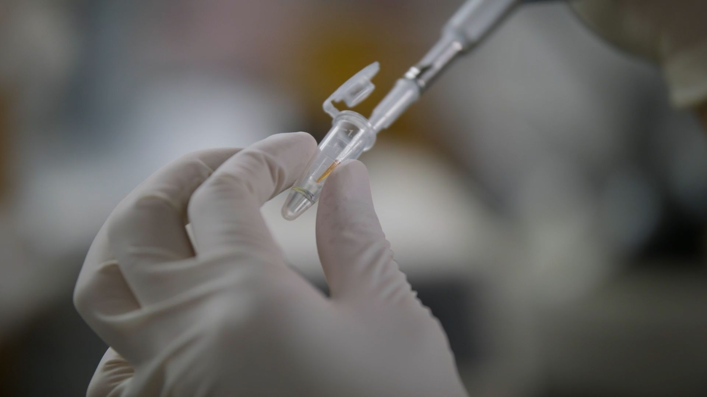
Why use SPRI cleanups?
SPRI: Solid Phase Reversible Immobilisation
Removes contaminants introduced during library preparation
Does not compromise sample quality
Easily modified for various target fragment lengths

Slide 3
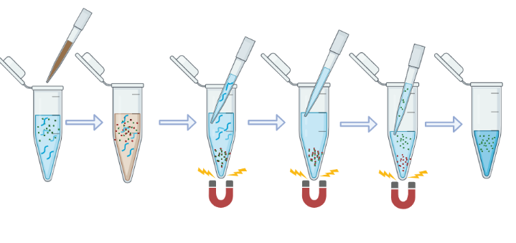
SPRI Overview
Add beads
Binding
Remove
Supernatant
EtOH wash
Elute in H2O
Transfer elution
Created with BioRender.com
Notes:
figure made in biorender

Slide 4
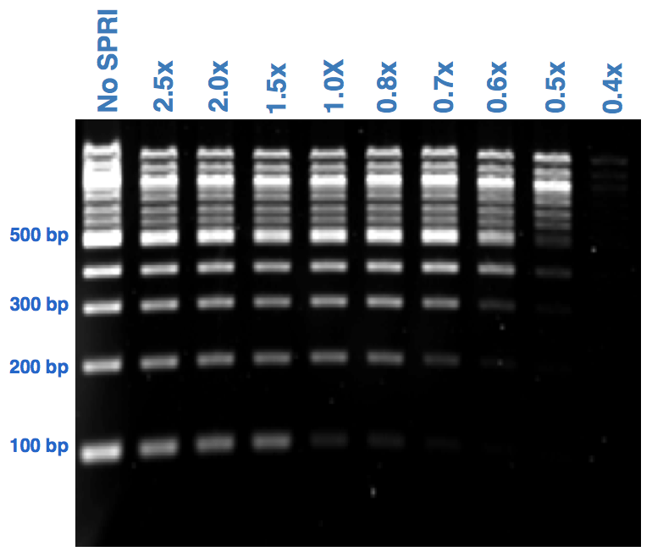
Image from Broad Institute Bootcamp: https://www.broadinstitute.org/genome-sequencing/broadillumina-genome-analyzer-boot-camp

Slide 5
SPRI Overview
Add beads
Binding
Remove
Supernatant
EtOH wash
Elute in H2O
Transfer elution
Created with BioRender.com
Notes:
figure made in biorender

Slide 6
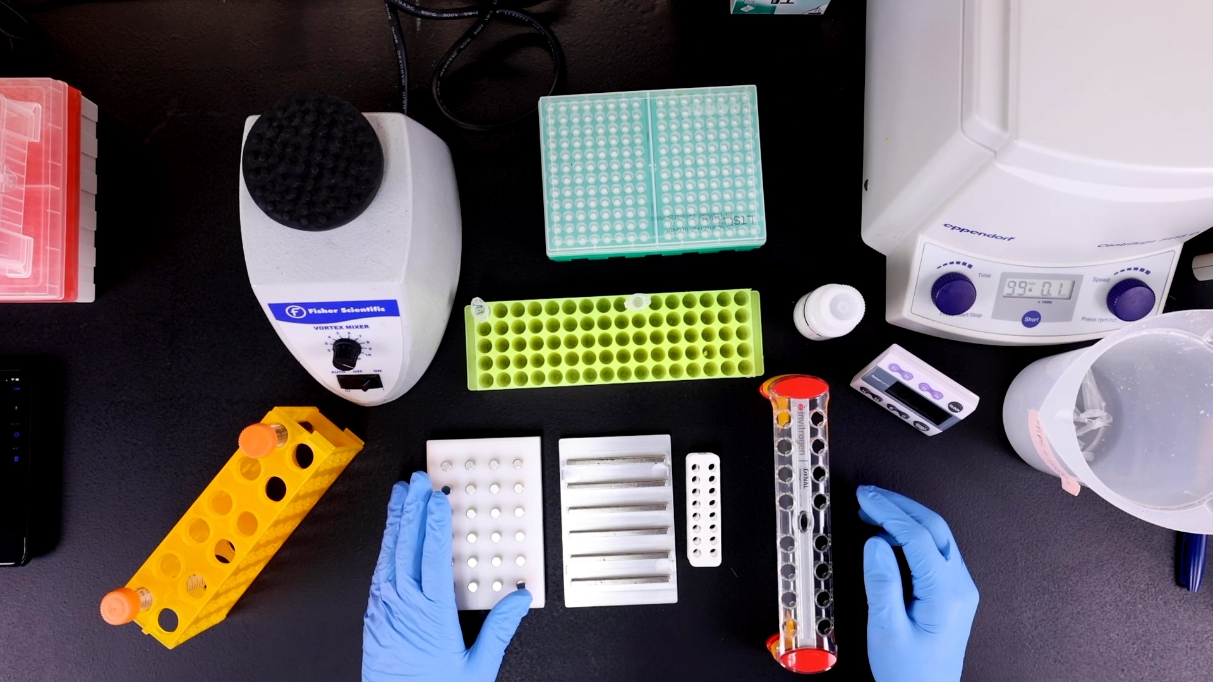
Notes:
figure made in biorender

Slide 7
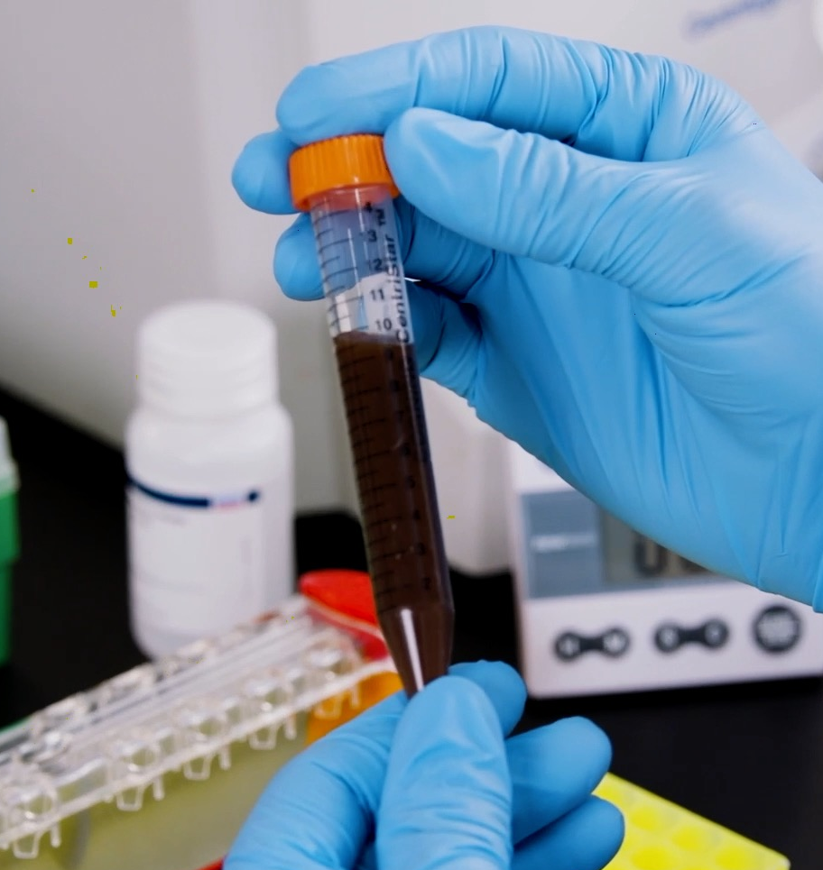
Important considerations for SPRI cleanups
Divide beads into 4-5 mL aliquots
Always warm beads to room temperature and mix well before using
80% ethanol should be freshly prepared

