Slide 1
Introduction to Bioinformatics – Illumina Sequencing
Bioinformatics Module

Slide 2
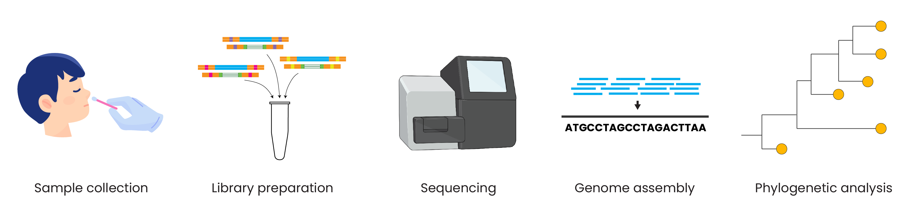
Genomic epidemiology workflow
BioRender.com
Pixel True https://www.pixeltrue.com/about, CC BY-SA 4.0, via Wikimedia Commons

Slide 3
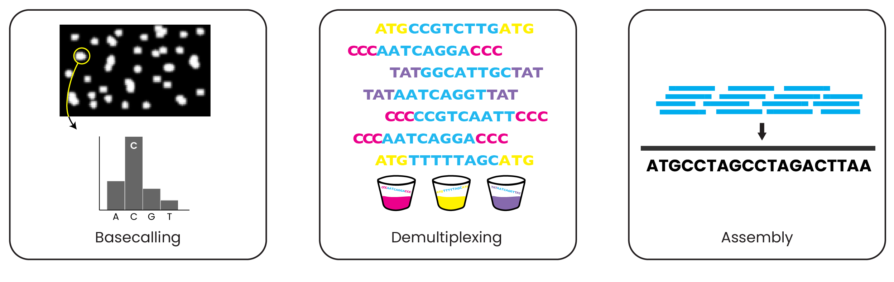
Key steps in pathogen genome assembly
Call nucleotides from raw signal data
Divide reads by sample barcode
Assemble reads into a complete genome
Basecalling
Demultiplexing
Assembly

Slide 4
Key steps in pathogen genome assembly
Call nucleotides from raw signal data
Divide reads by sample barcode
Assemble reads into a complete genome
Raw data
FASTQ
FASTQ
FASTQ
1 FASTQ per sample
FASTA

Slide 5
Basecalling on the Illumina platform
Call nucleotides from raw signal data
Raw data
FASTQ

Slide 6
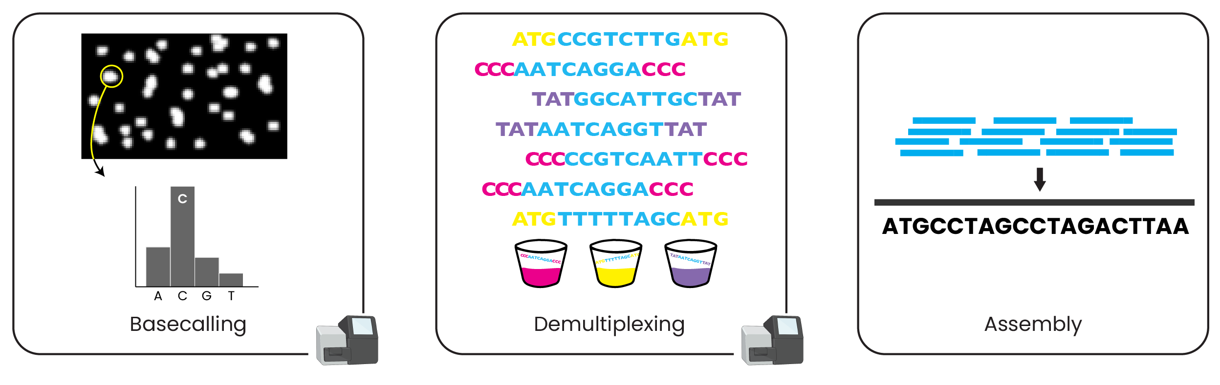
Basecalling on the Illumina platform
Call nucleotides from raw signal data
Image files
FASTQ

Slide 7
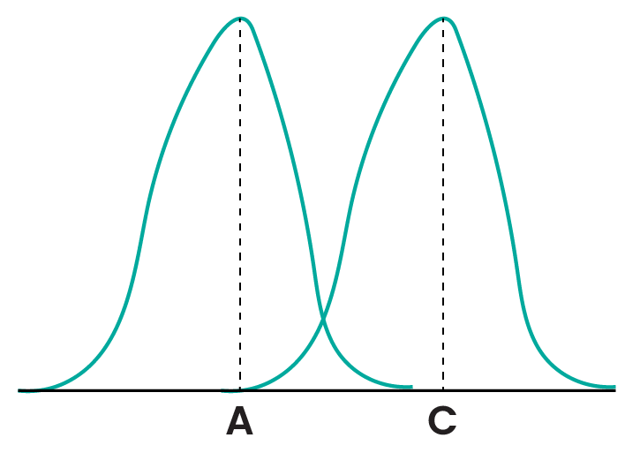
Basecalling on the Illumina platform
Call nucleotides from raw signal data
Image files
FASTQ
Notes:
Complicated process involving analyses of each cluster of light, subtracting background, and determining which channel has most signal, as shown in bar graph

Slide 8
Basecalling on the Illumina platform
Call nucleotides from raw signal data
Image files
Detailed explanation on Illumina website:
https://support.illumina.com/content/dam/illumina-support/courses/MiSeq_Imaging_and_Base_Calling/story_html5.html
FASTQ

Slide 9
Understanding the FASTQ format
Call nucleotides from raw signal data
Image files
FASTQ
Basecalling converts raw data into files that end with .fastq (or .fastq.gz) – these contain raw reads

Slide 10
Understanding the FASTQ format
@M01244:353:000000000-GC8JL:1:1101:16145:1385 1:N:0:5
GGCTTCATTTAATTATTTGAAGTCACCTAATTTTTCTAAACTGATAAATATTATAATTTGGTTTTTACTATTAAGTGTTTGCC+
B@AABFFFFFFFGGGGGGGFGGFHFFFHHHFFFHHFGHGFGHHHHFFFFHFHHGGGFHFDGBFFFGEGHHHHHHGGGHHHHEF
@M01244:353:000000000-GC8JL:1:1101:16975:1388 1:N:0:5
GGCTTCATTTAATTATTTGAAGTCACCTAATTTTTCTAAACTGATAAATATTATAATTTGGTTTTTACTATTAAGTGTTTGCC+
>AAAA1@DFDD@GFFFG3AFGFHGGHBB1AGHBFGGHBGHBGE1FGGFDD2FG2A2DHF2GH/GGEHHGDAGB2F22DGA0FF
Information for 1 read
There are 4 lines of information for each read
Image files
FASTQ
Basecalling converts raw data into files that end with .fastq (or .fastq.gz) – these contain raw reads

Slide 11
Understanding the FASTQ format
Read identifier: starts with @
@M01244:353:000000000-GC8JL:1:1101:16145:1385 1:N:0:5
GGCTTCATTTAATTATTTGAAGTCACCTAATTTTTCTAAACTGATAAATATTATAATTTGGTTTTTACTATTAAGTGTTTGCC+
B@AABFFFFFFFGGGGGGGFGGFHFFFHHHFFFHHFGHGFGHHHHFFFFHFHHGGGFHFDGBFFFGEGHHHHHHGGGHHHHEF
@M01244:353:000000000-GC8JL:1:1101:16975:1388 1:N:0:5
GGCTTCATTTAATTATTTGAAGTCACCTAATTTTTCTAAACTGATAAATATTATAATTTGGTTTTTACTATTAAGTGTTTGCC+
>AAAA1@DFDD@GFFFG3AFGFHGGHBB1AGHBFGGHBGHBGE1FGGFDD2FG2A2DHF2GH/GGEHHGDAGB2F22DGA0FF
There are 4 lines of information for each read
Image files
FASTQ
Basecalling converts raw data into files that end with .fastq (or .fastq.gz) – these contain raw reads

Slide 12
Understanding the FASTQ format
Read identifier: starts with @
Single read
sequence
@M01244:353:000000000-GC8JL:1:1101:16145:1385 1:N:0:5
GGCTTCATTTAATTATTTGAAGTCACCTAATTTTTCTAAACTGATAAATATTATAATTTGGTTTTTACTATTAAGTGTTTGCC+
B@AABFFFFFFFGGGGGGGFGGFHFFFHHHFFFHHFGHGFGHHHHFFFFHFHHGGGFHFDGBFFFGEGHHHHHHGGGHHHHEF
@M01244:353:000000000-GC8JL:1:1101:16975:1388 1:N:0:5
GGCTTCATTTAATTATTTGAAGTCACCTAATTTTTCTAAACTGATAAATATTATAATTTGGTTTTTACTATTAAGTGTTTGCC+
>AAAA1@DFDD@GFFFG3AFGFHGGHBB1AGHBFGGHBGHBGE1FGGFDD2FG2A2DHF2GH/GGEHHGDAGB2F22DGA0FF
There are 4 lines of information for each read
Image files
FASTQ
Basecalling converts raw data into files that end with .fastq (or .fastq.gz) – these contain raw reads

Slide 13
Understanding the FASTQ format
Read identifier: starts with @
Single read
sequence
@M01244:353:000000000-GC8JL:1:1101:16145:1385 1:N:0:5
GGCTTCATTTAATTATTTGAAGTCACCTAATTTTTCTAAACTGATAAATATTATAATTTGGTTTTTACTATTAAGTGTTTGCC+
B@AABFFFFFFFGGGGGGGFGGFHFFFHHHFFFHHFGHGFGHHHHFFFFHFHHGGGFHFDGBFFFGEGHHHHHHGGGHHHHEF
@M01244:353:000000000-GC8JL:1:1101:16975:1388 1:N:0:5
GGCTTCATTTAATTATTTGAAGTCACCTAATTTTTCTAAACTGATAAATATTATAATTTGGTTTTTACTATTAAGTGTTTGCC+
>AAAA1@DFDD@GFFFG3AFGFHGGHBB1AGHBFGGHBGHBGE1FGGFDD2FG2A2DHF2GH/GGEHHGDAGB2F22DGA0FF
Quality scores for each base
There are 4 lines of information for each read
Image files
FASTQ
Basecalling converts raw data into files that end with .fastq (or .fastq.gz) – these contain raw reads

Slide 14
Understanding the FASTQ format
Read identifier: starts with @
Single read
sequence
@M01244:353:000000000-GC8JL:1:1101:16145:1385 1:N:0:5
GGCTTCATTTAATTATTTGAAGTCACCTAATTTTTCTAAACTGATAAATATTATAATTTGGTTTTTACTATTAAGTGTTTGCC+
B@AABFFFFFFFGGGGGGGFGGFHFFFHHHFFFHHFGHGFGHHHHFFFFHFHHGGGFHFDGBFFFGEGHHHHHHGGGHHHHEF
@M01244:353:000000000-GC8JL:1:1101:16975:1388 1:N:0:5
GGCTTCATTTAATTATTTGAAGTCACCTAATTTTTCTAAACTGATAAATATTATAATTTGGTTTTTACTATTAAGTGTTTGCC+
>AAAA1@DFDD@GFFFG3AFGFHGGHBB1AGHBFGGHBGHBGE1FGGFDD2FG2A2DHF2GH/GGEHHGDAGB2F22DGA0FF
Quality scores for each base
Beginning of next read
There are 4 lines of information for each read
Image files
FASTQ
Basecalling converts raw data into files that end with .fastq (or .fastq.gz) – these contain raw reads

Slide 15
Key steps in pathogen genome assembly
Call nucleotides from raw signal data
Divide reads by sample barcode
Assemble reads into a complete genome
Raw data
FASTQ
FASTQ
FASTQ
1 FASTQ per sample
FASTA

Slide 16
Demultiplexing on the Illumina platform
Divide reads by sample barcode
FASTQ
1 FASTQ per sample

Slide 17


Demultiplexing on the Illumina platform
@M01244:353:000000000-GC8JL:1:1101:16145:1385 1:N:0:5
GGCTTCATTTAATTATTTGAAGTCACCTAATTTTTCTAAACTGATAAATATTATAATTTGGTTTTTACTATTAAGTGTTTGCC+
B@AABFFFFFFFGGGGGGGFGGFHFFFHHHFFFHHFGHGFGHHHHFFFFHFHHGGGFHFDGBFFFGEGHHHHHHGGGHHHHEF
@M01244:353:000000000-GC8JL:1:1101:16975:1388 1:N:0:5
GGCTTCATTTAATTATTTGAAGTCACCTAATTTTTCTAAACTGATAAATATTATAATTTGGTTTTTACTATTAAGTGTTTGCC+
>AAAA1@DFDD@GFFFG3AFGFHGGHBB1AGHBFGGHBGHBGE1FGGFDD2FG2A2DHF2GH/GGEHHGDAGB2F22DGA0FF
Your sample sheet tells the machine (or computer) what barcodes to look for and the sample name corresponding to each set of barcodes
sample1.fastq
sample2.fastq
@475b2a54-105d-438d-896d-ec3b37dadf2a
GCACCTCTTTCTTACTGCAGCACCGATTTCCCTCAGAC
+
/:<CC<3AHEDLE2$&'*''&&)45357BCG)7B:8=5
@525a4adc-ffe9-4ce3-9fe3-e4b0d6e9c975
GCACCTAAACGTAACTCGCTGGCATGCGGCATCAAACG
+
-22/$032(())=0()-4<C=:32)((-4;93>754?>
@27bf0fae-6ea7-4a2f-a846-b5064ee98b25
TTAGCGTTCATGCTCAAGCTTGGCGCGTTAGCCACCGG
+
,49<749>95;@@3ACA0&&+5;26%'@A;0/.*,,-0
@ef7b477d-6cc1-4694-a3dd-4de2eba0975e
TTAGCGATCGTACCCATGAAACCGCGAAAATCGAGTTG
+
79;A>;69:/91112$&(2<C::0@AAEI84:)$&%(&

Slide 18
Demultiplexing on the Illumina platform
After demultiplexing you should have 1 FASTQ file per sample on your sample sheet
Transfer the per-sample FASTQ files on the Illumina machine to a computer for assembly
Notes:
Transfer often automatic through basespace or another cloud setup but can do it manually
This is what you want assuming you don’t want to redo demux
All the raw files and pre-demux fastq are available as well

Slide 19
Demultiplexing on the Illumina platform
After demultiplexing you should have 1 FASTQ file per sample on your sample sheet
Transfer the per-sample FASTQ files on the Illumina machine to a computer for assembly
For paired-end sequencing, there will be two FASTQ files per sample:
sample1_R1_001.fastq
sample1_R2_001.fastq

Slide 20
Key steps in pathogen genome assembly
Call nucleotides from raw signal data
Divide reads by sample barcode
Assemble reads into a complete genome
Raw data
FASTQ
FASTQ
FASTQ
1 FASTQ per sample
FASTA

Slide 21
Understanding the FASTA format
Assemble reads into a complete genome
FASTQ
Assembly converts .fastq files into .fasta files
FASTA

Slide 22
Understanding the FASTA format
>sample1
AGGGTCATTAAATATATATAAAGATCTATATAGAGATCTTTTTATTAGATCTACT
GGAGCAGGATCTTTGTGGATAAGTGAAAAATGATCAACAAGATCATGCGATTCAG
TCAGATCGTGTGATCAACCACTGATCTGTTCAAGGATTAGCTGGGATCAAAAACC
TATACACAGCCACCTTGGGATCTAAAACTTGTTATATGGATAACTATAGGAAGAT
GATAATCGTATAGTTATCCACATGAGATTTGATTGAAAAAGCATCAATCAATTTT
TACCGTTAAATTTATCCACAATCCNAAAAAAAGAGCGGCATTAAGCCGCTCTGCA
TAGGTCATTATTTAGAAGCGATTGATGACGCGTTTGAGCCAAGCTTCAGCGGCAT
GGCACTGGGTGCTCTTGTACATCGATGGTAAAGCAGTTGGCCAGAGGTTTAGCAC
TACCGTTAAATTTATCCACAATCCNAAAAAAAGAGCGGCATTAAGCCGCTCTGCA
Assemble reads into a complete genome
The first line of a sequence starts with >
FASTA files contain only the sequence name and nucleotide sequence
All of the individual reads have been put together into a complete genome

Slide 23
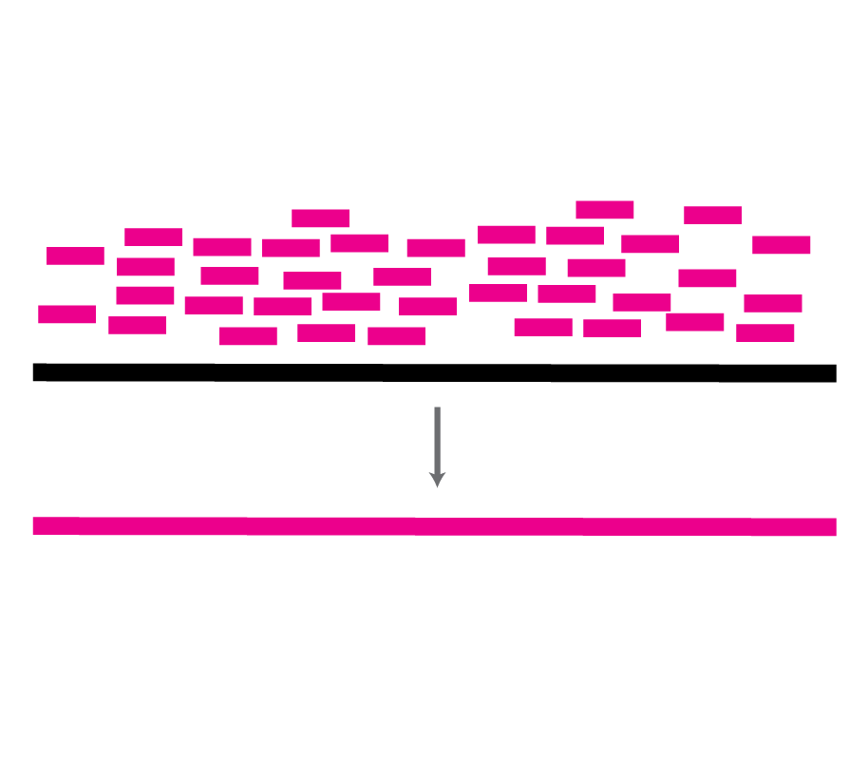
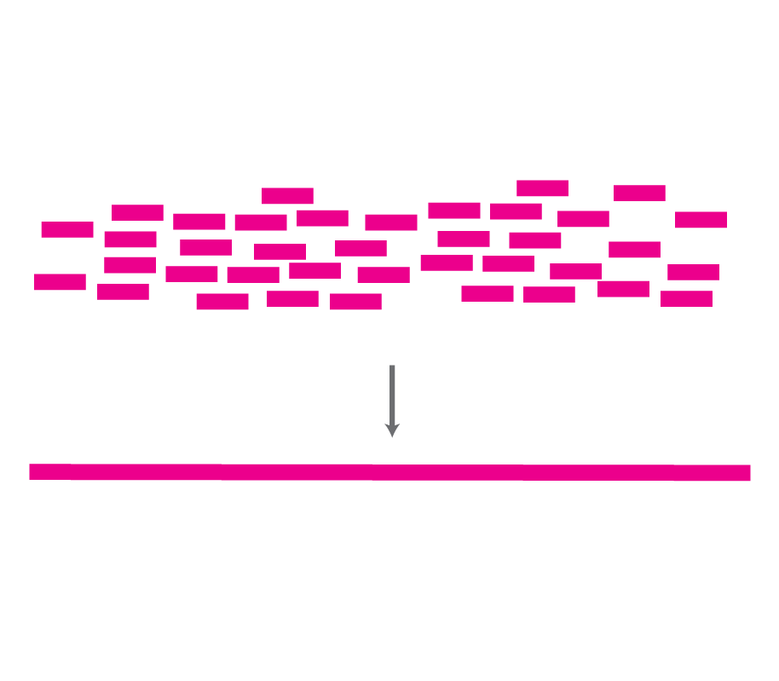
Two types of genome assembly
Reference-based assembly
Requires selection of an appropriate reference genome
Each read is aligned to the correct position along the reference
De novo assembly
Does not require a reference genome
Useful when infectious pathogen is unknown
Overlapping parts of reads are used to create genome

Slide 24
Two types of genome assembly
Reference-based assembly
Requires selection of an appropriate reference genome
Each read is aligned to the correct position along the reference
De novo assembly
Does not require a reference genome
Useful when infectious pathogen is unknown
Overlapping parts of reads are used to create genome

Slide 25
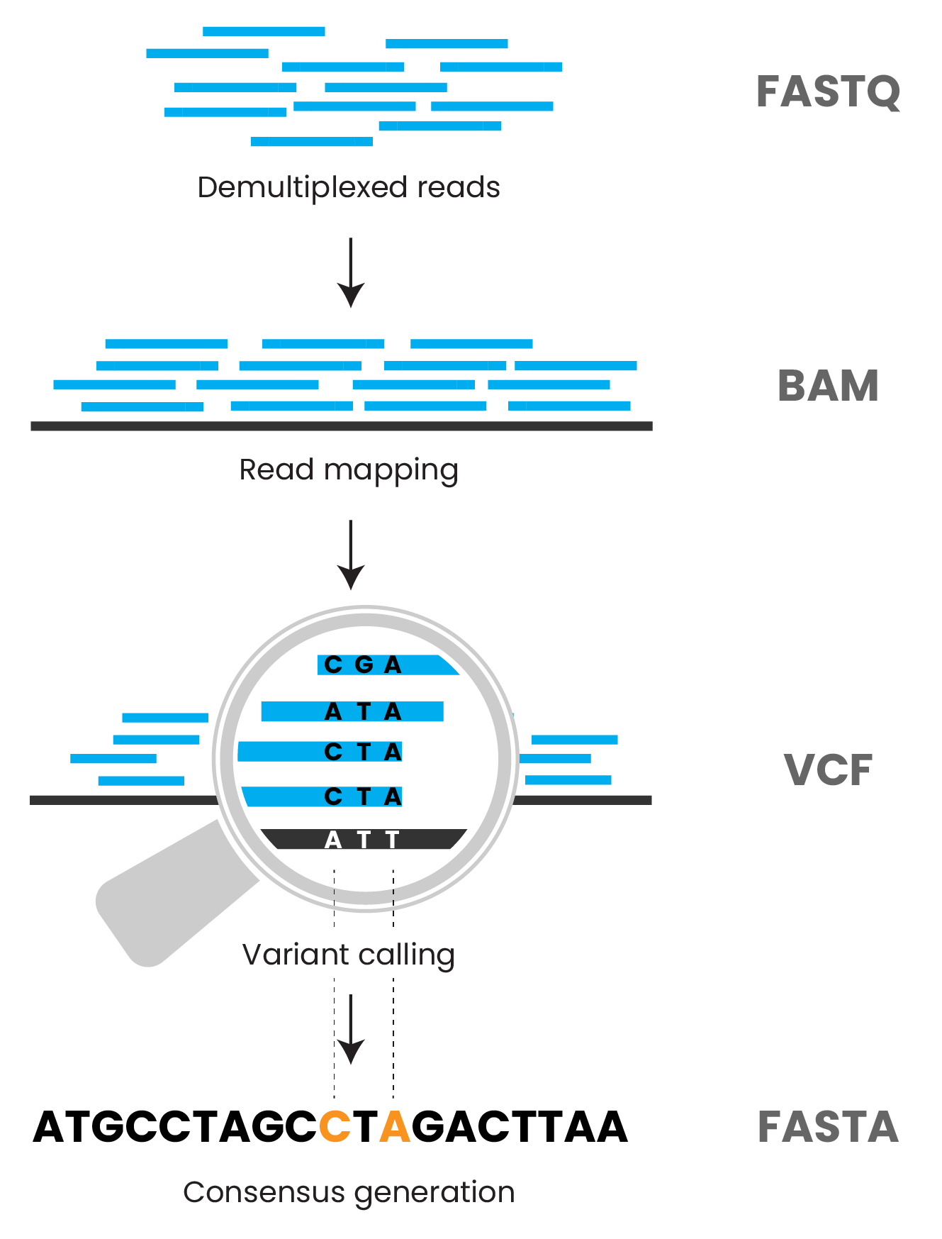

Slide 26
TGCCTAATCGG
ACTTAGCCTCG
CGCATGTCATCC
reads aligned to reference
AGTCGGGACT
CTCGATTTCGCA
ATGCCTAATCGGGACTTAGCCTGGATTTCGCCTGTCATCCGAT
reference genome
Position of each read along reference genome saved in BAM file
Not human-readable file format, requires special software to view

Slide 27
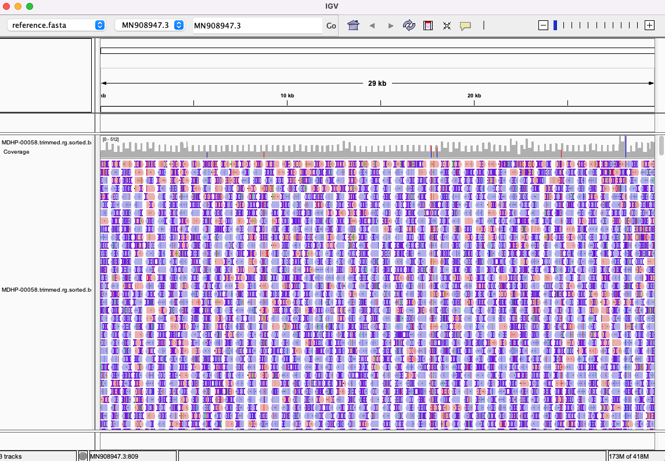
Position of each read along reference genome saved in BAM file
Not human-readable file format, requires special software to view

Slide 29
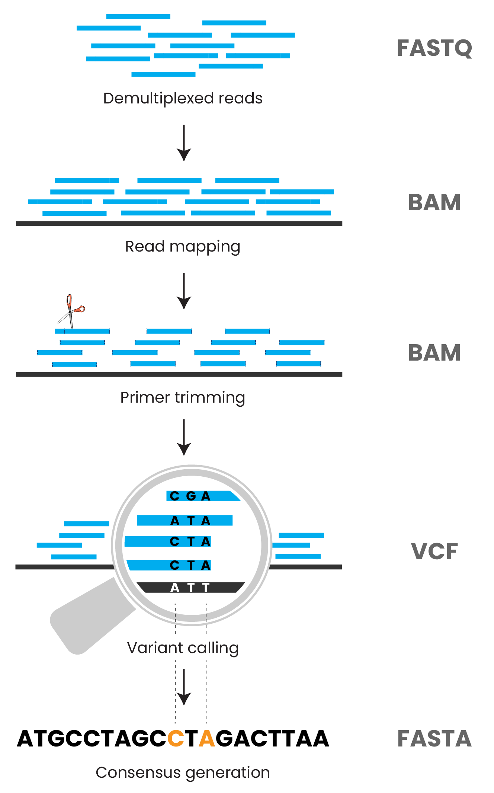
Notes:
The next step after mapping reads to the reference is calling variants, or differences from the reference genome
But if you performed amplicon sequencing, there is one more step first

Slide 30
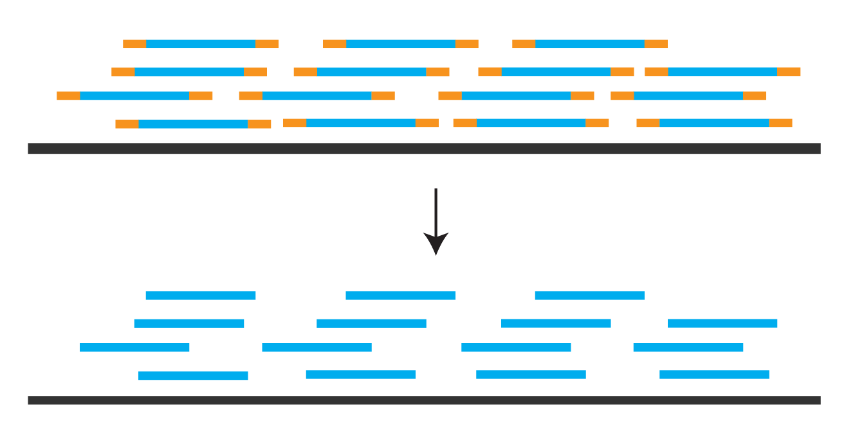
Notes:
The next step after mapping reads to the reference is calling variants, or differences from the reference genome
But if you performed amplicon sequencing, there is one more step first

Slide 31
Trim off primer regions using a BED file
Notes:
The next step after mapping reads to the reference is calling variants, or differences from the reference genome
But if you performed amplicon sequencing, there is one more step first

Slide 32
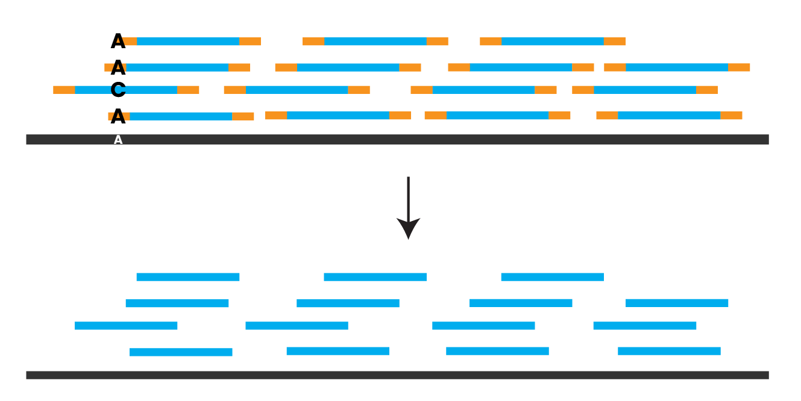
Trim off primer regions using a BED file

Slide 34
TGCCTAATCGG
ACTTAGCCTCG
CGCATGTCATCC
AGTCGGGACT
CTCGATTTCGCA
ATGCCTAATCGGGACTTAGCCTGGATTTCGCCTGTCATCCGAT
T

Slide 35
TGCCTAATCGG
ACTTAGCCTCG
CGCATGTCATCC
AGTCGGGACT
CTCGATTTCGCA
ATGCCTAATCGGGACTTAGCCTGGATTTCGCCTGTCATCCGAT
TG

Slide 36
TGCCTAATCGG
ACTTAGCCTCG
CGCATGTCATCC
AGTCGGGACT
CTCGATTTCGCA
ATGCCTAATCGGGACTTAGCCTGGATTTCGCCTGTCATCCGAT
TGCCTAATCGGGACTTAGCCTCGATTTCGCATGTCATCC

Slide 37
TGCCTAATCGG
ACTTAGCCTCG
CGCATGTCATCC
AGTCGGGACT
CTCGATTTCGCA
ATGCCTAATCGGGACTTAGCCTGGATTTCGCCTGTCATCCGAT
N
TGCCTAATCGGGACTTAGCCTCGATTTCGCATGTCATCCNNN

Slide 38
within-host variant
ATAGCCTCG
TGCCTAATCGG
ACTTAGCCTCG
CGCATGTCATCC
AGTCGGGACT
CTCGATTTCGCA
ATGCCTAATCGGGACTTAGCCTGGATTTCGCCTGTCATCCGAT
N
TGCCTAATCGGGACTTAGCCTCGATTTCGCATGTCATCCNNN
consensus variants

Slide 39
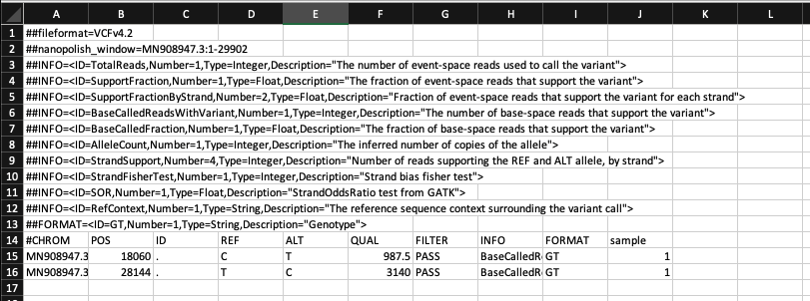
TGCCTAATCGG
ACTTAGCCTCG
CGCATGTCATCC
AGTCGGGACT
CTCGATTTCGCA
ATGCCTAATCGGGACTTAGCCTGGATTTCGCCTGTCATCCGAT
N
TGCCTAATCGGGACTTAGCCTCGATTTCGCATGTCATCCNNN
consensus genome stored in FASTA file
All variants are stored in a special file format called a VCF file
Includes consensus and within-host variants

Slide 40
Key steps in pathogen genome assembly
Call nucleotides from raw signal data
Divide reads by sample barcode
Assemble reads into a complete genome
Raw data
FASTQ
FASTQ
FASTQ
1 FASTQ per sample
FASTA

Slide 41
Summary
There are three key steps in pathogen assembly
Raw reads are stored in FASTQ files
Final assemblies are stored in FASTA files
There are two methods of assembling genomes
Other special file formats store intermediate files

