Slide 1
Submitting Viral Assemblies to GISAID
Bioinformatics Module

Slide 2
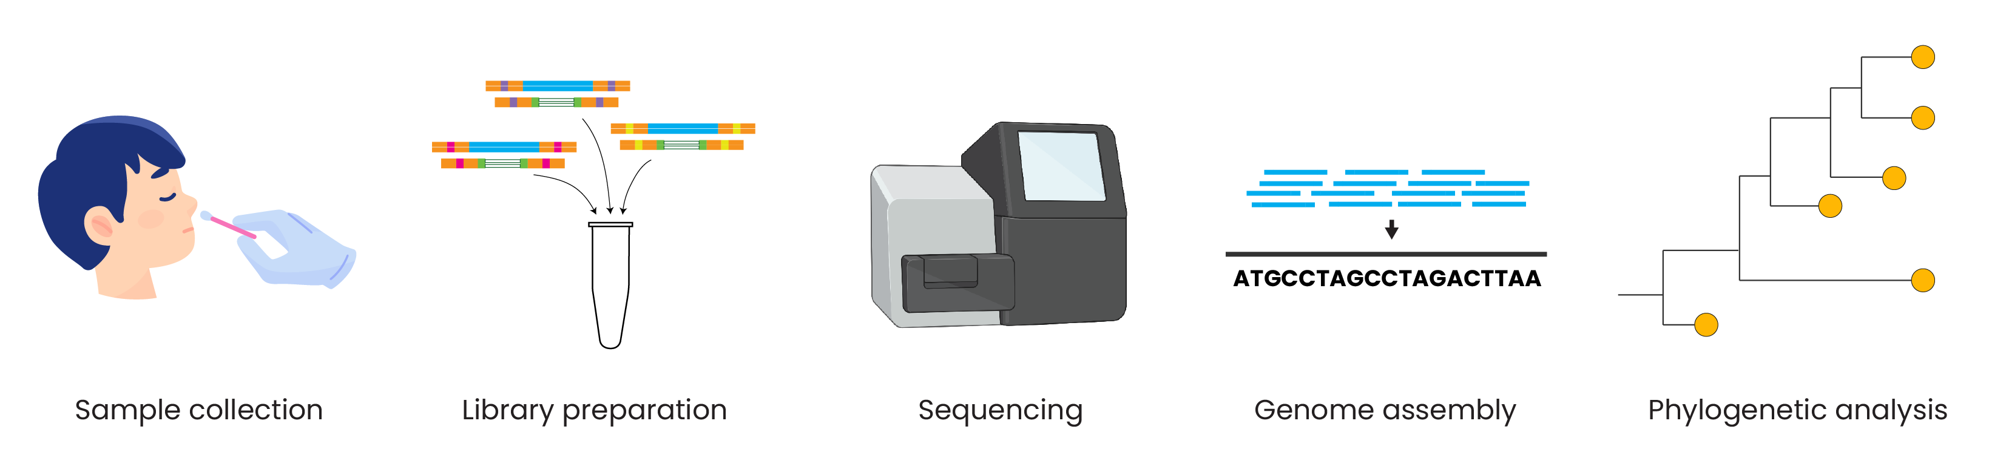
Genomic epidemiology workflow
BioRender.com
Pixel True https://www.pixeltrue.com/about, CC BY-SA 4.0, via Wikimedia Commons

Slide 3
Outline
GISAID Overview
Batch vs Single Sequence Upload
SARS-CoV-2 Metadata Format
Common Errors and Troubleshooting

Slide 4


Slide 5
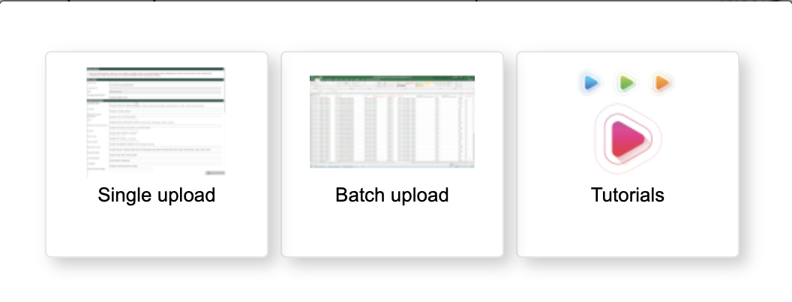
Select batch upload to upload multiple genomes at once

Slide 6
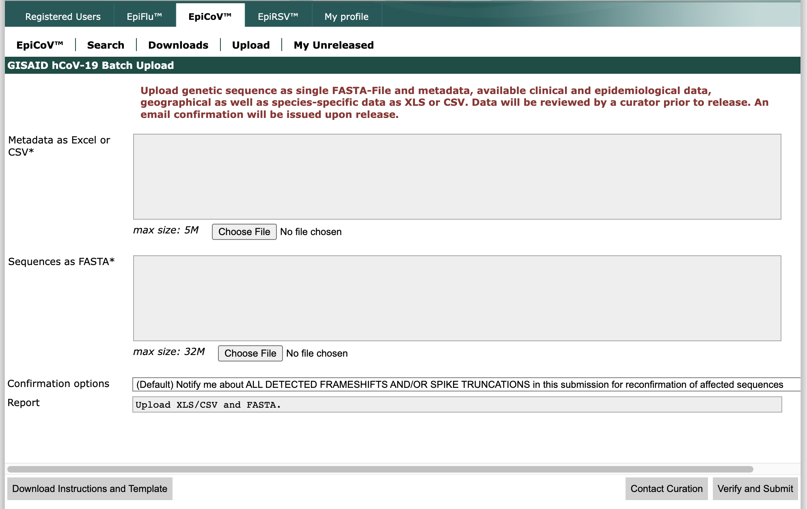

Slide 7
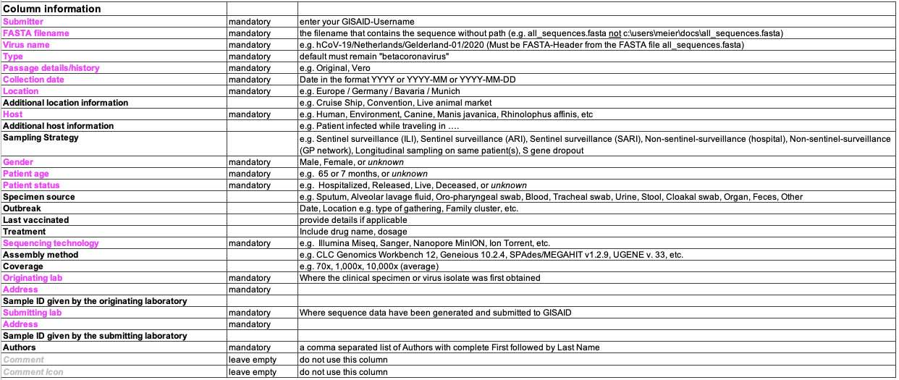
Metadata fields for GISAID submission

Slide 9
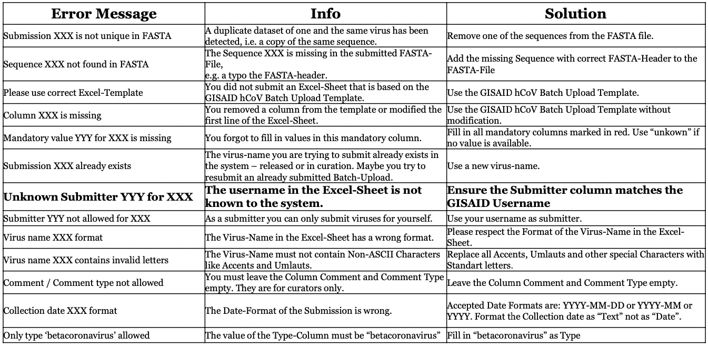
Common errors and troubleshooting

Slide 10
Summary
GISAID is a key assembly sharing consortium for influenza and now, SARS-CoV-2 genomes
Batch upload is the most often used method for submitting sequences
GISAID provides a data standard for metadata submission, which must be strictly followed
Errors in GISAID sequence submission can be corrected with curation staff over email

