Slide 1
Introduction to the Command Line
Command Line Module

Slide 2
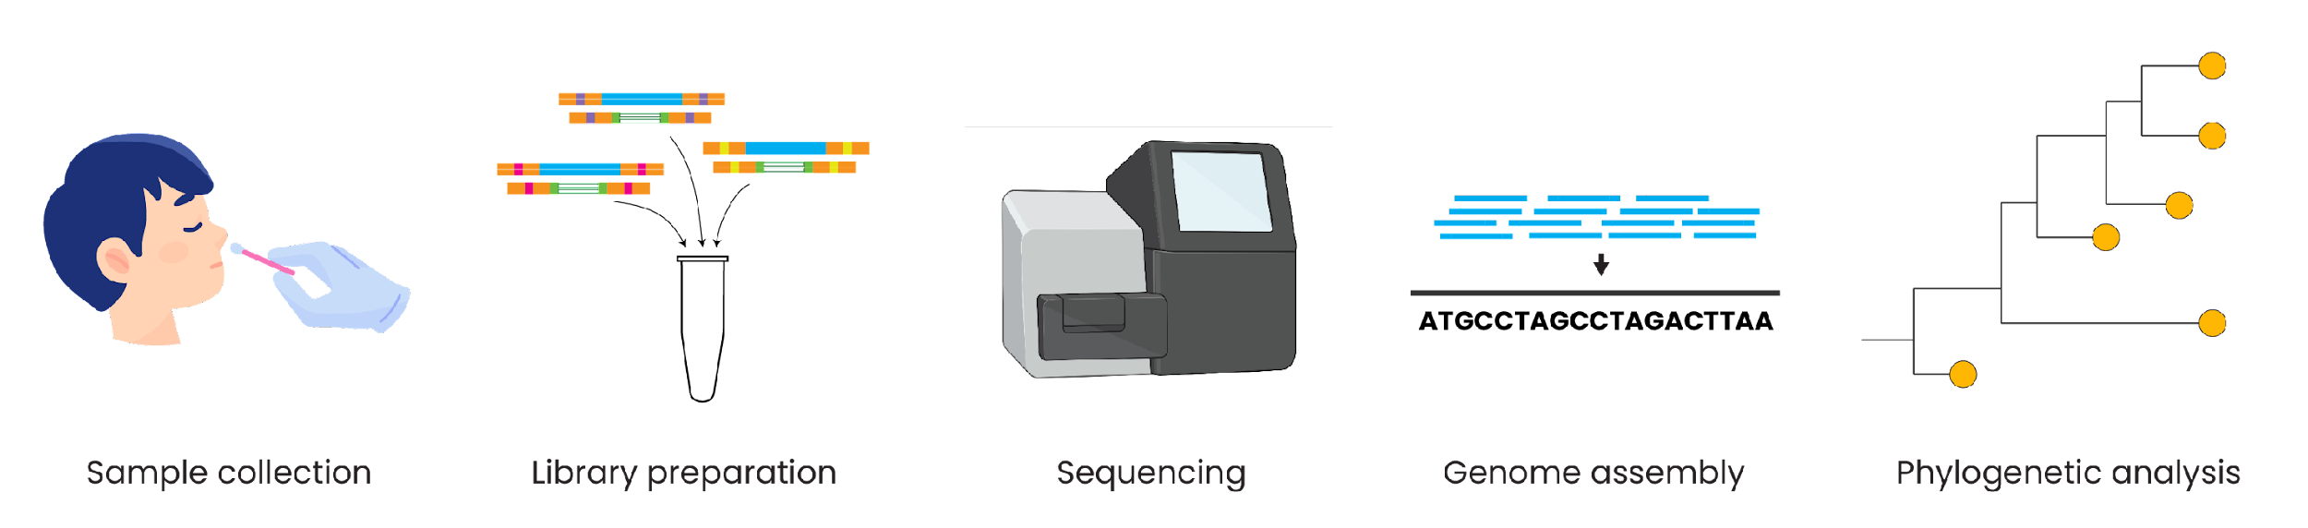
Genomic epidemiology workflow
BioRender.com
Pixel True https://www.pixeltrue.com/about, CC BY-SA 4.0, via Wikimedia Commons

Slide 3
Outline
What is the command line?
Why use the command line?
Types of command lines

Slide 4
Outline
What is the command line?
Why use the command line?
Types of command lines

Slide 5
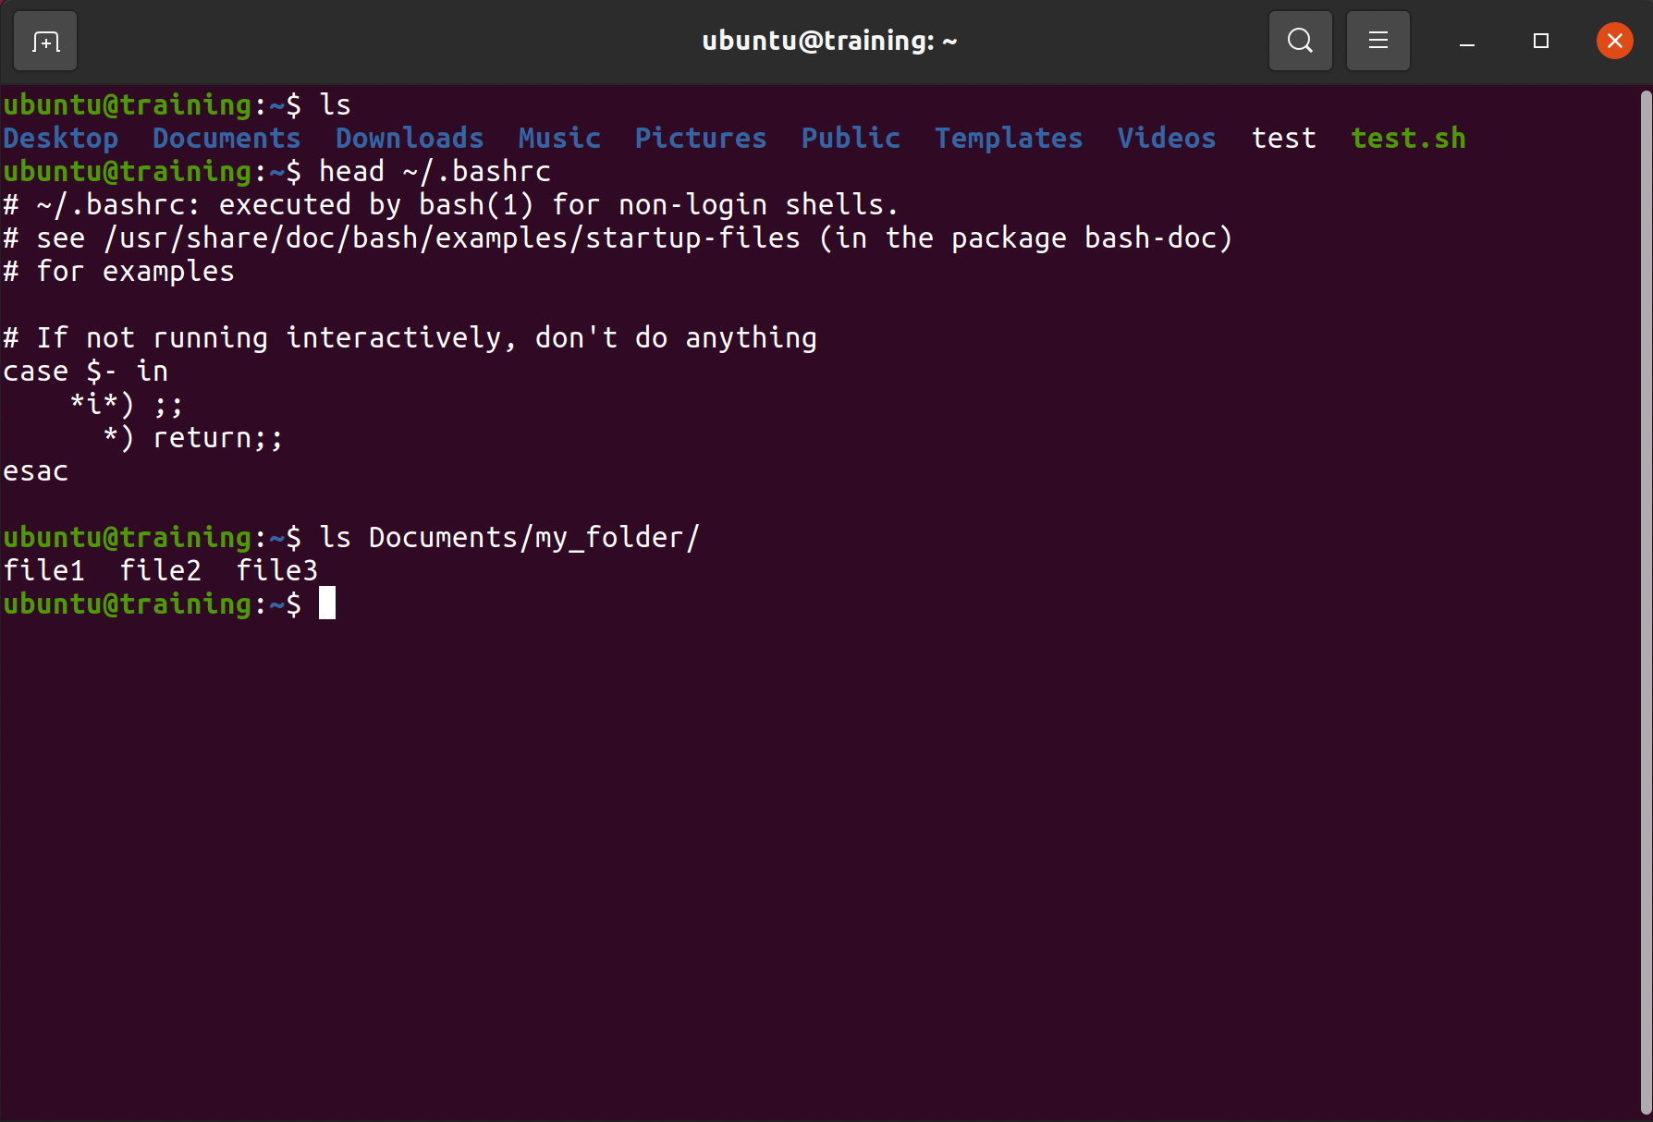
What is the command line?

Slide 6
What is the command line?
Computer interface: a way to interact with and control a computer.

Slide 7
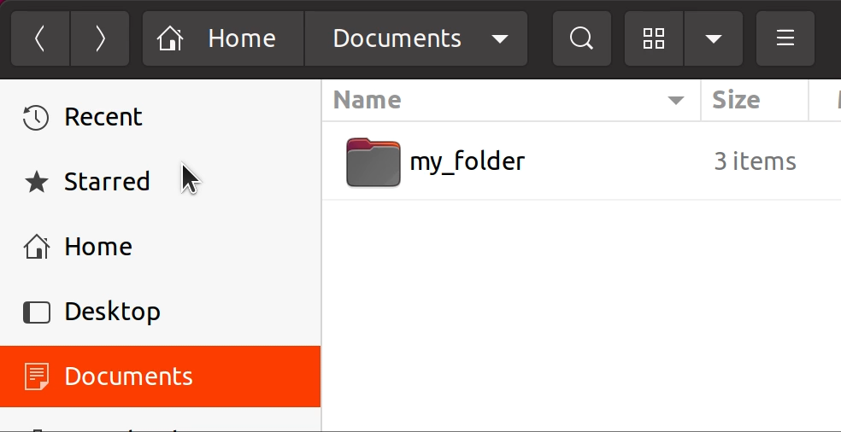
What is the command line?
Graphical interface
⇒ point and click with a mouse

Slide 8
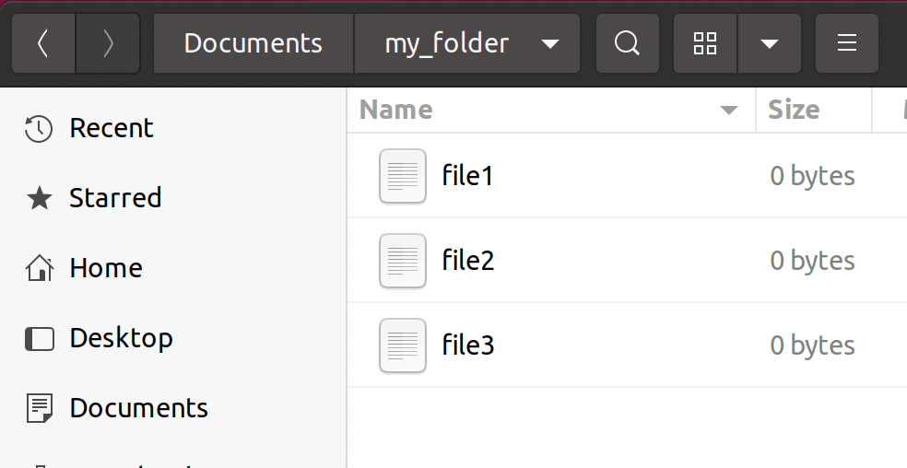
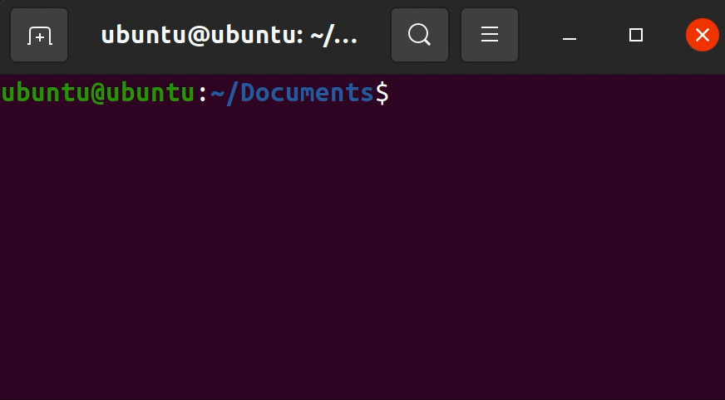
What is the command line?
Graphical interface
⇒ point and click with a mouse
Text-based interface
⇒ write a series of commands
Notes:
convert video to gif-like objects

Slide 9
SCREENCAST

Slide 10
What is the command line?
Computer interface: a way to interact with and control a computer

Slide 11
What is the command line?
Computer interface: a way to interact with and control a computer
A text-based interface
As opposed to a graphical interface

Slide 12
What is the command line?
Computer interface: a way to interact with and control a computer
A text-based interface
As opposed to a graphical interface
Can perform the same functions as many graphical interfaces

Slide 13
Outline
What is the command line?
Why use the command line?
Types of command lines

Slide 14
Why use the command line?
Powerful way to control a computer
Powerful built-in commands
Numerous external packages that can be installed

Slide 15
Why use the command line?
Powerful way to control a computer
Simple to automate tasks
Every action must be described with written text
Easy to share
Improves reproducibility

Slide 16
Outline
What is the command line?
Why use the command line?
Types of command lines

Slide 17
Types of command line interfaces
MacOS
Linux
Windows
Notes:
Feedback:
See comments in script about potentially moving away from different languages
Instead perhaps you could have some slides showing windows/mac/linux computers

Slide 18
Types of command line interfaces
MacOS
Linux
Windows
Notes:
Feedback:
See comments in script about potentially moving away from different languages
Instead perhaps you could have some slides showing windows/mac/linux computers

Slide 19

Types of command line interfaces
MacOS
Linux
Windows
Terminal
Notes:
Feedback:
See comments in script about potentially moving away from different languages
Instead perhaps you could have some slides showing windows/mac/linux computers

Slide 20
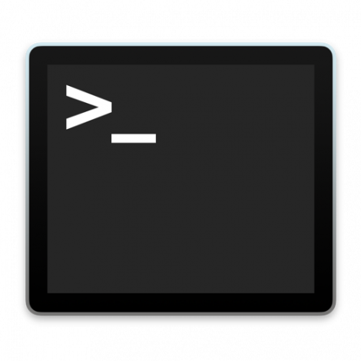
Types of command line interfaces
MacOS
Linux
Windows
Terminal
Terminal
Notes:
Feedback:
See comments in script about potentially moving away from different languages
Instead perhaps you could have some slides showing windows/mac/linux computers

Slide 21

Types of command line interfaces
MacOS
Linux
Windows
Terminal
Terminal
Notes:
Feedback:
See comments in script about potentially moving away from different languages
Instead perhaps you could have some slides showing windows/mac/linux computers

Slide 22
Summary
The command line is a text-based computer interface
The command line is a powerful way to control a computer and automate tasks
The command line can be used on most computers
Notes:
Feedback:
- Please add 2-5 bullet points with key takeaways from this video

