Slide 1
Navigating the Command Line
Command Line Module

Slide 2
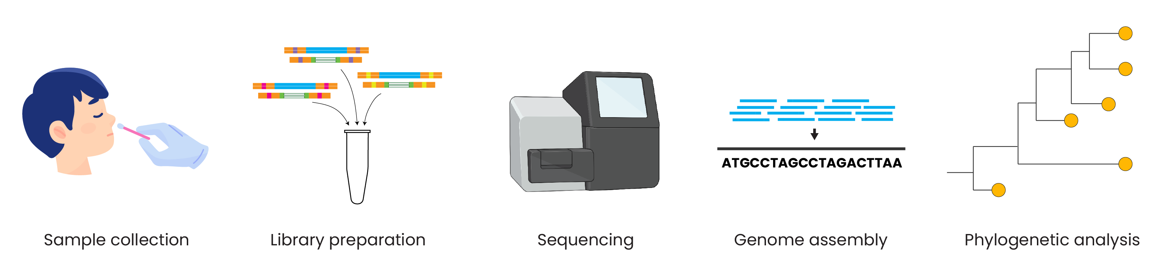
Genomic epidemiology workflow
BioRender.com
Pixel True https://www.pixeltrue.com/about, CC BY-SA 4.0, via Wikimedia Commons

Slide 3
Outline
Navigate the computer
Interact with files and folders
Learn about directories and file paths

Slide 4
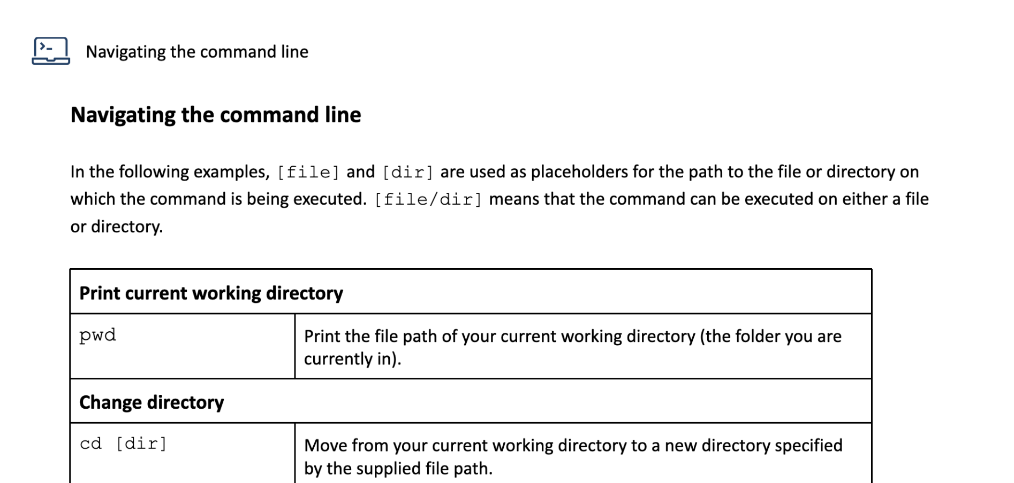
Run each command as we cover it in the video

Slide 5
<screencast>

Slide 6
Understanding file paths
/home/seqlaptop/test/fastas

Slide 7
Understanding file paths
/home/seqlaptop/test/fastas
file or folder name

Slide 8
Understanding file paths
/home/seqlaptop/test/fastas
file or folder name
location of the file or folder

Slide 9
Understanding file paths
/home/seqlaptop/test/fastas

Slide 10
Understanding file paths
/home/seqlaptop/test/fastas

Slide 11
Understanding file paths
/home/seqlaptop/test/fastas

Slide 12
Understanding file paths
/home/seqlaptop/test/fastas

Slide 13
Relative vs absolute file paths
Relative file path
Set of directions that must be followed from a specific starting point
e.g. ”turn left, then turn right”

Slide 14
Relative vs absolute file paths
Relative file path
Set of directions that must be followed from a specific starting point
e.g. ”turn left, then turn right”
Absolute file path
Set of directions that can be followed from any starting point
e.g. “latitude 30, longitude -50”

Slide 15
Relative vs absolute file paths
Relative file path
Set of directions that must be followed from a specific starting point
e.g. ”turn left, then turn right”
Absolute file path
Set of directions that can be followed from any starting point
e.g. “latitude 30, longitude -50”
Current location: /home/seqlaptop/

Slide 16
Relative vs absolute file paths
Relative file path
Set of directions that must be followed from a specific starting point
e.g. ”turn left, then turn right”
Absolute file path
Set of directions that can be followed from any starting point
e.g. “latitude 30, longitude -50”
Current location: /home/seqlaptop/
test/

Slide 17
Relative vs absolute file paths
Relative file path
Set of directions that must be followed from a specific starting point
e.g. ”turn left, then turn right”
Absolute file path
Set of directions that can be followed from any starting point
e.g. “latitude 30, longitude -50”
Current location: /home/seqlaptop/
test/fastas

Slide 18
Relative vs absolute file paths
Relative file path
Set of directions that must be followed from a specific starting point
e.g. ”turn left, then turn right”
Absolute file path
Set of directions that can be followed from any starting point
e.g. “latitude 30, longitude -50”
Current location: /home/seqlaptop/
test/fastas
Current location: /home/seqlaptop/test

Slide 19
Relative vs absolute file paths
Relative file path
Set of directions that must be followed from a specific starting point
e.g. ”turn left, then turn right”
Absolute file path
Set of directions that can be followed from any starting point
e.g. “latitude 30, longitude -50”
Current location: /home/seqlaptop/
test/fastas
Current location: /home/seqlaptop/test
fastas

Slide 20
<screencast>

Slide 21
Relative vs absolute file paths
Relative file path
Set of directions that must be followed from a specific starting point
e.g. ”turn left, then turn right”
Absolute file path
Set of directions that can be followed from any starting point
e.g. “latitude 30, longitude -50”
Current location: /home/seqlaptop/
Current location: anywhere
test/fastas
Current location: /home/seqlaptop/test
fastas

Slide 22
Relative vs absolute file paths
Relative file path
Set of directions that must be followed from a specific starting point
e.g. ”turn left, then turn right”
Absolute file path
Set of directions that can be followed from any starting point
e.g. “latitude 30, longitude -50”
Current location: /home/seqlaptop/
Current location: anywhere
test/fastas
/home/seqlaptop/
Current location: /home/seqlaptop/test
fastas

Slide 23
Relative vs absolute file paths
Relative file path
Set of directions that must be followed from a specific starting point
e.g. ”turn left, then turn right”
Absolute file path
Set of directions that can be followed from any starting point
e.g. “latitude 30, longitude -50”
Current location: /home/seqlaptop/
Current location: anywhere
test/fastas
/home/seqlaptop/test
Current location: /home/seqlaptop/test
fastas

Slide 24
Relative vs absolute file paths
Relative file path
Set of directions that must be followed from a specific starting point
e.g. ”turn left, then turn right”
Absolute file path
Set of directions that can be followed from any starting point
e.g. “latitude 30, longitude -50”
Current location: /home/seqlaptop/
Current location: anywhere
test/fastas
/home/seqlaptop/test/fastas
Current location: /home/seqlaptop/test
fastas

Slide 25
Relative vs absolute file paths
Relative file path
Set of directions that must be followed from a specific starting point
e.g. ”turn left, then turn right”
Absolute file path
Set of directions that can be followed from any starting point
e.g. “latitude 30, longitude -50”
Current location: /home/seqlaptop/
Current location: anywhere
test/fastas
/home/seqlaptop/test/fastas
Current location: /home/seqlaptop/test
fastas

Slide 26
Relative vs absolute file paths
Relative file path
Set of directions that must be followed from a specific starting point
e.g. ”turn left, then turn right”
Absolute file path
Set of directions that can be followed from any starting point
e.g. “latitude 30, longitude -50”
Current location: /home/seqlaptop/
Current location: anywhere
test/fastas
/home/seqlaptop/test/fastas
Current location: /home/seqlaptop/test
fastas

Slide 27
Relative vs absolute file paths
Relative file path
Set of directions that must be followed from a specific starting point
e.g. ”turn left, then turn right”
Absolute file path
Set of directions that can be followed from any starting point
e.g. “latitude 30, longitude -50”
Current location: /home/seqlaptop/
Current location: anywhere
test/fastas
~/test/fastas
Current location: /home/seqlaptop/test
fastas

Slide 28
Relative vs absolute file paths
Relative file path
Set of directions that must be followed from a specific starting point
e.g. ”turn left, then turn right”
Absolute file path
Set of directions that can be followed from any starting point
e.g. “latitude 30, longitude -50”
Current location: /home/seqlaptop/
Current location: anywhere
test/fastas
~/test/fastas
Current location: /home/seqlaptop/test
Use the absolute path!
fastas

Slide 29
<screencast>

Slide 30
Review
Navigating to folders [cd] and viewing the contents [ls]
Viewing the file path of our current working directory [pwd]

Slide 31
Review
Navigating to folders [cd] and viewing the contents [ls]
Viewing the file path of our current working directory [pwd]
cd filepath

Slide 32
Review
Navigating to folders [cd] and viewing the contents [ls]
Viewing the file path of our current working directory [pwd]
cd filepath
pwd

Slide 33
Summary
11 basic commands
Absolute versus relative file paths
Separate commands and arguments with a space
Use the tab button
Only use the “rm” command when absolutely necessary

