Slide 1
Introduction to Phylogenetics
Analysis Module

Slide 2
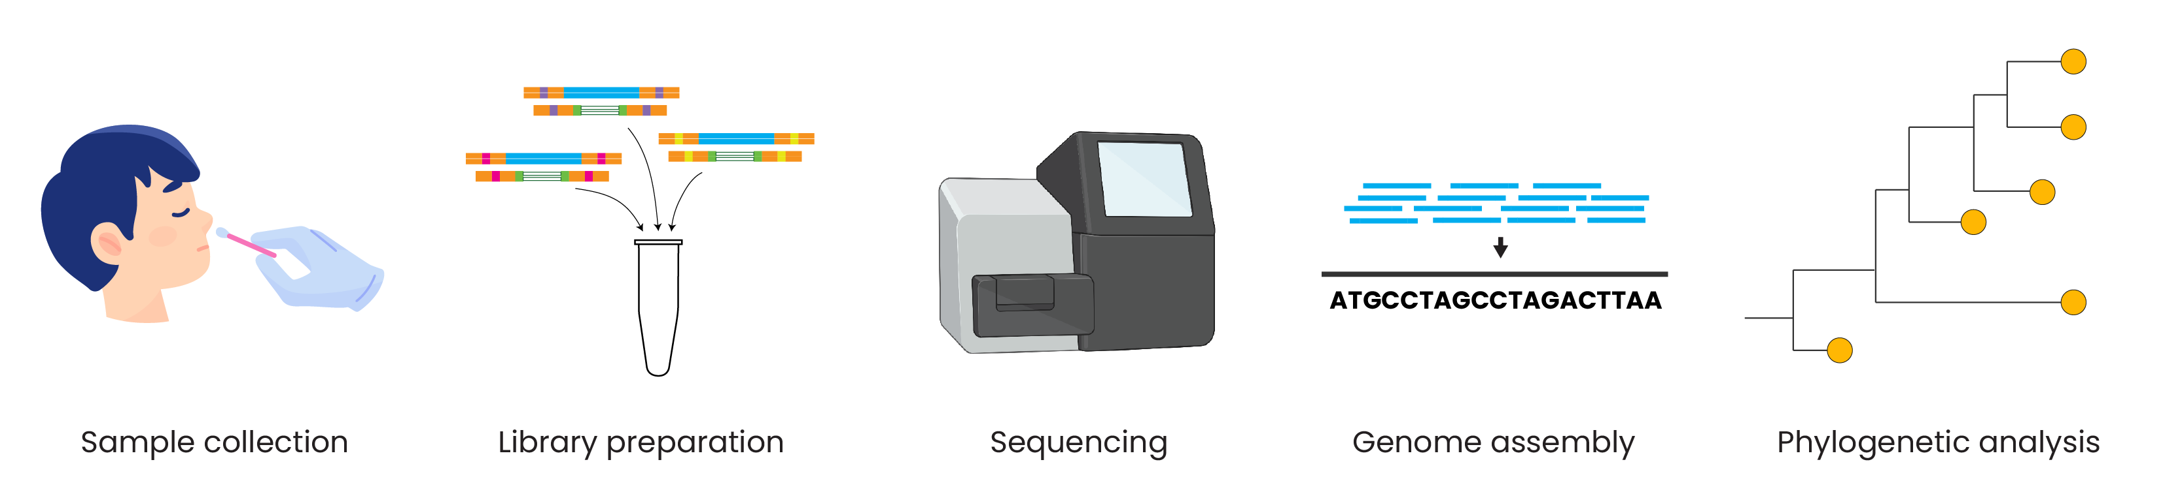
Genomic epidemiology workflow
BioRender.com
Pixel True https://www.pixeltrue.com/about, CC BY-SA 4.0, via Wikimedia Commons
Notes:
Feedback:
- I will provide an overview figure to go here, this is a placeholder for now

Slide 3
Outline
Why do we build phylogenies?
How do we read phylogenies?
How do we build phylogenies?
How do we root trees?
What is bootstrapping?

Slide 4
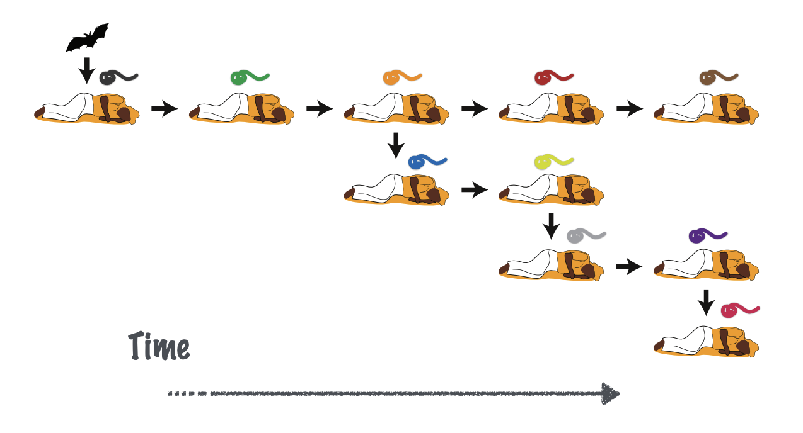
The virus evolves as it spreads between hosts
Time

Slide 5
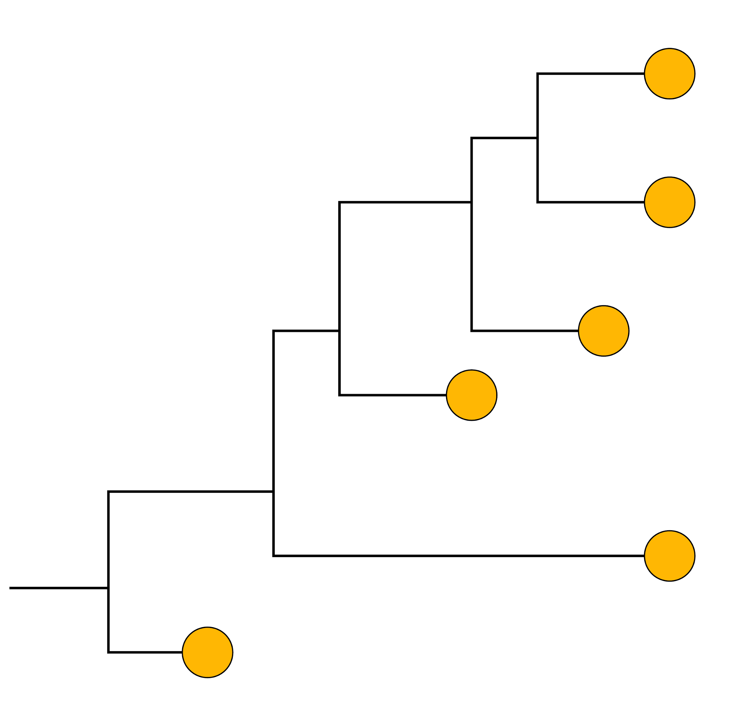
How are the pathogen sequences related?

Slide 6
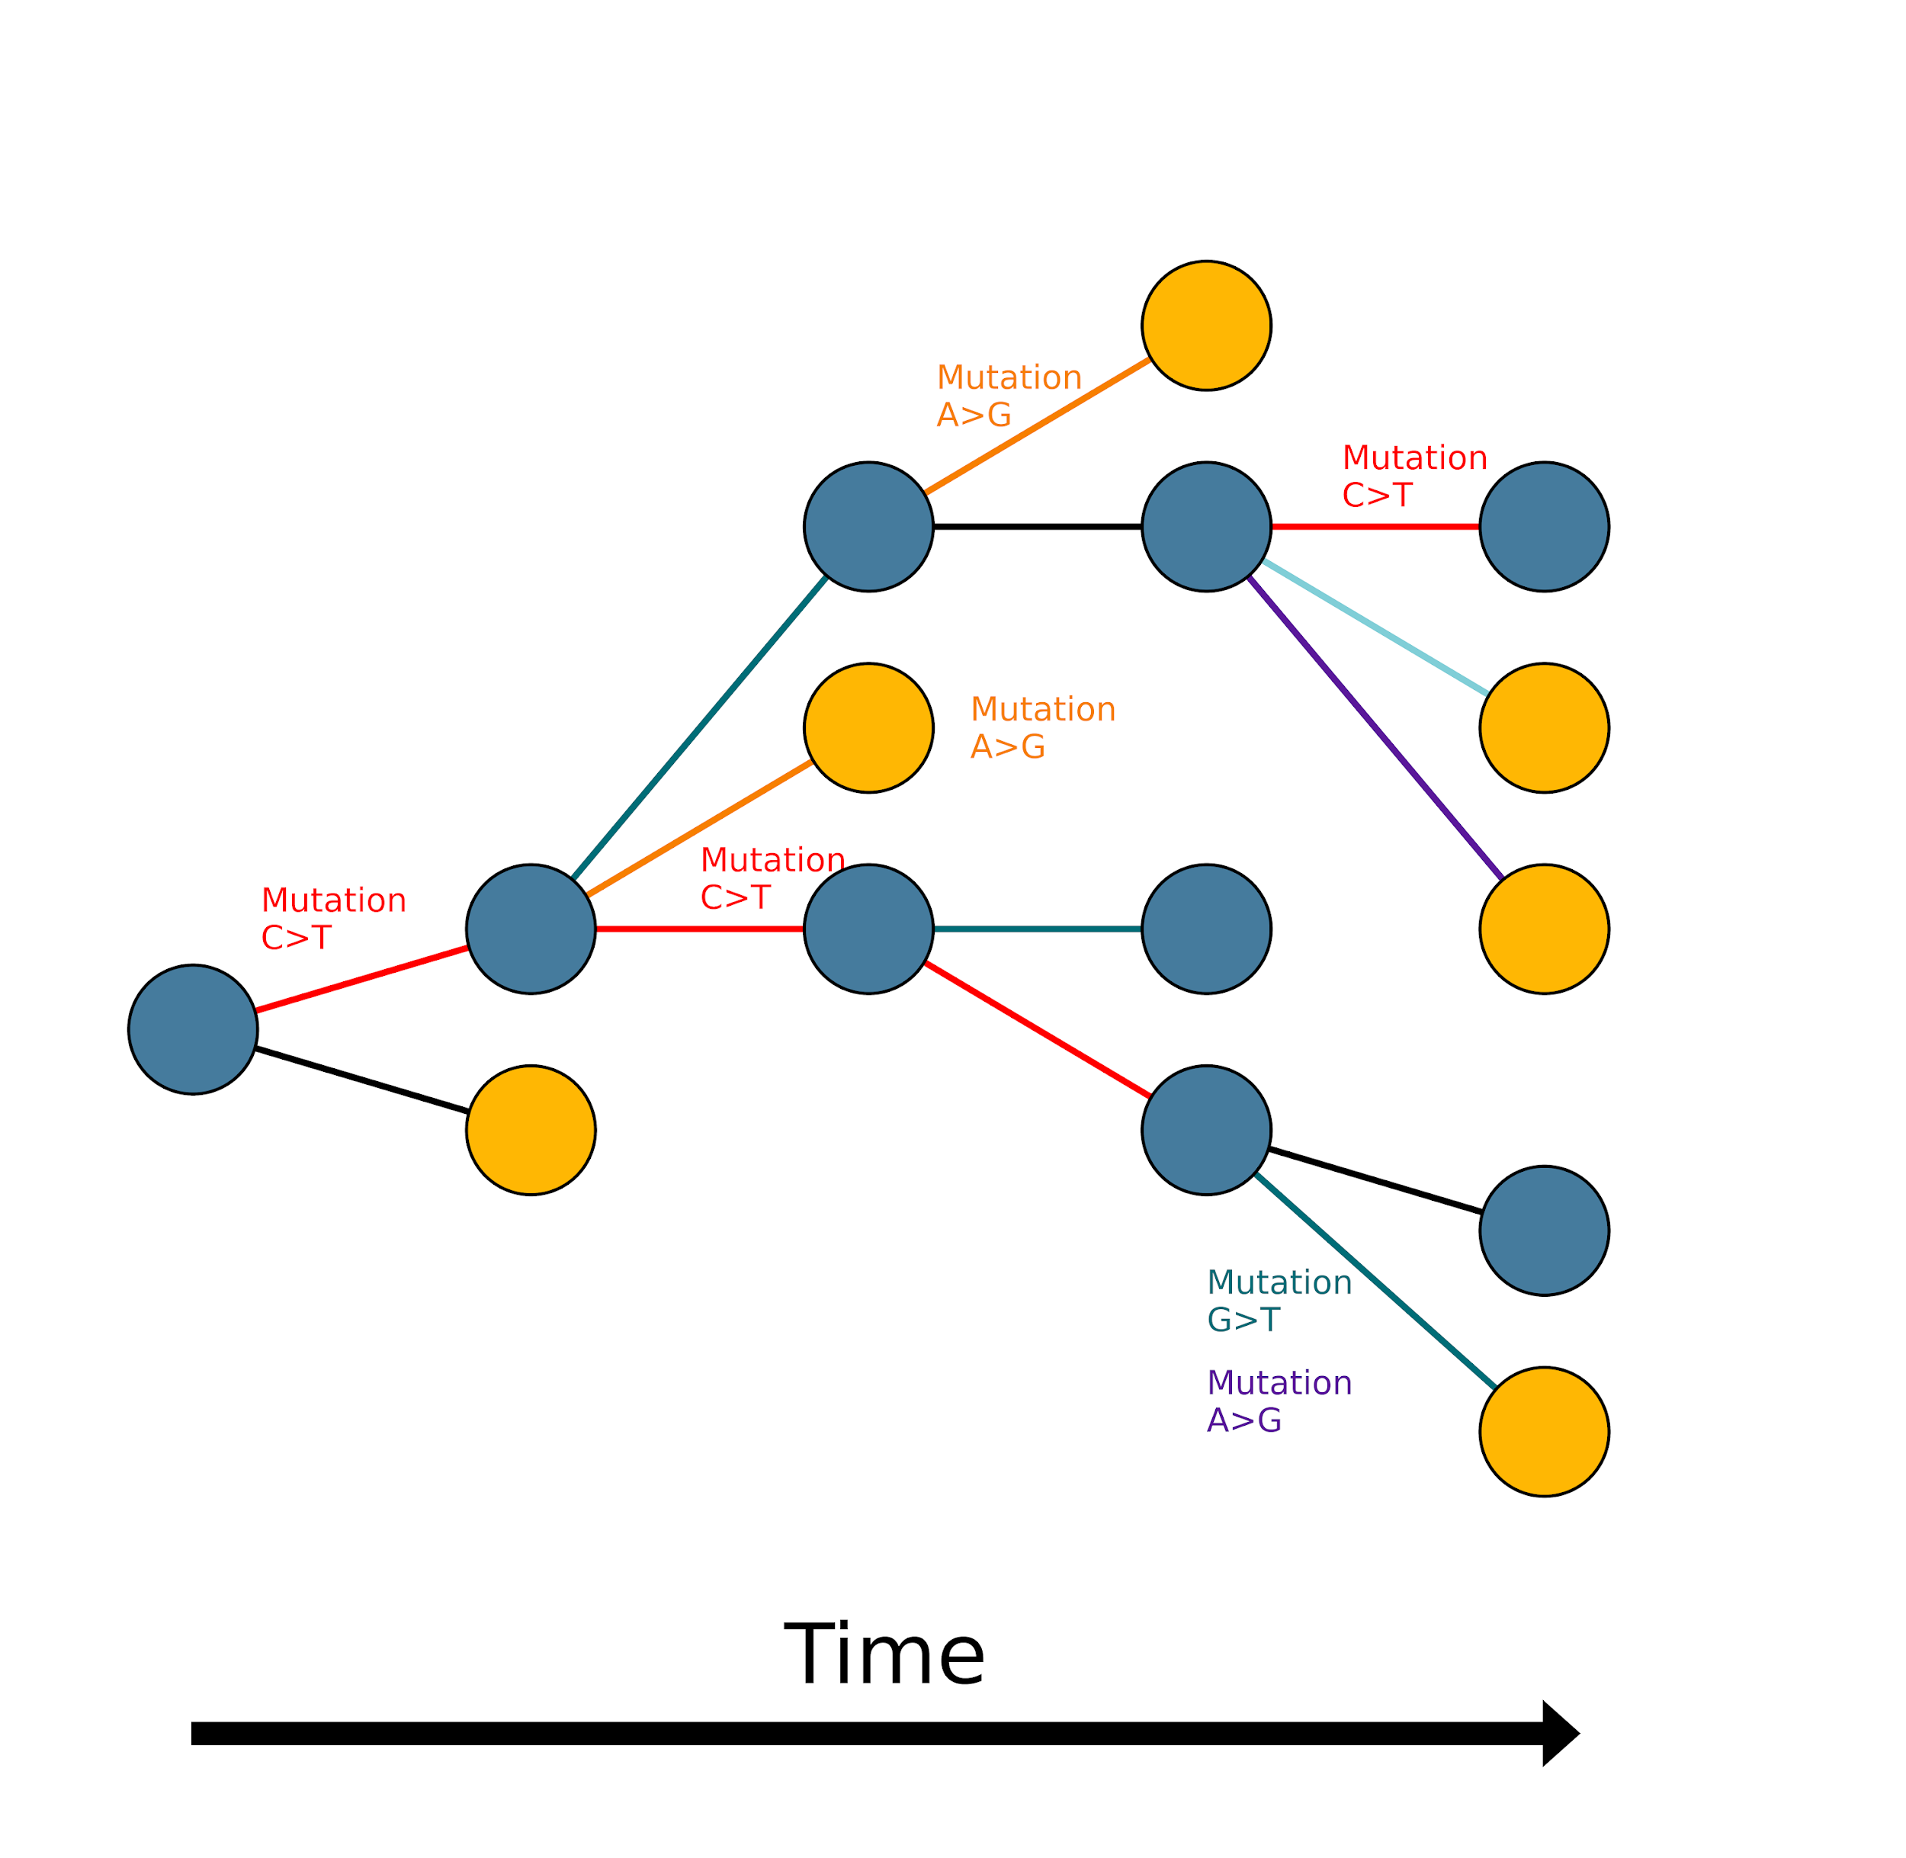
Mutations accumulate over time
Sampled
Unsampled
Time

Slide 7
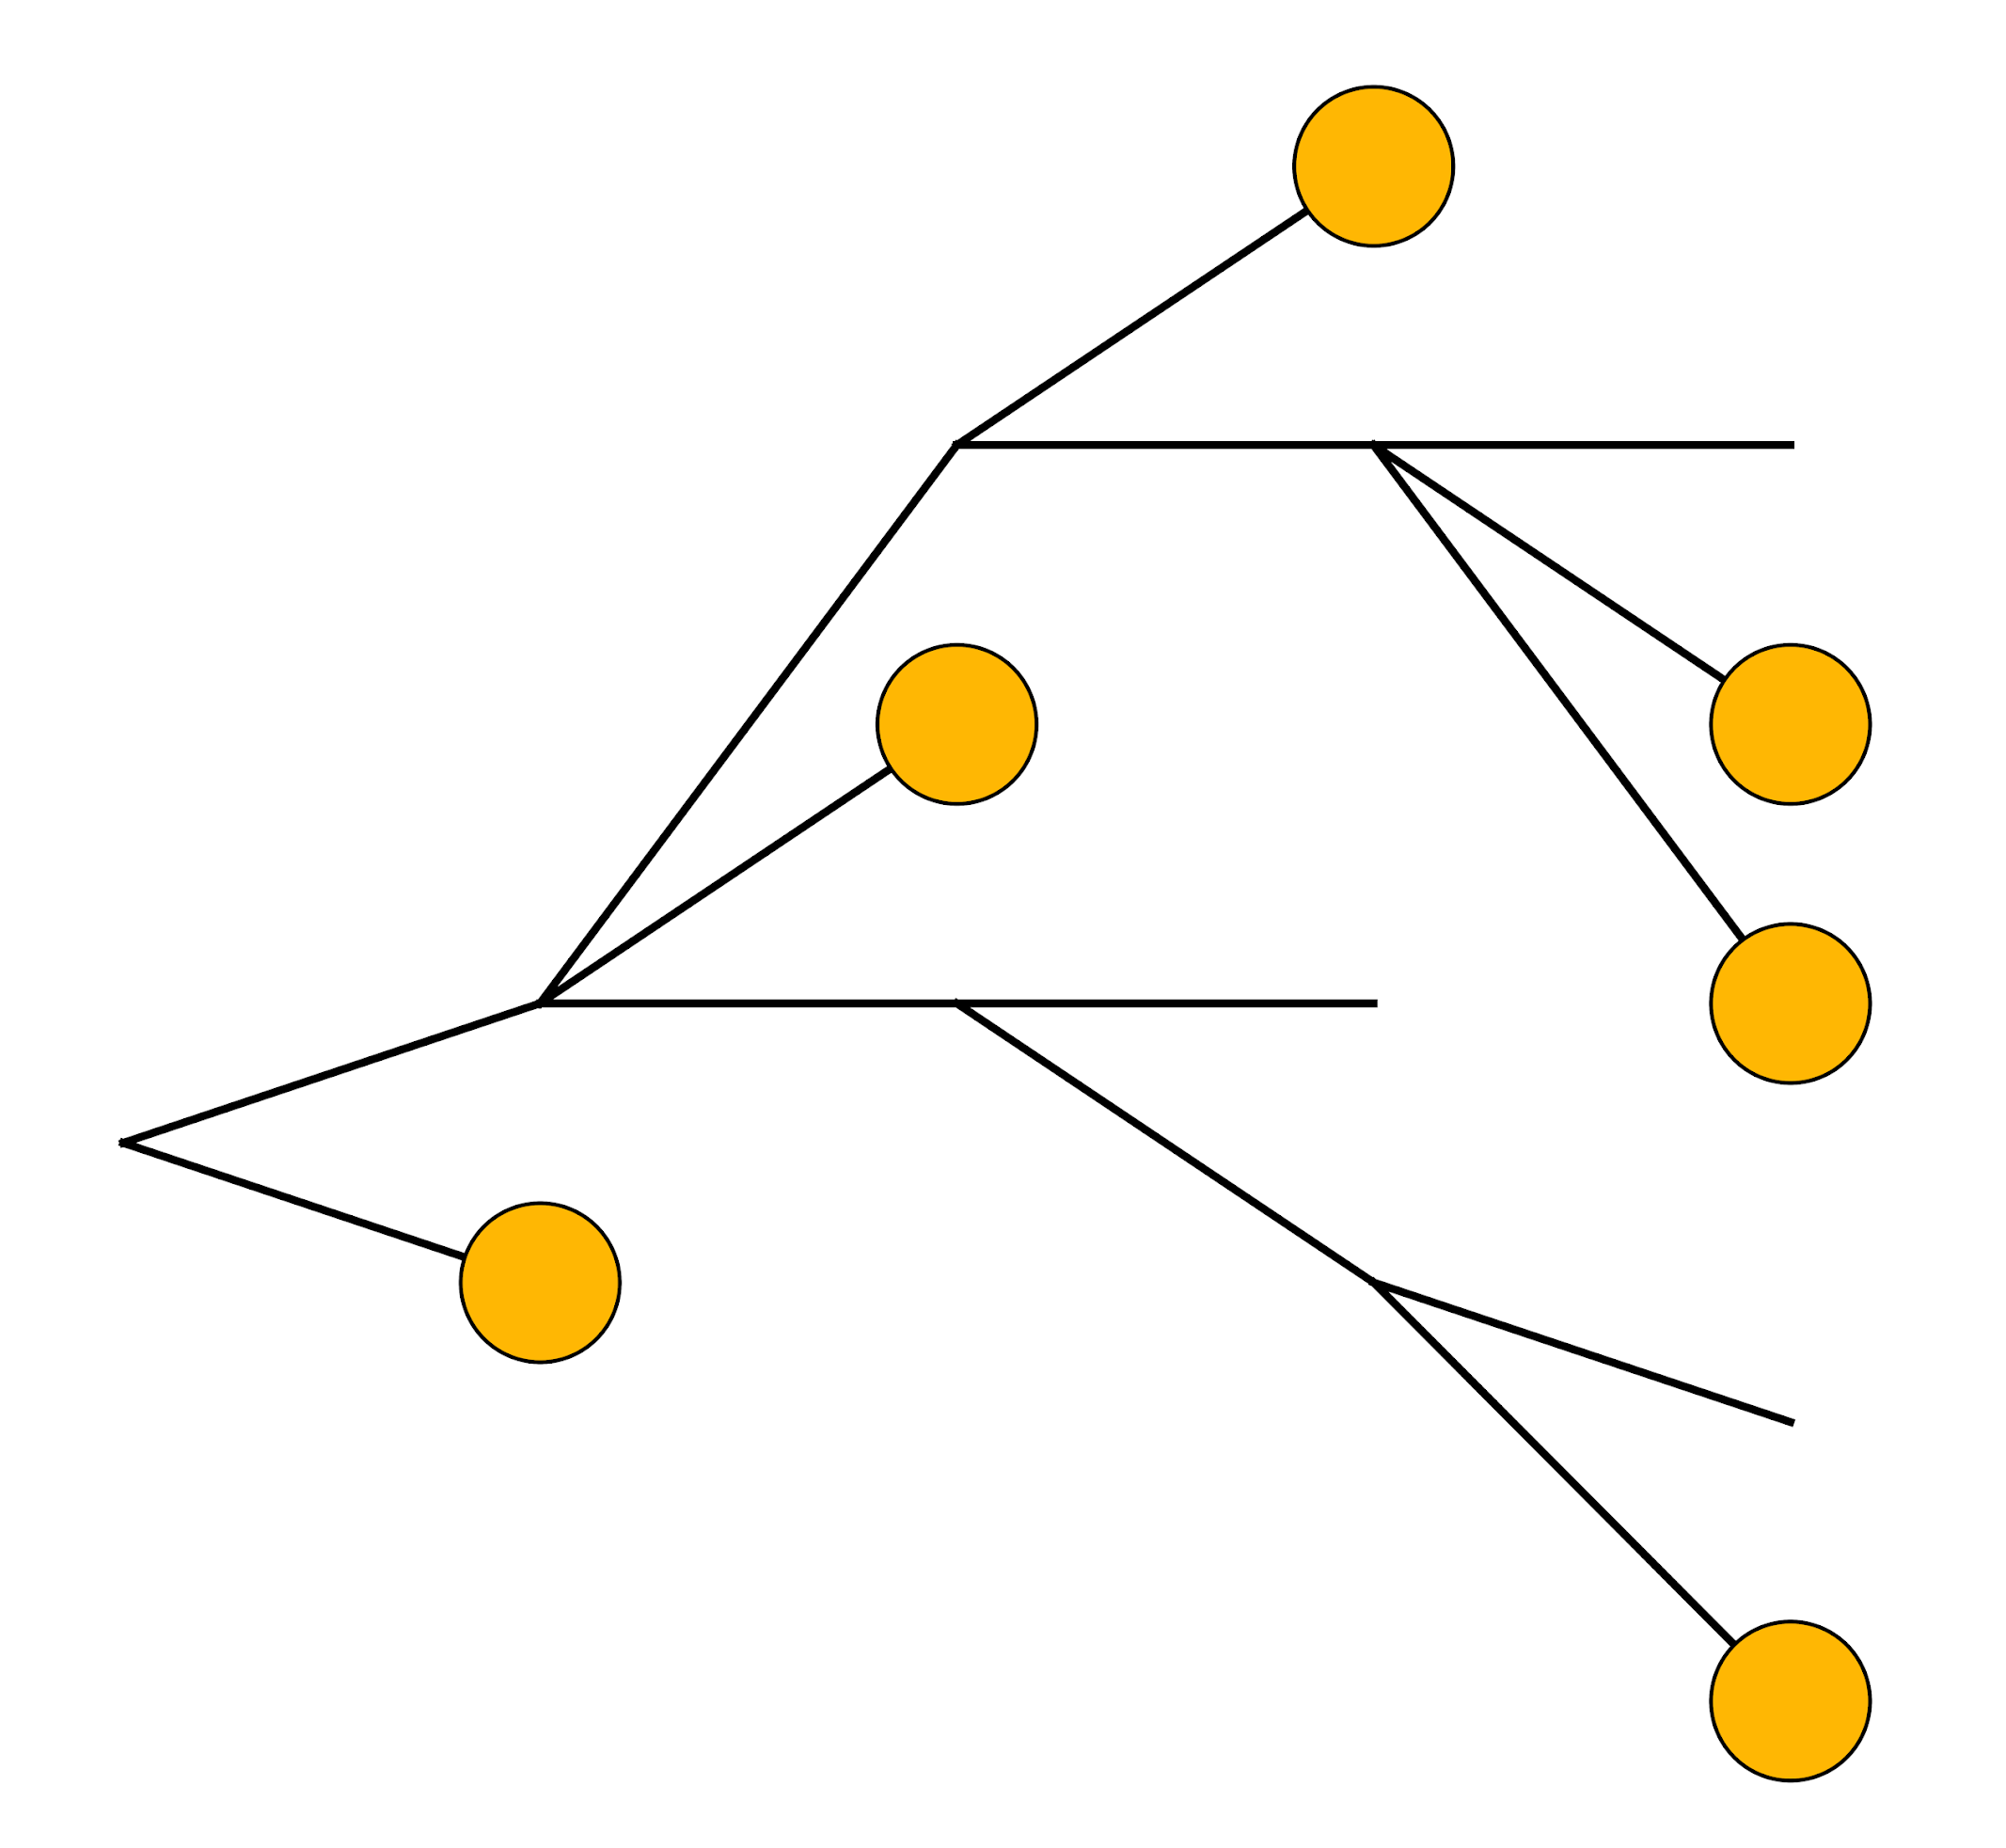
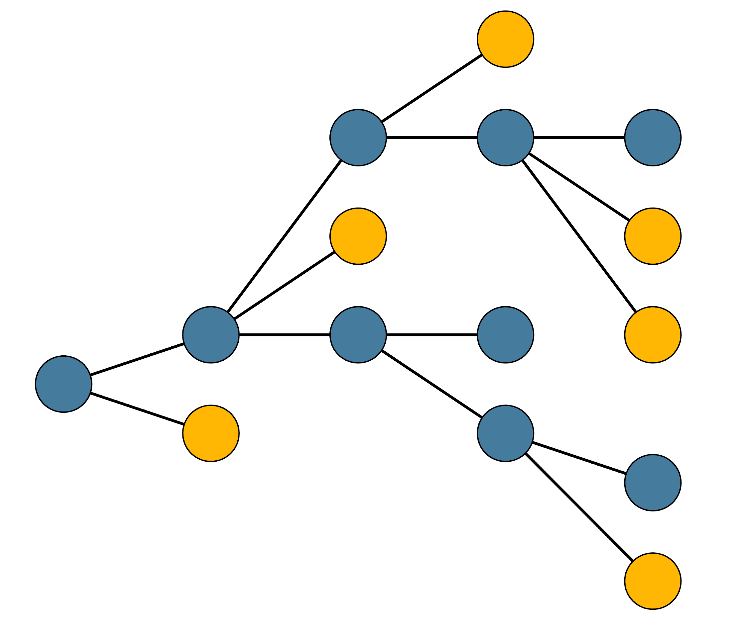
Reconstructing epidemic spread with phylogenetics

Slide 8
Phylogenies reconstruct evolutionary relationships among sampled genomes

Slide 9
Genomes must be aligned for phylogenetics
Genome 1: GTCTCGGCTC
Genome 2: GTGTCGGCTA
Genome 3: GTGTCAGCTA
Genome 4: GTGCCAGCTA
Genome 5: GGGCCATCTA
Genome 6: ATGCCAGCTA

Slide 10
Genomes must be aligned for phylogenetics
Genome 1: GTCTCGGCTC
Genome 2: GTGTCGGCTA
Genome 3: GTGTCAGCTA
Genome 4: GTGCCAGCTA
Genome 5: GGGCCATCTA
Genome 6: ATGCCAGCTA
GTCTCGGCTC
GTGTCGGCTA
GTGTCAGCTA
GTGCCAGCTA
GGGCCATCTA
ATGCCAGCTA

Slide 11
Sequence data is used to create phylogenetic trees
GTCTCGGCTC
GTCTCGGCTC
GTGTCGGCTA
GTGTCAGCTA
GTGCCAGCTA
GGGCCATCTA
ATGCCAGCTA
GTGTCGGCTA
GTGTCAGCTA
GTGCCAGCTA
GGGCCATCTA
ATGCCAGCTA
Genetic change

Slide 12
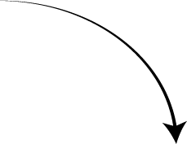
Reading phylogenetic trees
Mutations
Tips
GTCTCGGCTC
Units = nucleotide substitutions
GTGTCGGCTA
Common ancestor
(internal node)
GTGTCAGCTA
0.02
GTGCCAGCTA
Root
GGGCCATCTA
ATGCCAGCTA
Branch
Genetic change

Slide 13
Phylogenetic trees are not transmission trees

Slide 14
Mutations underlie phylogenies
Sequences that have the same mutations group together
Some mutations are unique, some shared
SNP = Single Nucleotide Polymorphism
GTCTCGGCTC
GTGTCGGCTA
GTGTCAGCTA
Clade
GTGCCAGCTA
G
GGGCCATCTA
ATGCCAGCTA
Genetic change

Slide 15
Mutations underlie phylogenies
GTCTCGGCTC
Multiple Sequence Alignment
T
GTCTCGGCTC
GTGTCGGCTA
GTGTCAGCTA
GTGCCAGCTA
GGGCCATCTA
ATGCCAGCTA
GTGTCGGCTA
GTGTCAGCTA
Clade
GTGCCAGCTA
G
G,T
GGGCCATCTA
ATGCCAGCTA
Genetic change

Slide 16
Mutations underlie phylogenies
G
GTCTCGGCTC
Multiple Sequence Alignment
T
GTCTCGGCTC
GTGTCGGCTA
GTGTCAGCTA
GTGCCAGCTA
GGGCCATCTA
ATGCCAGCTA
GTGTCGGCTA
GTGTCAGCTA
Clade
GTGCCAGCTA
G
G,T
GGGCCATCTA
ATGCCAGCTA
Genetic change

Slide 17
Outline
Why do we build phylogenies?
How do we read phylogenies?
How do we build phylogenies?
How do we root trees?
What is bootstrapping?

Slide 18
How do we build phylogenetic trees?
Need to measure genetic distance between sequences.
Multiple Sequence Alignment
GTCTCGGCTC
GTGTCGGCTA
GTGTCAGCTA
GTGCCAGCTA
GGGCCATCTA
ATGCCAGCTA

Slide 19
Observed distance between sequences
GTCTCGGCTA
GTGTCGGCGA

Slide 20
Observed distance between sequences
GTCTCGGCTA
GTGTCGGCTA
GTGTCGGCGA
P-distance: 2/10

Slide 21
Observed distance between sequences
 | Seq 1 | Seq 2 | Seq 3 | Seq 4 | Seq 5 | Seq 6
Seq 1 | 0 | 3 | 1 | 2 | 3 | 4
Seq 2 | 3 | 0 | 2 | 3 | 4 | 5
Seq 3 | 1 | 2 | 0 | 1 | 2 | 3
Seq 4 | 2 | 3 | 1 | 0 | 1 | 2
Seq 5 | 3 | 4 | 2 | 1 | 0 | 1
Seq 6 | 4 | 5 | 3 | 2 | 1 | 0
GTCTCGGCTC
GTGTCGGCTA
GTGTCAGCTA
GTGCCAGCTA
GGGCCATCTA
ATGCCAGCTA

Slide 22
Branch lengths represent genetic distance
G
GTCTCGGCTC
T
GTGTCGGCTA
GTGTCAGCTA
GTGCCAGCTA
G
G,T
GGGCCATCTA
ATGCCAGCTA
Genetic distance

Slide 23
Branch lengths represent genetic distance
Vertical distance means nothing
Add horizontal branch lengths to get distance between two sequences
G
G,T
GGGCCATCTA
ATGCCAGCTA
Genetic distance

Slide 24
Multiple substitutions can happen at same position
G
At position 2, not just T>G: T>A>G
G,T
GGGCCATCTA
ATGCCAGCTA
Uncorrected genetic distance underestimates evolutionary distance

Slide 25
How do we build phylogenetic trees?
Multiple Sequence Alignment
Nucleotide substitution model
GTCTCGGCTC
GTGTCGGCTA
GTGTCAGCTA
GTGCCAGCTA
GGGCCATCTA
ATGCCAGCTA
A
G
Model selection
C
T

Slide 26
Understanding substitution models
Model describes the process of evolution
Allows us to correct distances for multiple substitutions
Parameter: relative rates of the four nucleotides
Parameter: relative rates of pairwise substitutions (e.g., rate of A to C mutation)
v
A
G
w
u
z
x
C
T
y

Slide 27
How do we build phylogenetic trees?
A
G
GTCTCGGCTC
GTGTCGGCTA
GTGTCAGCTA
GTGCCAGCTA
GGGCCATCTA
ATGCCAGCTA
C
T
Multiple sequence alignment
Substitution model
Phylogenetic tree

Slide 28
There are several methods of building trees
Distance-based neighbor-joining
Parsimony
Maximum likelihood
Bayesian

Slide 29
Outline
Why do we build phylogenies?
How do we read phylogenies?
How do we build phylogenies?
How do we root trees?
What is bootstrapping?

Slide 30
Trees must be rooted
G
GTCTCGGCTC
T
GTGTCGGCTA
GTGTCAGCTA
GTGCCAGCTA
G
Ancestor
G,T
GGGCCATCTA
ATGCCAGCTA
ATGCCAGCTA
Genetic distance

Slide 31
There are many ways to root a tree
Outgroup rooting
Midpoint rooting
Molecular clock

Slide 32
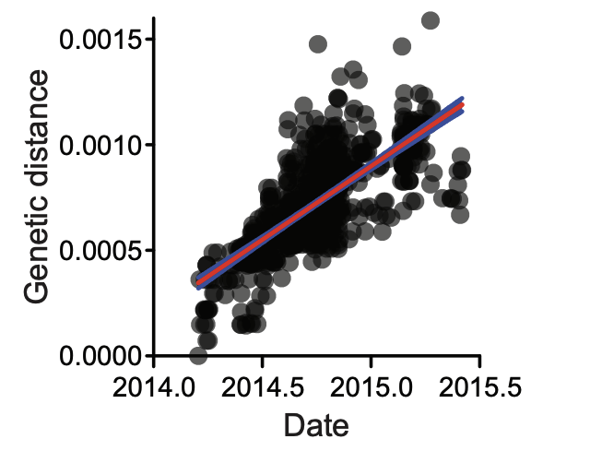
Model evolutionary rate with the molecular clock
Molecular clock: relationship between genetic change and time
Helps us understand the rate of evolution
Can be used to understand directionality of evolutionary events

Slide 33
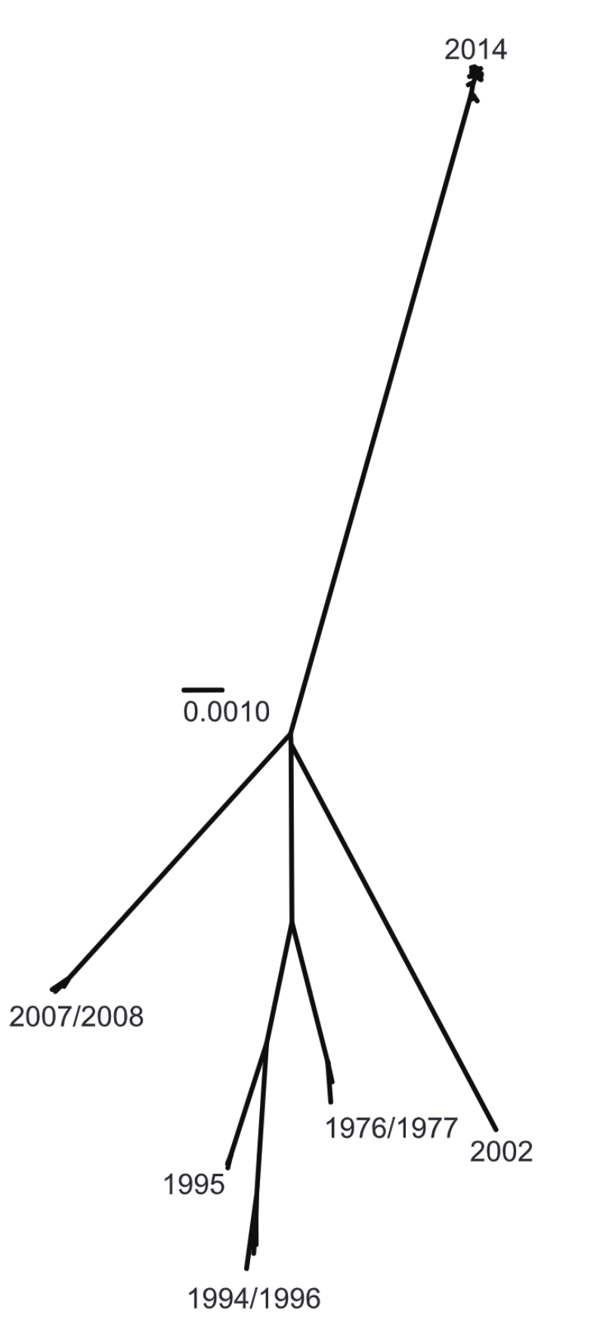
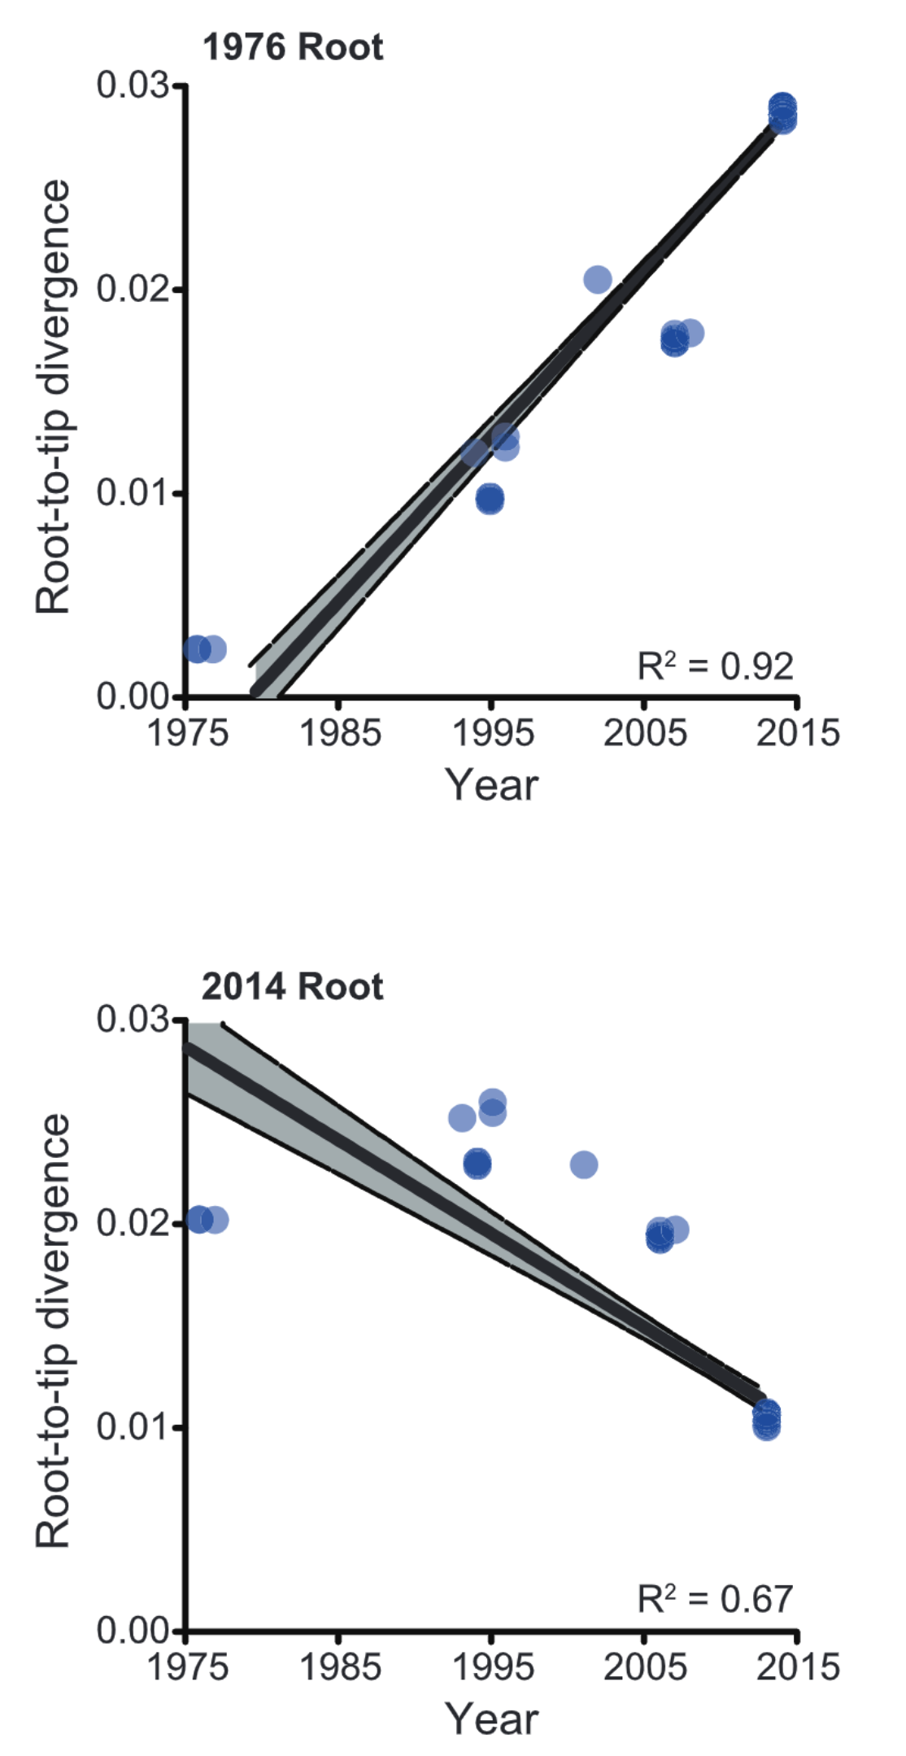
What happens when you choose the wrong root?
Gire et al. 2014. Science

Slide 34
Outline
Why do we build phylogenies?
How do we read phylogenies?
How do we build phylogenies?
How do we root trees?
What is bootstrapping?

Slide 35
How do we build phylogenetic trees?
A
G
GTCTCGGCTC
GTGTCGGCTA
GTGTCAGCTA
GTGCCAGCTA
GGGCCATCTA
ATGCCAGCTA
C
T
Multiple sequence alignment
Substitution model
Phylogenetic tree
Bootstrapping

Slide 36
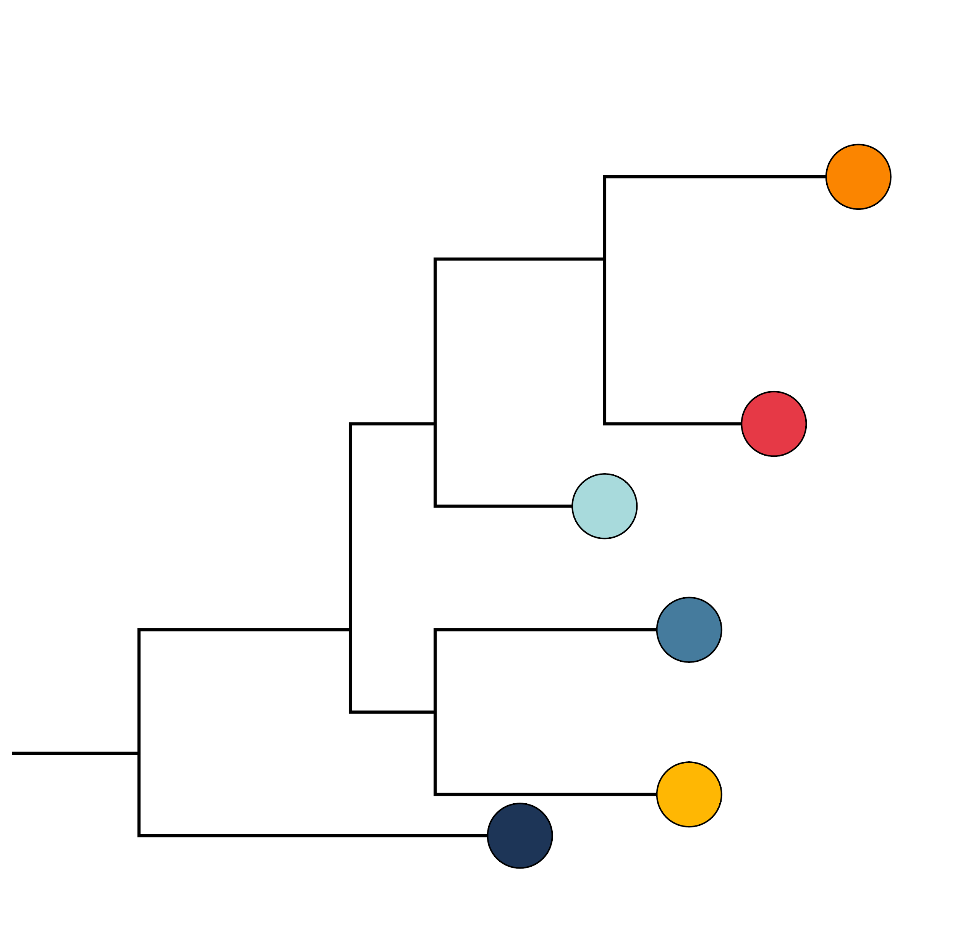
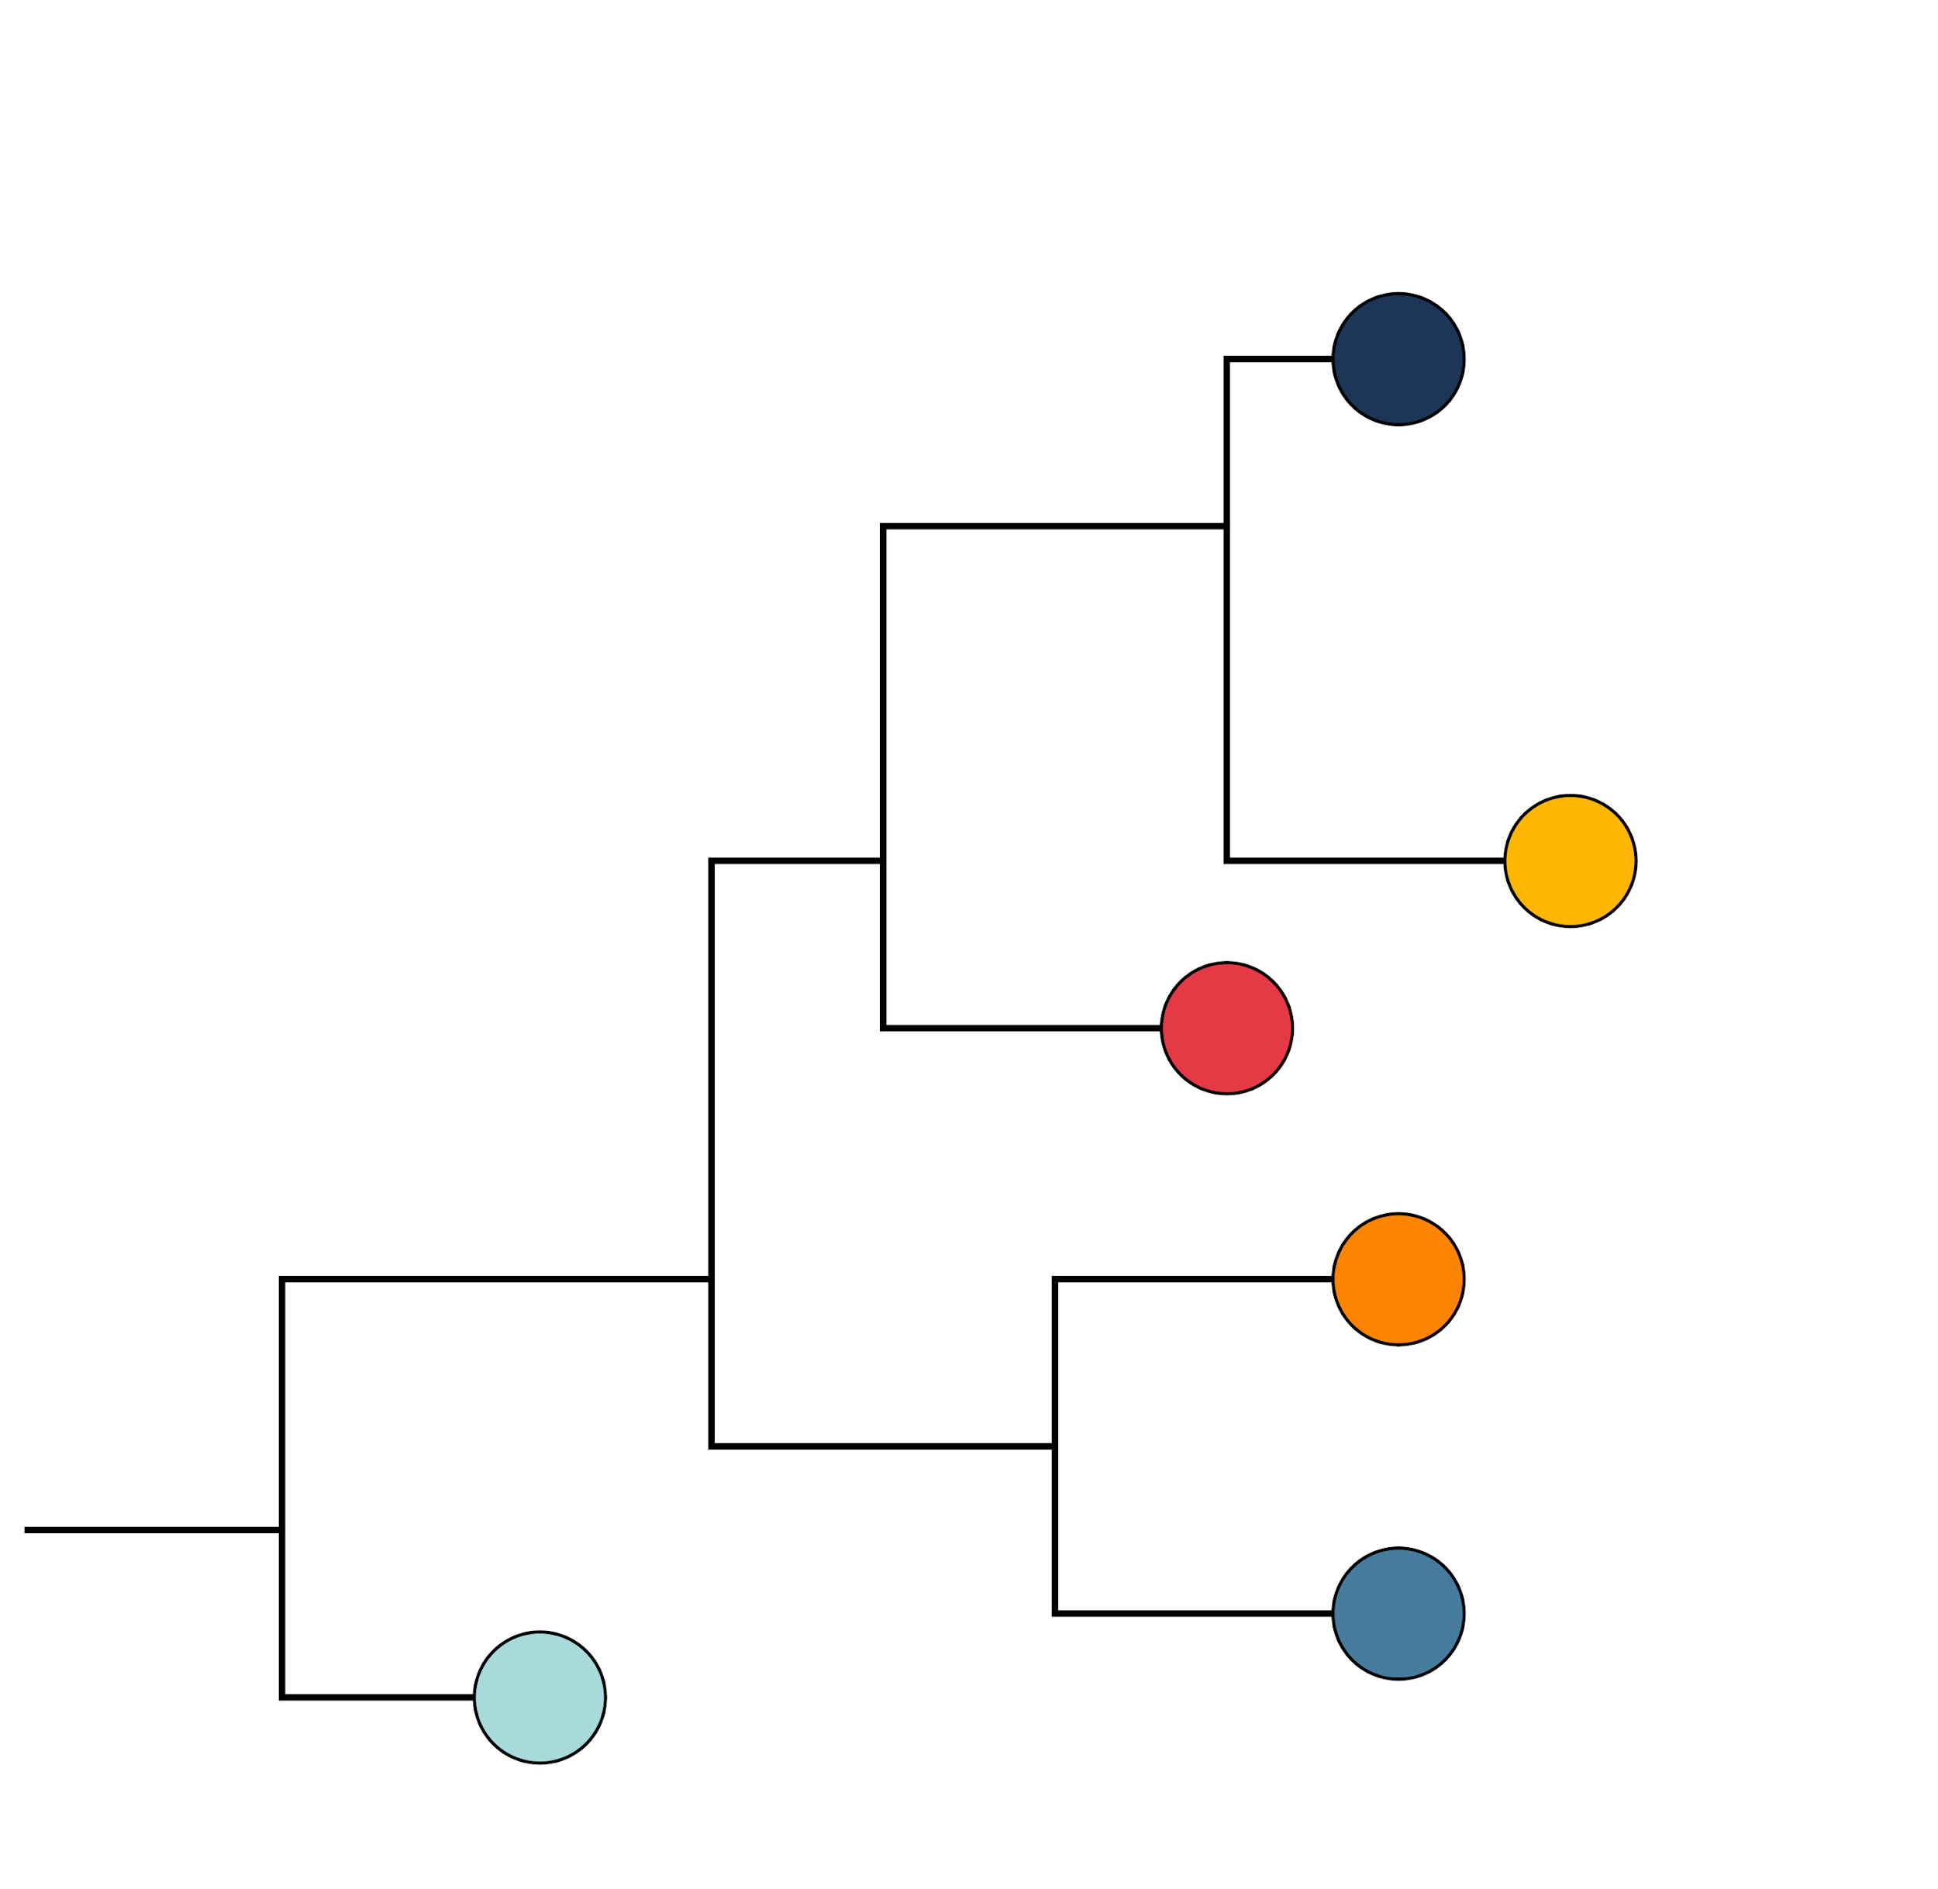
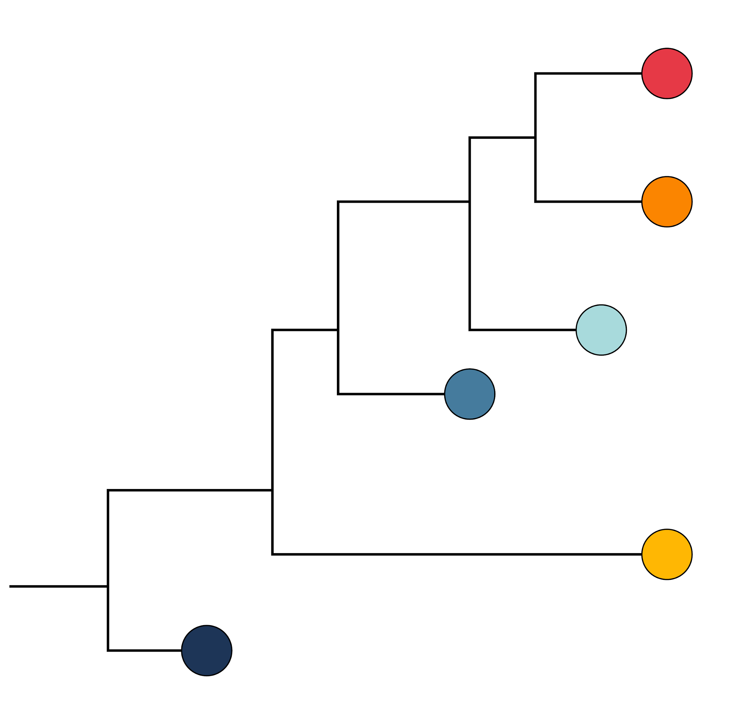
What is bootstrapping?
Maximum likelihood phylogenetic approaches produce a single best tree
It does not quantify how much you can trust the tree
How much uncertainty is there in evolutionary relationships in the tree?
That’s where bootstrapping comes in!

Slide 37
What is bootstrapping?
If the data (alignment) is slightly different, would it still support the same tree?
“Bootstrap support" is the number of times that a grouping appears in the collection of trees

Slide 38
Assumptions of phylogenetic reconstruction
Relationships among taxa can be represented by a tree
Violated by recombination, reassortment, horizontal gene transfer
Homologous characters are being compared
Assumes shared ancestry
Assumes multiple sequence alignment is valid
Evolution at each site is independent

Slide 39
Assumptions of phylogenetic reconstruction
Relationships among taxa can be represented by a tree
Violated by recombination, reassortment, horizontal gene transfer
Homologous characters are being compared
Assumes shared ancestry
Assumes multiple sequence alignment is valid
Evolution at each site is independent
Data is assumed to be correct

Slide 40
Summary
Phylogenies reconstruct evolutionary relationships among sampled genomes
There are many ways to build trees
Branch lengths show us the genetic distance between sequences
With the right root, we can understand ancestor-descendant relationships
We can test the reliability of our trees with bootstrapping

