Slide 1
Introduction to genome assembly
Javan Okendo, PhD
Bioinformatician ACEGID/NIH

Slide 2


“ The rediscovery of Mendel's laws of heredity in the opening weeks of the 20th century sparked a scientific quest to understand the nature and content of genetic information that has propelled biology for the last hundred years.”
International Human Genome Sequencing Consortium, Nature 2001
Chromosomes
DNA
Genetic code
Genome
Cellular basis of heredity
Molecular basis of heredity
Informational
basis of heredity

Slide 3
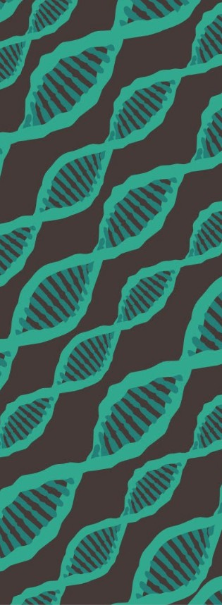
Part I
History of
Genome Assembly

Slide 4
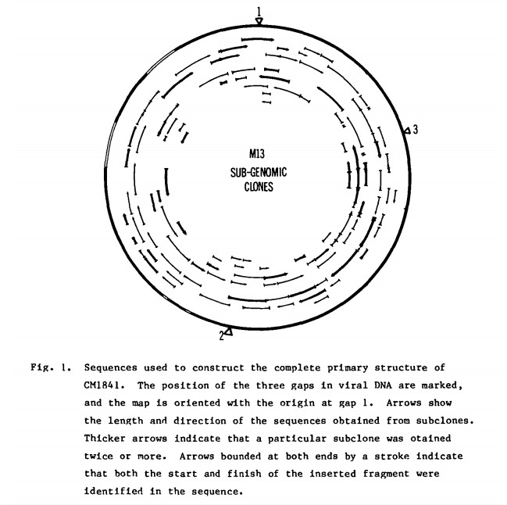
The cauliflower mosaic virus was the first complete genome to be sequenced
Sequenced in 1981
8031 base pairs
Produced using shotgun restriction fragments
Sequenced using dideoxy chain termination reaction
(Sanger)
Source: Gardner, R.C. et al. 1981

Slide 5
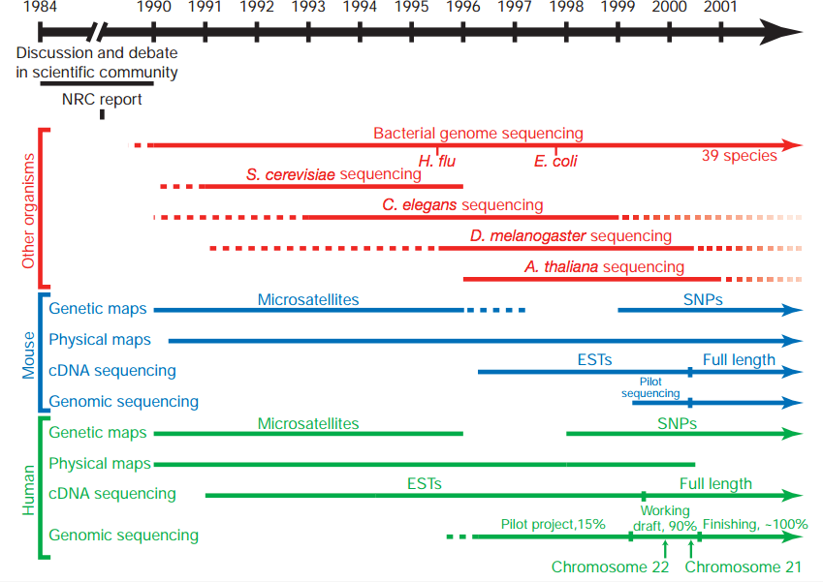
The human genome required a significant technological push
25✕ larger than any previously sequenced genome
Construction of genetic and physical maps of human and mouse genomes
Sequencing of yeast and worm
genomes
Pilot projects to test the feasibility and cost-
effectiveness of large-scale
sequencing
Source: The International Human Genome Sequencing Consortium, 2001

Slide 6
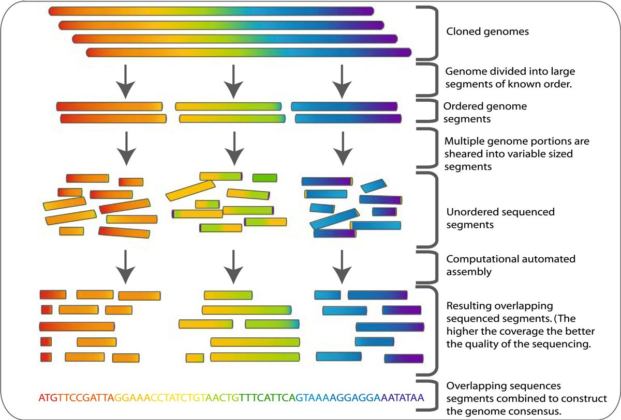
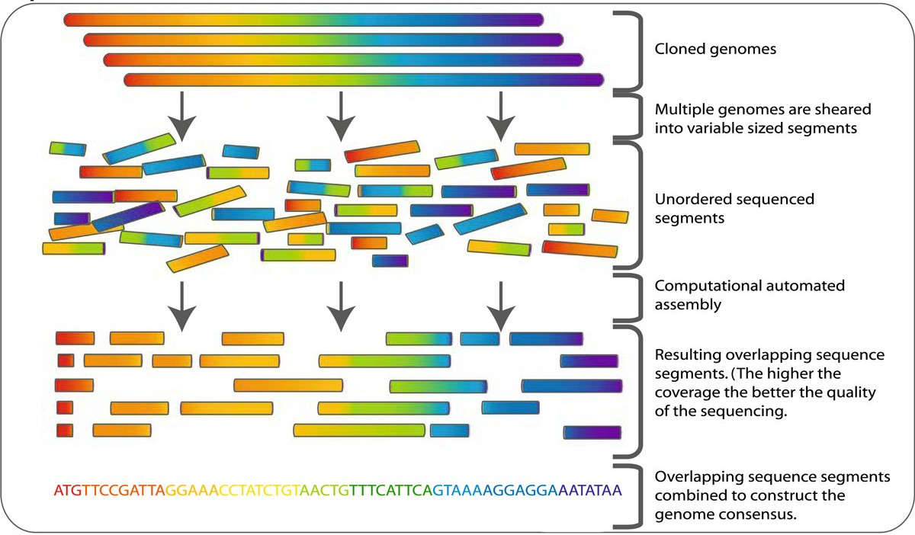
Two sequencing strategies were pursued to assemble the human genome
Hierarchical Shotgun Sequencing
Whole Genome Shotgun (WGS) Sequencing
Private Human Genome Project (Celera)
Public Human Genome Project
Source: Cummins, J. et al. 2009

Slide 7
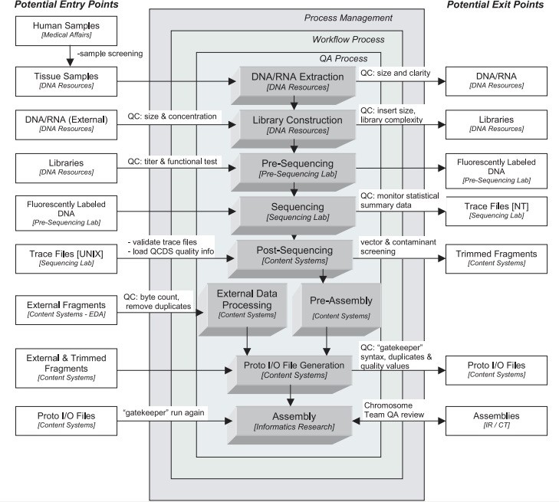
WGS Sequencing became the preferred method for sequencing other genomes
The sequencing strategy used by Venter et al. has changed surprisingly little in these last 16 years!
Next Generation Sequencing has only increased the popularity of the the WGS approach
Source: Venter, C.
et al. 2001

Slide 8
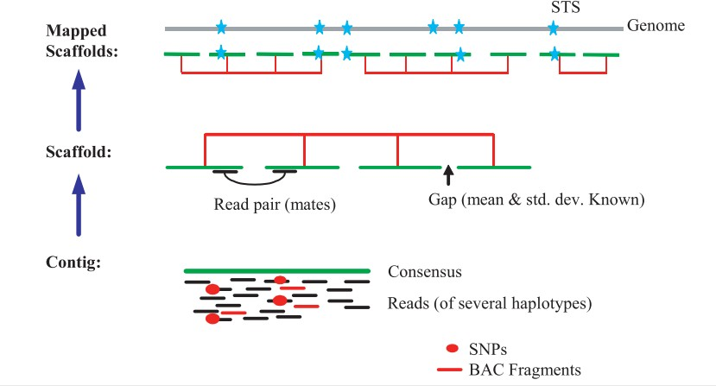
Bioinformatics methods for genome assembly are a critical step in the process
Steps for genome assembly:
Align reads to find
overlapping regions
Determine a consensus sequence (or contig)
Scaffold contigs based on read pairs and/or overlapping regions
Generate pseudo- molecules based on
Source: Venter, C. et al. 2001
genetic maps

Slide 9

Part II
Basics of Genome Assembly Algorithms

Slide 10
Terminologies
Genome: The complete set of an organism's genetic material, including all of its genes and non-coding sequences
Reads: Short DNA sequences generated through DNA sequencing techniques
Contig: Contigs are intermediate sequences in the assembly process and represent portions of the genome
Scaffold: A scaffold is a collection of ordered and oriented contigs that represent a portion of the genome
N50: A statistical measure used to assess the quality of an assembly
Assembly graph: A graphical representation of how reads overlap and can be assembled into contigs
Coverage: The average number of times a base in the genome is represented by reads
K-mer: A k-mer is a sequence of k nucleotides
De novo assembly: Genome assembly performed without using a reference genome
Haplotype: Different versions of a specific genomic region on homologous chromosomes

Slide 11
Can you identify which of these is a graph?
A.
B.
C.
D.

Slide 12
Can you identify which of these is a graph? B
Edge
Vertex (node)
In mathematics, a graph is a term that refers to a collection of vertices connected by edges.

Slide 13
Can you draw these graphs without lifting your pencil?
You are not allowed to draw the same edge twice.
✔
✘
✔

Slide 14
Looking at the vertices may give us a clue as to why some graphs have an Eulerian path
2
2
3
2
2
4
2
4
4
3
4
3
3
4
4
3
3
2 3 2 2 3
2
Eulerian path: visits every edge of a graph only once
Balanced node: has the same number of “in” and “out” edges.

Slide 15
Balanced graphs have Eulerian cycles, nearly balanced graphs have Eulerian paths
2
2
3
2
✘
3
2
4
2
4
4
3
4
3
4
4
3
3
2 3 2 2 3 2
Balanced graph: only has balanced nodes
Nearly balanced graph: becomes balanced by adding one edge

Slide 16
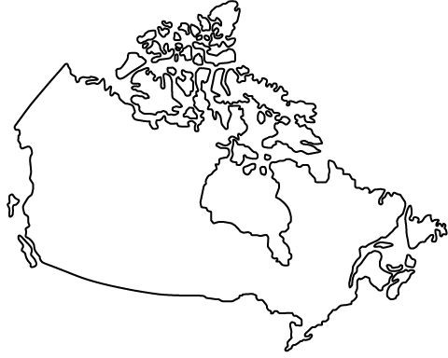




Graph problems that involve finding Hamiltonian paths are much harder to solve in polynomial time
Hamiltonian path: a path that visits every vertex only once
The famous traveling salesman problem currently has no polynomial-time solution
This is an example of an
NP-hard problem

Slide 17
Graph theory revolutionized and streamlined the genome assembly process
TAA
AAT
Can you think of a way to represent this using graphs?
ATG
TGC
GCC
CCA
CAT
ATG
TGG
GGG
GGA
GAT
ATG
TGT
GTT
TAATGCCATGGGATGTT

Slide 18
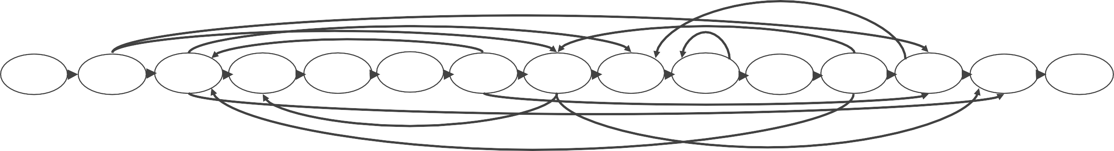
The consensus sequence can be represented as a path within an overlap graph
Target sequence (‘genome’)
TAATGCCATGGGATGTT
Genome path
TAA AAT ATG TGC CAT ATG TGG GGG GGA GAT ATG TGT GTT
Overlap graph
GCC CCA
GCC CCA
TAA AAT ATG TGC CAT ATG TGG GGG GGA GAT ATG TGT GTT
The genome path is a Hamiltonian path of the overlap graph!
Source: Compeau, P. & Pevzner, P. 2015

Slide 19
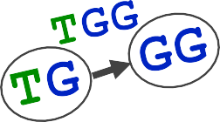


De Bruijn graphs are an alternative representation of the problem that offers considerable advantages
Reads are now 2-node graphs
TAA
TA AA
Nodes are prefix/suffix
Edge is the actual read
Genome path
TAA
AAT ATG
TGC GCC
CCA
CAT ATG
TGG
GGG GGA GAT
ATG TGT GTT
TA AA AT
TG
GC CC CA AT
TG
GG GG GA AT
TG GT TT
To construct the actual De Bruijn graph, nodes that are identical should be merged.
Source: Compeau, P. & Pevzner, P. 2015

Slide 20
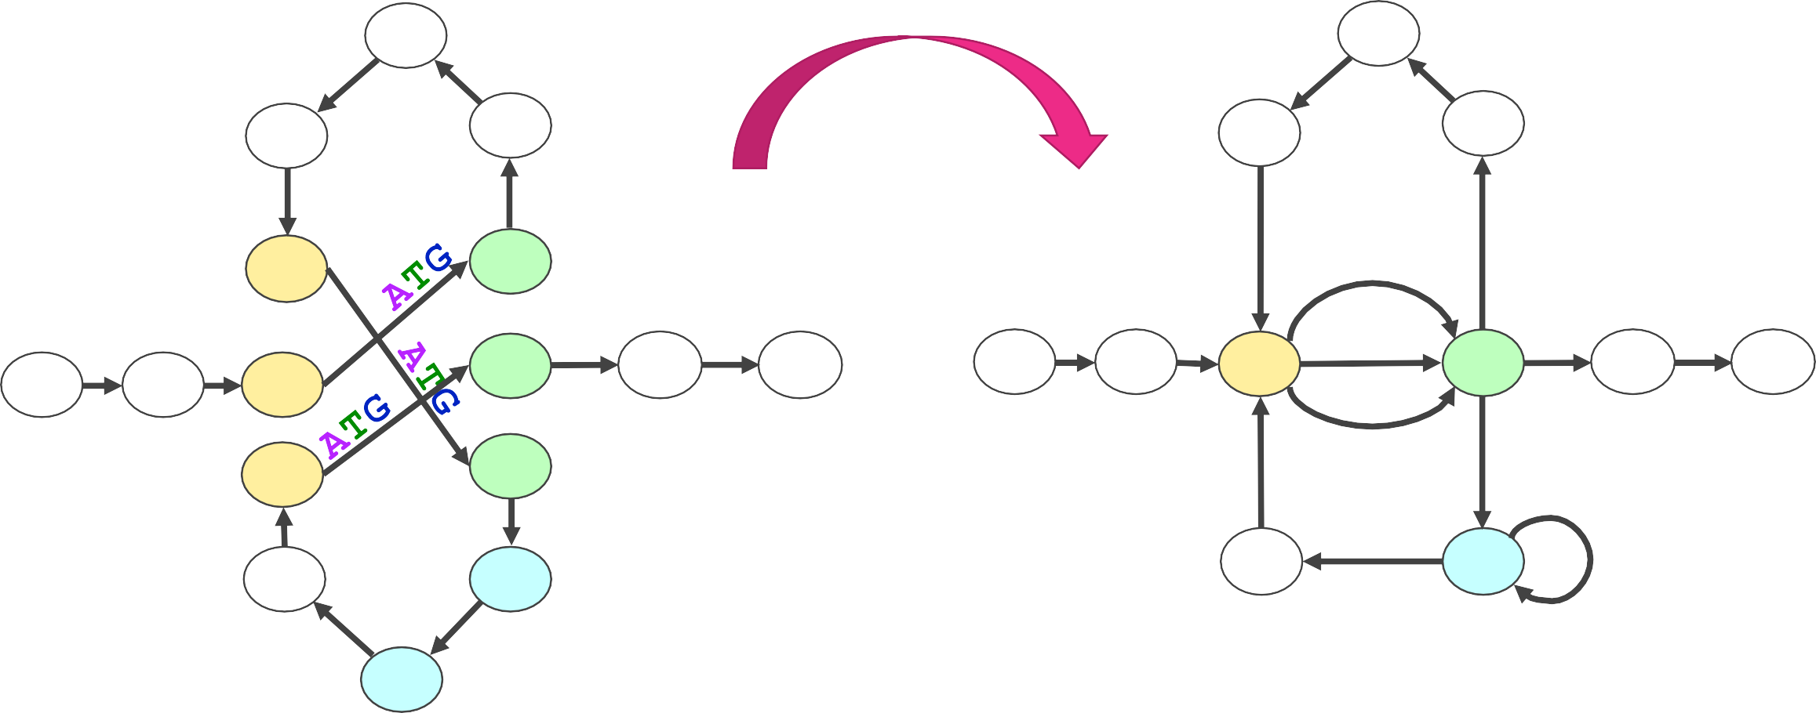
De Bruijn graphs are an alternative representation of the problem that offers considerable advantages
CCA
CA
CAT
AT
AAT
CC
GCC
GC
TGC
TG
TGT
TG GT TT
TG
TGG
GG
GGG
CCA
CA
CAT
CC
GCC
GC
TGC
ATG
TAA
GTT
TAA
AAT
TGT GTT
TA AA AT
AT
TA
AA AT
ATG
TG GT TT
GAT
GA GG
TGG
ATG
GAT
GA
GGA
GGG
GGA
GG
The genome path is an Eulerian path of the De Bruijn graph!
Source: Compeau, P. & Pevzner, P. 2015

Slide 21
Modern genome assemblers
Name | Algorithm
Hifiasm | De Bruijn graph
Verkko | De Bruijn graph
Spades [metaspade etc] | De Bruijn graph

Slide 22
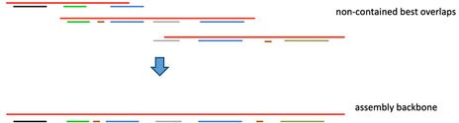
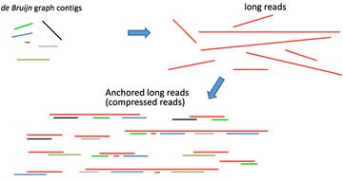
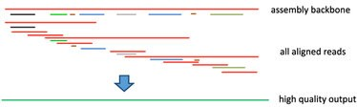
Long-read sequencing and more available genomes have changed the assembly process
Increased assembly quality
Ability to assemble more complex genomes
Example: DBG2OLC Assembler
1)
2)
3)
Source: Ye, C., et al. 2016

Slide 23
The quality of a genome assembly can be estimated by calculating several parameters
No. of contigs: Total number of contigs in the assembly
Largest contig: Number of bases in the largest contig
Total length: Number of bases in all the contigs
N_{x}: Length of largest contig (L) such that contigs of length ≥ L account for at least x % of the bases in the assembly
The most commonly used is N₅₀
A larger number usually means a better assembly
GC (%): Percentage of G and C bases in the assembly
Misassembly breakpoint: when aligning to a reference
The left flanking sequence aligns over 1 kb away from the right flanking sequence
Flanking sequences overlap by ≥ 1kb
Flanking sequences align on opposite strands or different chromosomes
Source: Gurevich, A., et al. 2013

Slide 24
Genome dot-plots provide visual information about the two assemblies
A-T
C-G
A-T
G-C
G-C
T-A
T-A
T-A
A-T
T-A
C-G
T-A
C-G
C-G
T-A
G-C
C-G
T-A
Dots correspond to 3-mers shared by two sequences.
Red = identical shared k-mer
Blue = reverse complementary k-mer
Synteny blocks correspond to diagonals.
There are also six “nosiy” dots.
Source: Compeau, P. & Pevzner, P. 2015
A | | G | | C | | A | | G | | G | | T | | T | | A | | T | | C | | T | | A | | C | | C | | T | | G | | T |
T | C | G | T | C | C | A | A | T | A | G | A | T | G | G | A | C | A

Slide 25
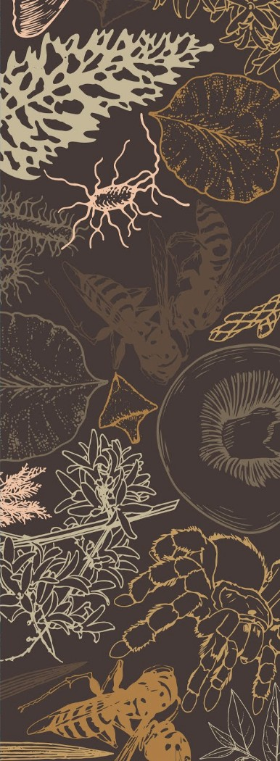
Part III
Future of Genome Assembly and Analysis

Slide 26
As sequencing becomes less expensive, “big science” projects have explored genome variation
1000 genomes project (2010): Sequence genomes from at least 1,000 volunteers worldwide from African, Asian and European populations to analyze variation in the human genome.
100k pathogen genome project (2012): create a publicly available genetic database of the most common foodborne disease causing microbes.
1000 plants initiative (2015): international consortium for generating large-scale sequencing data for over 1000 plant species.

Slide 27
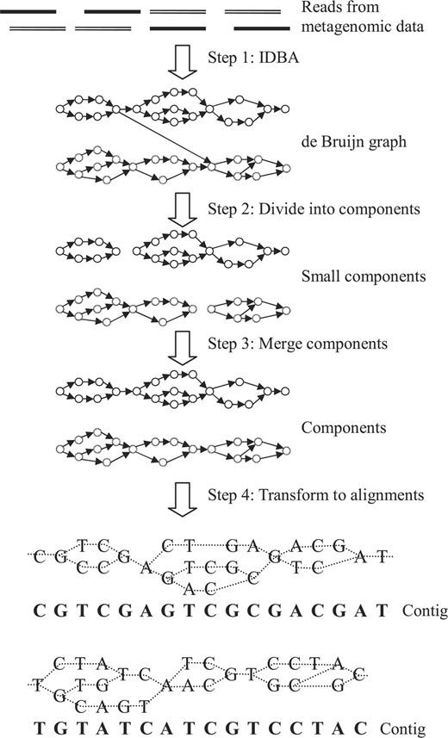
Metagenome assembly has become an important tool in microbiome studies
It has been estimated that 99% of microbes cannot be isolated nor cultured!
Two issues complicate metagenome assemblies:
Polymorphisms among similar subsp. and common genomic regions
Uneven abundance ratios of species in a sample
Source: Peng, Y., et al., 2011 (Meta-IDBA)

Slide 28
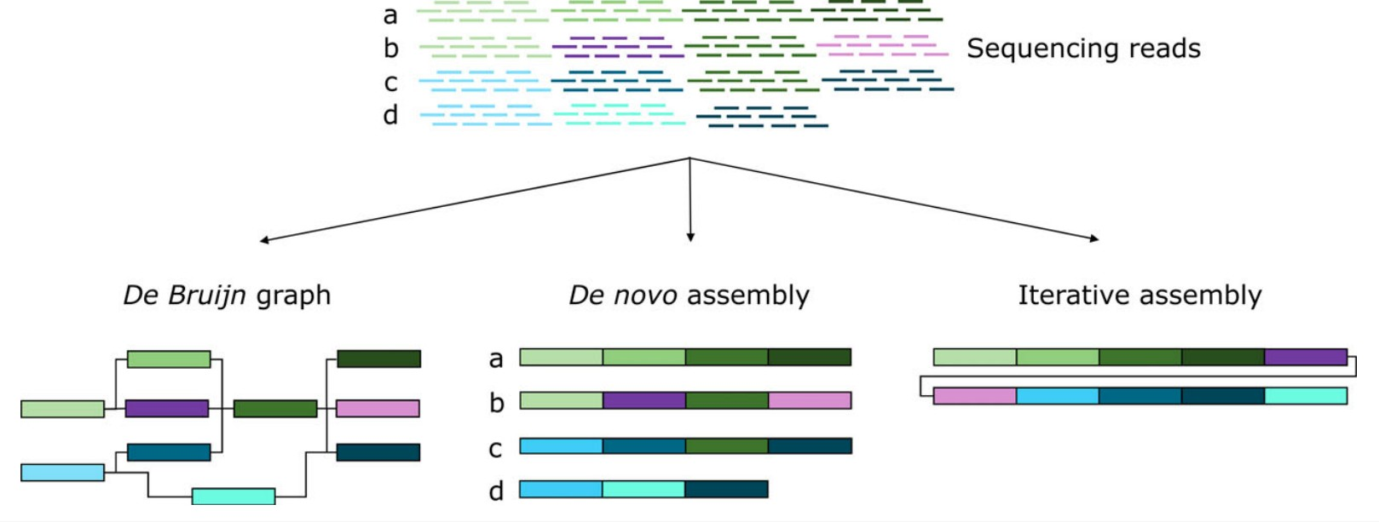
Pan-genomes have also been used to characterize the genome of a complete species
Pan-genome analyses should answer 3 main questions:
What is the “core” genome size?
What is the pan-genome size?
How many genes/gene families are added with each individual?
Pan-genome:
the complete collection of genes that are either present in all individuals of a species or dispensable/accessory
Source: Golicz, A.A., et al., 2016

Slide 29
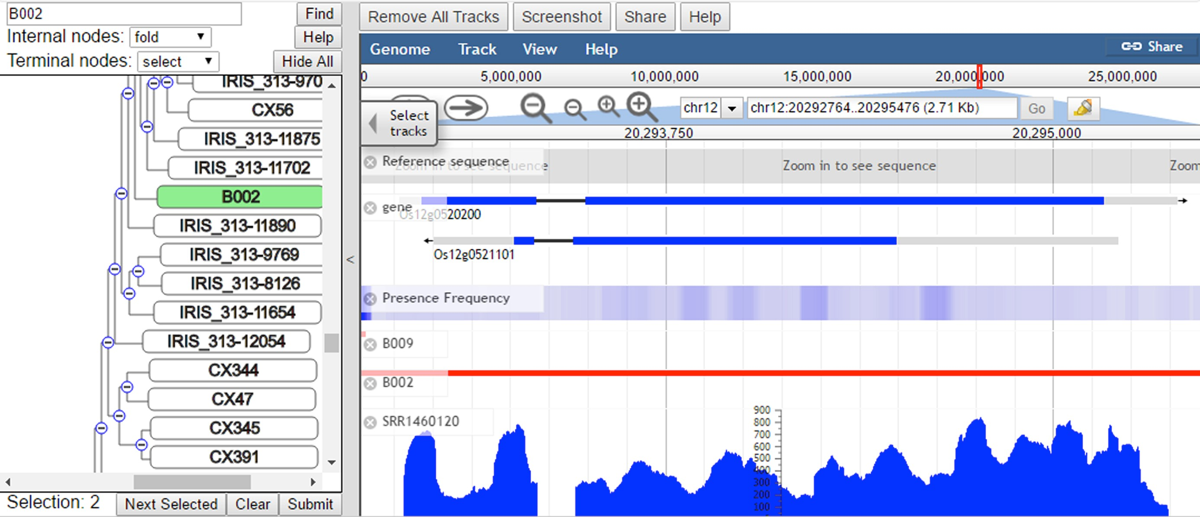
As genomic analyses incorporate more data, visualization and analysis become more difficult
Rice (Oryza sativa L.) pan-genome:
~3000 rice genomes sequenced at 14.3✕
Rice Pan-genome Browser (RPAN)
Enable visualization of subspecies and relative frequency of genes/alleles
Source: Sun, C., et al. 2017

Slide 30

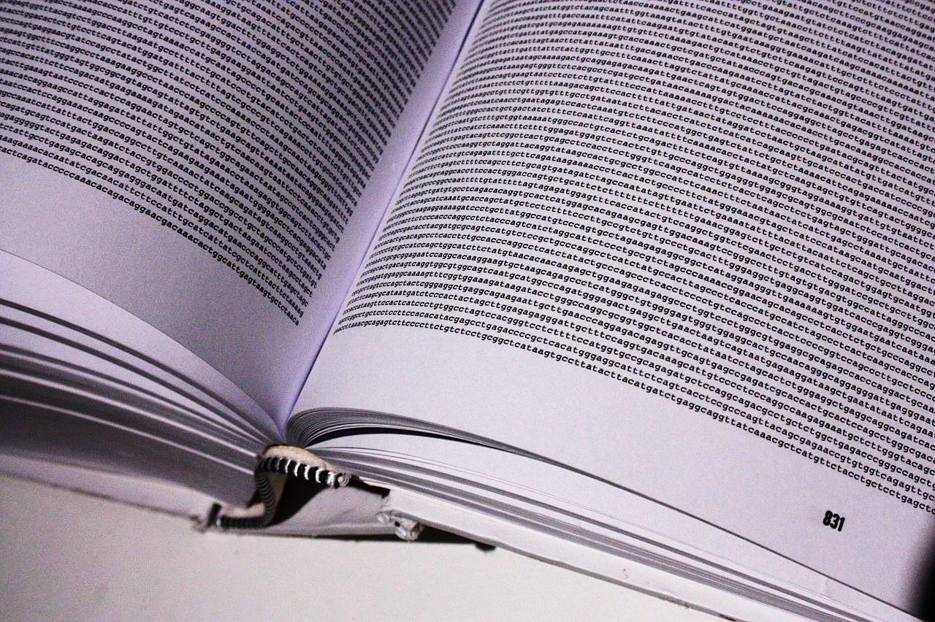
“ Finally, it has not escaped our notice that the more we learn about the human genome, the more there is to explore.”
International Human Genome Sequencing Consortium, Nature 2001
Image source: Wellcome Trust

