Slide 1


LINE ASSESSMENT · Q3 2026
We build your line,
product to pallet.
One contract. One number to call. This review covers throughput, changeover,
and the uptime we own after the line ships.
PREPARED FOR [CUSTOMER] · JULY 2026
HARPAK-ULMA · TAUNTON, MA
Notes:
COVER, DARK (default deck master per Brand Book Section 10).
Use for: customer pitches, internal reviews, any dim room.
Replace: eyebrow (deck type + date), title (one claim, sentence case, 12 words max), support line, PREPARED FOR.
Rules: title is a claim, not a topic label. One red rule is the only red element. Never place the lockup on red. Keep 1 S clear space around the lockup (S = symbol square height).

Slide 2


AUTOMATION FAIR 2026 · SESSION T-412
The fault flagged before
the line stops.
Aura Edge by Harpak-ULMA runs the same intelligence on hardware at the line.
This session shows a measured fault catch on a running tray-seal line.
CO-PRESENTED WITH
PACK EXPO 2026
AUTOMATION FAIR 2026
Notes:
COVER, DARK, CO-BRANDED (event or partner session).
Compliance (Section 7): the partner mark sits on a neutral white card, never on red or the dark field directly. The Rockwell mark shown is a reference raster; production requires the partner-approved vector and brand-team sign-off [GET]. Keep at least 1 S of neutral separation between the mark and any brand-red element (red-proximity ruling). The red eyebrow and the mark are separated by the neutral card and distance by design; do not move them closer.
Aura ring: the only gradient on the slide. External signature: 'Aura Edge by Harpak-ULMA'.

Slide 3


PACKAGING PARABLES WEBINAR · JULY 2026
Flexible seafood lines:
variety without the changeover tax.
A systems view of multi-SKU seafood packaging: one integrated line,
recipe-driven changeover, and the numbers to hold it accountable.
MIKE MARCHAND · SENIOR PRODUCT MANAGER
Notes:
COVER, LIGHT (bright rooms, webinars, the show floor; Section 10). Same anatomy as the dark cover: eyebrow, claim title, one red rule, support line, motif strip.

Slide 4
FOR DECK BUILDERS · DELETE BEFORE PRESENTING
What's in this template
01 to 04
Covers and setup
05 to 10
Structure
Dark, co-branded, light, this index
Agendas, section and product-line dividers
11 to 15
Narrative
16 to 22
Evidence and data
Statements, big number, quotes, full-bleed
Stat bands, charts, tables, sourced quotes
23 to 34
Solutions and scope
35 to 38
People
Cards, machines, glyph motif, roadmap, industries
Bios, team grid, speakers
39 to 42
Partners
43 to 45
Aura
Ecosystem walls, built-with, partner detail
Sub-brand, event slide, demo frame
46 to 52
Commercial and closing
53 to 55
Governance
Case study, options, FAQ, asks, contact
Appendix and legal, cheat sheet, back cover
PICK ARCHETYPES, DUPLICATE, REFILL. USAGE RULES LIVE IN EACH SLIDE'S SPEAKER NOTES. DELETE SLIDES 04 AND 54 BEFORE PRESENTING.
04 · TEMPLATE
Notes:
TEMPLATE INDEX. Builder navigation only; delete before presenting (along with the cheat sheet, slide 54).

Slide 5
AGENDA
What we'll cover
01
The line today
02
Where throughput is lost
Where the current line stands, measured
Changeover, faults, and waiting
03
The integrated approach
04
What the numbers say
One line, one accountable owner
Throughput, changeover, scrap
05
Service and uptime
06
Decision and next steps
Who owns the line after it ships
The ask, dated
05 · LINE ASSESSMENT
Notes:
AGENDA, DARK. Six items max; cut the agenda for decks under 20 slides unless the audience is new to each other. Each item: short title + what the section proves.

Slide 6
AGENDA
What we'll cover
01
The line today
02
Where throughput is lost
Where the current line stands, measured
Changeover, faults, and waiting
03
The integrated approach
04
What the numbers say
One line, one accountable owner
Throughput, changeover, scrap
05
Service and uptime
06
Decision and next steps
Who owns the line after it ships
The ask, dated
06 · LINE ASSESSMENT
Notes:
AGENDA, LIGHT. Six items max; cut the agenda for decks under 20 slides unless the audience is new to each other. Each item: short title + what the section proves.

Slide 7
02
Where throughput is lost
Three failure modes we measured on the current line.
SECTION 02 OF 06
Notes:
SECTION DIVIDER, DARK. Number in mono, muted; title is a claim about the section where possible. Use every 5 to 8 slides in decks over 15 slides.

Slide 8
03
The integrated approach
One control layer, one recipe, every machine in step.
SECTION 03 OF 06
Notes:
SECTION DIVIDER, LIGHT. Number in mono, muted; title is a claim about the section where possible. Use every 5 to 8 slides in decks over 15 slides.

Slide 9
04
What the numbers say
Throughput, changeover, and scrap, measured on the line.
SECTION 04 OF 06
Notes:
SECTION DIVIDER, DARK WITH MOTIF. Number in mono, muted; title is a claim about the section where possible. Use every 5 to 8 slides in decks over 15 slides.

Slide 10

PRODUCT LINE
Tray sealing
G. Mondini platform
PRODUCT LINES: TRAY SEALING · THERMOFORMING · FLOW WRAPPING · VERTICAL FFS · AUTOMATION · WEIGHING AND INFEED
Notes:
PRODUCT-LINE DIVIDER (v0.4 6.A.10.6). One equipment glyph paired with its Archivo label and sub line. The label is always present; the glyph never stands alone. Swap the glyph and label per the six product lines: Tray Sealing (glyph-tray-sealer, G. Mondini platform), Thermoforming (glyph-thermoformer, TFS / TFX series), Flow Wrapping (glyph-flow-wrapper, FM series), Vertical FFS (glyph-vffs, Bagging systems), Automation (glyph-robot, Robotics and line control), Weighing and Infeed (glyph-weigher, CabinPlant systems). Glyph is neutral on dark, ink on light; minimum 40 px display height.

Slide 11
We own the whole line.
Rockwell controls and Mondini sealing run on the line. We integrate them
and stand behind the combined result.
Notes:
STATEMENT, DARK. One claim, 8 words or fewer if possible. Use before or after a dense section to reset attention. Squint test: the claim must dominate.

Slide 12
THE COST OF MANUAL CHANGEOVER
47 min
Average changeover on the current line, timed across 12 SKU changes.
Each one is lost production plus a scrap ramp at restart. At 4.6 changeovers
per day, the line gives back more than three hours of capacity, daily.
SOURCE: LINE ASSESSMENT WK 1 TIMING STUDY · ILLUSTRATIVE [GET]
12 · LINE ASSESSMENT
Notes:
BIG NUMBER, DARK. One number, huge, in Mono; the claim explains what it means; the source line makes it defensible. Use when a single figure carries the argument. Replace with the measured value [GET].

Slide 13
“They quoted the changeover time before we signed.
The line holds it.”
OPERATIONS DIRECTOR · FROZEN FOODS PLANT · [PLACEHOLDER · REPLACE WITH APPROVED QUOTE]
13 · LINE ASSESSMENT
Notes:
QUOTE, DARK. One real, approved quote; never invent a customer voice. Attribute by role on the line. A number inside a quote is verified like any other spec.

Slide 14
“The operator picks the SKU at one screen.
Everything downstream just follows.”
PLANT ENGINEER · SEAFOOD PROCESSOR · [PLACEHOLDER · REPLACE WITH APPROVED QUOTE]
14 · WEBINAR
Notes:
QUOTE, LIGHT. Mirror of the dark quote. Same rules: real, approved, attributed by role.

Slide 15
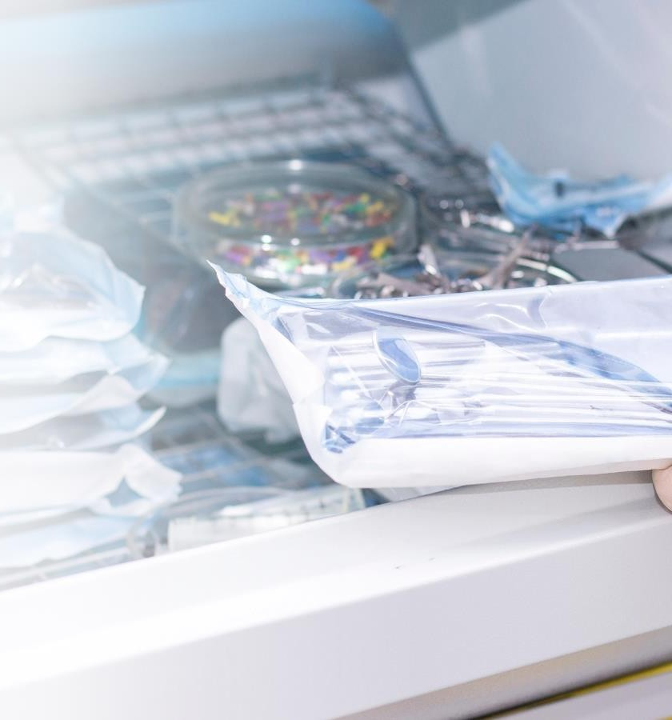


MEDICAL AND PHARMA
Validated medical device packaging,
one accountable line.
ISO 11607 PROCESS VALIDATION
TYVEK, POUCH, AND RIGID TRAY FORMATS
Notes:
FULL-BLEED PHOTO (mode-neutral). Over photography the lockup runs as the one-color white knockout (Section 3). The scrim guarantees contrast; keep text inside the scrim zone. Real installed lines only.

Slide 16
WHAT WE COMMIT TO
The line we stand behind, in numbers
120 ppm
<20 min
4 hr
TRAY-SEAL THROUGHPUT
TOOLING CHANGEOVER
LINE-DOWN RESPONSE
Every figure is quoted before the line ships and measured after it runs. If a spec is at risk, you hear it from us first.
ILLUSTRATIVE FIGURES · REPLACE WITH VERIFIED SPECS BEFORE PRESENTING [GET]
16 · LINE ASSESSMENT
Notes:
STAT BAND, DARK. Three stats max, Mono. Units follow the value with one space. Delete the [GET] line only when verified figures are in.

Slide 17
WHAT WE COMMIT TO
The line we stand behind, in numbers
120 ppm
<20 min
4 hr
TRAY-SEAL THROUGHPUT
TOOLING CHANGEOVER
LINE-DOWN RESPONSE
Every figure is quoted before the line ships and measured after it runs. If a spec is at risk, you hear it from us first.
ILLUSTRATIVE FIGURES · REPLACE WITH VERIFIED SPECS BEFORE PRESENTING [GET]
17 · LINE ASSESSMENT
Notes:
STAT BAND, LIGHT. Three stats max, Mono. Units follow the value with one space. Delete the [GET] line only when verified figures are in.

Slide 18

THE CHANGE, MEASURED
Changeover before and after recipe control
BEFORE · MANUAL SETPOINTS
AFTER · RECIPE-DRIVEN
45 to 90 min
10 to 20 min
Crew-dependent, verified after the fact.
Guided, validated before restart, same result every shift.
The spread is the point: recipe control does not just cut the average, it removes the variance a schedule cannot plan around.
ILLUSTRATIVE RANGES · REPLACE WITH MEASURED VALUES [GET]
18 · LINE ASSESSMENT
Notes:
BEFORE/AFTER, DARK. Two figures, one red arrow (the single red element). The after value is white, the before value muted; the hierarchy does the arguing. Ranges use 'to'.

Slide 19
WHAT THE NUMBERS SAY
Recipe-driven changeover cut setup from 30 to 18 minutes
-40%
SETUP TIME PER SKU CHANGE
At 4.6 changeovers per day, that is about an hour of production back, every day.
ILLUSTRATIVE PILOT DATA · REPLACE WITH VERIFIED LINE DATA [GET]
19 · WEBINAR
Notes:
CHART BAR, LIGHT. Headline states the takeaway; the chart is proof. Steel blue carries data (Section 4 role). Native chart: edit via right-click > Edit Data.

Slide 20
AFTER GO-LIVE
OEE climbed 16 points in eight shifts
78%
OEE, SHIFT 8
62%
OEE, SHIFT 1
ILLUSTRATIVE TREND · REPLACE WITH MEASURED OEE FROM THE LINE [GET]
20 · LINE ASSESSMENT
Notes:
CHART LINE, DARK. Trend data in blue-300 (the dark-surface data color). No markers, no smoothing, quiet grid. The kicker column repeats the start and end values in Mono so the delta reads without the axis.

Slide 21
OPTIONS
Three paths to the rate you need
 | Upgrade in place | Integrated line | New greenfield
Throughput gain | +10 to 15% | +35 to 50% | +50% and up
Tooling changeover | unchanged | < 20 min | < 20 min
Integration risk | stays with you | owned by us | owned by us
Typical timeline | 8 to 10 wk | 16 to 20 wk | 40+ wk
Budget band | $ | $$ | $$$$
ILLUSTRATIVE RANGES · REPLACE WITH THE QUOTED FIGURES FOR THIS LINE [GET]
21 · WEBINAR
Notes:
COMPARISON TABLE, LIGHT. Neutral header, hairlines, figures in Mono. Recommended column gets the n50 tint and weight, never a colored band. Ranges use 'to'.

Slide 22
THE EVIDENCE
Changeover cost is documented, not anecdotal
“Changeovers are not only time-consuming but are also accompanied by production losses … with significant financial loss.”
STAPELBROEK ET AL., 2024 · RUG RESEARCH
“Crucial production time is lost every hour equipment sits idle during changeovers.”
REINKE, 2013 · MANUFACTURING.NET
“High-mix, high-volume operations result in increased setups and changeovers, impacting efficiency and profitability.”
CRB GROUP, 2015
22 · WEBINAR
Notes:
EVIDENCE, LIGHT. Sourced third-party quotes, Mono citations right-aligned. Every quote keeps its source. Three max.

Slide 23



HOW WE WORK
One accountable integrator, three commitments
Accountability
Excellence
Integrity
We own the line after the sale. Support is staffed by people who know your installed line, with response measured in hours.
We hold the line to stated throughput, tolerance, and changeover times, and we are willing to publish them.
We quote what the line will actually do. If a spec is at risk, you hear it from us first.
23 · LINE ASSESSMENT
Notes:
THREE CARDS, DARK. One idea per card, 40 words max each. Cards lift by hairline border, not luminance. Icons monochrome.

Slide 24



SOLUTIONS
The line, in three scopes
Tray sealing
Thermoforming
Automation
G. Mondini Trave and Cigno lines, integrated and supported product to pallet.
The TFX platform for higher throughput and recyclable materials.
ULMA robot loading and full-line integration on Allen-Bradley controls.
View solution
View solution
View solution
24 · WEBINAR
Notes:
OFFERINGS, LIGHT. Steel blue carries links (underlined). Cards name real machines, not 'solutions'.

Slide 25
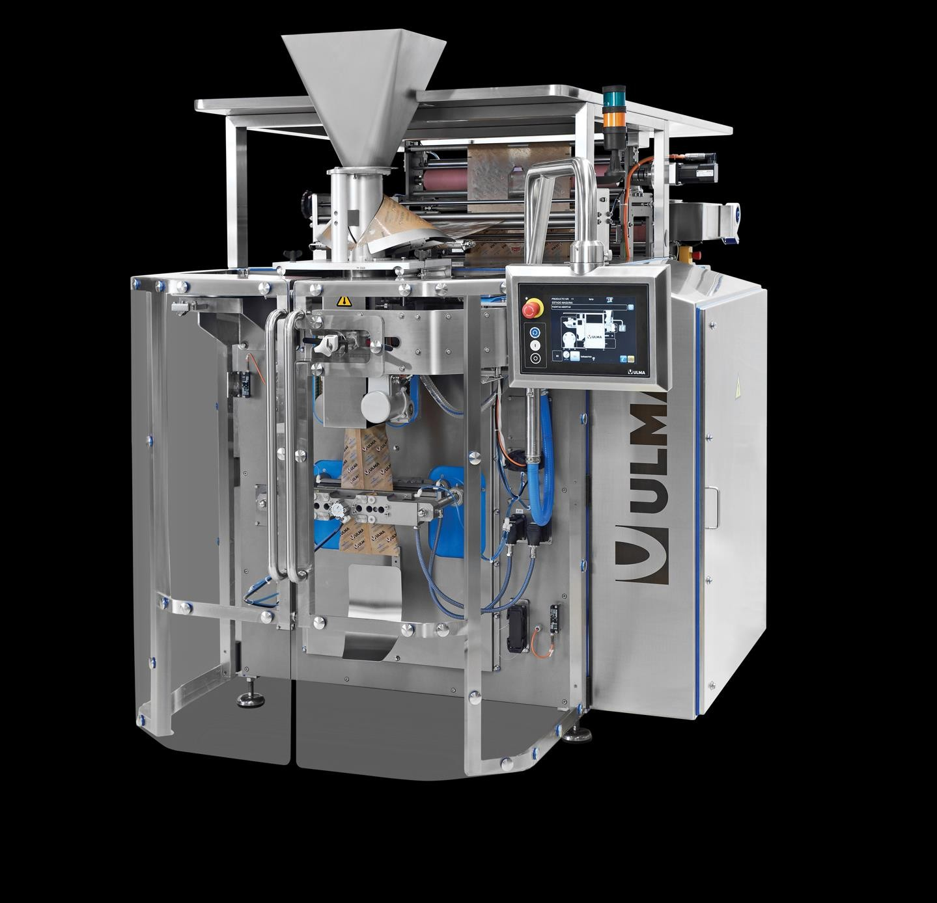

THE APPROACH
You tell us the product and the rate.
We spec the line that hits it.
One project owner spans Harpak-ULMA and every partner brand on the line. You never integrate vendors.
Recipes push new product specs to every HMI at once, so a SKU change is a selection, not a procedure.
The line auto-validates readiness before start, so a missed setting shows up before scrap does.
ULMA VERTICAL BAGGER ON A MULTI-SKU SEAFOOD LINE
25 · WEBINAR
Notes:
CONTENT + PHOTO, LIGHT. Claim headline, three proof rows, real equipment photo with a Mono caption naming the machine.

Slide 26
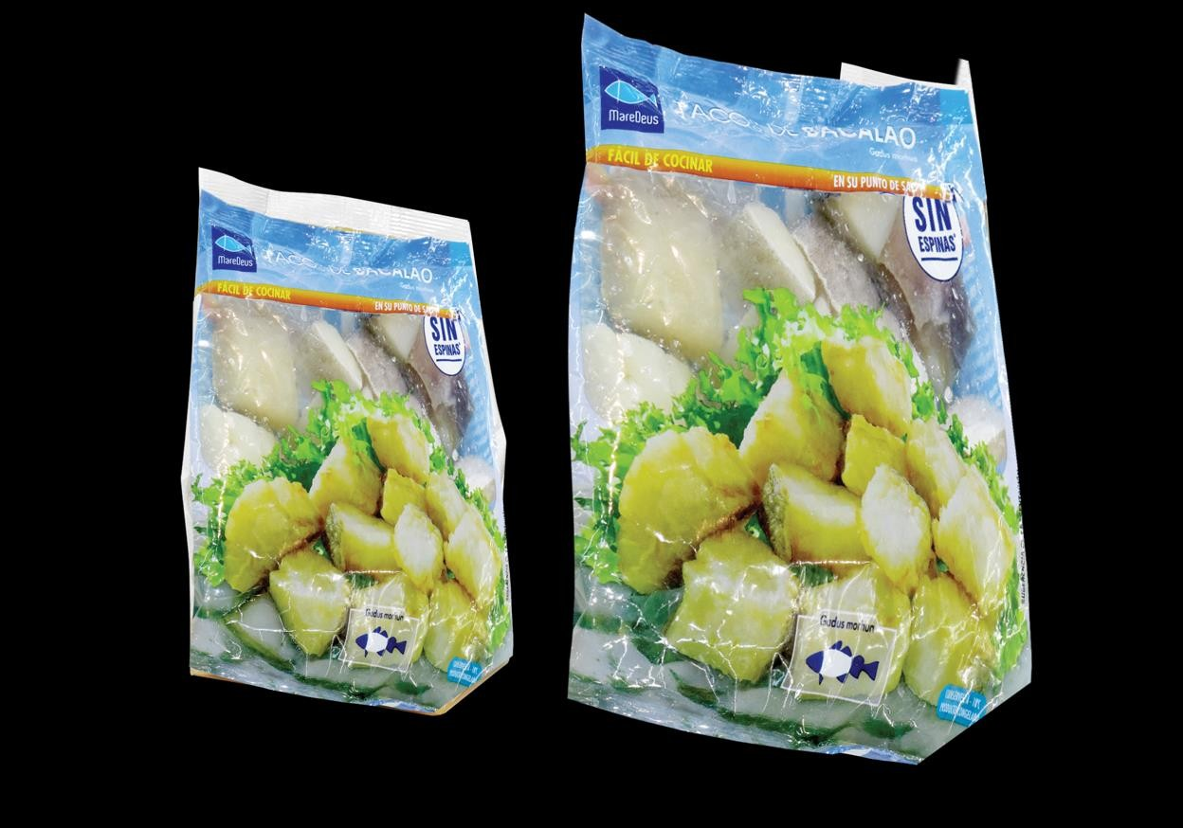
SOLUTIONS / TRAY SEALING
One tray-seal line, held to its numbers
G. MONDINI · PLATFORM
Trave tray sealer
Throughput
up to 120 ppm
Tooling changeover
< 20 min
Formats per tool
multiple
Control platform
Allen-Bradley
Reference part
RA-4520
MULTIPLE PACK FORMATS THROUGH A SINGLE LINE · REAL EQUIPMENT PHOTOGRAPHY
26 · LINE ASSESSMENT
Notes:
MACHINE + SPEC, DARK. Specs lead. All figures in Mono with units; part numbers always Mono. Replace with actual machine spec [GET].

Slide 27
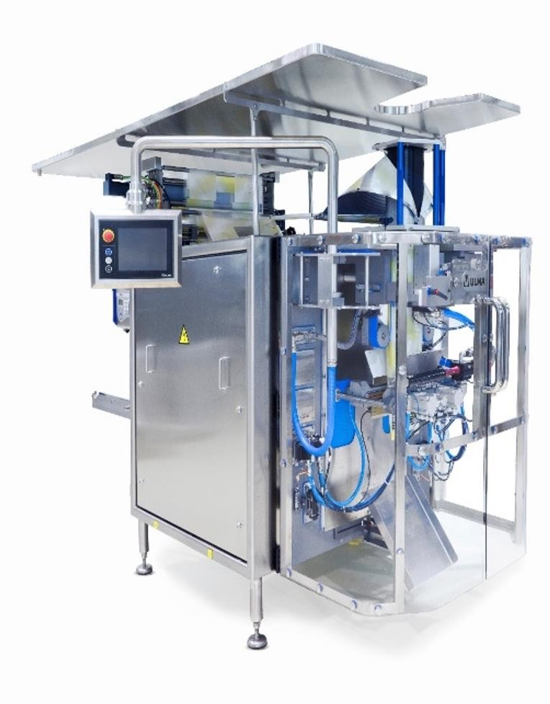
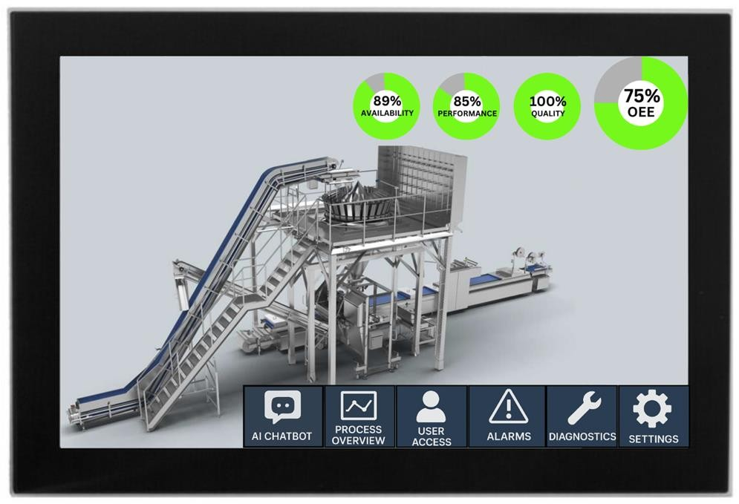


THE HARDWARE ON THIS LINE
Three machines, one control layer
ULMA VB 44
ULMA TFX 500
Line control
Vertical bagger, multihead weigher infeed
Thermoformer, recyclable film ready
Allen-Bradley recipe layer, one HMI
120 bpm
11 SKUs
120 mm draw
<20 min
1 recipe
5 machines
MACHINE NAMES AND FIGURES ILLUSTRATIVE · REPLACE WITH THE QUOTED LINE [GET]
27 · LINE ASSESSMENT
Notes:
MACHINE LINEUP, DARK. Three machine cards: photo on a white inset panel (equipment photography stays on neutral), name, role, two Mono spec chips. Use for the proposed line's bill of machines.

Slide 28

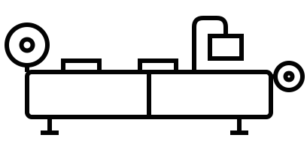


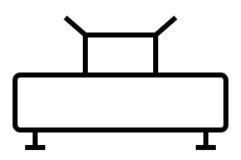
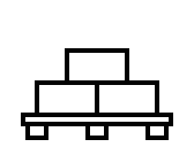
THE PRODUCT-TO-PALLET LINE
Product to pallet, one accountable line
INFEED
FORM
SEAL
LOAD
PACK
PALLET
AURA
CabinPlant weigher
TFS thermoformer
Mondini Trave
ULMA robot
Case packer
Palletizer
Line intelligence
Stations swap to match the quoted line. A vertical line runs weigher, VFFS, case packer. Never show a station the quote does not include.
28 · WEBINAR
Notes:
PROCESS MOTIF, LIGHT (v0.4 6.A.10.5). Stations are equipment glyphs on a shared 2 px baseline, feet touching, real machine names below an eyebrow cap. The Aura ring floats slightly above the baseline at the end, labeled AURA / Line intelligence. Default order: weigher, thermoformer, tray sealer, robot, case packer, palletizer, ring. Swap stations to match the quoted line; never show a station the quote does not include (vertical example: weigher, VFFS, case packer). Glyphs are ink on light; at most one red accent dot per slide on the mechanism of the station discussed, default zero.

Slide 29
FROM DECISION TO RUNNING LINE
From assessment to accountable line
WK 0 to 2
WK 2 to 6
WK 6 to 22
WK 22 to 26
ONGOING
Line assessment
Line spec and quote
Build and integrate
FAT and install
Uptime ownership
Product, rates, constraints, measured on site
Throughput and changeover commitments in writing
Machines, controls, and recipes as one system
Acceptance against the quoted numbers
Parts, response, and the number you call
ILLUSTRATIVE DURATIONS · REPLACE WITH THE PROJECT PLAN FOR THIS LINE [GET]
29 · WEBINAR
Notes:
TIMELINE, LIGHT. Five nodes max; the single red node marks the current or decision step.

Slide 30
ROLLOUT
Four quarters from first line to full-plant recipes
Q3 2026
Q4 2026
Q1 2027
Q2 2027
Line 1 conversion
Lines 2 and 3
Aura Edge pilot
Plant standard
Bagging line to recipe control; baseline OEE captured
Tray-seal and thermoform lines onto the same layer
Fault prediction on the highest-scrap line
One recipe model, every line, one service owner
Each phase ships with its own acceptance numbers. No phase starts until the last one holds its spec for 30 days.
ILLUSTRATIVE PLAN · DATE THE PHASES TO THE SIGNED PROJECT [GET]
30 · LINE ASSESSMENT
Notes:
ROADMAP, DARK. Quarters in Mono; the red node is the quarter being decided in this meeting. Four phases max; more belongs in a project plan, not a slide.

Slide 31




SCOPE
What one accountable integrator covers
Line design and integration
Stated performance
Machines, controls, conveyance, and recipes specified as one system.
Throughput, tolerance, and changeover quoted in writing and measured after install.
Service and parts
Compliance and hygiene
Parts same day, a technician on site within 4 hours of a line-down call.
Washdown design, food safety, and validation support where the line demands it.
SERVICE FIGURES ILLUSTRATIVE · REPLACE WITH THE PUBLISHED COMMITMENT [GET]
31 · WEBINAR
Notes:
2x2 GRID, LIGHT. Four capabilities max; icon + claim + one line of proof.

Slide 32
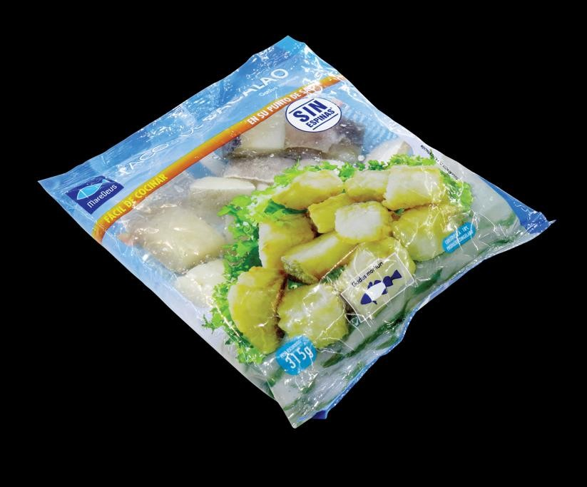
WHERE THE LINES RUN
Food first, then medical, then consumer goods
FOOD
MEDICAL AND PHARMA
CONSUMER GOODS
Washdown lines for fresh, frozen, and proteins. The volume priority.
Validated packaging: Tyvek, pouch, and rigid tray under ISO 11607.
Format flexibility for retail-ready and e-commerce packs.
INTERIM PHOTOS FROM FOOD LINES · REPLACE PER VERTICAL WHEN APPROVED IMAGERY EXISTS [GET]
32 · WEBINAR
Notes:
INDUSTRIES, LIGHT. Vertical priority per the owner: food, then medical and pharma, then consumer goods. Red Mono eyebrows are the accent; keep the photos real. The consumer-goods photo is a food pack standing in until vertical-specific imagery exists [GET].

Slide 33

COMPLIANCE
The paperwork ships with the line
ISO 11607-1
USDA SANITARY
CE MACHINERY
UL 508A PANELS
3-A SSI
Design files, validation protocols, and acceptance records are deliverables, not extras. Ask for the compliance binder from a recent install.
VERIFY THE APPLICABLE CERTIFICATIONS PER LINE BEFORE PRESENTING [GET]
33 · WEBINAR
Notes:
CERTIFICATIONS, LIGHT. Neutral chips, Mono labels, badge icon. This is a claims surface: confirm every certification applies to the quoted line before it ships [GET].

Slide 34


VERBAL IDENTITY IN PRACTICE
Say the spec, not the slogan
Say this
Not this
Tray sealing at up to 120 ppm, with tooling changeover under 20 minutes.
End-to-end solutions that drive innovation.
Parts shipped same day. A technician on site within 4 hours.
World-class service and support.
Aura reads line data and flags a fault before the line stops.
AI-powered insights for smart packaging.
FULL BANNED AND WATCH LIST: BRAND BOOK SECTION 2 · SEMANTIC TINTS CARRY STATUS ONLY, NEVER DECORATION
34 · WEBINAR
Notes:
DO/DON'T, LIGHT. Semantic tints pair with an icon and text so color is never the only signal.

Slide 35
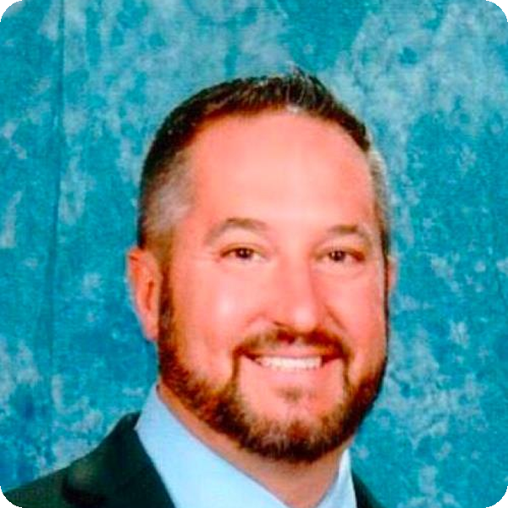
YOUR PRESENTER
Eighteen years on packaging lines
Mike specs weighing and bagging lines for food processors across North America. He ran changeover on a multihead line before he ever quoted one, and it shows: his line specs read like a shift plan, not a brochure. Lately he leads the recipe-driven changeover program on multi-SKU seafood and frozen lines.
18 yr
ON PACKAGING LINES
60+
Mike Marchand
LINES COMMISSIONED
Senior product manager
Multihead weighers and vertical baggers
11
SKUS ON HIS LAST LINE
M.MARCHAND@HARPAK-ULMA.COM
35 · WEBINAR
Notes:
BIO HERO, LIGHT. One presenter, full treatment: square photo with the 8 px radius, name in Archivo, bio written by what they do on the line (never adjectives; podcast rule, Section 11), Mono facts rail. Photo guidance: neutral background when reshot; this studio-blue interim shot is acceptable until then. Bio 60 words max.

Slide 36
YOUR PRESENTERS
Who's on the line tonight
Mike Marchand
DW
Dana Whitfield
Senior product manager
Field service engineer
Weighers and baggers. Runs the recipe-driven changeover program.
Tray-seal installs and commissioning. The number you call at 2 a.m.
M.MARCHAND@HARPAK-ULMA.COM
D.WHITFIELD@HARPAK-ULMA.COM
36 · LINE ASSESSMENT
Notes:
BIO DUAL, DARK. Two presenters. Photos use the rounded square chip; the initials chip is the placeholder until a real headshot exists. Describe each person by what they do on the line.

Slide 37
THE PROJECT TEAM
One owner, and the people behind the number
DW
RK
Mike Marchand
Dana Whitfield
Reyna Koh
Product · weighers and baggers
Field service · tray sealing
Project owner · your one contact
M.MARCHAND@HARPAK-ULMA.COM
D.WHITFIELD@HARPAK-ULMA.COM
R.KOH@HARPAK-ULMA.COM
EXTEND TO SIX BY DUPLICATING THE ROW · THE PROJECT OWNER CARD ALWAYS NAMES THE ONE CONTACT
37 · LINE ASSESSMENT
Notes:
TEAM GRID, LIGHT. Three cards per row, six max per slide. The one-contact model is the point: the project owner card carries the claim. Replace initials chips with photos as they exist.

Slide 38
YOUR PRESENTERS
Who you'll hear from
MM
Mike Marchand
DW
Dana Whitfield
Senior product manager
Field service engineer
Multihead weighers and vertical baggers
Tray-seal installs and line commissioning
M.MARCHAND@HARPAK-ULMA.COM
D.WHITFIELD@HARPAK-ULMA.COM
REPLACE THE INITIALS CHIP WITH A PHOTO: SQUARE CROP, NEUTRAL BACKGROUND, 8 PX RADIUS (SEE SLIDE 34)
38 · WEBINAR
Notes:
SPEAKERS, LIGHT. Compact two-up for webinars. For a fuller treatment use the bio hero (34) or bio dual (35).

Slide 39



THE ECOSYSTEM
Category specialists, one accountable line
TECHNOLOGY AND PLATFORM
END-OF-LINE PACKAGING
PROCESSING PARTNER
EXCLUSIVE NA SUPPLY
Controls and information layer: FactoryTalk, Allen-Bradley.
Case packing, cartoning, and wrap-around. Added via ULMA.
Food processing and weighing systems.
Tray sealing. We are the exclusive North American source.
REFERENCE MARKS FROM SUPPLIED FILES · PRODUCTION REQUIRES PARTNER-APPROVED VECTORS [GET] · NEVER RECOLOR OR RESTYLE · KEEP 1 S CLEAR OF BRAND RED
39 · LINE ASSESSMENT
Notes:
PARTNER WALL, LIGHT. Full-color marks on uniform white cards (marks never sit on the dark field or on red). RAMA shows the placeholder wordmark until the official vector arrives [GET]. Every card pairs the mark with what the partner does on the line; a logo wall with no claims is banned by the brief. Rockwell red-proximity ruling applies.

Slide 40
THE ECOSYSTEM
Category specialists, one accountable line
TECHNOLOGY AND PLATFORM
END-OF-LINE PACKAGING
PROCESSING PARTNER
EXCLUSIVE NA SUPPLY
Controls and information layer: FactoryTalk, Allen-Bradley.
Case packing, cartoning, and wrap-around. Added via ULMA.
Food processing and weighing systems.
Tray sealing. We are the exclusive North American source.
REFERENCE MARKS FROM SUPPLIED FILES · PRODUCTION REQUIRES PARTNER-APPROVED VECTORS [GET] · NEVER RECOLOR OR RESTYLE · KEEP 1 S CLEAR OF BRAND RED
40 · LINE ASSESSMENT
Notes:
PARTNER WALL, DARK. Full-color marks on uniform white cards (marks never sit on the dark field or on red). RAMA shows the placeholder wordmark until the official vector arrives [GET]. Every card pairs the mark with what the partner does on the line; a logo wall with no claims is banned by the brief. Rockwell red-proximity ruling applies.

Slide 41
CO-BRANDING
Four weights of partner presence
BUILT WITH
A
Endorsement badge
The partner's own issued badge, used exactly as issued.
B
Built-on credit
Text preferred: 'Runs on Rockwell Allen-Bradley controls.'
C
Ecosystem wall
Full-color marks on uniform neutral cards. The default.
D
Formal co-brand lockup
Only with a written agreement and partner sign-off. LEGAL gate.
LIGHTEST WEIGHT THAT DOES THE JOB WINS · WHEN IN DOUBT, USE B AND FLAG TO MARKETING
41 · LINE ASSESSMENT
Notes:
BUILT-WITH + CONTEXTS, LIGHT. The strip is context C in practice: uniform marks on one neutral band, no recoloring, generous spacing. Contexts A to D are the escalation ladder; D requires a written agreement and counsel (Section 7).

Slide 42

PARTNER DETAIL
Rockwell on the line: controls, data, and one owner
Use the partner-approved vector mark only; this raster is reference [GET].
The mark stays on white or neutral cards, never on the dark field or red.
TECHNOLOGY AND PLATFORM
Keep 1 S of neutral separation from any brand-red element.
ControlLogix and Kinetix run the machines. FactoryTalk carries recipes, telemetry, and the data model Aura reads. We engineer on it; you keep one control standard.
Never recolor, restyle, crop, or rebuild the mark.
CREDIT LINE: 'RUNS ON ROCKWELL ALLEN-BRADLEY CONTROLS'
Red proximity: brand red and Rockwell red read as one hue. Never adjacent, never on the same band, never harmonized.
42 · LINE ASSESSMENT
Notes:
PARTNER DETAIL, LIGHT. One partner deep: mark on a neutral slot, role stated as what it does on the line, the approved credit line in Mono, and the compliance rules beside it. Duplicate per partner as needed.

Slide 43
AURA BY HARPAK-ULMA
Aura reads line data and flags the fault
before the line stops
Source-grounded answers
AURA · LANE 2
Every answer cites the document it came from.
Seal temperature dropped on Lane 2.
Check tooling. Tap to view trend.
Confidence tier on every answer
High, medium, or low, stated up front.
SEAL TEMP 178 C, falling
THRESHOLD 180 to 200 C
TREND 12 min decline
Safety before any procedure
Full LOTO callout before a panel opens.
CONFIDENCE HIGH · SOURCE: TFS-407 MANUAL 4.2
PRODUCT SURFACE SHOWN AS ILLUSTRATION · REAL UI SCREENSHOTS CARRY THE AURA PRODUCT SYSTEM (DM SANS)
43 · LINE ASSESSMENT
Notes:
AURA SUB-BRAND (Section 8, Option B). Deep Navy surface; the ring is the only gradient and is never filled. Signature: 'Aura by Harpak-ULMA'. Steel blue never appears here (two blues, scope-separated). DM Sans only inside real product screenshots.

Slide 44
AUTOMATION FAIR 2026
One line. One number to call.
AURA EDGE by Harpak-ULMA
Calling faults before they stop the line. Live on a running tray-seal demo, twice a day.
BOOTH C-4120 · DEMOS 10:30 AND 14:30 · PACK EXPO 2026 · AUTOMATION FAIR 2026
Notes:
AURA EDGE EVENT, DARK. Booth and session slide. The EDGE-in-accent wordmark treatment is illustrative; drop in the official Aura Edge lockup artwork when placing this in production [GET]. The ring is the only gradient. External signature stays 'Aura Edge by Harpak-ULMA'. On the show floor the default field is white (Section 10); this dark variant is for screens and low-light stages.

Slide 45

THE DEMO
Watch the line catch its own fault
DEMO SCRIPT RULES
Action-first. What it does in plant terms, then how.
A real fault prediction, not a canned reel.
Confidence tier and cited source on every claim.
REPLACE THE POSTER WITH A REAL CAPTURE · EMBED VIA INSERT > VIDEO · KEEP THE 16:9 FRAME
45 · LINE ASSESSMENT
Notes:
DEMO / VIDEO FRAME, DARK. The media card holds a poster frame until a real video is embedded (Insert > Video over the frame). The red play chip is the one red element. Demo script rules come from Section 11: action-first, real prediction, confidence and source on every claim.

Slide 46
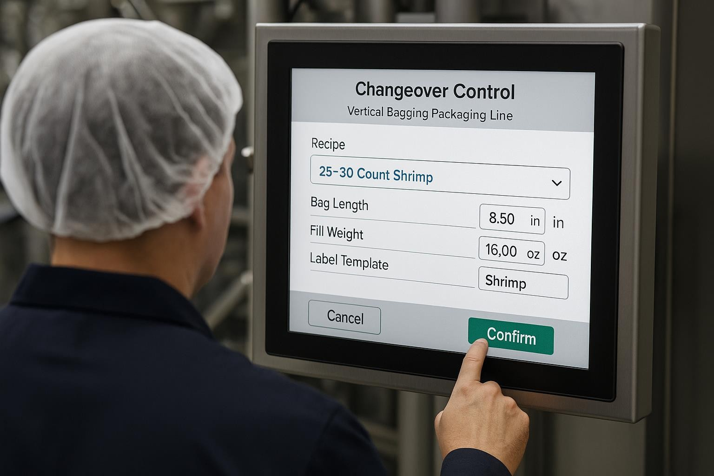
CASE STUDY · FROZEN FOODS
Film scrap down 15 percent,
payback in 9 months
The challenge. Eleven SKUs on one bagging line, with manual setpoint entry at every HMI. Recipe mismatches turned every changeover into startup scrap.
The approach. One integrated recipe layer on Allen-Bradley controls. The operator selects the SKU once; bag length, label data, and weigher targets update together, and the line validates readiness before start.
15%
9 mo
FILM SCRAP REDUCTION
PAYBACK ON THE RETROFIT
ILLUSTRATIVE CASE · REPLACE WITH A NAMED, APPROVED INSTALL [GET]
OPERATOR AT THE LINE HMI · REAL PPE, LEGIBLE SCREEN
46 · WEBINAR
Notes:
CASE STUDY, LIGHT. Challenge, approach, measured result in the ink panel. Every figure sourced or [GET].

Slide 47
COMMERCIAL
Three ways to buy the same accountability
RECOMMENDED FOR THIS LINE
Upgrade in place
Integrated line
New greenfield
$
$$
$$$$
Recipe layer on existing machines
New machines where they pay back
Full line design, product to pallet
Control migration, no new iron
One control layer, one recipe model
Every stage specified as one system
Service contract on the result
Throughput and changeover in writing
Commissioning and training included
Uptime ownership after install
BUDGET BANDS ILLUSTRATIVE · PRICE TO THE QUOTED LINE [GET]
47 · LINE ASSESSMENT
Notes:
COMMERCIAL OPTIONS, LIGHT. Three scopes, same accountability claim. The recommended tag in red Mono is the slide's one red element; the n50 tint does the rest. Never more than four included rows per card.

Slide 48
QUESTIONS WE GET
Asked in every assessment, answered up front
Do we have to replace machines that still run?
What happens to our operators?
No. The recipe layer runs on existing iron where the controls allow. New machines only where the payback is shown.
They stop re-keying setpoints and start supervising changeovers. Training is part of commissioning, not an extra.
Who do we call when something stops?
What if the line misses the quoted numbers?
One number. The project owner spans us and every partner brand on the line.
The commitments are in writing and measured at FAT. If a spec is at risk, you hear it from us first.
48 · LINE ASSESSMENT
Notes:
FAQ, LIGHT. Four questions max, real ones from sales calls. Answers hold the voice: plain, specific, honest about limits. No question marks in headlines elsewhere; this is the one Q-and-A surface.

Slide 49
SUMMARY
Three things to take back to the plant
01
Variety is a systems problem
SKU count is not the enemy. Uncoordinated machines are.
NEXT STEP
Book the two-week line assessment.
02
Recipes beat procedures
A selection at one HMI beats a checklist at five.
We measure the current line and quote the rate, changeover, and uptime we will commit to.
03
One owner for uptime
A multi-vendor line should still have one number to call.
49 · WEBINAR
Notes:
SUMMARY, LIGHT. Three takeaways, each a claim with support. The red arrow is the one accent and points at the same ask as the closer.

Slide 50
THE ASK
One line. One number to call.
Approve the two-week line assessment and we will spec the line that hits your rate,
with the changeover and uptime commitments in writing.
Request a line assessment
PACKAGING@HARPAK-ULMA.COM · +1 508 555 0142 [PLACEHOLDER] · HARPAK-ULMA.COM
Notes:
CLOSING, DARK. The final slide is the ask with a date, never 'Thank you'. One red button, 4 px radius.

Slide 51
THE ASK
One line. One number to call.
Approve the two-week line assessment and we will spec the line that hits your rate,
with the changeover and uptime commitments in writing.
Request a line assessment
PACKAGING@HARPAK-ULMA.COM · +1 508 555 0142 [PLACEHOLDER] · HARPAK-ULMA.COM
Notes:
CLOSING, LIGHT. Identical anatomy to the dark closer. White on red-500 passes AA at 4.91:1.

Slide 52


CONTACT
One number to call
Headquarters
175 John Quincy Adams Rd
Taunton, MA 02780
Line-down service
+1 508 555 0142 [PLACEHOLDER]
Parts same day. Technician within 4 hours [GET]
Sales and assessments
PACKAGING@HARPAK-ULMA.COM
HARPAK-ULMA.COM
THE PEOPLE WHO ANSWER KNOW YOUR INSTALLED LINE
52 · LINE ASSESSMENT
Notes:
CONTACT, LIGHT. Contact details in Mono (they are data). Verify the address, phone, and service commitment before shipping [GET]; the placeholders are intentional guards.

Slide 53
A
Appendix
Reference material. Not presented live.
CONFIDENTIAL · FOR THE NAMED RECIPIENT
PERFORMANCE FIGURES ARE QUOTED PER LINE AND VERIFIED AT FAT
AURA AND AURA EDGE NAMING SUBJECT TO COUNSEL CLEARANCE
PARTNER MARKS BELONG TO THEIR OWNERS AND FOLLOW EACH PARTNER'S GUIDELINES
Notes:
APPENDIX + LEGAL. Overflow lives here. The four Mono lines are the standing legal and governance footers; keep them intact.

Slide 54
FOR DECK BUILDERS · DELETE BEFORE PRESENTING
The system on one slide
Display · Archivo ExtraBold
INK 030303
RED 500 DC220A
RED 600 BD1C08
BLUE 600 235980
Heading · Archivo Bold
Emphasis · Inter SemiBold
Body · Inter Regular, 11 to 13 pt, line 1.35
N600 5B5F64
N200 E0E2E4
N50 F7F8F9
NAVY (AURA) 0C1B33
DATA · JETBRAINS MONO · 120 PPM · RA-4520
One red element per slide. If two reds both look clickable, one is wrong.
Headlines are claims in sentence case, 12 words max. Body 40 words max.
Figures, units, and part numbers in Mono. Ranges use 'to', never a dash.
No banned words: seamless, unlock, AI-powered, world-class, cutting-edge, end-to-end.
Grid: 0.67 in margins, 12 columns, 0.25 in gutters. Radius: 4 px buttons, 8 px cards.
Every figure is verified or tagged [GET]. Delete slides 04 and 54 before presenting.
54 · TEMPLATE
Notes:
CHEAT SHEET. Build reference only; delete before presenting (with the index, slide 04). Fonts required: Archivo, Inter, JetBrains Mono (assets/fonts install kit).

Slide 55
Product to pallet.
HARPAK-ULMA.COM · TAUNTON, MASSACHUSETTS
Notes:
BACK COVER, DARK. The span phrase anchors the close. Nothing else competes.

