Slide 1

All About The Green
By: Harper Xinag, Erik Beckwith, Monica Toledo, Danny Carlson

Slide 2
Agenda
Introduction
California
Washington
Neveda
Colorado
Illinois

Slide 3
Introduction
Core Question: How much money can marijuana make a state by share of tax revenue?
Can weed help Illinois budget revenue issues?
How we did it...

Slide 4
Agenda
Introduction
California
Washington
Neveda
Colorado
Illinois

Slide 5

California!
2018 is the first year of CALIFORNIA’s tax revenue for recreational marijuana.
Vice Sept, 6th “A lack of licensed options and the absence of a fully developed regulated market leaves illegal operations with the “lion’s share” of business..”
https://www.vice.com/en_us/article/a3q5yb/californias-illegal-weed-industry-is-doing-better-than-ever

Slide 6
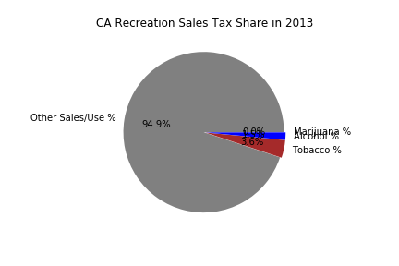
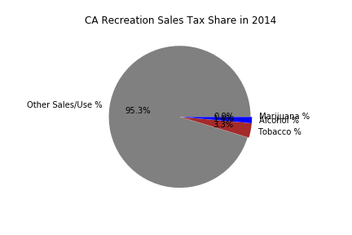

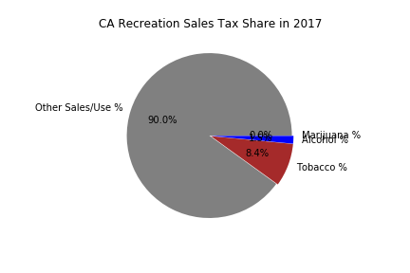
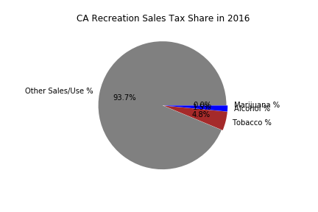
CA Vice Shares of Sales Tax Rev. Pies

Slide 7
Tobacco Revenue in California
Example of how policy change can affect the revenue drastically. CA added a $2 excise tax to each pack of cigarettes and the numbers are clear from 2017. This article from 2017 shows.
“California voters passed a measure in November to boost the cigarette tax by $2 a pack, up from the earlier 87-cent tax. Big tobacco companies spent more than $70 million fighting the voter measure, according to MapLight.-https://www.cnbc.com/2017/07/28/us-cigarette-volumes-take-hit-in-q2-as-california-tax-hike-causes-.html

Slide 8
Projected Income from California 2018
“The figures for the second quarter represent an increase over the previous one. In the first quarter of 2018, cannabis tax revenue totaled $60.9 million, which included $32 million in excise tax, $1.6 million cultivation tax, and $27.3 million in sales tax.
Officials had estimated that total revenue from cultivation and excise taxes for the first six months of the year would amount to $185 million. But the actual total of $82 million represents a deficit of more than $100 million from state estimates.”
https://hightimes.com/news/tax-revenue-californias-legal-marijuana-falls-short-estimates/

Slide 9
Agenda
Introduction
California
Washington
Neveda
Colorado
Illinois

Slide 10

Washington
On November 6, 2012, Washington State voters passed Initiative, makes it legal for businesses holding the appropriate marijuana license(s) to produce, process, or make retail sales of marijuana for recreational use.
The Liquor and Cannabis Board (LCB) administers and collects the 37 percent Marijuana excise tax.

Slide 11
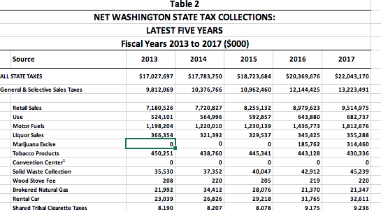
Resources:
https://lcb.wa.gov/marj/marijuana-2017
https://dor.wa.gov/about/statistics-reports/tax-statistics

Slide 12
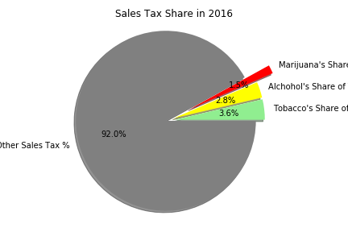
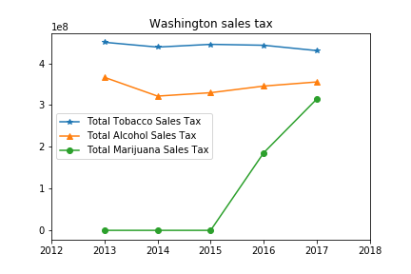
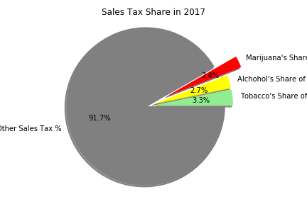
Analysis:

Slide 13
Agenda
Introduction
California
Washington
Neveda
Colorado
Illinois

Slide 14
Nevada
Medical marijuana use was legalized in 2000 and became available to licensed individuals shortly after this date. However, it wasn't until January 1, 2017 when recreational cannabis in Nevada became legal. With a 15% WholeSale tax and a 10% Retail Sales tax, Nevada made over $30 million in revenue in just the first six month of selling recreational marijuana.
https://www.census.gov/econ/currentdata/dbsearch?program=QTAX&startYear=2013&endYear=2017&categories=QTAXCAT3&dataType=TOTAL&geoLevel=NV&notAdjusted=1&submit=GET+DATA&releaseScheduleId=
https://tax.nv.gov/uploadedFiles/taxnvgov/Content/TaxLibrary/Annual%20Report%20(Fiscal%20Year%202015)%20(1.0)%20%5B2016-01-15%5D.pdf
https://tax.nv.gov/Forms/Sales___Use_Tax_Forms/#sales

Slide 15
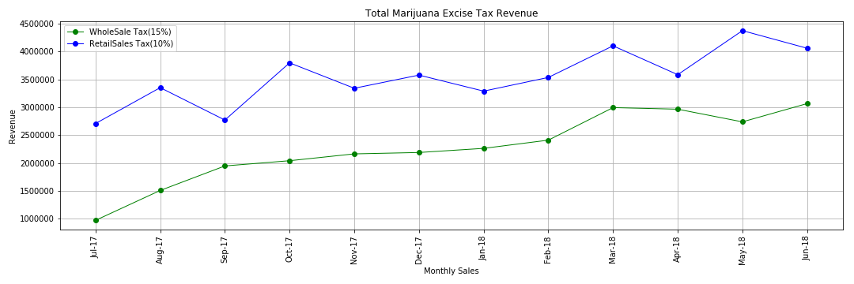
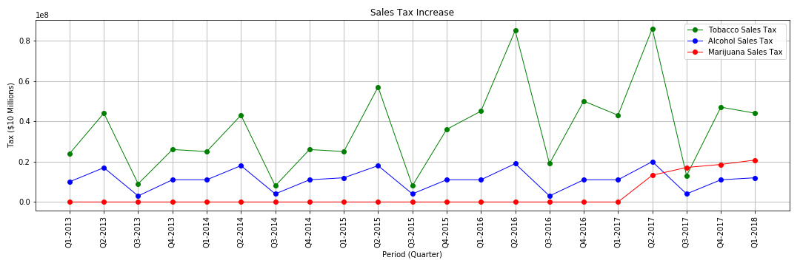
Nevada Analysis

Slide 16
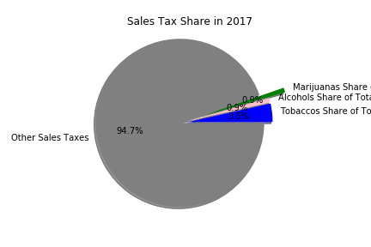
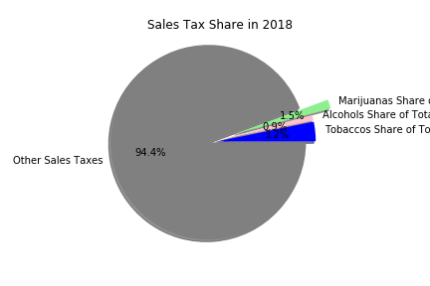
Nevada Analysis Pt.2

Slide 17
Agenda
Introduction
California
Washington
Neveda
Colorado
Illinois

Slide 18
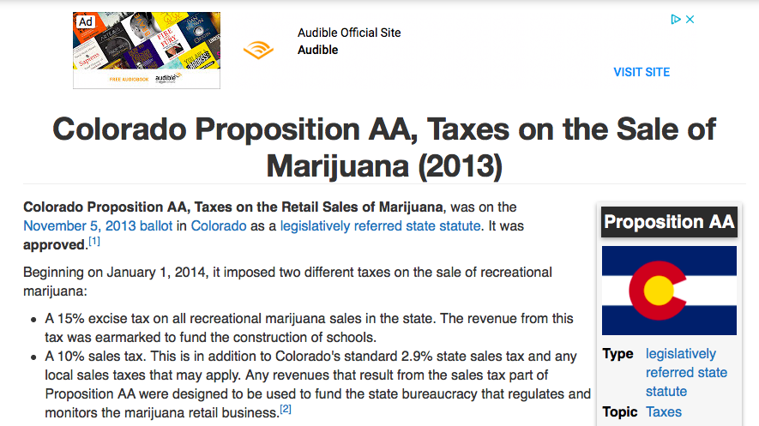
Research
https://en.wikipedia.org/wiki/Cannabis_in_Colorado
https://ballotpedia.org/Colorado_Proposition_AA,_Taxes_on_the_Sale_of_Marijuana_(2013)

Slide 19
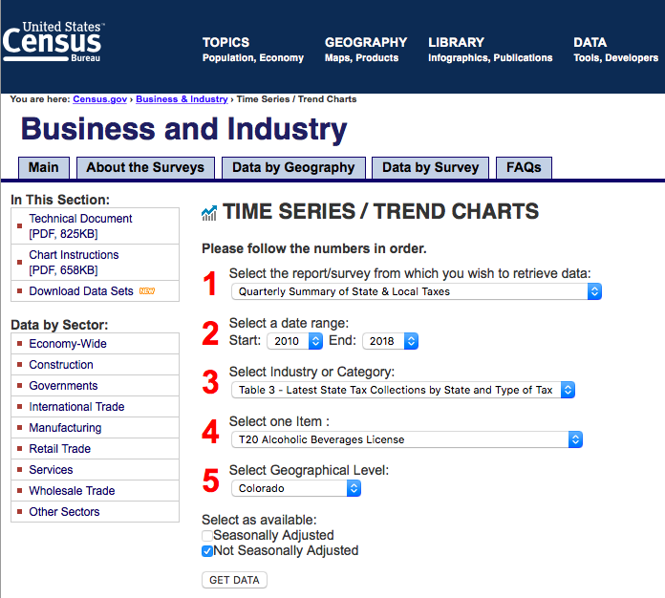
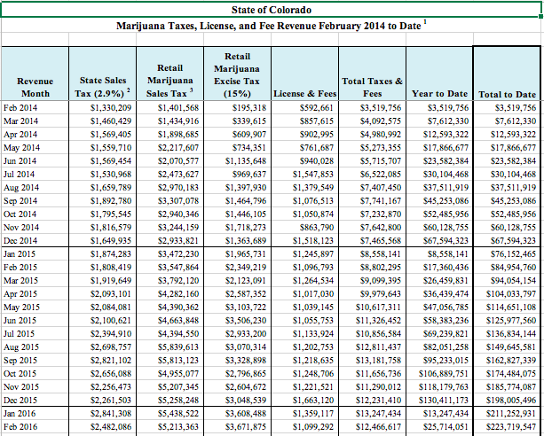
Data Resource
https://www.census.gov/econ/currentdata/dbsearch?program=QTAX&startYear=2010&endYear=2018&categories=QTAXCAT3&dataType=TOTAL&geoLevel=CO&notAdjusted=1&submit=GET+DATA&releaseScheduleId=
https://www.colorado.gov/pacific/revenue/colorado-marijuana-tax-data

Slide 20
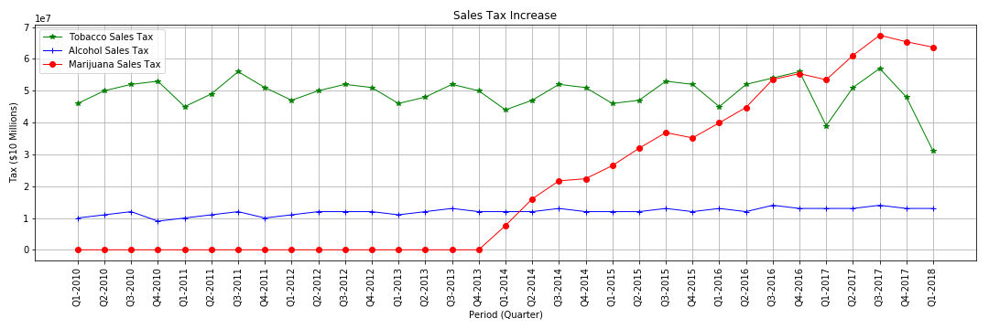
Analysis

Slide 21
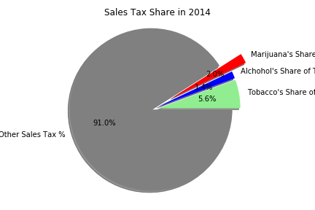
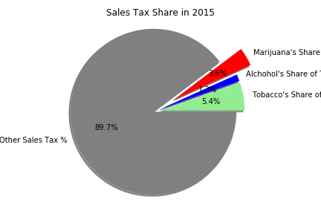
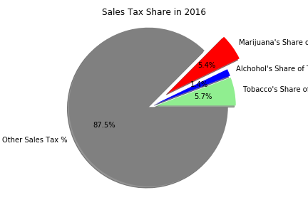
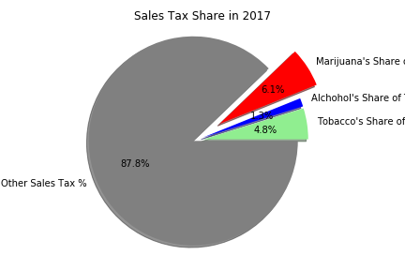
Analysis (cont.)

Slide 22
Agenda
Introduction
California
Washington
Neveda
Colorado
Illinois

Slide 23
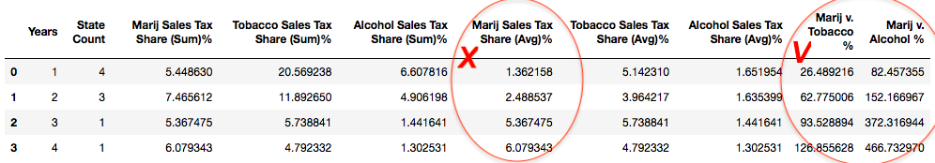
Forecast Process - Step 1
# Input : Other States’ Marijuana Sales Taxes (Historical Data) -->
# Output : Marijuana Sales Taxes Statistic
# Method : Induction

Slide 24
Forecast Process - Step 2
# Input : Illinois's Historical Sales Taxes -->
# Output : (Total, Tobacco, Alcohol) Sales Taxes forecast in the next years
# Method : Regression

Slide 25
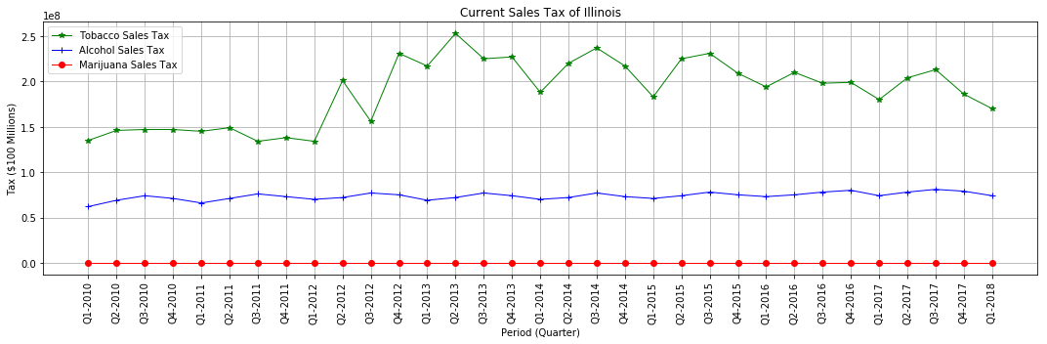
Forecast Process - Step 2

Slide 26
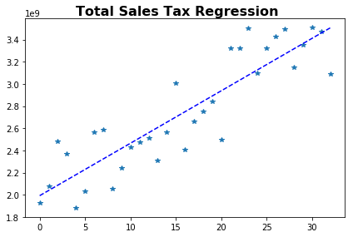
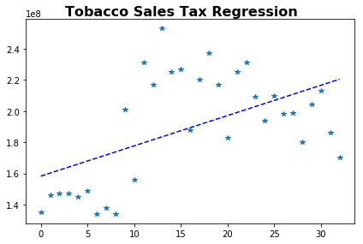
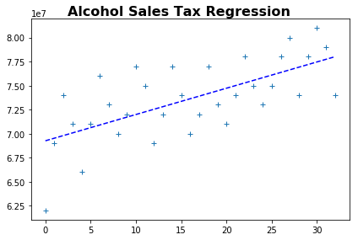
Forecast Process - Step 2

Slide 27
Forecast Process - Step 3
# Input : (Total, Tobacco, Alcohol) Sales Taxes Forecast of Illinois +
# Marijuana Statistic Data of other States -->
# Output : Illinois Marijuana Sales Taxes Forecast in the Next Years
# Method : Analogy

Slide 28
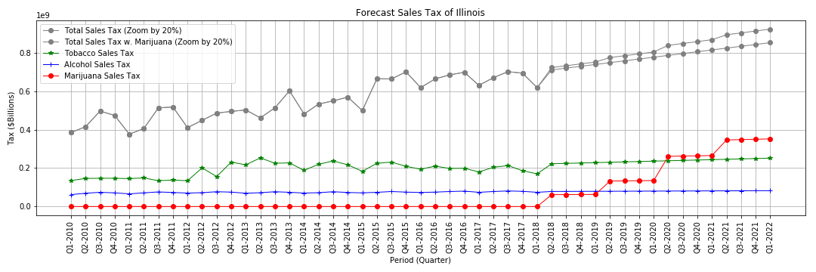
Forecast Process - Step 3

Slide 29
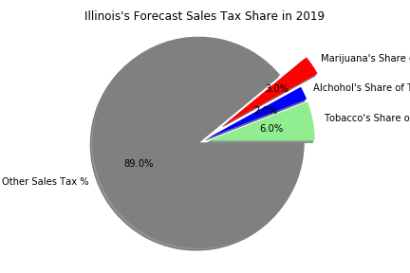
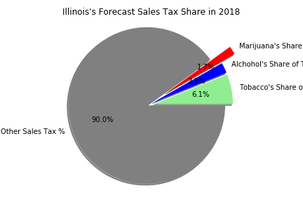
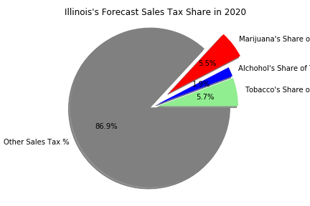
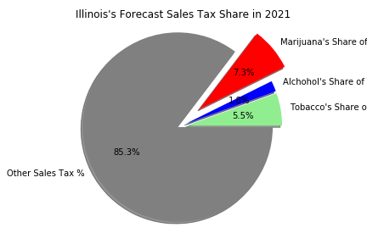
Forecast Process - Step 3

Slide 30
Group Project Summary
# 1 : Make It Clear
target / resources / methods
# 2 : Unify Output Interfaces
do not unify every member’s own process
# 3 : 80/20
method designing vs. trivia in coding (e. data clean)

