Slide 1
BioPlaN: Biologically Plausible Decision Making in RNNs
Keerthi (2023122009)
Harpreet(2022101048)
Video Link

Slide 2
Outline
Aim
Introduction & Literature Review
Methodologies
2AFC
2AFC and DMS
Curriculum Learning (Mid ends here)
Dale’s Law
Dynamic Causal Perturbations
Adaptive Contrastive Gating
Causal Analysis
Adaptive Deliberate Replay
Ablation Studies
References

Slide 3
Aim
To enhance Recurrent Neural Networks (RNNs) by integrating biological mechanisms—specifically Dale’s Law, Adaptive Gating, and Memory Replay—and to validate how these features improve robust decision-making.
All code files have been made available at: here

Slide 4
Introduction
RNNs: Compact model of temporal neural computations underlying working memory and perceptual decision-making
PsychRNN: A reproducible toolkit for training RNNs on cognitive tasks.
We enhance these networks with three key biological features:
1. Dale’s Law: biologically realistic connectivity.
2. Adaptive Gating (ACG): to filter noise and separate decisions.
3. Deliberate Replay (ADR): to mimic how the hippocampus stores memories
Notes:
PsychRNN: it allows easy manipulation of task parameters and network noise to probe factors that affect behavioral performance and latent dynamics.
We will use a PerceptualDiscrimination (2AFC) task as a testbed to measure behavioral robustness (psychometric curves) and to visualize hidden-state trajectories, comparing baseline vs noisy RNNs and later attention-augmented models.

Slide 5
Literature Review
RNNs & cognition: Elman (1990), Hochreiter & Schmidhuber (1997) — RNNs / LSTMs model temporal dependencies and working memory.
Decision-making in neuroscience: Gold & Shadlen (2007) — evidence-accumulation models for perceptual decisions (2AFC).
Attention & gating: Bahdanau et al. (2015), Vaswani et al. (2017) — attention improves selective processing.
Toolkit: Masse et al. (2019), PsychRNN –– A reproducible framework to run DMS/2AFC tasks and instrument RNNs for representational analysis.

Slide 6
Dataset
We use synthetic trials generated by PsychRNN's Perceptual Discrimination.
On each trial the network receives noisy evidence for one of two choices across time.
No external dataset needed.

Slide 7
Method-1 2AFC
Train two versions of a recurrent neural network on the Perceptual Discrimination task using PsychRNN.
Baseline RNN: no recurrent noise
Noisy RNN: adds a small biological-like recurrent noise
Train both models
Compare training losses
Run psychometric sweeps for both models and plot psychometric curves
Visualize hidden-state dynamics (PCA) for one representative test trial from each model

Slide 8
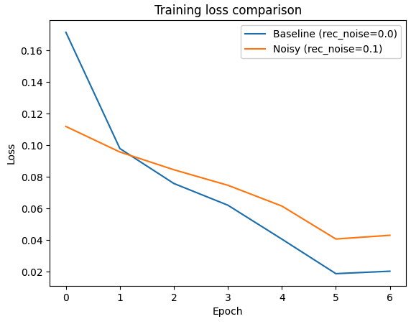
Plots

Slide 9
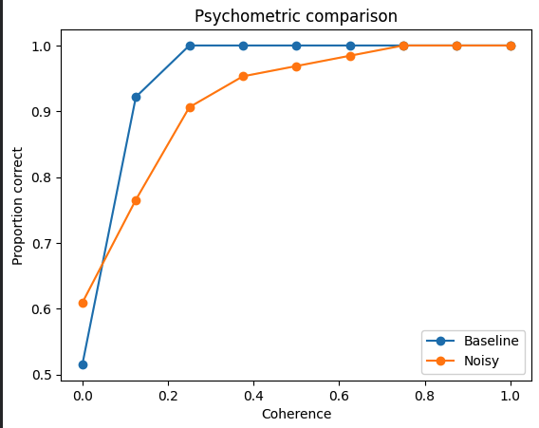
Plots

Slide 10
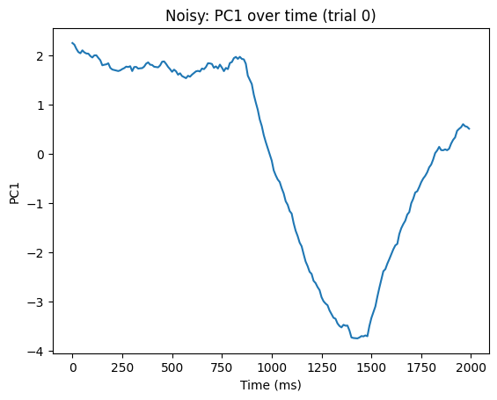
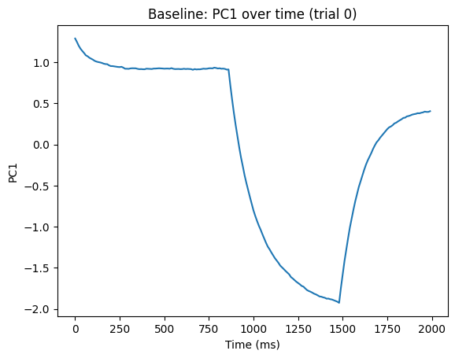
Plots

Slide 11
Method-2 2AFC and DMS
Here we run four separate RNN training experiments.
Namely, Delayed and Perceptual Discrimination, with and without noise.
Train both models
Compare training losses
Run psychometric sweeps for both models and plot psychometric curves
Visualize hidden-state dynamics (PCA) for one representative test trial from each model

Slide 12
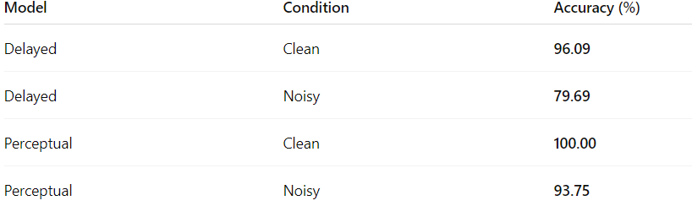
Results

Slide 13
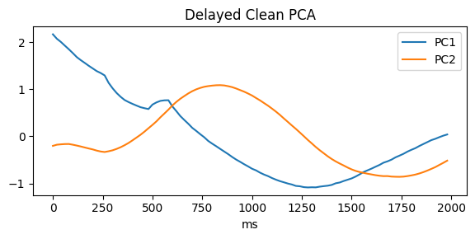
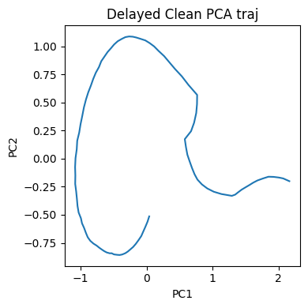
Plots

Slide 14
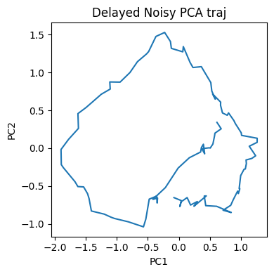
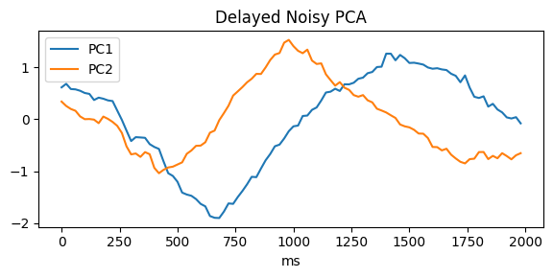
Plots

Slide 15
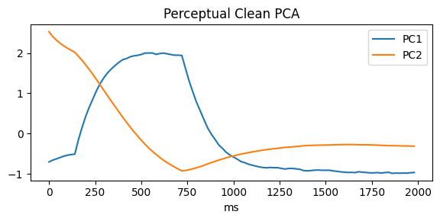
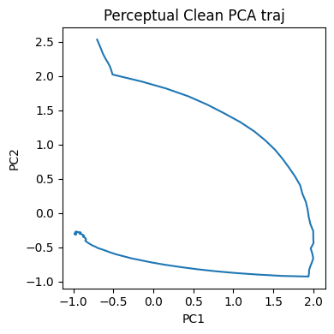
Plots

Slide 16
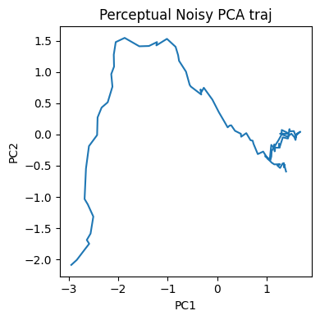
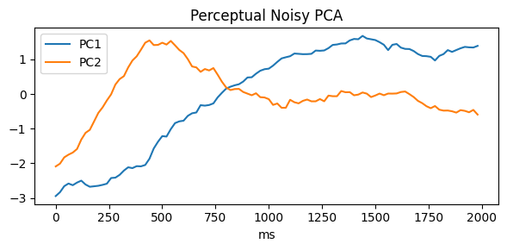
Plots

Slide 17
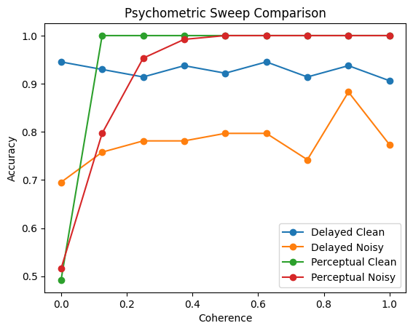
Plots

Slide 18
Method-3 Curriculum Learning
We experiment three training applied to the same cognitive task.
Basic Training: No noise or step wise learning.
Adding a Noise: Adding a little noise to attempt to improve generalization.
Curriculum (task shaping) Learning: The network is first trained on easy trials. As the network reaches a performance threshold, the difficulty is increased

Slide 19
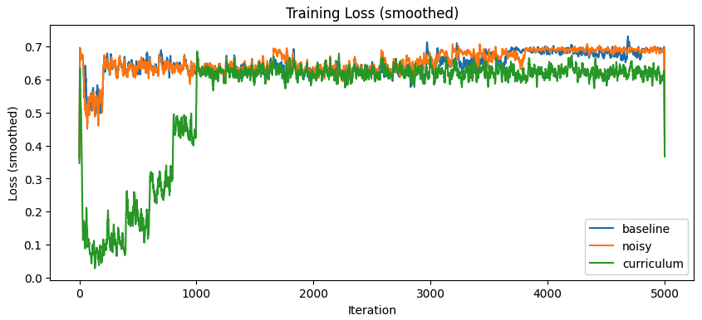
Plots

Slide 20
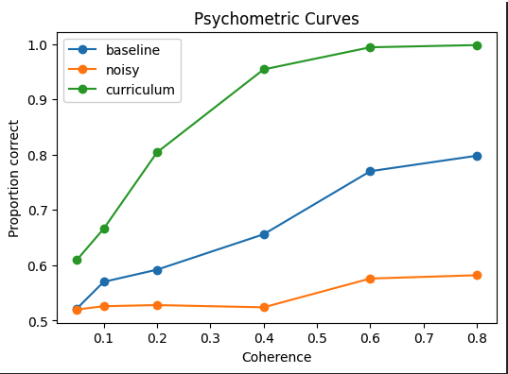
Plots

Slide 21
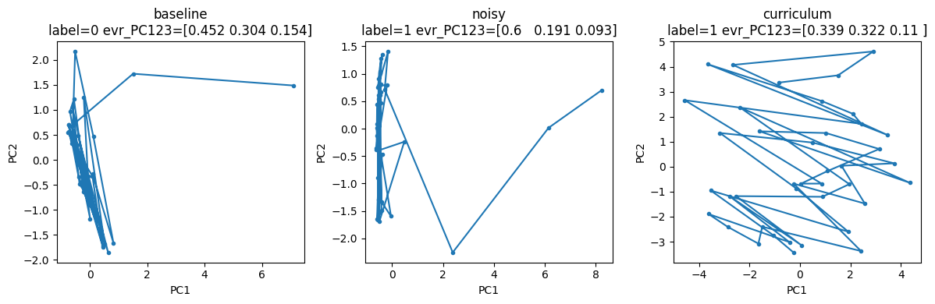
Plots

Slide 22
Incorporating Dale’s Law into the RNN
Concept:
In the brain, neurons follow Dale’s Law each neuron is either excitatory or inhibitory, never both.
Current RNNs violate this, as they allow positive and negative weights from the same unit. We force the network to follow rules that real biological brains follow.
Experimental Setup:
We run DalesRNN in 3 different scenarios
Baseline
Noisy
Curriculum Learning
Notes:
Dale’s Law enforces biological sign constraints in the recurrent weights — excitatory neurons can only send positive outputs, inhibitory only negative. This reflects real cortical connectivity and can significantly alter learning dynamics.

Slide 23
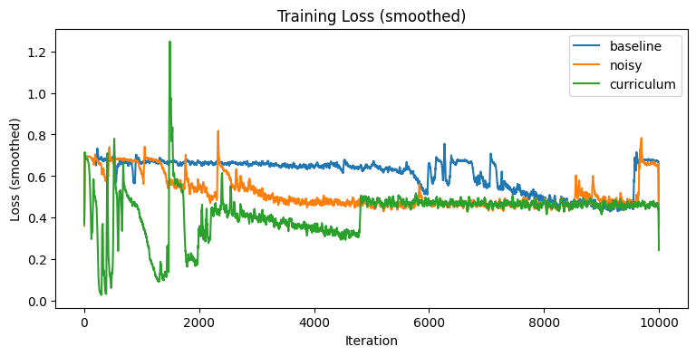

Slide 24
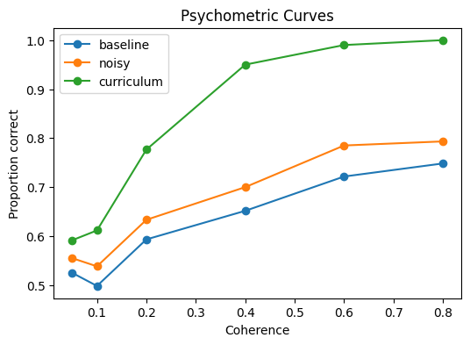

Slide 25
Dynamic Causal Perturbations
Now that we have a trained our brain (RNN), we try to figure out how it solves the task.
We treat AI model like a lab rat: measuring which neurons are important and then "damaging" (lesioning) them to see if the AI forgets how to do the task.

Slide 26
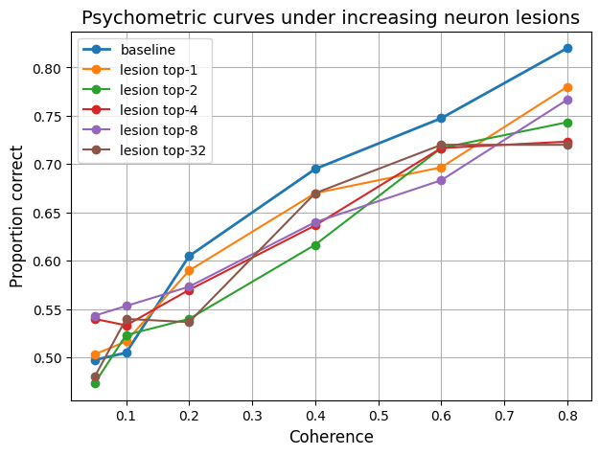

Slide 27
Adaptive Contrastive Gating- A New Way to Learn
We propose a novel improvement to standard RNNs called ACG.
Our aim is to make the network learn faster and be more robust against noise.
It essentially forces the network to organize its "thoughts" more clearly.
Methodology
Gating: The network learns to listen to important signals and not the noise.
Contrastive Loss: This concept forces the AI to make the internal brain state for "Choice A" look as different as possible from "Choice B"
Attractor Dynamics (Fixed Points): Prioritize stability. Once a decision is at a fixed point, it stays there.

Slide 28
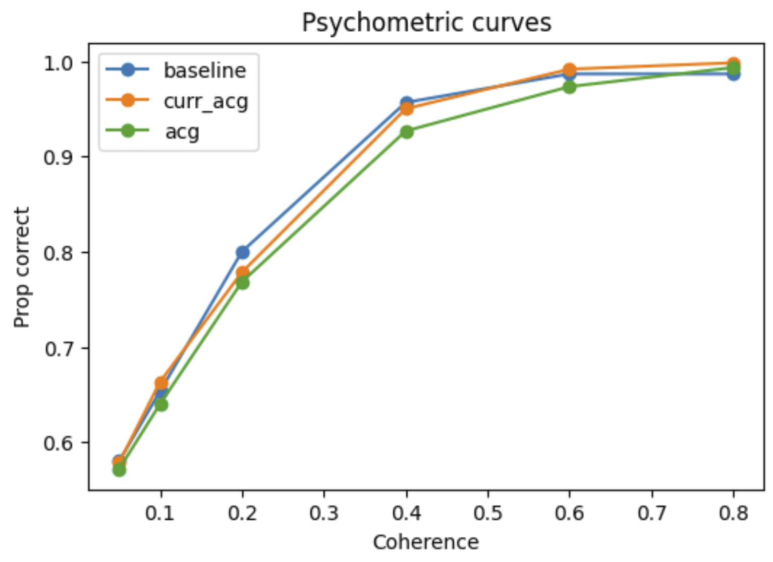
Results

Slide 29
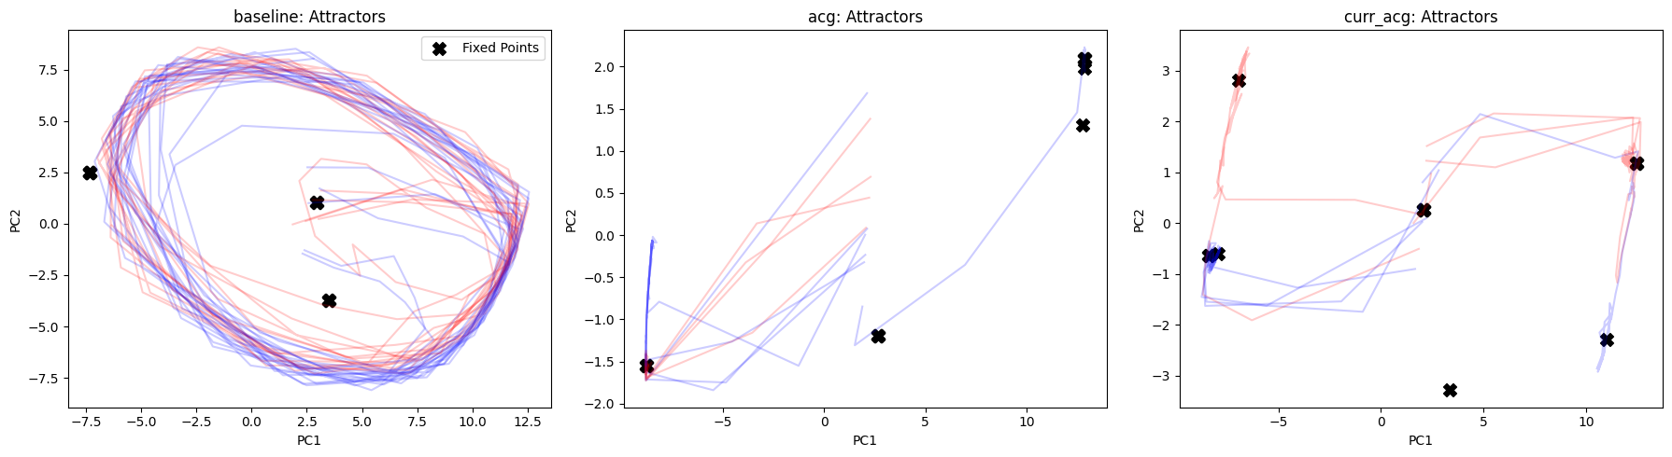
Attractors analysis

Slide 30
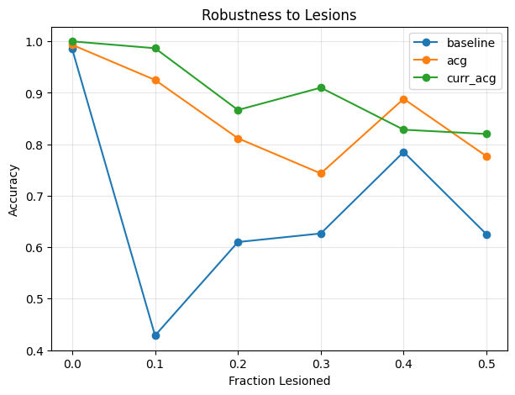
Robustness to Lesions

Slide 31
Adaptive Deliberate Replay (ADR): A Novel PsychRNN Experiment
• Working memory is usually modeled by persistent firing.
• Biological systems use selective replay (hippocampus & PFC).
• PsychRNN lacks any replay-based WM mechanism.
• We introduce ADR: an adaptive replay controller.

Slide 32
What is Adaptive Deliberate Replay (ADR)?
• A trainable gating module p(t) controlling when to replay memory.
• A memory decoder reconstructs stimulus identity.
• Replay feedback strengthens hidden state only when beneficial.
• A replay penalty ensures sparse, strategic replay.

Slide 33
ADR Architecture
1. Hidden state h(t) from PsychRNN RNN.
2. Replay controller: p(t) = σ(Wₚ h(t)).
3. Memory decoder: m(t) = softmax(Wₘ h(t)).
4. Replay correction: h(t+1) += p(t) · W_fb · m(t).
5. Loss = Task + AuxDecode + λ·ReplayPenalty.

Slide 34
Delayed Match-to-Sample (DMS) Task
• Implemented using PsychRNN Task API.
• Inputs: sample, delay, distractors, probe.
• Outputs: match decision at probe.
• Produces (x, y, mask) for training ADR.
Delayed-Match-to-Sample (DMS) is a working-memory task:
The network sees a sample stimulus,
Holds it across a delay period,
Then receives a test stimulus,
And must decide whether it matches the original sample.
This task requires the model to actively maintain information internally, because during the delay there is no input.

Slide 35
Novelty of the Approach
• First implementation of selective replay in PsychRNN.
• Not present in GRU, LSTM, or Dale-constrained RNNs.
• Enables interpretable, biologically plausible mechanisms.

Slide 36
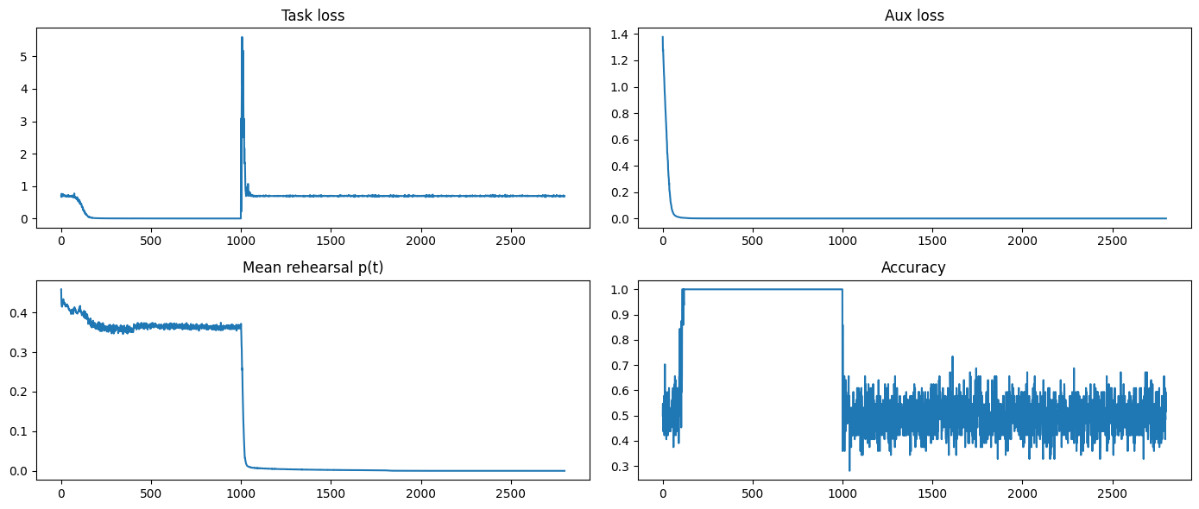
Output

Slide 37
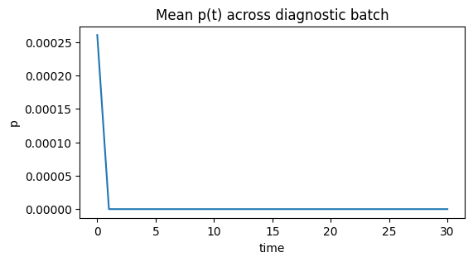

Slide 38
Key Results
Early stages: perfect accuracy.
Long-delay stages: sparse replay emerges.
Memory decoder accuracy = 1.0.
Replay ablation → accuracy collapses to 0.5.
The novelty gate p(t) works:It correctly reduces rehearsal when stimuli become predictable.
Memory decode = 1.0 even when accuracy fluctuates →The information is stored, but readout becomes harder.

Slide 39
Interpretation
• ADR learns when replay is useful.
• Balances accuracy vs. replay effort.
• Mirrors hippocampal reinstatement behavior.
• Reveals structured neural trajectories in PCA.

Slide 40
Ablation Results
Tested the model with λ_rehe = 1.0 (forcing full rehearsal):
Accuracy became chance level (0.50).
Because rehearsing every time destroys stored information just like overwriting RAM every step.
Interpretation:
Rehearsal must be selective the novelty gate is essential.
When novelty is removed, the memory collapses.
This is the central novelty-driven working memory principle.

Slide 41
Ablation Studies
Trying different number of epochs
Overfitting after 1e4 epochs.
Trying different hidden layers, hidden dimensions
Goldilocks zone around 128.
Getting too heavy or too light models otherwise.

Slide 42


Slide 43
References:
Li, P., et al. (2023). Learning Better with Dale’s Law: A Spectral Perspective. NeurIPS.
van den Berg, A. R., et al. (2024). Biologically Plausible Gated Recurrent Networks. Nature Communications.
Sadeh, S., et al. (2021). Excitatory–Inhibitory Balance and Assembly Dynamics in Cortex. Science Advances.
Lam, N. H., et al. (2022). E/I Balance and Decision-Making in Cortical Circuits. Journal of Neuroscience.
Mastrogiuseppe, F., & Ostojic, S. (2018). Linking Connectivity, Dynamics and Computations in Low-Rank RNNs. Neuron.

