Slide 1
Start
00:05
List
Boat
Davey’s Locker
King John’s Treasure
Paititi Treasure
Copper Scroll
Flor de la Mar
Money Pit
Notes:
As you can see you can select the treasures that you want and place them where ever you please

Slide 2
Start
00:05
List
Boat
King John’s Treasure
Davey’s Locker
x2 Copper Scroll
Copper Scroll
Paititi Treasure
King John’s Treasure
Money Pit
Flor de la Mar
Money Pit
Davey’s Locker
King John’s Treasure
Paititi Treasure
Copper Scroll
Flor de la Mar
Money Pit
Notes:
As you can see now the user has now selected what treasures that he/she wants and placed them in the destination they please

Slide 3
Start
00:05
List
Boat
King John’s Treasure
Davey’s Locker
x2 Copper Scroll
Copper Scroll
Paititi Treasure
King John’s Treasure
Money Pit
Flor de la Mar
Money Pit
Davey’s Locker
King John’s Treasure
Paititi Treasure
Copper Scroll
Flor de la Mar
Money Pit
Notes:
Now the boat will now go to the most closest treasure location, in this situation means Davey’s Locker.

Slide 4
Start
00:05
List
King John’s Treasure
Davey’s Locker
x2 Copper Scroll
Boat
Copper Scroll
Paititi Treasure
King John’s Treasure
Money Pit
Flor de la Mar
Money Pit
Davey’s Locker
King John’s Treasure
Paititi Treasure
Copper Scroll
Flor de la Mar
Money Pit
Notes:
The boat has now sailed to Davey’s Locker.

Slide 5
Start
00:05
List
King John’s Treasure
Davey’s Locker
x2 Copper Scroll
Boat
Copper Scroll
Paititi Treasure
King John’s Treasure
Find out about Davey’s Locker
Click here!
Money Pit
Flor de la Mar
Money Pit
Davey’s Locker
King John’s Treasure
Paititi Treasure
Copper Scroll
Flor de la Mar
Money Pit
Notes:
Now a Shooting star will appear with the option of more information.

Slide 6
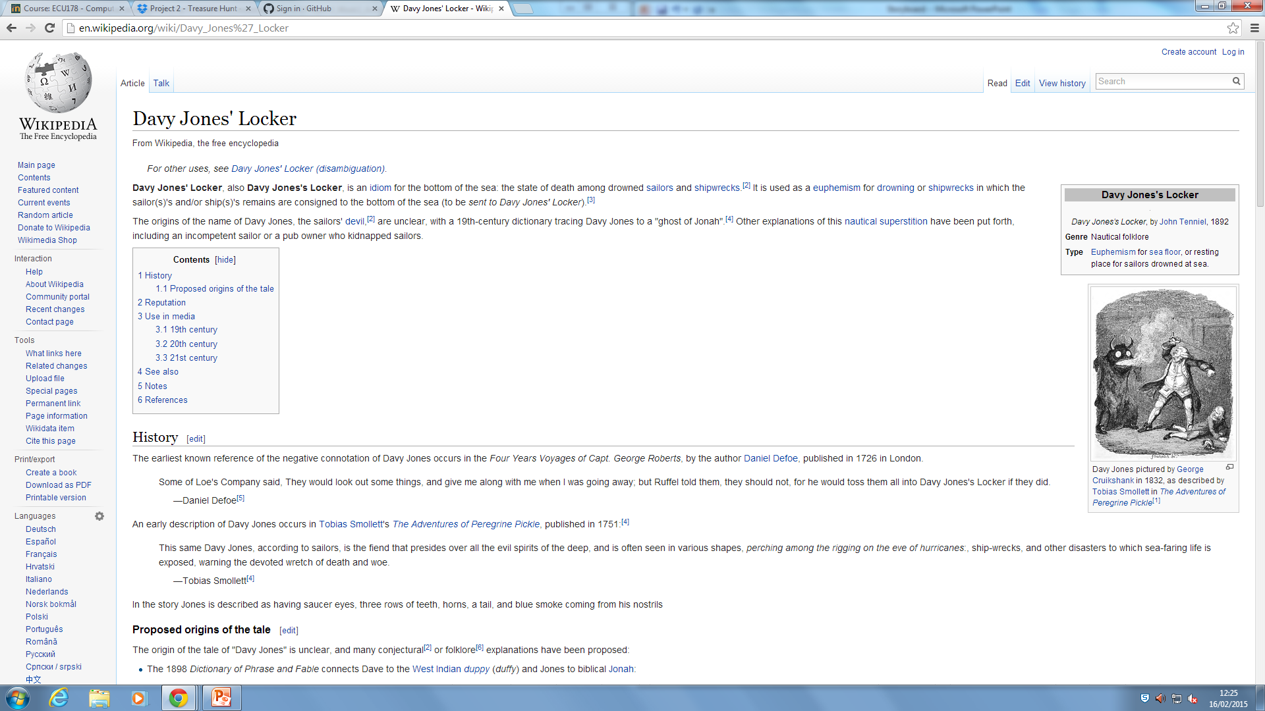
Start
00:05
List
King John’s Treasure
Davey’s Locker
Boat
Copper Scroll
Paititi Treasure
Find out about Davey’s Locker
Click here!
Money Pit
Flor de la Mar
Davey’s Locker
King John’s Treasure
Paititi Treasure
Copper Scroll
Flor de la Mar
Money Pit
Notes:
It is option to click the star but if you decide to, it will bring you information about the treasure the boat is on.

