Slide 1
Case study on College enrollment SYSTEM

Slide 2

Mission
- To simplify enrollment and academic management while ensuring accurate data handling.

Slide 3
objective
- Maintain accurate records of student details, course schedules, and faculty assignments.
- Enable payments and fee management.
- Monitor performance and generate detailed reports.

Slide 4
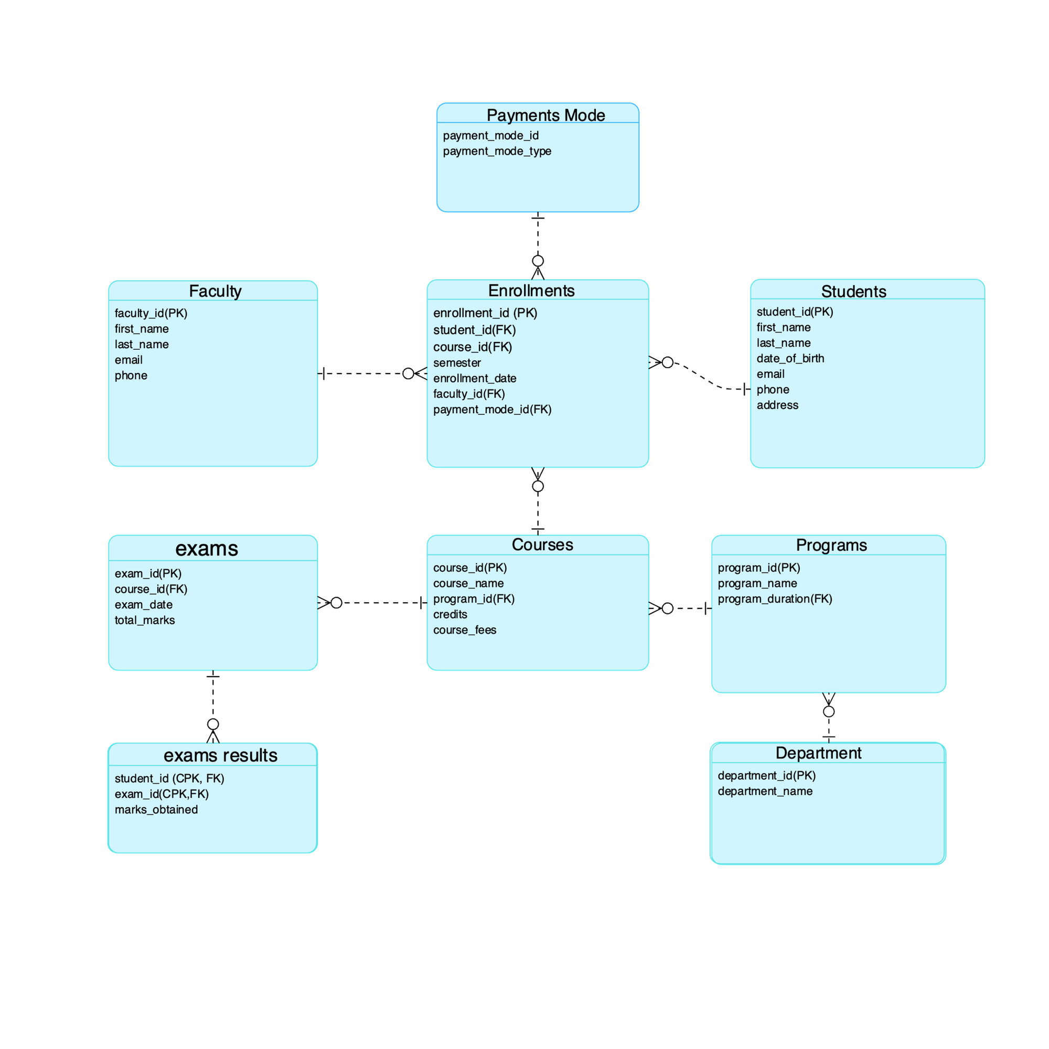
ER diagram

Slide 5
Table creation
Key Tables in the Database
students: Stores student details such as name, date of birth, email, phone, and address.
payment_mode: Contains different modes of payment available for students.
department: Holds information about various academic departments.
programs: Defines academic programs, their duration, and associated departments.
faculty: Stores faculty members' details, including contact information.
courses: Lists courses under different programs along with their fees and credits.
exams: Maintains exam details, including course, date, and total marks.
exam_result: Records student performance in exams with marks obtained.
enrollments: Tracks student course enrollments, faculty assignments, and payment modes.

Slide 6
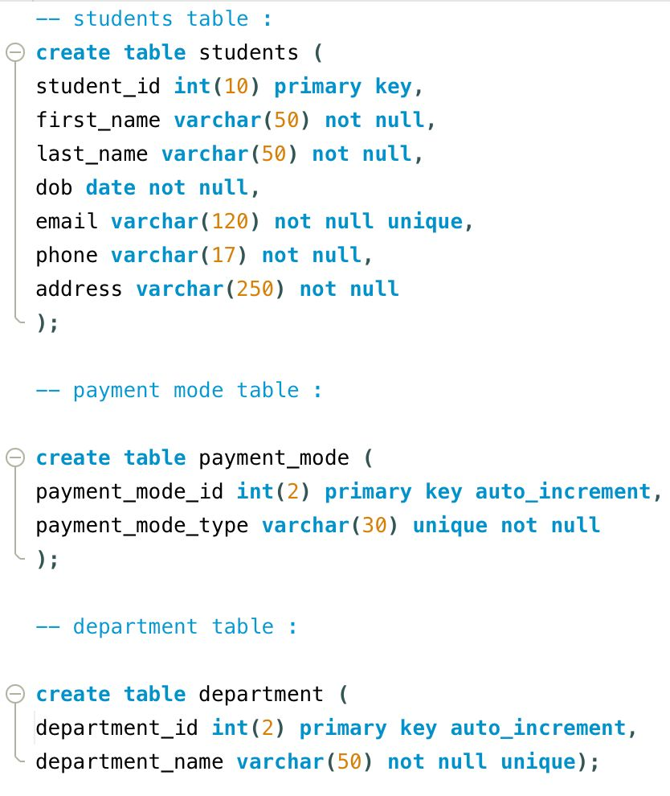
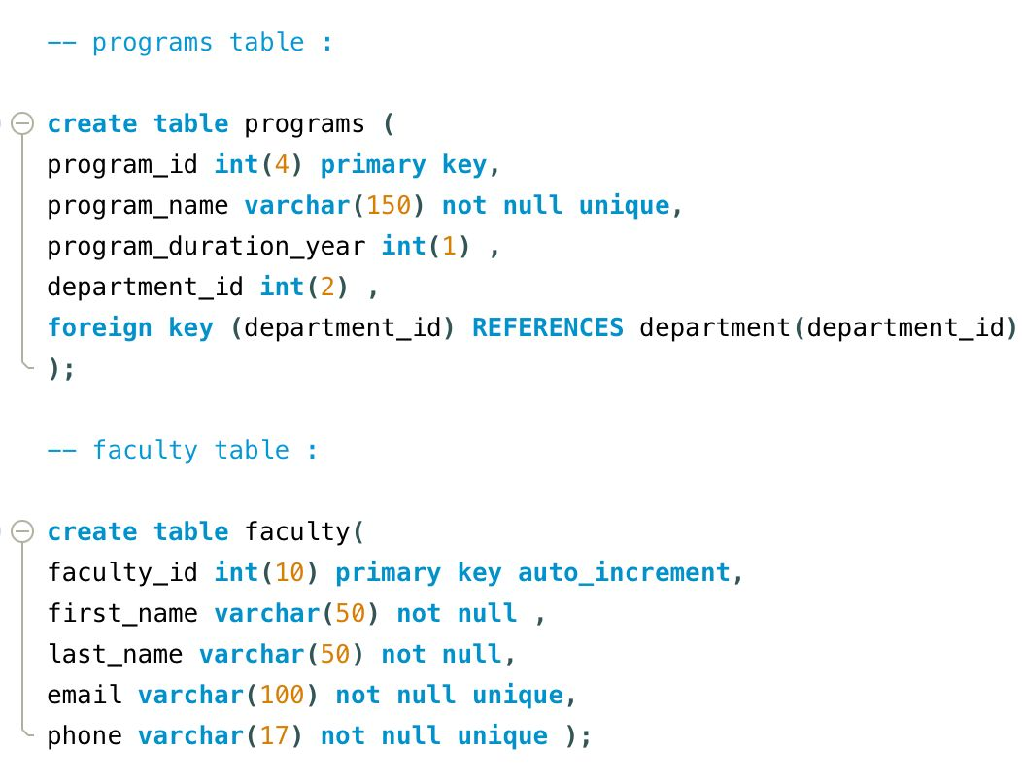
Table creation
Code to create tables:

Slide 7
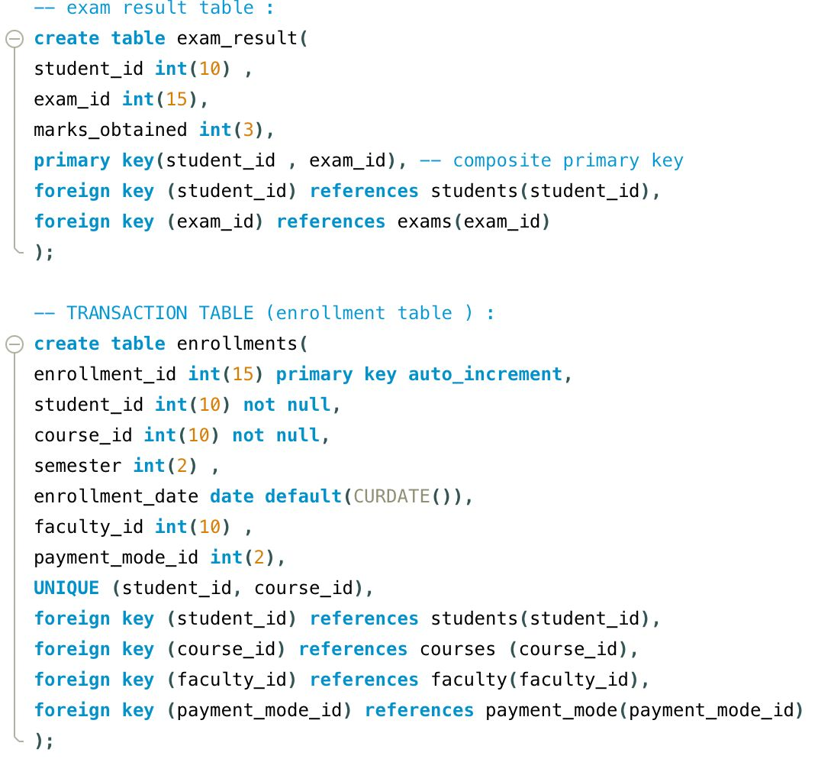
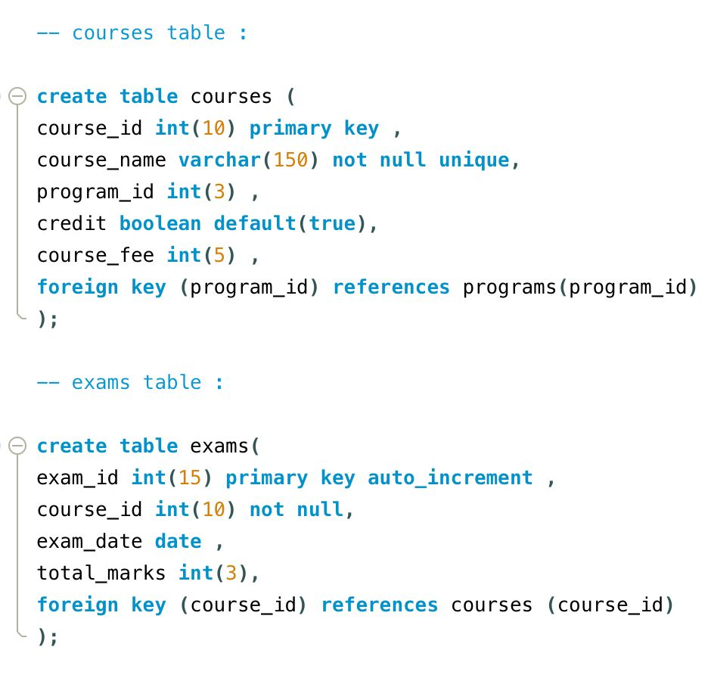
Table creation
Code to create tables:

Slide 8
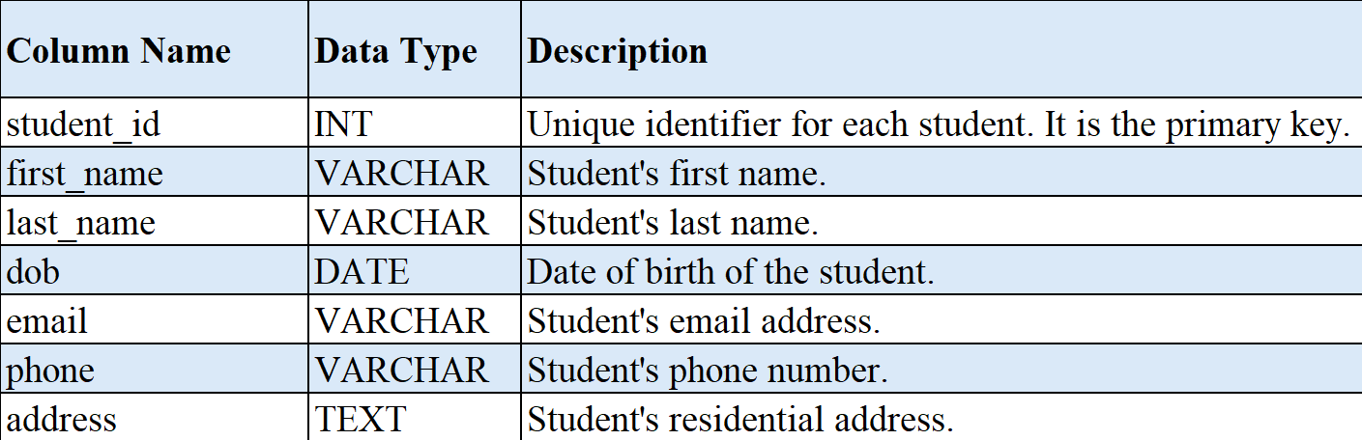
Database Table Descriptions for College Enrollment System
Students Table
Purpose: Stores student details such as personal information and contact details.
Relationship Type:
One-to-Many with exam_result (One student can have multiple exam results).
One-to-Many with enrollments (One student can enroll in multiple courses).

Slide 9
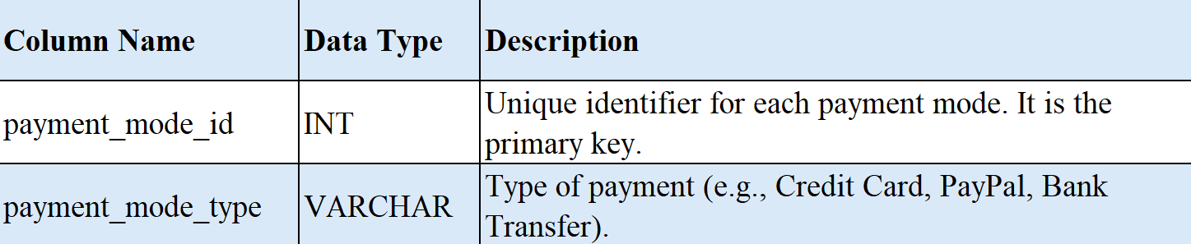
Database Table Descriptions for College Enrollment System
2. Payment Mode Table
Purpose: Stores different modes of payment for course enrollments.
Relationship Type:
One-to-Many with enrollments (One payment mode can be used for multiple enrollments).

Slide 10
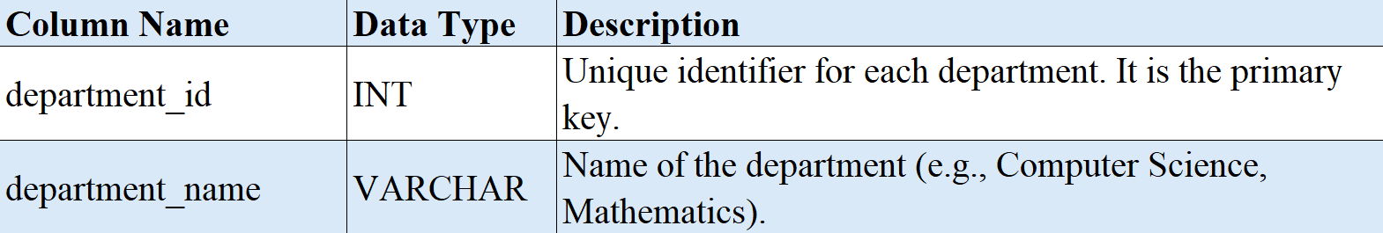
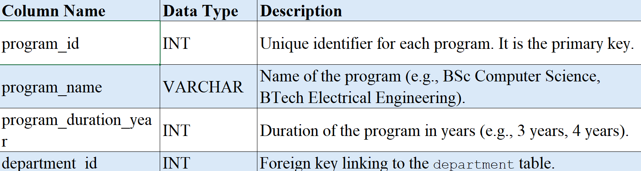
3. Department Table
Purpose: Represents academic departments offering various programs.
Relationship Type:
One-to-Many with programs (One department can offer multiple programs).
4. Program Table
Purpose: Defines academic programs, their duration, and associated departments.
Relationship Type:
Many-to-One with department (Many programs belong to one department).
One-to-Many with courses (One program can have multiple courses).

Slide 11
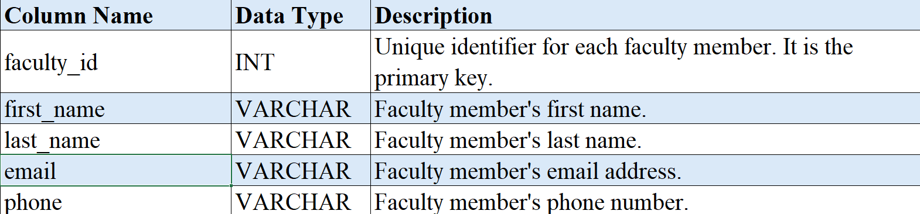
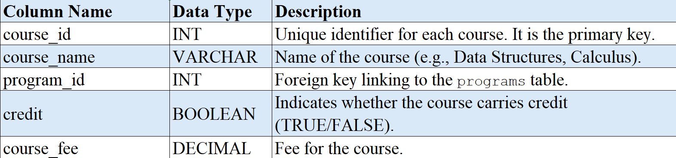
5. Faculty Table
Purpose: Stores faculty members' details, including their contact information.
Relationship Type:
One-to-Many with enrollments (One faculty member can be assigned to multiple enrollments).
6. Course Table
Purpose: Represents courses under different programs along with credit information and fees.
Relationship Type:
Many-to-One with programs (Many courses belong to one program).
One-to-Many with exams (One course can have multiple exams).
One-to-Many with enrollments (One course can have multiple students enrolled).

Slide 12
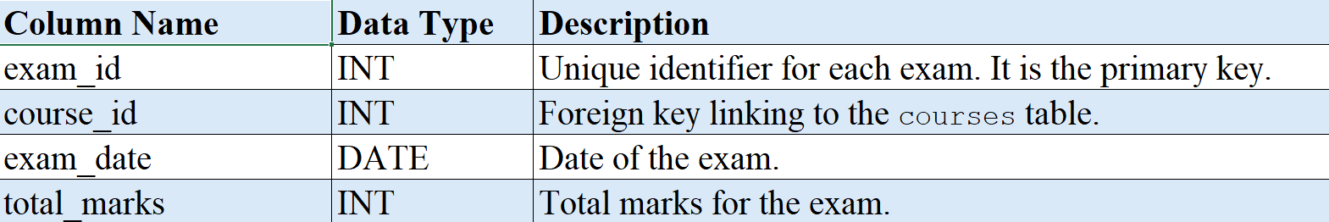
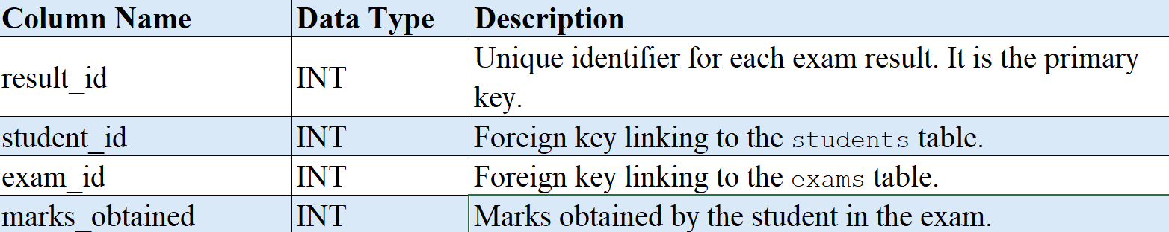
7. Exam Table
Purpose: Maintains exam details such as course, date, and total marks.
Relationship Type:
Many-to-One with courses (Many exams belong to one course).
One-to-Many with exam_result (One exam can have multiple student results).
8. Exam result Table
Purpose: Records student performance in exams, storing marks obtained.
Relationship Type:
Many-to-One with students (Many results belong to one student).
Many-to-One with exams (Many students take the same exam).

Slide 13
9. Enrolment Table
Purpose: Tracks student course enrollments, faculty assignments, and payment modes.
Relationship Type:
Many-to-One with students (Many enrollments belong to one student).
Many-to-One with courses (Many enrollments belong to one course).
Many-to-One with faculty (Many enrollments belong to one faculty member).
Many-to-One with payment_mode (Many enrollments can use the same payment mode).

Slide 14
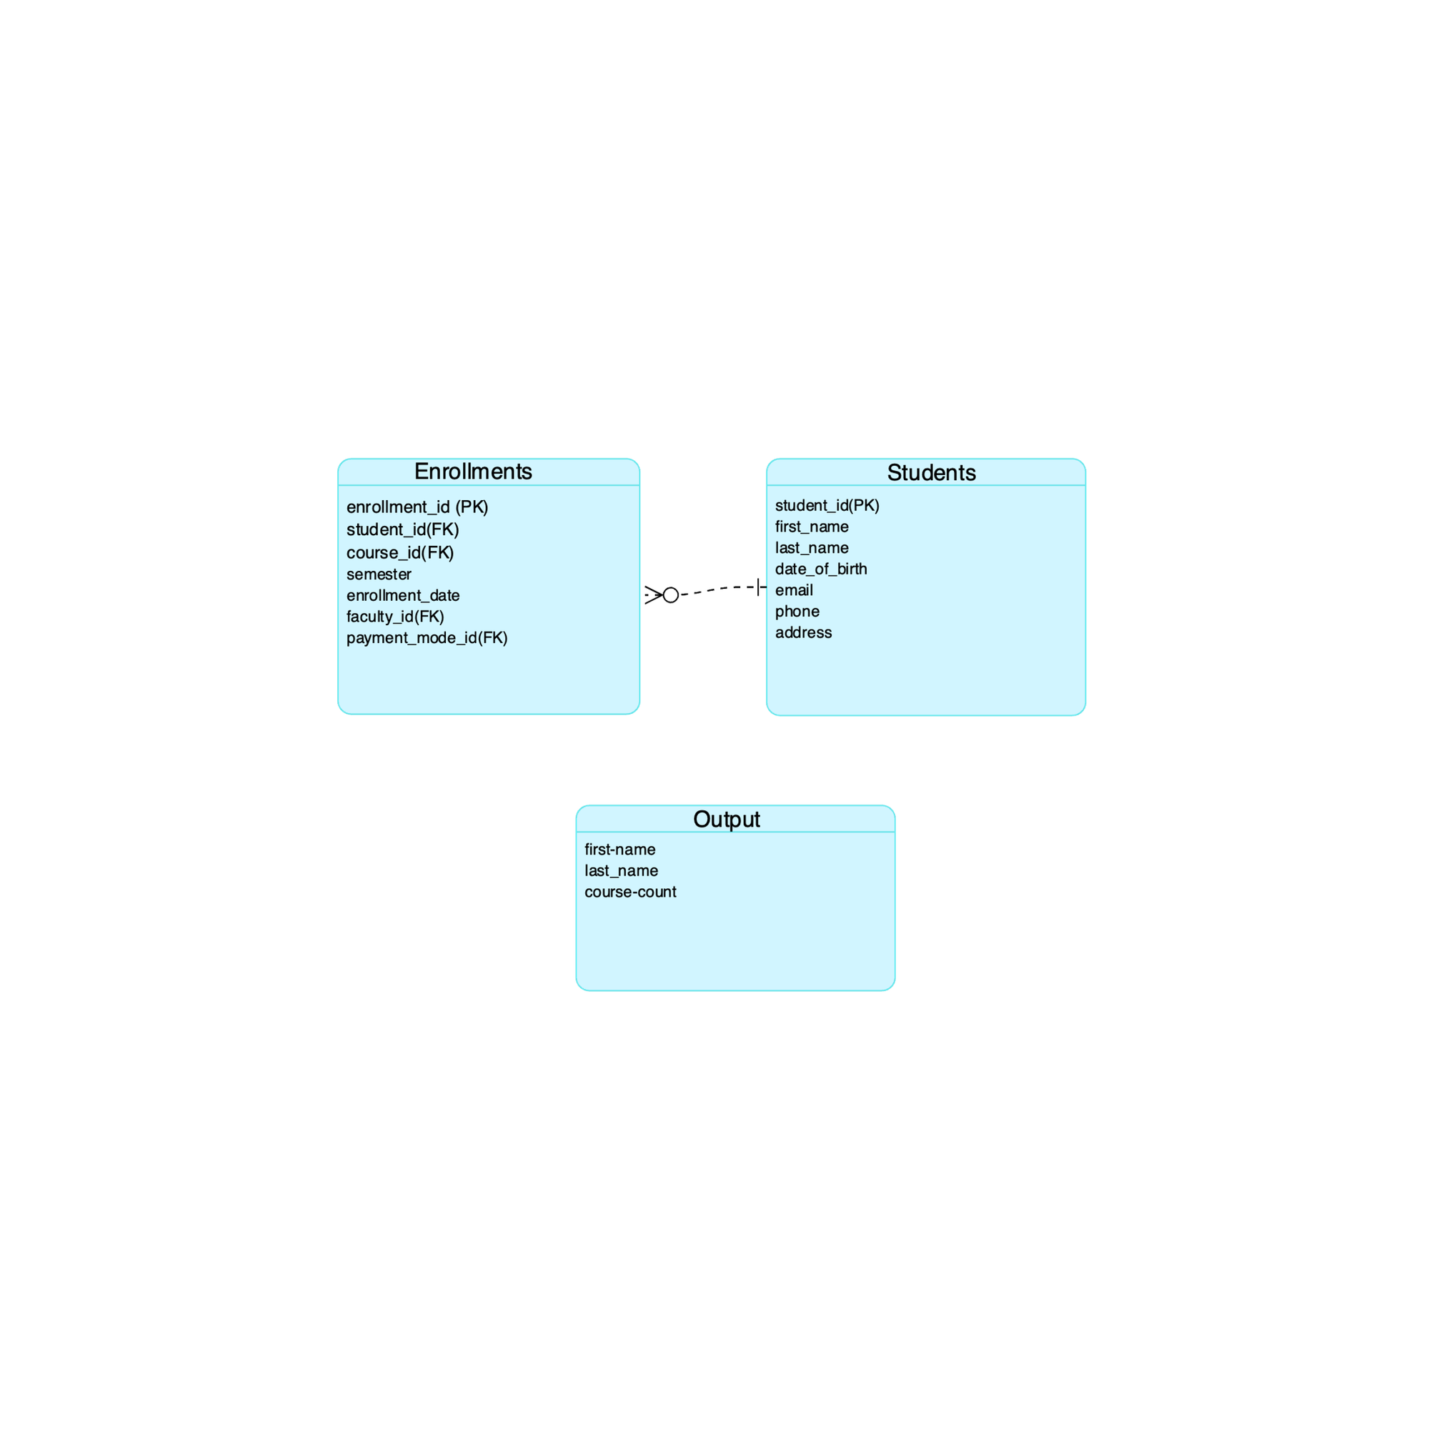
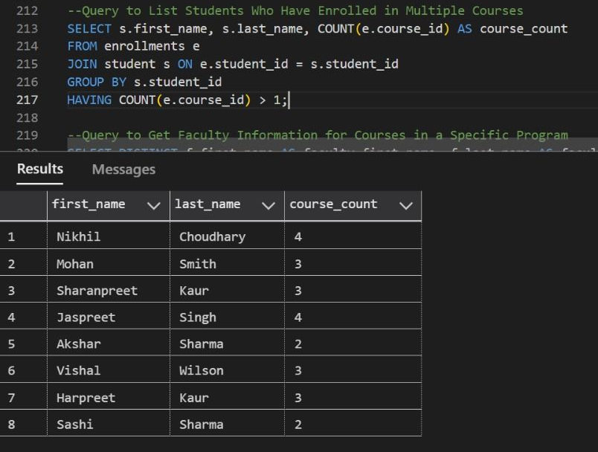
Complex Queries
Query to list students who have enrolled in multiple courses

Slide 15
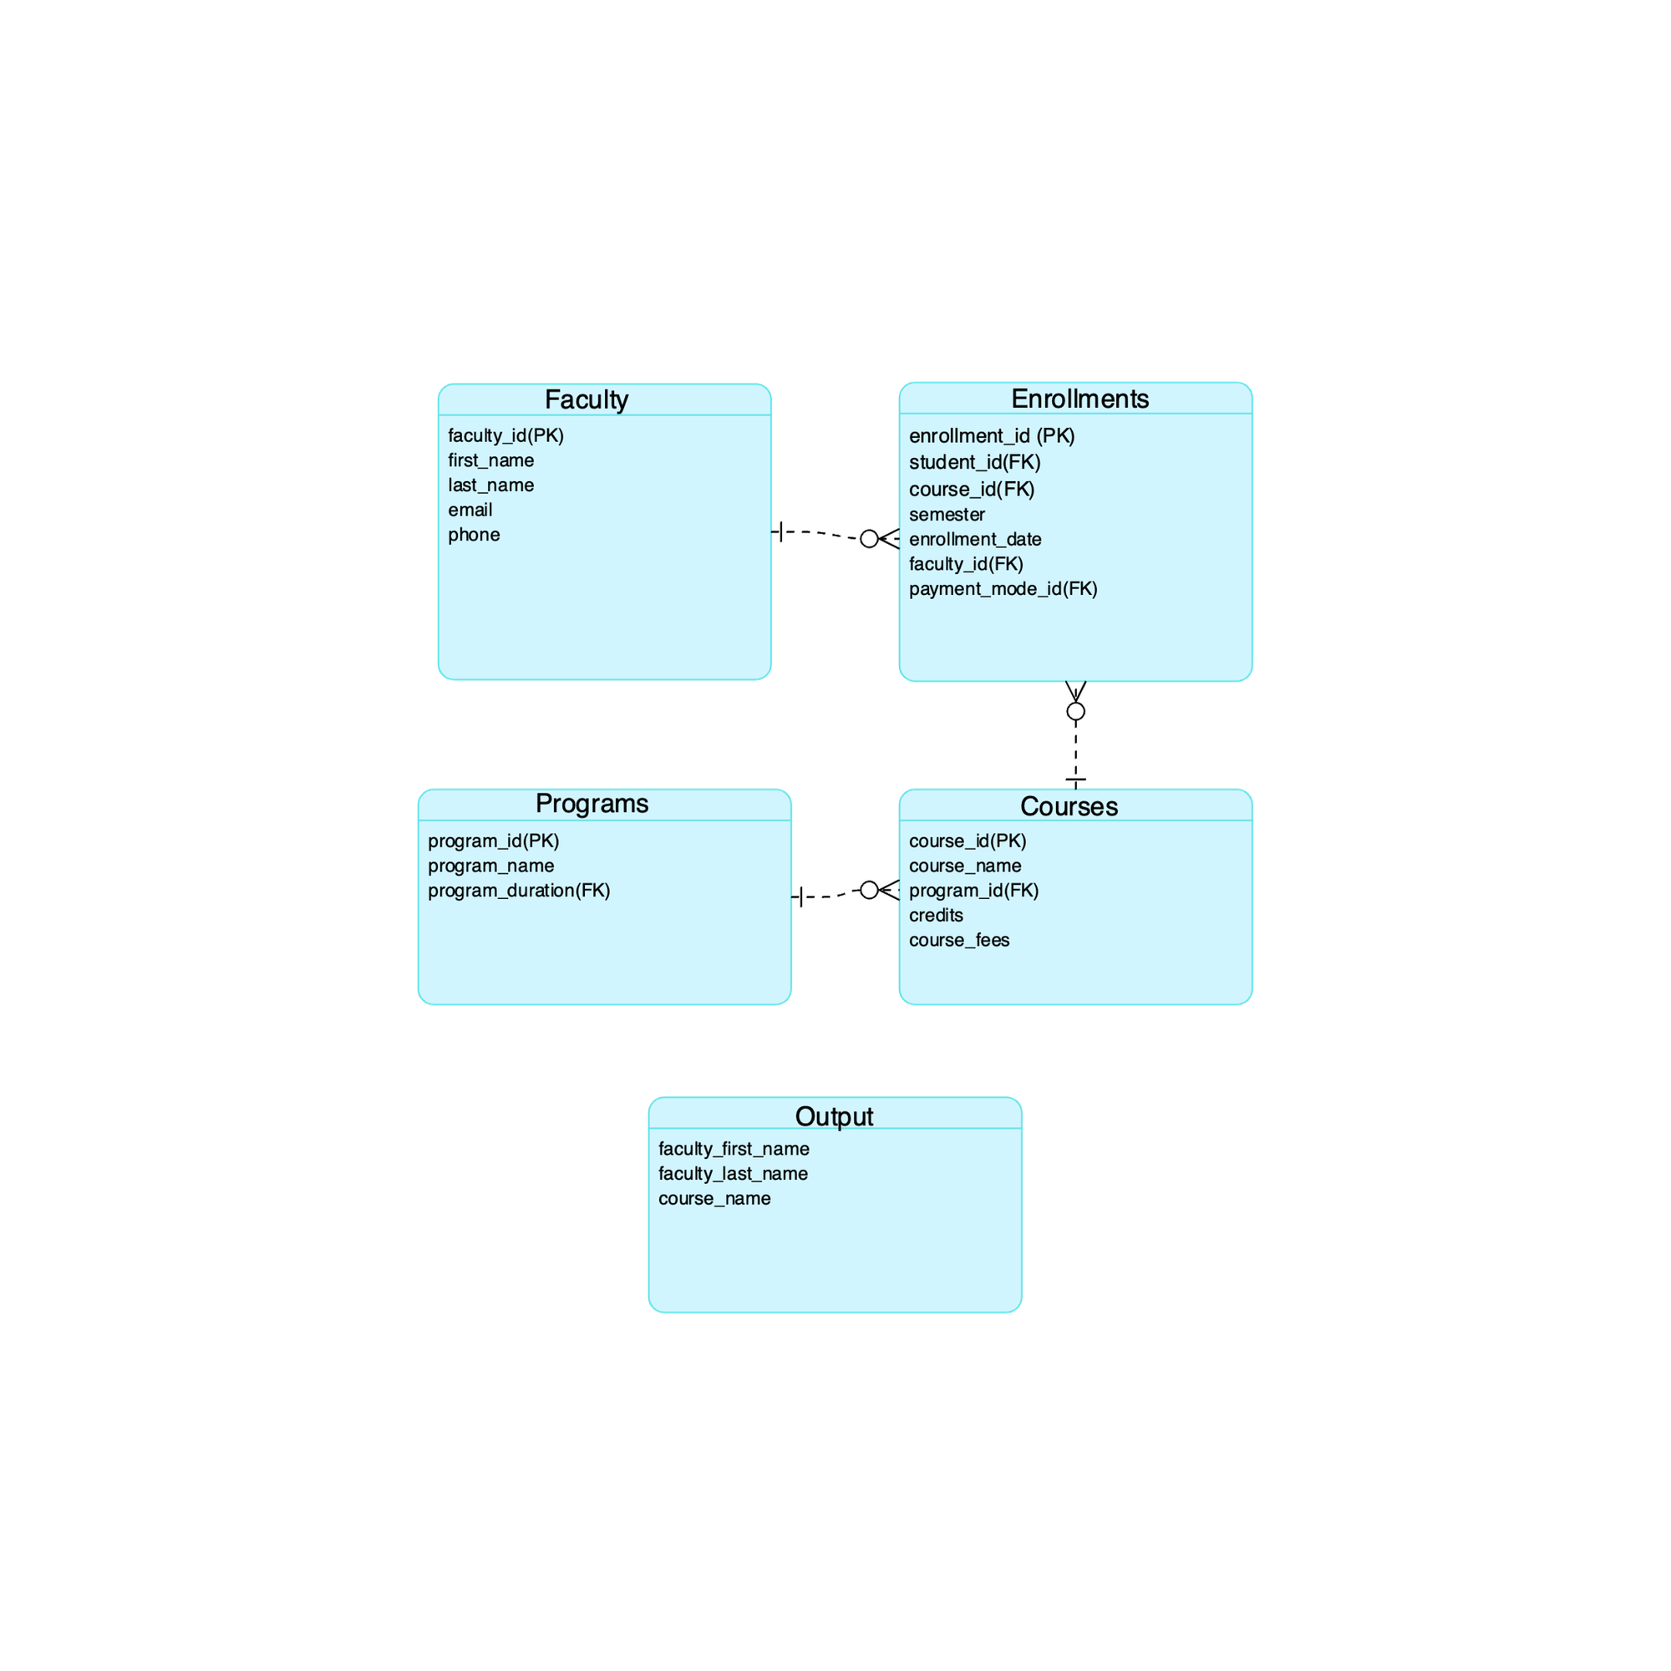
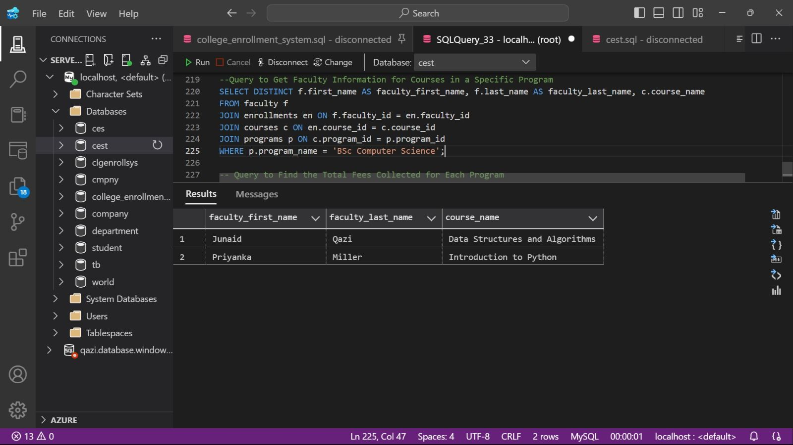
Complex Queries
Query to get faculty information for courses in a specific program

Slide 16
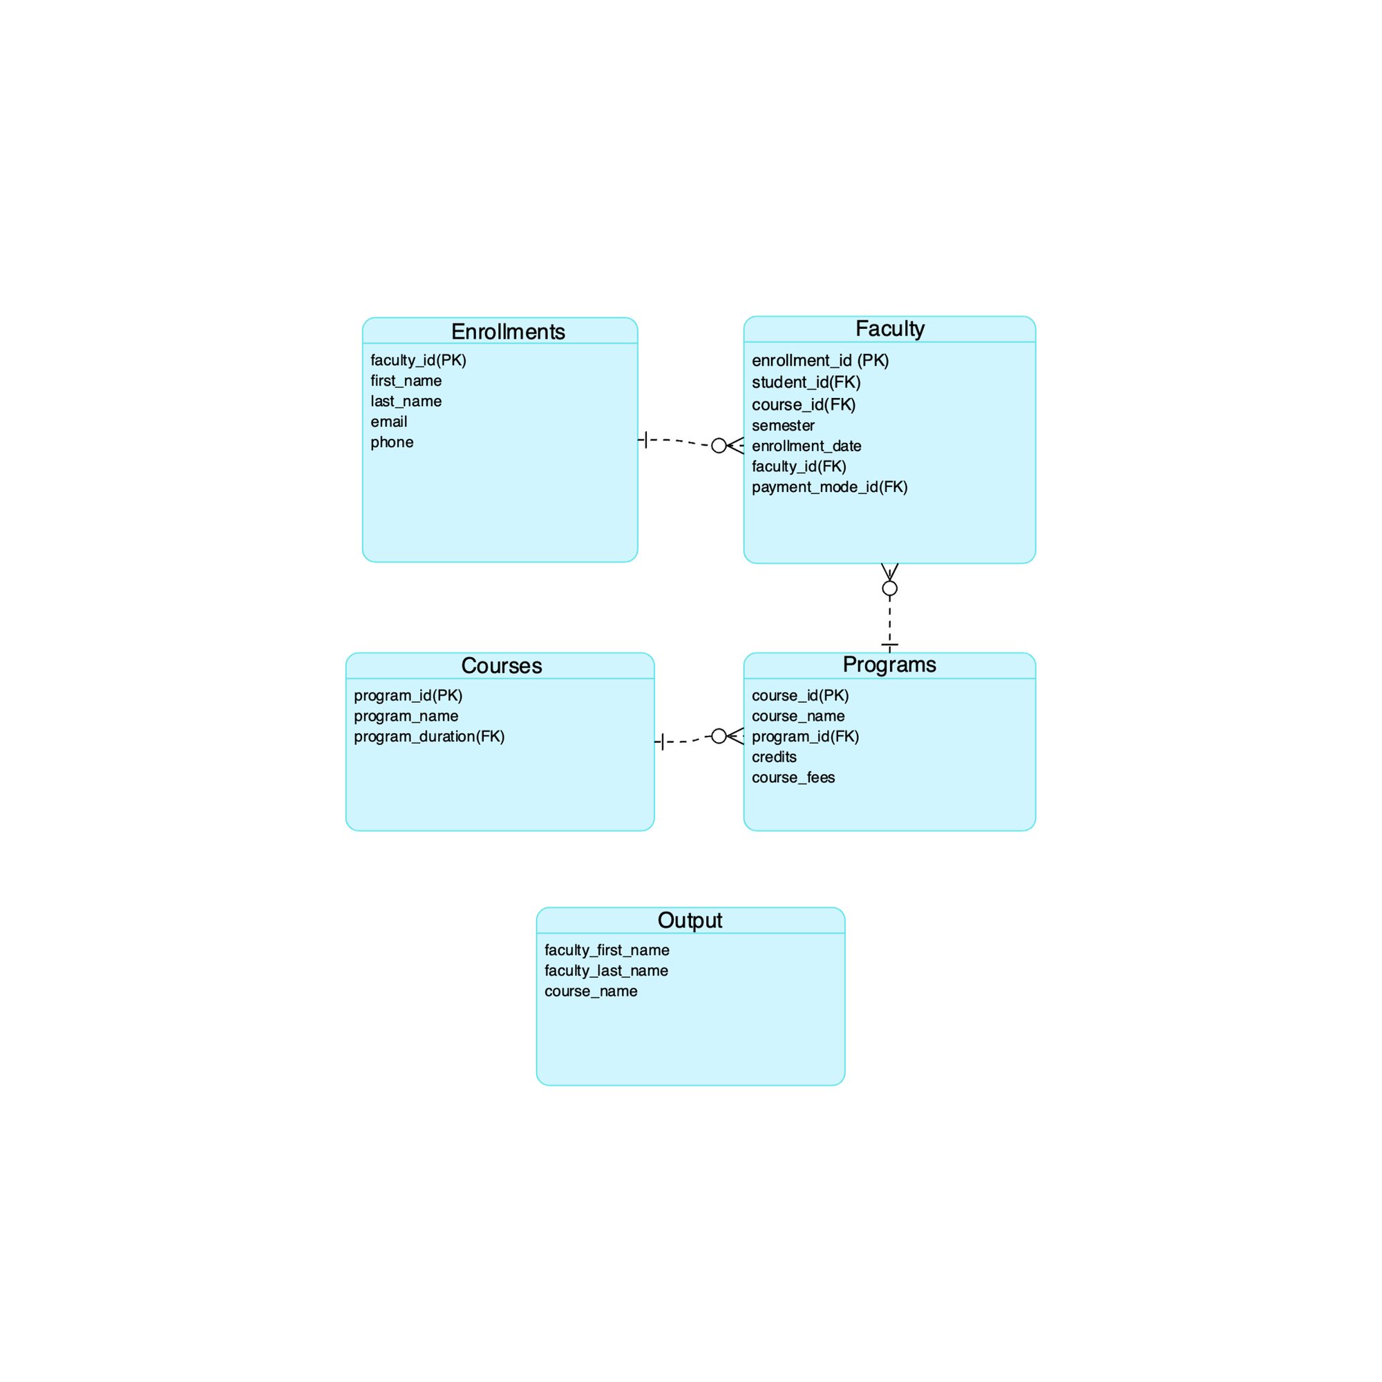
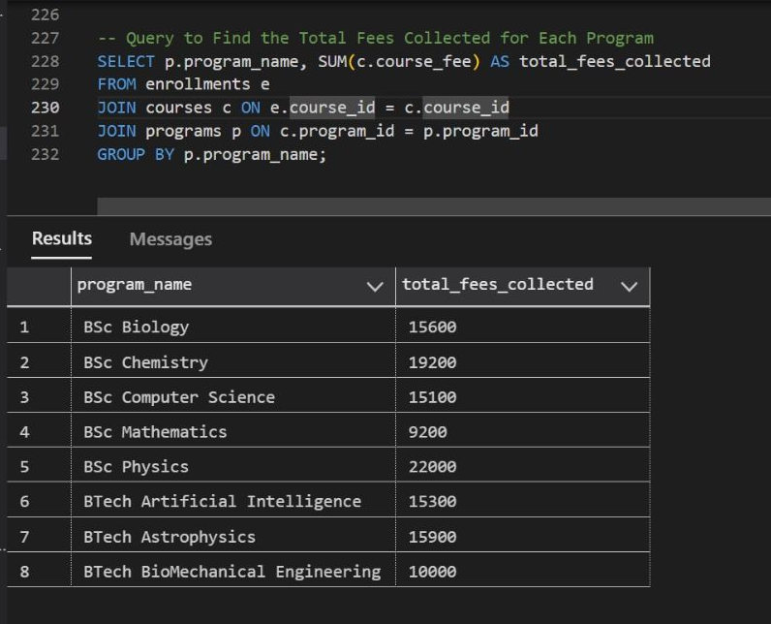
Complex Queries
Query to find the total fees collected for each program

Slide 17
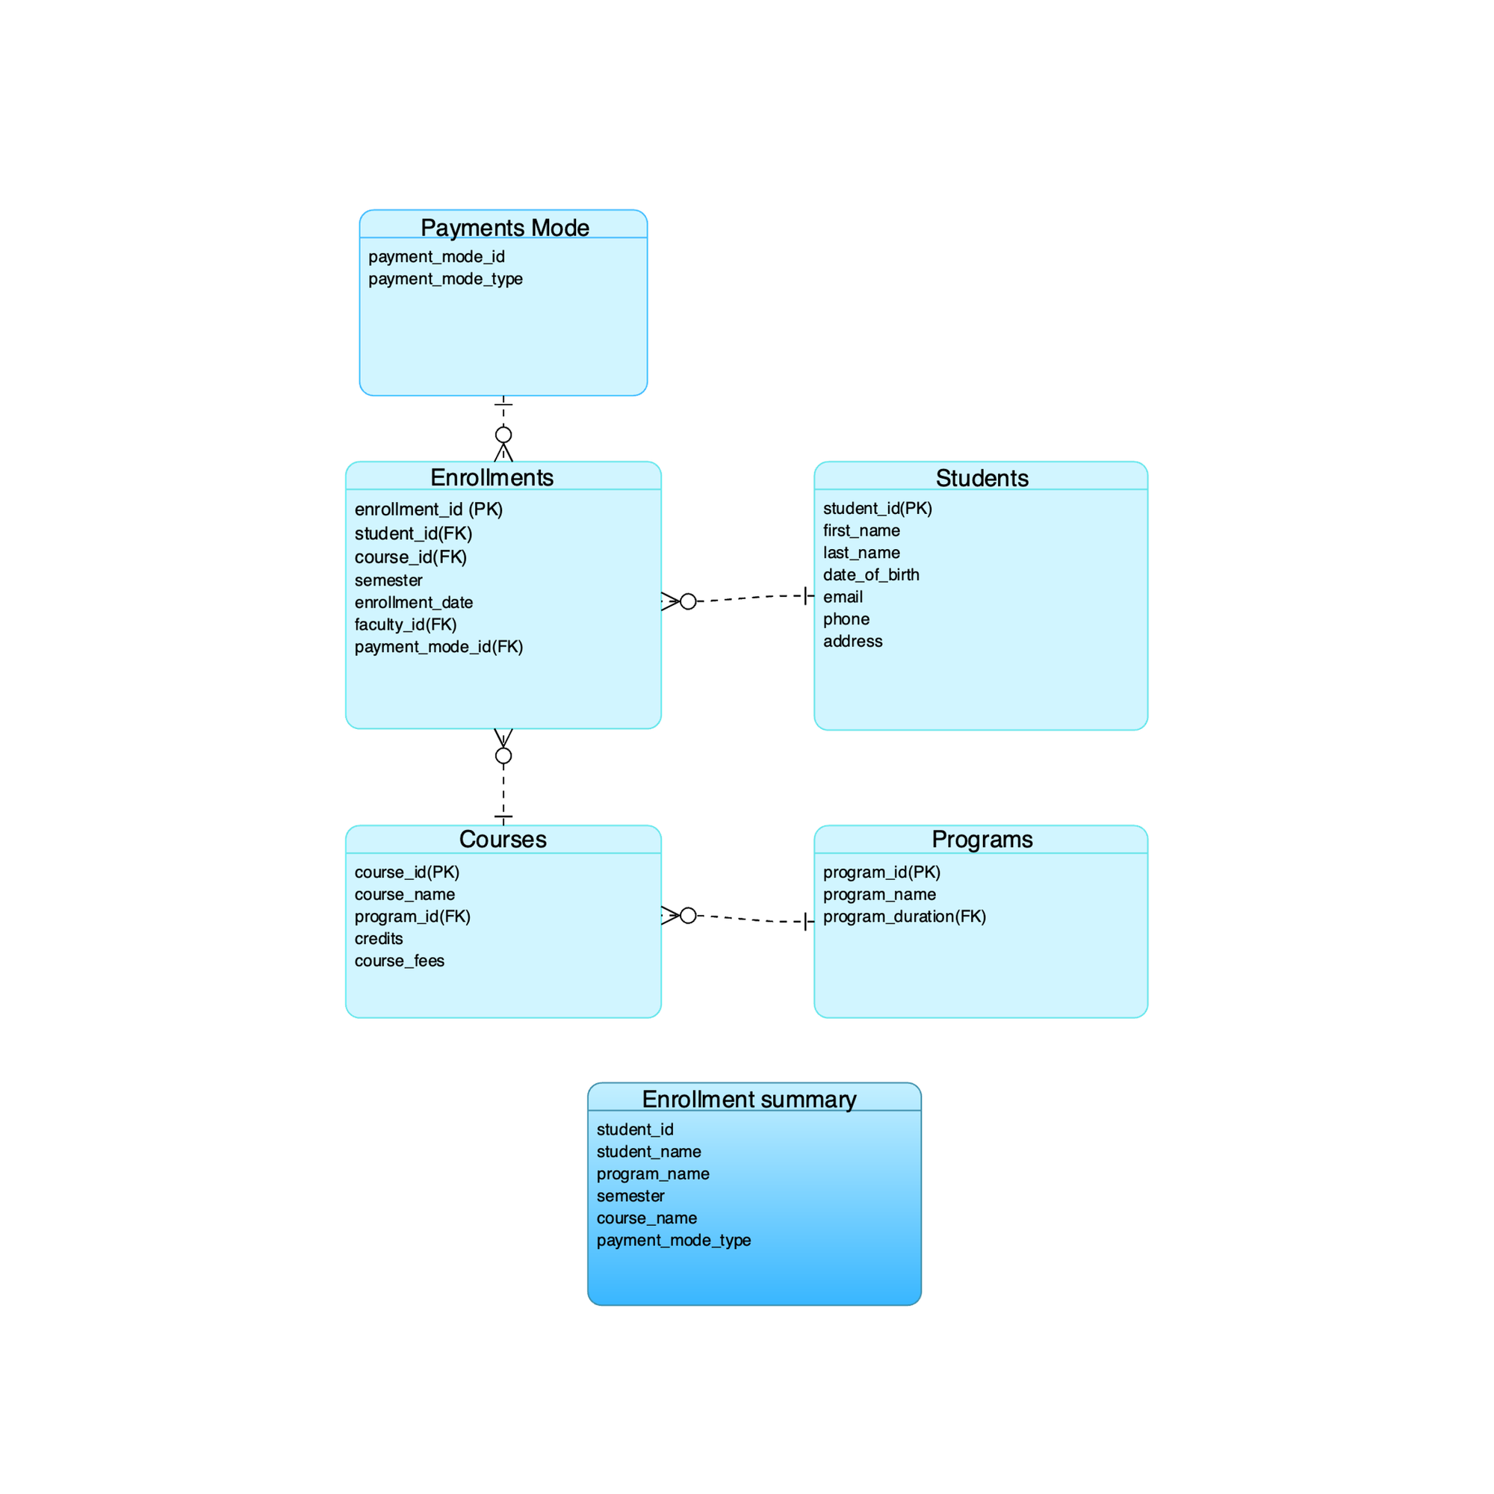
STUDENT ENROLLMENT SUMMARY VIEW
Scenario: Track student enrollments by course, program, semester and payment mode.
Table used: Students ,enrollments, courses, programs, payment_mode .
Fields: Student_id, students_name, program_name, semester, course_name, payment_mode_type.
Purpose: Monitor students enrollment and specify reporting
SQL techniques used: Join

Slide 18
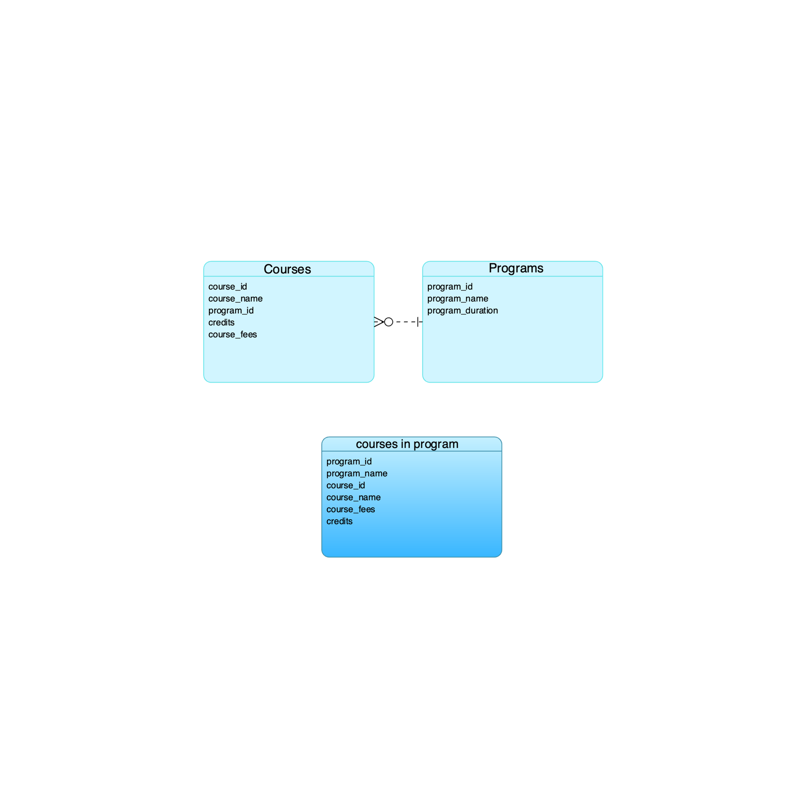
COURSES IN PROGRAM VIEW
Scenario: Display all courses under a specific program.
Table used: Courses, programs
Fields: Program_id, Program_name, course_id
Purpose: Help students & faculty to view available course in program.
SQL Techniques used: JOIN

Slide 19
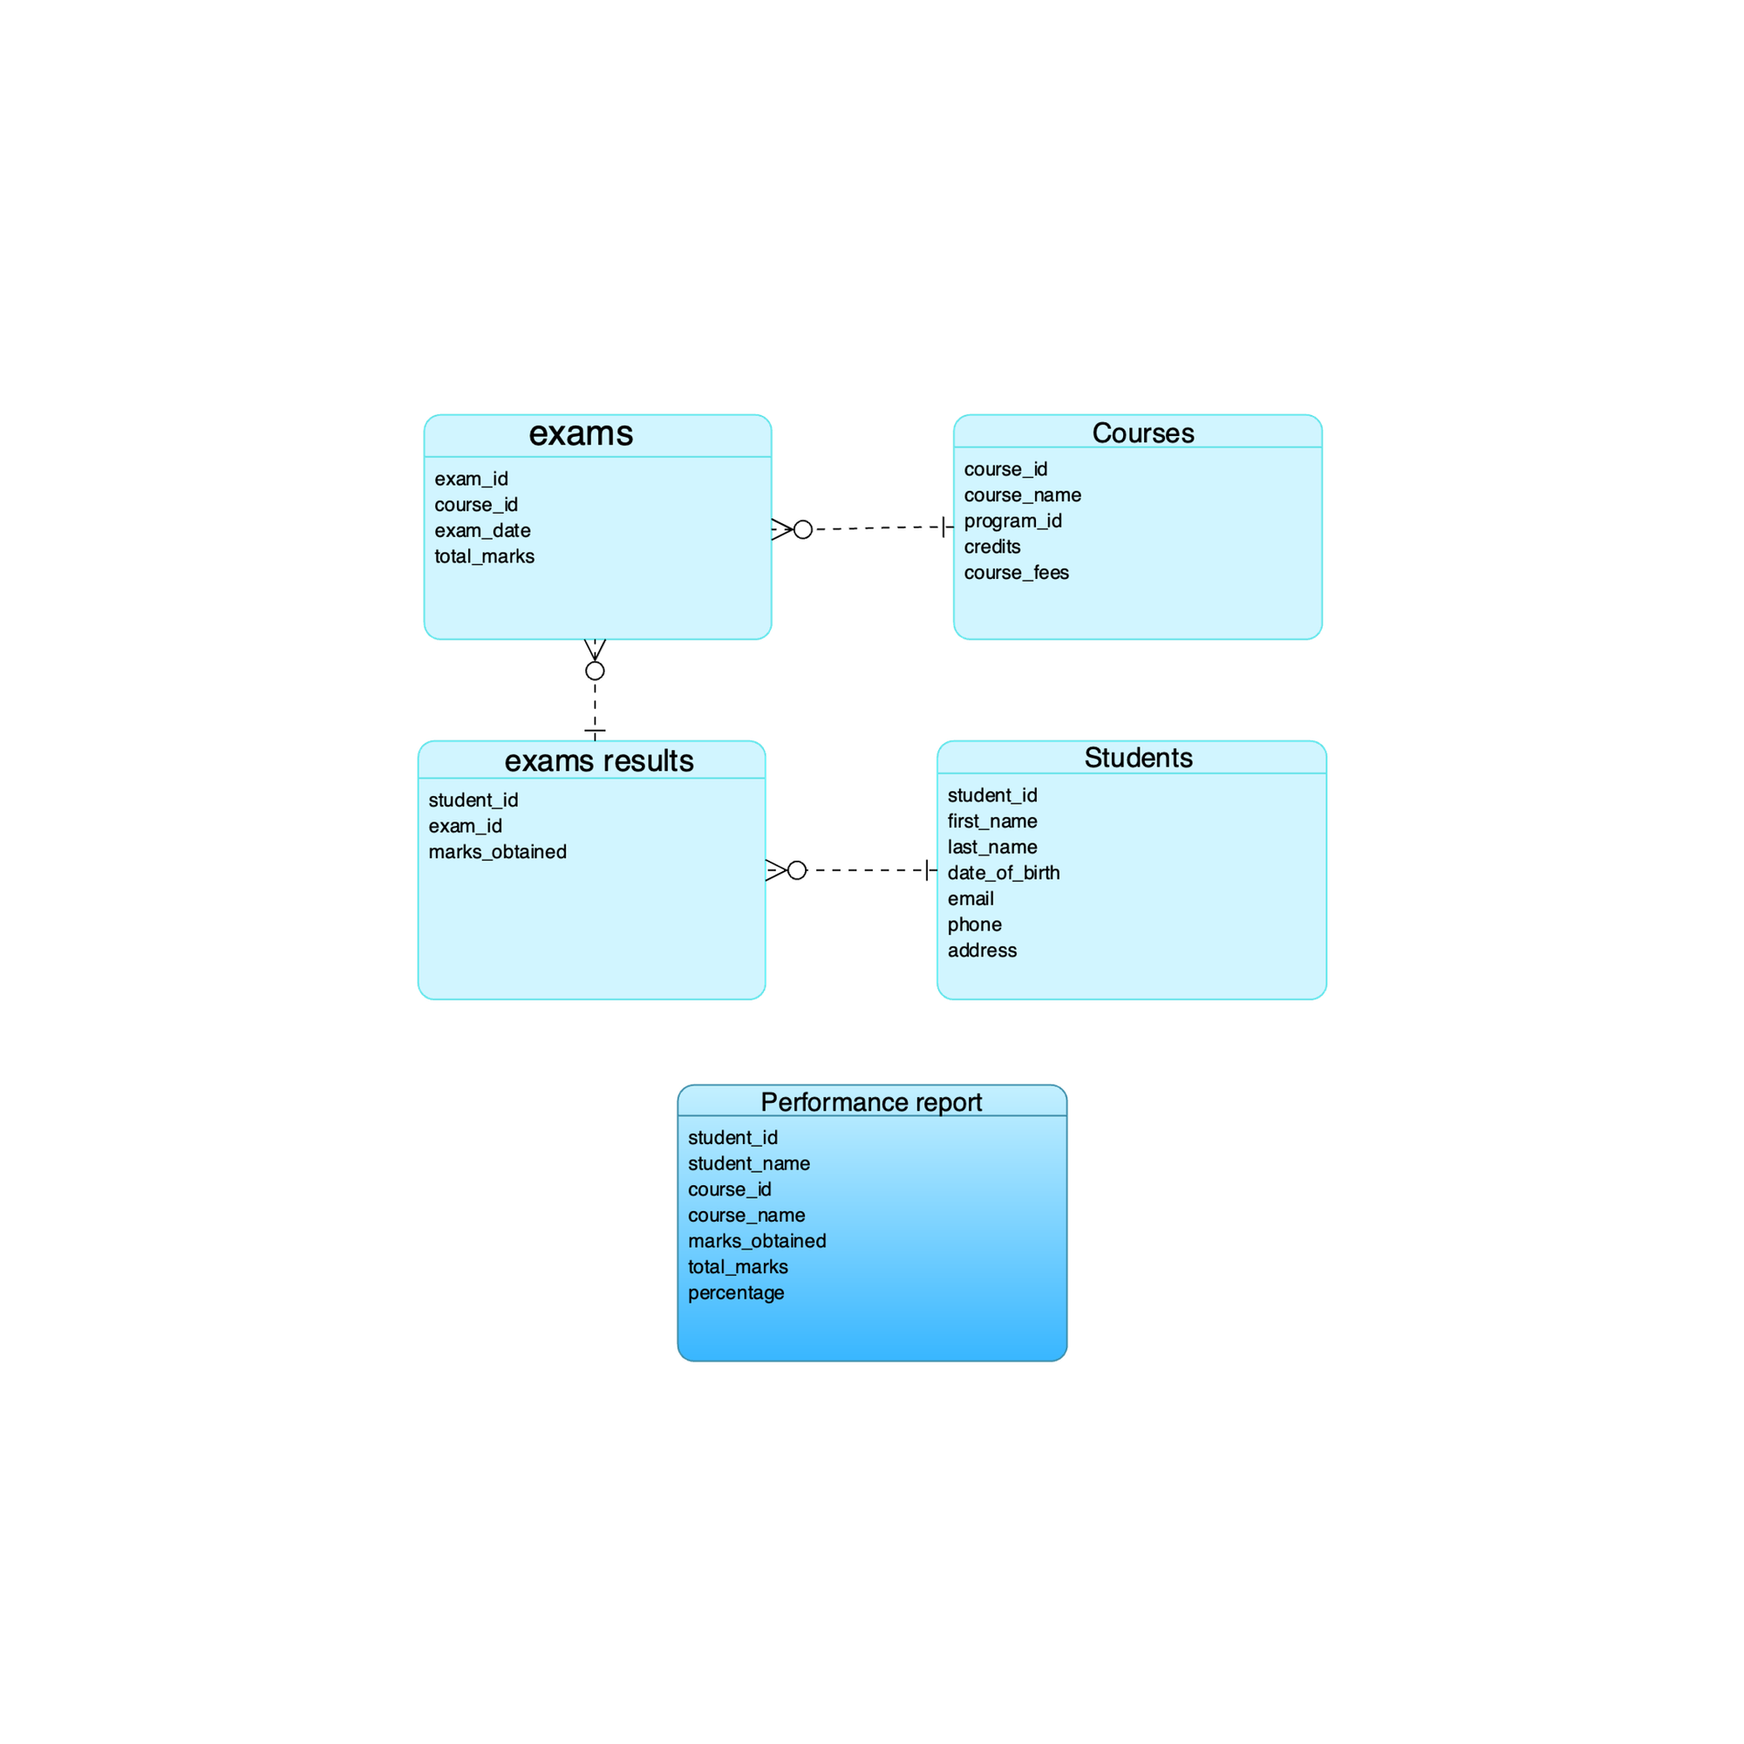
STUDENT PERFORMANCE REPORT
Scenario: Display students exam result along with course details
Table used: Students, exam_results, exams, courses
Fields: Student_id, first_name, last_name, course_name, exam_date, total_marks , marks_obtained
Purpose: Track student performance in exams Identify top & struggling students Provide insights for academic improvements
SQL Technique used: JOIN, GROUP BY & SUM()

Slide 20

conclusion
This document should provide your colleague with a comprehensive understanding of each table in the database, as well as how they relate to each other. If needed, you can expand on the descriptions based on any specific business logic or further data constraints your system requires.

Slide 21
Contribution
Nikhil Mohan: Created the presentation slides, ensuring they were well-designed and coherent. Also developed the ER diagram to accurately represent the data model.
Jaspreet Singh: Contributed to the preparation of the presentation slides with detailed explanations. Created database views to simplify data access and abstraction.
Harpreet Kaur: Authored the project content, including explanations and documentation, and wrote efficient and accurate SQL queries. Guided the project to ensure its successful completion.
Akshar Patel: Inserted data into the database tables, ensuring correct format and accuracy. Implemented and tested SQL queries to produce the correct results.

Slide 22

THANK YOU

