Slide 1
Uber_Ride_2016
File created on: 8/11/2022 6:11:04 AM

Slide 2
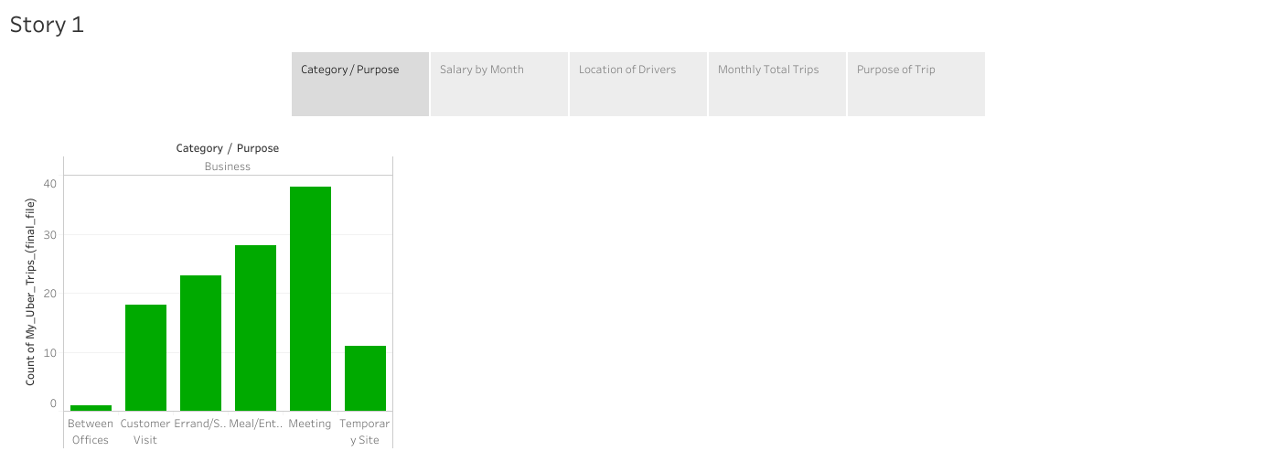

Slide 3
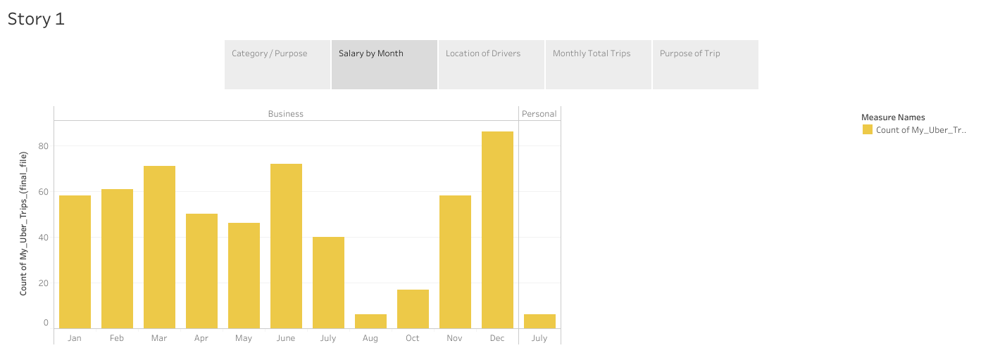

Slide 4
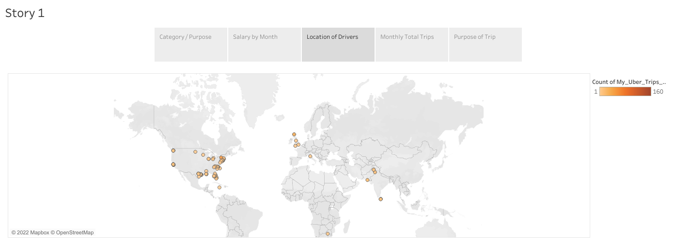

Slide 5
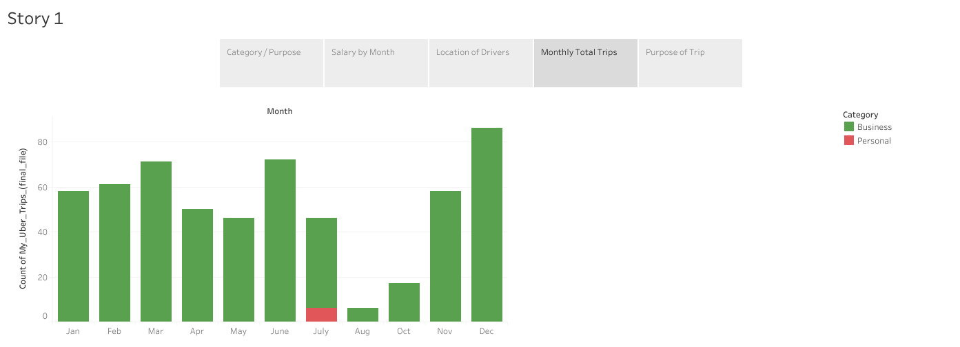

Slide 6
