Slide 1
CTF
Capture The Flag is it a game or a new learning paradigm ? - 2023

Slide 2
Disclaimer & Laws

Slide 3

Disclaimer Boring but necessary
Information in this presentation is intended for educational and awareness purposes only.
Live presentation. Not a controlled environment and some contents may be inappropriate for some users.
I accept no responsibility in any kind for the use, misuse, downloading, viewing in whatever way the links in this presentation.
This presentation is not related to my work or employer.

Slide 4

Who Am I Let’s OSINT me ☺
Just got a name
Pedro António Oliveira Vieira
Google (link)
Google “Improved Search” (link)
Google “Improved Search” (link)
LinkedIn (link)
Public profile was showing way too much
Certified Ethical Hacker (link)

Slide 5
Capture The Flag

Slide 6
CTF Capture The Flag
TryHackMe - https://tryhackme.com/
HackTheBox - https://www.hackthebox.eu/
VulnHub - https://www.vulnhub.com/
OTW - https://overthewire.org/wargames/
PicoCTF - https://picoctf.org/
CryptoPals - https://cryptopals.com/
CryptoHack - https://cryptohack.org/

Slide 7
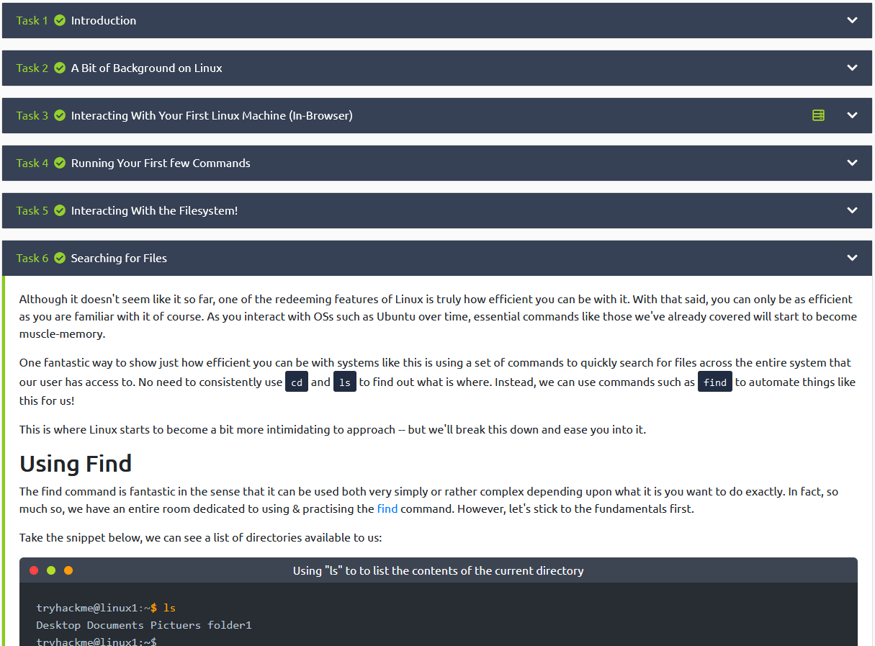
CTF THM – Try Hack Me
Try Hack Me (link)
TryHackMe is a free online platform for learning cyber security, using hands-on exercises and labs, all through your browser!
Learn
Our content is guided with interactive exercises based on real world scenarios, from hacking machines to investigating attacks, we've got you covered.
Practice
Put your knowledge into practice with gamified cyber security challenges.
Cost – Free or $10/month

Slide 8
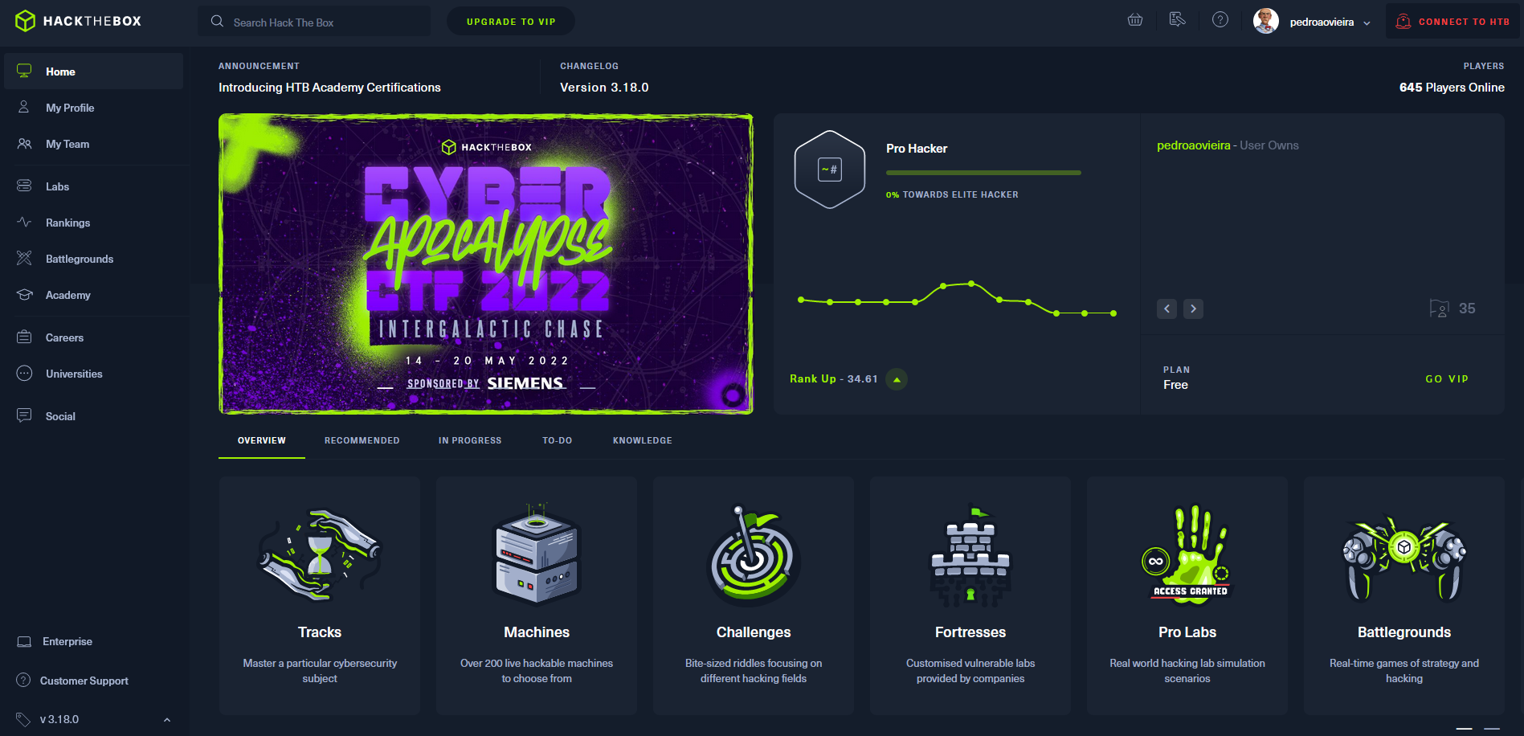
CTF HTB –Hack The Box
Hack The Box (link)
Hack The Box is a massive, online cybersecurity training platform, allowing individuals, companies, universities and all kinds of organizations around the world to level up their hacking skills.
Challenges
Hardware, Crypto, Pwn, Mobile, Reversing, Web, …
Machines / Tracks
Cost – Free / €12/month
Job Board

Slide 9
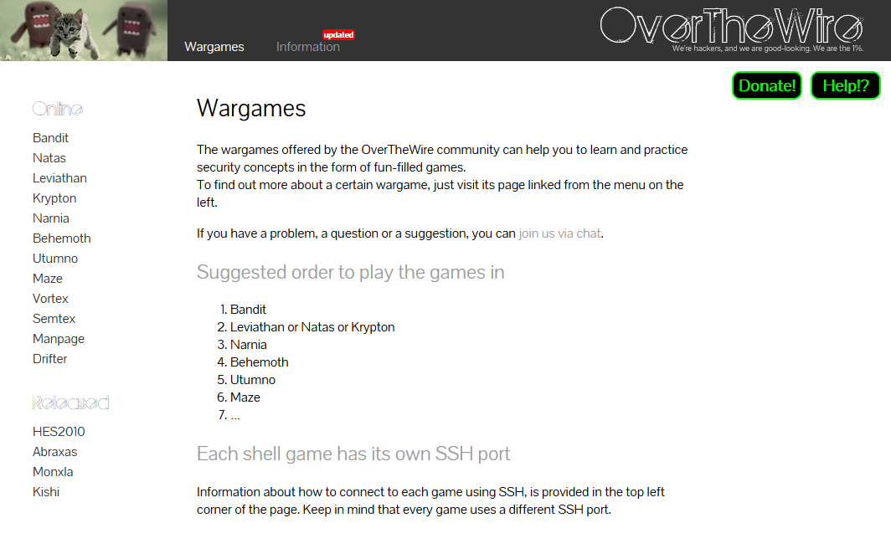
CTF OTW –Over The Wire
Over The Wire (link)
Linux and Web based games
Linux - Bandit
Web - Natas

Slide 10
ONLINE SAFETY

Slide 11
Helping Tools Privacy
VPN (Different country, different advertisements, what else ?)
ProtonVPN (link)
Temporary Email (Need to register? Activate software?)
10 minute email (link)
20 minute email (link)
Disposable Email
60 minute email (link)
Internet Access (DarkWeb included)
Tor (link) (internet browser)
Tails (link) (OS that runs on usb or VM)

Slide 12
Free to Share

Slide 13
License
Feel free to use/modify/share
Teach someone
Improve awareness

