Slide 1
SHODAN
Beware. Your data is out there.
OSINT IOT - 2023

Slide 2
OSINT – Open-source intelligence Digital Footprint
Open-source intelligence (OSINT) is the collection and analysis of data gathered from open sources (overt and publicly available sources) to produce actionable intelligence. (Wikipedia)
It’s about digital footprint. Gathering information from:
search engines (Google, …)
social media (Facebook, …)
government sites
…
The constant battles:
Privacy vs Publicaly available information
Convinience vs Security

Slide 3
Disclaimer & Laws

Slide 4

Disclaimer Boring but necessary
Information in this presentation is intended for educational and awareness purposes only.
Live presentation. Not a controlled environment and some contents may be inappropriate for some users.
I accept no responsibility in any kind for the use, misuse, downloading, viewing in whatever way the links in this presentation.
This presentation is not related to my work or employer.

Slide 5
Disclaimer Avoid illegal activities
Some links, websites, software or other items listed may or may not be legal, illegal, a felony, misdemeanor, or worse, in your country.
Please make sure that you are allowed to browse the websites, download links and software BEFORE USING!
Ignorance about laws or rules is no excuse for illegal activities or wrongdoing.
Illegal activities may get you in trouble or arrested.
Always check what is legal, and what laws apply.

Slide 6
Laws Portuguese Law and Organizations
Laws
Diário República Eletrónico (link)
ANACOM (link)
Organizations
CNCS – Centro Nacional de Cibersegurança (link)
Incident Notification (link)
CERT.PT (link)
Unidade Nacional de Combate ao Cibercrime e à Criminalidade Tecnológica (UNC3T) (link)
Ministério Público (link)

Slide 7
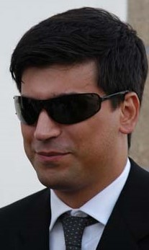
Who Am I Let’s OSINT me ☺
Just got a name
Pedro António Oliveira Vieira
Google (link)
Google “Improved Search” (link)
Google “Improved Search” (link)
LinkedIn (link)
Public profile was showing way too much
Certified Ethical Hacker (link)

Slide 8
SHODAN

Slide 9
Shodan Search Engine for Internet Of Things
Internet Exposure Observatory
Exposure Dashboard (link)
Explore
Shodan explore (link)
Images
Shodan images (link)
Maps
Shodan maps (link)

Slide 10
Shodan Internet of Things
Remote Desktop (link)
Total results: 3,482,756
Braga (link)
Images
Braga (link)
VNC Remote Access and Loggedin (link)
Authentication Disabled
Portugal (link)
Primavera (link)
Contabilidade (link)

Slide 11
Shodan Internet of Things
Fotos
Portugal (link)
IP Cameras
Portugal (link) (default credentials?)
Webcams (link)

Slide 12
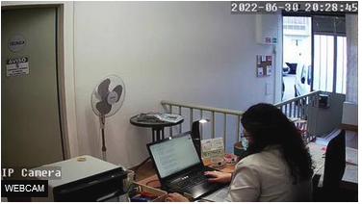
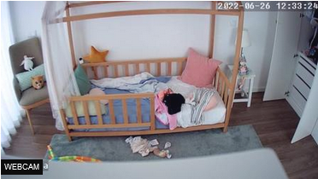
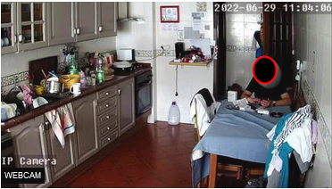
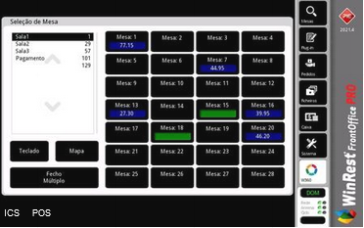
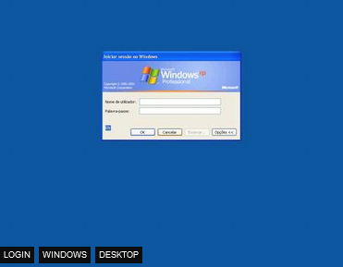
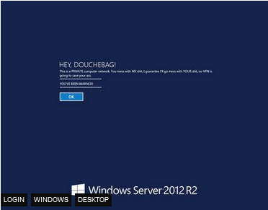
Shodan Internet of Things - Images

Slide 13
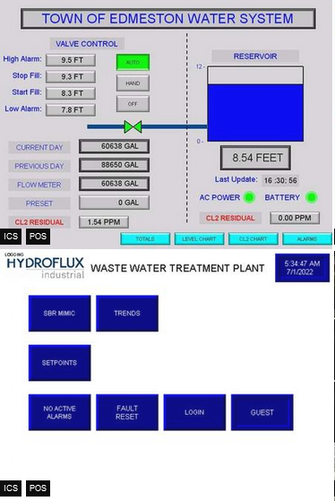
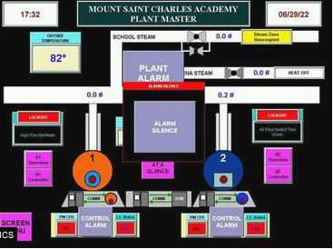
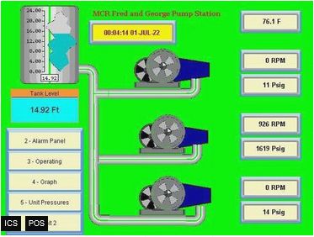
Shodan Industrial Control Systems
Industrial Control Systems (link)

Slide 14
Shodan Portugal – Internet Exposure
Internet Exposure Dashboard (link)
Top Vulnerability
CVE-2015-0204 – CVSS2 4.3 Medium (link)
BlueKeep Unpatched (link)
107 (link)
Industrial Control Systems
516
SMB (shared folders)
Authentication Disabled: 2898

Slide 15
ONLINE SAFETY

Slide 16
Helping Tools Privacy
VPN (Different country, different advertisements, what else ?)
ProtonVPN (link)
Temporary Email (Need to register? Activate software?)
10 minute email (link)
20 minute email (link)
Disposable Email
60 minute email (link)
Internet Access (DarkWeb included)
Tor (link) (internet browser)
Tails (link) (OS that runs on usb or VM)

Slide 17
Free to Share

Slide 18
License
Feel free to use/modify/share
Teach someone
Improve awareness

