Slide 1
311 Data Cold Season – Pre Covid
Braeden Vaughn, Harrison Terry, Caston Stack and Alex Schaeffer
2/18/2021

Slide 2

Overview
Our Team
Introduction
Overarching Goals
Materials & Methods
Statistical Findings
Concluding Remarks

Slide 3
Group 2
Braden
Harrison
Caston
Alex
Team Lead:
Id: 16307352
Analyst
Id:
Project Manager
Id: 16275552
Analyst
Id:

Slide 4
Introduction
311 is similar to 911 but for non-emergencies
Across many US cities, this data is free to analyze through a project called Open311
311 service data is a good indicator of the efficacy of the local government(s)
There are many uses for this data
Retrospective analysis on the fulfillment time of a service
Compare to other similar sized cities and have governments coordinate on efficiencies
Through the OpenData KC project, we will be taking a look at 311 calls specifically between September of 2019 and February of 2020

Slide 5
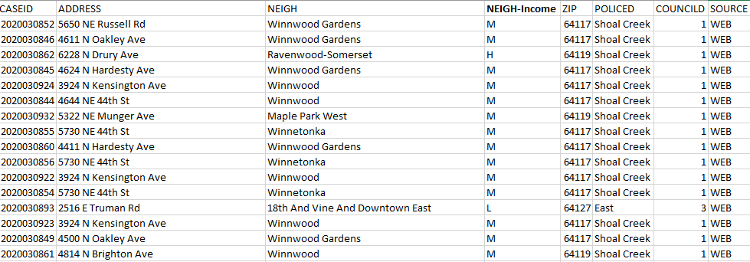
Introduction
The OpenData KC project for 311 data has recorded data from 2007 to present
We have data coming across the KC MO area including: Jackson, Clay, Platte, and Cass Counties
Our dataset has several categories that need to be analyzed to identify intra and extra-group differences

Slide 6

Objectives & Method
The main questions that we will answer are:
Does average service completion time change based on neighborhood income?
Does the service completion time’s variance and average vary on the type of call?
We will be looking at summary statistics as well as one and two way ANOVAs to answer these questions

Slide 7
Results

Slide 8
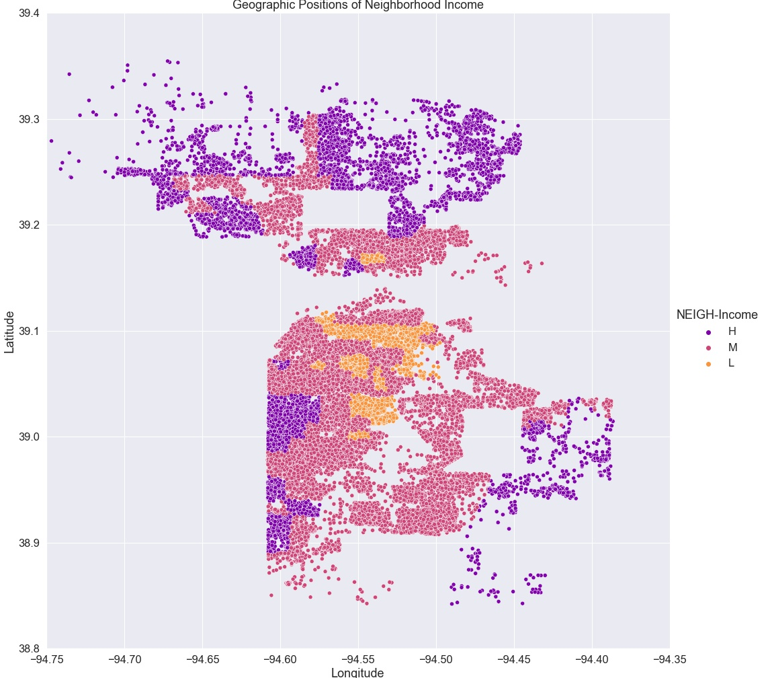

Slide 11
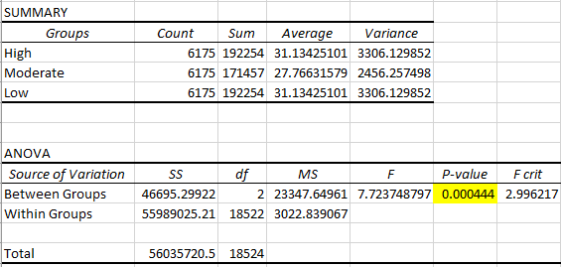
Neighborhood Income ANOVA
Note: With the major disparity in sample sizes between income groups and each 311 category, the homoscedastic assumption was violated. To remedy this, we took a (pseudo)random sample and analyzed the subset

Slide 12
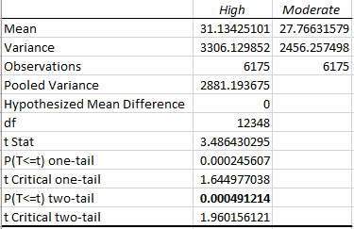
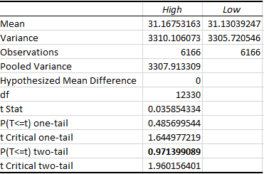
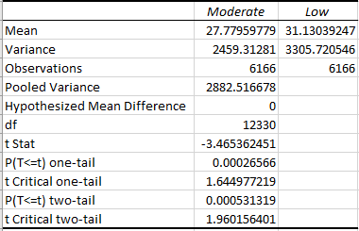
T-Tests

Slide 13
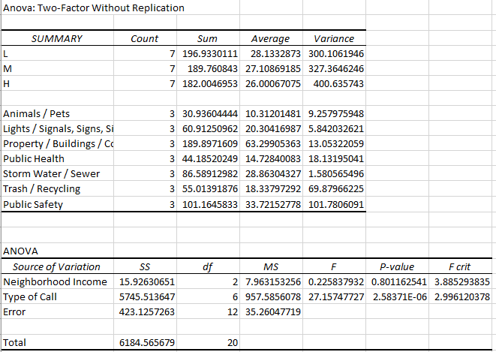
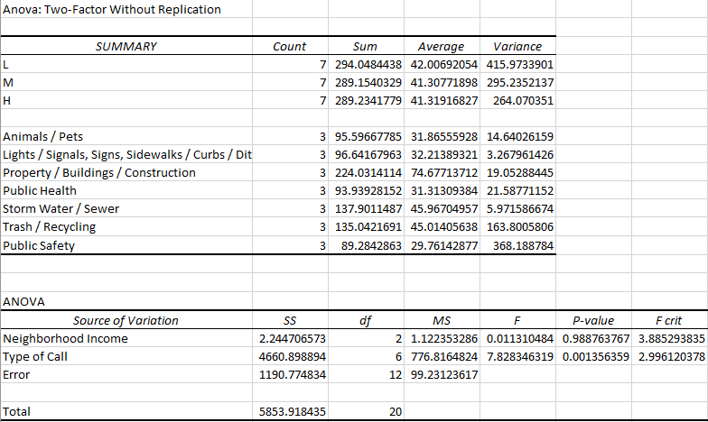
2-Way Anova on Means
2-Way Anova on Standard Deviation

Slide 14
Summary
Using α=.05 for our hypothesis tests we found:
In our one-way Anova, we found that there is a difference in mean between each income level
In the pairwise T-Tests, we found that:
In comparing High-Low that there was not a significant difference in average time to completing 311 services
In both High-Medium and Medium-Low tests, there was a significant difference in average time to completing the 311 services
In our two-way Anovas on the mean and standard deviations, we found:
The neighborhood income level does not significantly contribute to the average or standard deviation of the time to complete 311 services
The type of call does significantly contribute to the average and the standard deviation of the time to complete 311 service calls.

Slide 15

Thank you

Slide 16
Appendix

Slide 17
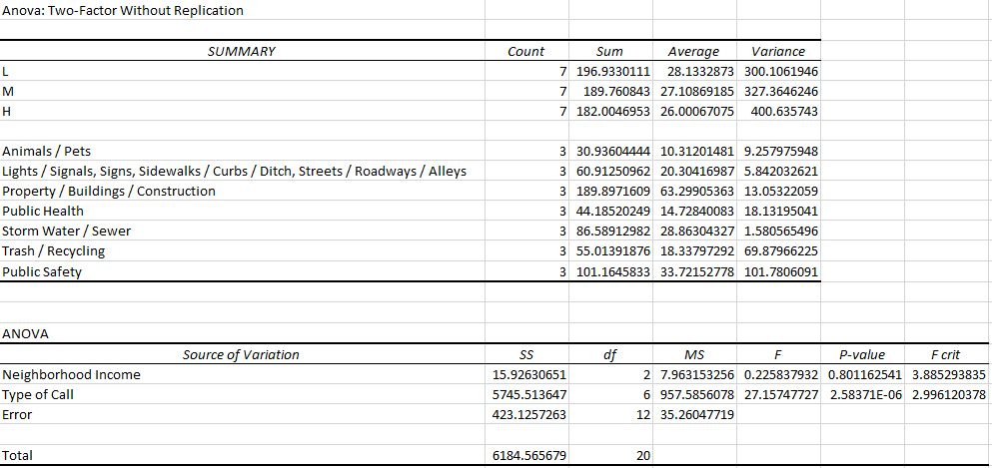
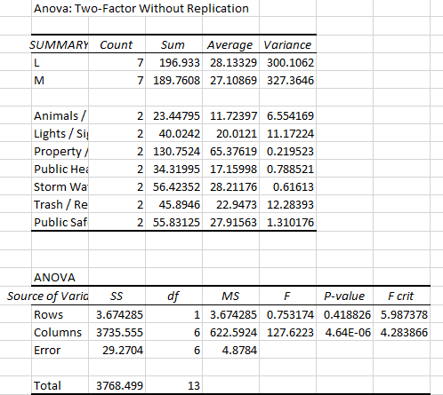
2-Way Anova on Means

Slide 18
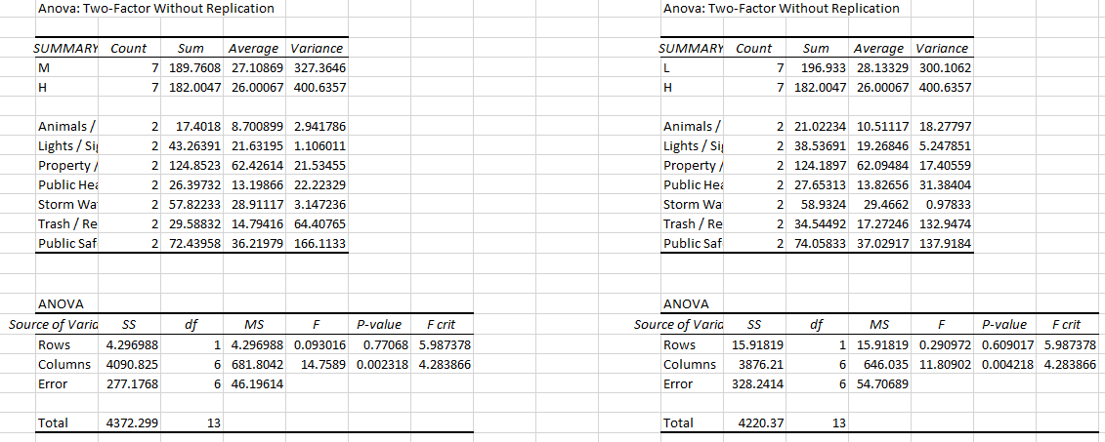
2-Way Anova on Means

Slide 19
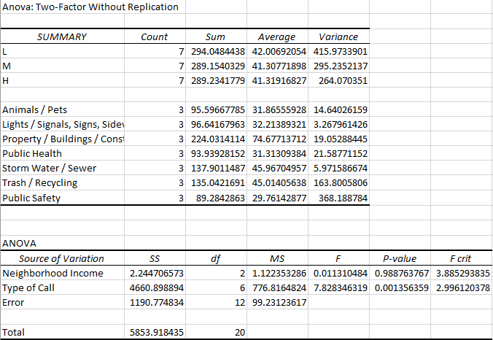
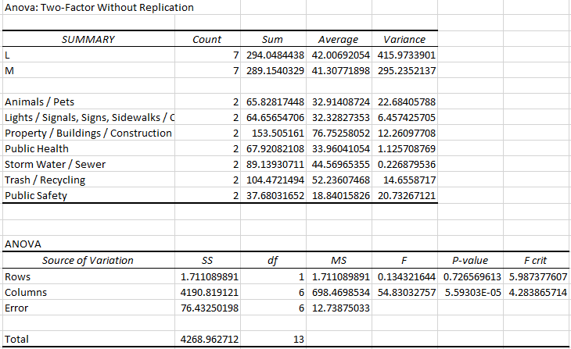
2-Way Anova on Std Dev

Slide 20
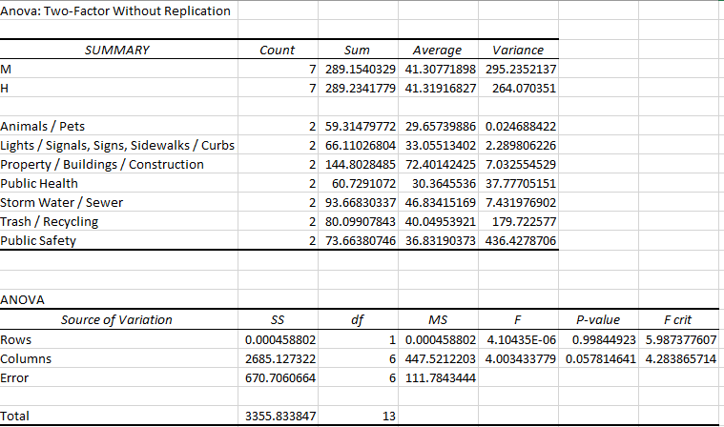
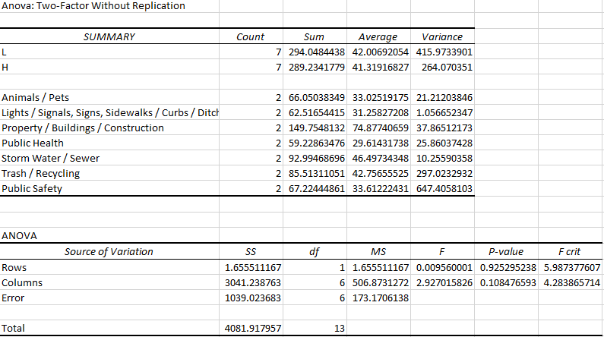
2-Way Anova on Std Dev

