Slide 1
Rydberg Atom RF Sensing
Runzhao Guo & Venkata Madugula(Sai)

Slide 2
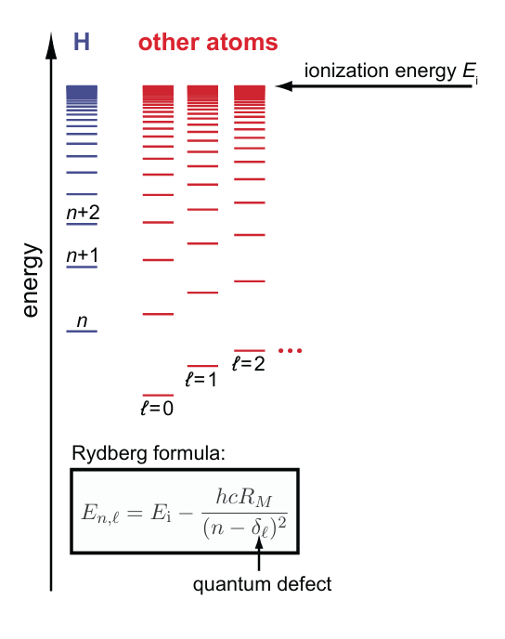
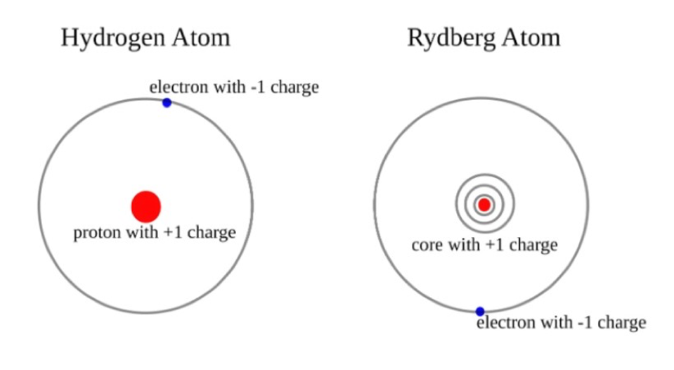

Rydberg Atom
[2] Jacob T. Paul.
$E_{n,l}$: The energy of an electron in a state with principal quantum number n and orbital angular momentum quantum number ℓ
$E_{i}$: The ionization energy
$R_{M}$: The Rydberg constant for an atom with mass M
n: The principal quantum number
${\text{δ}}_{l}$: The quantum defect (correction factor that depends on ℓ)
[1] Daniel et al.

Slide 3
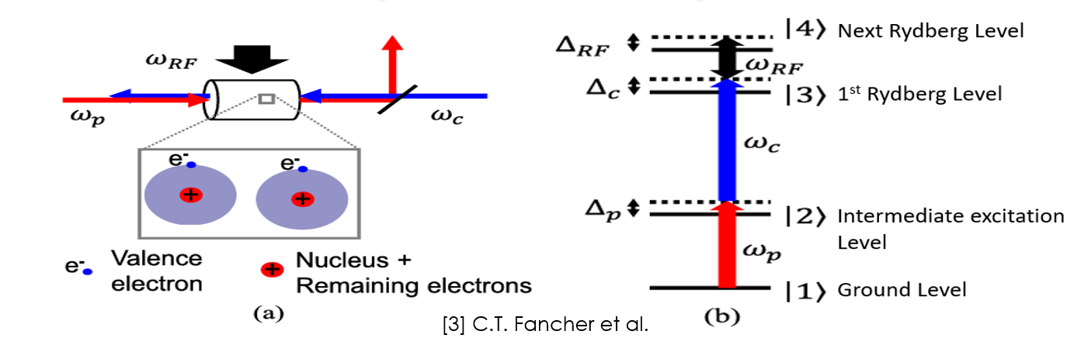
Vapor Chamber Setup
Red is the probe laser used to excite to intermediate state |2> from ground |1>
Blue is the control laser to get to Rydberg state |3> from intermediate state.
The atom is very sensitive to the electric fields due to large electron orbit in Rydberg state.
Presence of any RF field will perturb the natural excitation levels of atom.
These perturbations will in turn show up in spectroscopy measurements and reveal the strength of the external field.

Slide 4
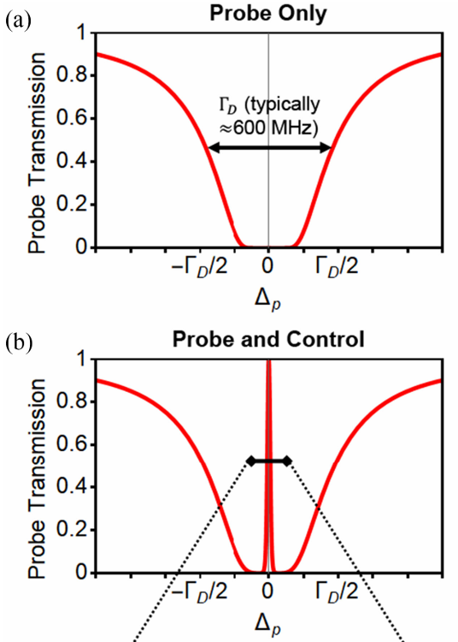
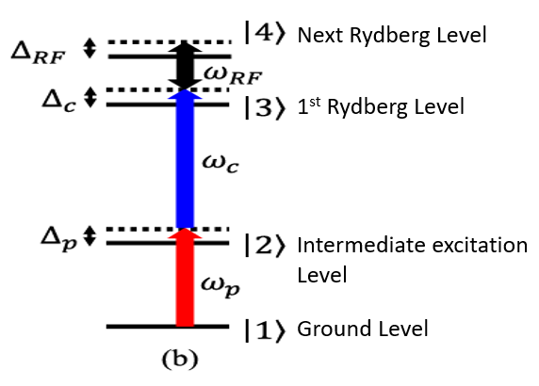
Electromagnetically Induced Transparency(EIT)
[3] C.T. Fancher
Vapor chamber is opaque to the probe laser, when the laser frequency is in resonance with levels 1 and 2.
Control laser will couple the valence electron to levels 2 and 3, creating a window of transparency(EIT) for probe laser.

Slide 5
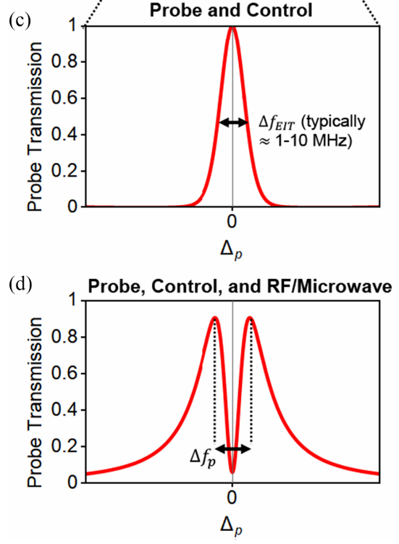
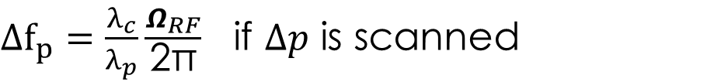

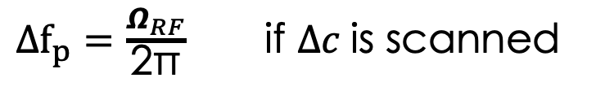
Autler-Townes Splitting
$Δf_{p}=\frac{λ_{c}}{λ_{p}}\frac{Ω_{RF}}{\text{2}\text{π}}$ if $Δp$ is scanned
$Δf_{p}=\frac{Ω_{RF}}{\text{2}\text{π}}$ if $Δc$is scanned
$Ω_{RF}\text{=}\frac{μ_{RF} . E_{RF} }{\text{ℏ}}$ Rabi frequency of the RF source
$μ_{RF} \text{=}$ the dipole moment of the transition
$E_{RF}=$ Amplitude of the Electric field
The presence of an RF/microwave field that is resonant or nearly resonant with a neighboring Rydberg state can induce a version of AC Stark shift to the energy levels.
These shifts will cause the EIT transmission window to split which is proportional to the Rabi frequency of RF signal.
This phenomena is called “Autler-Townes splitting”.
[3] C.T. Fancher et al.

Slide 6
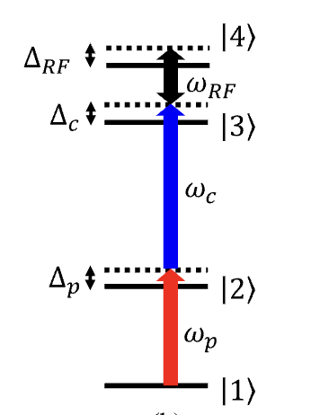
Off-resonant incident fields
AC Stark Shift
[4] D. Anderson et al. [5] C. T. Fancher et al.

Slide 7
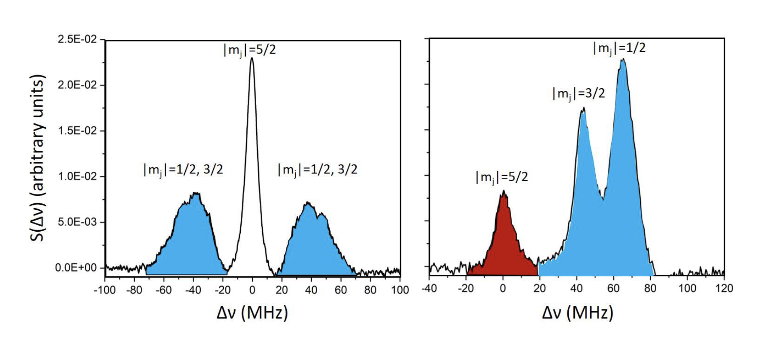

AC Stark Shift
$$△ν=\frac{1}{4}αE^{2}$$
Less sensitive than the resonant Autler–Townes technique
[4] D. Anderson et al.

Slide 8
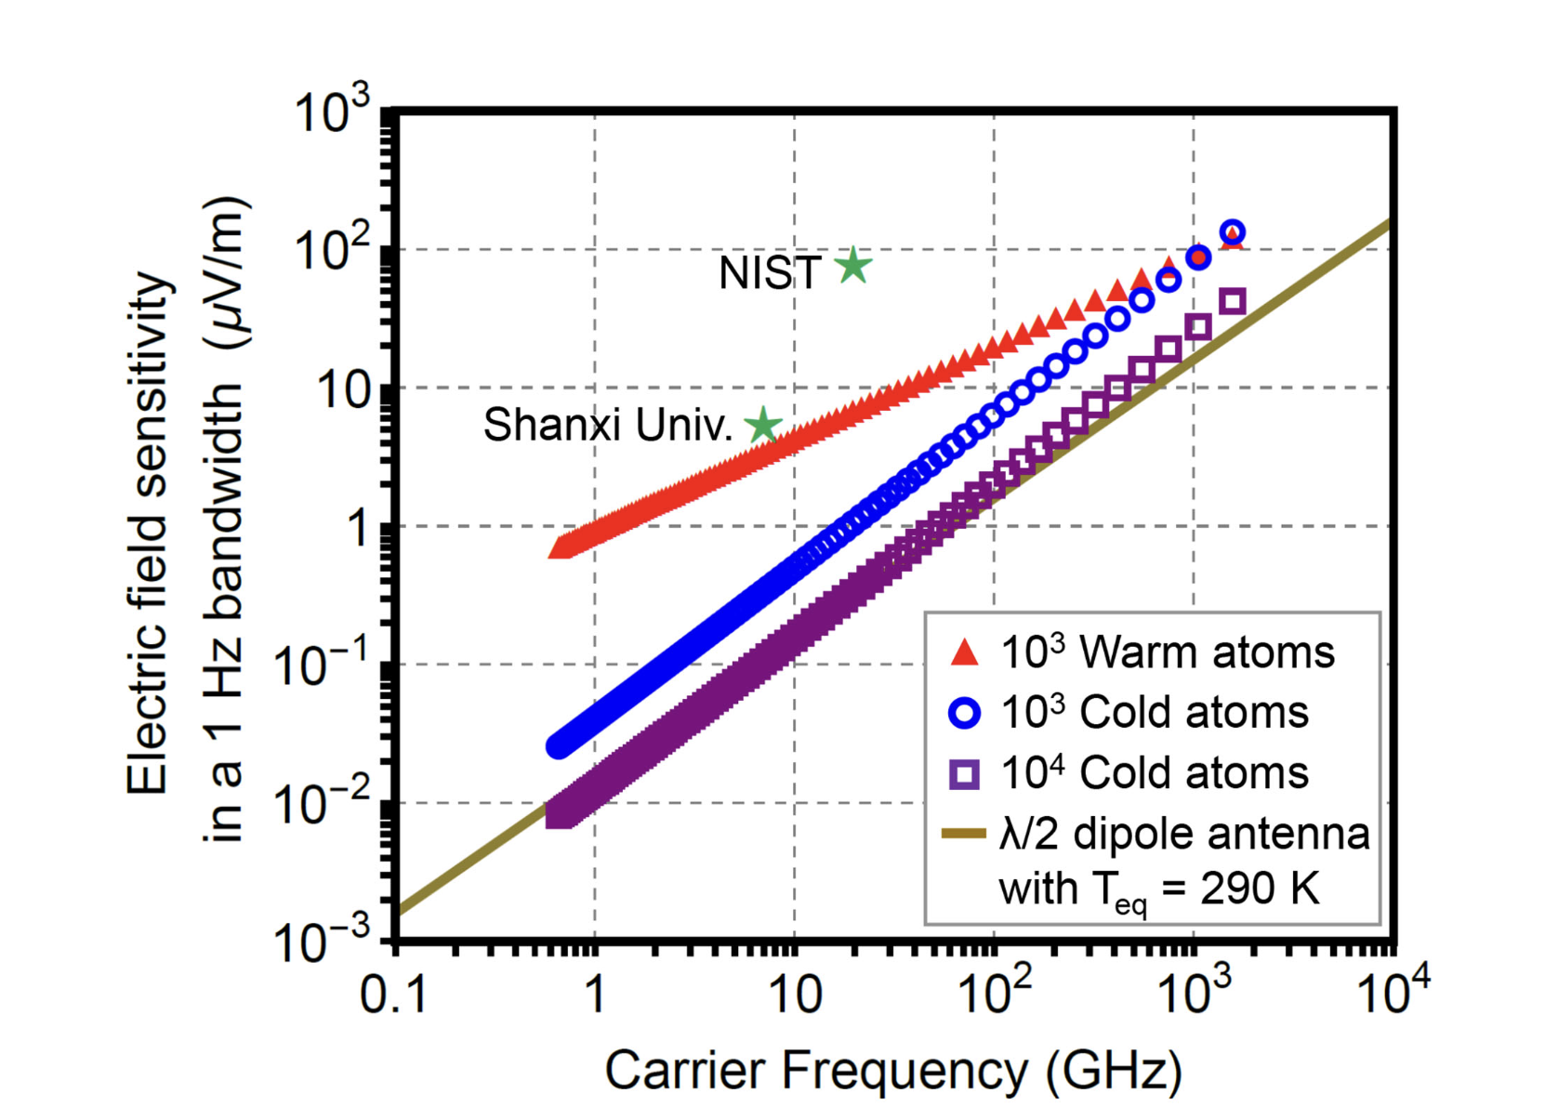
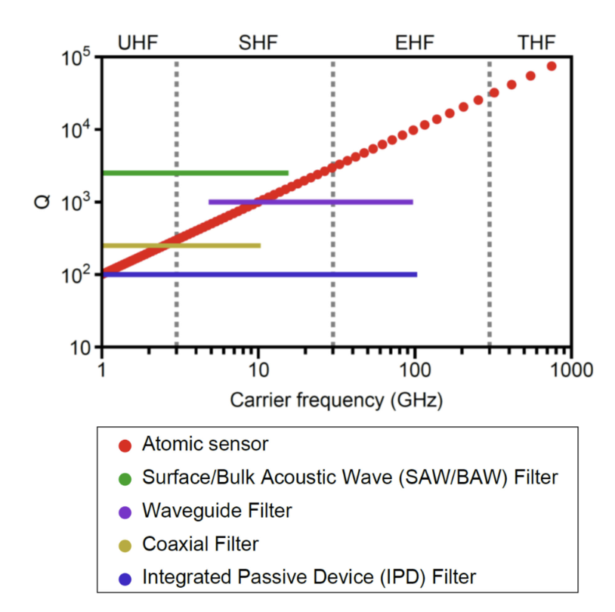


Sensitivity
Sensitivity of Atomic Electric Field Sensor:
$$E_{min}=\frac{h}{|{\overset{→}{μ}}_{RF}|T_{meas}\sqrt{N_{a}T_{int}T_{2}}}$$
Sensitivity of traditional antenna:
$$E_{min}=\sqrt{2P_{N}/(ε_{0}cA_{d})}$$
,where $A_{d}=\frac{Gλ^{2}}{4π}$
Dynamic Range
Autler-Townes | AC Stark Shift
10 dB | 80dB
Trad. sys. in THz | Trad. sys. in GHz
40~80dB | 60~120dB
Selectivity
Q-factor
$$Q=ν/△ν$$
For Atoms,$△ν=10MHz$
[5] C. T. Fancher et al. [6] A. B. Deb et al.

Slide 9
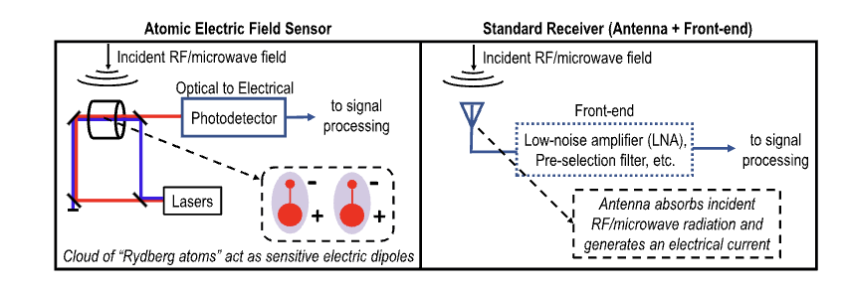
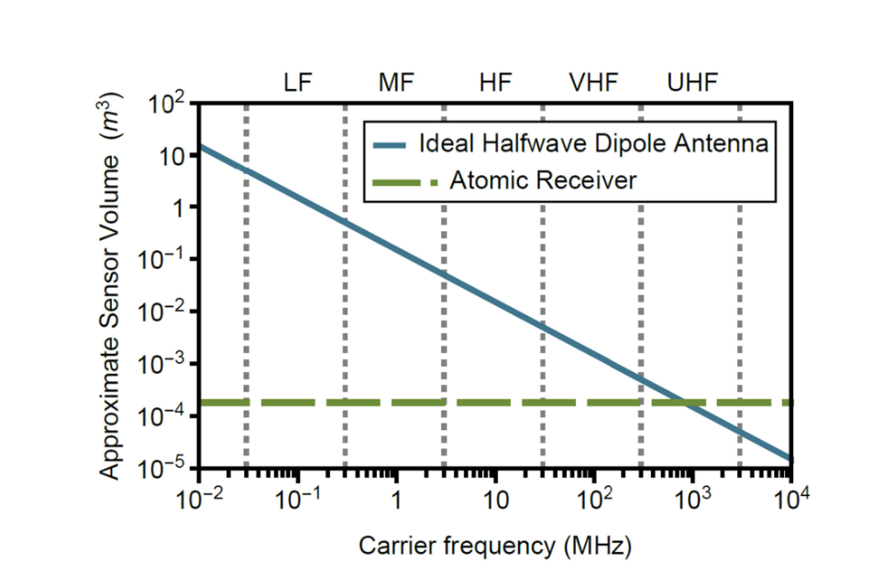
Advantages
Broad Frequency Tunability:
Compact Size:
$$Z_{L}=Z_{S}$$
[5] C. T. Fancher et al.

Slide 10
References
[1] Measurement of rotational levels of the homonuclear helium dimer cation by extrapolation of Rydberg series by Daniel et al.
[2] https://www.forbes.com/sites/moorinsights/2020/04/30/big-atoms-make-small-super-sensitive-quantum-receivers/
[3] Rydberg Atom Electric Field Sensors for Communications and Sensing by C. T. Fancher et al.
[4] D. Anderson, R. Sapiro, and G. Raithel, “A self-calibrating SI-traceable broadband Rydberg atom-based radio-frequency electric field probe and measurement instrument,” IEEE Trans. Antennas Propag., doi: 10.1109/TAP.2021.3060540.
[5] C. T. Fancher, D. R. Scherer, M. C. S. John and B. L. S. Marlow, "Rydberg Atom Electric Field Sensors for Communications and Sensing," in IEEE Transactions on Quantum Engineering, vol. 2, pp. 1-13, 2021, Art no. 3501313, doi: 10.1109/TQE.2021.3065227
[6] A. B. Deb, N. Kjærgaard; Radio-over-fiber using an optical antenna based on Rydberg states of atoms. Appl. Phys. Lett. 21 May 2018; 112 (21): 211106.

