Slide 1

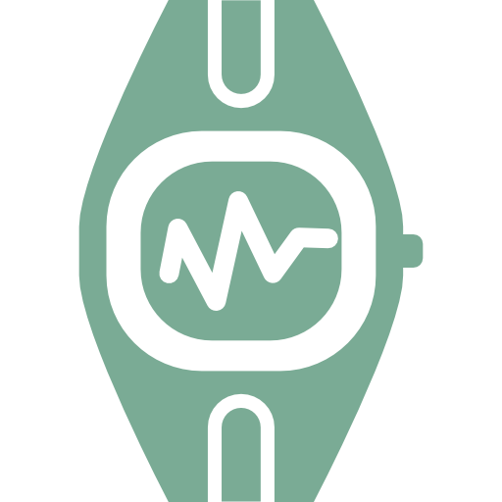


Team HOBL
Harrison Lucas | Alan Brown
Ong Tee Han | Jason Hullick
M nstero
Making exercise COOL!

Slide 2

Problem space and Background survey
Children are reporting low self-esteem
Peaks between the ages of 6-13
Has many negative effects
Exercise improves self-esteem
Directly improves self-esteem
Has other obvious physical and mental benefits
Gamification can motivate children to exercise
The majority of children play games
Several components to successfully gamifying an experience
Extremely effective when done correctly
Notes:
Teenagers with low self esteem are often prone towards materialism (6-10)
Exercise can help in improving self esteem however,
Procrastination is a common problem among teenagers and thus they are not motivated to exercise.

Slide 3
Design Opportunities
A gamified wearable
Targeted to 6-9 years old children
Creature ‘evolves’ as the child exercises and makes friends
Heart Rate sensor
Detect nearby devices
Parental controls
Track children’s exercise rate
Goal Setting
Reward
Notes:
Creature snooze when its on a car(heart rate)
Mobile application targeted at 10-15 years old teenagers
Interesting interface and interactive creature growth
They more they exercise the more the creature will grow
Creature battle to improve gamification
Wearables for phone to track exercise rate

Slide 4



Methods to further explore
Research
Interviews
Prototype
Notes:
Going forward with the project there are a number of methods and approaches we will have to explore to further develop this idea. The first method is to conduct additional research so that we can gain a better understanding of the problem space. This will include the underlying reasons why exercise is beneficial for self esteem and seeing if we can capitalize on them. Next we will need to conduct interviews with teenagers so we can learn more about the target about. Questions that we might ask include; exploring what elements keep them coming back to games, what types of exercise they currently do and would they actually wear a wristband around. The final stages will be testing out prototypes. There are two main goals we want to explore using two different prototypes. The first prototype would be a basic wristband to test whether people would feel comfortable wearing it, and to make sure it wouldn’t get in the way playing sport. The second would be a mobile phone app to explore the functionality and interface whilst having a similar representation to the goal product.

Slide 5

Team Strengths
Strong background in related technologies
Web technologies
Java
Front and back end technologies
eg. React JS, NodeJs, Ionic 3 Framework
Communication
Verbal
Written
Team members from a range of disciplines
IT
Software Engineering
UI/UX Design
Notes:
Teamwork
Communication skills
Goal oriented
Multidisciplinary

