Slide 1
Programming Design
ROBOTC Software
Principles of Engineering
© 2012 Project Lead The Way, Inc.

Slide 2
Behavior-Based Programming
A behavior is anything your robot does
Example: Turn on a single motor or servo
Three main types of behavior
Complex behavior: Robot performs a complex task
Example: automate fan control
Simple behavior: Robot performs a simple task
Example: fan stops when sensor is activated
Basic behavior: Single command to a robot
Example: start a motor
Complex behaviors are broken down into simple behaviors, which are broken down into basic behaviors

Slide 3
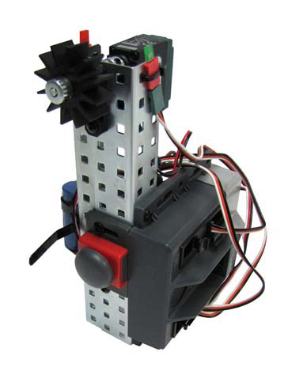
Complex Behaviors
Describe a task or overall goal that a program will accomplish
A fan runs until someone needs it to stop.
A safety device warning light turns on before a fan turns on.
Another light indicates that a fan has stopped.
This can be described as one or more complex behaviors

Slide 4
Creating Pseudocode
Break down behaviors into individual actions
Do not be concerned about syntax or which commands will be used with ROBOTC
Simply describe them in short phrases
Example
Turn a motor on for three seconds
Follow a line until it runs into a wall

Slide 5
Simple Behaviors
Break each complex behavior down into simple behaviors
List simple behaviors line by line in the correct sequence
Describe actions and the prompt for each action to start

Slide 6
Creating Pseudocode
Example
Warning light turns on before the fan starts for three seconds
Fan turns on and runs until a button is pressed
A different light turns on for three seconds before the program stops

Slide 7
Basic Behaviors
Break each simple behavior down further into basic behaviors
Write in terms of the input and output relative to the device

Slide 8
Creating Pseudocode
Example
Program starts
Light 1 (LED 1) turns on for three seconds
Fan (Motor 1) turns on until a button (bumper switch) is pressed
Light 2 (LED 2) turns on for 3 seconds
Program ends

Slide 9
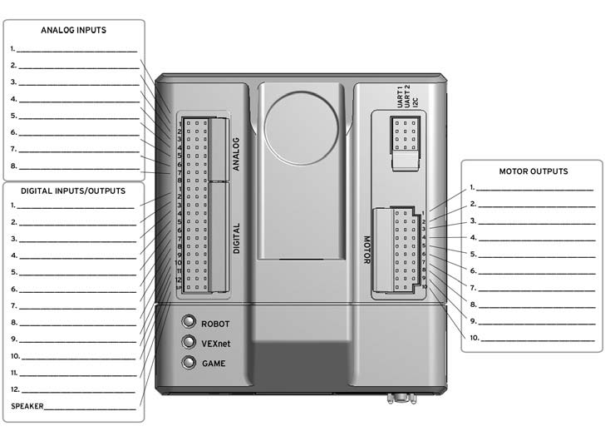
Identify Inputs and Outputs
Identify the ports by which each input and output will be connected to the Cortex
Be conscious which sensors are analog and which are digital
Label a planning diagram

Slide 10
PLTW ROBOTC Program Template
Open Sample Program PLTWtemplate
Enter an initial task description of the overall program goal in terms of complex behaviors
Enter pseudocode in terms of basic behaviors in the pseudocode section of the PLTW ROBOTC program template
Notes:
Select File, Open Sample Program. Navigate to the PLTW folder. Select the PLTWtemplate file, then select Open.

Slide 11
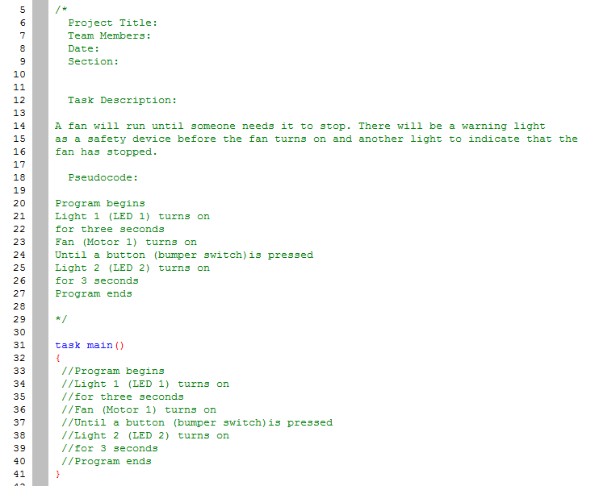
PLTW ROBOTC Program Template

Slide 12
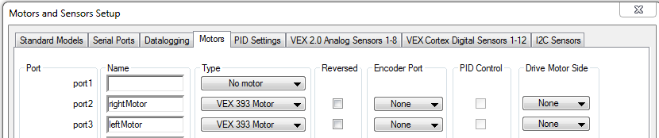
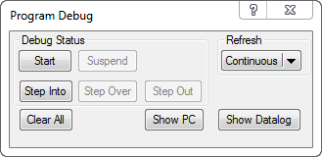
Program Design
Enter label for inputs and outputs in the Motors and Sensors Setup window and change drop down to identify
Use the Program Debugger to confirm that all inputs and outputs are working as expected

Slide 13
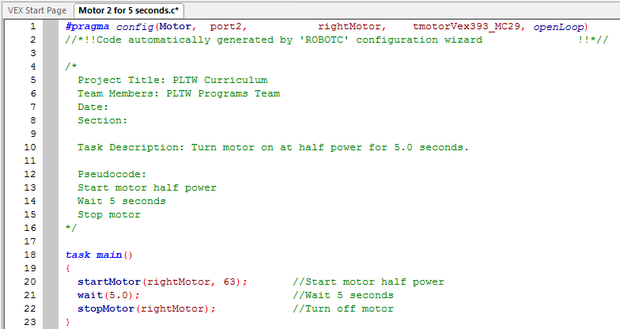
Motor 2 for 5 Seconds
Notes:
This example is best demonstrated using the test bed.

Slide 14
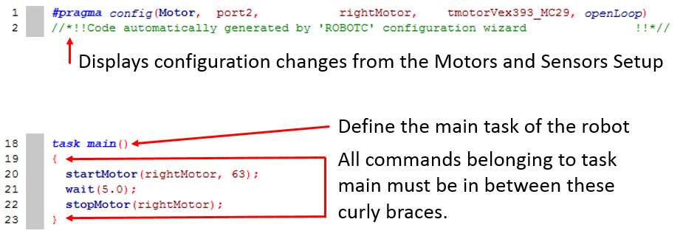
Motor 2 for 5 Seconds

Slide 15
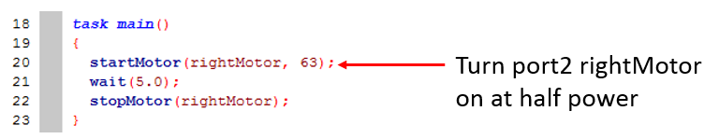
Motor 2 for 5 Seconds

Slide 16
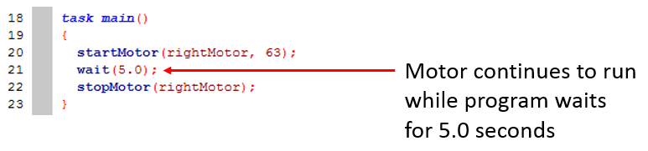
Motor 2 for 5 Seconds

Slide 17
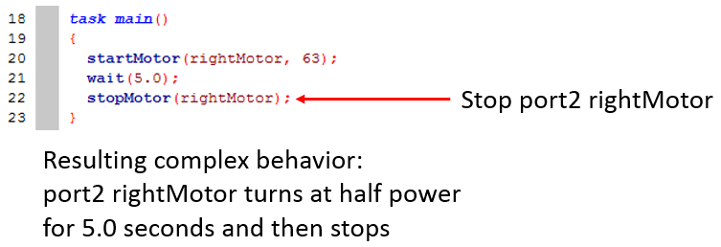
Motor 2 for 5 Seconds

Slide 18
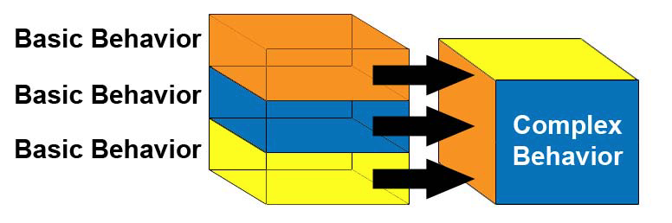
Program Design
Generally basic behaviors combine to create a complex behavior
Troubleshoot basic behaviors individually as method of troubleshooting a complex behavior

Slide 19
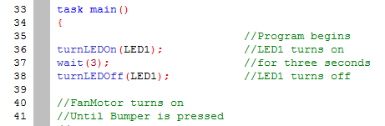
Program Design
Create code and test small behaviors or sets of behaviors individually
Edit or add comments as you build code

Slide 20
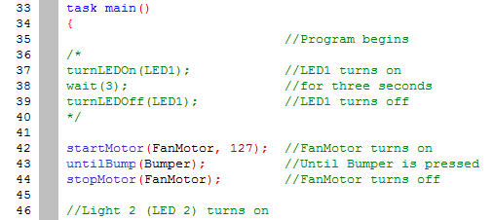
Program Design
Continue programming while testing individual behaviors
Temporarily turn sections of code into comments using /* followed by */

Slide 21
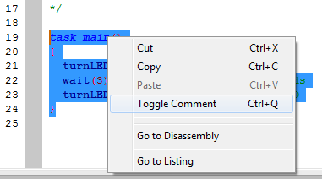
Program Design
Sections of code can also be temporarily turned into comments using Toggle Comment using a right mouse click

Slide 22
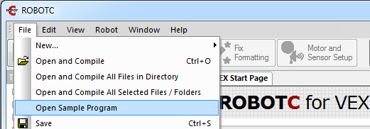
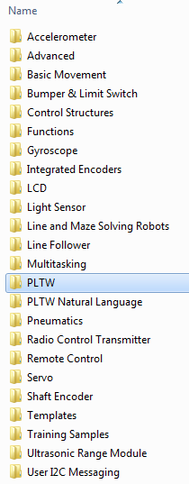
Sample Programs

Slide 23
ROBOTC Natural Language
Language developed especially for PLTW
Lines of code for common robot behaviors are consolidated into single commands
forward();
lineTrackforTime();
stop();
untilBump();

Slide 24
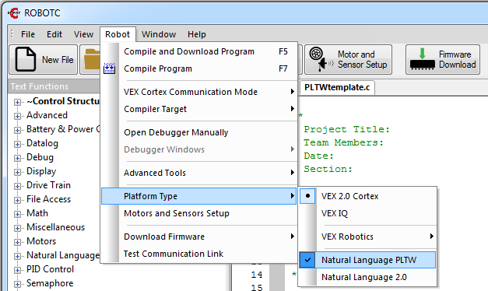
ROBOTC Natural Language
Natural Language PLTW is a ROBOTC Platform Type

Slide 25
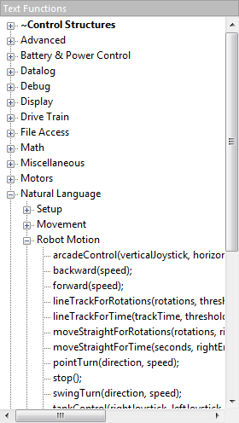
ROBOT Motion
Commands that cause the entire robot to perform a behavior

Slide 26
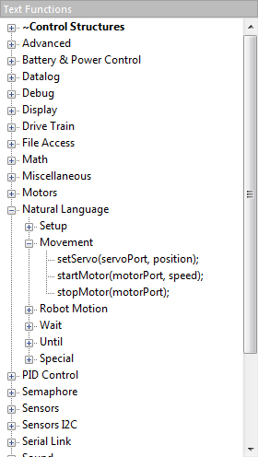
Movement
Commands that allow control of individual motors or servos

Slide 27
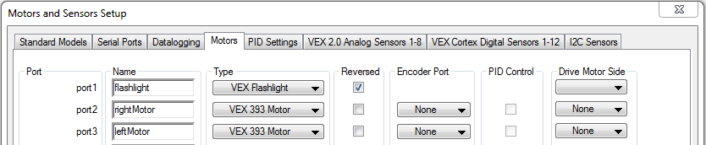
Motor Reversal
Reversing motor polarity
Check Reverse in Motors and Setup
Change speed + / - in program
startMotor(rightMotor, 63);
startMotor(rightMotor, -63);

Slide 28
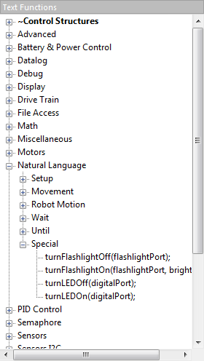
Special
Commands that control unique VEX® Hardware: LEDs and Flashlights

Slide 29
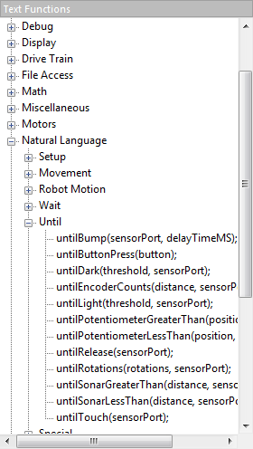
Until
Commands that allow behaviors to be created for the robot to perform until an event occurs such as:
Button Press
Encoder Count Reached

Slide 30
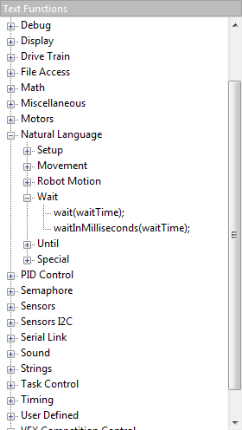
Wait
Commands that wait for an amount of time measured in seconds or milliseconds

Slide 31
Wait States Accuracy
Motor Speed is affected by battery power
Motors rotate faster when using a fully charged battery
Motors rotate slower when using a partially depleted battery
Device or robot does not move consistently as the battery power drains

Slide 32
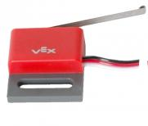
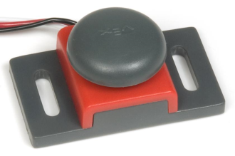

Touch Sensors
Digital sensor
Pressed = 1 and Released = 0
Caution
When sensor is pressed or released, its value may rapidly bounce between 0 and 1 briefly
A brief wait command can reduce the bounce effect

Slide 33
References
Carnegie Mellon Robotics Academy. (2017). ROBOTC. Retrieved from http://www.robotc.net

