Slide 1
Variables and Functions
ROBOTC Software
Principles of Engineering
© 2012 Project Lead The Way, Inc.

Slide 2

Variables
A variable is stored in a robot memory
Examples include whole numbers, decimal numbers, and words
Variable names use the same rules for naming a motor or sensor, including capitalization, spelling, and availability
Variables can improve the readability and expandability of your programs

Slide 3

Variable Creation
Declare a variable by stating the type and a name once before task main:
Type of data
integer
float
Name of variable
Starts with letter
Letters, numbers, and underscores are allowed
Cannot be a reserved word
Notes:
The name of a variable should be descriptive and should make sense to a human. When using multiple words, most programmers start with lowercase and then capitalize the first letter of each additional word. This is affectionately known as “drinking camel” notation: first letter lowercase is the head down drinking, then the later uppercase letters are the humps. Example:
numberOfWords = 3;

Slide 4
Variable Types
Data Type | Description | Example | Code
Integer | Positive and negative whole numbers, as well as zero | -35, -1, 0, 33, 100 | int
Floating Point Number | Numeric values with decimal points (even if the decimal part is zero) | -.123, 0.56, 3.0, 1000.07 | float
Boolean | True or false – Useful for expressing the outcomes of comparisons | true, false | bool
Character | Individual characters, placed in single quotes. Not useful with POE kits. | ‘L’, ‘f’, ‘8’ | char
String | Strings of characters, such as words and sentences placed in double quotes. Not useful with POE kits. | “Hello World!”, “asdf” | string

Slide 5
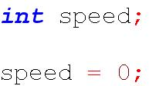

Variable Creation
Initialize a variable by stating an initial value
Declare and initialize are typically combined into a single statement

Slide 6
Variable Usage
The value of a variable can be referenced by using the variable name in place of the value
Value of a variable is only referenced when a line with a variable is executed
In the example above, the motor speed is set when the line is executed and the motor does not change automatically as the variable changes
Notes:
When this command executes, the leftMotor’s speed will be set to the opposite of the value of the variable speed.
Note the asterisk is used as multiplication operation.

Slide 7
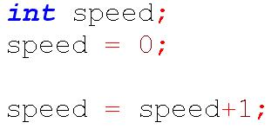
Assigning a Value to a Variable
An assignment operator is a single equal sign
The statement right of the equal sign is evaluated, and then the value is assigned to the variable on the left side
This is not the equality from algebra!
Declaration
Initialization
Assignment
Assignment
Notes:
speed=speed+1 has “no solution” in algebra. The algebra equal sign is most similar to the conditional ==, but in algebra it is taken as a claim that it is true instead of a question asking whether it is true.

Slide 8


Assigning a Value to a Variable
The left side of the assignment operator must be a variable name
Correct:
Incorrect:

Slide 9
Variable Applications
Variables can be used for most programs Examples:
Repeat a code 5 times
Count button presses by a user
Remember if a user EVER pushed a button
Remember a maximum value
Debug a program by remembering which branch of code has been executed

Slide 10
Variable Application #1: Loop n times
Task description: Start and stop a motor 5 times.
Instead of writing the same code multiple times, use a variable to remember how many times the code was executed.

Slide 11
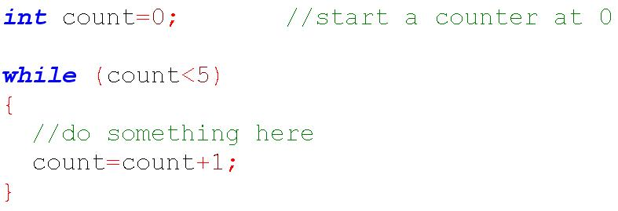
Variable Application #1: Loop n times
Increment count
This loop will run five times where the variable count changes as described by the following sequence: 0,1,2,3,4.
Notes:
The “Do something here” comment can be replaced by code that you want to run 5 times.
An assignment that increments is so commonly used that there is a shorthand way to write it:
count=count+increment;
is the same as
count+=increment;

Slide 12
Variable Application #2: Count the user’s actions
Task description: Count the number of times a user does something.
Example: How many times did a user press the “increase volume” button on a remote control?
Use a variable to remember how many times a user performed that action.

Slide 13
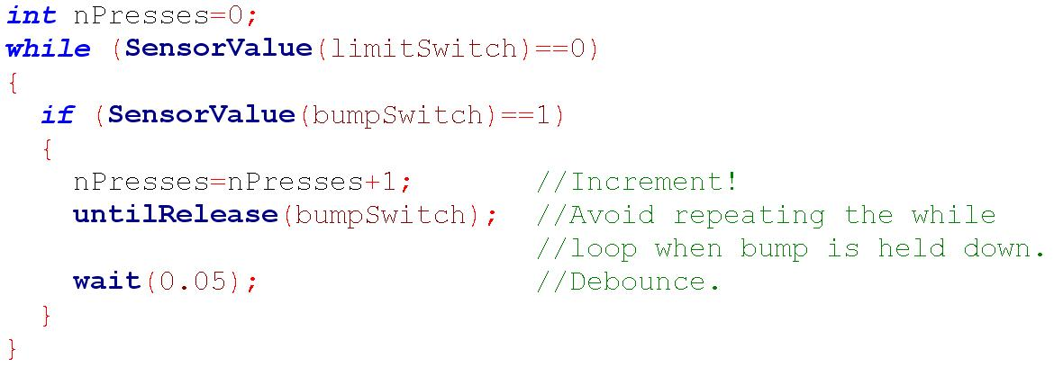
Variable Application #2: Count the user’s actions
The variable “nPresses” remembers how many times a bump switch was pressed before a limit switch was pressed.
Notes:
If the untilRelease is left out, nPresses will increment by 1 every 0.050 seconds. A typical quick press of the bumpSwitch might last 0.400 seconds!
If the wait(0.05) is left out, nPresses might increment several times when the button is released. This is because “releasing” the bump switch actually makes it bounce back and forth between 1 and 0 several times as microscopic sparks jump across the small air gap as the button is first released.

Slide 14
Variable Application #3: Set a flag
Task description: Observe a user for 5 seconds and remember whether a switch was EVER pressed, even if only briefly.
Use a variable to remember whether the event has happened yet. This is called a flag. Once a flag is thrown, it stays thrown until cleared.

Slide 15
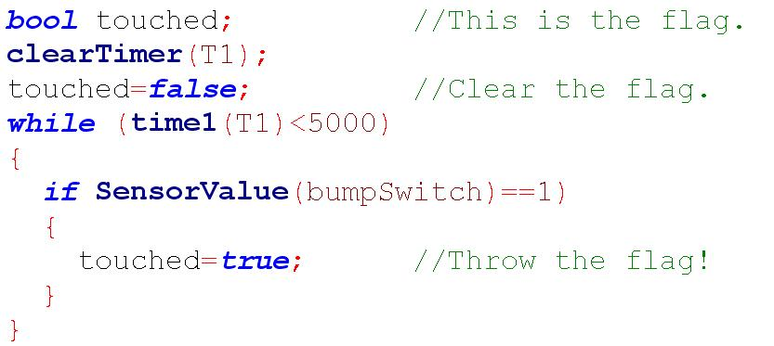
Variable Application #3: Set a flag
The variable touched remembers if a bump switch was EVER pushed.
After executing this code, touched will be true, even if bump was pressed and released.
Notes:
A flag is “raised” (i.e., set to true) if a condition is *ever* met during a certain time period, even if it was *usually* not met.
This snippet of code might be useful in a material sorter if the machine is checking for conductivity as a marble rolls by. Two 24- or 26-gauge wires, connected to where the black and white wires normally go in a digital input, can make a “conductivity sensor”.

Slide 16
Variable Application #4: Remember a maximum value
Task description: Observe a sensor for 5 seconds and remember the highest value.
Use a variable to remember a highest value that occurred.
Notes:
This might be used with a scale as a truck drives over the scale. The heaviest value was when the entire truck was on the scale.
It might also be used with a light sensor as an opaque object passes in front of a light. The dimmest value was when the object was blocking the light.

Slide 17
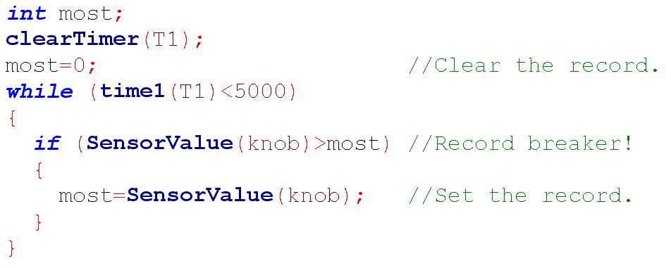
Variable Application #4: Remember a maximum value
Remember the new max!
Similar to a flag, but a variable remembers an int instead of a bool.
Notes:
This snippet of code might be useful to remember the darkest value of a light sensor as an object passes in front of it.

Slide 18
Variable Application #4: Remember what was executed
Run-time errors can be hard to determine without knowing which parts of a program were executed.
Slowing down a program with the step debugger is typically impractical.
Use a variable to remember and report which parts of a program were executed.

Slide 19
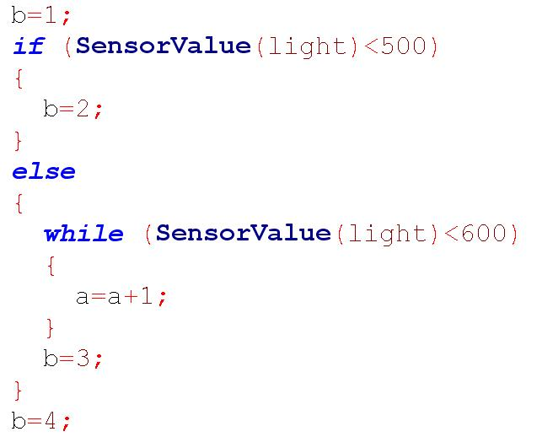
Variable Application #5: Debug a program
Remembers the most recent code
Counts the # of times loop was executed
Notes:
By opening the “variables” tab of the debugger windows, your program can run. The value of “a” will indicate where the program most recently set the value of “a”.

Slide 20
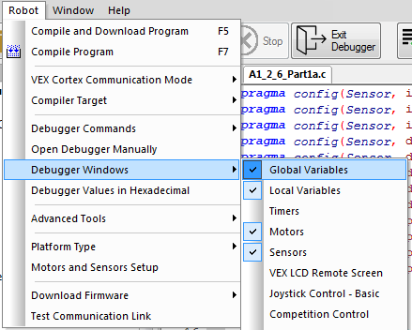
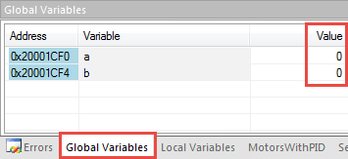
Variable Application #5: Debug a program
Activate the Global Variables tab in the debug window.
Values of variables are reported here as a program runs
Notes:
By opening the “variables” tab of the debugger windows, your program can run and the value of “a” will indicate where the program most recently set the value of “a”.

Slide 21
Global vs. Local Variables
Variables are either of a “global” or “local” scope
Global variable
Can be read or changed from any task or function in a code
Value can be seen or read globally

Slide 22
Global vs. Local Variables
Variables are either of a “global” or “local” scope
Local variable
Belongs only to the task or function in which it was created
Value can only be read or changed from within that task or function
Value can only be seen/read locally
Generally the type of variable you’ll want to use, local to “main”

Slide 23
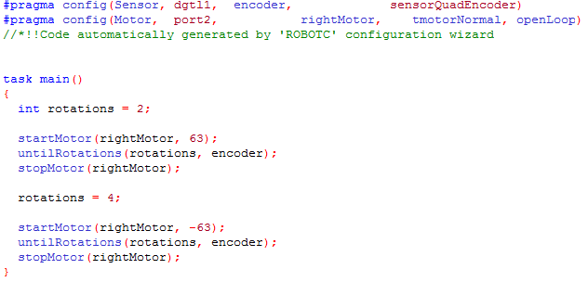
Creating Local Variables (preferred)
Create a local variable by declaring it within the task main curly braces
The value of a variable can only be changed within its task or function

Slide 24
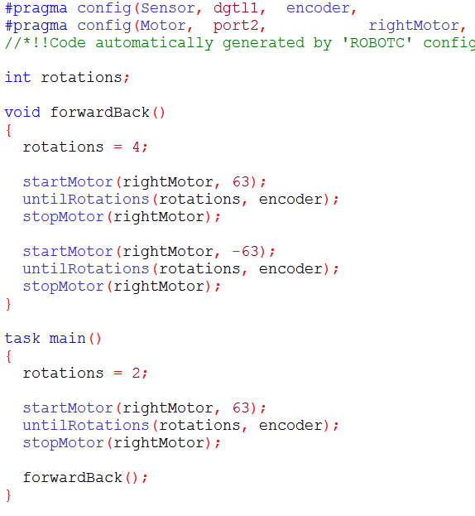
Creating Global Variables
Create a global variable by declaring it after a pragma statement and before task main or any function declarations
This will allow a variable to be changed by any task or function within a program

Slide 25
Functions
Functions
Group together several lines of code
Referenced many times in task main or in other functions
Creating Functions
Example: LED is on if bumper is pressed, off if released
Function header (name of function)
Function definition (code in the function)
Function call (where function code will run)

Slide 26
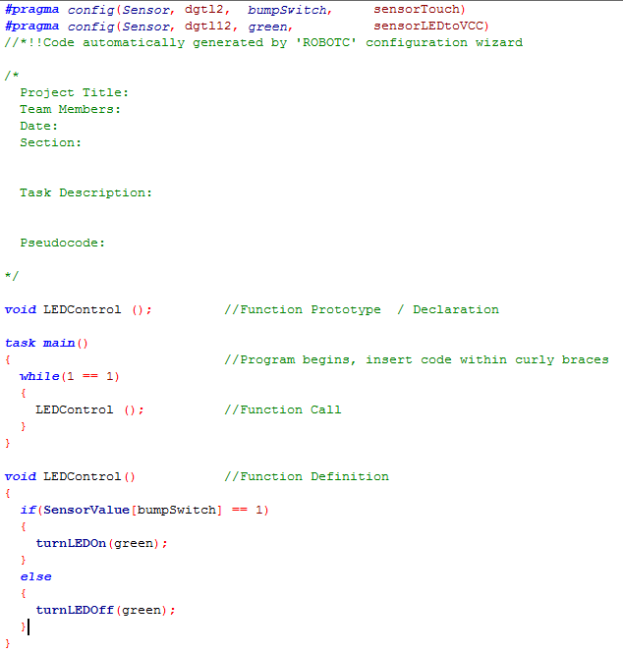
Sample Function “LEDControl()”

Slide 27
Function Declaration
Function declarations (or prototypes) declare that a function exists and indicates its name
Function declarations between #pragma statements and task main
Function declaration optional if function definition is above task main

Slide 28
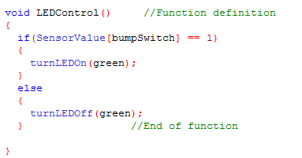
Function Definition
Function definitions define the code that belongs to the function

Slide 29
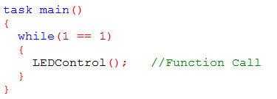
Function Call
Call and run code from function
Placed in task main or other functions

Slide 30
References
Carnegie Mellon Robotics Academy. (2017). ROBOTC. Retrieved from http://www.robotc.net

