Slide 1
While Loops
and
If-Else Structures
ROBOTC Software
Principles Of Engineering
© 2012 Project Lead The Way, Inc.

Slide 2

While loops
While loop is a structure within ROBOTC
Allows a section of code to be repeated as long as a certain condition remains true
Three main parts to every while loop
The word “while”
The condition
Commands to be repeated

Slide 3

1. The word while
Every while loop begins with the keyword while

Slide 4
2. The condition
Condition controls how long or how many times a while loop repeats
When condition is true, the while loop repeats
When condition is false, the while loop ends and the remainder of the program executes
Condition is checked once every time the loop repeats just before the commands between curly braces run

Slide 5
3. Commands to be repeated
Commands between curly braces will repeat while condition is true
Program checks at the beginning of each pass through the loop

Slide 6
Boolean logic
Program decisions are always based on questions
Only two possible answers
yes or no
true or false
Statements that can be only true or false are called Boolean statements
Their true-or-false value is called a truth value.

Slide 7
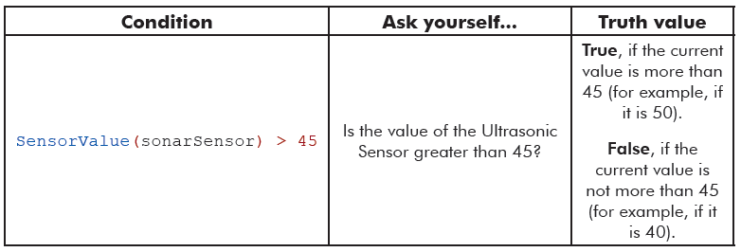
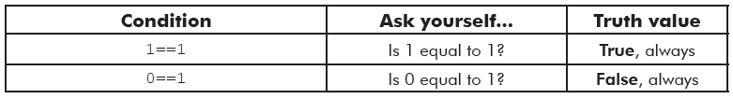
Boolean logic

Slide 8
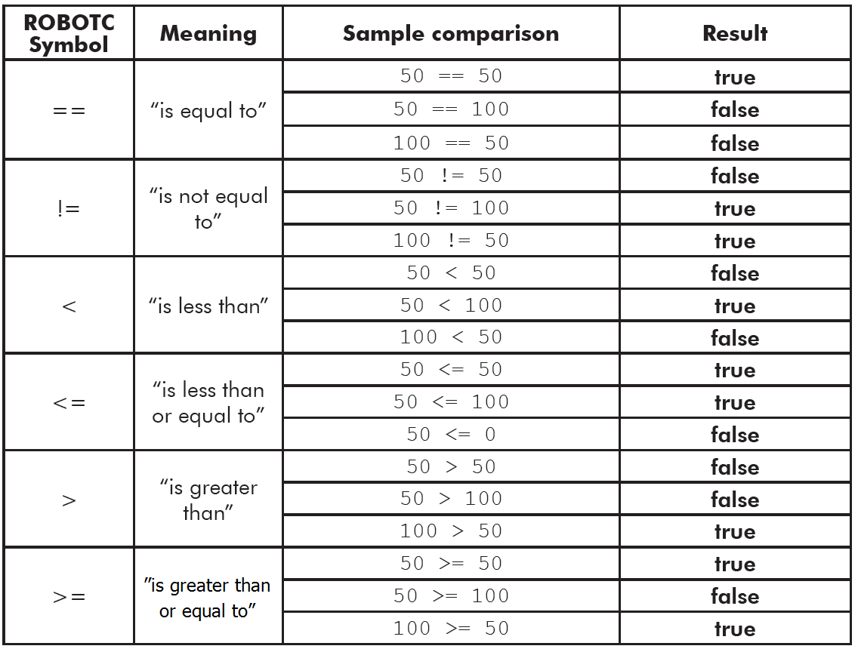
Boolean logic

Slide 9
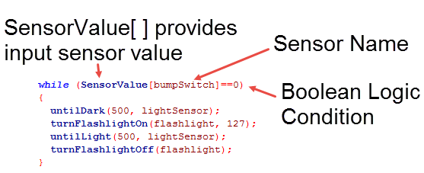
Writing a condition: Example
While the bump switch is not pressed:
wait until it’s dark, then turn on light;
wait until it’s light, then turn off light

Slide 10
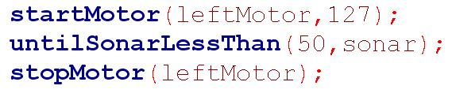
While loop: More flexible than an until statement
In this code a motor runs until an object is within 50 cm.
The program can’t respond to an emergency shutoff switch.
The program can’t control other outputs in response to other inputs.
Program waits here until an object is near

Slide 11
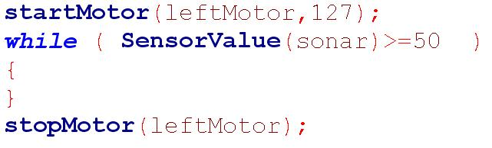
While loop: More flexible than an until statement
A while loop can do the same thing as the until statement.
Example code using until statement:
Program waits here until an object is near
While loop can do the same thing:
Program loops here until an object is near

Slide 12
While loop: More flexible than an until statement
Other conditions can be added to the while condition, e.g., an emergency shutoff.
Other code can be executed in the while loop.
Can expand the condition
Can control other outputs inside this bracket
Notes:
Later, in slide #22, we’ll see how to make the “and” from the && operator.

Slide 13
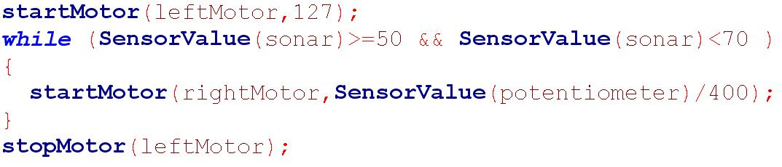
While loop: More flexible than an until statement
Example equivalent to until:
Can expand the condition
Can control other outputs inside this bracket
Example using this flexibility:
&& means “AND”
range from 0 to 10
Notes:
In the top example, the leftMotor starts and then continues until 50<=sonar.
In the bottom example, the leftMotor starts and continues until 50<=sonar<70. Meanwhile, the potentiometer controls the rightMotor speed.
Note: Potentiometer ranges from 0 to 4095, so dividing by 400 creates a number within the range required for the motor speed.
Note: After the loop exits, the rightMotor will continue running at its last assigned speed until reassigned or until the program ends.
Note: Compound inequalities are correct math language, but not correct RobotC: 50<SensorValue(sonar)<70 is not an acceptable syntax for a condition. Use the &&.

Slide 14
Timers
Loop control
Where would the wait statement go if we wanted the loop to repeat for a controlled amount of time?
Nowhere! We need something else.
Solution: Timers
Internal stopwatches (4 available)
Like encoders, timers should be cleared before they are used.
Be careful: Don’t clear a timer in a timed loop.
Notes:
Clearing timers within a loop may continually reset the timers, which may create an infinite loop.

Slide 15
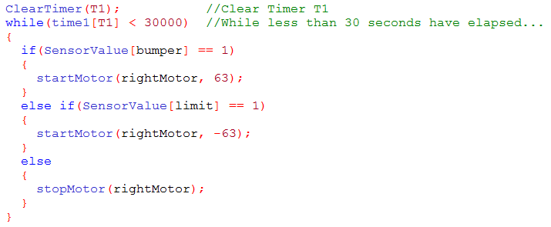
Timers
Timer T1 is used as the condition for the while loop, which will run for 30 seconds.

Slide 16

If statements
If statement in the program is evaluated by condition contained in parentheses
If condition is true, commands between braces are run
If condition is false, those commands are ignored
Very similar to how a while loop works, but does not repeat the code

Slide 17
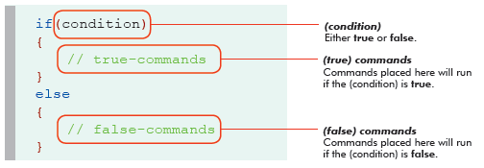
If-else statements
If-else statement is an expansion of if statement
If checks condition and runs appropriate commands when it evaluates to true
Else allows code to run when condition is false
Either if or else branch is always run once

Slide 18
Multiple if-else statements
Be careful when using two separate if-else statements, particularly if both are used to control the same mechanism
One branch of each if-else statement is always run so that you may create a scenario where the two statements ‘fight’ one another

Slide 19
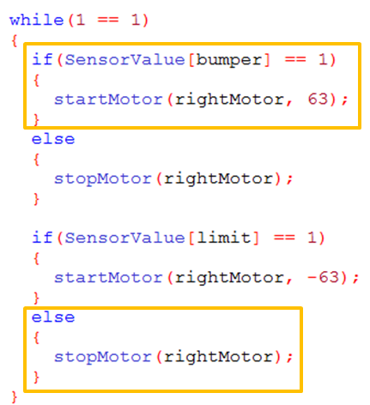
Multiple if-else statements
In this example, if one of the touch sensors is pressed, the rightMotor will be turned on in one if-else statement and immediately turned off in the other.

Slide 20
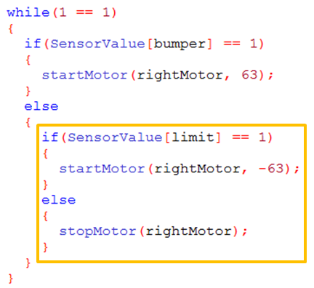
Multiple if-else statements
This can be corrected by embedding the second if-else within the else branch of the first if-else. The second condition is only checked if the first condition is false.

Slide 21
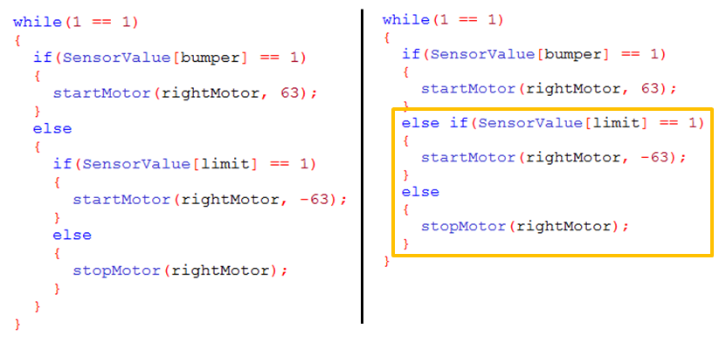
Nested if-else statements: Else if
An else {if else} statement can also be represented as an else if - else

Slide 22
Using a range of values in a condition
Two strategies will work:
Boolean logic
Nested if-else statements
Example:
Task: Control motor with potentiometer
Potentiometer Value | Motor Speed
0-500 | 0
501-1000 | 63
1001-4095 | 127

Slide 23
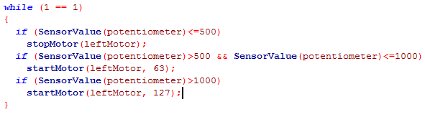
Using a range of values in a condition
Strategy #1: Boolean logic
Potentiometer Value | Motor Speed
0-500 | 0
501-1000 | 63
1001-4095 | 127
Boolean operator | ROBOTC symbol
AND | &&
OR | ||
True only if the sensor value is more than 500 AND less than 1000
.
Notes:
The AND symbol is a double ampersand, found as the “uppercase” version of the 7 on most keyboards.
The OR symbol is typed using two of the “pipe” characters in a row. The “pipe” character can be found on most keyboards above the return/enter key, as the “uppercase” version of the backslash.
Note: Since the potentiometer (nicknamed “knob” here using sensor and motor setup) has to be between 0 and 4095, there was no need to use && in the first and third if statements.

Slide 24
Using a range of values in a condition
Strategy #1: Boolean logic
In this example, this strategy wastes time and processor power. The next strategy is better.
Four comparisons waste time here each loop
Notes:
The AND symbol is a double ampersand, found as the “uppercase” version of the 7 on most keyboards.
The OR symbol is typed using two of the “pipe” characters in a row. The “pipe” character can be found on most keyboards above the return/enter key, as the “uppercase” version of the backslash.
Note: Since the potentiometer (nicknamed “knob” here using sensor and motor setup) has to be between 0 and 4095, there was no need to use a && in the first and third if statements.

Slide 25
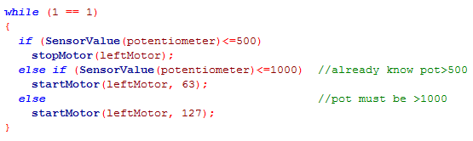
Using a range of values in a condition
Strategy #2: Nested if-else
preferable in this example.
In this case the false value
of the first condition can be used again by nesting a 2nd if statement inside the first else.
Potentiometer Value | Motor Speed
0-500 | 0
501-1000 | 63
1001-4095 | 127
Notes:
The AND symbol is a double ampersand, found as the “uppercase” version of the 7 on most keyboards.
The OR symbol is typed using two of the “pipe” characters in a row. The “pipe” character can be found on most keyboards above the return/enter key, as the “uppercase” version of the backslash.
Note: Since the potentiometer (nicknamed “knob” here using sensor and motor setup) has to be between 0 and 4095, there was no need to use && in the first and third if statements.

Slide 26
References
Carnegie Mellon Robotics Academy. (2017). ROBOTC. Retrieved from http://www.robotc.net

