Slide 1
Introduction to the
VEX® Robotics Platform and ROBOTC Software
Principles of Engineering
© 2012 Project Lead The Way, Inc.

Slide 2
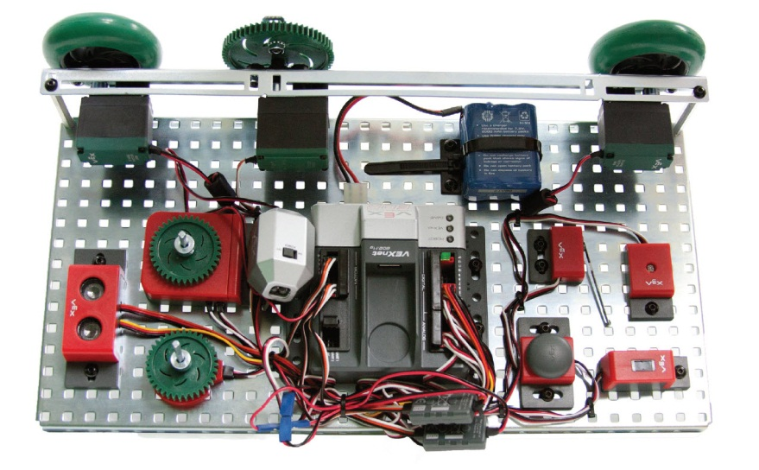
VEX® Robotics Platform: Testbed for Learning Programming

Slide 3
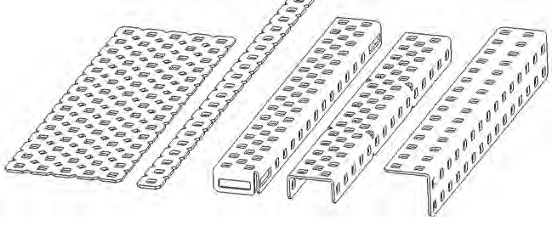
VEX® Structure Subsystem
VEX® Structure Subsystem forms a robot base
Contains square holes on a standardized ½ in. grid
Allows VEX® components to be assembled in various configurations
Notes:
This is a very brief overview of the VEX robotics platform. Refer to the Inventor’s Guide shown in the student resources for more details.

Slide 4
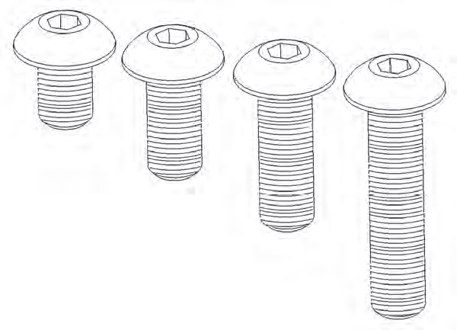
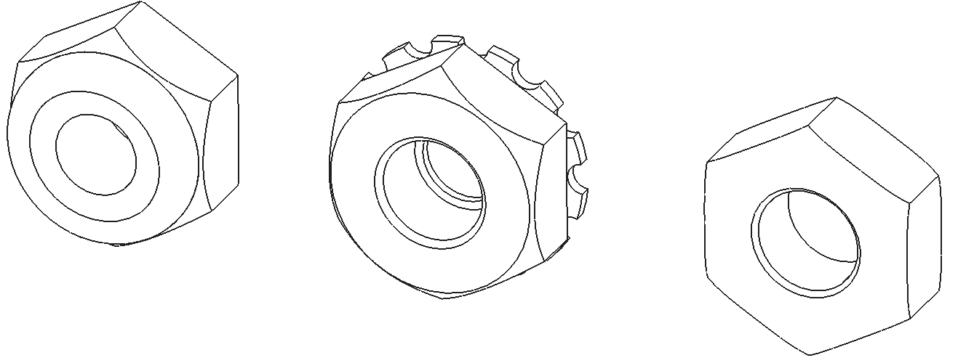
VEX® Structure Subsystem
Metal components directly attached using 8-32 screws and nuts
Nylock nut has a plastic insert to prevent unscrewing
KEPS nut has a ring of “teeth” on one side to grip the piece being installed
Regular nut has no locking feature
Nylock
Nut
KEPS
Nut
Regular
Nut
8-32 screws

Slide 5
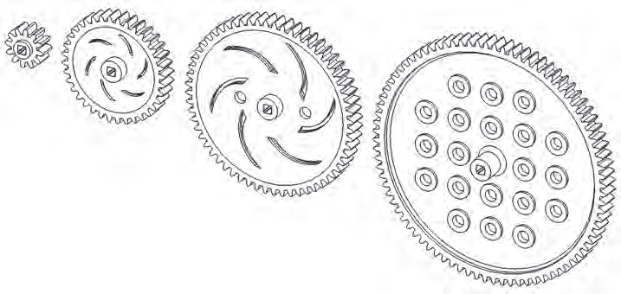
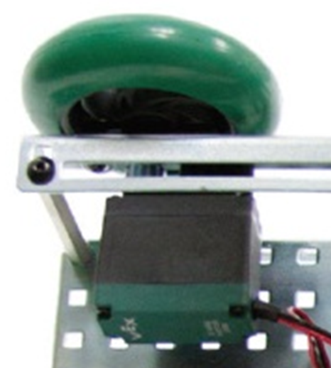
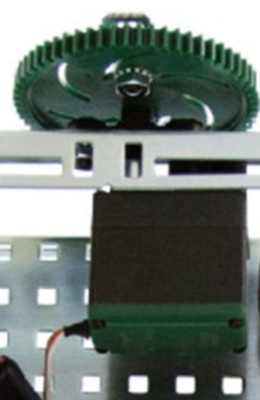
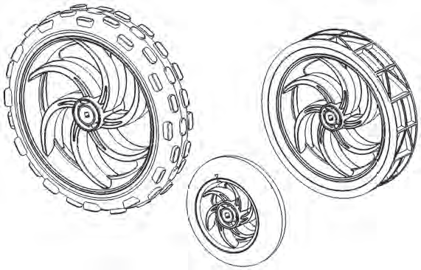
VEX® Motion Subsystem
Components which make a robot move
Gear
Wheel
Motor
Servo
Gears
Motor
Servo
Wheels

Slide 6
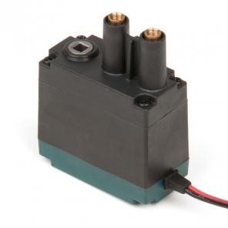
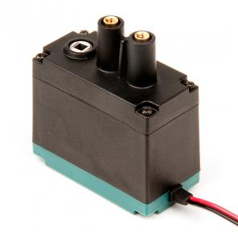
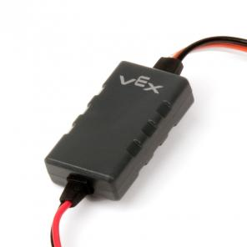
VEX® Motion Subsystem – Motors
2-wire motor 269 and 2-wire motor 393
Two methods to connect to Cortex
Motor ports 1 and 10
Motor port 2-9 using Motor Controller 29
2-Wire 269
2-Wire 393
Controller 29
Notes:
Two-wire motors connect directly to Cortex motor ports 1 and 10. A Motor Controller 29 is needed to connect to Cortex motor to port 2 – 9.

Slide 7
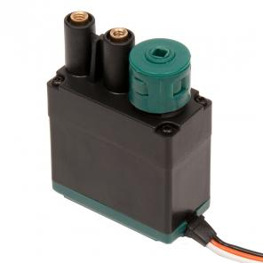
VEX® Motion Subsystem – Servos
Similar appearance to a motor
Operation is significantly different
Motor spins continuously at a power value
Servo rotates to a position between 0º to 120º degrees

Slide 8
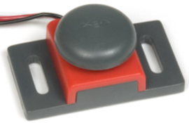
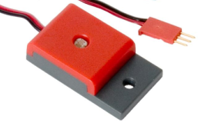
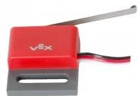
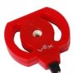
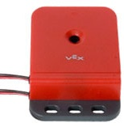
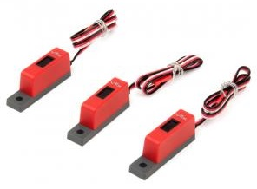
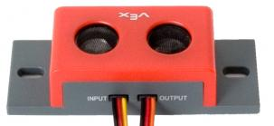
VEX® Sensors Subsystem
Provide inputs to sense the environment
Digital Sensors:
Bumper Switch
Limit Switch
Optical Shaft
Encoder
Ultrasonic Range
Finder
Analog Sensors:
Light Sensor
Potentiometer
Line Follower

Slide 9
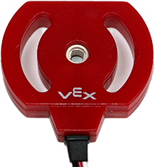
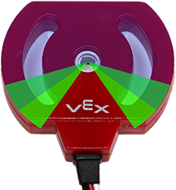
Potentiometers
How It Works
Analog sensor
Measures rotation of a shaft between 0 and ~265 degrees
Cortex returns values between 0 and ~4095
Caution
Internal mechanical stops prevent potentiometer from turning a full revolution
Excess torque against the internal mechanical stops will cause them to wear away
Notes:
Excess torque against the internal mechanical stops by hand or by a VEX motor will cause the stops to wear away. The potentiometer will continue to function but will have a range between the positions where mechanical stops were located. This is known as a dead zone. In this range, values are not sensed.

Slide 10
Optical Shaft Encoders
How It Works
Digital counting sensor
Inner shaft spins as the encoder measures angle of revolution
Capabilities and Resolution
360 counts per revolution
Counts up and down
The distance which a robot moves can be controlled by monitoring the angle at which the wheels attached to the shaft encoder spin

Slide 11
Ultrasonic
How It Works
Similar to how bats and submarines
sense distance
Digital sensor returns distance values between 0 and 255 inches or the equivalent centimeters or millimeters
Returns values of -1 or -2 if used outside of this range or if a return signal is not sensed

Slide 12
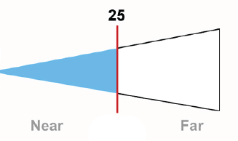
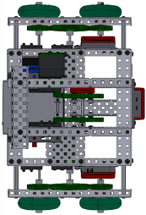
Ultrasonic Range Finder
Ultrasonic Range Finder detects objects in a “cone” field of view
Sensor detects object distance from the center of the sensor
Sensor distance calculations based on sound waves
Objects that may not be detectable include soft objects that absorb sound, sharp objects that deflect sound, etc.
Notes:
Do not use the ultrasonic sensor as the very first command of a program. Until the first sound echo returns to the sensor, it will have a value of -1. A simple delay at the beginning of your program solves this.

Slide 13
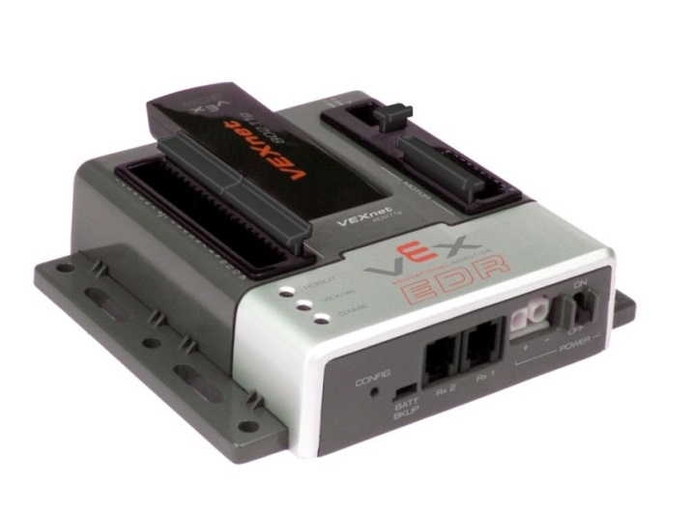
VEX® Cortex Microcontroller
VEX® Cortex (VEX® 2.0)
12 Digital Ports
Digital Ports
Bumper Switch
Limit Switch
Optical Shaft Encoder
Ultrasonic Range
Finder

Slide 14
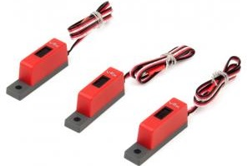
VEX® Cortex Microcontroller
Analog Ports
VEX® Cortex (VEX® 2.0)
12 Digital Ports
8 Analog Inputs
Light Sensor
Potentiometer
Line Follower

Slide 15
VEX® Cortex Microcontroller
VEXnet
Wireless Key
VEX® Cortex (VEX 2.0)
12 Digital Ports
8 Analog Inputs
VEXnet Connection
10 Motor Ports
Ports 1 and 10 are 2-wire DC ports
Ports 2 through 9 are 3-wire pulse width modulated (PWM) ports
Motor Ports
2 Wire 269
2 Wire 393
Controller 29
Notes:
VEXnet connection via USB cable or wireless key for remote control and wireless programming. VEX® hardware extends beyond the PLTW classroom kit to support hardware such as an external LCD screen and video camera.

Slide 16

Return to Activity

Slide 17
ROBOTC Software
ROBOTC developed specifically for classrooms and competitions
Complete programming solution for VEX® Cortex and several other popular robot platforms
Real-time debugger
Similar to industry-standard C Programming

Slide 18
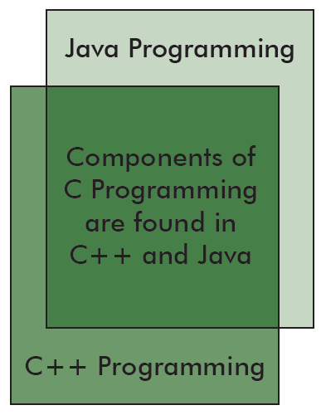
Industry Standard Coding
ROBOTC programming is a key component of industry-standard programming languages

Slide 19
Industry-Standard Skillsets
Java and C++, along with the Eclipse and Visual Studio IDEs, have been used to program:
Microsoft® Windows OS
Mac OSX
US Navy UAV Drones
Flight Simulators
DVD Player Firmware
Video Games
Microwaves
CAT Scanners
Smart Cars
Satellites
Cell Phones
Electronic Toys
ROBOTC

Slide 20
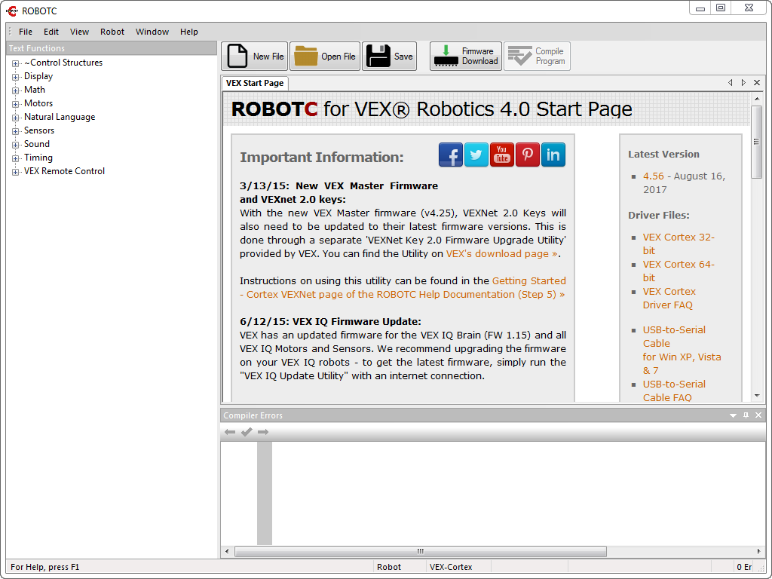
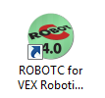
ROBOTC Start Page
Open ROBOTC for VEX Robotics
Display of the latest ROBOTC news, version of ROBOTC, and ROBOTC Resources

Slide 21
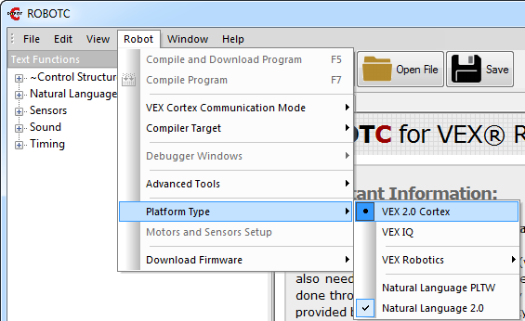
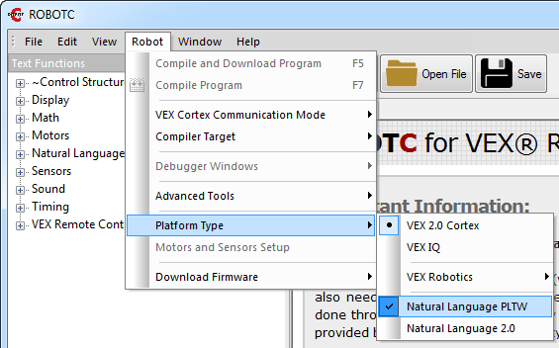
VEX Cortex and Natural Language
Change the Platform Type to VEX 2.0 Cortex
Change the Platform Type to Natural Language PLTW

Slide 22
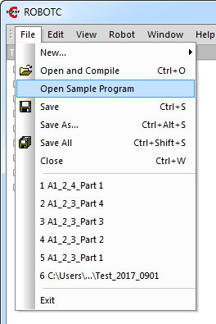
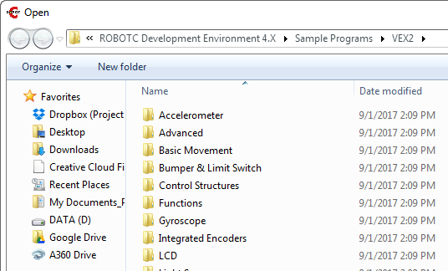
Sample Programs
Over 75 ROBOTC Sample programs, organized by robot behavior

Slide 23
Comments
Comments are used to make notes in code for the human programmers
Every sample program contains comments pertaining to robot configuration, ROBOTC commands, robot behavior, etc.
// Single line comment – All material after “//” is ignored by the ROBOTC compiler
/* Multi-line comment*/ – All material between the “/*” and “*/” symbol is ignored by the ROBOTC compiler

Slide 24
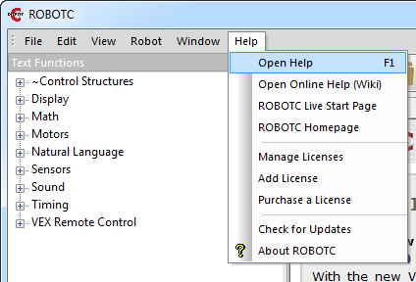
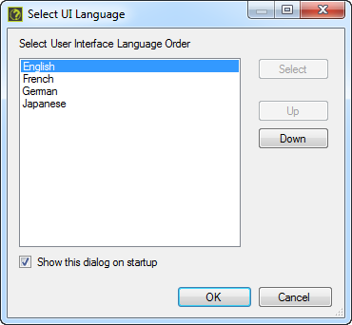
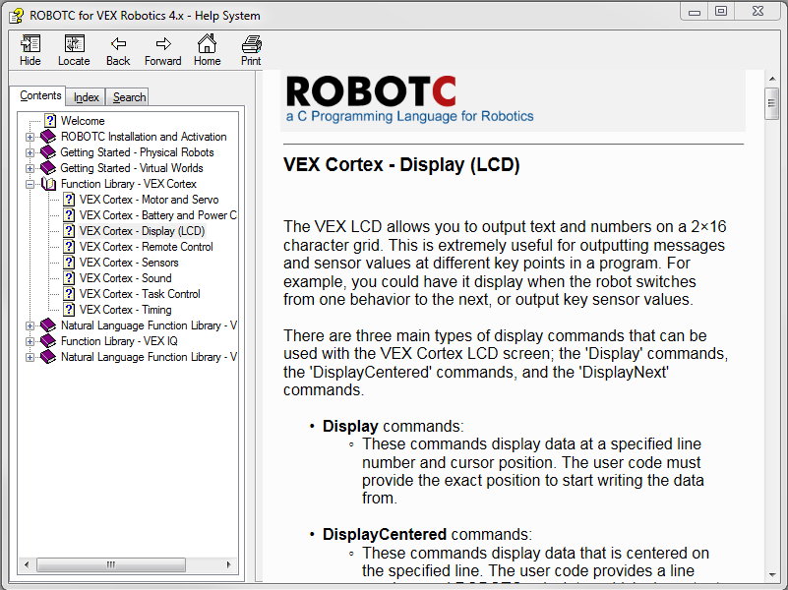
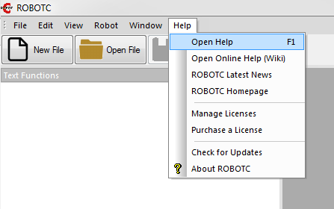
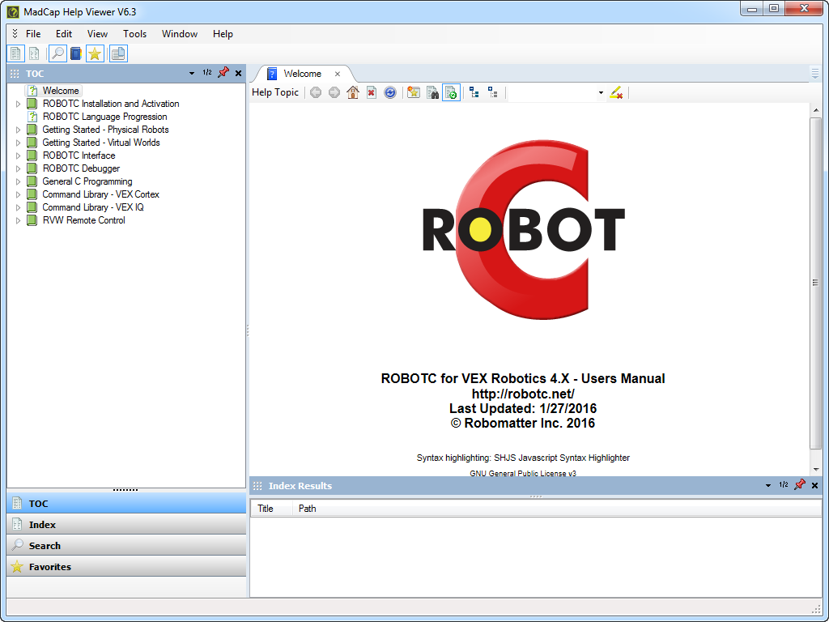
ROBOTC Help
In-depth explanations about ROBOTC installation, commands, debugger, etc.

Slide 25
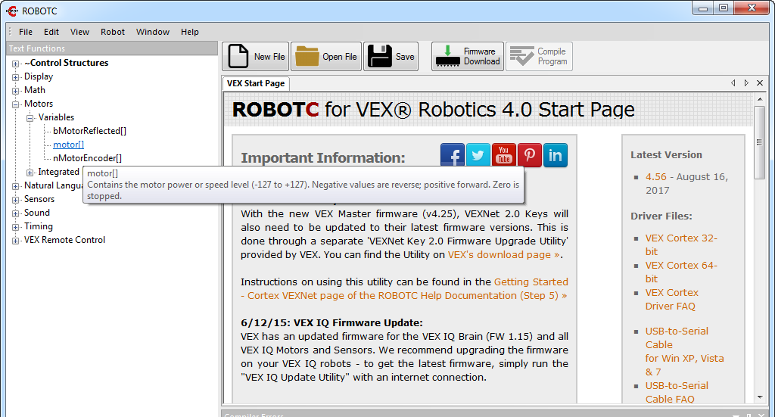
Text Function Library
Available functions are listed with a description
List of available functions will expand or shrink depending on the menu level

Slide 26
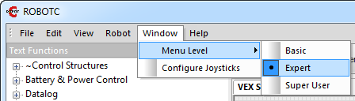
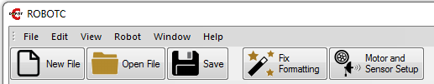
Menu Level
Customizes the ROBOTC interface and Text Function Library based on user’s experience level
Select File and then New or select the New File icon to begin creating a program

Slide 27
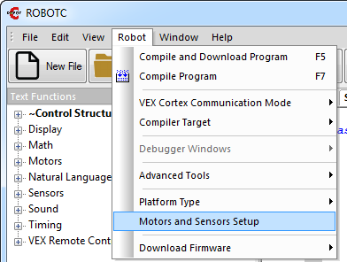
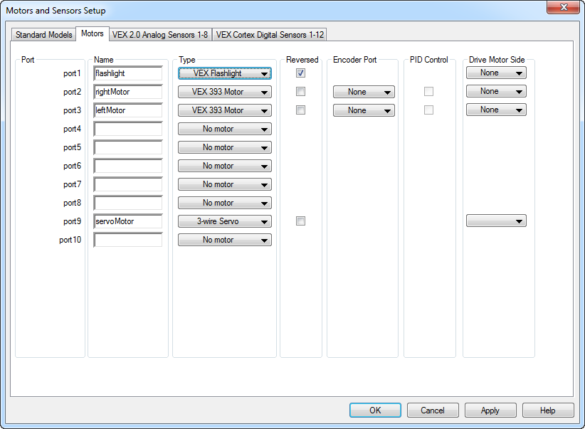
Motors and Sensor Setup
Open Motor and Sensors Setup and update to match the physical configuration
OR

Slide 28
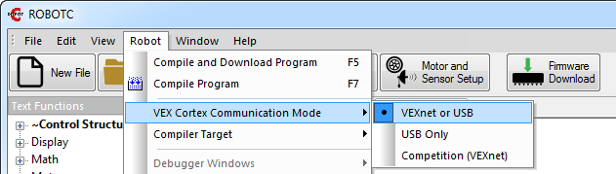
VEX® Cortex Download Method
Allows you to specify:
How programs are downloaded
Whether the Cortex looks for VEXnet connection when it starts up
The VEXnet or USB option will result in the Cortex looking for a VEXnet connection for up to10 seconds before running code

Slide 29
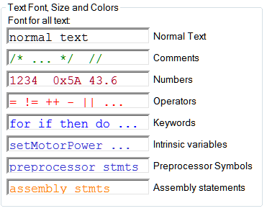
ROBOTC Color Coding
ROBOTC is color coded to distinguish elements of the program as shown

Slide 30
References
Carnegie Mellon Robotics Academy. (2017). ROBOTC. Retrieved from http://www.robotc.net
VEX Robotics. (2017). ROBOTC. Retrieved from http://www.vexrobotics.com

