Slide 1
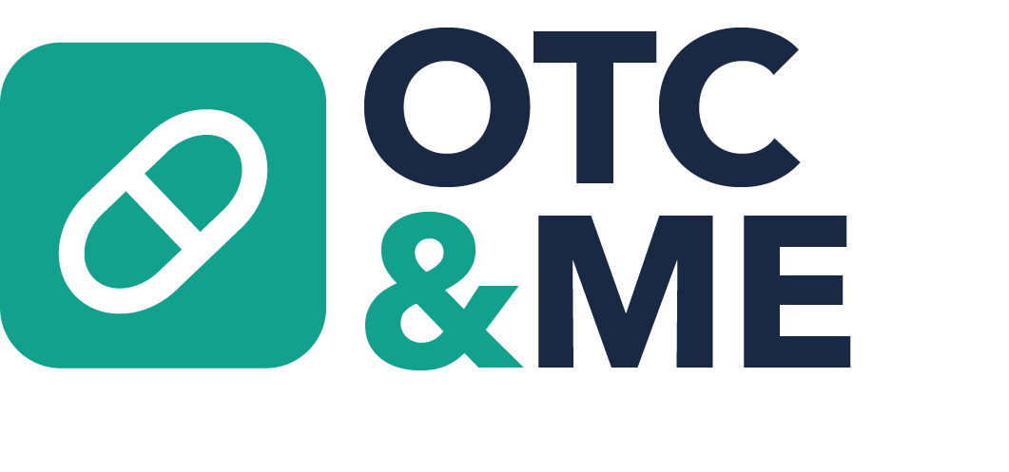
Personalized over-the-counter guidance for the people you care about most.
https://otc-me-connect.lovable.app

Slide 2
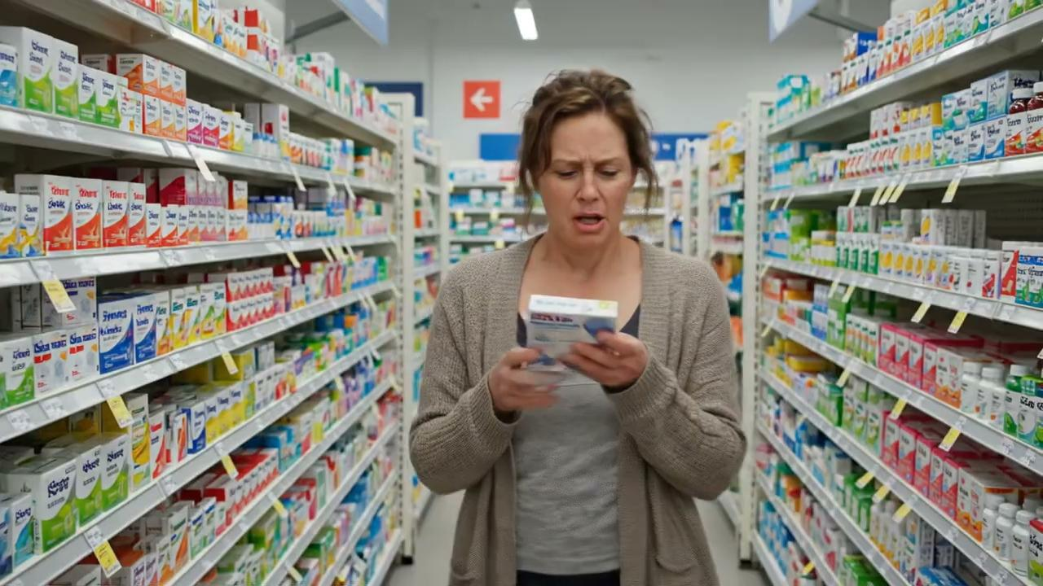
Made with ElevenLabs
Made with ElevenLabs

Slide 3
The Problem
Nearly 1 in 2 American adults live with one or more chronic conditions without OTC guidance
100,000+ ER visits each year are associated with OTC medication misuse, adverse reactions, and accidental pediatric exposures
Community pharmacists answer OTC medication questions ~32 times per week
Notes:
First bullet: yet most OTC labels offer no guidance on drug interactions or comorbidities, leaving patients to guess at the shelf
Women are the healthcare decision-makers for America's families. OTC medication choices remain confusing, fragmented, and potentially unsafe.
Bullet 1 source: This statistic is widely cited by the U.S. Department of Labor and the National Institutes of Health.
3 in 5 family caregivers are women and more than 53 million Americans provide care for loved ones.
Second bullet switch?? - Every year in the U.S., there are over 100,000 emergency department visits directly linked to over-the-counter (OTC) medication overdoses, reactions, and unsupervised pediatric ingestions.

Slide 4

The solution:
OTC&Me
OTC&Me helps people choose safer OTC medications by using the patient’s pharmacy profile, symptoms, age, life stage, medications, and health conditions to generate personalized recommendations.
Notes:
Empowering patients with personalized medication guidance to make safer, more confident healthcare decisions.

Slide 5
How OTC&Me works
Step 3
Step 2
Step 1
Recommend the right OTC option or escalate
Screen for safety risks
Start with the person, not the product
Notes:
1. Start with the person, not the product
Caregiver selects who they are shopping for: self, child, pregnant individual, older adult, or family member.
2. Screen for safety risks
OTC&Me checks age, pregnancy status, allergies, medical conditions, prescription medications, and contraindications.
3. Recommend the right OTC option
The tool suggests safe ingredients/products, flags products to avoid, and explains why in plain language.
4. Escalate only when needed
Routine questions are answered digitally; high-risk cases are routed to a pharmacist.

Slide 6
Demo

Slide 7
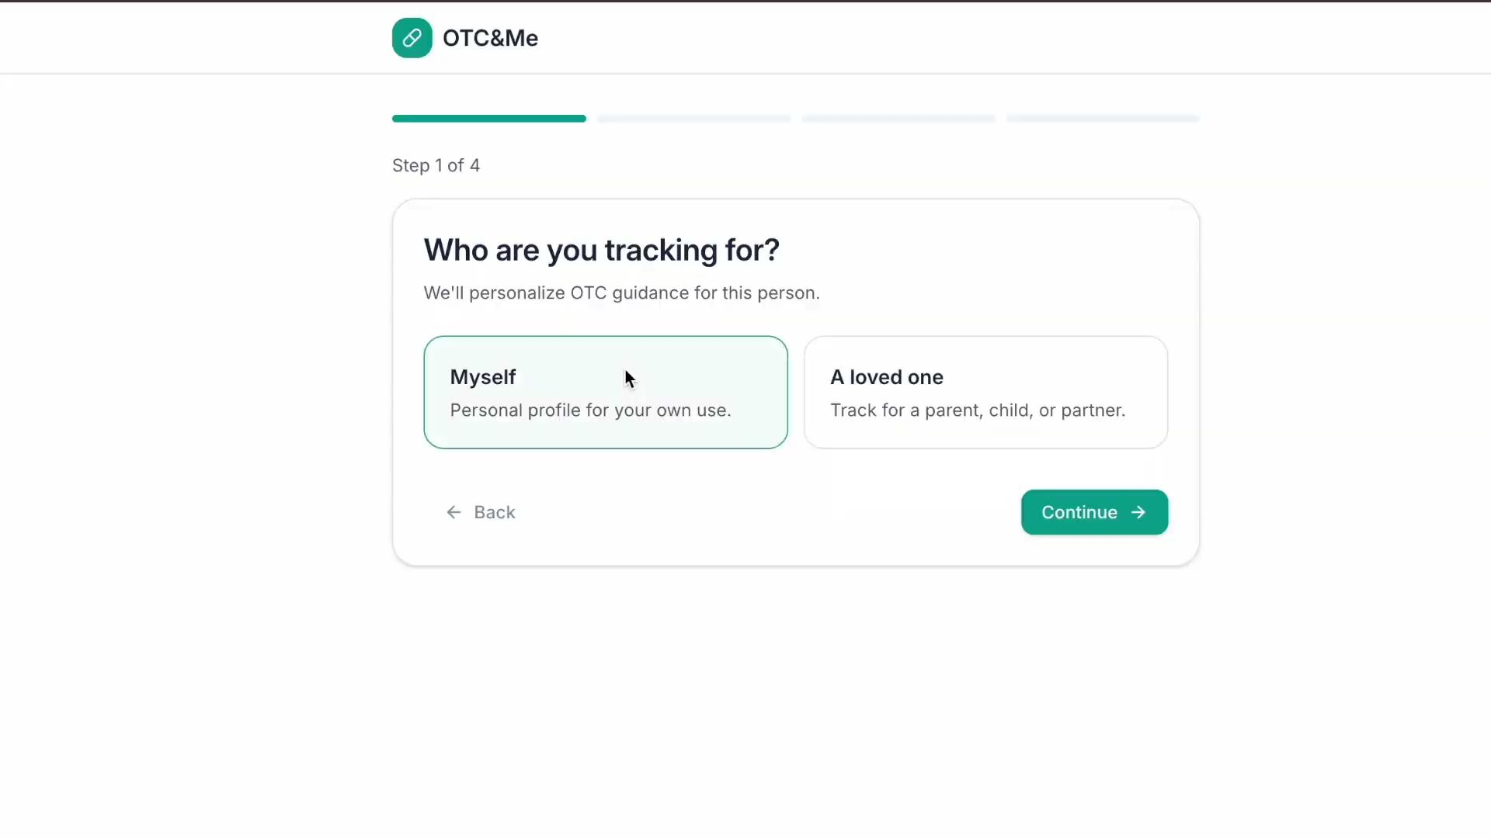

Slide 8
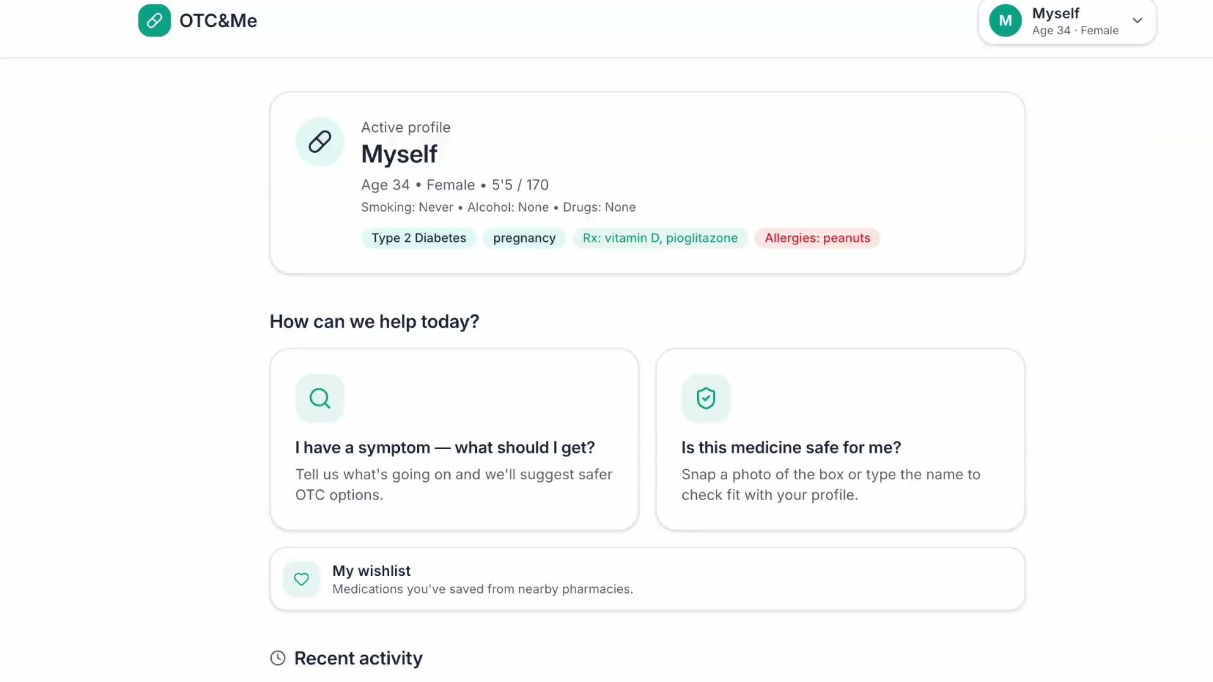

Slide 9
A Scalable SaaS Opportunity Across Retail Pharmacy
TAM: $170B in estimated annual front-store sales across ~68,000 U.S. retail pharmacies, representing the total retail revenue base that OTC&Me could ultimately influence.
SAM: $42.5B in estimated annual sales across the OTC and health-product categories initially supported by OTC&Me, assuming these categories represent approximately 25% of total front-store sales.
SOM: $5.6B in estimated addressable OTC-related sales through an initial CVS-scale national partnership, with a smaller paid pilot used to validate that we drive purchases before chain-wide expansion.
TAM: Total Addressable Market
SAM: Serviceable Available Market
SOM: Serviceable Obtainable Market
Notes:
OTC&Me is a B2B2C model — we partner with pharmacies and brands who pay for featured placement, while patients get a free, personalized tool that recommends the right medicine for their specific health profileOTC&Me is a B2B2C model — we partner with pharmacies and brands who pay for featured placement, while patients get a free, personalized tool that recommends the right medicine for their specific health profile

Slide 10
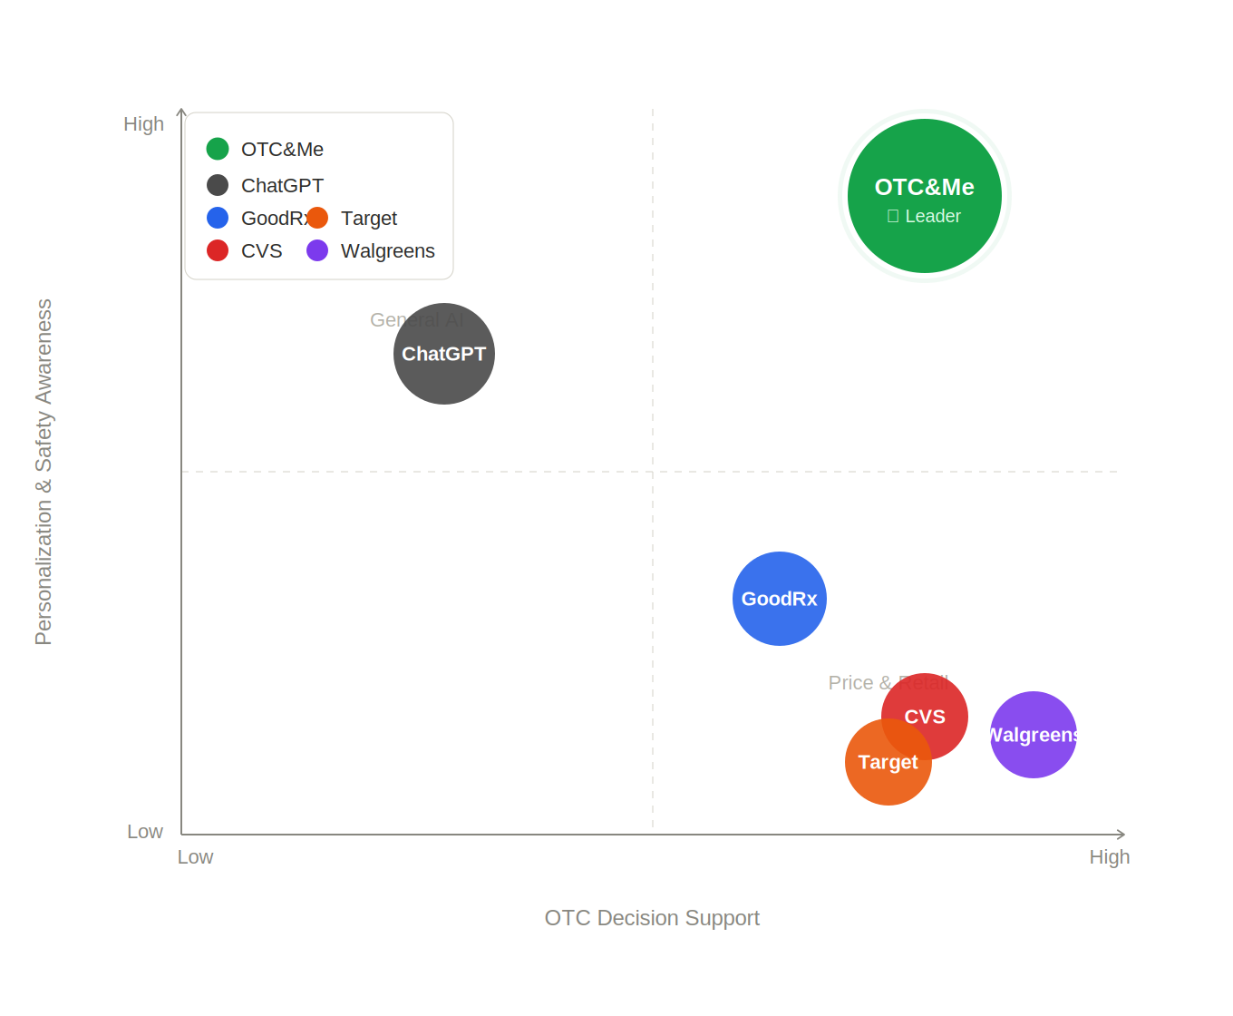
Notes:
CVS, Walgreens, and Target cluster together as retail-focused solutions that help users find products but offer limited personalization.
GoodRx provides pricing and medication information, offering moderate decision support but limited personalized guidance.
ChatGPT offers conversational AI, but lacks dedicated OTC-focused safety screening, pharmacy integration, and health profile management.
OTC&Me stands apart by integrating symptom conversations, personalized safety checks, medication scanning, family profiles, voice assistance, and pharmacy lookup into a single platform.
No direct competitor currently combines all of these capabilities, creating a differentiated position in the OTC healthcare market.

Slide 11
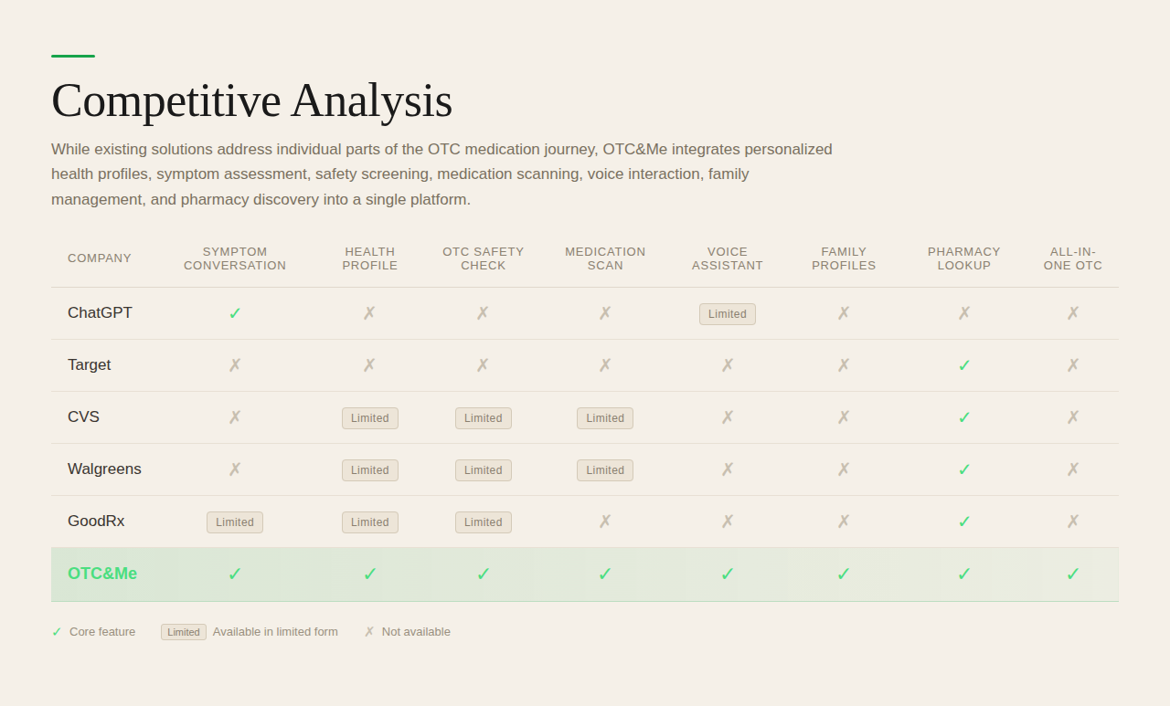

Slide 12
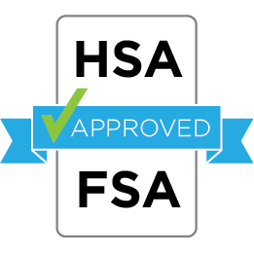


OTC&Me Future Endeavors
Integrated electronic health records
Time sensitive reminders to update health status (i.e. no longer pregnant)
HSA/FSA or insurance eligibility to cover OTCs

Slide 13
Personalized over-the-counter guidance for the people you care about most.
Questions?

Slide 14

Pharmacy Partnerships
Retail Chain Example
$22.5B estimated annual front-store sales
$5.6B conservatively assumed to be relevant to initial OTC&Me categories
A 0.25% conversion lift could generate approximately $14.1M in incremental annual sales
OTC&Me national enterprise license: $1M–$2.5M annually
Notes:
Phase 1: The retailer gets a measurable test without committing to a national rollout.

Slide 15
Business Model - Hybrid Enterprise SaaS
Component | Suggested Price
Setup, integration, and clinical configuration | $150K–$300K
Pilot platform license | $100K–$250K
Total pilot contract | $250K–$550K
Notes:
Phase 1: The retailer gets a measurable test without committing to a national rollout.

