Slide 1
Adversarial Search

Slide 2
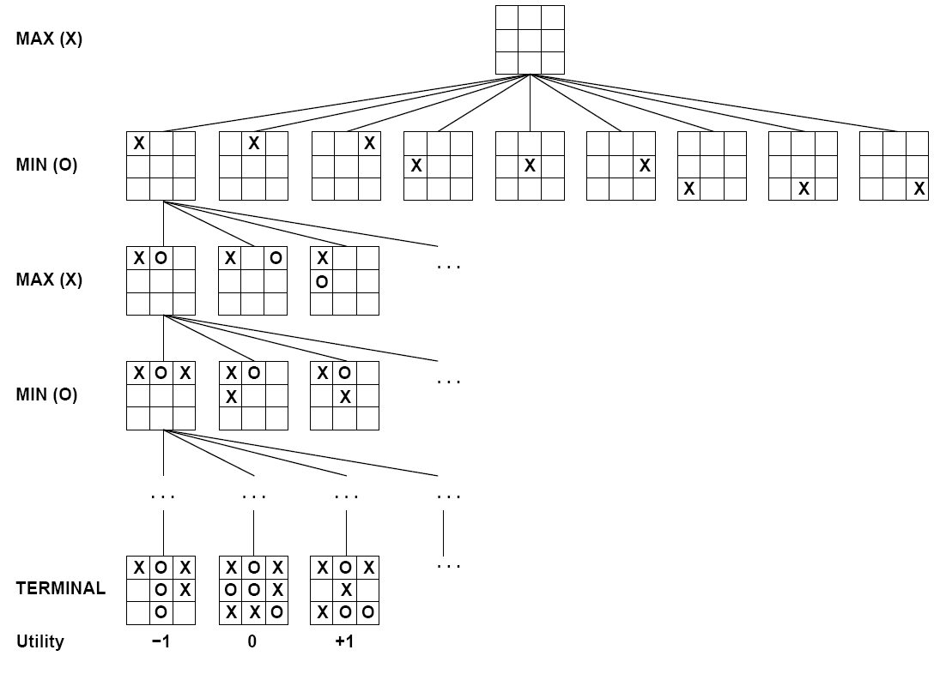
How is Tic Tac Toe different from maze search?
Multi-Agent, Adversarial, Zero Sum
Single Agent

Slide 3
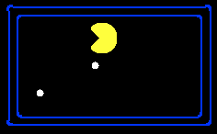
Value of a State
Non-Terminal States:
V(s) = max V(s’)
Value of a state: The best achievable outcome (utility) from that state
s’ ∈ successors(s)
8
2
0
…
2
6
…
4
6
Terminal States:
V(s) = known

Slide 4
Multi-Agent Applications
(Football)
Adversarial
Team: Collaborative
Competition: Adversarial
Collaborative Maze Solving

Slide 5
How could we model multi-agent collaborative problems?

Slide 6
How could we model multi-agent problems?
Simplest idea: each agent plans their own actions separately from others.

Slide 7
Many Single-Agent Trees
Choose the best action for each agent independently
Non-Terminal States:
V(s) = max V(s’)
s’ ∈ successors(s)
8
2
0
…
2
6
…
4
6
Notes:
10 points for eating dot; -1 for each time step

Slide 8

Idea 2: Joint State/Action Spaces
Combine the states and actions of the N agents
$$S_{0}=(S_{0}^{A},S_{0}^{B})$$

Slide 9

Idea 2: Joint State/Action Spaces
Combine the states and actions of the N agents
$$S_{K}=(S_{K}^{A},S_{K}^{B})$$

Slide 10
Idea 2: Joint State/Action Spaces
Search looks through all combinations of all agents’ states and actions
Think of one brain controlling many agents
$$S_{K}=(S_{K}^{A},S_{K}^{B})$$

Slide 11
Idea 2: Joint State/Action Spaces
Search looks through all combinations of all agents’ states and actions
Think of one brain controlling many agents

Slide 12
Idea 3: Alternate Searching One Agent at a Time
Search one agent’s actions from a state, search the next agent’s actions from those resulting states , etc…
Choose the best cascading combination of actions
Non-Terminal States:
V(s) = max V(s’)
Agent 1
s’ ∈ successors(s)
Agent 2
Agent 1

Slide 13
Types of Games
Deterministic or stochastic?
Perfect information (fully observable)?
One, two, or more players?
Turn-taking or simultaneous?
Zero sum?

Slide 14
Standard Games
Standard games are deterministic, observable, two-player, turn-taking, zero-sum
Game formulation:
Initial state: s₀
Players: Player(s) indicates whose move it is
Actions: Actions(s) for player on move
Transition model: Result(s,a)
Terminal test: Terminal-Test(s)
Terminal values: Utility(s,p) for player p
Or just Utility(s) for player making the decision at root

Slide 15
Zero-Sum Games
Zero-Sum Games
Agents have opposite utilities
Pure competition:
One maximizes, the other minimizes
General Games
Agents have independent utilities
Cooperation, indifference, competition, shifting alliances, and more are all possible

Slide 16
Tic-Tac-Toe Game Tree
Search one agent’s actions from a state, search the competitor’s actions from those resulting states , etc…
This is a zero-sum game,
the best action for X is the worst action for O
and vice versa

Slide 17


Tic-Tac-Toe Game Tree
Instead of taking the max utility at every level, alternate max and min

Slide 18
Tic-Tac-Toe Minimax
MAX nodes: under Agent’s control
V(s) = max V(s’)
s’ ∈ successors(s)
MIN nodes: under Opponent’s control
V(s) = min V(s’)
s’ ∈ successors(s)

Slide 19

Small Pacman Example
MAX nodes: under Agent’s control
V(s) = max V(s’)
MIN nodes: under Opponent’s control
V(s) = min V(s’)
s’ ∈ successors(s)
s’ ∈ successors(s)
-8
-8
-10
-8
-5
-10
+8
Terminal States:
V(s) = known

Slide 20
Minimax Example
3
3
2
2
3
12
8
2
4
6
14
5
2
Notes:
Add values by hand if on tablet, or add by animation steps

Slide 21
Minimax Implementation
function minimax-decision(s) returns action
return the action a in Actions(s) with the highest min-value(Result(s,a))
Result(s,a)→s’
function max-value(s) returns value
if Terminal-Test(s) then return Utility(s)
initialize v = -∞
for each a in Actions(s):
v = max(v, min-value(Successor))
return v
function min-value(s) returns value
if Terminal-Test(s) then return Utility(s)
initialize v = +∞
for each a in Actions(state):
v = min(v, max-value(Successor)
return v
V(s) = max V(s’)
V(s) = min V(s’)
s’ ∈ successors(s)
s’ ∈ successors(s)

Slide 22
What kind of search is Minimax Search?
BFS
DFS
UCS
A*

Slide 23
Minimax is Depth-First Search
MAX nodes: under Agent’s control
V(s) = max V(s’)
MIN nodes: under Opponent’s control
V(s) = min V(s’)
s’ ∈ successors(s)
s’ ∈ successors(s)
-8
-8
-10
-8
-5
-10
+8
Terminal States:
V(s) = known

Slide 24
Minimax Efficiency
How efficient is minimax?
Just like (exhaustive) DFS
Time: O(b^{m})
Space: O(bm)
Example: For chess, b ≈ 35, m ≈ 100
Exact solution is completely infeasible
Humans can’t do this either, so how do we play chess?

Slide 25



Generalized minimax
What if the game is not zero-sum, or has multiple players?
Generalization of minimax:
Terminals have utility tuples
Node values are also utility tuples
Each player maximizes its own component
Can give rise to cooperation and
competition dynamically…
8,8,1
8,8,1
7,7,2
0,0,7
8,8,1
7,7,2
0,0,8
1,1,6
0,0,7
9,9,0
8,8,1
9,9,0
7,7,2
0,0,8
0,0,7
Notes:
If both ghosts go the same way, pacman wins; if they go different ways, pacman loses

Slide 26
Resource Limits
Problem:
In realistic games, cannot search to leaves!
The minimax algorithm generates the entire game search space
Solution 1: Bounded lookahead
Search only to a preset depth limit
Use an evaluation function for non-terminal positions
Guarantee of optimal play is gone
Evaluation functions are widely employed in depth-limited minimax.
• where we treat non-terminal nodes located at our maximum solvable depth as terminal nodes.
• Assigning mock terminal utilities as determined by a carefully selected evaluation function.
4
max
-2
4
min
-1
-2
4
9
?
?
?
?

Slide 27
Evaluation Functions
Evaluation functions score non-terminals in depth-limited search
Ideal function: returns the actual minimax value of the position
In practice: typically weighted linear sum of features:
EVAL(s) = w₁ f₁(s) + w₂ f₂(s) + …. + w_{n} f_{n}(s)
E.g., w₁ = 9, f₁(s) = (num white queens – num black queens), etc.
Terminate search only in quiescent positions, i.e., no major
changes expected in feature values

Slide 28
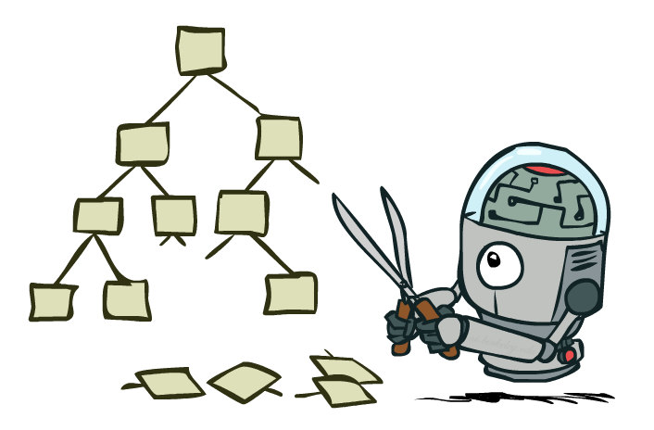
Solution 2: Game Tree Pruning

Slide 29
Intuition: prune the branches that can’t be chosen
3
3
2
2
3
12
8
2
4
6
14
5
2
Notes:
Add values by hand if on tablet, or add by animation steps

Slide 30

Alpha-Beta Pruning Example
α = best option so far from any
MAX node on this path
3
α =3
α =3
3
3
12
8
2
14
5
2
We can prune when: min node won’t be higher than 2, while parent max has seen something larger in another branch
The order of generation matters: more pruning
is possible if good moves come first
Notes:
Add values by hand if on tablet, or add by animation steps

Slide 31
Alpha-Beta Implementation
α: MAX’s best option on path to root
β: MIN’s best option on path to root
def max-value(state, α, β):
initialize v = -∞
for each successor of state:
v = max(v, value(successor, α, β))
if v ≥ β
return v
α = max(α, v)
return v
def min-value(state , α, β):
initialize v = +∞
for each successor of state:
v = min(v, value(successor, α, β))
if v ≤ α
return v
β = min(β, v)
return v
Notes:
Pick an order for two reasons: sequential processor and pruning

Slide 32
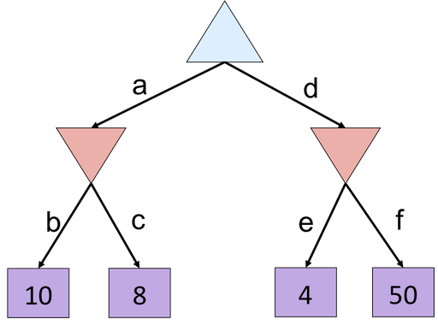
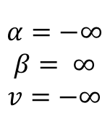
Alpha-Beta Small Example
def max-value(state, α, β):
initialize v = -∞
for each successor of state:
v = max(v, value(successor, α, β))
if v ≥ β
return v
α = max(α, v)
return v
$$α=−∞$$
$$β= ∞$$
$$v=−∞$$
def min-value(state , α, β):
initialize v = +∞
for each successor of state:
v = min(v, value(successor, α, β))
if v ≤ α
return v
β = min(β, v)
return v
Notes:
f is not evaluated

Slide 33
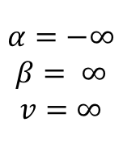
Alpha-Beta Small Example
def max-value(state, α, β):
initialize v = -∞
for each successor of state:
v = max(v, value(successor, α, β))
if v ≥ β
return v
α = max(α, v)
return v
$$α=−∞$$
$$β= ∞$$
$$v=−∞$$
$$α=−∞$$
$$β= ∞$$
$$v=∞$$
def min-value(state , α, β):
initialize v = +∞
for each successor of state:
v = min(v, value(successor, α, β))
if v ≤ α
return v
β = min(β, v)
return v
Notes:
f is not evaluated

Slide 34
Alpha-Beta Small Example
def max-value(state, α, β):
initialize v = -∞
for each successor of state:
v = max(v, value(successor, α, β))
if v ≥ β
return v
α = max(α, v)
return v
$$α=−∞$$
$$β= ∞$$
$$v=−∞$$
$$α=−∞$$
$$β= ∞$$
$$v=∞$$
def min-value(state , α, β):
initialize v = +∞
for each successor of state:
v = min(v, value(successor, α, β))
if v ≤ α
return v
β = min(β, v)
return v
Notes:
f is not evaluated

Slide 35
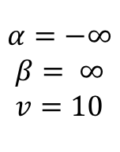
Alpha-Beta Small Example
def max-value(state, α, β):
initialize v = -∞
for each successor of state:
v = max(v, value(successor, α, β))
if v ≥ β
return v
α = max(α, v)
return v
$$α=−∞$$
$$β= ∞$$
$$v=−∞$$
$$α=−∞$$
$$β= ∞$$
$$v=10$$
def min-value(state , α, β):
initialize v = +∞
for each successor of state:
v = min(v, value(successor, α, β))
if v ≤ α
return v
β = min(β, v)
return v
Notes:
f is not evaluated

Slide 36
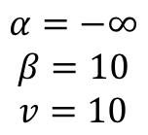
Alpha-Beta Small Example
def max-value(state, α, β):
initialize v = -∞
for each successor of state:
v = max(v, value(successor, α, β))
if v ≥ β
return v
α = max(α, v)
return v
$$α=−∞$$
$$β= ∞$$
$$v=−∞$$
$$α=−∞$$
$$β=10$$
$$v=10$$
def min-value(state , α, β):
initialize v = +∞
for each successor of state:
v = min(v, value(successor, α, β))
if v ≤ α
return v
β = min(β, v)
return v
Notes:
f is not evaluated

Slide 37
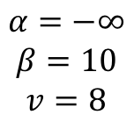
Alpha-Beta Small Example
def max-value(state, α, β):
initialize v = -∞
for each successor of state:
v = max(v, value(successor, α, β))
if v ≥ β
return v
α = max(α, v)
return v
$$α=−∞$$
$$β= ∞$$
$$v=−∞$$
$$α=−∞$$
$$β=10$$
$$v=8$$
def min-value(state , α, β):
initialize v = +∞
for each successor of state:
v = min(v, value(successor, α, β))
if v ≤ α
return v
β = min(β, v)
return v
Notes:
f is not evaluated

Slide 38
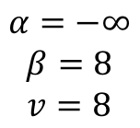
Alpha-Beta Small Example
def max-value(state, α, β):
initialize v = -∞
for each successor of state:
v = max(v, value(successor, α, β))
if v ≥ β
return v
α = max(α, v)
return v
$$α=−∞$$
$$β= ∞$$
$$v=−∞$$
$$α=−∞$$
$$β=8$$
$$v=8$$
def min-value(state , α, β):
initialize v = +∞
for each successor of state:
v = min(v, value(successor, α, β))
if v ≤ α
return v
β = min(β, v)
return v
Notes:
f is not evaluated

Slide 39
Alpha-Beta Small Example
def max-value(state, α, β):
initialize v = -∞
for each successor of state:
v = max(v, value(successor, α, β))
if v ≥ β
return v
α = max(α, v)
return v
$$α=−∞$$
$$β= ∞$$
$$v=−∞$$
$$α=−∞$$
$$β=8$$
$$v=8$$
8
def min-value(state , α, β):
initialize v = +∞
for each successor of state:
v = min(v, value(successor, α, β))
if v ≤ α
return v
β = min(β, v)
return v
Notes:
f is not evaluated

Slide 40
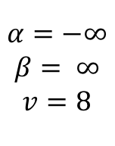
Alpha-Beta Small Example
def max-value(state, α, β):
initialize v = -∞
for each successor of state:
v = max(v, value(successor, α, β))
if v ≥ β
return v
α = max(α, v)
return v
$$α=−∞$$
$$β= ∞$$
$$v=8$$
$$α=−∞$$
$$β=8$$
$$v=8$$
8
def min-value(state , α, β):
initialize v = +∞
for each successor of state:
v = min(v, value(successor, α, β))
if v ≤ α
return v
β = min(β, v)
return v
Notes:
f is not evaluated

Slide 41
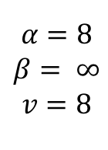
Alpha-Beta Small Example
def max-value(state, α, β):
initialize v = -∞
for each successor of state:
v = max(v, value(successor, α, β))
if v ≥ β
return v
α = max(α, v)
return v
$$α=8$$
$$β= ∞$$
$$v=8$$
$$α=−∞$$
$$β=8$$
$$v=8$$
8
def min-value(state , α, β):
initialize v = +∞
for each successor of state:
v = min(v, value(successor, α, β))
if v ≤ α
return v
β = min(β, v)
return v
Notes:
f is not evaluated

Slide 42
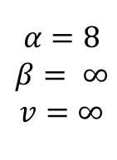
Alpha-Beta Small Example
def max-value(state, α, β):
initialize v = -∞
for each successor of state:
v = max(v, value(successor, α, β))
if v ≥ β
return v
α = max(α, v)
return v
$$α=8$$
$$β= ∞$$
$$v=8$$
$$α=−∞$$
$$β=8$$
$$v=8$$
$$α=8$$
$$β= ∞$$
$$v=∞$$
8
def min-value(state , α, β):
initialize v = +∞
for each successor of state:
v = min(v, value(successor, α, β))
if v ≤ α
return v
β = min(β, v)
return v
Notes:
f is not evaluated

Slide 43
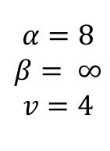
Alpha-Beta Small Example
def max-value(state, α, β):
initialize v = -∞
for each successor of state:
v = max(v, value(successor, α, β))
if v ≥ β
return v
α = max(α, v)
return v
$$α=8$$
$$β= ∞$$
$$v=8$$
$$α=−∞$$
$$β=8$$
$$v=8$$
$$α=8$$
$$β= ∞$$
$$v=4$$
8
def min-value(state , α, β):
initialize v = +∞
for each successor of state:
v = min(v, value(successor, α, β))
if v ≤ α
return v
β = min(β, v)
return v
Notes:
f is not evaluated

Slide 44
Alpha-Beta Small Example
def max-value(state, α, β):
initialize v = -∞
for each successor of state:
v = max(v, value(successor, α, β))
if v ≥ β
return v
α = max(α, v)
return v
$$α=8$$
$$β= ∞$$
$$v=8$$
$$α=−∞$$
$$β=8$$
$$v=8$$
$$α=8$$
$$β= ∞$$
$$v=4$$
8
4
def min-value(state , α, β):
initialize v = +∞
for each successor of state:
v = min(v, value(successor, α, β))
if v ≤ α
return v
β = min(β, v)
return v
Notes:
f is not evaluated

Slide 45
Alpha-Beta Small Example
def max-value(state, α, β):
initialize v = -∞
for each successor of state:
v = max(v, value(successor, α, β))
if v ≥ β
return v
α = max(α, v)
return v
$$α=8$$
$$β= ∞$$
$$v=8$$
$$α=−∞$$
$$β=8$$
$$v=8$$
$$α=8$$
$$β= ∞$$
$$v=4$$
8
4
def min-value(state , α, β):
initialize v = +∞
for each successor of state:
v = min(v, value(successor, α, β))
if v ≤ α
return v
β = min(β, v)
return v
Notes:
f is not evaluated

Slide 46
Alpha-Beta Small Example
def max-value(state, α, β):
initialize v = -∞
for each successor of state:
v = max(v, value(successor, α, β))
if v ≥ β
return v
α = max(α, v)
return v
$$α=8$$
$$β= ∞$$
$$v=8$$
$$α=−∞$$
$$β=8$$
$$v=8$$
$$α=8$$
$$β= ∞$$
$$v=4$$
8
4
def min-value(state , α, β):
initialize v = +∞
for each successor of state:
v = min(v, value(successor, α, β))
if v ≤ α
return v
β = min(β, v)
return v
Notes:
f is not evaluated

Slide 47
Alpha-Beta Small Example
def max-value(state, α, β):
initialize v = -∞
for each successor of state:
v = max(v, value(successor, α, β))
if v ≥ β
return v
α = max(α, v)
return v
$$α=8$$
$$β= ∞$$
$$v=8$$
8
$$α=−∞$$
$$β=8$$
$$v=8$$
$$α=8$$
$$β= ∞$$
$$v=4$$
8
4
def min-value(state , α, β):
initialize v = +∞
for each successor of state:
v = min(v, value(successor, α, β))
if v ≤ α
return v
β = min(β, v)
return v
Notes:
f is not evaluated

Slide 48
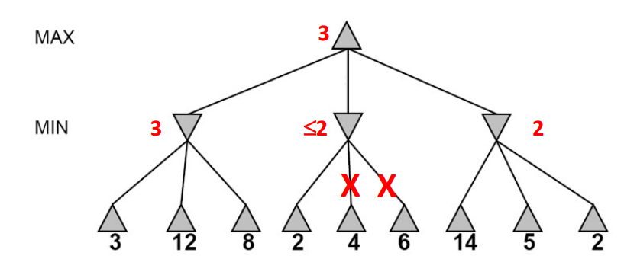

Slide 49
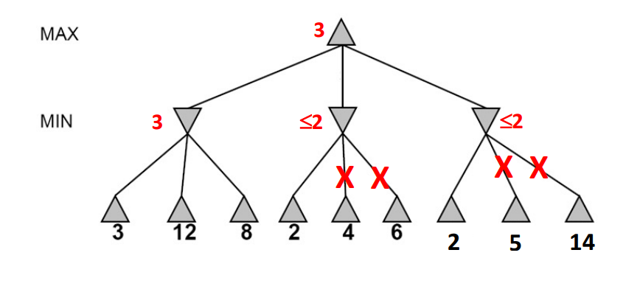
In this tree, the moves ARE optimally ordered, so we are able to prune four nodes (out of nine).

Slide 50
Optimal ordering
Minimum computational complexity
The children of a MAX node are evaluated, in order, starting with the highest-value child.
The children of a MIN node are evaluated, in order, starting with the lowest-value child.

Slide 51
Games with uncertain outcomes

Slide 52
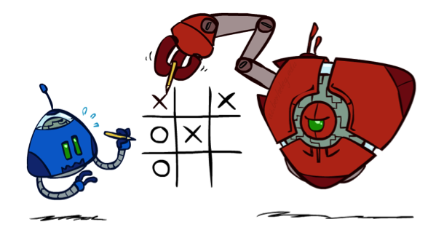
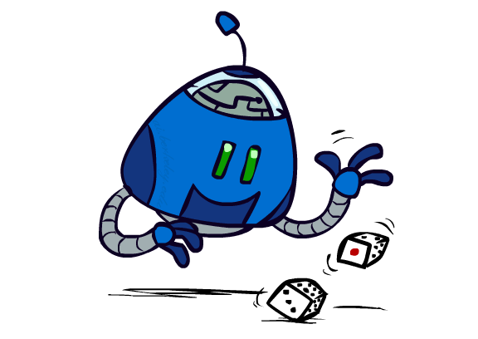
Chance outcomes in trees
10
10
9
100
10
10
9
100
Minimax
Worst Case Scenarios
Expectimax
10
9
10
9
10
100

Slide 53
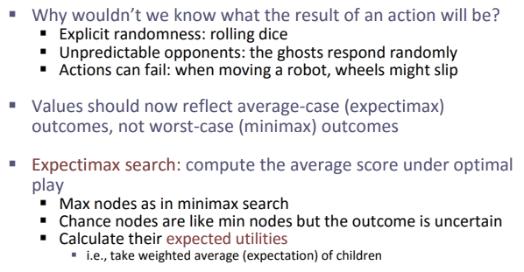
Expectimax
Notes:
At least 10, or otherwise just rather dead; or just 100, or otherwise rather dead; that’s yet something different than minimax or expectimax

Slide 54
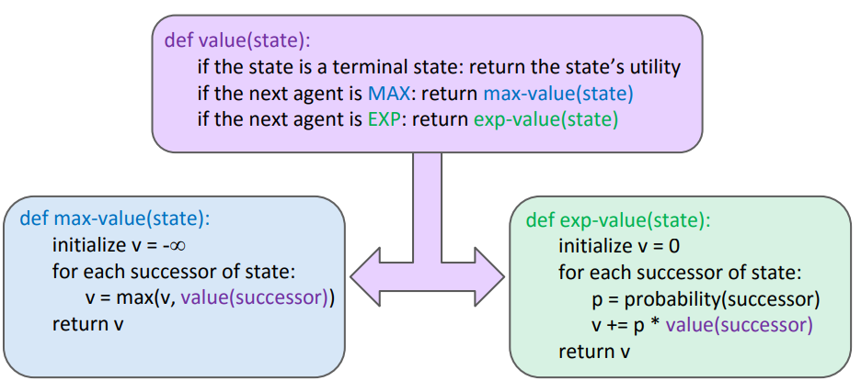
Expectimax
Notes:
Note that “minimax-decision” has become just “decision”

Slide 55
Expectations
The expected value of a random variable is the average, weighted by the probability distribution over outcomes
Example: How long to get to the airport?
Time:
20 min
30 min
60 min
+
+
35 min
x
x
x
Probability:
0.25
0.50
0.25

Slide 56
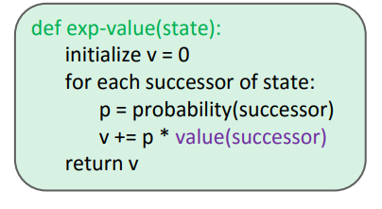
Expectimax Pseudocode
1/2
1/6
1/3
5
8
7
24
-12
v = (1/2) (8) + (1/3) (24) + (1/6) (-12) = 10

Slide 57
Expectimax Example
3
12
9
2
4
6
15
6
0

Slide 58
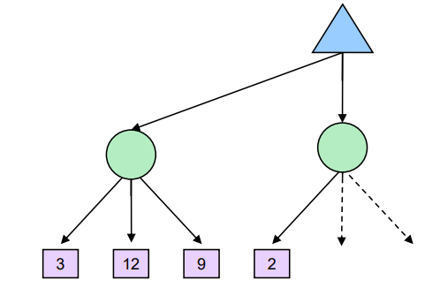
Expectimax Pruning
Can we Prune ?

Slide 59
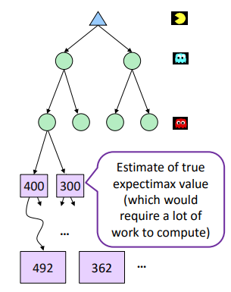
Expectimax Pruning

Slide 60
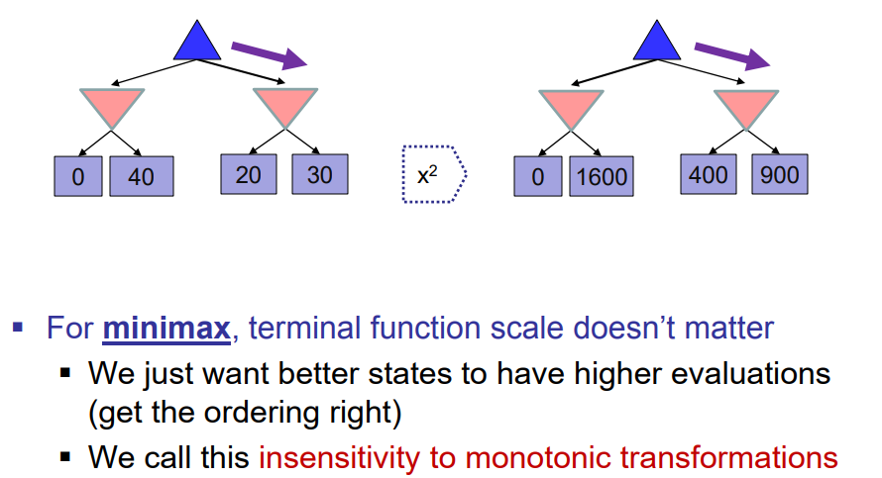
What Utilities to use?

Slide 61
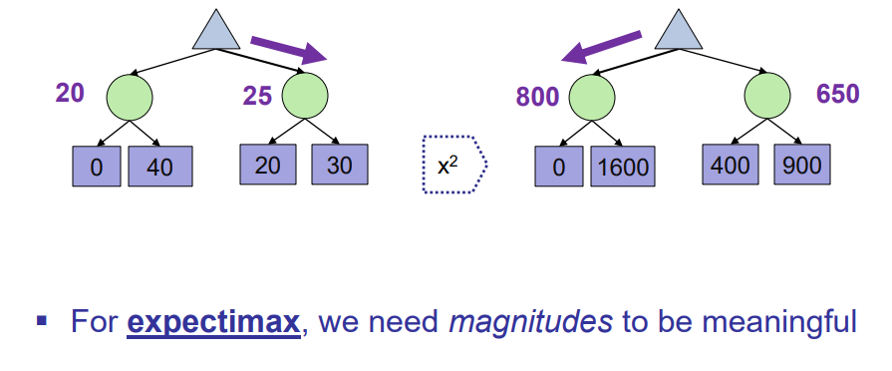
What Utilities to use?

Slide 62
Expectiminimax self Study

Slide 63
Summary
Multi-agent problems can require more space or deeper trees to search
Games require decisions when optimality is impossible
Bounded-depth search and approximate evaluation functions
Games force efficient use of computation
Alpha-beta pruning
Game playing has produced important research ideas
Reinforcement learning (checkers)
Iterative deepening (chess)
Rational metareasoning (Othello)
Monte Carlo tree search (Go)
Solution methods for partial-information games in economics (poker)
Video games present much greater challenges – lots to do!

