Slide 1
Constraint Satisfaction Problems (CSPs)

Slide 2
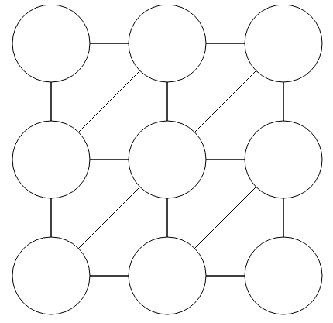
CSP Warm-up
Assign Red, Green, or Blue
Neighbors must be different
Sudoku
1
2
1
3
4

Slide 3
What is Search For?
Planning: sequences of actions
The path to the goal is the important thing
Paths have various costs, depths
Heuristics give problem-specific guidance
Identification: assignments to variables
The goal itself is important, not the path
All paths at the same depth (for some formulations)
CSPs are specialized for identification problems

Slide 4
Constraint Satisfaction Problems
Variables - CSPs possess a set of N variables X₁,...,X_{N} that can each take on a single value from some defined set of values.
Domain - A set {x₁,..., x_{d}} representing all possible values that a CSP variable can take on.
Constraints define restrictions on the values of variables, potentially with regard to other variables.
or
A goal test is a set of constraints specifying allowable combinations of values for subsets of variables
Notes:
Goal test has structure, it ‘s more like a manual describing a set of constraints that have to hold true

Slide 5
Real-World CSPs
Assignment problems: e.g., who teaches what class
Timetabling problems: e.g., which class is offered when and where?
Hardware configuration
Transportation scheduling
Factory scheduling
Circuit layout
Fault diagnosis
… lots more!
Many real-world problems involve real-valued variables…

Slide 6
CSP Examples

Slide 7

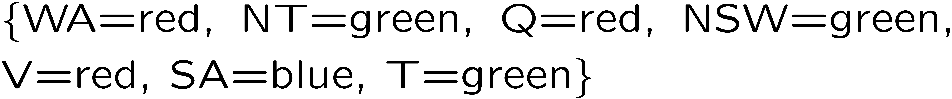
Example: Map Coloring
Variables:
Domains:
Constraints: adjacent regions must have different colors
Solutions are assignments satisfying all constraints, e.g.:
Implicit:
Explicit:

Slide 8
Constraint Graphs

Slide 9
Constraint Graphs
Binary CSP: each constraint relates (at most) two variables
Binary constraint graph: nodes are variables, arcs show constraints
General-purpose CSP algorithms use the graph structure to speed up search. E.g., Tasmania is an independent subproblem!

Slide 10
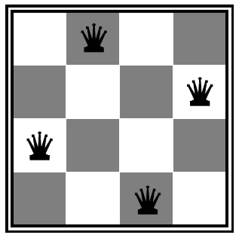
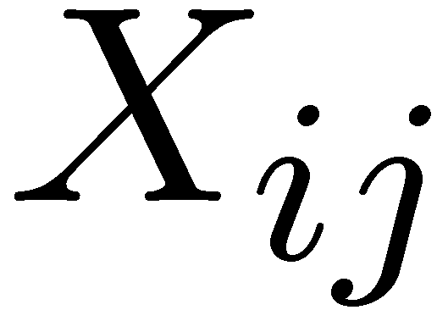

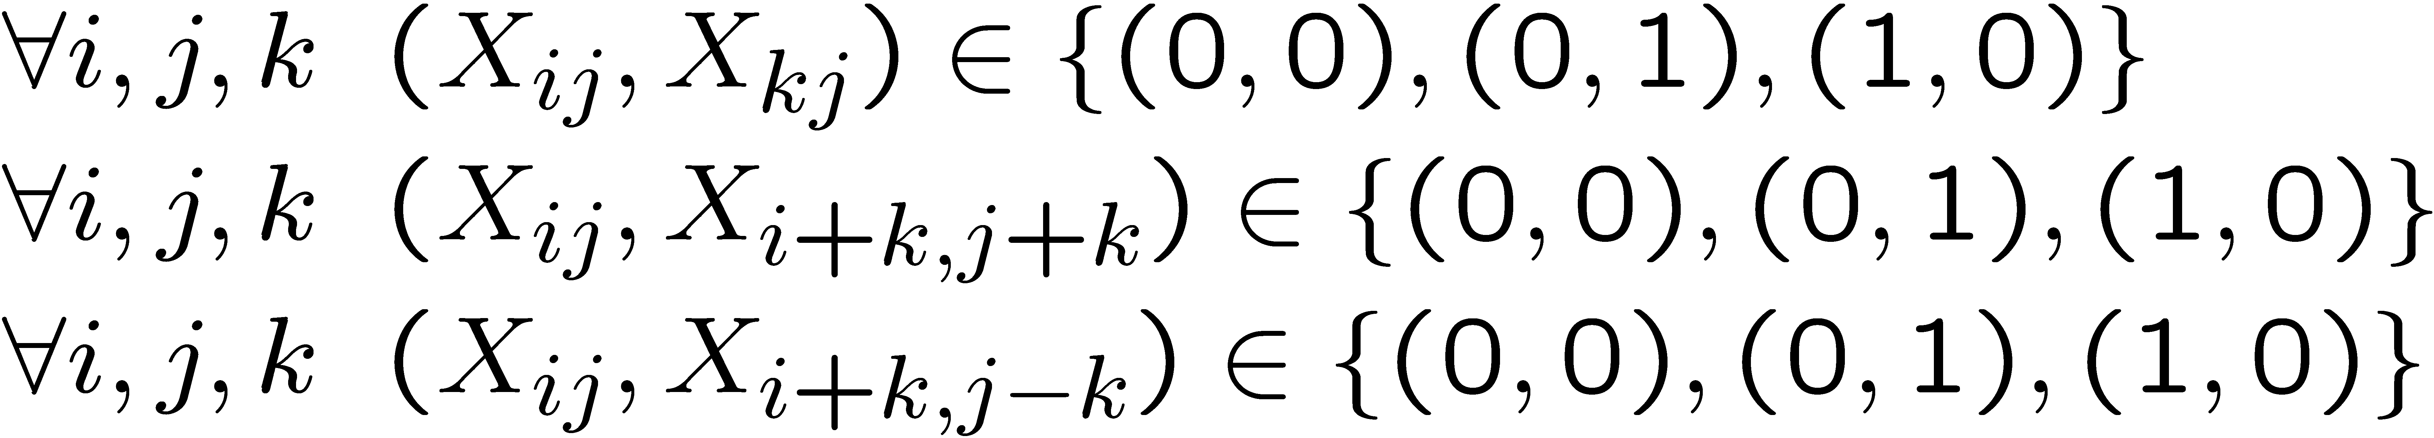
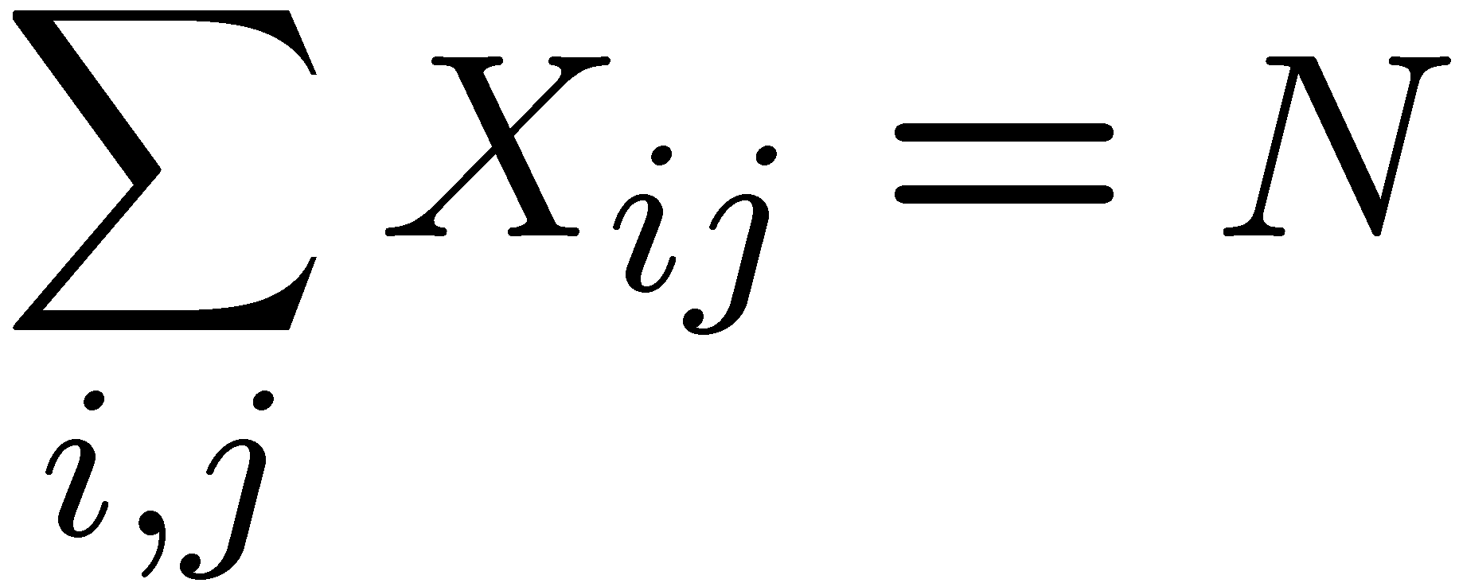
Example: N-Queens
Varieties of CSPs and Constraints
Formulation 1:
Variables:
Domains:
Constraints

Slide 11







Example: N-Queens
Formulation 2:
Variables:
Domains:
Constraints:
Explicit:

Slide 12
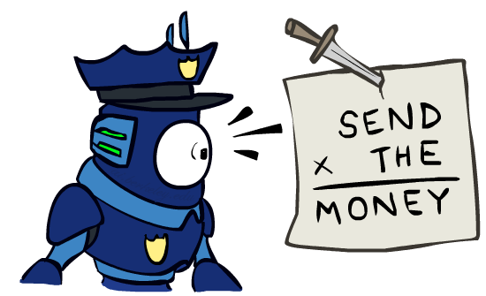

Example: Cryptarithmetic
Variables:
Domains:
Constraints:
0=7, R=4, W=6, U=2, T=8, F=1; 867 + 867 = 1734
Notes:
0=7, R=4, W=6, U=2, T=8, F=1; 867 + 867 = 1734

Slide 13
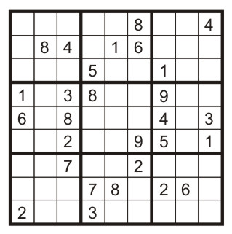
Example: Sudoku
Variables:
Each (open) square
Domains:
{1,2,…,9}
Constraints:
9-way alldiff for each column
9-way alldiff for each row
9-way alldiff for each region
(or can have a bunch of pairwise inequality constraints)

Slide 14


Varieties of Constraints
Varieties of Constraints
Unary constraints involve a single variable (equivalent to reducing domains), e.g.:
Binary constraints involve pairs of variables, e.g.:
Higher-order constraints involve 3 or more variables:
e.g., cryptarithmetic column constraints
Preferences (soft constraints):
E.g., red is better than green
Often representable by a cost for each variable assignment
Gives constrained optimization problems

Slide 15
Varieties of CSPs
Discrete Variables
Finite domains
Variables: Each region on the map is a variable.
Domains: Each variable can have a finite number of possible values ( red, green, blue) .
Constraints: Two neighboring regions cannot have the same color.
Solving such a problem involves finding "coloring" where neighboring regions differ in color.
This CSP problem with finite domains can be solved efficiently, similar to checking all possible combinations in a small puzzle.
CSP is complete in O(d^{n}) time, where d = size of the domain and n = number of variables.
.

Slide 16
Varieties of CSPs
Infinite domains (integers, strings, etc.)
E.g., job scheduling, variables are start/end times for each job
Variables: Each meeting is a variable.
Domains: Each meeting can be scheduled at any time within a day (infinite possibilities).
Constraints: Two meetings for the same person cannot overlap.
This problem involves scheduling meetings for everyone without causing conflicts.
While the domain might be infinite (any time within a day), the constraint can be represented linearly (e.g., meeting A cannot end before meeting B starts).

Slide 17
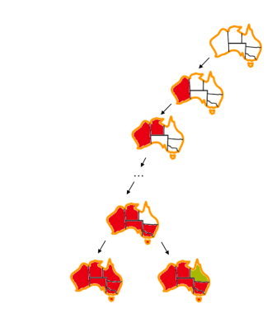
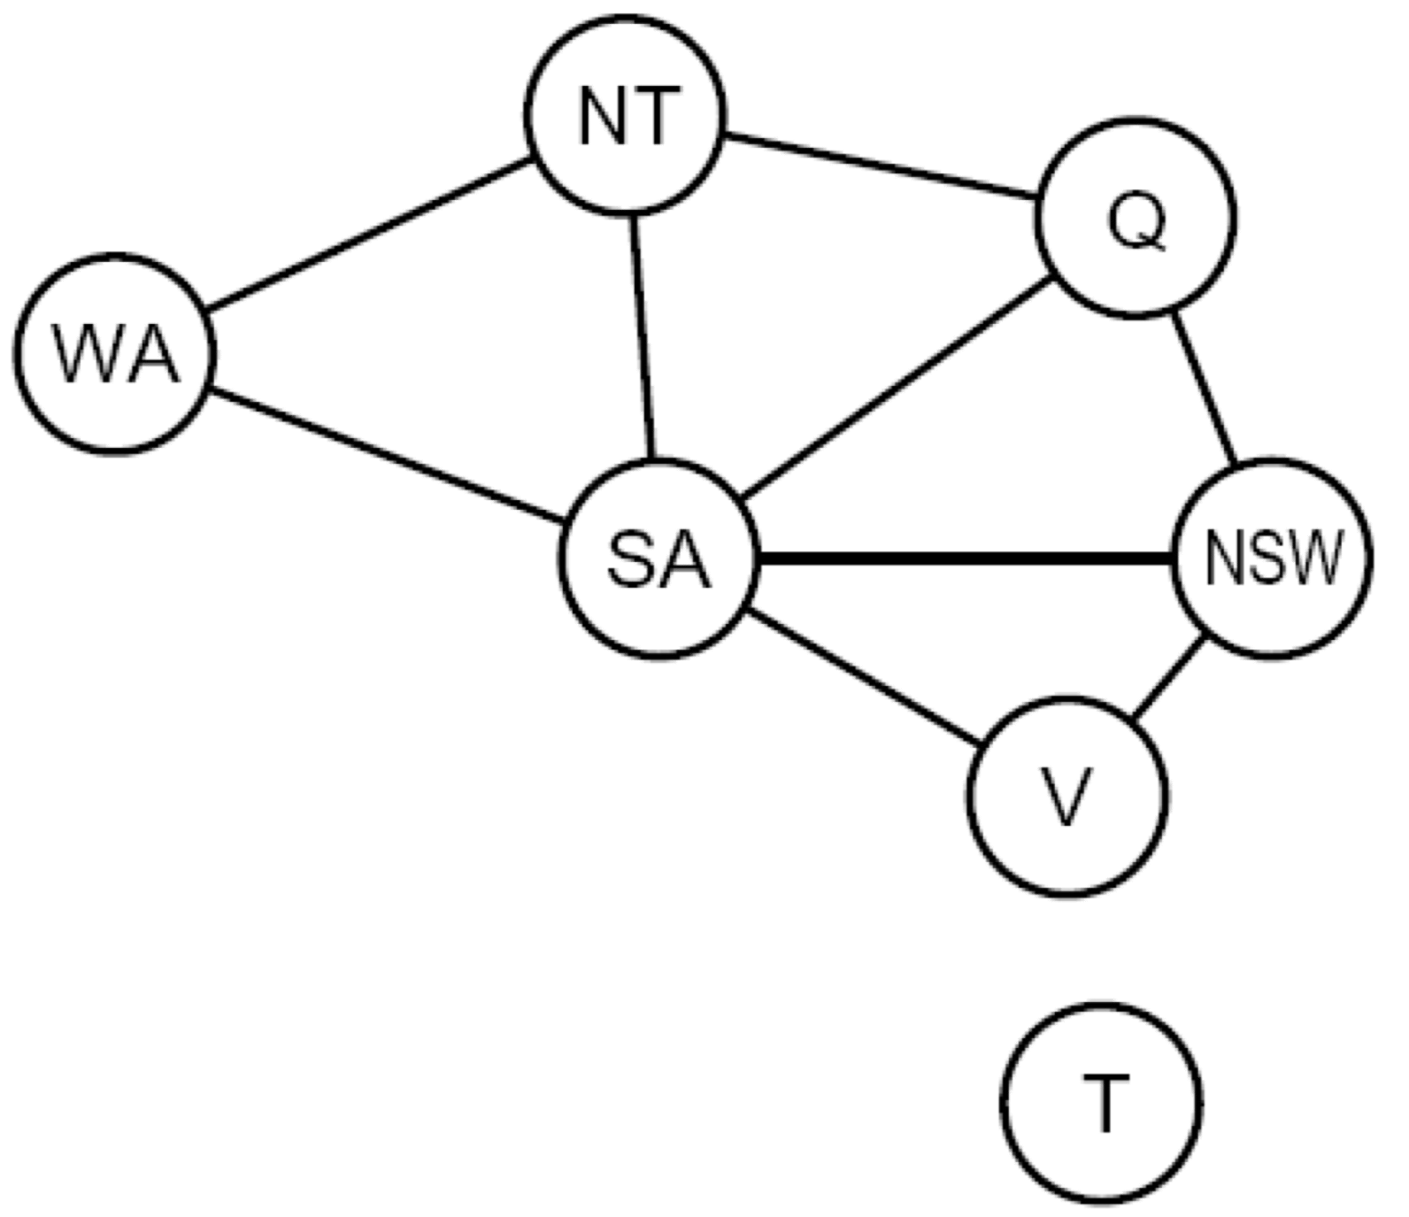
Search Methods
What would DFS do?
What would BFS do?

Slide 18
Backtracking Search
Backtracking search is the basic uninformed algorithm for solving CSPs
Idea 1: One variable at a time
Variable assignments are commutative, so fix ordering
I.e., [WA = red then NT = green] same as [NT = green then WA = red]
Only need to consider assignments to a single variable at each step
Idea 2: Check constraints as you go
I.e. consider only values which do not conflict previous assignments
Might have to do some computation to check the constraints
“Incremental goal test”
Depth-first search with these two improvements
is called backtracking search (not the best name)
Can solve n-queens for n ≈ 25

Slide 19
Backtracking Example

Slide 20
Backtracking Search
Notes:
Demo:
CS188 javascript demos -> source -> exercises -> csps -> CSPs demos -> CSPs demos.html
Settings:
Graph = Simple
Algorithm = Backtracking
Ordering = None
Filtering = None

Slide 21
Backtracking Search
General Search checks consistency on full assignment
Notes:
Demo:
CS188 javascript demos -> source -> exercises -> csps -> CSPs demos -> CSPs demos.html
Settings:
Graph = Simple
Algorithm = Backtracking
Ordering = None
Filtering = None

Slide 22
Backtracking Search
Backtracking Search checks consistency at each assignment
Notes:
Demo:
CS188 javascript demos -> source -> exercises -> csps -> CSPs demos -> CSPs demos.html
Settings:
Graph = Simple
Algorithm = Backtracking
Ordering = None
Filtering = None

Slide 23
Backtracking Search
Notes:
Demo:
CS188 javascript demos -> source -> exercises -> csps -> CSPs demos -> CSPs demos.html
Settings:
Graph = Simple
Algorithm = Backtracking
Ordering = None
Filtering = None

Slide 24
Backtracking Search
Backtracking = DFS + variable-ordering + fail-on-violation

