Slide 1
Constraint Satisfaction Problems (CSPs)

Slide 2
Improving Backtracking
General-purpose ideas give huge gains in speed
Filtering: Can we detect inevitable failure early?
Ordering:
Which variable should be assigned next?
In what order should its values be tried?
Structure: Can we exploit the problem structure?

Slide 3
Filtering: Forward Checking
Filtering: Keep track of domains for unassigned variables and cross off bad options
Forward checking: Cross off values that violate a constraint when added to the existing assignment
NT
Q
WA
SA
NSW
V
Notes:
Demo:
CS188 javascript demos -> source -> exercises -> csps -> CSPs demos -> CSPs demos.html
Settings:
Graph = Simple
Algorithm = Backtracking
Ordering = None
Filtering = Forward Checking

Slide 4
Filtering: Forward Checking
Filtering: Keep track of domains for unassigned variables and cross off bad options
Forward checking: Cross off values that violate a constraint when added to the existing assignment
NT
Q
WA
SA
NSW
V
Notes:
Demo:
CS188 javascript demos -> source -> exercises -> csps -> CSPs demos -> CSPs demos.html
Settings:
Graph = Simple
Algorithm = Backtracking
Ordering = None
Filtering = Forward Checking

Slide 5
Filtering: Forward Checking
Filtering: Keep track of domains for unassigned variables and cross off bad options
Forward checking: Cross off values that violate a constraint when added to the existing assignment
NT
Q
WA
SA
NSW
V
Notes:
Demo:
CS188 javascript demos -> source -> exercises -> csps -> CSPs demos -> CSPs demos.html
Settings:
Graph = Simple
Algorithm = Backtracking
Ordering = None
Filtering = Forward Checking

Slide 6
Filtering: Forward Checking
Filtering: Keep track of domains for unassigned variables and cross off bad options
Forward checking: Cross off values that violate a constraint when added to the existing assignment
NT
Q
WA
SA
NSW
V
Notes:
Demo:
CS188 javascript demos -> source -> exercises -> csps -> CSPs demos -> CSPs demos.html
Settings:
Graph = Simple
Algorithm = Backtracking
Ordering = None
Filtering = Forward Checking

Slide 7
Filtering: Forward Checking
Filtering: Keep track of domains for unassigned variables and cross off bad options
Forward checking: Cross off values that violate a constraint when added to the existing assignment
NT
Q
WA
SA
NSW
V
FAIL – variable with no possible values
Notes:
Demo:
CS188 javascript demos -> source -> exercises -> csps -> CSPs demos -> CSPs demos.html
Settings:
Graph = Simple
Algorithm = Backtracking
Ordering = None
Filtering = Forward Checking

Slide 8
Filtering: Constraint Propagation
Forward checking propagates information from assigned to unassigned variables, but doesn't provide early detection for all failures
NT
Q
WA
SA
NSW
V
Notes:
Demo:
CS188 javascript demos -> source -> exercises -> csps -> CSPs demos -> CSPs demos.html
Settings:
Graph = Simple
Algorithm = Backtracking
Ordering = None
Filtering = Forward Checking

Slide 9
Filtering: Constraint Propagation
Forward checking propagates information from assigned to unassigned variables, but doesn't provide early detection for all failures
NT and SA cannot both be blue! Why didn’t we detect this yet?
NT
Q
WA
SA
NSW
V
Notes:
Demo:
CS188 javascript demos -> source -> exercises -> csps -> CSPs demos -> CSPs demos.html
Settings:
Graph = Simple
Algorithm = Backtracking
Ordering = None
Filtering = Forward Checking

Slide 10
Filtering: Constraint Propagation
Forward checking propagates information from assigned to unassigned variables, but doesn't provide early detection for all failures
NT and SA cannot both be blue! Why didn’t we detect this yet?
Constraint propagation: reason from constraint to constraint
NT
Q
WA
SA
NSW
V
Notes:
Demo:
CS188 javascript demos -> source -> exercises -> csps -> CSPs demos -> CSPs demos.html
Settings:
Graph = Simple
Algorithm = Backtracking
Ordering = None
Filtering = Forward Checking

Slide 11
Consistency of A Single Arc
An arc X → Y is consistent iff for every x in the tail there is some y in the head which could be assigned without violating a constraint
Remove values in the domain of X if there isn’t a corresponding legal Y
Forward checking: Enforcing consistency of arcs pointing to each new assignment
NT
Q
WA
SA
NSW
V

Slide 12

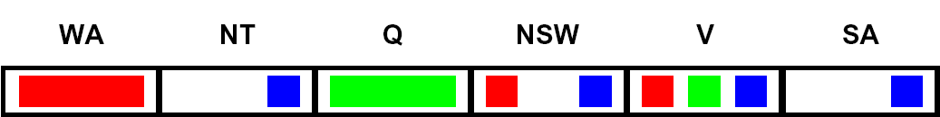
Arc Consistency of an Entire CSP (1/6)
A simple form of propagation makes sure all arcs are consistent:
NT
SA
Q
NSW
V
WA
Arc V to NSW is consistent: for every x in the tail there is some y in the head which could be assigned without violating a constraint

Slide 13
Arc Consistency of an Entire CSP (2/6)
A simple form of propagation makes sure all arcs are consistent:
NT
SA
Q
NSW
V
WA
Arc SA to NSW is consistent: for every x in the tail there is some y in the head which could be assigned without violating a constraint

Slide 14
Arc Consistency of an Entire CSP (3/6)
A simple form of propagation makes sure all arcs are consistent:
NT
SA
Q
NSW
V
WA
Arc NSW to SA is not consistent: if we assign NSW = blue, there is no valid assignment left for SA
To make this arc consistent, we delete NSW = blue from the tail

Slide 15
Arc Consistency of an Entire CSP (4/6)
A simple form of propagation makes sure all arcs are consistent:
NT
SA
Q
NSW
V
WA
Remember that arc V to NSW was consistent, when NSW had red and blue in its domain
After removing blue from NSW, this arc might not be consistent anymore! We need to recheck this arc.
Important: If X loses a value, neighbors of X need to be rechecked!

Slide 16
Arc Consistency of an Entire CSP (5/6)
A simple form of propagation makes sure all arcs are consistent:
NT
SA
Q
NSW
V
WA
Arc SA to NT is inconsistent. We make it consistent by deleting from the tail (SA = blue).

Slide 17
Arc Consistency of an Entire CSP (6/6)
A simple form of propagation makes sure all arcs are consistent:
NT
SA
Q
NSW
V
WA
SA has an empty domain, so we detect failure. There is no way to solve this CSP with WA = red and Q = green, so we backtrack.
Arc consistency detects failure earlier than forward checking
Can be run as a preprocessor or after each assignment

Slide 18
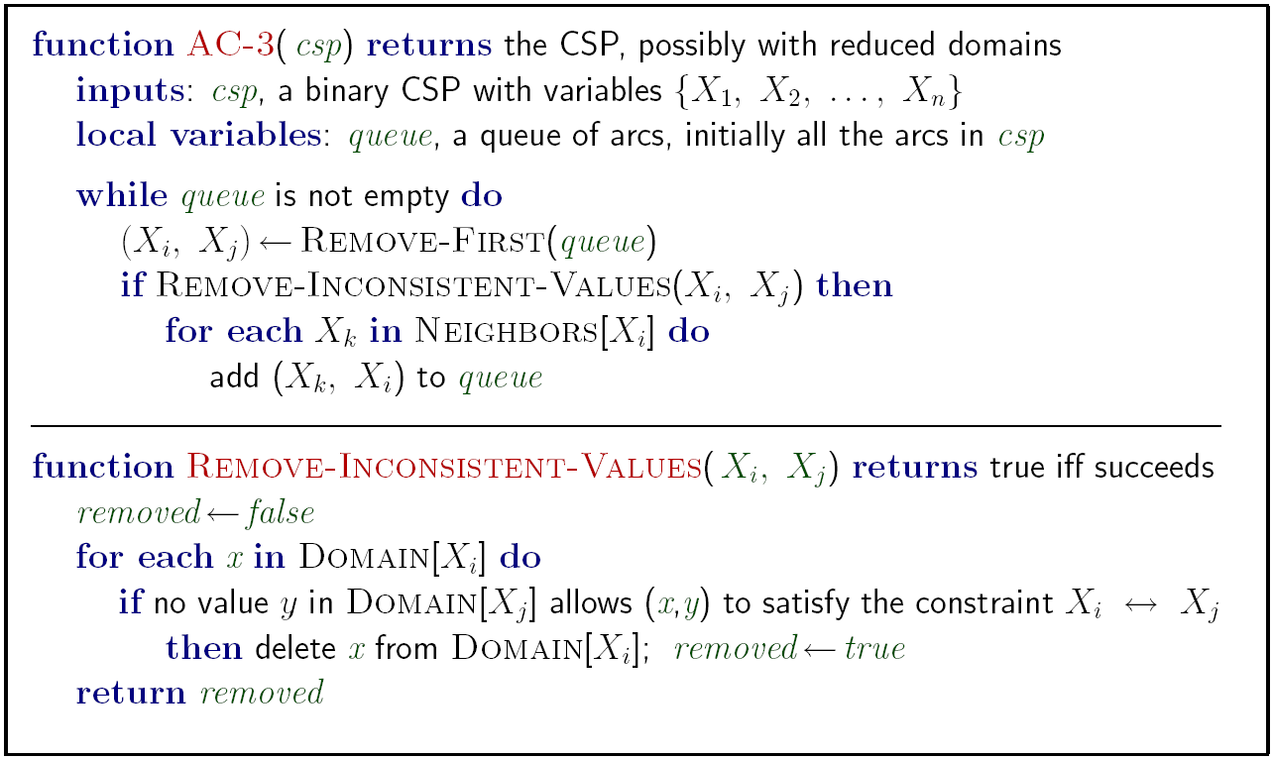
Enforcing Arc Consistency in a CSP
Notes:
Auto-consistency (note initially nothing gets deleted/pruned since there are consistent options for all constraints for initial variable domains)
Flashes whenever something needs to be re-checked

Slide 19
Limitations of Arc Consistency
After enforcing arc consistency:
Can have one solution left
Can have multiple solutions left
Can have no solutions left (and not know it)
Arc consistency still runs inside a backtracking search!
Notes:
Demo:
CS188 javascript demos -> source -> exercises -> csps -> CSPs demos -> CSPs demos.html
Settings:
Graph = Complex
Algorithm = Backtracking
Ordering = None
Filtering = Forward Checking (first) / Arc Consistency (second)

Slide 20
Ordering: Minimum Remaining Values
Variable Ordering: Minimum remaining values (MRV):
Choose the variable with the fewest legal left values in its domain
Why min rather than max?
Increased Chance of Early Failure:
Also called “most constrained variable”
“Fail-fast” ordering

Slide 21
Ordering: Least Constraining Value
Value Ordering: Least Constraining Value
Given a choice of variable, choose the least constraining value
I.e., the one that rules out the fewest values in the remaining variables
Why least rather than most?
the algorithm keeps the domains of those future variables as large as possible.
"Fail-Safe" Strategy:
Combining these ordering ideas makes
1000 queens feasible

Slide 22
Structure
A final class of improvements to solving constraint satisfaction problems are those that exploit their structure. In particular, if we’re trying to solve a tree-structured CSP (one that has no loops in its constraint graph).
First, pick an arbitrary node in the constraint graph for the CSP to serve as the root of the tree .
Convert all undirected edges in the graph to directed edges pointing away from the root node (designated as node A).
Linearize (or topologically sort) the resulting directed acyclic graph by ordering the nodes such that all edges point rightwards, representing a consistent direction of traversal away from the root node.

Slide 23
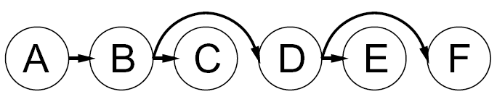
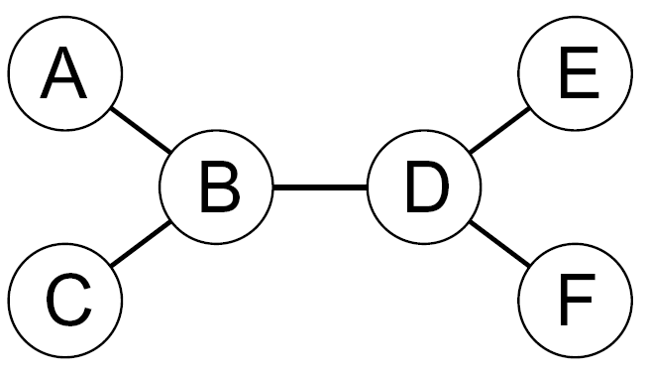

Tree-Structured CSPs
Algorithm for tree-structured CSPs:
Order: Choose a root variable, order variables so that parents precede children
Remove backward: For i = n : 2, apply RemoveInconsistent(Parent(X_{i}),X_{i})
Assign forward: For i = 1 : n, assign X_{i} consistently with Parent(X_{i})

Slide 24
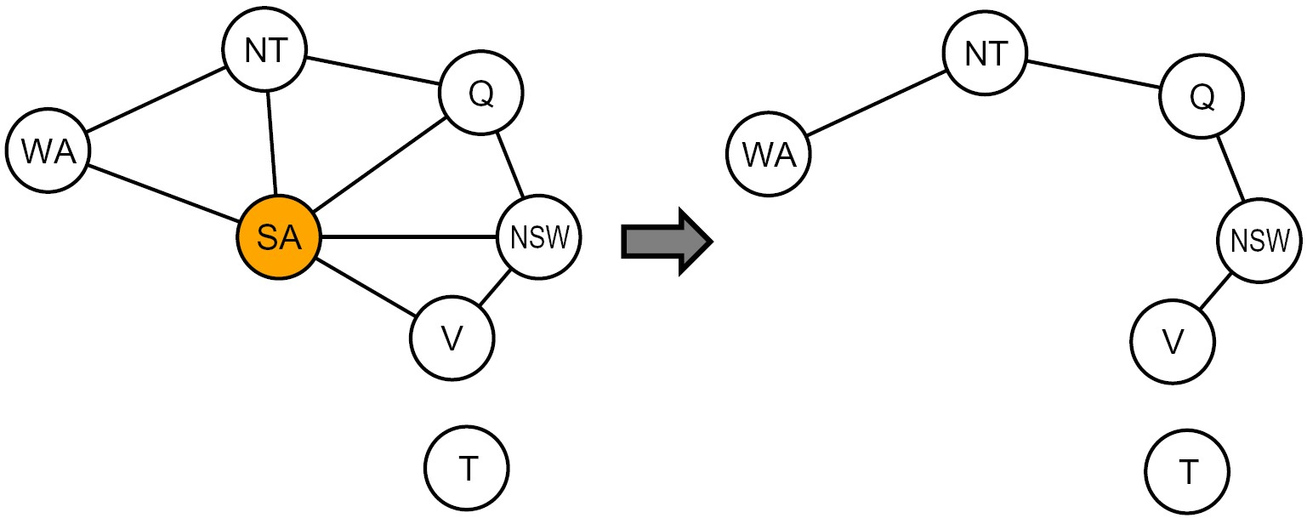
Nearly Tree-Structured CSPs
Conditioning: instantiate a variable, prune its neighbors' domains
Cutset conditioning: instantiate (in all ways) a set of variables such that the remaining constraint graph is a tree

Slide 25
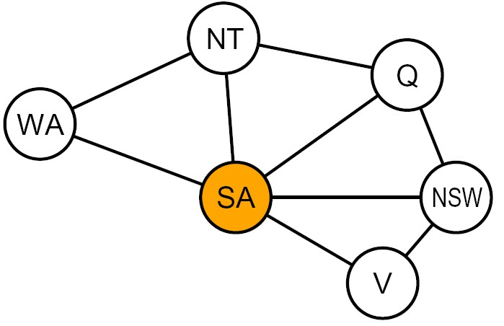
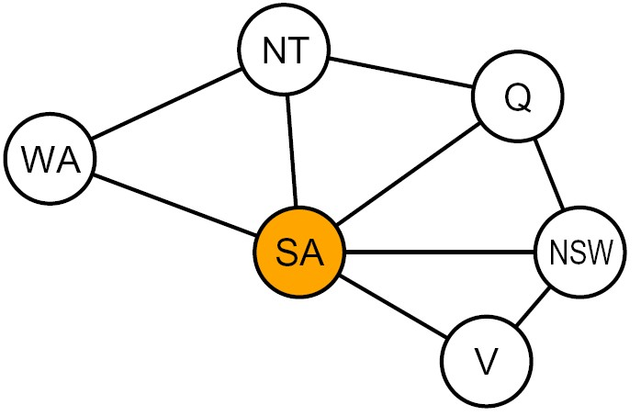


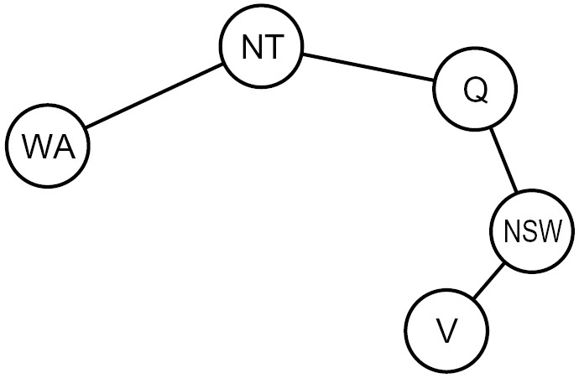
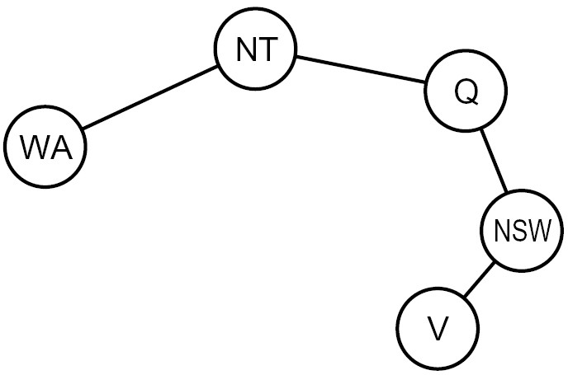

Cutset Conditioning
Choose a cutset
SA
Instantiate the cutset (all possible ways)
SA
SA
SA
Compute residual CSP for each assignment
Solve the residual CSPs (tree structured)

Slide 26
Iterative Algorithms for CSPs
Backtracking search is not the only algorithm that exists for solving constraint satisfaction problems.
Another widely used algorithm is local search, for which the idea is simple but remarkably useful.
Local search works by iterative improvement
- Start with some random assignment to values
- Algorithm: While not solved,
Variable selection: randomly select any conflicted variable
Value selection: min-conflicts heuristic:
Choose a value that violates the fewest constraints
I.e., hill climb with h(n) = total number of violated constraints

Slide 27
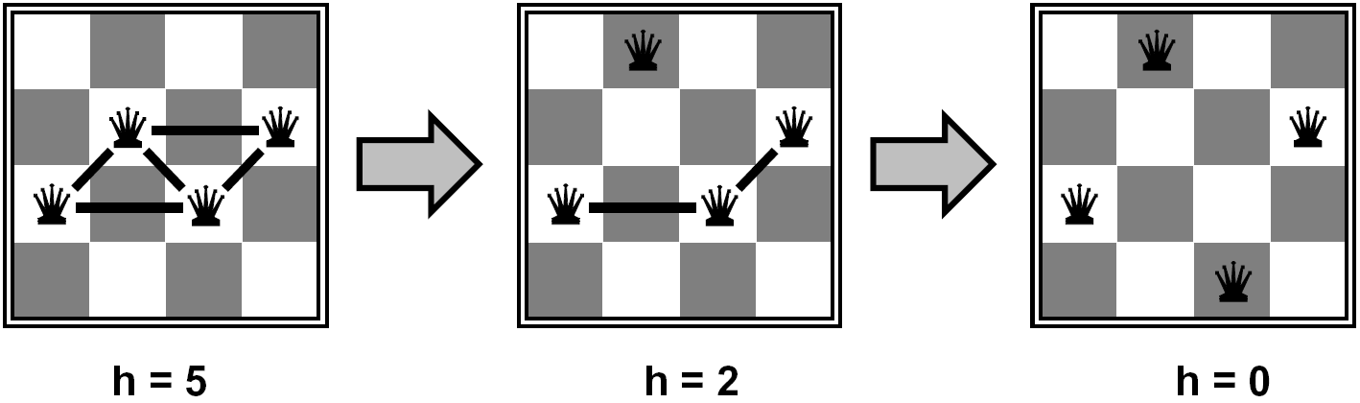
Example: 4-Queens
States: 4 queens in 4 columns (4⁴ = 256 states)
Operators: move queen in column
Goal test: no attacks
Evaluation: c(n) = number of attacks

Slide 28
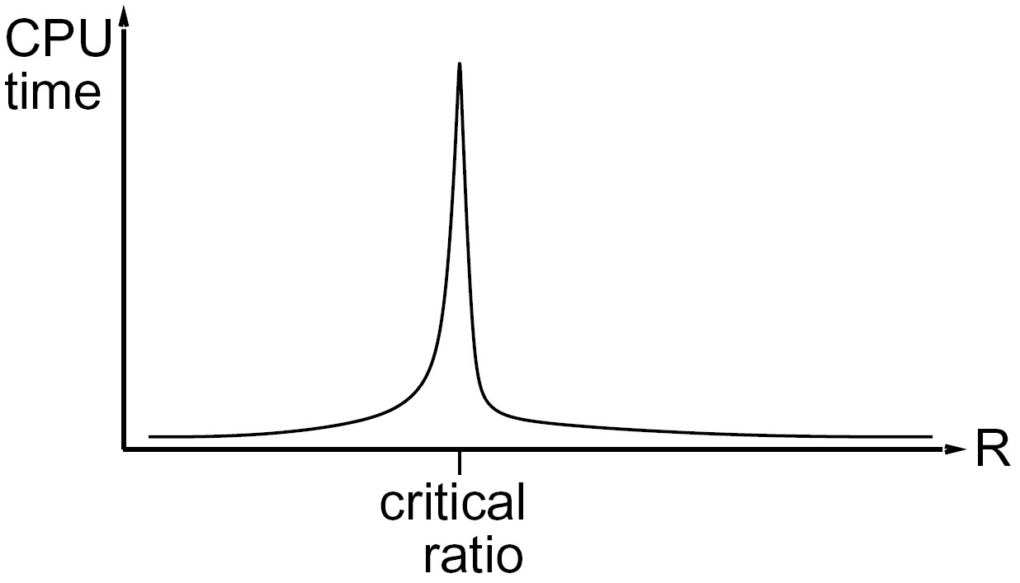
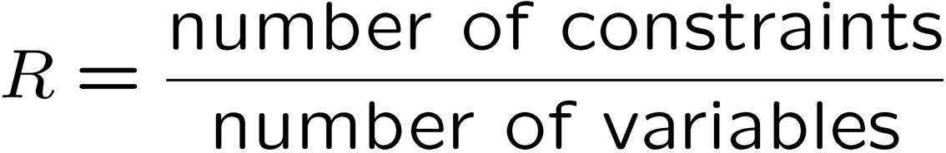
Performance of Min-Conflicts
Given a random initial state, can solve n-queens in almost constant time for arbitrary n with high probability (e.g., n = 10,000,000)!
The same appears to be true for any randomly generated CSP except in a narrow range of the ratio.
However, local search is both incomplete and suboptimal and so won’t necessarily converge to an optimal solution.
Additionally, there is a critical ratio around which using local search becomes extremely expensive:
The time needed by iterative algo to get to solution
R very small i.e. Number of Constraints is less and variables are a lot
R very large i.e. Number of Constraints are lot and few variables

Slide 29
Local Search
Tree search keeps unexplored alternatives on the fringe (ensures completeness)
Local search: improve a single option until you can’t make it better (no fringe!)
New successor function: local changes
Possible local Changes
Generally, much faster and more memory efficient (but incomplete and suboptimal)
Methodology
Initial assignment
Hill Climbing
Simulated Annealing

Slide 30
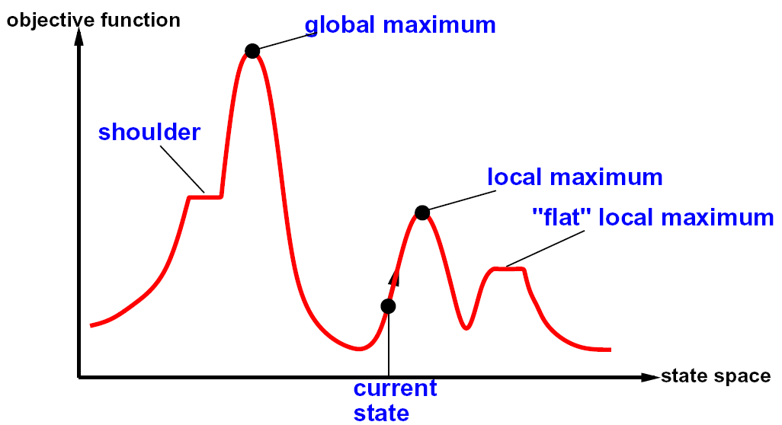
Hill Climbing Diagram

Slide 31
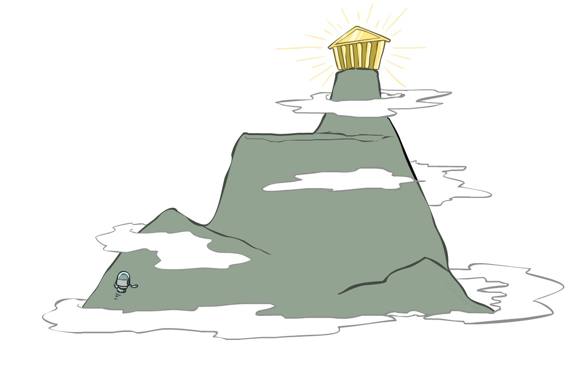
Hill Climbing Greedy Local Search
Simple, general idea:
Start wherever
Repeat: move to the best neighboring state
If no neighbors better than current, quit
What’s bad about this approach?
Complete?
Optimal?
What’s good about it?

Slide 32
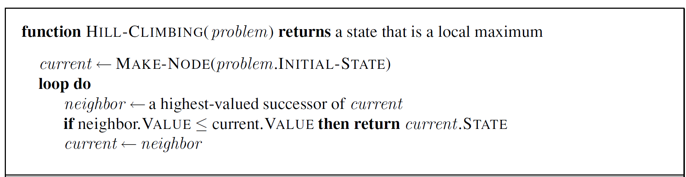
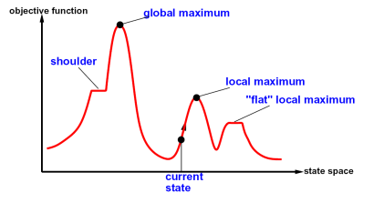

Hill Climbing (Greedy Local Search)
What if there is a tie?
Typically break ties randomly
What if we do not stop here?
Make a sideway move if “$=$”

Slide 33
Hill-climbing on 8-Queens
Randomly generated 8-queens starting states.
14% the time it solves the problem
86% of the time it get stuck at a local minimum
However…
Takes only 4 steps on average when it succeeds
And 3 on average when it gets stuck
(for a state space with 8^8 =~17 million states)

Slide 34
Escaping Shoulders: Sideways Move
If no downhill (uphill) moves, allow sideways moves in hope that algorithm can escape
Must limit the number of possible sideways moves to avoid infinite loops
For 8-queens
Allow sideways moves with limit of 100
Raises percentage of problems solved from 14 to 94%
However….
21 steps for every successful solution
64 for each failure

Slide 35
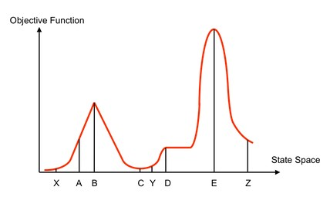
Hill Climbing
Starting from X, where do you end up ?
Starting from Y, where do you end up ? Starting from Z, where do you end up ?

Slide 36
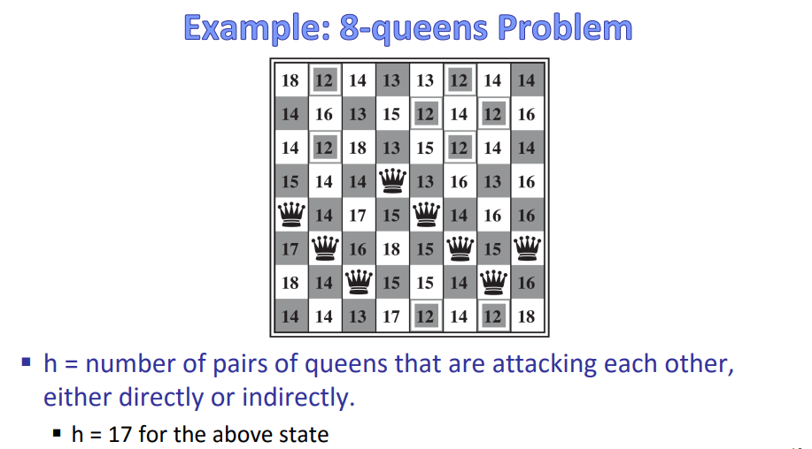

Slide 37
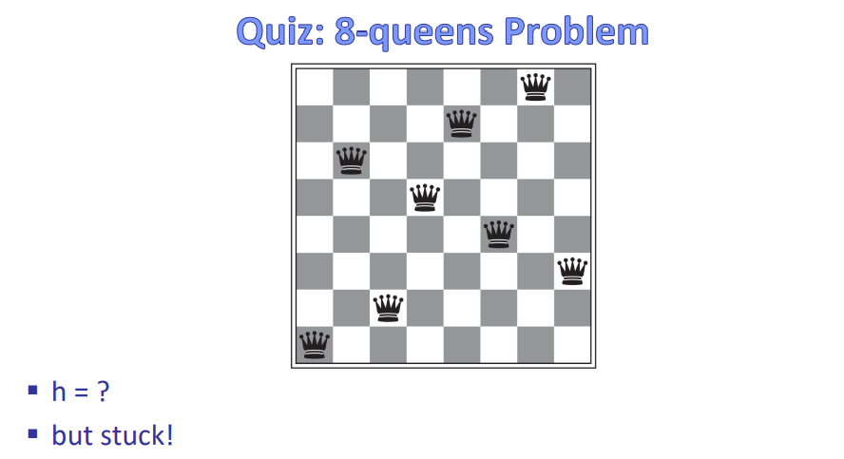

Slide 38
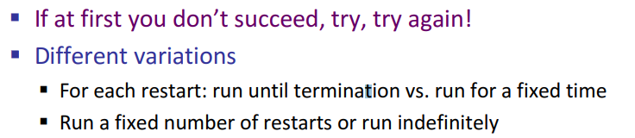
Variants of Hill Climbing
Stochastic hill climbing chooses at random from among the uphill moves.
At each step do one of the following:
Greedy: With prob p move to the neighbor with largest value
Random: With prob 1-p move to a random neighbor
Random-restart hill climbing
With random restart values

Slide 39

Variants of Hill Climbing
What if variables are continuous, e.g., find $x∈[0,1]$ that maximizes $f\left(x\right)$?
Gradient ascent
Use gradient to find best direction
Use the magnitude of the gradient to determine how big a step you move
Value space of variables

Slide 40
Hill-Climbing with Both Random Walk & Random Sampling
At each step do one of the three
– Greedy: move to the neighbor with largest value
– Random Walk: move to a random neighbor
– Random Restart: Start over from a new, random state

Slide 41
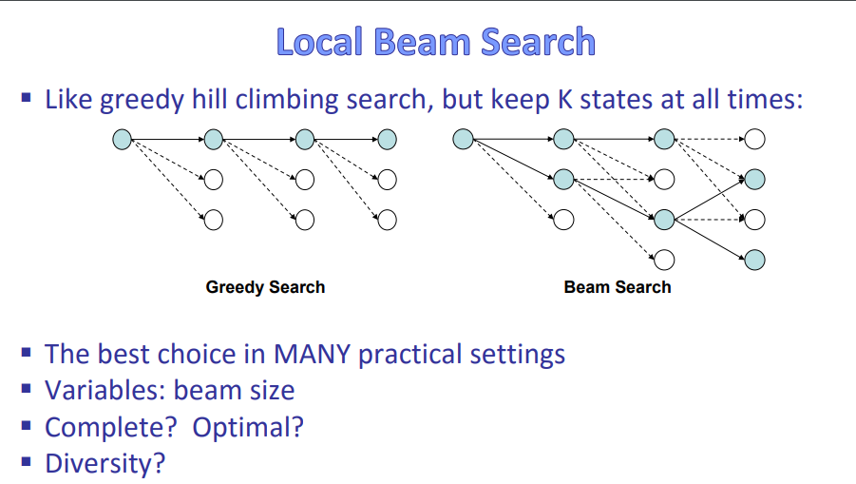

Slide 42
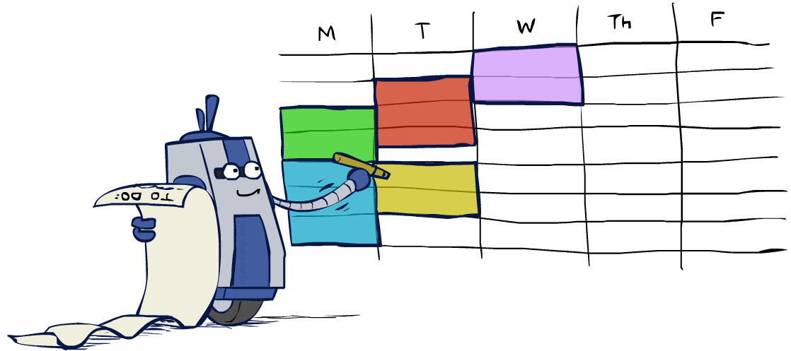
Summary: CSPs
CSPs are a special kind of search problem:
States are partial assignments
Goal test defined by constraints
Basic solution: backtracking search
Speed-ups:
Ordering
Filtering
Structure

