Slide 1

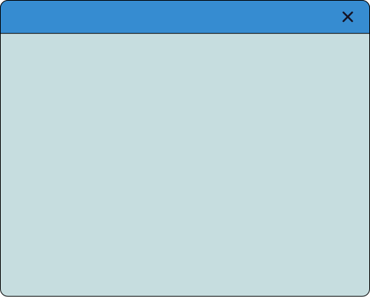
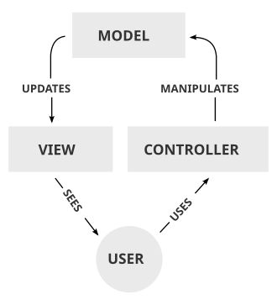


SE Course Presentation
MVC
- What is MVC
- Why it is useful
- Examples
- Advantages and disadvantages
Mohammad Ali - 2023
Abdullah Waheed - 2023048
Rafay Akram - 2023491
page 001

Slide 2


Understanding MVC
What is MVC
MVC is an Architectural Design Pattern. It is not a programming language; it is a way of organizing code. It forces you to separate your code into three distinct sections so that the files don't get messy.
Used mainly in the development of Web applications, Desktop applications as well as mobile application, the MVC architecture model separates the presentation layer of the software application from the business logic layer.
page 002

Slide 3
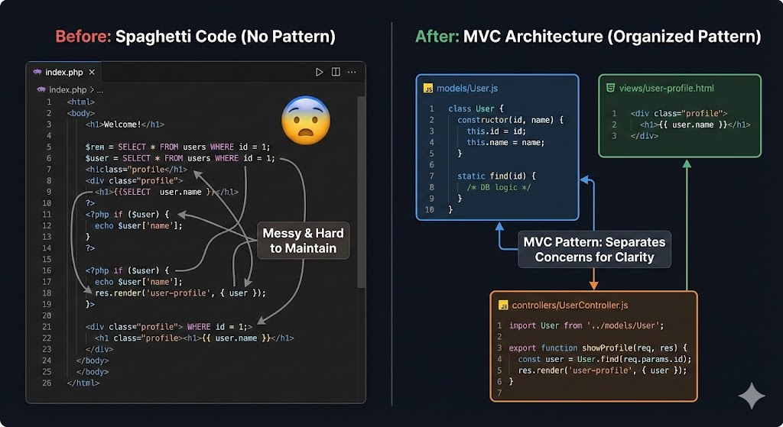
MVC Codebase
page 003

Slide 4
MVC BreakDown
M - Model (The Data & Logic): This represents the data structure. It manages the data, logic, and rules of the application. It talks to the database.
V - View (The User Interface): This is what the user sees. It displays data. It contains no logic (it shouldn't calculate things, just show them).
C - Controller (The Coordinator): The intermediary. It listens to the user (inputs), tells the Model what to do, and then tells the View what to show.
page 004

Slide 5
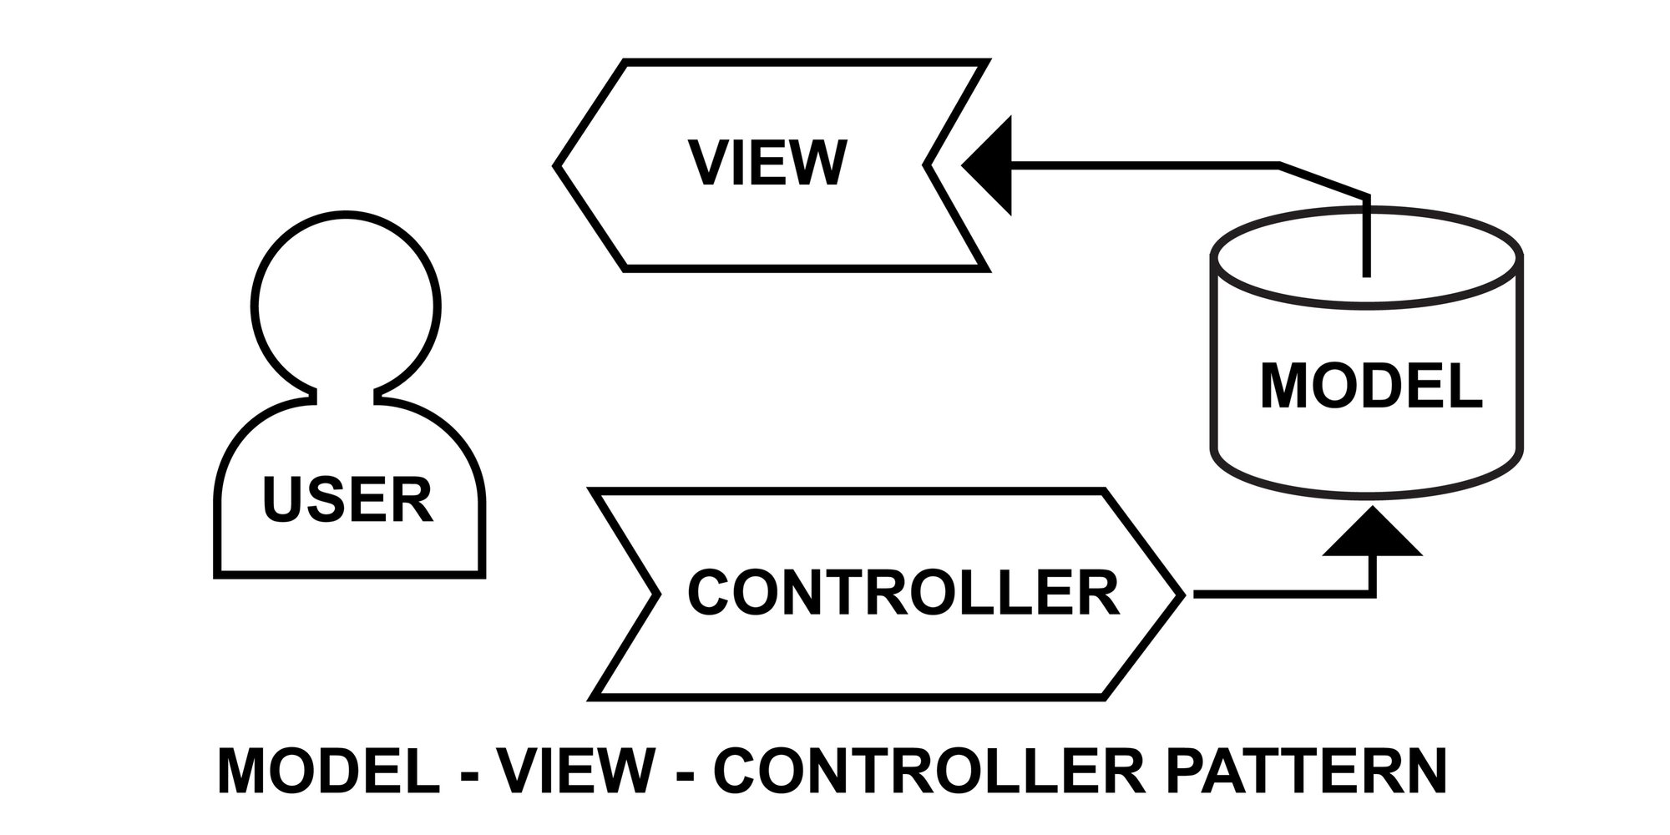
MVC Cycle
page 005

Slide 6
Analogy to Understand MVC
Resturant
The User: The Customer.
The View: The Menu (and the food when it arrives). It’s what you look at.
The Controller: The Waiter. You give them instructions. They don't cook the food; they just take your order to the kitchen and bring the food back.
The Model: The Kitchen (Chefs, Ingredients). This is where the raw work happens. The customer never sees the kitchen.
page 006

Slide 7
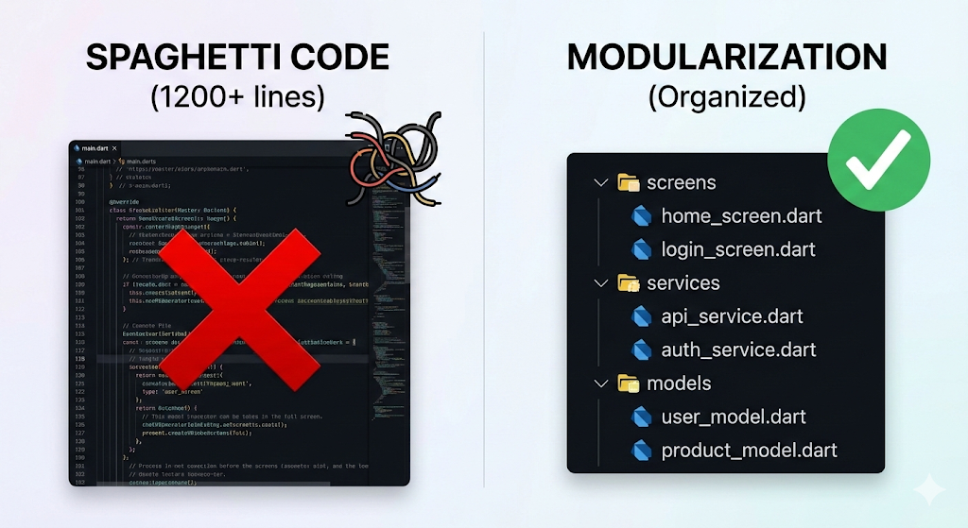
The Necessity of Modularization
Spaghetti Code: Hard to debug, impossible to maintain.
Modularization: Separation of Concerns.
Goal: Scalability & Reusability.
page 007

Slide 8
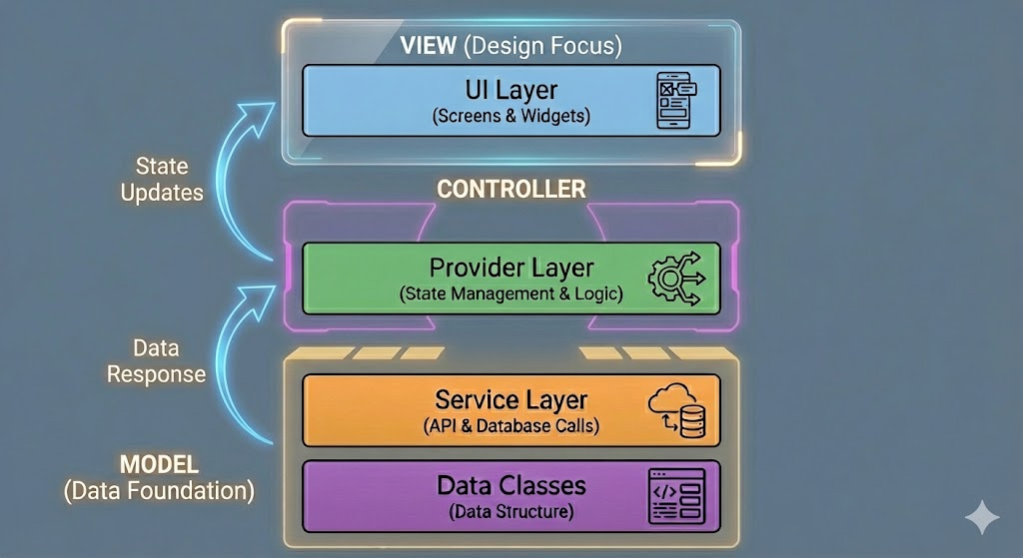
A Practical Approach
UI Layer: The screens and widgets.
Provider Layer: State management & logic.
Service Layer: API & Database calls.
Data Classes: The structure of the data.
page 008

Slide 9
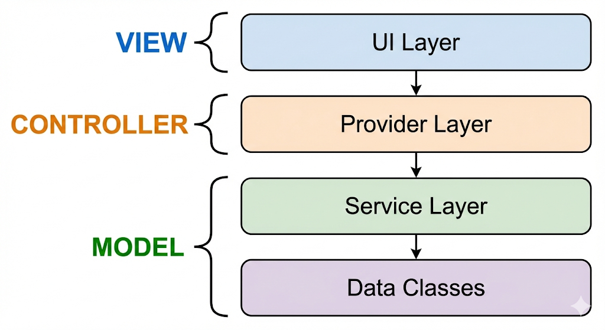
A Practical Approach
View: Focuses purely on Design.
Controller: Focuses purely on Logic.
Model: Focuses purely on Data.
Result: Easy scaling & instant debugging.
page 009

Slide 10
MVC Features
It provides a clear separation of business logic, UI logic, and input logic.
It offers full control over your HTML and URLs which makes it easy to design web application architecture..
It is a powerful URL-mapping component using which we can build applications that have comprehensible and searchable URLs.
It supports Test Driven Development (TDD).
page 010

Slide 11
MVC - Advantages
1. Parallel Development
Multiple developers/teams can work simultaneously
Speeds up development time.
2. Improved Maintainability
Changing UI doesn’t affect business logic.
3. Reusability of Components
Models can be reused across different interfaces (web, mobile, desktop).
4. Better Testing
Since logic is separated, unit testing becomes simpler.
page 011

Slide 12
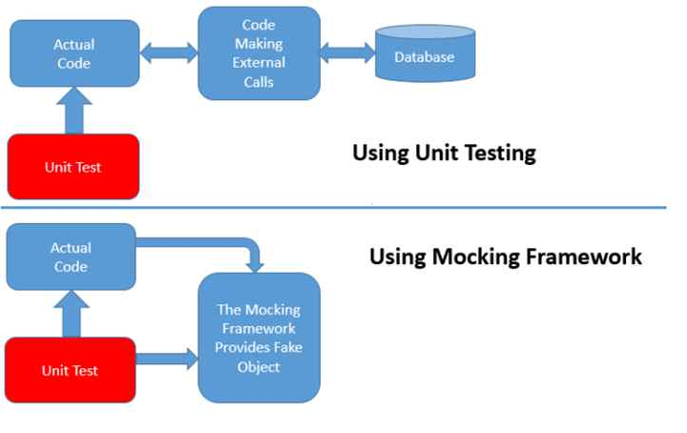
Advantages - Unit Testing
Unit Testing: Verifying logic without dependencies
Mocking: Verifying logic with dependecies using fake data.
page 012

Slide 13
MVC - Disadvantages
1. Increased Complexity for Small Projects
The structure may feel too heavy for simple apps.
2. Requires Strict Separation Discipline
Poor implementation can break the benefits of MVC.
3. More Files and Code
Each feature usually requires changes in multiple components (Model + View + Controller).
Can feel overwhelming for beginners.
4. Steeper Learning Curve
Understanding how components interact takes time.
page 013

Slide 14
Final Summary
MVC organizes applications into Model, View, Controller for clean and structured code.
Encourages separation of concerns, improving debugging, scalability, and maintenance.
Helps teams work in parallel and makes testing easier.
Slightly complex for small projects but highly effective for building organized, modular systems.
page 014

Slide 15
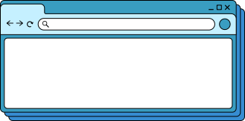
Thank You!
Thank you for your attention. We hope this presentation enhanced your understanding of computer software essentials.
page 015

