Slide 1
Software Testing Life-Cycle(STLC)

Slide 2
What is Software Testing Life Cycle (STLC)?
Software Testing Life Cycle (STLC) is a sequence of specific activities conducted during the testing process to ensure software quality goals are met.
STLC involves both verification and validation activities.

Slide 3
What is Software Testing Life Cycle (STLC)?
Software Testing is not just a single/isolate activity, i.e. testing. It consists of a series of activities carried out methodologically to help certify your software product.
Several Phases/steps
Fulfill goal to move next step.

Slide 4
Purpose
Clearly defining the deadlines of project testing
Proper documenting the goal & objective
Ensure objective of each step
Testing each and every feature of software before adding more features

Slide 5
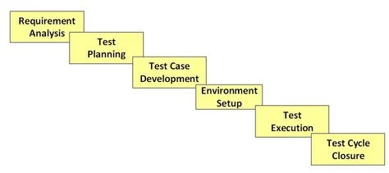
STLC Steps

Slide 6
STLC Steps
Requirement Analysis
Test Planning
Test case development
Test Environment setup
Test Execution
Test Cycle closure

Slide 7
What is Entry and Exit Criteria in STLC?
Each of these stages has a definite Entry and Exit criteria, Activities & Deliverables associated with it.
Entry Criteria: Entry Criteria gives the prerequisite items that must be completed before testing can begin.
Exit Criteria: Exit Criteria defines the items that must be completed before testing can be concluded

Slide 8
Requirement Analysis
Requirement Analysis in which test team studies the requirements from a testing point of view to identify testable requirements.
Activities in Requirement Phase Testing
Identify types of tests to be performed.
Gather details about testing priorities and focus.
Prepare Requirement Traceability Matrix (RTM).
Identify test environment details where testing is supposed to be carried out.
Notes:
Clear and Unambiguous: The requirement is stated in a way that leaves no room for interpretation. It should be specific and detailed.
Measurable: The requirement can be quantified or evaluated objectively. For example, "The system should respond within 2 seconds" is measurable, whereas "The system should be fast" is not.
Feasible: The requirement can be tested within the given constraints (time, resources, tools, etc.).
Complete: The requirement provides enough information to design test cases.
Traceable: The requirement can be linked to specific test cases, ensuring full coverage.

Slide 9
Deliverables of Requirement Phase Testing
RTM

Slide 10
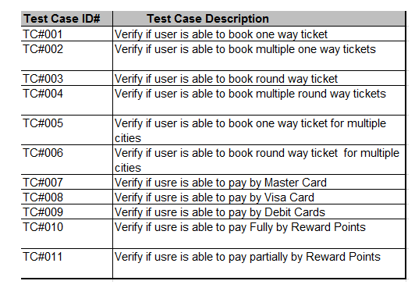
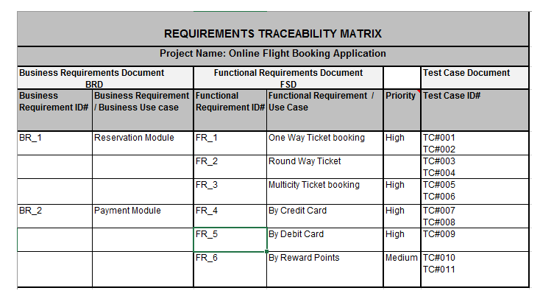

Slide 11
Test Planning
Detailed test plan document, objective, scope, schedule and resources allocation etc
Roles & Responsibilities
Estimated timeline
Risk and cost analyze

Slide 12
Deliverables of Test Planning
Test plan/strategy document.
Effort estimation document.

Slide 13
Test case development
The Test Case Development Phase involves the creation, verification and rework of test cases & test scripts after the test plan is ready.
Test Case Development Activities
Create test cases, automation scripts
Review and baseline test cases and scripts
Create test data (If Test Environment is available)

Slide 14
Deliverables of Test Case Development
Test cases/scripts
Test data

Slide 15
Test Environment Setup
Test Environment Setup decides the software and hardware conditions under which a work product is tested.
Test Environment Setup Activities
Understand the required architecture, environment set-up and prepare hardware and software requirement list for the Test Environment.
Setup test Environment and test data
Perform smoke test on the build

Slide 16
Deliverables of Test Environment Setup
Environment ready with test data set up
Smoke Test Results.

Slide 17
Test Execution Phase
Test Execution Phase is carried out by the testers in which testing of the software build is done based on test plans and test cases prepared.
Test Execution Activities
Execute tests as per plan
Document test results, and log defects for failed cases
Map defects to test cases in RTM
Retest the Defect fixes

Slide 18
Deliverables of Test Execution
Completed RTM with the execution status
Test cases updated with results
Defect reports

Slide 19
Test Cycle Closure
Test Cycle Closure phase is completion of test execution which involves several activities like test completion reporting, collection of test completion matrices and test results.
Evaluate cycle completion criteria based on Time, Test coverage, Cost,Software, Critical Business Objectives, Quality
Document the learning out of the project
Prepare Test closure report
Qualitative and quantitative reporting of quality of the work product to the customer.

Slide 20
Deliverables of Test Cycle Closure
Test Closure report
Test metrics

Slide 21
Thank You

