Slide 1
JAVA 程序设计
1. Course Overview and Java Introduction
黄 骏
jun.huang@pku.edu.cn

Slide 2
课程介绍
黄骏
北京大学理科五号楼515S
jun.huang@pku.edu.cn
18310998523
每周二7-8节
文史201

Slide 3
参考资料
Java程序设计（第二版）
  清华大学出版社、北京交通大学出版社
  唐大仕
华文慕课：Java程序设计
  http://www.chinesemooc.org/mooc/4746

Slide 4
成绩标准
Homework 3 x 10% = 30%
Course project 40%
Final Exam 30%

Slide 5
作业说明
迟交减50%
提交源代码
作业-1
  俄罗斯方块机器人
作业-2
  基于数据挖掘的文本分类
作业-3
  TBD，涉及网络

Slide 6
课设说明
成绩占比40%
  源码、报告和ppt（Due 5.20号0点）
题目任选
2到5人一组
由所有同学根据pre，代码和报告一起打分
Pre安排在14到16周

Slide 7
第1周 课程介绍和Java简介
第2周 数据运算、控制流、数组
第3周 面向对象（1）、 HW-1
第4周 面向对象（2）
第5周 面向对象（3）
第6周 异常处理和输入输出
第7周 HW-2
第8周 泛型和集合类
第9周 网络编程
第10周 HW-3
第12周 多线程
第13周 TBD
第14周 Pre（1）
第15周 Pre（2）
第16周 Pre（3）

Slide 8
Outline
认识Java
Java的历史
Java的运行机制
Java语言的特点
Java开发环境

Slide 9
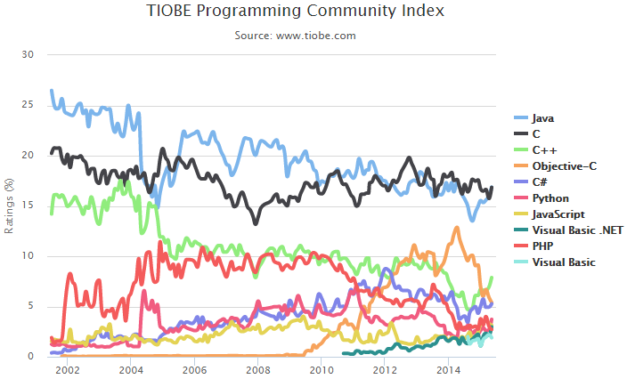
What is Java
The most popular programming language

Slide 10
Where is Java
In a wide range of software systems
    Desktop, web, mobile and embedded applications
    MATLAB, Eclipse, Minecraft, Hadoop …
In about 3 billions of devices
    Scientific supercomputers, data centers, smartphones, printers, game consoles …

Slide 11
Java Platforms
Java SE (Java Standard Edition)
  Desktop and server environments
Java EE (Java Enterprise Edition)
  Distributed computing and web services
  Large-scale, multi-tiered enterprise software
Java ME (Java Micro Edition)
  Embedded and Mobile devices

Slide 12
Outline
认识Java
Java的历史
Java的运行机制
Java语言的特点
Java开发环境

Slide 13

The Origin of Java
1991: Initiated by James Gosling at SUN Microsystems
Named as “Oak”, and then re-named as “Java”
Originally designed for interactive TV, and then re-targeted to Web apps
Designed with a C/C++ style syntax
Java 1.0 released in 1995
Quickly became popular, mostly outside browsers

Slide 14
Java Version History
J2SE 1.4
Stability
Regular Expression, IPv6, XML,
Security and Cryptograph
2002
Java 6.0
JDBC 4.0
GUI Improvement
2006
J2SE 1.2
Graphical API
Known as Java2
1998
JDK 1.0
1996
Java 7.0
2011
2014
Java 9.0
1995
First release
1997
JDK 1.1
Inner classes, JavaBeans, JDBC
RMI
2000
J2SE 1.3
HotSpot JVM
Debugger architecture
2004
JavaSE 1.5 (Java 5.0)
Maturity
Scalability
Security
2010
Oracle acquired SUN
2014
Java 8.0
Lambda
expression

Slide 15
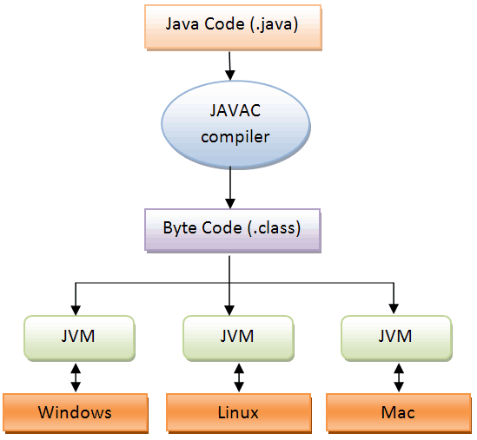
Java程序运行机制
计算机的高级编程语言类型:
  解释型：
    运行时翻译并直接执行源程序
    Matlab, Python, 平台兼容性，效率低
  编译型：
    执行前将源程序翻译为机器语言
    C/C++, 高效，兼容性差
Java 语言是两种类型的结合；
Java源程序(source code)
字节码(byte code)
机器码指令

Slide 16
Virtual Machine
A virtual machine is a layer of abstraction that gives a program one simplified and unified interface for interacting with a variety of heterogenous physical computers and their operating systems
Not a real hardware machine but a software layer that resembles an hardware platform

Slide 17
Java Virtual Machine (JVM)
JVM converts Java byte code into machine language and executes it
JVM is machine and operating system depended
Java byte code can be executed on any platform that has a JVM
  Write once, run anywhere

Slide 18
JVM Architecture
Class loader
  Loading
  Memory allocation
  Initialization …
bytecode
Class Loader
Byte code verifier
Garbage
collector
Interpreter
JIT
Hardware platform

Slide 19
JVM Architecture
Byte code verifier
  Assures that no user program can crash the host machine or interfere with other operations on the host machine
  Protect certain methods and data structures belonging to trusted code from access or corruption by untrusted code executing within the same JVM
  Prevent corruptions caused by programmer errors
  Crucial component for security
bytecode
Class Loader
Byte code verifier
Garbage
collector
Interpreter
JIT
Hardware platform

Slide 20
JVM Architecture
Interpreter and JIT
  Interpreting byte code by executing instructions
  When Java bytecode is executed by an interpreter, the execution will always be slower than the execution of the same program compiled into native machine language.
  JIT (just-in-time compiler)：
    translate byte code to machine code while executing
    applied to frequently executed components
bytecode
Class Loader
Byte code verifier
Garbage
collector
Interpreter
JIT
Hardware platform

Slide 21
JVM Architecture
Garbage collector
  Automatically freeing objects that are no longer used by the program
  Relieves java programmer from memory management
bytecode
Class Loader
Byte code verifier
Garbage
collector
Interpreter
JIT
Hardware platform

Slide 22
Java Runtime Environment (JRE)
A software package that contains what is required to run a Java program
  Java virtual machine
  Java class library: a set of dynamically loadable libraries that Java applications can call at runtime

Slide 23
Java Development Kit (JDK)
is a superset of a JRE and contains tools for Java programmers, e.g. a javac compiler.

Slide 24
Java语言的特点
Simple, and object oriented
  Derived from C/C++
  Simpler than C/C++
  Completely object oriented
Robust and secure
  Extensive compile-time checking, followed by a second level of run-time checking
Architecture neutral and portable
  Write once, run anywhere
Notes:
线程封装成类，runtime monitor
在需要时动态链接需要的资源，从网络获取

Slide 25
Java语言的特点
High performance
  Compute-intensive sections can be compiled into native machine code
  Automatic garbage collection, ensuring high performance memory use
Threaded, interpreted, and dynamic
  Thread encapsulated as class, monitored at run-time
  Linking to classes (even from sources across a network) when needed at run-time
Notes:
线程封装成类，runtime monitor
在需要时动态链接需要的资源，从网络获取

Slide 26
丰富的类库
Java提供了大量的类以满足网络化、多线程、面向对象系统的需要
  语言包(package)
  实用程序包
  I/O包
  网络包
  图形用户界面包
  And More……

Slide 27
Outline
认识Java
Java的历史
Java的运行机制
Java语言的特点
Java开发环境

Slide 28
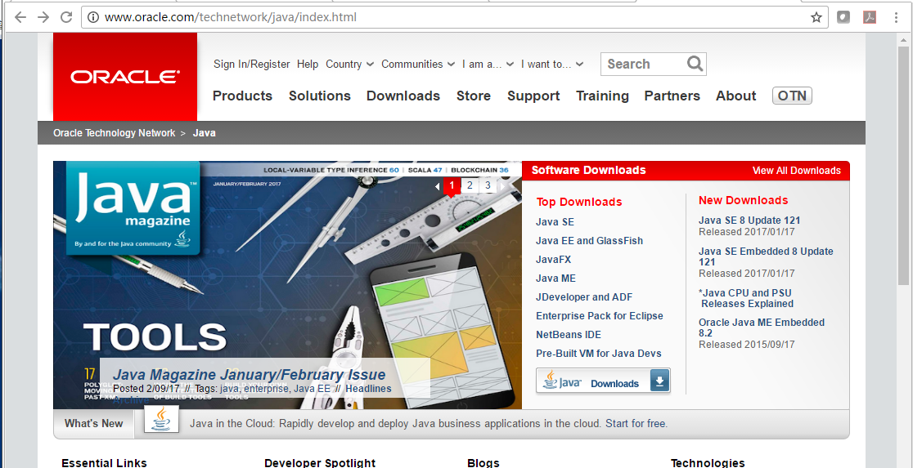
Java Development Kit (JDK)
Including JRE
Can be downloaded from Oracle website
http://java.sun.com

Slide 29
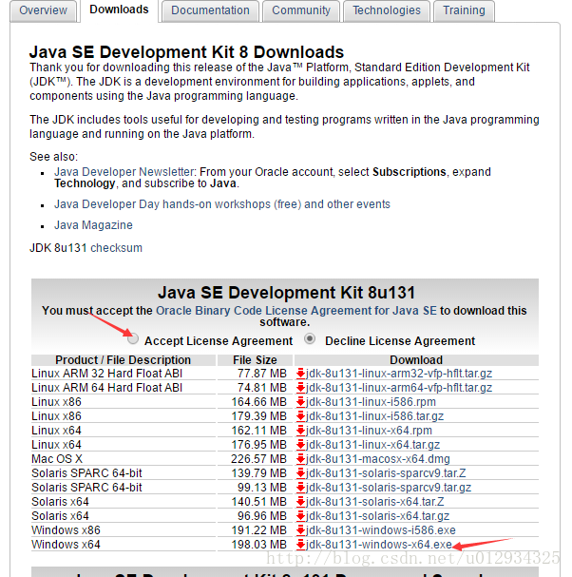
下载和安装JDK
http://java.sun.com

Slide 30
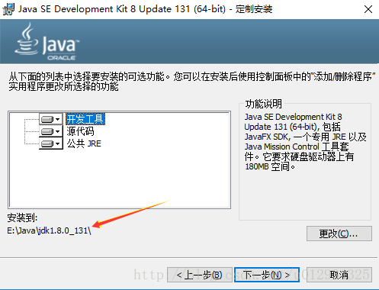
下载和安装JDK

Slide 31
安装目录
bin: 可执行程序和工具
  java编译器 javac.exe
  java解释器 java.exe
  java文档生成器 javadoc.exe
  java调试器 jdb.exe
db: 与数据库访问有关的文件
demo：一些实例程序
include: 与C相关的头文件
jre: 运行环境相关文件
lib：程序库

Slide 32
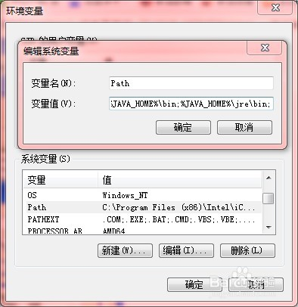
配置环境变量
  我的电脑-属性-高级-环境变量
  1. 设置JAVA_HOME
  指代JDK安装路径
  2. 设置Path
  %JAVA_HOME%\bin;%JAVA_HOME%\jre\bin;
  让系统识别java、javac等命令

Slide 33
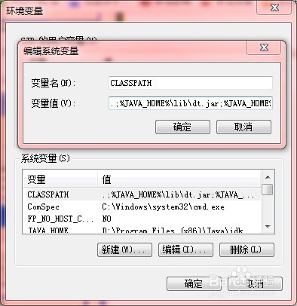
配置环境变量
  3. 设置CLASSPATH
.;%JAVA_HOME%\lib\dt.jar;%JAVA_HOME%\lib\tools.jar;
告诉jvm要使用或执行的class放在什么路径上，便于JVM加载class文件，.;表示当前路径，tools.jar和dt.jar为类库路径
tools.jar为工具类库，工具的实现，RMI等.
dt.jar: 运行环境类库，主要是swing包(用于GUI)
基本类库和扩展类库由jvm自动加载，不需要在classpath中设置

Slide 34
程序的编辑
程序编辑：编辑器——文件名要与public class的类名一致。区分大小写。
程序编译——转换为字节码文件，扩展名.class .其中包含 java虚拟机的指令。编译可以使用JDK工具javac.exe。
程序的运行——执行 .class文件中的指令的过程。

Slide 35
HelloWorld程序
// 源文件命名必须与定义的类名一致，区分大小写
// 以下源代码所在文件必须命名为HelloWorld.java
public class HelloWorld // 定义类
{
public static void main (String[] args) // 主函数
{
// 打印字符串Hello World
System.out.println (“Hello World”);
}
}

Slide 36
编译和运行
打开命令行终端
到HelloWorld.java所在目录
javac HelloWorld.java //编译,得到HelloWorld.class
java HelloWorld //执行HelloWorld.class

Slide 37


