Slide 1
JAVA 程序设计
7. 多线程
黄 骏
jun.huang@pku.edu.cn

Slide 2
第1周 课程介绍和Java简介
第2周 数据运算、控制流、数组
第3周 面向对象（1）抽象、封装、继承， HW-1
第4周 面向对象（2）多态、工具类
第5周 面向对象（3）内部类、局部类和匿名类
垃圾回收和异常处理
第6周 多线程
第7周 输出输出，HW2
第8周 泛型和集合类
第9周 网络编程
第10周 HW-3
第12周 设计模式（1）
第13周 设计模式（2）
第14~16周 Pre

Slide 3
Review
接口（interface）
  一种抽象类型，定义多个类可能具有的相似行为
  有常量和抽象函数生命组成
  对接口的实现和引用
// in file `Printable.java’
interface Printable {
void print();
}
// in file `Main.java’
public class Main {
public static void main (String args[]) {
// declare an interface type variable
Printable p;
// point to the instance of Hello
p = new Hello();
// call the method defined by interface, system will print ‘Hello’
p.print();
}
}
// in file `Hello.java’
public class Hello implements Printable{
void print() {
System.out.println(“Hello”);
}
}

Slide 4
Review
内部类
  定义在类内部的类
  用途：共同工作的类的组织（如人体、器官）
  语法规范和访问控制
  Static内部类

Slide 5
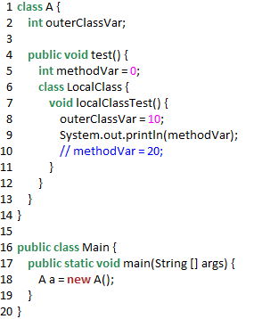
局部类（local class）
定义在方法中的类
不能够用public/private/protected /static修饰
可以被final和abstract修饰
可以访问外部类的成员
可读取该方法的局部变量
不能操作该方法的局部变量
// wrong

Slide 6
The difference is between local (method) variables vs class member variables.
A class member variable exists during the lifetime of the enclosing object, so it can be referenced by the local class instance.
A local variable, however, exists only during the method invocation, and is handled differently by the compiler, in that an implicit copy of it is generated as the member of the local class.
Without declaring the local variable final, one could change it, leading to subtle errors due to the inner class still referring to the original value of that variable.
-- From StackOverflow

Slide 7
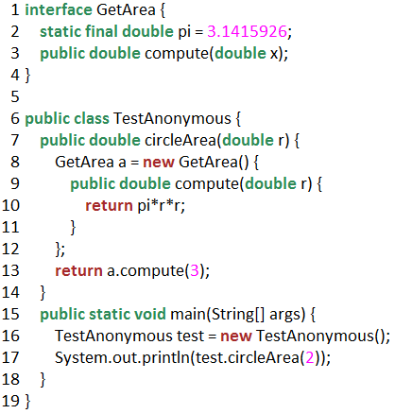
匿名类（anonymous class）
一种特殊的内部类
  没有类名(因此没有构造函数)
  定义时直接生成实例，一次性使用
  简化代码的书写
  编译器将生成xxxx$1.class
  接口是不能实例化的，接口的实现类才可以。new接口实质上是new接口的实现类，所以必须在new之后对类进行定义

Slide 8
垃圾回收和异常处理
垃圾回收
  时机
  try-finally, try-with-resources
异常处理
  error和exception
  RuntimeException和受检的异常
  处理方式：catch, throws
  自定义异常，extends Exception
  重抛异常

Slide 9
This Week
Java中的线程及其创建
线程的控制和同步

Slide 10
Multitasking vs. Multithreading
Multitasking:
  Refers to a computer’s ability to perform multiple jobs concurrently
  More than one program run concurrently
Multithreading
  A thread is a sequence of execution within a program
  Refers to multiple threads of control within a single program

Slide 11
Processes vs. Threads
CPU
程序（program）
  静态的代码
进程（process）
  程序的动态执行过程
  有私有的内存空间
线程（thread）
  更小的执行单位
  单个顺序的流控制
  可共享内存
Thread 1
Thread 2
process 1
process 2
process 3
Thread N

Slide 12
MultiThreads in an Application
Each thread has its private run-time task
  If two threads execute the same method, each will have its own copy of the local variables
All threads see the same memory
  Two different threads can act on the same object and same static fields concurrently

Slide 13
Java中的多线程
Java从语言级别支持多线程
  如Object类中的wait()和notify()
java.lang中的类Thread

Slide 14
创建多线程
方法1：Subclassing the Thread class and instantiating a new object of that class
  不建议使用该方法，继承Thread类之后不能再继承其他的类，降低程序的可扩展性
方法2：Implementing the Runnable interface
  将Thread类与要处理的任务分开，允许从其他类继承
In both cases the run() method should be implemented

Slide 15
方法1：继承java.lang.Thread
void start()
  Creates a new thread and makes it runnable
  Can be called only once
void run()
  The new thread begins its life inside this method

Slide 16
方法1：继承java.lang.Thread
public class ThreadExample extends Thread {
// 重写run()方法，该线程的start()方法被调用后JVM会自动调用该方法
public void run() {
System.out.println(“I’m running!”);
}
}
public class Test {
public static void main(String [] args) {
Thread t = new ThreadExample();
// 启动线程，t的run()方法将被调用
t.start();
}
}

Slide 17
方法1：继承java.lang.Thread
public class ThreadExample extends Thread {
// 重载run()方法，不会在start()方法被调用后被JVM自动执行
public void run(int times) {
System.out.println(“I’m running! (Overload));
}
}
public class Test {
public static void main(String [] args) {
Thread t = new ThreadExample();
t.start();
}
}

Slide 18
方法2：实现Runnable接口
public class RunnableExample implements Runnable {
public void run() {
System.out.println(“I’m running”);
}
}
public class Test {
public static void main(String [] args) {
RunnableExample r = new RunnableExample();
// 通过向Thread构造方法传递runnable对象创建线程
Thread t = new Thread(r);
t.start();
}
}

Slide 19
方法2：实现Runnable接口
When running the Runnable object, a Thread object is created from the Runnable object
The Thread object’s run() method calls the Runnable object’s run() method
Allows threads to run inside any object, regardless of inheritance

Slide 20
An Example
public class MyThread implements Runnable {
private String name;
MyThread (String name) { this.name = name; }
public void run() {
for (int i = 0; i < 5; i++)
System.out.println(name+“:”+i);
}
public static void main(String args[]) {
MyThread a = new MyThread (“A”);
MyThread b = new MyThread (“B”);
new Thread(a).start();
new Thread(b).start();
}
}

Slide 21
Outline
Java中的线程及其创建
线程的控制和同步

Slide 22
Java线程的状态
新建（New）
  尚未开始。
就绪（Runnable）
  进入线程队列排队等待CPU时间片。
运行（Running）
  正在运行，直至任务完成或时间片用尽。
阻塞（Blocked）
  人为挂起或者资源被占用时暂时中止运行。
  阻塞时不能进入排队队列。阻塞原因消除后转入就绪状态。
  例如等待用户输入而让出CPU
死亡（Dead）
  完成全部工作或被强行终止

Slide 23
线程的基本控制
终止：通常采用设定标记变量的方法
class MyThread implements Runnable {
boolean end = false;
public void run() {
while (!end) System.out.println (“I’m running!”);
}
public boolean stop() {
end = true;
}
}
public class Test {
public static void main(String args[]) {
MyThread t = new MyThread();
new Thread(t).start();
for (int i = 0; i < 1000000; i++);
t.stop();
}
}

Slide 24
线程的基本控制
  挂起:
void sleep(int m) or sleep(int m, int n)
  The thread sleeps for m milliseconds, plus n nanoseconds
  try {
  Thread.sleep(1000);
  }
  catch (InterruptedException e){
  // …
  }
  InterruptedException为受检异常

Slide 25
class MyThread implements Runnable {
public void run() {
for (int i = 0; i < 100; i++) {
System.out.println(i);
try {
Thread.sleep(1000);
}
catch (InterruptedException e) {
;
}
}
}
}
public class Test {
public static void main(String args[]) {
MyThread t = new MyThread();
new Thread(t).start();
}
}

Slide 26
线程的基本控制
  join()：调用某Thread对象的join()方法，可以将一个线程B加入到本线程A中，A的执行会等待B执行完毕。
  Thread t; // t是另一线程
  try {
  t.join();
  } catch (InterruptedException e) {
  //….
  }

Slide 27
import java.util.*;
class Runner implements Runnable {
public void run() {
for( int i=0; i<100; i++ ){
System.out.println( i );
try { Thread.sleep(100); } catch (InterruptedException e) {}
}
}
}
public class ThreadJoin {
public static void main(String args[]) {
Runner r = new Runner();
Thread thread = new Thread( r );
thread.start();
try { thread.join(); } catch (InterruptedException e) {} // 将runner线程加入
for( int i=0; i<10; i++ ){
System.out.println("\t" + i );
try { Thread.sleep(100); } catch( InterruptedException e ){}
}
}
}

Slide 28
线程的基本控制
Java中线程的优先级
MIN_PRIOPRITY
NORM_PRIORIT
MAX_PRIORITY
主线程具有普通优先级
新建线程继承创建它的父线程的优先级
setPriority(int priority)

Slide 29
class Runner implements Runnable {
public long counter = 0;
int id; boolean end = false;
Runner (int id) { this.id = id; }
public void run () { while (!end) counter ++; }
public void stopRun() { end = true; }
}
public class Test {
public static void main (String args[]) {
Runner a = new Runner(1); Thread ta = new Thread(a);
Runner b = new Runner(2); Thread tb = new Thread(b);
ta.setPriority (Thread.MIN_PRIORITY); ta.start();
tb.setPriority (Thread.MAX_PRIORITY); tb.start();
try { Thread.sleep(10000); } catch (Exception e) {}
a.stopRun(); b.stopRun();
System.out.println (a.counter);
System.out.println (b.counter);
}
}

Slide 30
线程的基本控制
void yield()
  使当前线程由运行状态进入就绪状态
  使其他具有相同优先级的线程获取执行权
  但不保证其他线程一定获得执行权
  不释放锁

Slide 31
class MyThread extends Thread {
public MyThread (String name) { super(name);
}
public synchronized void run() {
for (int i = 0; i < 10; i++) { System.out.printf("%s, priority:%d, %d\n",
this.getName(), this.getPriority(), i);
if (i%4 == 0)
Thread.yield();
}
}
}
public class YieldTest {
public static void main(String[] args) {
Thread t1 = new MyThread("t1");
Thread t2 = new MyThread("t2");
t1.start();
t2.start();
}
}

Slide 32
线程的基本控制
void wait()
  使当前线程由运行状态进入阻塞状态
  释放锁

Slide 33
线程的基本控制
Daemon和非Daemon线程
  非Daemon线程（普通线程）
  Daemon线程（守护线程）
    运行在后台（如垃圾回收）
    主线程不能是Daemon线程
  当所有非Daemon线程运行结束时,
  JVM将强制结束所有Daemon线程并退出
  setDaemon(true)：将线程设置为守护线程

Slide 34
import java.util.*;
public class TestThreadDaemon {
public static void main(String args[]) {
Thread t = new MyThread();
t.setDaemon(true); t.start();
System.out.println ("Main Begin");
try { Thread.sleep (500); } catch (InterruptedException e) {}
System.out.println("Main End");
}
}
class MyThread extends Thread {
public void run() {
for (int i=0; i<10; i++ ){
System.out.println (“MyThread" + i);
try { Thread.sleep(1000); } catch (InterruptedException e){}
}
}
}

Slide 35
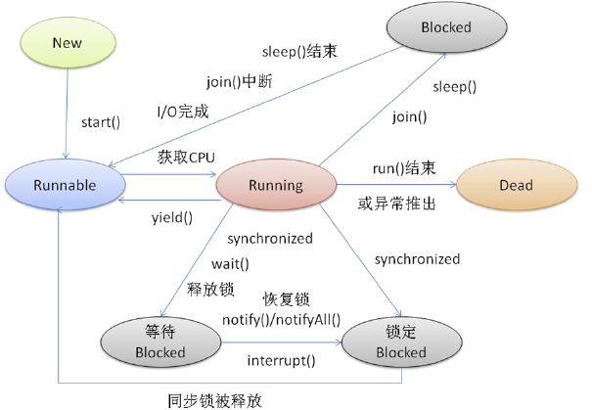

Slide 36
Outline
Java中的线程及其创建
线程的控制和同步

Slide 37
线程的同步
线程都是独立的，而且异步执行，也就是说每个线程都包含了运行时所需要的数据或方法，而不需要外部的资源或方法，也不必关心其它线程的状态或行为。
经常有一些同时运行的线程需要共享数据，例如线程A向文件写数据，而线程B从同一文件中读数据。因此就必须考虑其它线程的状态与行为，这时就需要实现同步来得到预期结果。

Slide 38
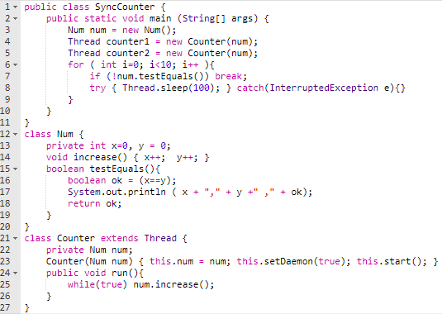

Slide 39
class SyncCounter1 {
public static void main (String[] args) {
Num num = new Num();
Thread counter1 = new Counter(num);
Thread counter2 = new Counter(num);
for ( int i=0; i<10; i++ ){
if (!num.testEquals()) break;
try { Thread.sleep(100); } catch(InterruptedException e){}
}
}
}
class Num {
private int x=0, y = 0;
void increase() { x++; y++; }
boolean testEquals(){
boolean ok = (x==y);
System.out.println ( x + "," + y +" ," + ok);
return ok;
}
}
class Counter extends Thread {
private Num num;
Counter( Num num ) { this.num = num; this.start(); }
public void run() { while(true) num.increase(); }
}

Slide 40
线程安全（Thread Safe）
线程间的切换或调度不影响最终结果的正确性
若对某个对象只有读操作而无写操作，则一般来说这个对象是线程安全的
若多个线程同时读写，一般需要考虑同步，否则将影响线程安全

Slide 42
互斥锁
保证共享数据操作的完整性
  将一个内存对象作为“互斥锁”
  这个标记用来保证在任一时刻，只能有一个线程访问该对象。
  关键字synchronized用来与对象的互斥锁联系

Slide 43
synchronized
对代码片段
  Synchronized(对象) { //同步代码块 }
对某个方法
  用synchronized声明方法
  public synchronized void foo() { … }
  表示整个方法为同步代码块

Slide 44
synchronized
首先尝试取得对象obj的互斥锁
若成功则执行代码块
否则线程进入阻塞状态
Object obj = new Object();
synchronized(obj) {
// code block
}

Slide 45
synchronized
将类的实例作为锁对象
首先尝试取得实例a的互斥锁
若成功则执行代码块
否则线程进入阻塞状态
class A {
public synchronized void foo() {
// code block
}
}
A a = new A();
a.foo();

Slide 46
synchronized
首先尝试取得所有A实例(a0和a1)的互斥锁
若成功则执行代码块
否则线程进入阻塞状态
class A {
public static synchronized void foo() {
// code block
}
}
A a0 = new A();
A a1 = new A();
A.foo();

Slide 47
Synchronized关键字
对于同步方法块，锁是Synchonized括号里配置的对象。
对于实例同步方法，锁是当前实例对象。
对于静态同步方法，锁是当前Class的所有对象。

Slide 48
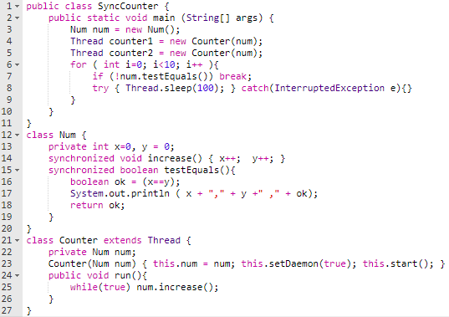

Slide 50
class MyThread implements Runnable {
private int threadId;
public MyThread(int id) {
this.threadId = id;
}
public void run() {
print();
}
private synchronized void print() {
for (int i = 0; i < 5; ++i) {
System.out.println("ID: " + threadId + " : " + i);
}
}
}
public class Test {
public static void main(String[] args) throws InterruptedException {
for (int i = 0; i < 10; ++i) {
new Thread(new MyThread(i)).start();
}
}
}

Slide 51
class MyThread implements Runnable {
private int threadId;
private Object lock;
public MyThread(int id, Object lock) {
this.threadId = id;
this.lock = lock;
}
public void run() {
synchronized(lock) { print(); }
}
private void print() {
for (int i = 0; i < 5; ++i)
System.out.println("ID: " + threadId + " : " + i);
}
}
public class Test {
public static void main(String[] args) throws InterruptedException {
Object obj = new Object();
for (int i = 0; i < 10; ++i)
new Thread(new MyThread(i, obj)).start();
}
}

Slide 52
class MyThread implements Runnable {
private int threadId;
static private Object lock = new Object();
public MyThread(int id) { this.threadId = id; }
public void run() {
synchronized(lock) { print(); }
}
private void print() {
for (int i = 0; i < 5; ++i) {
System.out.println("ID: " + threadId + " : " + i);
}
}
}
public class Test {
public static void main(String[] args) throws InterruptedException {
for (int i = 0; i < 10; ++i) {
new Thread(new MyThread(i)).start();
}
}
}

Slide 53
class MyThread implements Runnable {
private int threadId;
public MyThread(int id) {
this.threadId = id;
}
public void run() {
print(threadId);
}
private static synchronized void print(int threadId) {
for (int i = 0; i < 5; ++i) {
System.out.println("ID: " + threadId + " : " + i);
}
}
}
public class Test {
public static void main(String[] args) throws InterruptedException {
for (int i = 0; i < 10; ++i) {
new Thread(new MyThread(i)).start();
}
}
}

Slide 54
notify() and wait()
notify()和notifyAll()
  使正在等待的一个或所有线程进入就绪状态
wait()
  释放对象锁

Slide 55
生产者和消费者
  class CubbyHole {
  private int index = 0;
  private int [] data = new int[3];
  public synchronized void put (int value){
  // producer
  while (index == data.length) { // data is full, wait for consumer …
  try {
  this.wait();
  }
  catch (InterruptedException e){}
  }
  data[index] = value;
  index++;
  this.notify();
  }

Slide 56
生产者和消费者
    public synchronized int get() {
    // consumer
    while (index <=0){
    try {
    this.wait();
    }
    catch (InterruptedException e) {}
}
    index--;
    int val = data[index];
    this.notify();
    return val;
    }
}

Slide 57
死锁
两个以上的线程争抢资源，造成永远阻塞
Thread A:
synchronized (lock1) {
dosomething();
synchronized (lock2) {
dosomething();
}
}
Thread B:
synchronized (lock2) {
dosomething();
synchronized (lock1) {
dosomething();
}
}

Slide 58
Summary
创建
  extends Threads vs implements Runnable
控制
  状态转移：新建、就绪、运行、阻塞、死亡
  stop, sleep, join, setPriority, yield, wait, setDaemon
同步
  线程安全
  synchronized
  死锁

