Slide 1
JAVA 程序设计
8. 输入输出流
黄 骏
jun.huang@pku.edu.cn

Slide 2
Review
线程的创建
  extends Thread
  implements runnable
线程的状态和控制
线程的同步

Slide 3
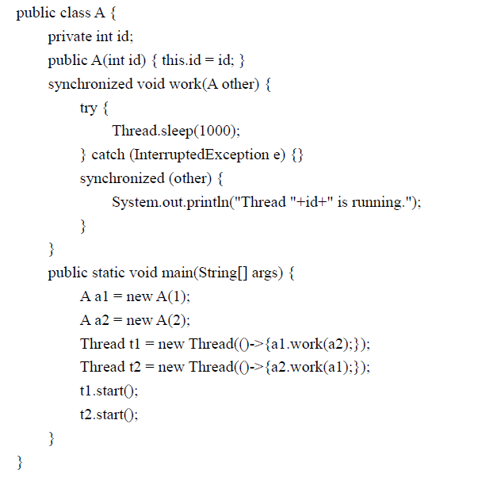

Slide 4
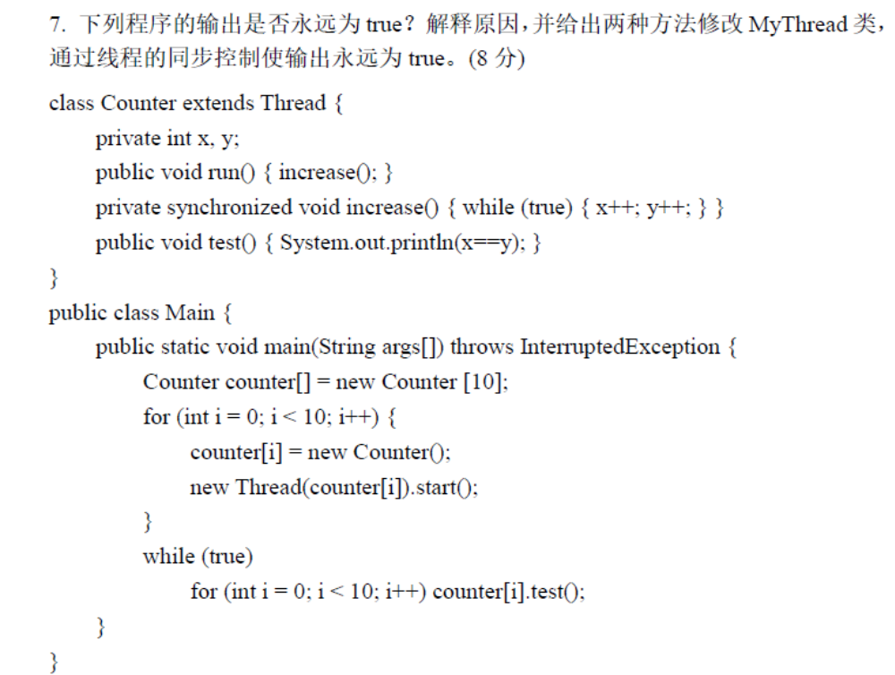

Slide 5
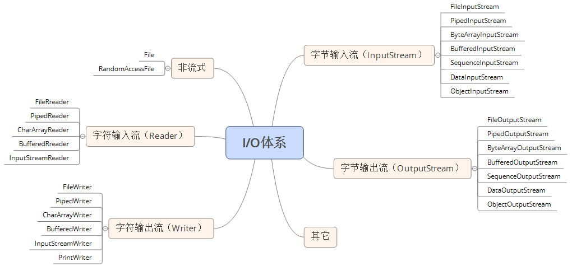
核心

Slide 6
核心

Slide 7
File类
java.io.File 是对文件名和目录路径名的一种抽象的、系统无关的表示
  An abstract, system-independent view of hierarchical pathnames (files or directories)
  Prefix + Names
该类主要用于文件和目录的创建、文件的查找和文件的删除等

Slide 8
Constructor
File (File parent, String child) Creates a new File instance from a parent abstract pathname and a child pathname string.
File (String pathname) Creates a new File instance by converting the given pathname string into an abstract pathname.
File (String parent, String child) Creates a new File instance from a parent pathname string and a child pathname string.

Slide 9
Methods
GetName(), GetParent(), GetParentFile()
isDirectory(), isFile()
exists()
  Test whether the file or directory exists
mkdir()/mkdirs()
  Creates the directory named by this abstract pathname
  如上级目录不存在
    mkdir会抛出异常, mkdirs将上级目录一起创建
list()/listFiles()
  Returns an array of strings/File objects that denote the files and directories in the current directory

Slide 10
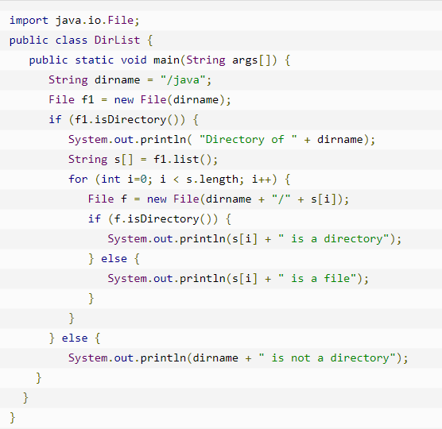

Slide 11
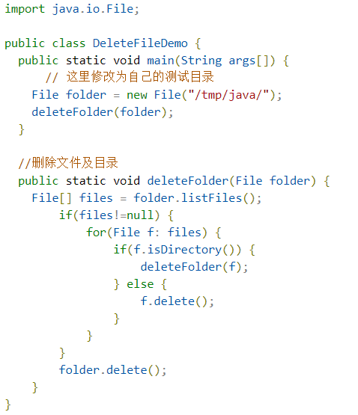

Slide 12
RandomAccessFile
File类针对文件本身进行操作（创建、删除、查询…）
RandomAccessFile类对文件内容进行操作
Random Access File: 表现为存储在文件系统中的字节数组
读写一个文件中指定位置的数据
  文件位置由file pointer表示
只能读写文件，不能操作其他IO设备

Slide 13
构造函数
public RandomAccessFile (String name, String mode)
throws FileNotFoundException
public RandomAccessFile (String name, String mode)
throws FileNotFoundException
Mode
“r” Open for reading only. Invoking any of the write methods of the resulting objects will cause an IOException to be thrown
“rw” Open for reading and writing. If the file does not already exist then an attempt will be made to create it
“rws” Open for reading and writing, as with “rw”, and also require that every update to the file’s content or metadata be written synchronously to the underlying storage device
“rwd” Open for reading and writing, as with “rw”, and also require that every update to the file’s content be written synchronously to the underlying storage device

Slide 14
“rws” and “rwd”
“rw”模式下使用buffer, 只有cache满或调用RandomAccessFile.close()关闭流时才真正写入存储器
“rws” 每修改一个byte立刻写入存储器，同时更新文件属性（如大小、路径、是否隐藏…）
“rwd” 只对文件内容同步更新到存储器，而不更新文件属性

Slide 15
Methods
public long length ()
  Return the length of this file
public void seek (long pos)
  Sets the file-pointer offset, measured from the beginning of this file, at which the next read or write occurs
public long getFilePointer ()
  Return the current offset in this file

Slide 16
Methods
public int read () throws IOException
  读取一个字节
  返回0~255，如果遇到end of file则返回-1
  block if no input is available
public int read (byte[] b) throws IOException
  将最多b.length字节读入到b，
  返回读到的字节数，如果遇到end of file则返回-1
  blocks until at least one byte of input is available

Slide 17
Methods
public int read (byte[] b, int off, int len) throws IOException
  读入最多len字节，并写入到b中
  从off指定的位置开始写入
  返回读到的字节数，如果遇到end of file则返回-1
  blocks until at least one byte of input is available
  Throws …

Slide 18
Methods
public int read (byte[] b, int off, int len) throws IOException
  读入最多len字节，并写入到b中
  从off指定的位置开始写入
  返回读到的字节数，如果遇到end of file则返回-1
  blocks until at least one byte of input is available
  Throws …
    IOException If the first byte cannot be read for any reason other than end of file, or if the random access file has been closed, or if some other I/O error occurs
    NullPointerException: if b is null
    IndexOutofBoundsException: if off is negative, len is negative, or len is greater then b.length-off

Slide 19
Methods
public int readFully (byte[] b)
public int readFully (byte[] b, int off, int len)
  Reads b.length or len bytes from this file into b.
  off is the start offset in b at which the data is written.
  This method reads repeatedly from the file until b.length or len bytes are read.
  It blocks until b.length or len bytes are read, the end of the stream is detected, or an exception is thrown.

Slide 20
Methods
public void write (byte[] b)
  Write b.length bytes from b to this file
public void write (byte[] b, int off, int len)
  Write len bytes from b starting at offset off to this file
public void close ()
  Close the file and releases system resources

Slide 21
public class Test {
public static void main (String args[]) {
String path = “file pathname”;
RandomAccessFile raf = null;
try {
raf = new RandomAccessFile (path, “rw”);
raf.seek (raf.length());
raf.write (“Hello world!”.getBytes());
raf.seek (0);
byte [] buff = new byte[1024]; int len = 0;
while ((len = raf.read(buff)) > 0)
System.out.println (new String(buff, 0, len));
} catch (Exception e) {
e.printStackTrace();
} finally {
if (raf != null) {
try { raf.close(); } catch (IOException e) { }
}
}
}
}

Slide 22
核心

Slide 23
Outline
字节流和字符流
管道流
节点流和处理流

Slide 24
字节流与字符流
字节流
  InputStream / OutputStream
  以字节为单元
  操作二进制对象时应使用字节流
字符流
  Reader / Writer
  以字符（16位）为单元

Slide 25
InputStream
抽象类，所有字节输入流的祖先
主要方法
public abstract int read ()
public int read (byte[] b)
public int read (byte[] b, int off, int len)
public long skip (long n)
public int available ()
public void close ()

Slide 26
abstract int read () throws IOException
Reads the next byte of data from the input stream.
Return 0 to 255 if success.
Return -1 if the end of the stream has been reached.
Blocks until input data is available, end of stream, or exeption

Slide 27
public int read (byte[] b, int off, int len) throws IOException
Reads up to len bytes from the input stream into b.
An attempt is made to read as many as len bytes.
The number of bytes actually read is returned as an integer.
Return -1 is if end of stream
The first byte read is stored at b[off]
This method simply call read() repeatedly.

Slide 28
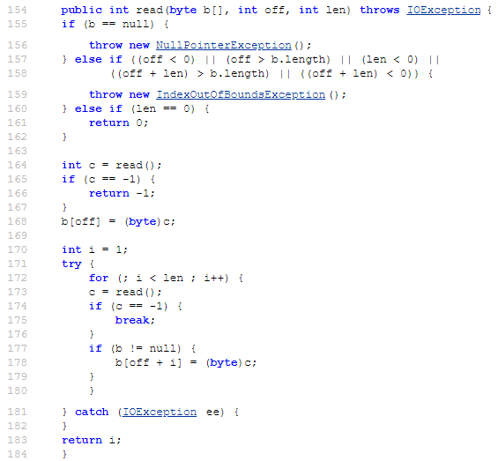

Slide 29
public long skip (long n)
Skips over up to n bytes of data from this input stream
May end up skipping over a smaller number of bytes (e.g., reaching the end of a file)
public int available ()
Returns an estimate of the number of bytes that can be read (or skipped over) from this input stream without blocking

Slide 30
OutputStream
抽象类，所有字节输出流的祖先
主要方法
public abstract void write (int b)
public void write (byte[] b)
public void write (byte[] b, int off, int len)
public void flush ()
public void close ()

Slide 31
abstract void write (int b) throws IOException
Writes the specified byte to this output stream
The eight low-order bits of b will be written
the 24 high-order bits are ignored

Slide 32
public void write (byte[] b, int off, int len) throws IOException
Writes up to len bytes from b starting at off to this stream
The first byte to write is b[off]
Exceptions
  b is null; off or len is negative; off+len is greater than b.length
public void flush () throws IOException
Flushes this output stream and forces any buffered output bytes to be written out

Slide 33
字节流的实现类
ByteArrayInputStream/ByteArrayOutputStream
  以内存中的一个缓冲区作为io对象
FileInputStream/FileOutputStream
  以文件为io对象
SequenceInputStream/SequencedOutputStream
  多个InputStream/OutputStream的合并

Slide 34
字节流的实现类
ByteArrayInputStream/ByteArrayOutputStream
  以内存中的一个缓冲区作为io对象
FileInputStream/FileOutputStream
  以文件为io对象
SequenceInputStream/SequencedOutputStream
  多个InputStream/OutputStream的合并

Slide 35
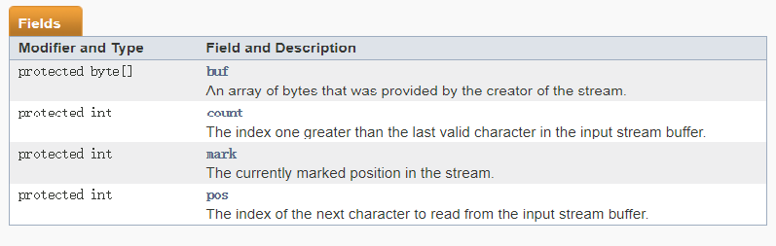
字节流的实现类
ByteArrayInputStream/ByteArrayOutputStream
  以内存中的一个缓冲区作为io对象

Slide 36
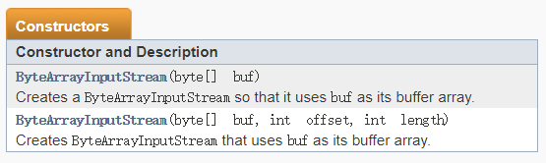
字节流的实现类
ByteArrayInputStream/ByteArrayOutputStream
  以内存中的一个缓冲区作为io对象

Slide 37
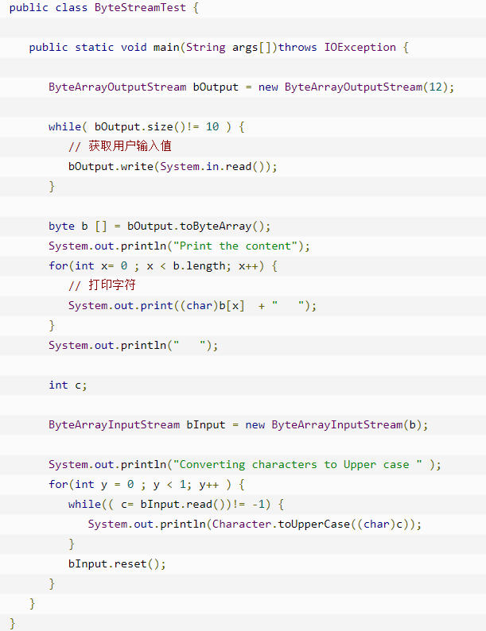

Slide 38
字符流：Reader
Reader类与InputStream类相似，都是输入流，但差别在于Reader类读取的是字符（char），而不是字节。
Reader的重要方法是read()，有三种形式：
  public int read()；//将读入的字符转为int型返回，若成功则返回值为0~65535，否则返回-1
  public int read(char b[])；//读入的字符放入数组，返回读取的字符的长度
  public int read(char[] b, int off, int len)；

Slide 39
字符流： Write
Writer类与OutputStream类相似，都是输出流，但差别在于Writer类写入的是字符（char），而不是字节。Writer的方法有：
  public void write (int b)；// 将参数b的低两字节写入到输出流
  public void write (char b[])；// 将字符数组b[]中的全部字节顺序写入到输出流
  public void write(char[] b, int off, int len)；// 将字节数组b[]中从off开始的len个字节写入到流中
  public void write( String s)；// 将字符串写入流中
  public void write( String s, int off, int len)；// 将字符串写入流中, off为位置，len为长度
  public void flush ()；// 刷新流
  public void close()；// 关闭流

Slide 40
Outline
字节流和字符流
管道流
节点流和处理流

Slide 41
管道流
管道流是用来在多个线程之间进行信息传递的Java流。
管道流分为字节流管道流和字符管道流。
  字节管道流：PipedOutputStream 和 PipedInputStream。
  字符管道流：PipedWriter 和 PipedReader。
  PipedOutputStream、PipedWriter 是写入者/生产者/发送者；
  PipedInputStream、PipedReader 是读取者/消费者/接收者。
管道流的输入输出是成对的，一个输出流只能对应一个输入流，使用构造函数或者connect函数进行连接；
管道的读写操作是互相阻塞的，当缓冲区为空时，读操作阻塞；当缓冲区满时，写操作阻塞；

Slide 42
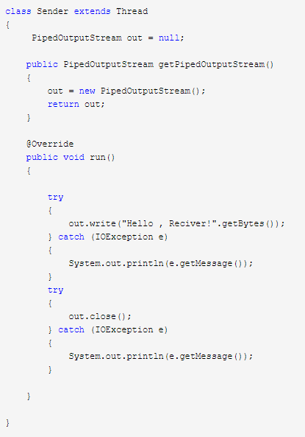

Slide 43
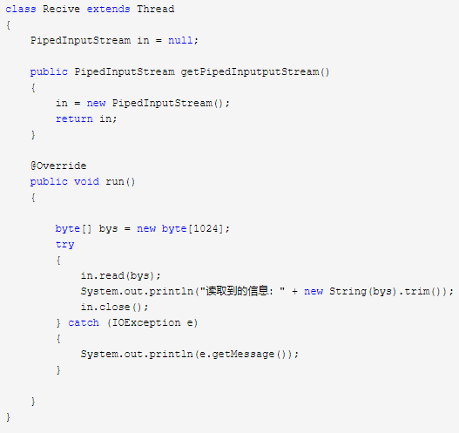

Slide 44
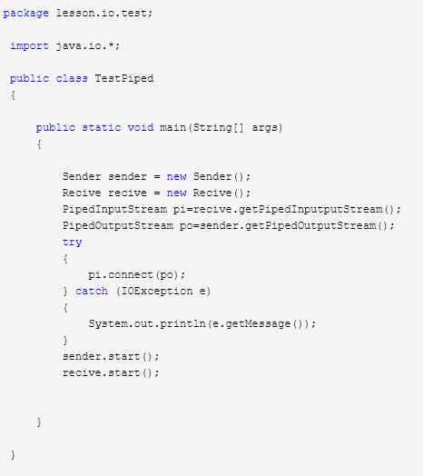

Slide 45
节点流和处理流
按照流是否直接与特定的地方（如磁盘、内存、设备等）相连，分为节点流与处理流两类。
  节点流（Node Stream）
    可以从或向一个特定的地方（节点）读写数据。如文件流FileReader。
  处理流（Processing Stream）
    不与IO设备直接相连
    是对一个已存在的流的连接和封装，通过所封装的流的功能调用实现数据读、写功能。处理流又称为过滤流，如缓冲处理流BufferedReader。

Slide 46
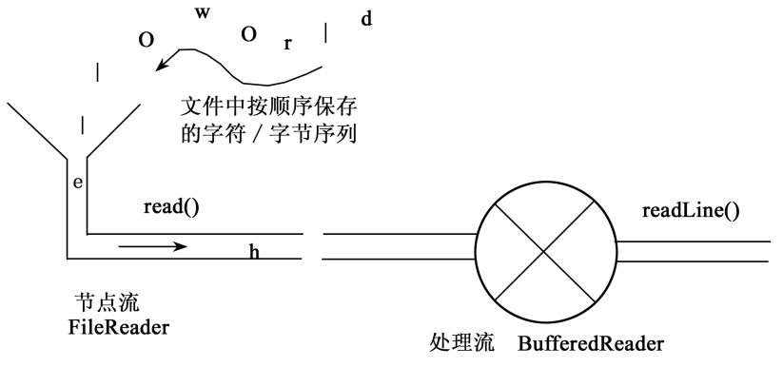
节点流和处理流
节点流与处理流的关系，如图所示。节点流直接与节点（如文件）相连，而处理流对节点流或其他处理流进一步进行处理（如缓冲、组装成对象，等等）。

Slide 47
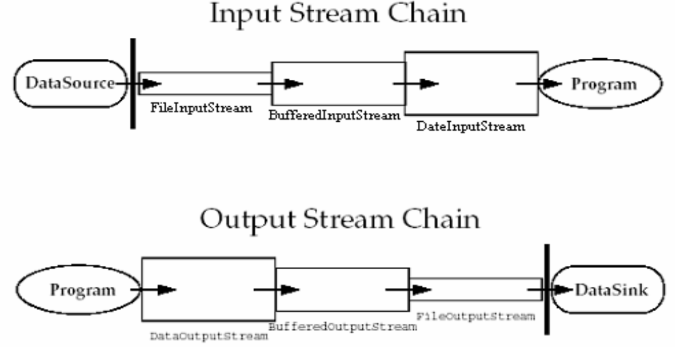
流的链接
处理流的构造方法总是要带一个其他的流对象作参数。如：
BufferedReader in = new BufferedReader(new FileReader(file));
BufferedReader in2 =
new BufferedReader(
new InputReamReader(
new FileInputStream(file)));
一个流对象经过其他流的多次包装，称为流的链接

