Slide 1
JAVA 程序设计
11. 网络编程
黄 骏
jun.huang@pku.edu.cn

Slide 2
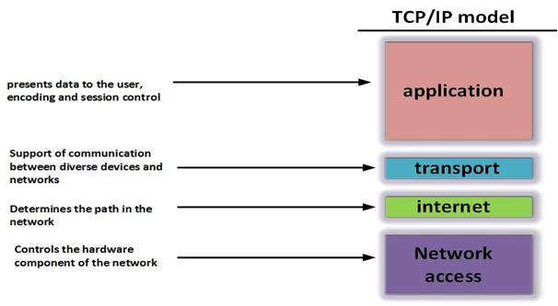
网络分层模型
TCP/IP模型

Slide 3
网络地址
  IP地址：
    网络层地址，主机的标识
  端口号：
    传输层地址，通信进程的标识

Slide 4
通信协议
网络层
  IP路由
传输层
  TCP：面向连接，可靠
  UDP：无连接，不可靠
应用层
  FTP、HTTP

Slide 5
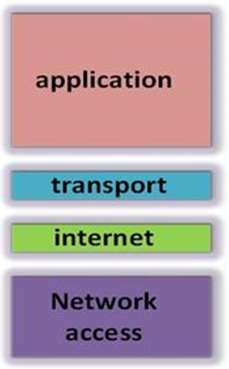
通信模型
Sender
Receiver

Slide 6
套接字（Socket）
位于传输层与应用层之间的接口
  sits on top of a platform-dependent implementation of network stack
  hiding the details of any particular system from your Java program
套接字的三要素
  IP地址、端口号、协议
  分类：流式（TCP）、数据报式（UDP）、Raw IP

Slide 7
java.net
Provides the classes for implementing networking applications.
Deals with the following abstractions:
  Addresses
  Sockets
  Interfaces
    网络接口（如以太网卡、无线网卡）的抽象

Slide 8
TCP通信：Socket类
Implements TCP client sockets
Constructors
  Socket ()
  Socket (InetAddress addr, int port)
  Socket (String host, int port)
  Socket (InetAddress addr, int port,
  InetAddress localAddr, int localPort)
  Socket (String host, int port,
  InetAddress localAddr, int localPort)

Slide 9
TCP通信：Socket类
Method
  void bind (SocketAddress bindpoint)
  void close ()
  InputStream getInputStream ()
  OutputStream getOutputStream ()
  void connect (SocketAddress endpoint, int timeout)

Slide 10
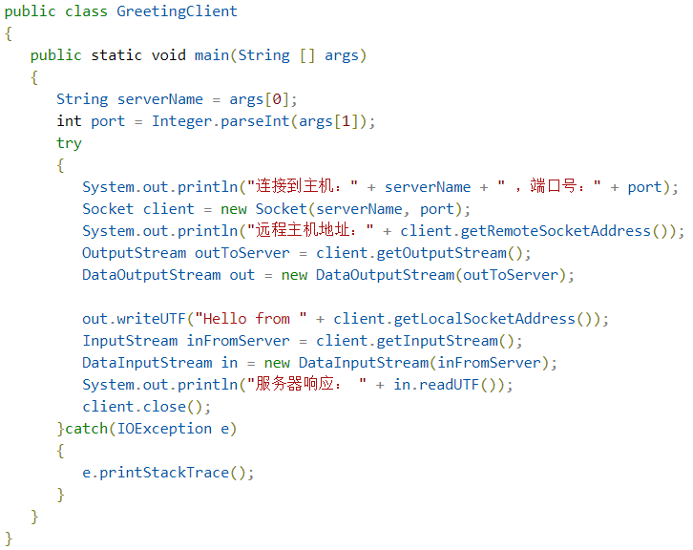

Slide 11
1.构造套接字，与服务器端连接，获取输出流
2.发送消息，获取输入流，接收服务器响应

Slide 12
TCP通信：ServerSocket类
Method
  Socket accept ()
    Listens for a connection request and accepts it.
    The method blocks until a connection is made.
    Returns a new Socket that connects with the client
  void setSoTimeout (int timeout)
    With this option set to a non-zero timeout, a call to accept() for this ServerSocket will block for only this amount of time
    If the timeout expires, a java.net.SocketTimeoutException
    will be raised

Slide 13
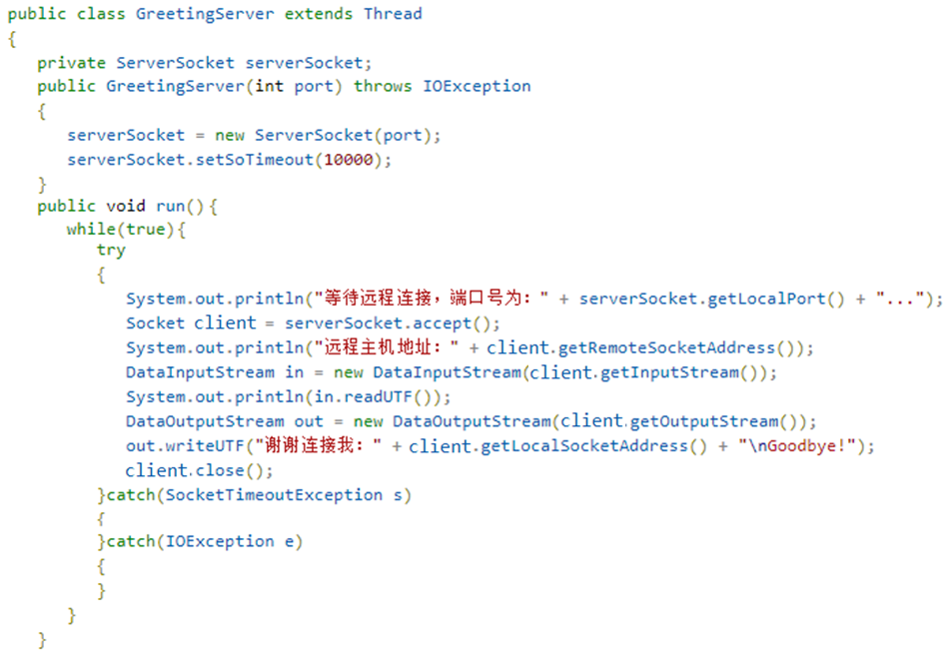

Slide 14
0.在指定端口建立server，设置timeout
1.等待Client连接，读取消息
2.发送响应，关闭socket

Slide 15
Server-Side Extension for Multiple Clients
基本模式
while (true) {
accept a connection;
create a thread to deal with the client;
}

Slide 16
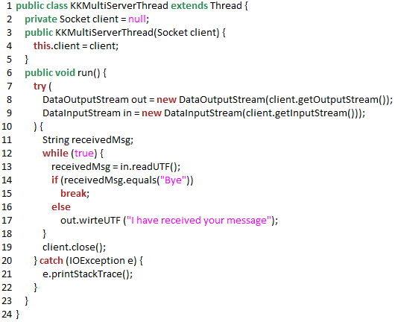

Slide 17
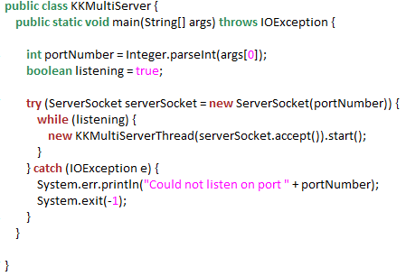

Slide 18
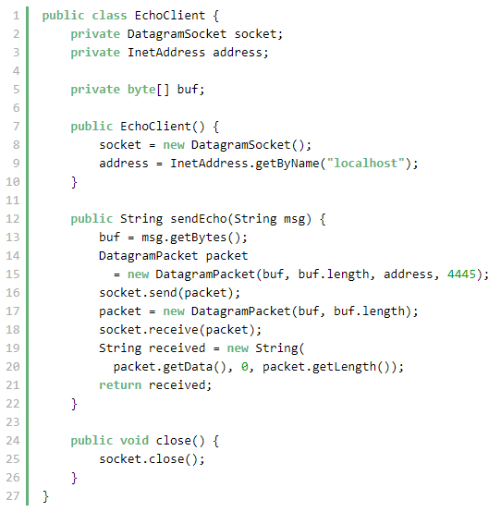
UDP通信

Slide 19
UDP通信
在packet中指定目的地址

Slide 20
UDP通信
接收packet

Slide 21
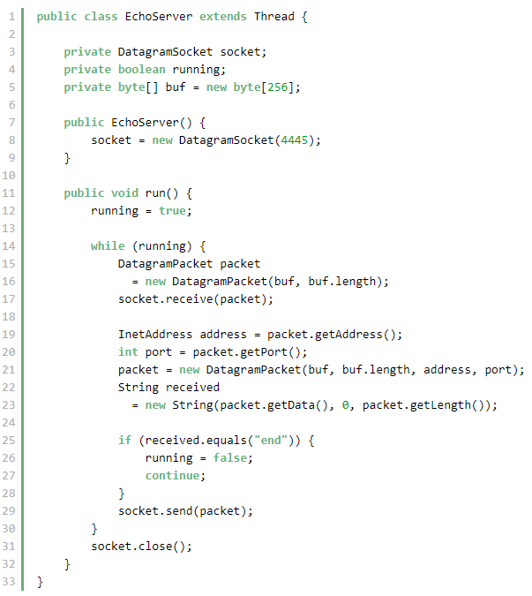
UDP通信

Slide 22
UDP通信：DatagramSocket类
A datagram socket is the sending or receiving point for a packet delivery service.
Each packet sent or received on a datagram socket is individually addressed and routed.

Slide 23
UDP通信：DatagramSocket类
Constructor
  DatagramSocket (int port)
  DatagramSocket (int port, InetAddress localAddr)
Methods
  void receive (DatagramPacket p)
  void send (DatagramPacket p)

Slide 24
UDP通信：DatagramPacket
Implement a connectionless packet
Each message is routed from one machine to another based solely on information contained within that packet

Slide 25
UDP通信：DatagramPacket
Implement a connectionless packet
Each message is routed from one machine to another based solely on information contained within that packet
Members：
  packet data (byte[]) and length (int)
  IP addr (InetAddress)
  port (int)

