Slide 1

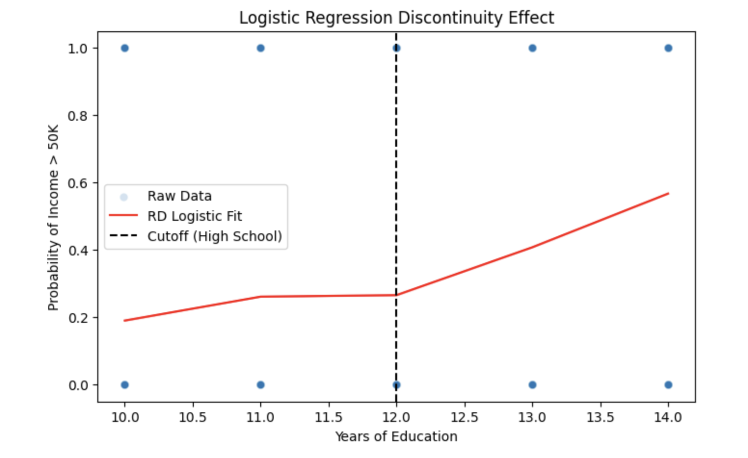
Causal Inference & Machine Learning: Analyzing Income Policies Through RD Design [Yishen Song] Duke Kunshan University, Data Science Department
Introduction
Background
Income-based policy thresholds (e.g., minimum wage laws, financial assistance programs) create eligibility cutoffs.
These cutoffs can introduce nonlinear effects on employment and income.
Regression Discontinuity (RD) Design helps analyze these impacts.
Machine Learning (ML) models enhance prediction and interpretability.
Objective
Apply ML and RD design to evaluate how minimum wage policies influence employment.
Research Question
How does RD design help assess the causal effect of income policies on employment outcomes?
Methodology
Data & Preprocessing
Dataset: UCI Adult Income Dataset.
Cleaning: Removed missing values, standardized features.
Feature Engineering: Categorical encoding, variable scaling.
ML for Explanation
NLP analysis: Extracted key income-related terms using TF-IDF & GPT-2 attention maps.
ML for Prediction
Models: Random Forest, Logistic Regression, Neural Networks.
Optimization: Hyperparameter tuning, cross-validation.
Evaluation Metrics: Accuracy, Precision, Recall, ROC-AUC.
Causal Inference (RD Analysis)
Cutoff: Income threshold at $35,000.
Identification: Comparing individuals just above and below the cutoff.
Estimation: Logistic RD model to determine employment probability shifts.
Results (Right Panel)
Causal Inference Findings (Regression Discontinuity
Analysis)
Regression Discontinuity (RD) Design was applied to assess the causal effect of education on income.
The logistic regression RD model demonstrates a clear discontinuity at 12 years of education, reinforcing the impact of completing high school on earning potential.
The probability of earning above $50K significantly increases after the high school threshold, confirming the policy relevance of education-based income thresholds.
Future Work (Bottom Panel)
Expand Real-World Applications
Use real economic datasets to validate findings.
Enhance ML Models
Implement LSTMs & Transformers for better prediction.
Refine Causal Analysis
Incorporate additional economic control variables for robustness.
Ethical Considerations
Address bias in AI-driven policy recommendations to ensure fairness.

