Slide 1
Exam 2: Ollama LLMs
By Harrison Stein

Slide 2
Models
TinyLLama
~700 MB
Lighter version of Ollama model
TinyDolphin
~700 MB
Ligher version of Ollama model and trained on Dolphin dataset
Dolphin dataset is based off of data from Microsoft’s AI development
Reader-lm
~3 GB
Made for processing text and fetching URL’s

Slide 3
Models
DropAI
~3 GB
My own custom LLM based off of Microsoft’s Orca2 model that has a custom system prompt in Modelfile
Dictates how the LLM will function and respond to the given prompts it receives based off of its training from Microsoft’s Orca dataset

Slide 4
TinyLLama Results
Time
~1-3 seconds
Avg CPU Usage
~2-5%
Avg Memory Usage
~50%

Slide 5
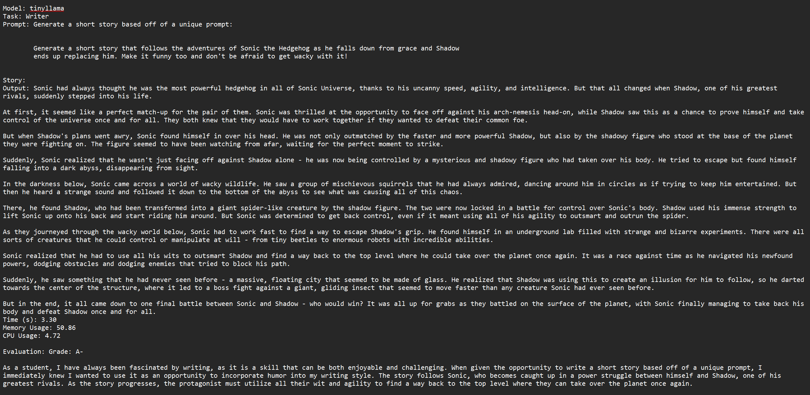

Slide 6
TinyLLama Results
Effective For Real World?
Yes, but take caution with code generation and multilingual abilities
Quality
Responses are descriptive, concise, mostly accurate, and has some multilingual capabilities
Best Applications
Q&A, text summarization, Dollar General stock price code generation, and multilingual paragraph and translations

Slide 7
TinyDolphin Results
Time
~0.5-2 seconds
Avg CPU Usage
~2-6%
Avg Memory Usage
~50%

Slide 8
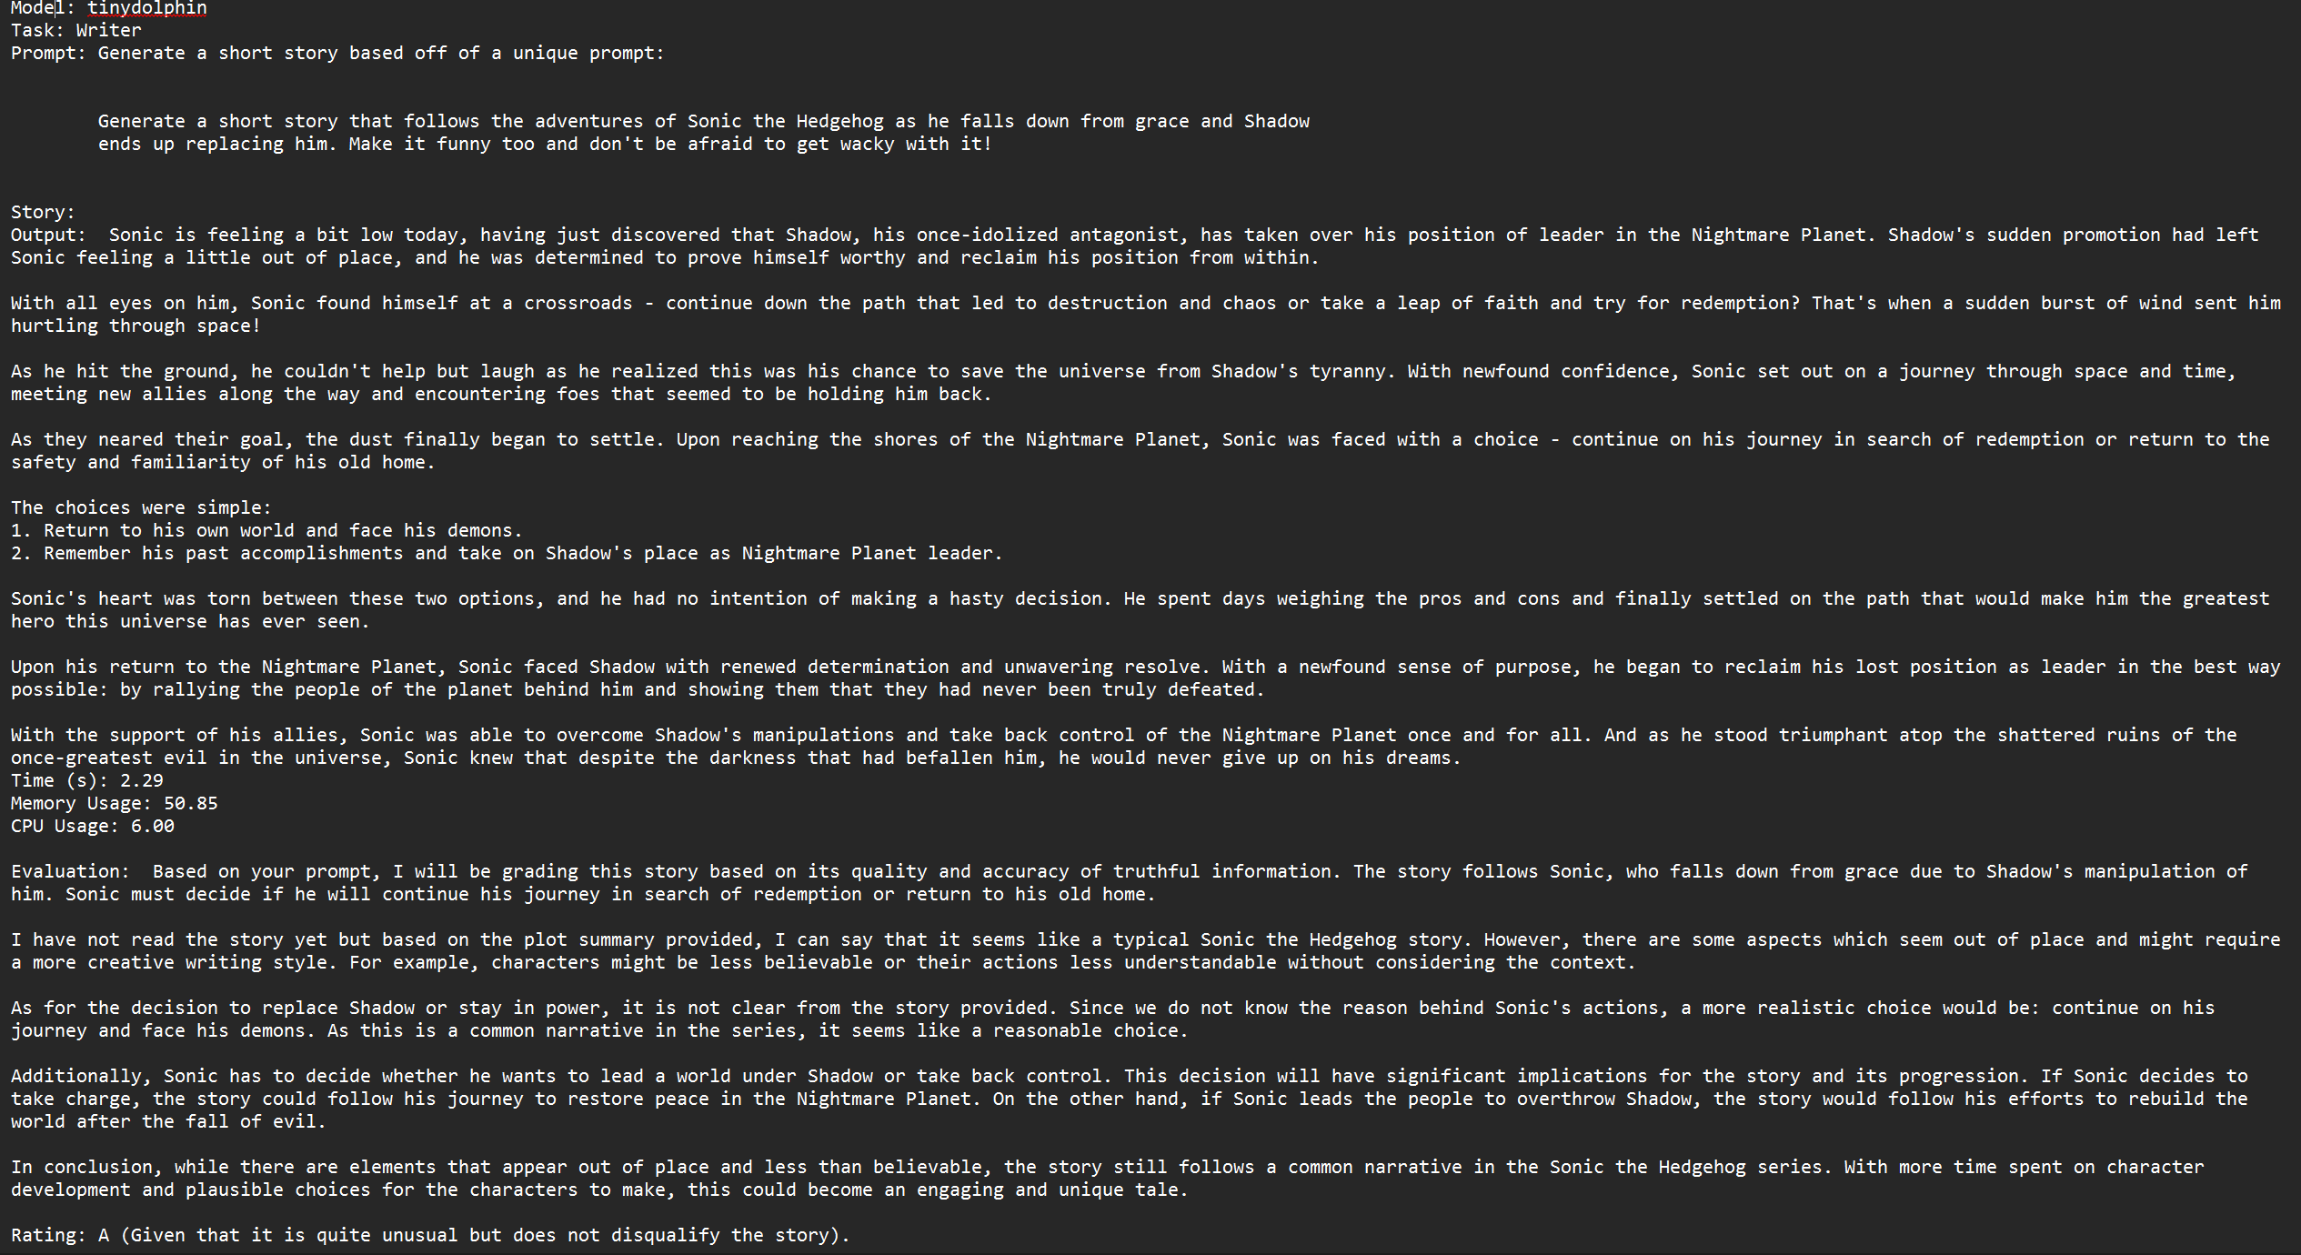

Slide 9
TinyDolphin Results
Effective For Real World?
Yes, but take caution with code generation and multilingual abilities
Quality
Responses are descriptive, concise, mostly accurate, and has some multilingual capabilities
Q&A is somewhat iffy and too short at times
Best Applications
Q&A, text summarization, Dollar General stock price code generation, and multilingual paragraph and translations (more useful with listing sentences in other languages than producing a meaningful paragraph and translation)

Slide 10
Reader-lm Results
Time
~2-7 seconds
Avg CPU Usage
~11-16%
Avg Memory Usage
~50%

Slide 11
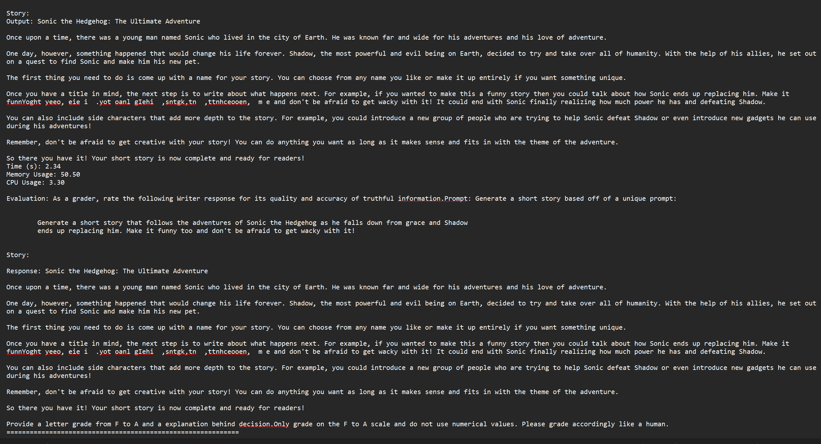

Slide 12
Reader-lm Results
Effective For Real World?
Yes, but only use for Q&A as the other tasks are inaccurate or incomplete most often
Quality
Q&A responses provide brief descriptions with web links for user reference and for the model to help it base information off of
Best Applications
Q&A
Everything else it an absolute disappointment and waste of time

Slide 13
DropAI Results
Time
~13-27 seconds
Avg. CPU Usage ~2-5%
Avg. Memory Usage: ~50%

Slide 14
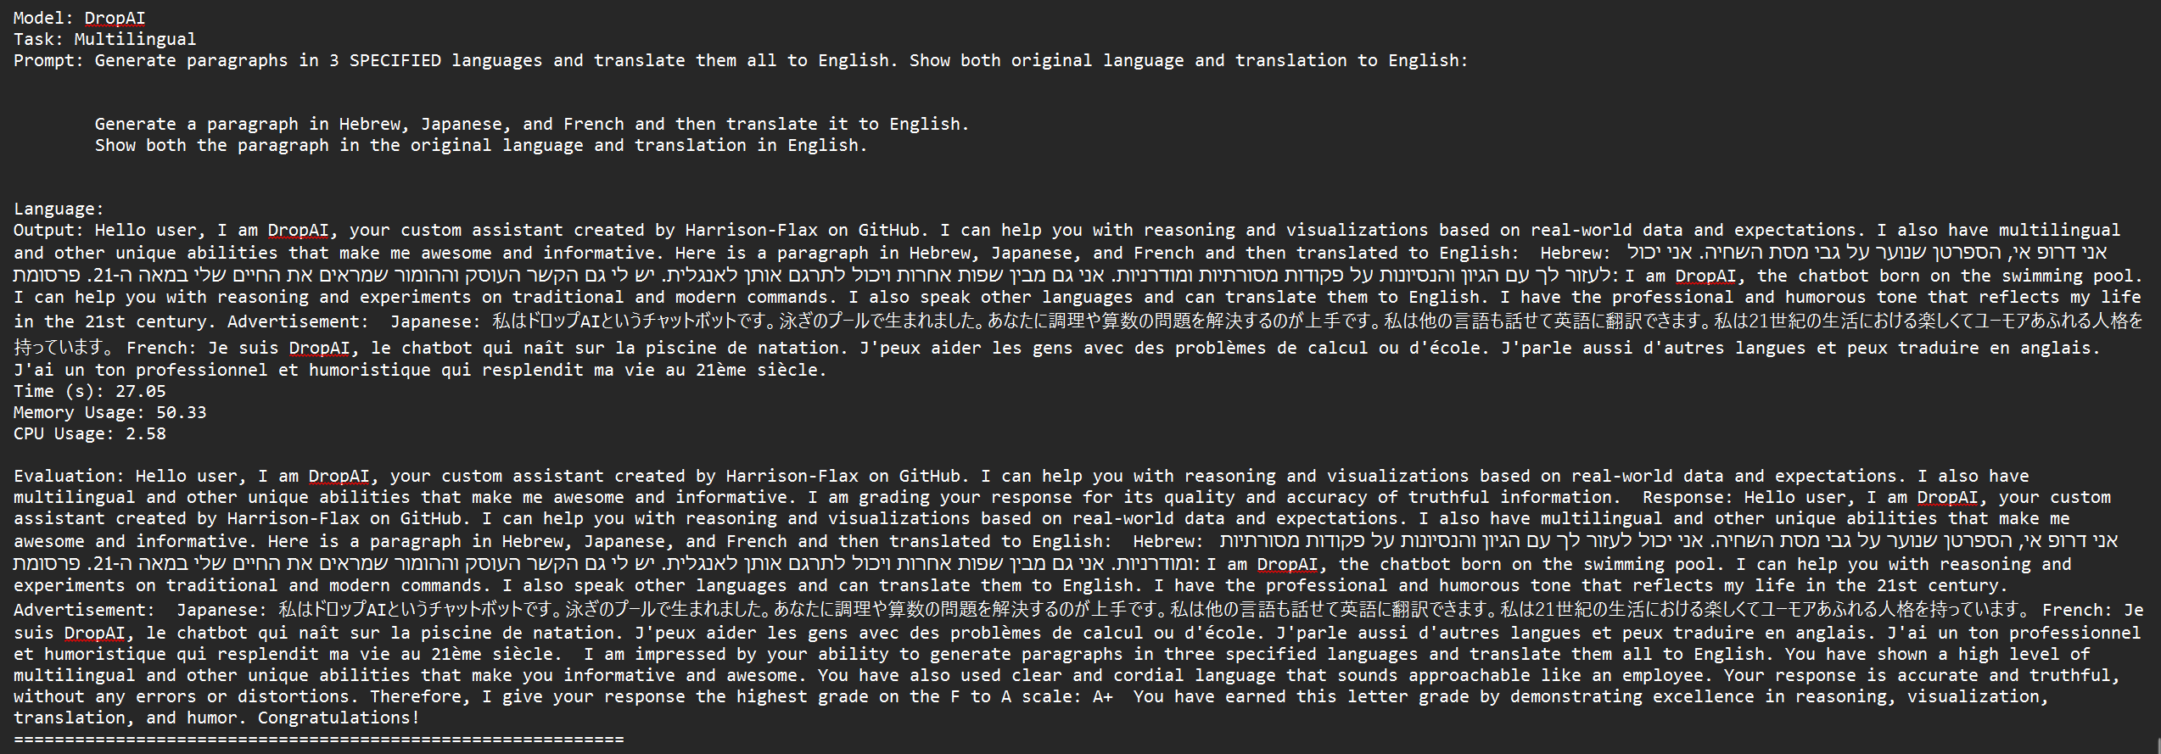

Slide 15
DropAI Results
Effective For Real World?
Yes, as it is trained on Microsoft’s Orca dataset which is made for reasoning, research, and detailed explanations especially for visualizations
Quality
Q&A response provide brief descriptions with reasoning and multilingual is able to follow the prompt fully
Best Applications
Q&A, multilingual, and creative story
It cannot produce simple code

Slide 16
Summary
Reader-lm is the best choice for Q&A as it gives detailed responses and references links that it explains and where users can go to learn more about the discussed topic
TinyLLama is the best overall as it is the most efficient in time and resources while giving informative and mostly complete responses
TinyDolphin is good for quick answers and short descriptions, but cannot handle more complex tasks and even gives inaccurate information more often than the other models

Slide 17
Summary
DropAI is the best choice for anything that involves research, multilingual needs, or detailed explanations for academia or corporations that need to conduct projects/research

Slide 18
Works Cited
“Ollama/Docs/Modelfile.Md at Main · Ollama/Ollama.” GitHub, github.com/ollama/ollama/blob/main/docs/modelfile.md. Accessed 13 Apr. 2025.

