Slide 1
Recurrent Neural Networks and Stock Price Prediction
By Harrison Stein

Slide 2
Overview
Stocks fetched from Yahoo Finance
XGBoost classifier
Time series split for X and y train and test
CNN, MLP, LSTM, and GRU models
GeLU, ReLU, sigmoid, and tanh activations
categorical_crossentropy for all models
Run over 50 epochs for each model

Slide 3
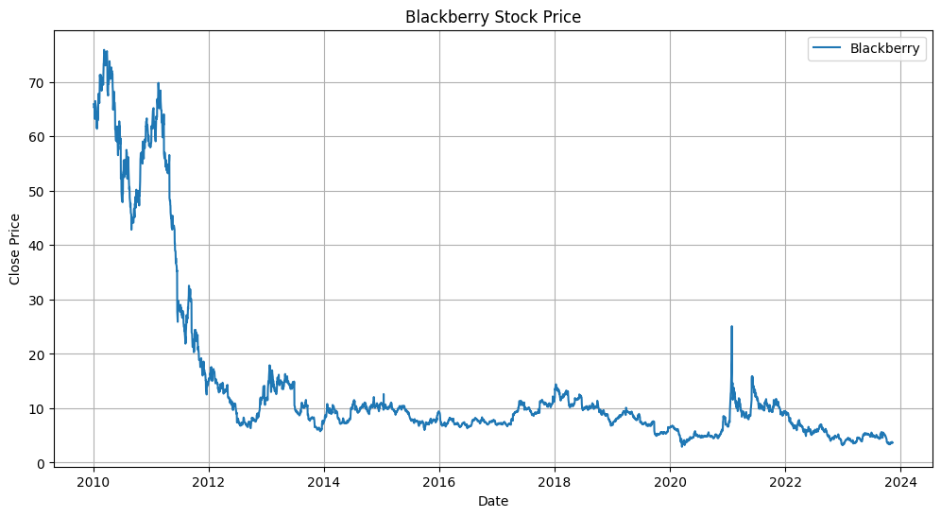
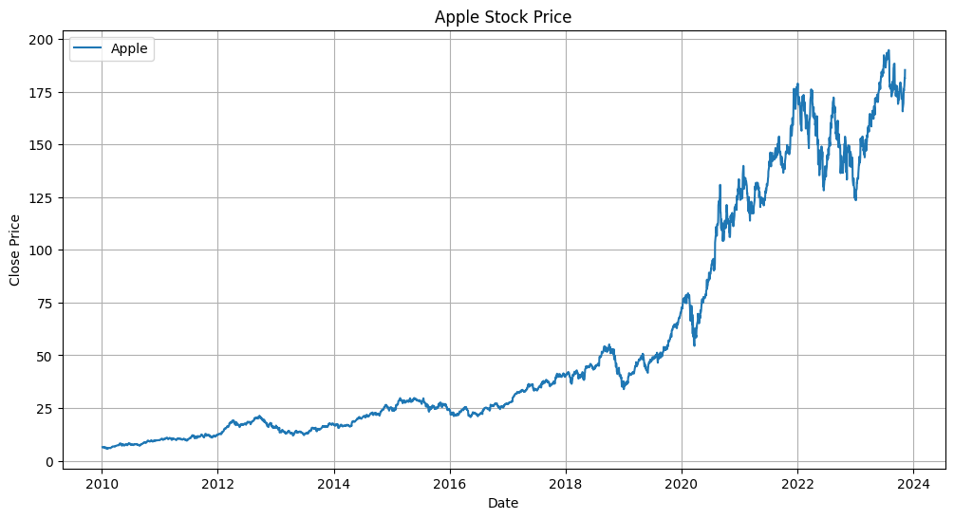
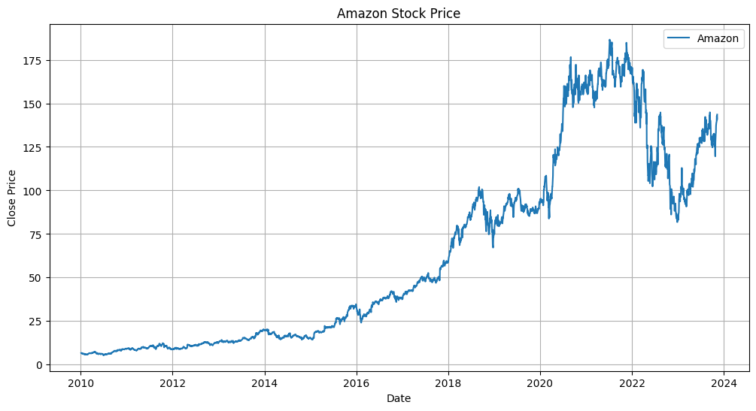
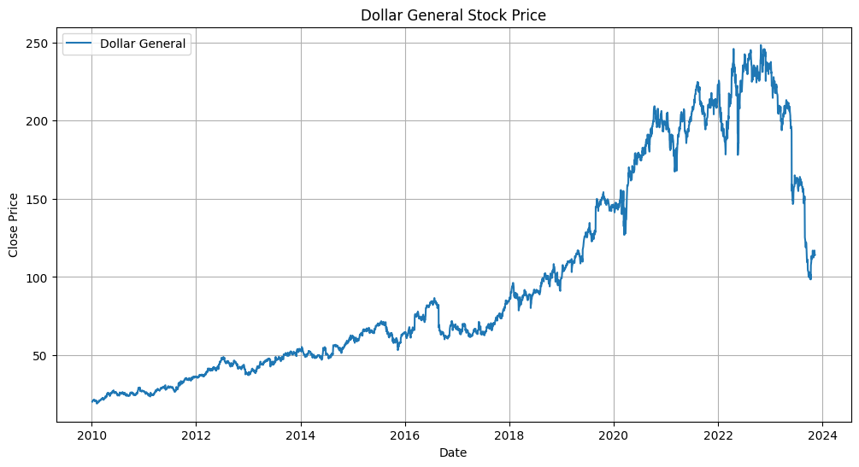
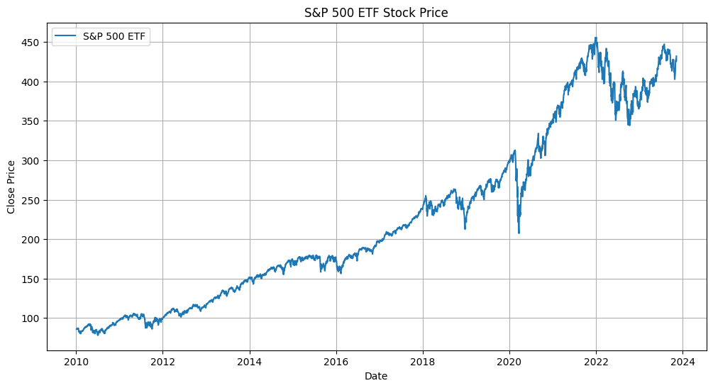
Stocks
Features are held in a list along with the combined stock data
Target is held separately in y

Slide 4
Stocks (Continued)
X and y train and test variables are in a time split for classification
Conditions and corresponding values:
Three sets of shifts upwards within the range of 0.005
Three classes with 0 index
Feature columns include:
Return, volume change, moving average ratios, volatility, and lag features (return previous and volume change previous)

Slide 5
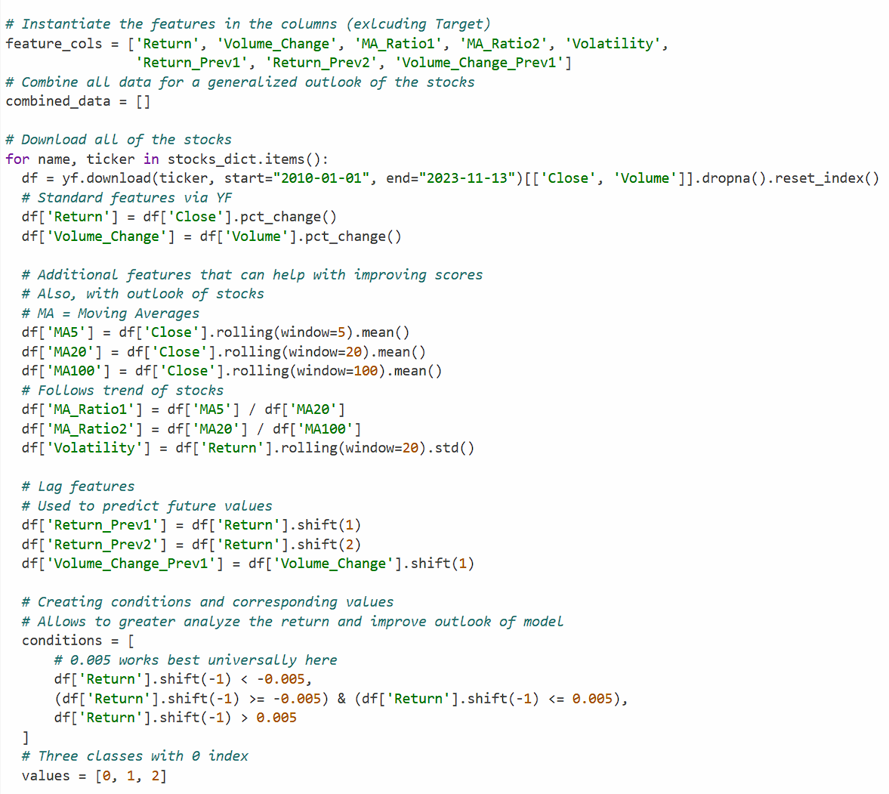

Slide 6
XGBoost Classifier
Built within a pipeline with StandardScaler
Works great for dealing with training and testing stocks over models
I will mainly use it with classification practices here

Slide 7
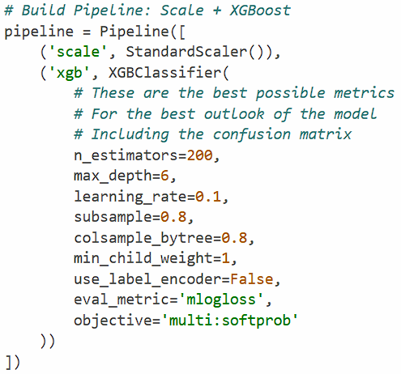

Slide 8
Interpreting The Confusion Matrix (XGBoost)
Performance of correct class classification (columns against the target data)
Shows correct predictions and misclassifications
Useful for classification models with combined stocks and multiple classes as it shows which features are reliable and which are not in model performance

Slide 9
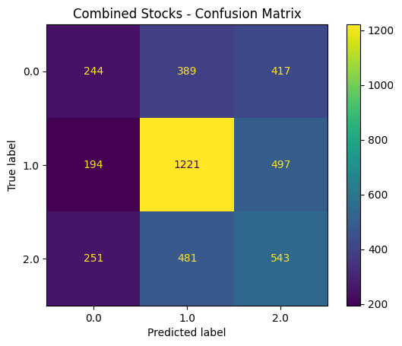
Notes:
Class 0 has the worst accuracy and correct predictions (high confusion)
Class 1 has the best accuracy and correct predictions (low confusion)
Class 2 performs worse than Class 1, but better than Class 0 (high confusion)

Slide 10
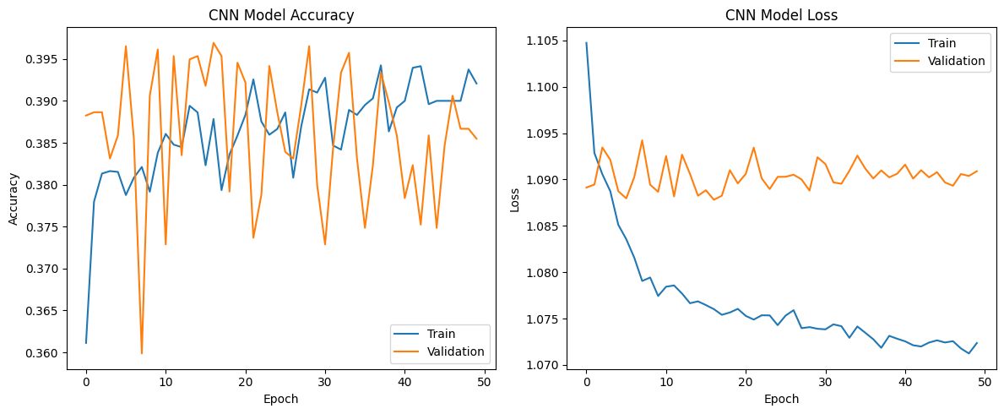
CNN Model

Slide 11
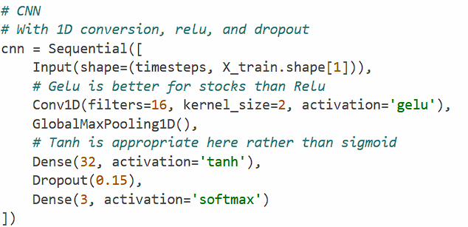
CNN Model (Continued)

Slide 12
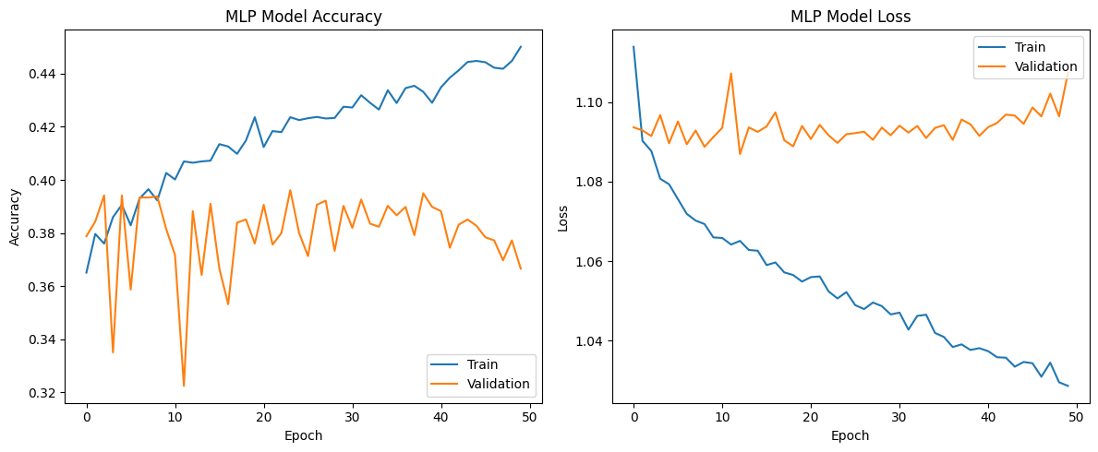
MLP Model

Slide 13
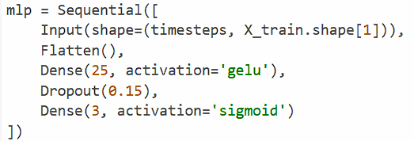
MLP Model (Continued)

Slide 14
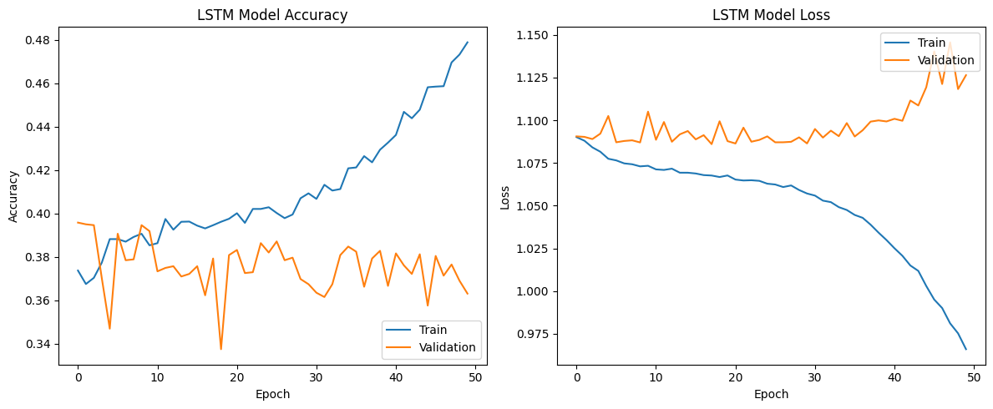
LSTM Model

Slide 15
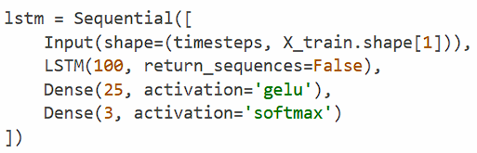
LSTM Model (Continued)

Slide 16
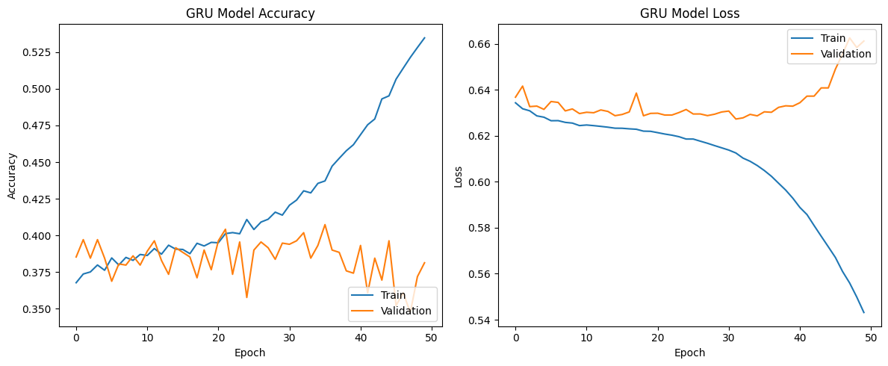
GRU Model

Slide 17
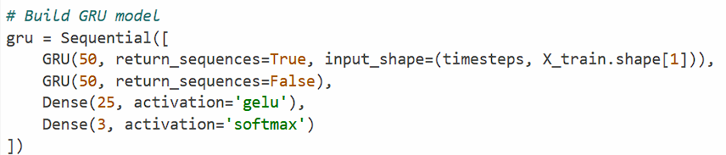
GRU Model (Continued)

Slide 18
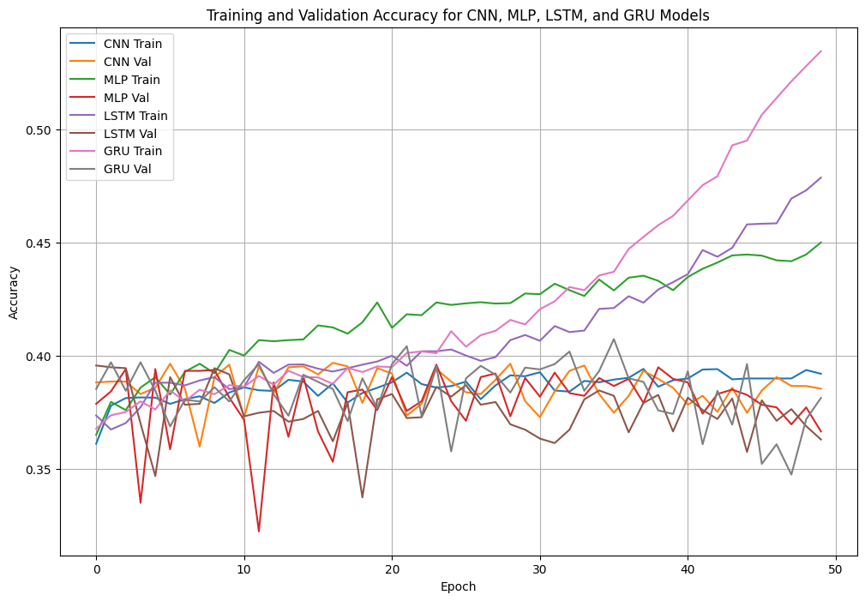
Performances Plotted Together

Slide 19
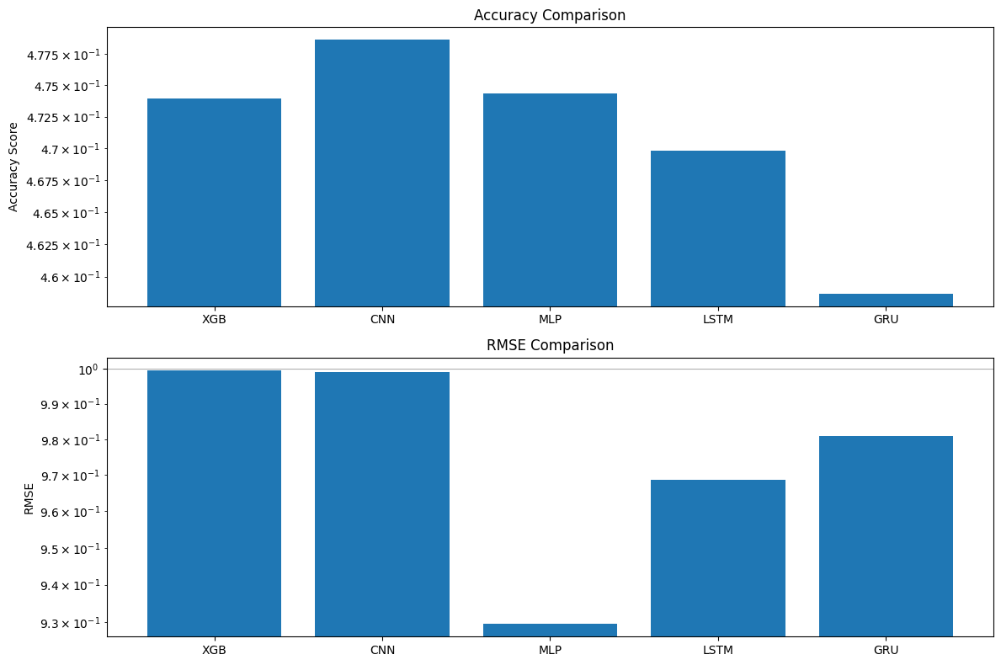
Accuracy and RMSE Log Graphs

Slide 20
Conclusion
The CNN is the best performing in accuracy as it has the highest accuracy, but a high RMSE which means it is inconsistent in its predictions
However, the MLP model is the best overall as it has the most consistent balance between accuracy and RMSE and is the most stable compared to the other models especially across multiple metrics
MLP does not overfit while CNN (slightly) and GRU does (majorly)

