Slide 1
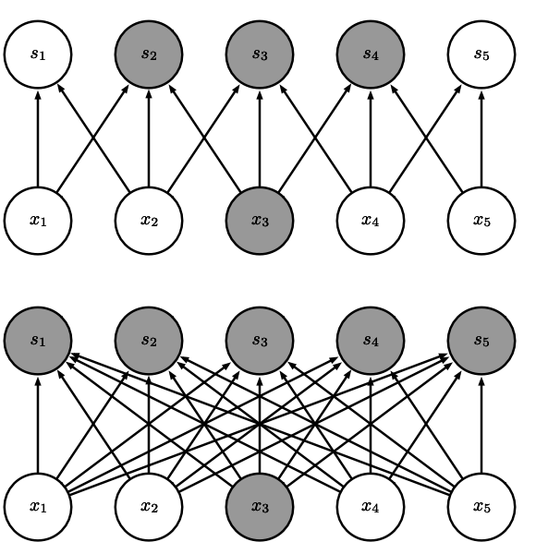
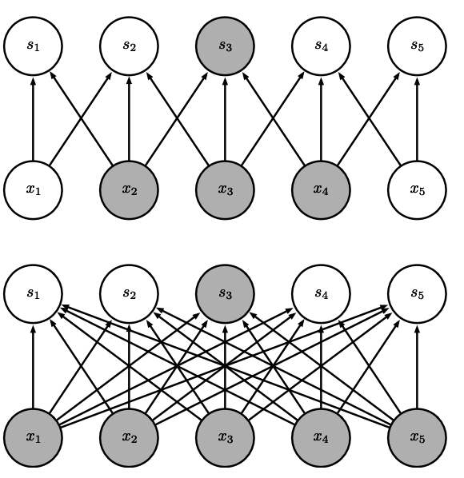
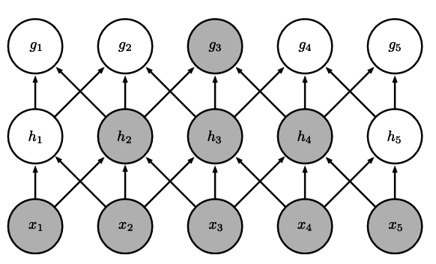
The receptive field of the units in the deeper layers of a convolutional network is larger than the receptive field of the units in the shallow layers. This effect increases if the network includes architectural features like strided convolution or pooling This means that even though direct connections in a convolutional net are very sparse, units in the deeper layers can be indirectly connected to all or most of the input image.
(Top)When s is formed by convolution with a kernel of width 3, only three outputs are affected by x. (Bottom)When s is formed by matrix multiplication, connectivity is no longer sparse, so all the outputs are affected by x3.
(Top)When s is formed by convolution with a kernel of width 3, only three inputs affect s3. (Bottom)When s is formed by matrix multiplication, connectivity is no longer sparse, so all the inputs affect s3.

Slide 2
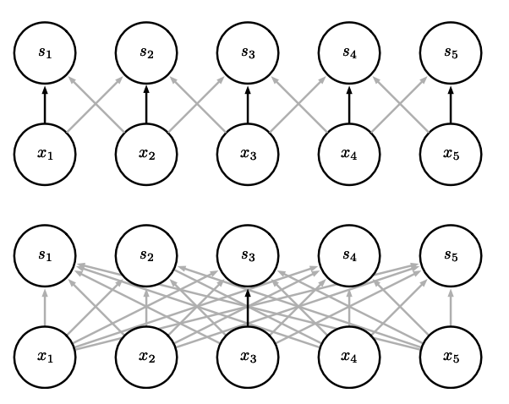
Parameter sharing. Black arrows indicate the connections that use a particular parameter in two different models. (Top)The black arrows indicate uses of the central element of a 3-element kernel in a convolutional model. Because of parameter sharing, this single parameter is used at all input locations. (Bottom)The single black arrow indicates the use of the central element of the weight matrix in a fully connected model. This model has no parameter sharing, so the parameter is used only once.

