Slide 1

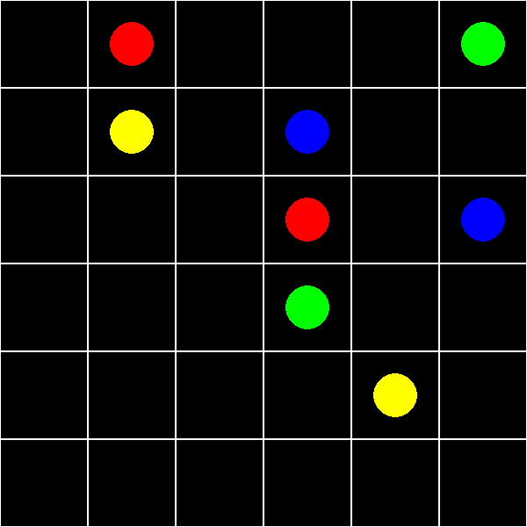

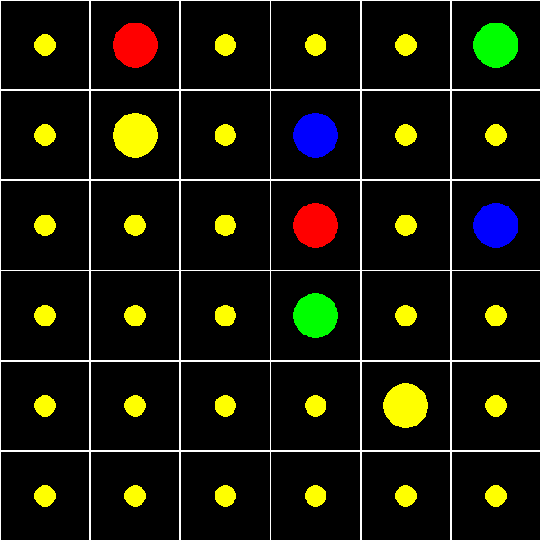
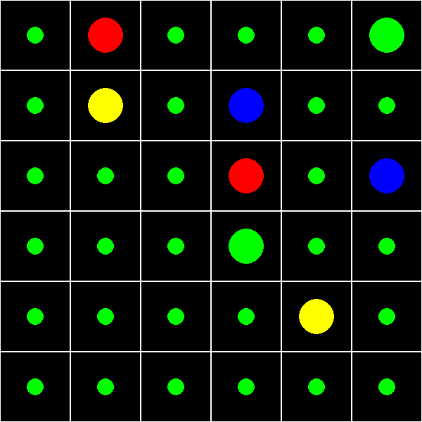
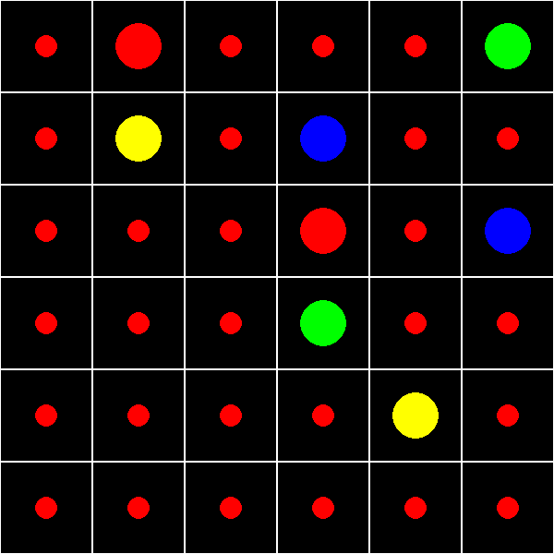
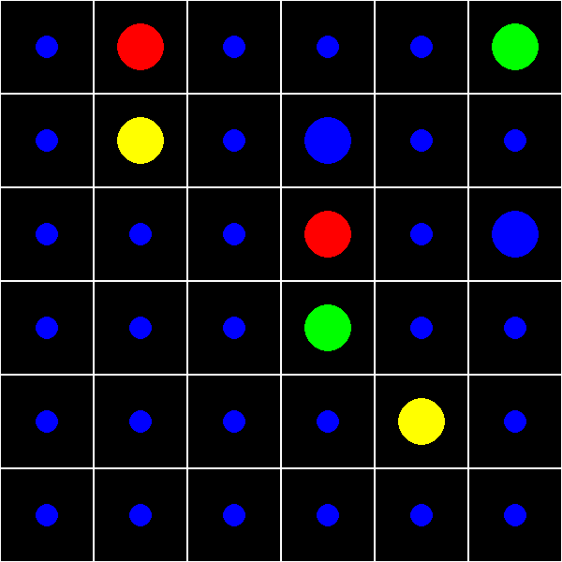
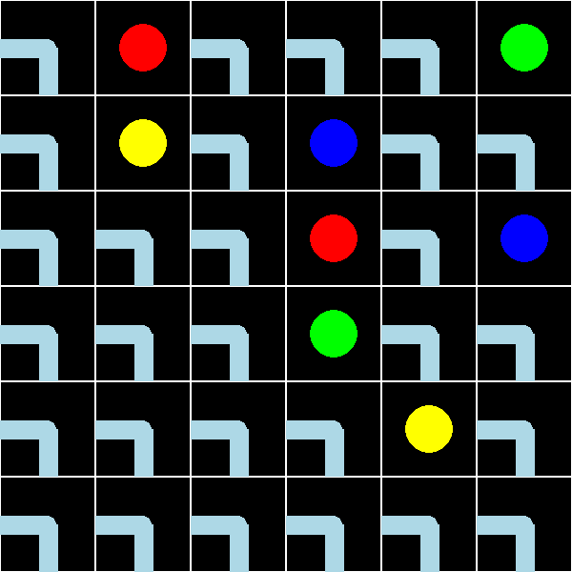
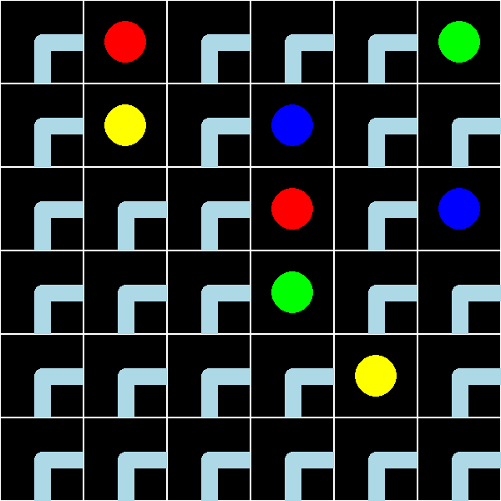
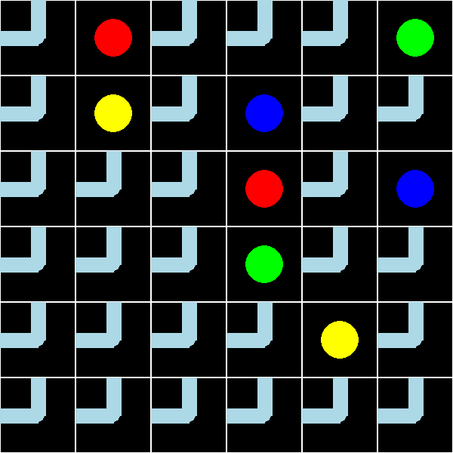
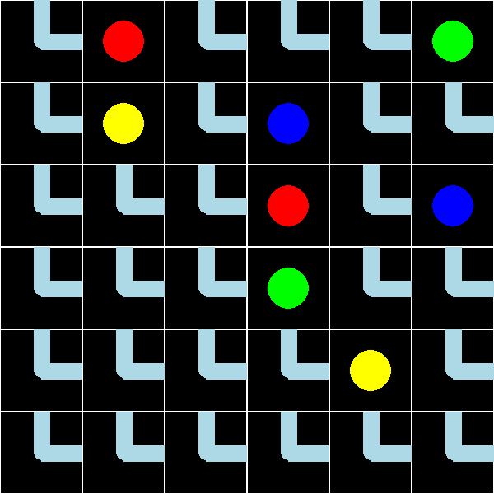
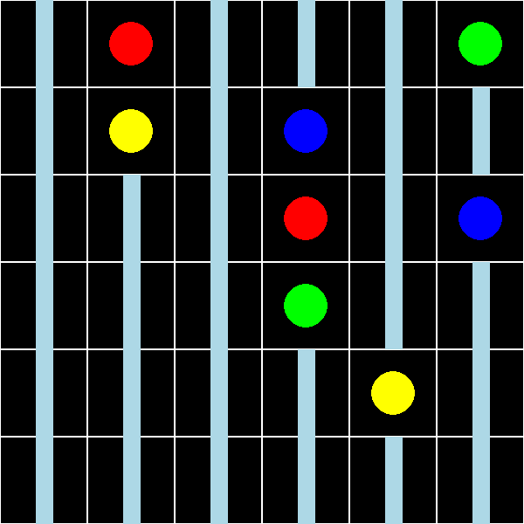
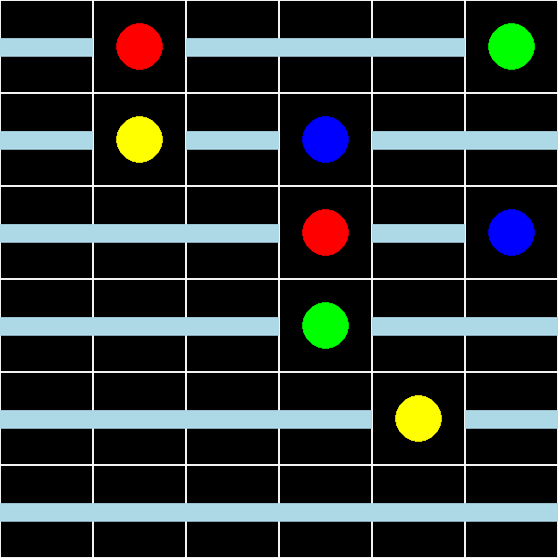

Flow Free Solver Using CNF and SAT
SAT Solver Algorithm (CDCL):
Propagate unit clauses
A unit clause is a clause where all but one variable is FALSE, while the remaining is unassigned
Check if all clauses are satisfied (at least one var is TRUE)
Pick and assign an unassigned var and record the decision level
Propagate unit clauses again
If a conflict occurred
Analyze the conflict and come up with a clause that will keep the conflicting assignment from being made again
Backtrack to the decision level that the conflicting assignment was made
Assign the var the opposite Boolean
If no conflict occurred, then repeat 2-4
Conflict was at level 0 (backtracking took you back to level 0 and another conflict immediately occurred) then CNF is "UNSAT”
Optimizations:
Pure Literal Elimination
If one variable only occurs in one state in ever clause (either entirely negated or unnegated), then you can assign the corresponding Boolean.
Watched Literals
Create a list for each clause of 2 of the variables in that clause that you will watch
If one is true, then it is satisfied
If both are false, conflict
If both are unassigned, continue
If one is false and one is unassigned, look for another unassigned to replace the false one with
If one cannot be found, it is a unit clause
VSIDS
Choose variables that appear often when assigning
Why CNF w/ SAT and not A*?
PycoSAT, one of Python's native SAT solvers, can find a solution for 5,000 clauses in 0.001 seconds
The idea is that if we can do most of the work up front by converting the constraints of the game into CNF, we can avoid the time and memory it would take to build and traverse the search space using A*
In other words, if we do more mental work ourselves, we can ease the work the computer has to do, which will improve performance.
Andrew Berman, Harrison Lampert
Constraints:
For every cell, there can only be EXACTLY ONE color and direction
For every dot, EXACTLY ONE neighbor shares it’s color
For every direction, the connecting 2 neighbors must be the same color
Given a list of CNF variables, you can constrain them such that EXACTLY ONE is true by combining the two constraints:
AT LEAST ONE is true:
$(x_{1}, x_{2},…, x_{n})$
AT MOST ONE is true:
$\left(¬x_{1},¬x_{2}\right) \left(¬x_{1}, ¬x_{3}\right) \left(¬x_{1}, ¬x_{4}\right)…$
$\left(¬x_{2},¬x_{3}\right) \left(¬x_{2}, ¬x_{4}\right)…$
…
($¬x_{n−1}, ¬x_{n})$
CNF Variables:
For every cell, there is a CNF variable for every color and direction.
That means that there are:
(rows * cols * num_colors) + (rows * cols * 6) = Number of CNF Variables
 | Clause Creation (ms) | Our Model (ms) | PyCoSAT (ms) | PySAT (ms)
6x6 | 10.867 | 33.213 | 1.718 | 2.220
7x7 | 20.849 | 89.550 | 3.196 | 2.963
8x8 | 27.273 | 166.891 | 6.348 | 5.544
9x9 | 41.320 | 336.799 | 5.564 | 8.413
10x10 | 57.983 | 594.686 | 11.762 | 15.043
12x12 | 121.185 | 1167.734 | 20.290 | 24.422

