Slide 1


Background layer
Sprites
Window Layer

Slide 2
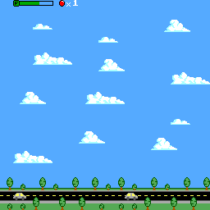
32 Tiles (256 px)
Scroll Y
Scroll Y
Scroll X
Viewport
Scroll X
Viewport
168 px
32 Tiles (256 px)
168 px
144 px
144 px

Slide 3


Color Palette
Unpaletted tile
Paletted Tile
00
01
10
11
00
01
10
11

Slide 4
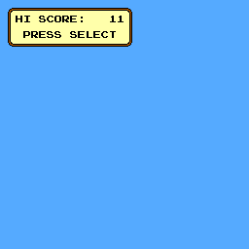
144 px
Viewport
Window offset y
168 px
Window offset x
32 Tiles (256 px)
32 Tiles (256 px)

Slide 5
Scroll Y
Scroll Y
Scroll X
Viewport
Viewport
168 px
168 px
144 px
144 px

Slide 6
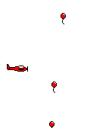
8 px
16 px
Sprite y
Viewport
Sprite x
168 px
144 px

