Slide 1
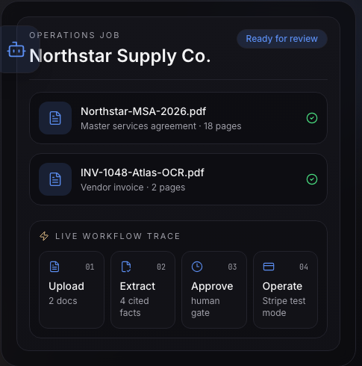
Paperline
Cited document intelligence with human-controlled operations
Full-stack Applied AI portfolio case study · Harrison Olvera
Synthetic recruiter demo · Stripe test mode
Next.js · TypeScript · Clerk · Supabase/pgvector · OpenAI · Stripe
Notes:
Paperline is my flagship portfolio project. It addresses the gap between an AI model reading a document and a team safely acting on the result. The interface you see here is the live Ops Agent demo route: two synthetic documents grouped into one operations job, moving through an upload, extract, approve, operate workflow. Everything consequential stays behind a human approval boundary, and billing runs in Stripe test mode. Over the next few minutes I'll walk through the product problem, the working architecture, and where I drew the line between working code, synthetic demo data, and planned productionization.

Slide 2
THE PRODUCT PROBLEM
Document AI needs evidence, structure, and control—not just plausible answers.
Evidence
Structure
Control
Can the reviewer trace a field or answer back to the source page?
Can the output enter a repeatable workflow instead of remaining chat text?
Can the system prepare actions without silently spending or changing external systems?
Paperline's answer
Quoted snippets + page-level citations
Paperline's answer
Schema-guided, runtime-validated extraction
Paperline's answer
Human approval before spend or provisioning
2
Notes:
I framed this as an engineering problem, not a demo problem. Teams get plausible answers from document AI, but three things are usually missing. First, evidence: a reviewer should be able to trace any extracted field to a quoted snippet and a page number. Second, structure: output has to be schema-validated so it can enter a repeatable workflow instead of staying chat text. Third, control: the system can prepare billing or vendor actions, but it must not silently spend money or change external systems. Underneath that sit mixed file types, tenant boundaries, uncertainty signals, and approval ownership—those constraints drove the architecture.

Slide 3
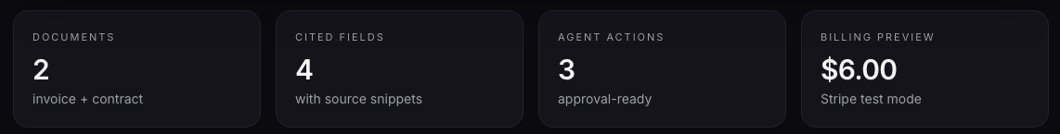
END-TO-END WORKFLOW
Synthetic recruiter demo — not a live customer workflow
From upload to approval-ready operations
01
02
03
04
Upload
Extract
Approve
Operate
2 synthetic documents
4 cited fields
3 recommended actions
Stripe test-mode preview
MSA + vendor invoice
values · quotes · pages
owners + approval states
$6.00 · 20 pages · paused
Live demo route: paperline-xi.vercel.app/ops-agent — one reviewer-friendly surface for the whole product story.
3
Notes:
The Ops Agent route compresses the product story into a single reviewer-friendly surface. Two synthetic documents—a master services agreement and a vendor invoice—flow through four stages: upload, extract, approve, operate. Extraction produces four cited fields with quoted snippets and page references. The agent proposes three actions, each with an owner and an approval state. And the operate step shows a six-dollar Stripe test-mode usage preview for twenty processed pages. I want to be explicit: this is a synthetic recruiter demo, not a live customer workflow—the point is showing the exact shape of the workflow the working product paths support.

Slide 4
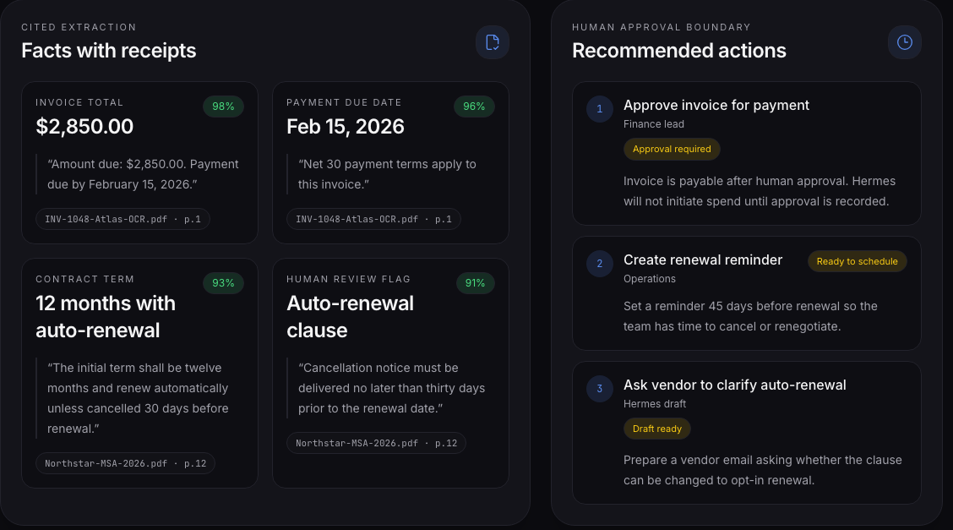
TRUSTWORTHY EXTRACTION
Facts with receipts
Page-level references
Every field cites its source document and page.
Quoted source snippets
The exact supporting text ships with the value.
Confidence = review signal
Labels prioritize review—not a guarantee.
Human review flag
Auto-renewal clause is explicitly flagged for a person.
Displayed documents, values, and confidence labels are synthetic fixtures
4
Notes:
Evidence is part of the product interface, not something hidden in logs or a developer console. Each extraction card shows the value, a quoted snippet of the source text, the document name, and the page reference—so a reviewer can verify the fact without reopening the file. Confidence labels are presented as a review signal, and the auto-renewal clause carries an explicit human-review flag because that's exactly the kind of term a person should confirm. One important caveat: the documents, values, and confidence labels on this screen are synthetic fixtures built to illustrate the workflow—not a live extraction run.

Slide 5
DETERMINISTIC CONTROLS AROUND AI
The model extracts; the application controls.
MODEL-ASSISTED
DETERMINISTIC APPLICATION CONTROLS
Document classification
Authentication + workspace authorization
Schema-guided extraction
Runtime schema validation of extraction output
OCR-assisted processing of scans and images
Private storage and persisted records
Grounded answer generation with citations
Usage and billing rules
Approval ownership and state
Probabilistic output is treated as a proposal: inspectable, cited, and validated before use.
Model judgment never owns identity, money, tenancy, or state.
Boundary map verified against repository source: src/lib/ai/*, src/lib/auth/workspace.ts, src/app/api/billing/*, supabase/migrations/*
5
Notes:
This is the design principle I care most about: knowing where probabilistic model behavior should stop. The model handles what models are good at—classification, schema-guided extraction, OCR-assisted processing, and grounded answers. Everything consequential is deterministic application code: Clerk authentication and workspace authorization, runtime schema validation of every extraction shape, private storage and persistence, usage and billing rules, and approval ownership and state. The model proposes; the application decides. That split is verifiable in the repository—the AI code lives in src/lib/ai, and the control paths live in the auth, billing, and migration layers.

Slide 6
SYSTEM ARCHITECTURE
Implemented
Synthetic demo
Planned
Full-stack document intelligence architecture
Signed-in user
Next.js routes
Workspace checks
Private storage + DB
Parsing / OCR
Clerk identity
authenticated App Router
membership + role
Supabase · RLS-aware
PDF · DOCX · scans · images
Chunks + embeddings
Extraction + cited chat
Workflow records
Billing
page-aware · pgvector
schema-validated · page citations
persisted · synchronous today
Stripe Checkout/Portal + signed webhook
OPS AGENT DEMO SURFACE — SYNTHETIC FIXTURES
PLANNED PRODUCTIONIZATION — NOT YET WIRED
Fixture docs
Actions + approvals
$6 test preview
Inngest
Sentry/PostHog
NemoClaw / OpenShell
MSA + invoice
owners · states
no real charge
durable execution
observability
secure runtime
Illustrates the workflow shape — never mistaken for live integration.
Explicit next steps — documented, not claimed as complete.
Service-role DB access bypasses RLS — route-level workspace filters remain an explicit, tested control.
6
Notes:
The top two rows are the implemented product path, all present in the repository: a signed-in user hits authenticated Next.js routes, workspace membership and role checks resolve tenancy, documents land in private Supabase storage, and parsing or OCR feeds page-aware chunks and embeddings into pgvector. From there, schema-validated extraction and cited chat produce reviewable output, workflow records persist—execution is synchronous today—and Stripe Checkout, Portal, and a signature-verified webhook handle billing. The amber box is the synthetic Ops Agent demo surface, and the gray box is planned productionization—kept visually separate so nobody mistakes them for live integration. One trust-boundary detail I always mention: server-side service-role access bypasses RLS, so route-level workspace filters are a critical control I treat as code to review and test, not an assumption.

Slide 7
EVALUATION, NOT VIBES
A deterministic extraction regression harness
Sample-prediction baseline used to validate the scorer — not live-model or production accuracy
3
20
40.00%
75.00%
94.12%
85.71%
synthetic document cases
labeled fields
exact accuracy
normalized accuracy
presence F1
list-item F1
WHY EXACT MATCHING UNDERSTATES QUALITY
TYPE-AWARE NORMALIZATION
Exact
40.00% (8/20)
Casing and whitespace
Currency and numbers
Dates and booleans
Order-insensitive lists
Normalized
75.00% (15/20)
Same predictions, scored two ways — normalization isolates formatting noise.
7
Notes:
I didn't want extraction quality judged only by screenshots, so the repository includes a small deterministic regression harness: three synthetic document cases and twenty labeled fields. The numbers here come from deliberately imperfect sample predictions whose job is to validate the scorer itself—they are not production accuracy or live-model quality. The interesting result is the gap: forty percent exact accuracy becomes seventy-five percent once type-aware normalization handles casing, currency, dates, booleans, and list order. That gap is exactly why naive exact matching understates extraction quality. Presence F1 is tracked separately because knowing when a field is genuinely absent—versus missed—deserves its own metric. The harness gives future model and prompt changes a deterministic contract.

Slide 8
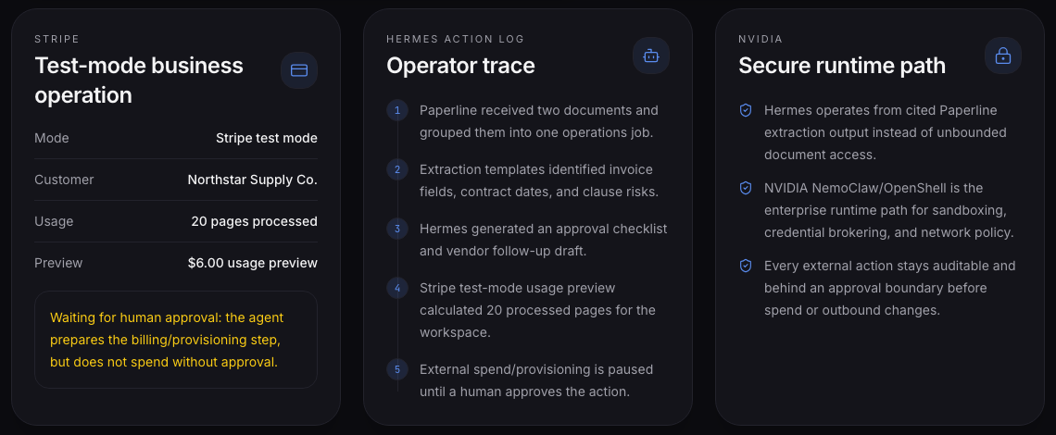
APPROVALS, BILLING, AND SECURE-RUNTIME DIRECTION
Agentic value without uncontrolled action
DEMONSTRATED ON THE SITE
IMPLEMENTED IN THE REPOSITORY
VALIDATED PATH — NOT YET INTEGRATED
· Visible action owners and states
· Stripe test-mode usage preview
· External spend/provisioning paused
· Stripe Checkout / Portal routes
· Signature-verified subscription webhook
· Persisted workflow records
· NVIDIA NemoClaw/OpenShell policy-governed Hermes sandbox
· Controlled network access
· Managed credential/inference handling
NVIDIA NemoClaw/OpenShell is a validated secure-runtime direction, not a completed Paperline integration. Source: NVIDIA/NemoClaw and NVIDIA/OpenShell official GitHub documentation, verified 2026-07-14.
8
Notes:
This slide separates three layers of honesty. What's demonstrated on the site: every proposed action shows an owner and an approval state, the billing card is explicitly Stripe test mode, and external spend and provisioning are paused pending a human decision. What's implemented elsewhere in the repository: real Stripe Checkout and Portal routes, a signature-verified subscription webhook, and persisted workflow records. And the third column is a validated architecture direction that is not yet integrated: running the Hermes operator inside an NVIDIA NemoClaw/OpenShell sandbox with policy-governed network access and managed credential and inference handling. What makes that direction credible is that official NVIDIA documentation explicitly supports Hermes through NemoClaw. But I want to be precise: Paperline has not wired that runtime yet, and NVIDIA does not secure the current deployment.

Slide 9
ENGINEERING TRADEOFFS AND NEXT STEPS
What I would productionize next
1
Durable execution
2
Persisted approvals
Move synchronous workflow execution to Inngest with idempotency, retries, resume, and dead-letter handling.
Add explicit approval policies and state transitions from proposed through completed/failed.
3
Evaluation expansion
4
Observability + isolation
Capture live predictions against a larger versioned, privacy-safe benchmark; add retrieval/citation evaluation.
Design safe Sentry/PostHog events and validate the NemoClaw/OpenShell path without logging document content.
Roadmap items — designed and documented, deliberately not claimed as complete.
9
Notes:
These are the four things I would productionize first, in priority order. Durable execution: workflows currently run synchronously in one request, so moving to Inngest gets idempotency, retries, resume, and dead-letter handling. Persisted approvals: the approval boundary should become explicit policies and state transitions from proposed through completed or failed. Evaluation expansion: I want live predictions captured against a larger versioned, privacy-safe benchmark, plus retrieval and citation evaluation. And observability with isolation: safe Sentry and PostHog events designed so document content never leaks into logs, alongside validating the NemoClaw/OpenShell path. None of these are done—being explicit about limitations is part of how I demonstrate production judgment.

Slide 10
RECRUITER CLOSE
What Paperline demonstrates
✓
Full-stack AI product engineering
SEE IT YOURSELF
✓
Cited retrieval and schema-guided extraction
Live Ops Agent
paperline-xi.vercel.app/ops-agent
✓
Multi-tenant auth/data-boundary thinking
GitHub
github.com/HarrisonBlake01/paperline
✓
Human-in-the-loop agent design
✓
Evaluation, billing, and productionization judgment
Harrison Olvera · Applied AI / Agentic AI / LLM Engineering
All demo data synthetic · Stripe test mode · no customer, revenue, or compliance claims
10
Notes:
To close: Paperline demonstrates full-stack AI product engineering—not a wrapper around a chat call. Cited retrieval and schema-guided extraction make output verifiable. Workspace-scoped auth and data design show multi-tenant boundary thinking. The approval boundary shows human-in-the-loop agent design. And the eval harness, billing paths, and explicit roadmap show judgment about what production actually requires. The live Ops Agent page and the GitHub repository are linked here. I'm happy to go deeper on any layer—the extraction pipeline, the tenancy model, the eval design, or the secure-runtime direction.

Slide 11
APPENDIX
Claims, sources, and boundaries
Implemented repository paths
src/lib/pipeline · src/lib/parsing · src/lib/ai/{ocr,extract,chat} · src/lib/auth/workspace.ts · src/app/api/workflows · src/app/api/billing/{checkout,portal} · src/app/api/webhooks/stripe · supabase/migrations/0001_init.sql, 0002_rls.sql
Synthetic demo boundary
Ops Agent route uses static fixtures from src/lib/ops-agent-demo.ts: Northstar Supply Co., document names, values, confidence labels, action states, operator trace, and the $6.00 / 20-page Stripe test-mode preview. No live extraction, payment, or external action.
Evaluation caveat
Metrics are a deliberately imperfect sample-prediction baseline validating the deterministic scorer (3 cases, 20 fields). Not production, live-model, or customer accuracy.
NVIDIA sources
github.com/NVIDIA/NemoClaw · github.com/NVIDIA/OpenShell · docs.nvidia.com/nemoclaw · docs.nvidia.com/openshell — NemoClaw lists Hermes as a supported agent. Verified 2026-07-14.
Compliance
Paperline does not claim HIPAA, SOC 2, or legal certification. No customer, revenue, or business-outcome claims.
Claims ledger: docs/portfolio/presentation-claims-audit.md · Repository gates passed 2026-07-14: test:templates, test:extraction-eval, test:demo, lint, build
11
Notes:
This appendix is the claims ledger behind the deck. Every implemented capability maps to a repository path. The synthetic demo boundary lists exactly which values are fixtures. The evaluation numbers are a scorer-validation baseline, not production accuracy. The NVIDIA direction cites official GitHub and docs sources verified on July 14, 2026, and Paperline makes no HIPAA, SOC 2, or legal certification claims. The full audit lives in the repository alongside the deck.

