Slide 1
Team #101
Illini Datathon 2020
2.16.2020

Slide 2
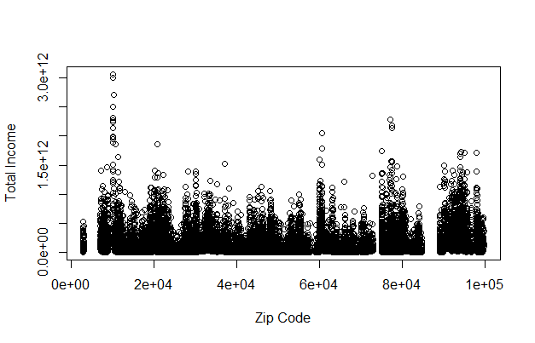
Zip Code to Total Income
We can see that income is heavily skewed with higher income zip codes being more sparse out than lower income zip codes. It is worthy to note this going forward in our data analysis

Slide 3
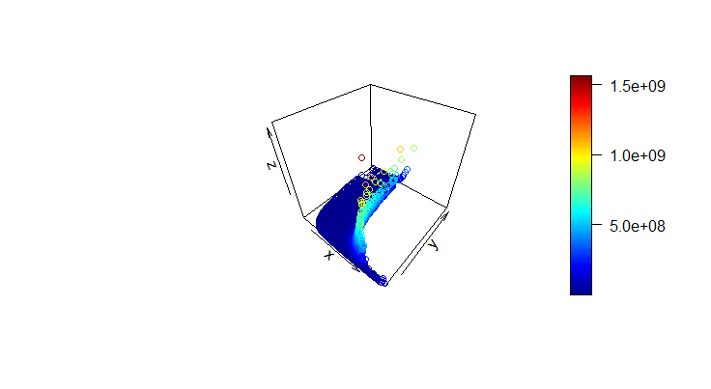
Market Potential (x-axis) to Total Income (y-axis) to Total Sales (z-axis)
We can see here that the greatest potential for growth occurs in the middle 50th percentile of market potential

Slide 4
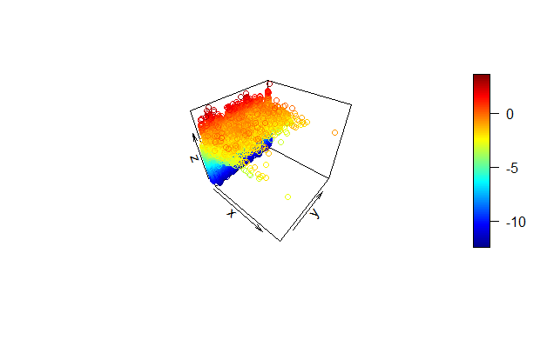
Establishments operated in a year (x axis) to Zip Code (y axis) to Market Potential (z axis)
This graph demonstrates that across all Zip Codes, we can identify areas of potential marketing growth in industries using the middle 50th percentile of our market potential as an indicator.
We assume that too high of a concentration of establishments for a certain industry in an area can lead to the saturation of a market, and thus (as shown correlated) we want to avoid extremely high market potential values (those nearing 0). Instead, we can see that those zip codes ranked in the middle 50th percentile of market potential values can help us identify good options for ad targeting
Note: Market Potential is our indicator and is how we organize and analyze our data by taking the revenue of each industry in a zip code divided by total income of that zip code and transformed in order to find patterns in data.

Slide 5
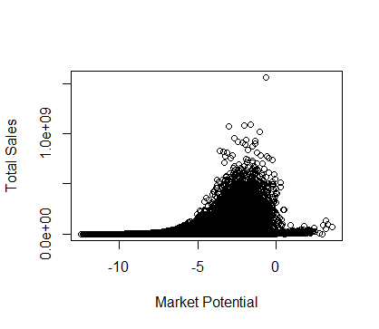
Market Potential (x axis) to Total Sales (y axis)
Here we can see that the Market Potential values are most optimal between -5 to -2.5 leading up to the greatest growth in total sales. However, Total Sales reaches its saturation point at the height of this bell shaped curve and drops significantly in the upper Market Potential values.

