Slide 1
Loyola MARS inert gas system simulator
Programmed and Designed by Harrison Leece
Presentation by Harrison Leece

Slide 2
Model overview:
Helium or N2
Pressure Regulator
Gas ullage and propellants
Kerosene
Liquid Oxygen

Slide 3
Assumptions
Adiabatic
Reversible
No pressure losses from regulator to tanks

Slide 4

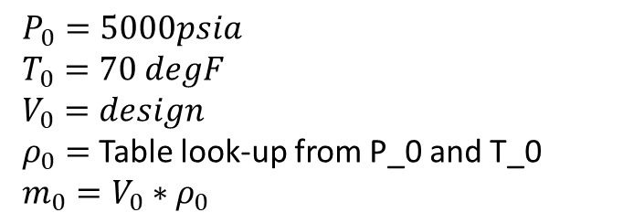

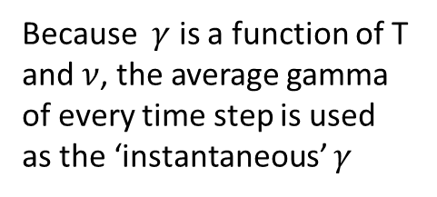
Method 1: Isentropic Expansion Eqns
Helium or N2
$P_{0}=5000psia$
$T_{0}=70 degF$
$V_{0}=design$
$ρ_{0}=$ Table look-up from P_0 and T_0
$m_{0}=V_{0}∗ρ_{0}$
Adiabatic expansion from P_0 and T_0 to P_t and T_t at any discrete time ‘t’ at step ‘n’
$P=P_{0}{\frac{ρ}{ρ_{0}}}^{γ}$ $T=T_{0}{\frac{ρ}{ρ_{0}}}^{(γ−1)}$
$P_{n}=P_{0}{\frac{ρ_{n}}{ρ_{0}}}^{γ}$ $T_{t/n}=T_{0}{\frac{ρ_{n}}{ρ_{0}}}^{(γ−1)}$
Heating or Cooling over Throttle
Because $γ$ is a function of T and $ν$, the average gamma of every time step is used as the ‘instantaneous’ $γ$
Desired Ullage pressure = 400-450 psia CONSTANT
Kerosene
Liquid Oxygen

Slide 5
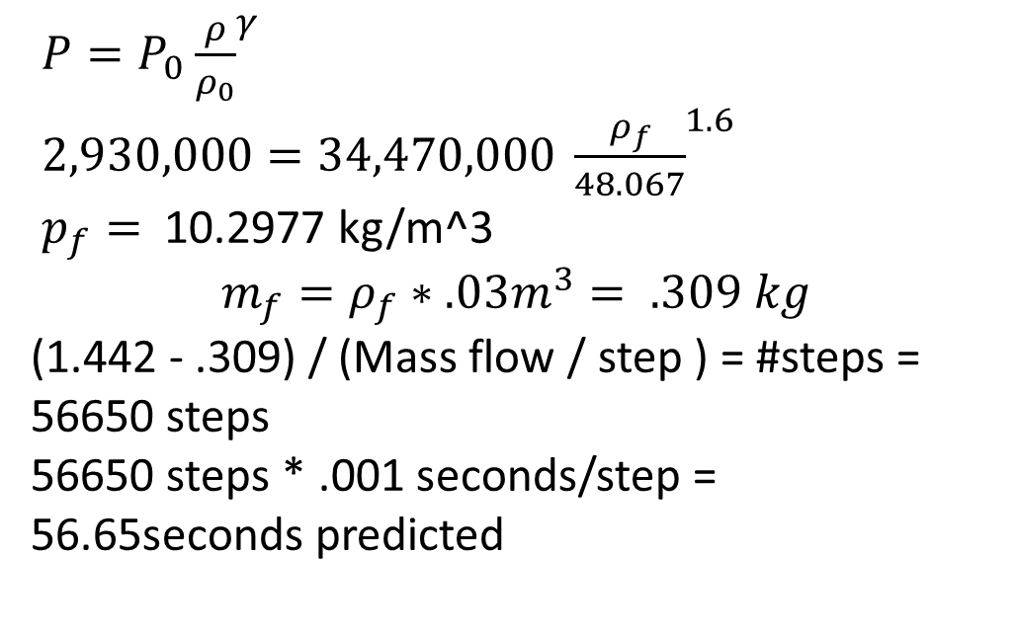
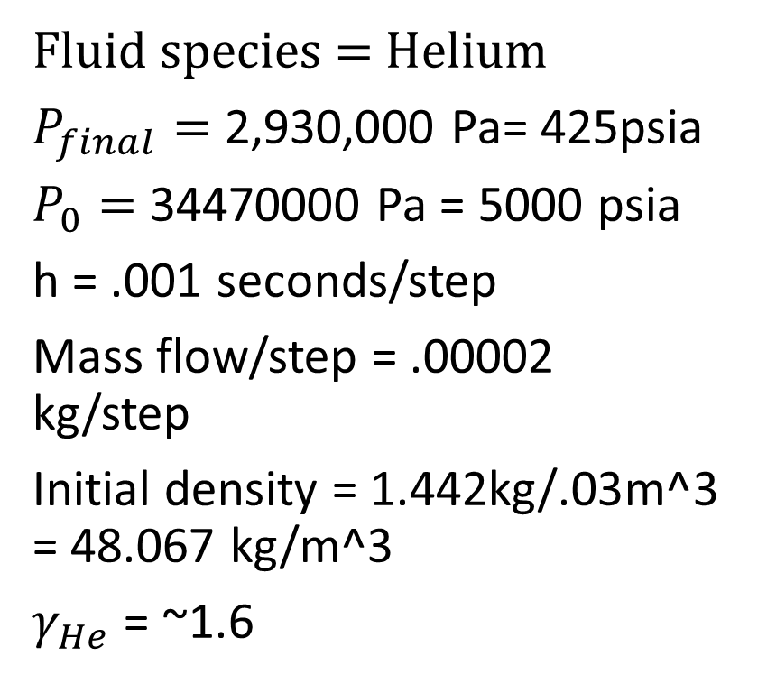
A quick hand-calc for this method
Fluid species = Helium
$P_{final}=$ 2,930,000 Pa= 425psia
$P_{0}=$ 34470000 Pa = 5000 psia
h = .001 seconds/step
Mass flow/step = .00002 kg/step
Initial density = 1.442kg/.03m^3 = 48.067 kg/m^3
$γ_{He}$ = ~1.6
$P=P_{0}{\frac{ρ}{ρ_{0}}}^{γ}$
$2,930,000=34,470,000 {\frac{ρ_{f}}{48.067}}^{1.6}$
$p_{f}=$ 10.2977 kg/m^3
$$m_{f}=ρ_{f}∗.03m^{3}= .309 kg$$
(1.442 - .309) / (Mass flow / step ) = #steps = 56650 steps
56650 steps * .001 seconds/step = 56.65seconds predicted

Slide 6
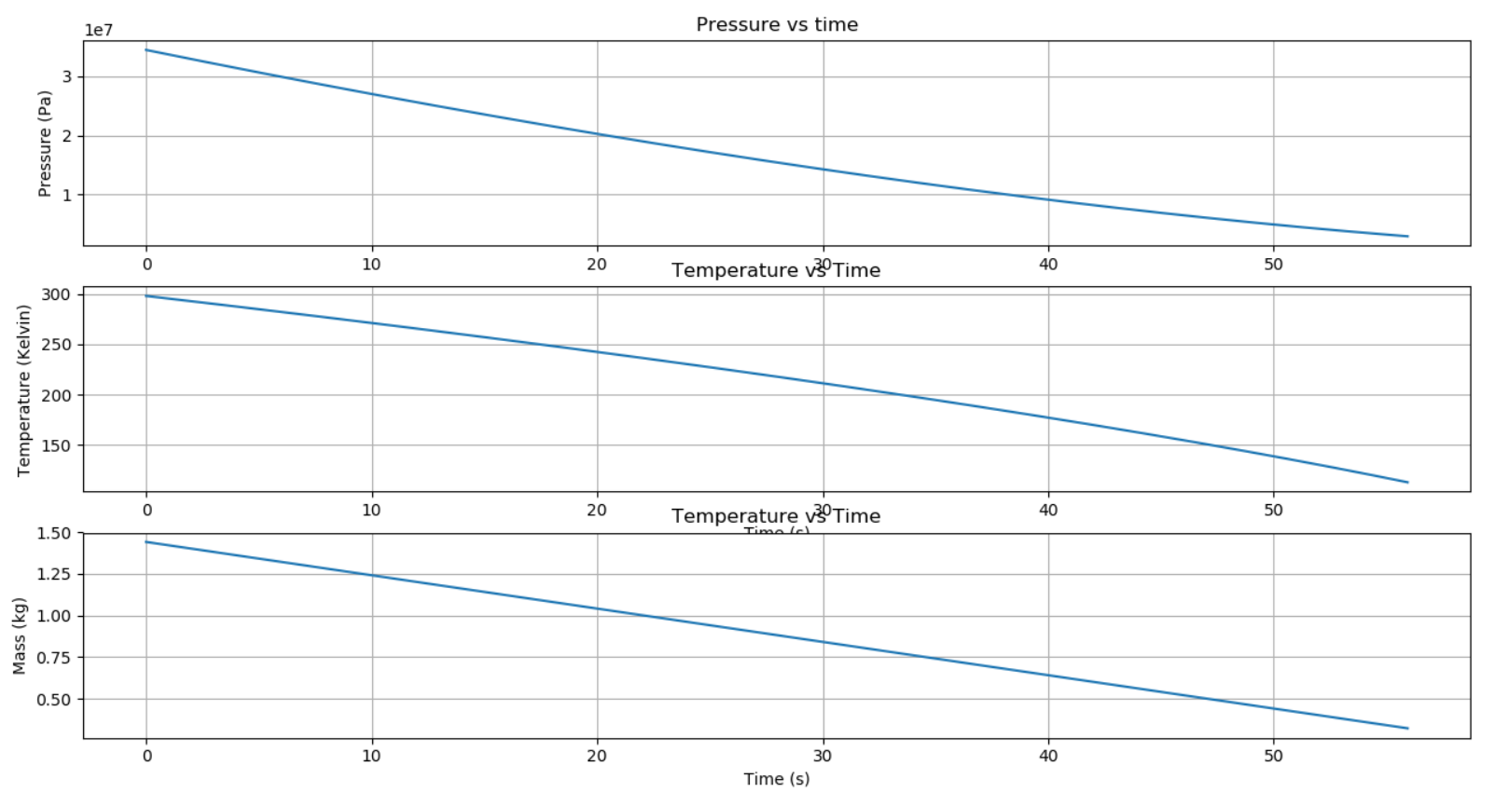
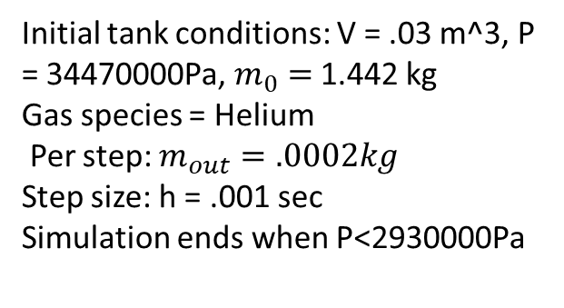
Unit testing, Method 1: Supply tank with constant mass flow rate
56.2 seconds Nice!
Initial tank conditions: V = .03 m^3, P = 34470000Pa, $m_{0}=$ 1.442 kg
Gas species = Helium
Per step: $m_{out}=.0002kg$
Step size: h = .001 sec
Simulation ends when P<2930000Pa
Decouples the unknown of required mass flow rate to test constant volume supply tank
Concave up pressure
Concave down temperature
Mass vs time

Slide 7
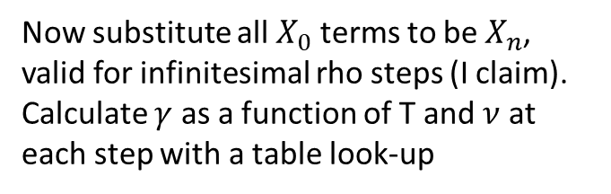

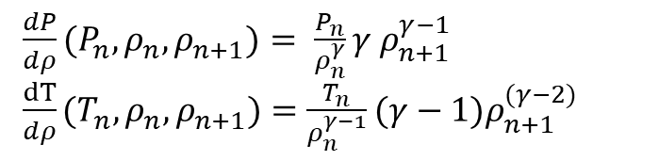
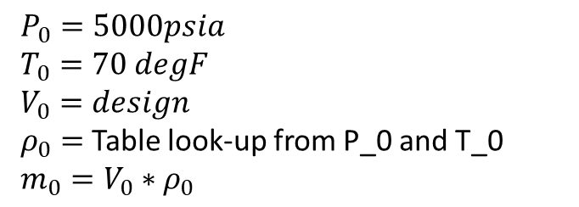



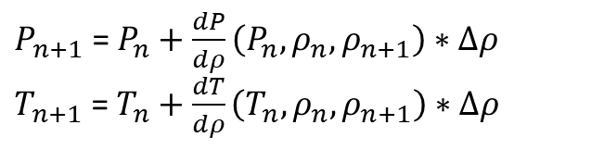
Method 2: Derivative of Isentropic Eqns
Differentiate adiabatic expansion equations:
Helium or N2
$P_{0}=5000psia$
$T_{0}=70 degF$
$V_{0}=design$
$ρ_{0}=$ Table look-up from P_0 and T_0
$m_{0}=V_{0}∗ρ_{0}$
$P_{t}=P_{0}({\frac{ρ}{ρ_{0}})}^{γ}$ $T_{t}=T_{0}({\frac{ρ}{ρ_{0}})}^{(γ−1)}$
With respect to rho:
$\frac{dP}{dρ}=\frac{d}{dρ}(P_{0}({\frac{ρ}{ρ_{0}})}^{γ})$ $\frac{dT}{dρ}=\frac{d}{dρ}(T_{0}({\frac{ρ}{ρ_{0}})}^{(γ−1)})$
$\frac{dP}{dρ}=\frac{d}{dρ}(\frac{P_{0}}{ρ_{0}^{γ}}ρ^{γ})$ $\frac{dT}{dρ}=\frac{d}{dρ}(\frac{T_{0}}{ρ_{0}^{γ−1}}ρ^{(γ−1)})$
Heating or Cooling over Throttle
$\frac{dP}{dρ}= \frac{P_{0}}{ρ_{0}^{γ}}γρ^{γ−1}$ $\frac{dT}{dρ}=(\frac{T_{0}}{ρ_{0}^{γ−1}}(γ−1)ρ^{(γ−2)})$
Now substitute all $X_{0}$ terms to be $X_{n}$, valid for infinitesimal rho steps (I claim).
Calculate $γ$ as a function of T and $ν$ at each step with a table look-up
Desired Ullage pressure = 400-450 psia CONSTANT
Kerosene
Liquid Oxygen
$\frac{dP}{dρ}(P_{n},ρ_{n}, ρ_{n+1})= \frac{P_{n}}{ρ_{n}^{γ}}γ ρ_{n+1}^{γ−1}$
$\frac{dT}{dρ}(T_{n},ρ_{n}, ρ_{n+1})=\frac{T_{n}}{ρ_{n}^{γ−1}}(γ−1)ρ_{n+1}^{(γ−2)}$
Apply Euler’s Method (can be improved with Heun’s or RK4 methods )
$P_{n+1}$ = $P_{n}+\frac{dP}{dρ}\left(P_{n}, ρ_{n},ρ_{n+1}\right)∗Δρ$
$T_{n+1}$ = $T_{n}+\frac{dT}{dρ}\left(T_{n}, ρ_{n},ρ_{n+1}\right)∗Δρ$

Slide 8
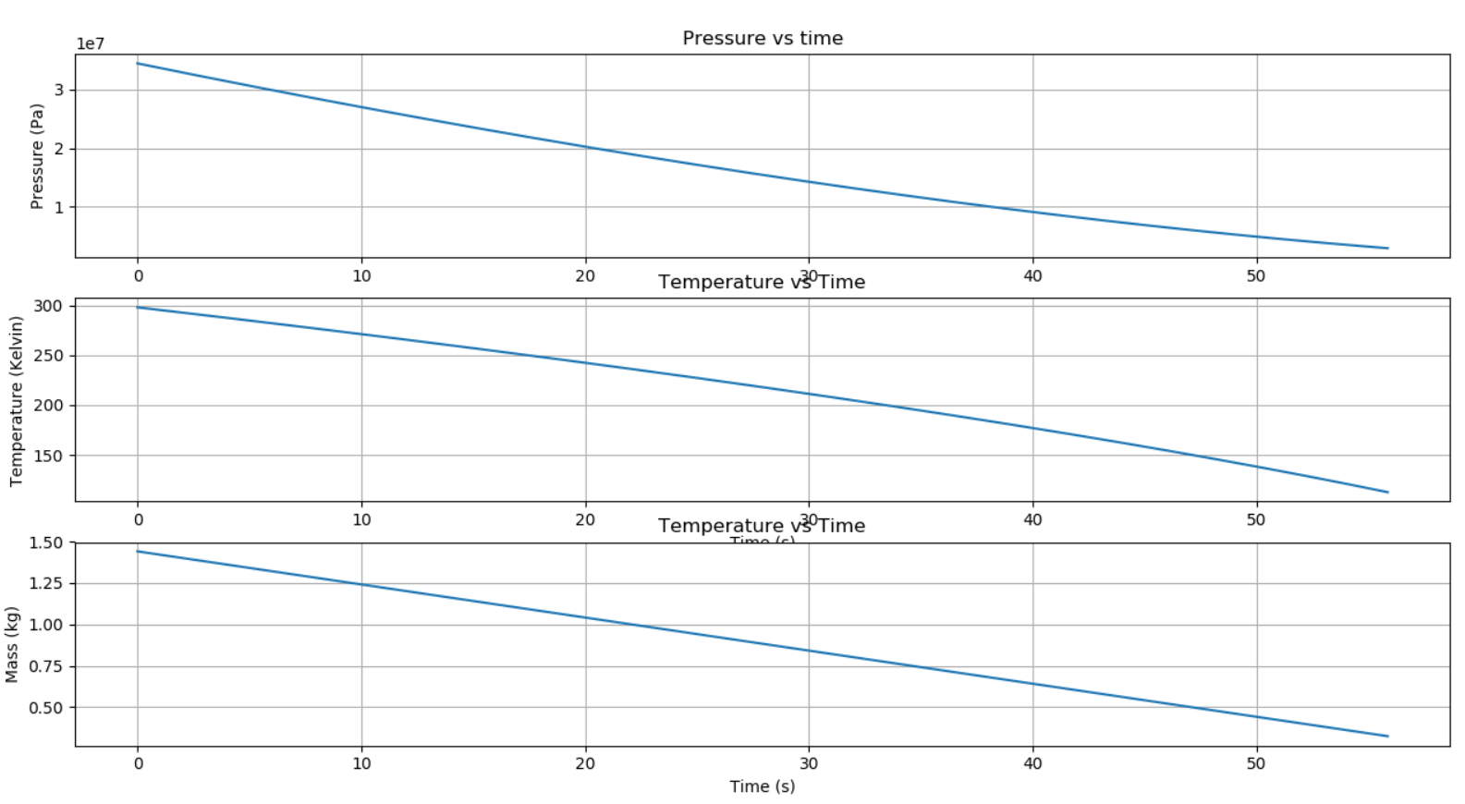
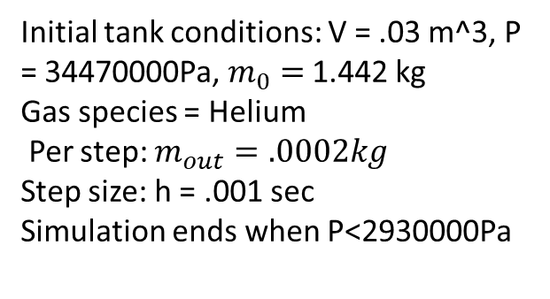
Unit testing, Method 2: Supply tank with constant mass flow rate
55.9 s
Initial tank conditions: V = .03 m^3, P = 34470000Pa, $m_{0}=$ 1.442 kg
Gas species = Helium
Per step: $m_{out}=.0002kg$
Step size: h = .001 sec
Simulation ends when P<2930000Pa
Decouples the unknown of required mass flow rate to test constant volume supply tank
Concave up pressure
Concave down temperature
Mass vs time

Slide 9
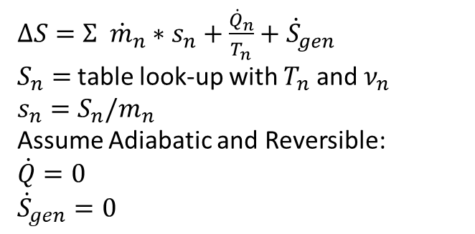
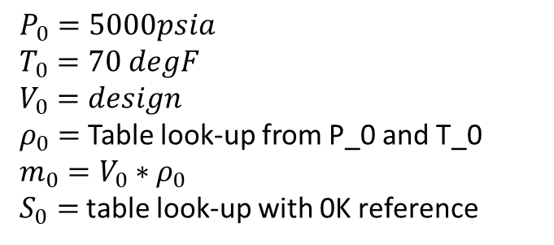
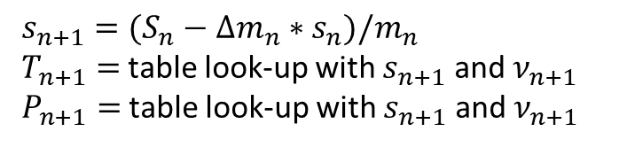
Method 3: Second Law of Thermodynamics for Open Systems
Helium or N2
$P_{0}=5000psia$
$T_{0}=70 degF$
$V_{0}=design$
$ρ_{0}=$ Table look-up from P_0 and T_0
$m_{0}=V_{0}∗ρ_{0}$
$S_{0}=$ table look-up with 0K reference
$ΔS=Σ {\dot{m}}_{n}∗s_{n}+\frac{{\dot{Q}}_{n}}{T_{n}}+{\dot{S}}_{gen}$
$S_{n}=$ table look-up with $T_{n}$ and $ν_{n}$
$s_{n}=S_{n}/m_{n}$
Assume Adiabatic and Reversible:
$\dot{Q}=0$
${\dot{S}}_{gen}=0$
Heating or Cooling over Throttle
Apply Euler’s Method (can be improved with Heun’s or RK4 methods)
$s_{n+1}=(S_{n}−Δm_{n}∗s_{n})/m_{n}$
$T_{n+1}=$ table look-up with $s_{n+1}$ and $ν_{n+1}$
$P_{n+1}=$ table look-up with $s_{n+1}$ and $ν_{n+1}$
Desired Ullage pressure = 400-450 psia CONSTANT
Kerosene
Liquid Oxygen

Slide 10
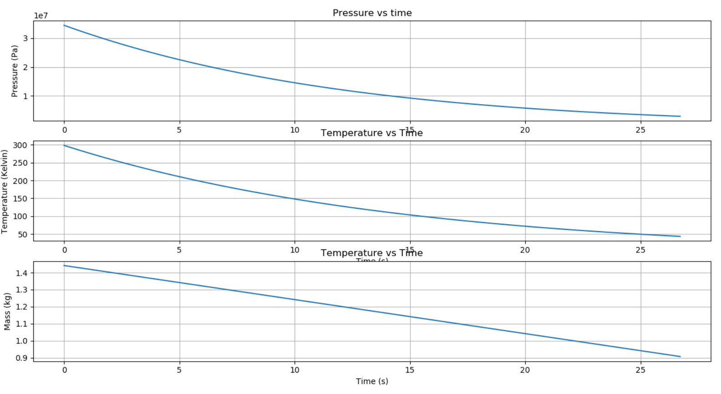
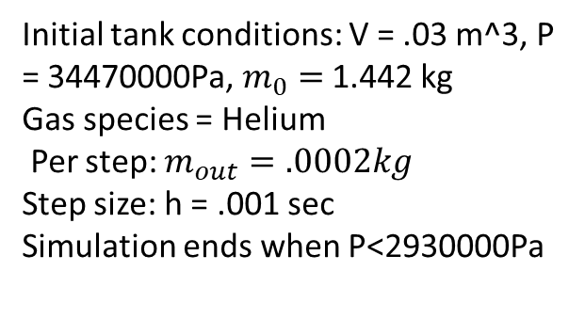
Unit testing, Method 3: Supply tank with constant mass flow rate
~28 seconds ?
Initial tank conditions: V = .03 m^3, P = 34470000Pa, $m_{0}=$ 1.442 kg
Gas species = Helium
Per step: $m_{out}=.0002kg$
Step size: h = .001 sec
Simulation ends when P<2930000Pa
Decouples the unknown of required mass flow rate to test constant volume supply tank
Concave up pressure
Concave up temperature
Temperature approaches 50K!
½ the time of method 1 and 2
Mass vs time

Slide 11
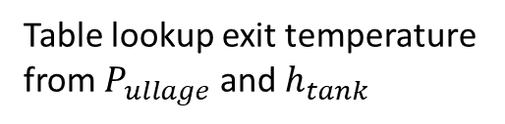
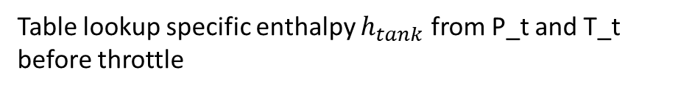
Helium or N2
Table lookup specific enthalpy $h_{tank}$ from P_t and T_t
before throttle
Table lookup exit temperature from $P_{ullage}$ and $h_{tank}$
Desired Ullage pressure = 400-450 psia CONSTANT
Kerosene
Liquid Oxygen

Slide 12
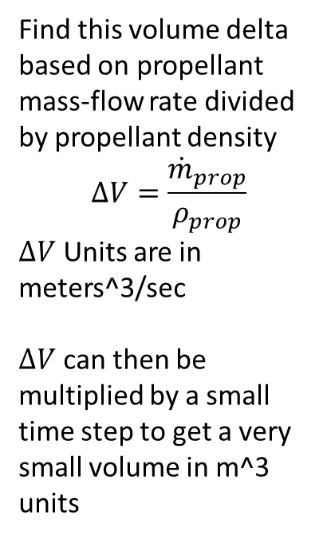
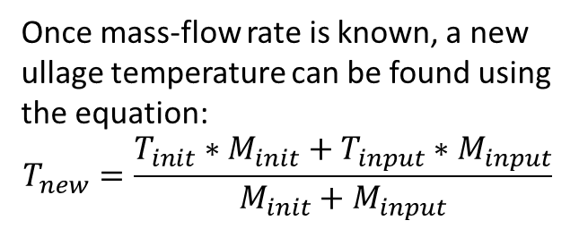
Objective: Maintain desired pressure in the ullage of the tank
Pressurizing gas flowing into engine with known temperature and pressure
Find this volume delta based on propellant mass-flow rate divided by propellant density
$$ΔV=\frac{{\dot{m}}_{prop}}{ρ_{prop}}$$
$ΔV$ Units are in meters^3/sec
$ΔV$ can then be multiplied by a small time step to get a very small volume in m^3 units
Mass-flow rate must be found to sustain desired pressure
Once mass-flow rate is known, a new ullage temperature can be found using the equation:
$$T_{new}=\frac{T_{init}∗M_{init}+T_{input}∗M_{input}}{M_{init}+M_{input}}$$
Mass-flow from upstream must be enough to maintain the density of the inert-gas in the ullage, BUT the properties of entering gas and ullage gas are not identical….
Propellant to Engine with known mass-flow rate kg/s

Slide 13
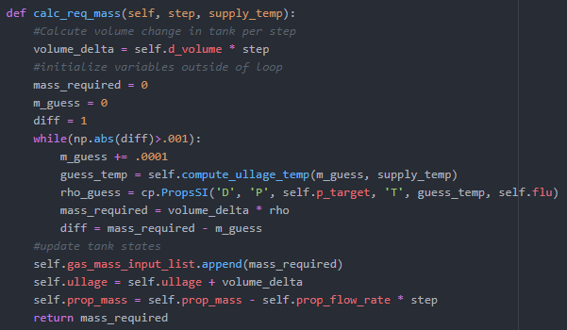
Density convergence algorithm
Simulation step size
J-T effect supply temperature
Seek convergence
Table look-up in cython
Once algorithm succeeds, update tank state and add added mass to plotting list for debugging

Slide 14
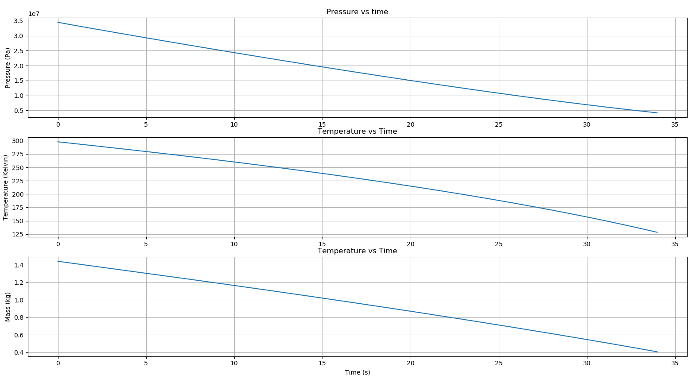
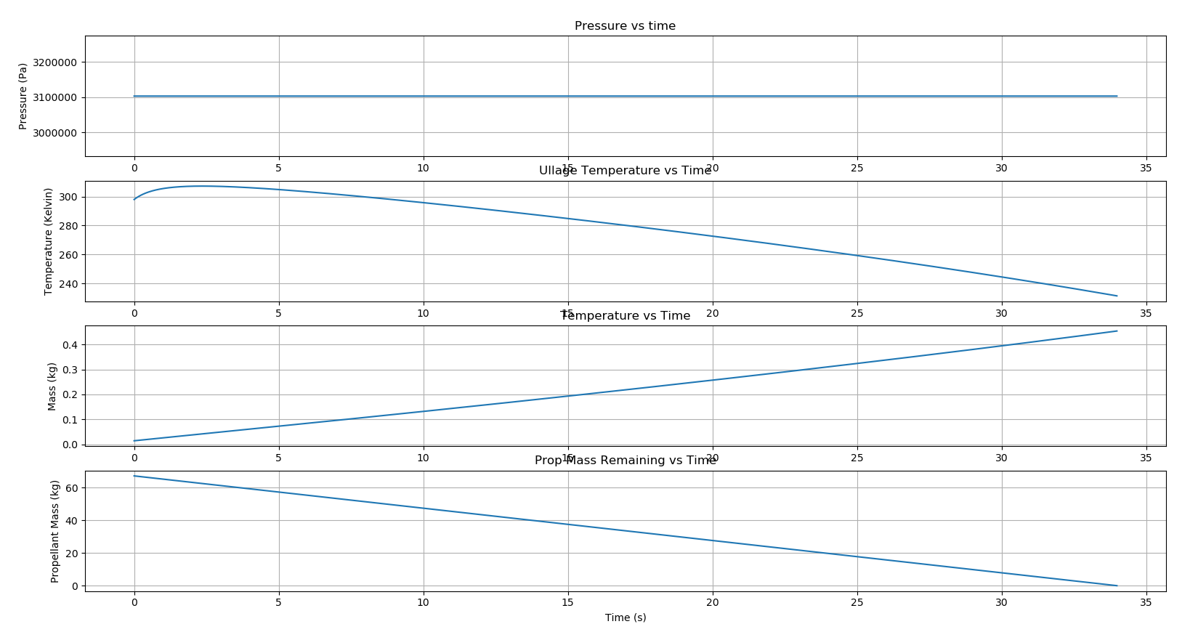
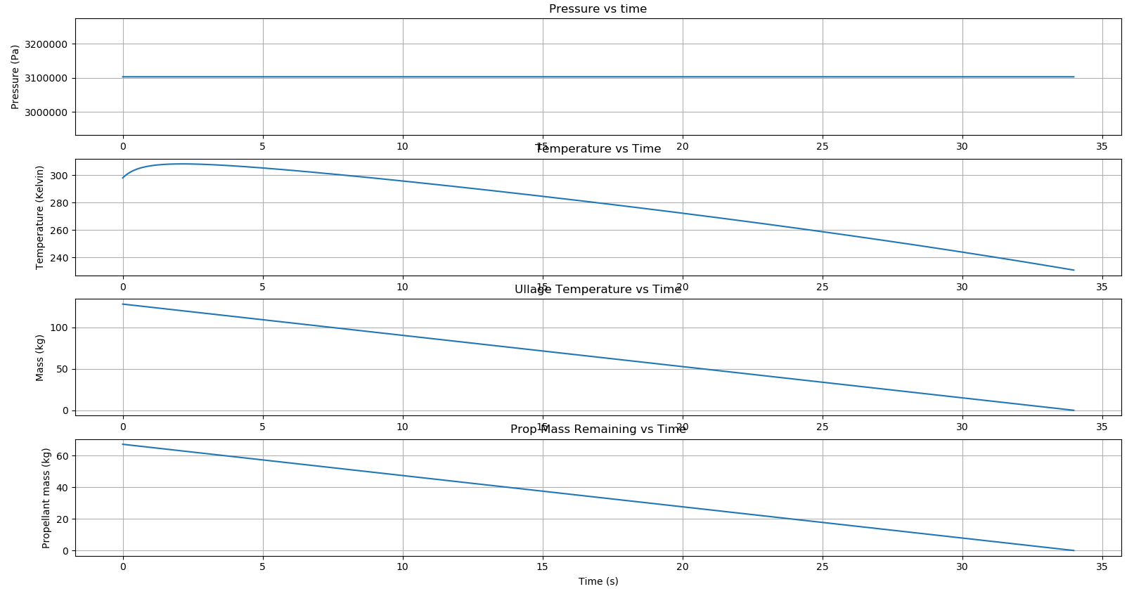
Plots
Mass of He required: 1.45 kg
Volume of supply tank: .03m^3 or ~8 US gallons
Pressure of supply tank: 5000 psia
Supply tank
Propellant tanks

Slide 15
What we can find from this
MINIMUM inert gas mass required per firing
Temperature ranges for components
Inert gas tank volume and pressure requirement MINIMUMS

Slide 16
Feedback
If anything looks suspicious in the methodology, PLEASE email me at hleece@lion.lmu.edu or text me at (669) 258-1729

