Slide 1
Multimedia networks
Harrison pierce

Slide 2
Defining a multimedia network
A multimedia network application that makes use of audio and/or video
It is used on a daily basis around the world. Uses include making calls over the internet and uploading videos to video sharing sites like Vimeo or YouTube.
While initially utilizing a multimedia network was only possible from a computer workstation, now with the introduction of cell phones and mobile devices, they can be used anywhere, any time.

Slide 3
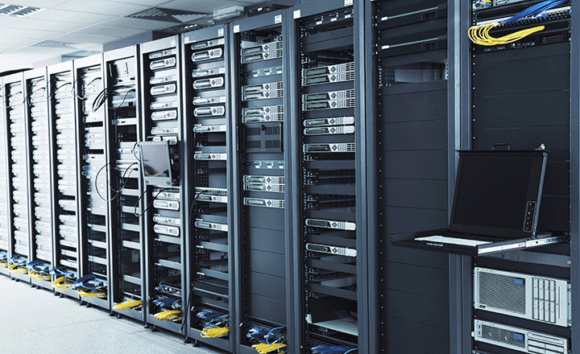
Attributes of Multimedia Networks
Servers host the content which is streamed to the client devices.
Many use audio and video on their website for easy access.
Examples include Instagram, Facebook, and even news websites like Fox or MSNBC.

Slide 4
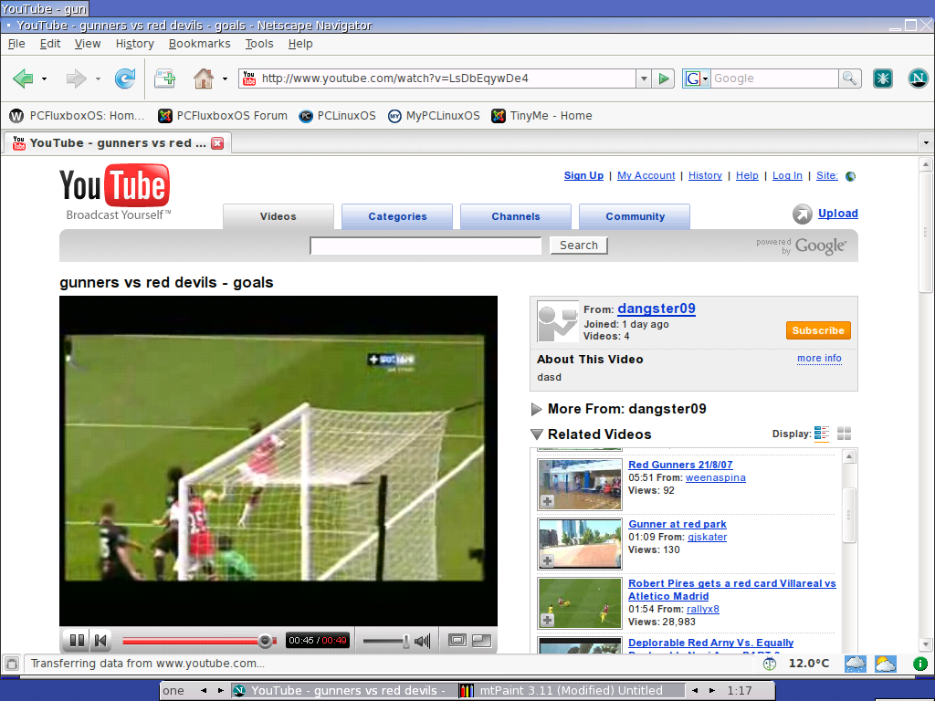
Methods of use
When accessing on demand media that is stored on a server, the most common transfer method is via TCP due to its encryption capabilities and mitigated jitter transmissions.
For a live feed, the most common method is processed through UDP due to the faster speeds and reduced latency due to not having a need to receive ACK signal from the client.

Slide 5

Usefulness of Multimedia networks
Up until only a few decades ago, transferring audio and video from one person or group to another was costly, slow and inconsistent. Introduction of the internet and personal computers has opened the door for the average consumer to send or receive multimedia from across the world at the click of a button.
Services like skype allow family and friends to see each other while on opposite sides of the world instantly. The transfer of information has increased dramatically.

Slide 6

Youtube
Youtube is one of the largest multimedia networks on the planet, being used regularly by over one third of the entire internet population.
Every minute there are more than 100 hours of content uploaded to youtube.

Slide 7
References
https://assets.cambridge.org/97805218/82040/excerpt/9780521882040_excerpt.pdf
https://www.intel.com/content/dam/www/programmable/us/en/images/solutions/industry/computer/computer-server-360-220.png
https://www.slideshare.net/KikimaJimmy/multimedia-networking-28567873
http://pcfluxboxos.wdfiles.com/local--files/tinyflux-screenshots/netscape-youtube.png
https://upload.wikimedia.org/wikipedia/fr/e/e0/Skype_2017_logo.png
https://cdn57.androidauthority.net/wp-content/uploads/2017/08/new-youtube-logo.jpg

