Slide 1
How Americans’ Time Use Patterns Have Changed From 2003 to 2017
Group July

Slide 2
Introduction
The ATUS dataset [1] used is based on research carried out as part of the American Time Use Survey [2] from 2003 to 2017, containing time use data for 431 different activities grouped into 17 over-arching categories.
Aim: Hypothesise, validate and present long-term trends based on the data.
Approach:
EDA
Exploring data from even months as training data (July excluded and used for validation);
Validation using left out “unseen” data
Formal hypothesis tests on the initial beliefs from the EDA using the odd months (and July) as the validation data;
Summary plots of findings

Slide 3
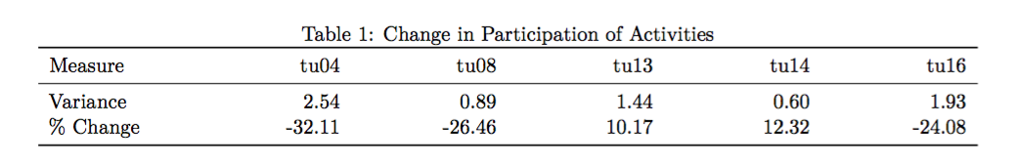
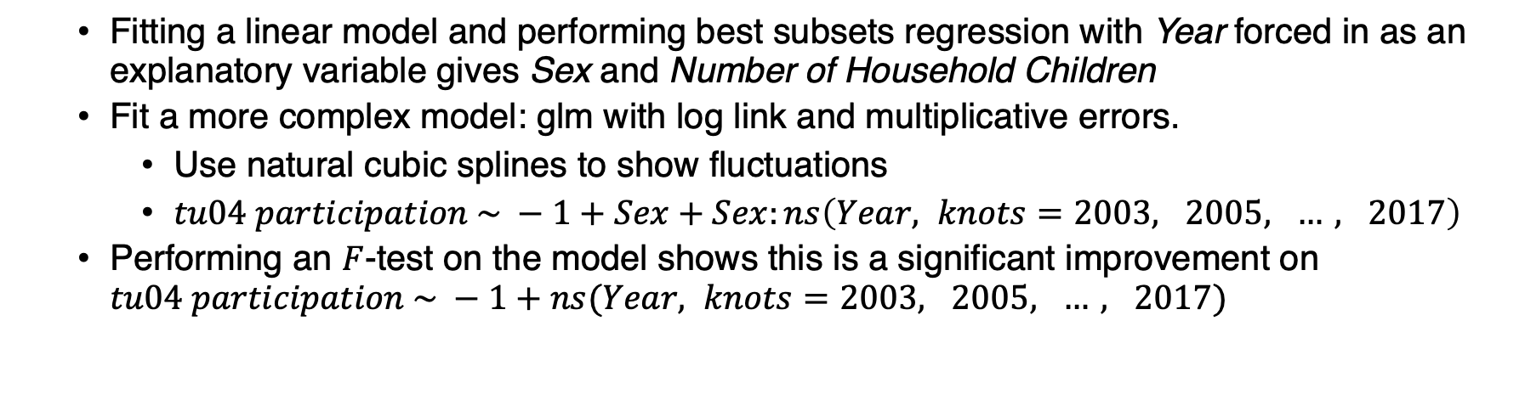
Observation 1: Participation in Caring for & Helping Non-HH Members
Exploratory Data Analysis
Activities with % change larger than 10% and variance greater than 0.5.
Fitting a linear model and performing best subsets regression with Year forced in as an explanatory variable gives Sex and Number of Household Children
Fit a more complex model: glm with log link and multiplicative errors.
Use natural cubic splines to show fluctuations
$tu04 participation \sim −1+Sex+Sex:ns\left(Year, knots=2003, 2005, …, 2017\right)$
Performing an $F$-test on the model shows this is a significant improvement on $tu04 participation \sim −1+ns(Year, knots=2003, 2005, …, 2017)$
Notes:
The 2 types of measures we decided upon were Variance and % change.
Without some further exploration, this is arguably uninteresting

Slide 4
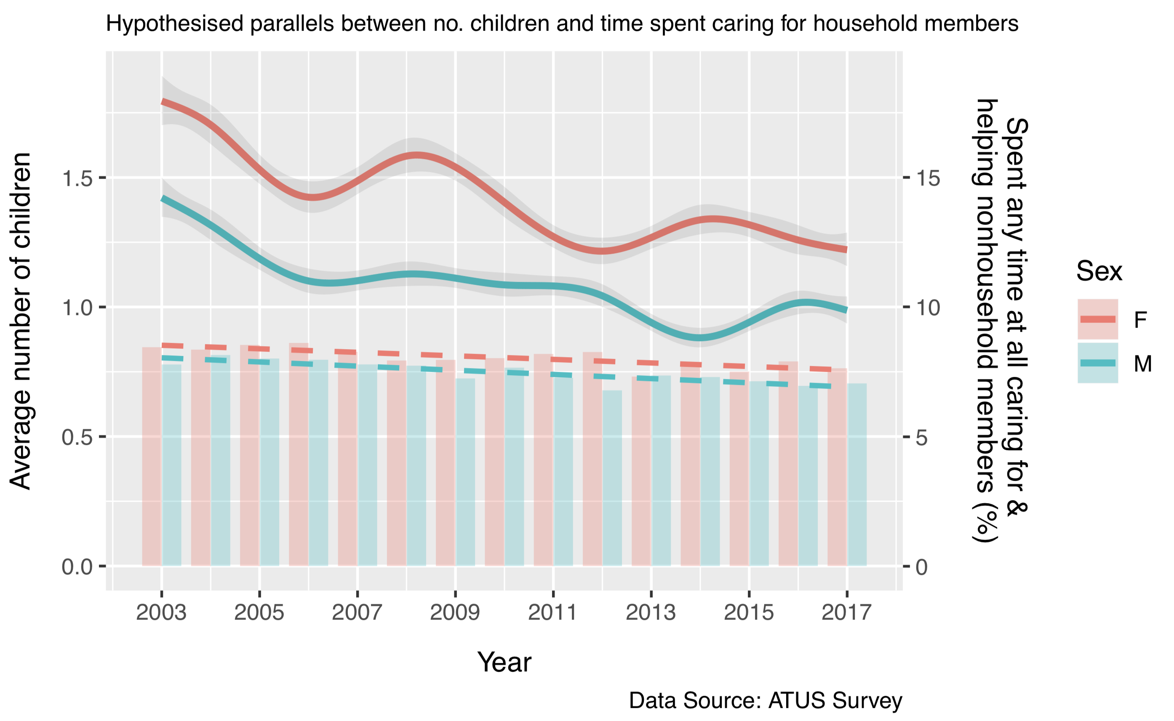
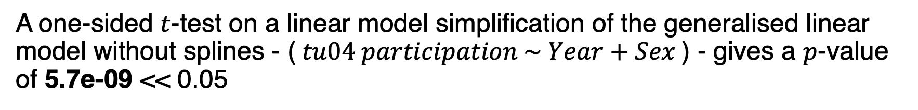
The plot indicates that over the period, the participation in tu04 has decreased for both men and women
Changes in the average number of household children initially seem to follow the trend in tu04 participation
However the link is fairly weak (correlations of 0.65 for Men and 0.49 for Women)
A one-sided $t$-test on a linear model simplification of the generalised linear model without splines - ($tu04 participation \sim Year+Sex$) - gives a $p$-value of 5.7e-09 << 0.05
Notes:
The plot is built on the training data
Simple linear model used as we want to conclude on long term trends

Slide 5
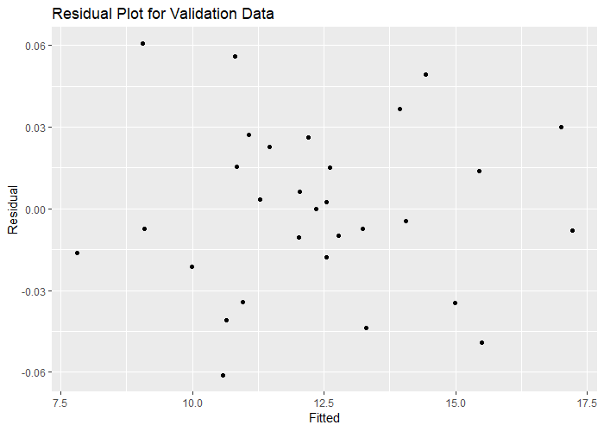
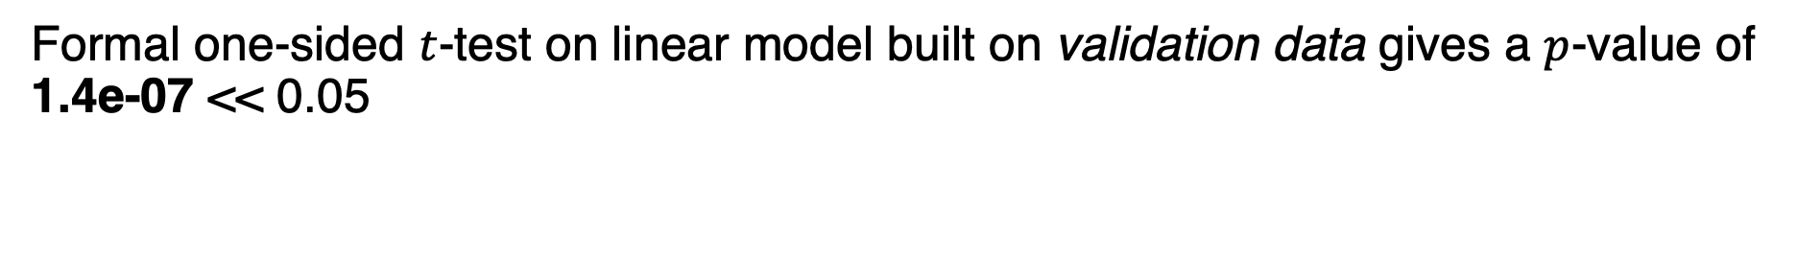
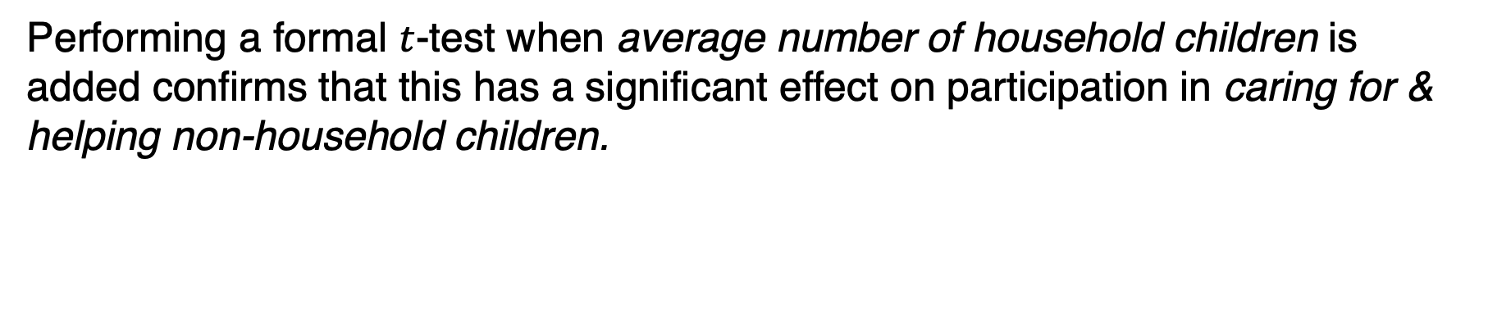
Validation
Formal one-sided $t$-test on linear model built on validation data gives a $p$-value of 1.4e-07 << 0.05
To test the suitability of the model on the validation dataset a residual plot was created
The errors:
Are uncorrelated
Have mostly equal variance
Seem to have mean 0
Performing a formal $t$-test when average number of household children is added confirms that this has a significant effect on participation in caring for & helping non-household children.

Slide 6
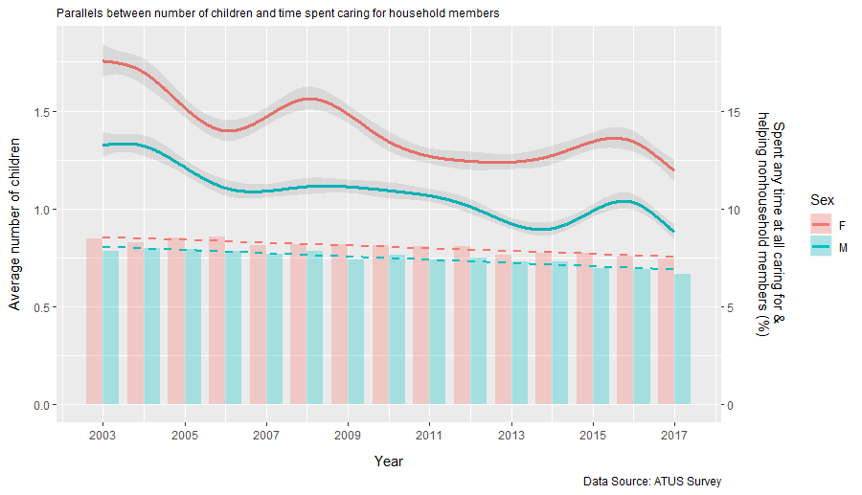
Final Plot Built on all Data Except July

Slide 7
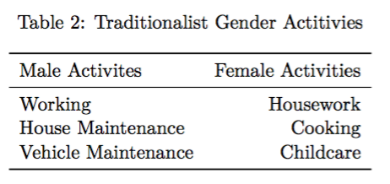
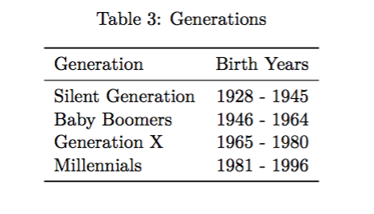
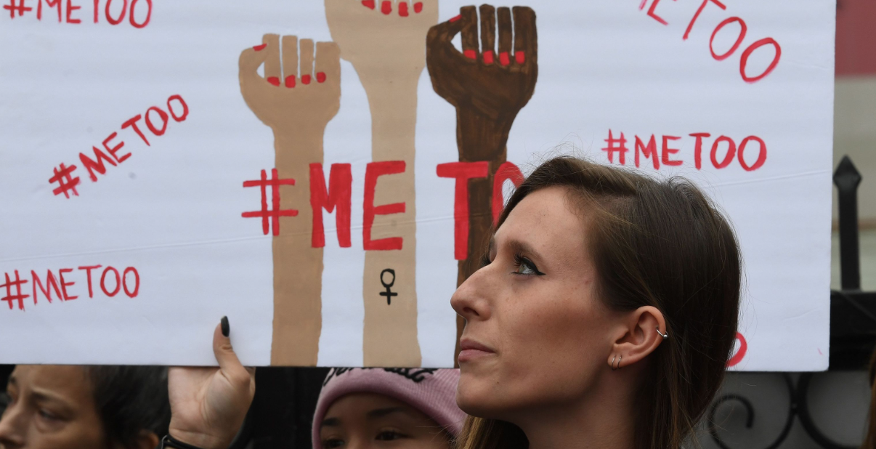
Observation 2: How Time Spent on Traditionally Gendered Activities has Changed as Gender Roles have Broken Down?
Division between genders in terms of societal roles is consistently featured in the news; evident in the “#MeToo” movement amongst others
The report aimed to investigate how this division changed over the given period through investigating long-term trends in each of the traditional gender activities
Table 2 is a simplified version of Talcott Parsons’ [3] study on gender roles
Table 3 shows how to break down the respondents into different generation groups [4]

Slide 8
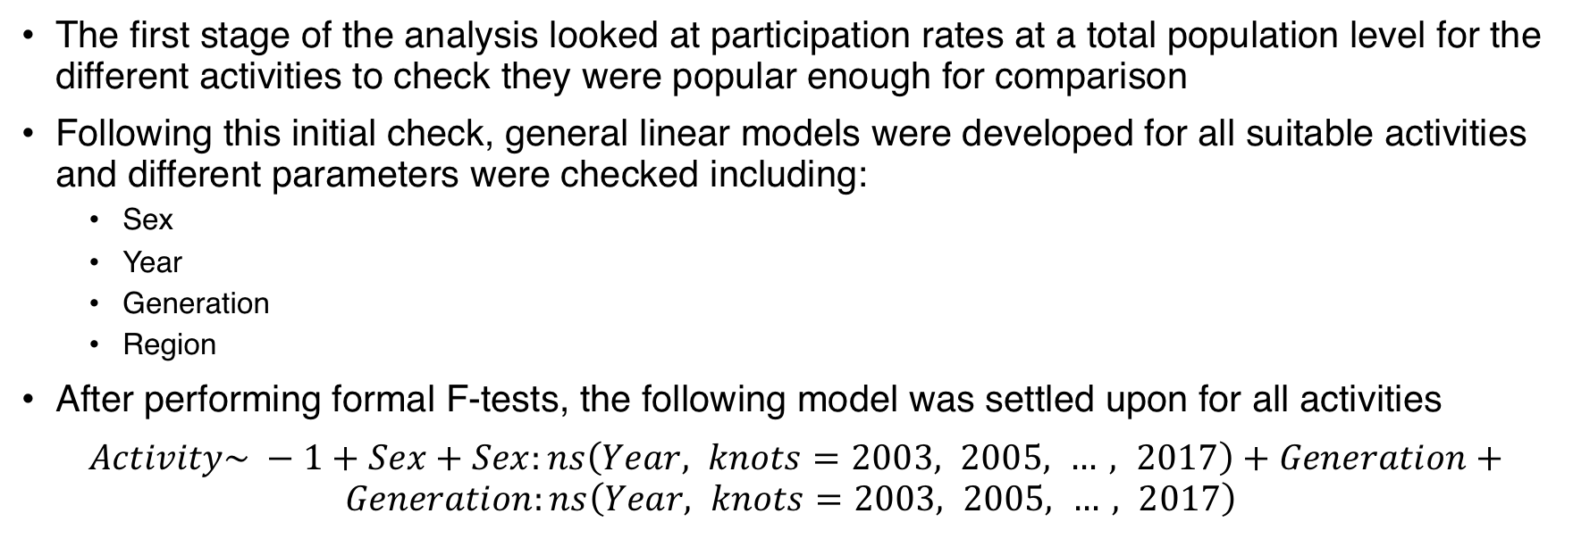
Exploratory Data Analysis
The first stage of the analysis looked at participation rates at a total population level for the different activities to check they were popular enough for comparison
Following this initial check, general linear models were developed for all suitable activities and different parameters were checked including:
Sex
Year
Generation
Region
After performing formal F-tests, the following model was settled upon for all activities
$Activity\sim −1+Sex+Sex:ns\left(Year, knots=2003, 2005, …, 2017\right)+Generation+Generation:ns\left(Year, knots=2003, 2005, …, 2017\right)$

Slide 9
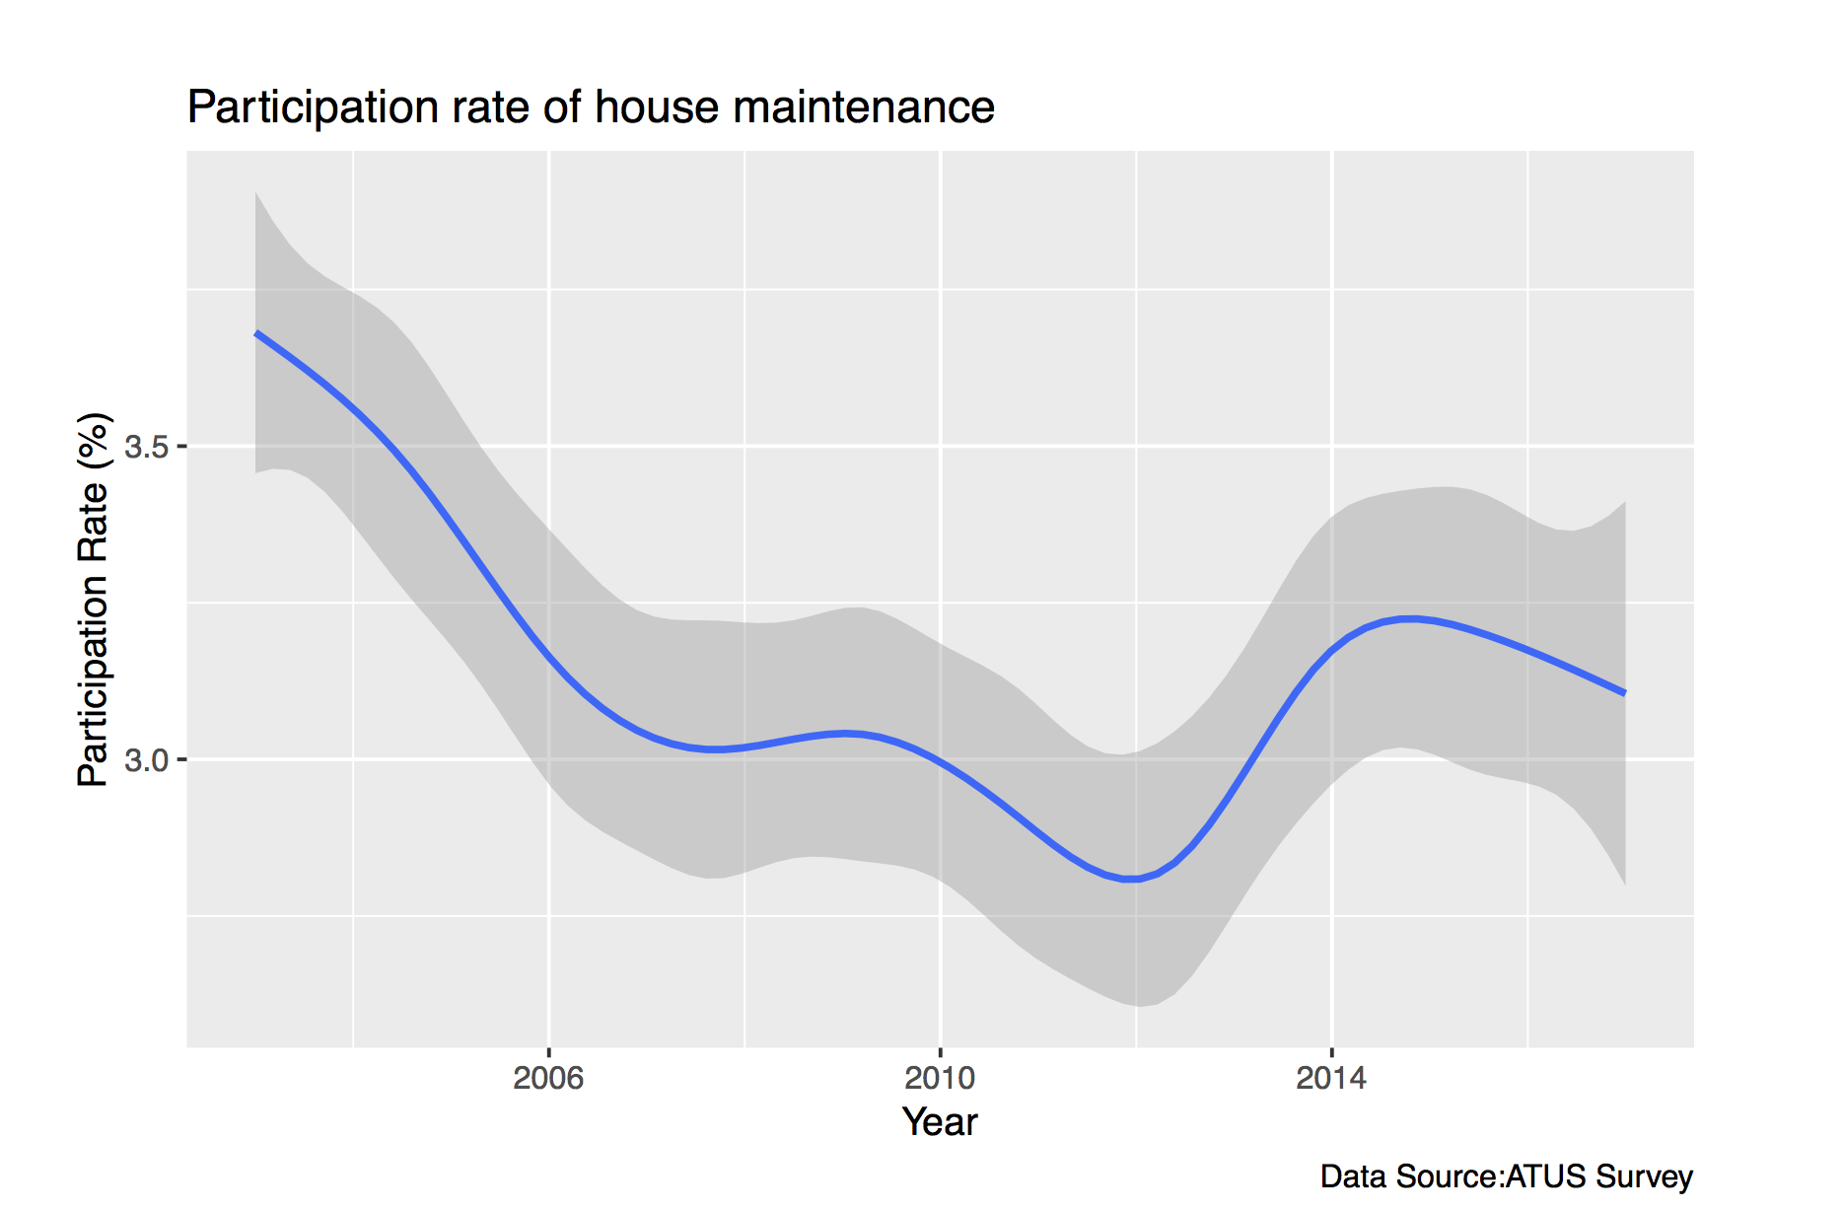
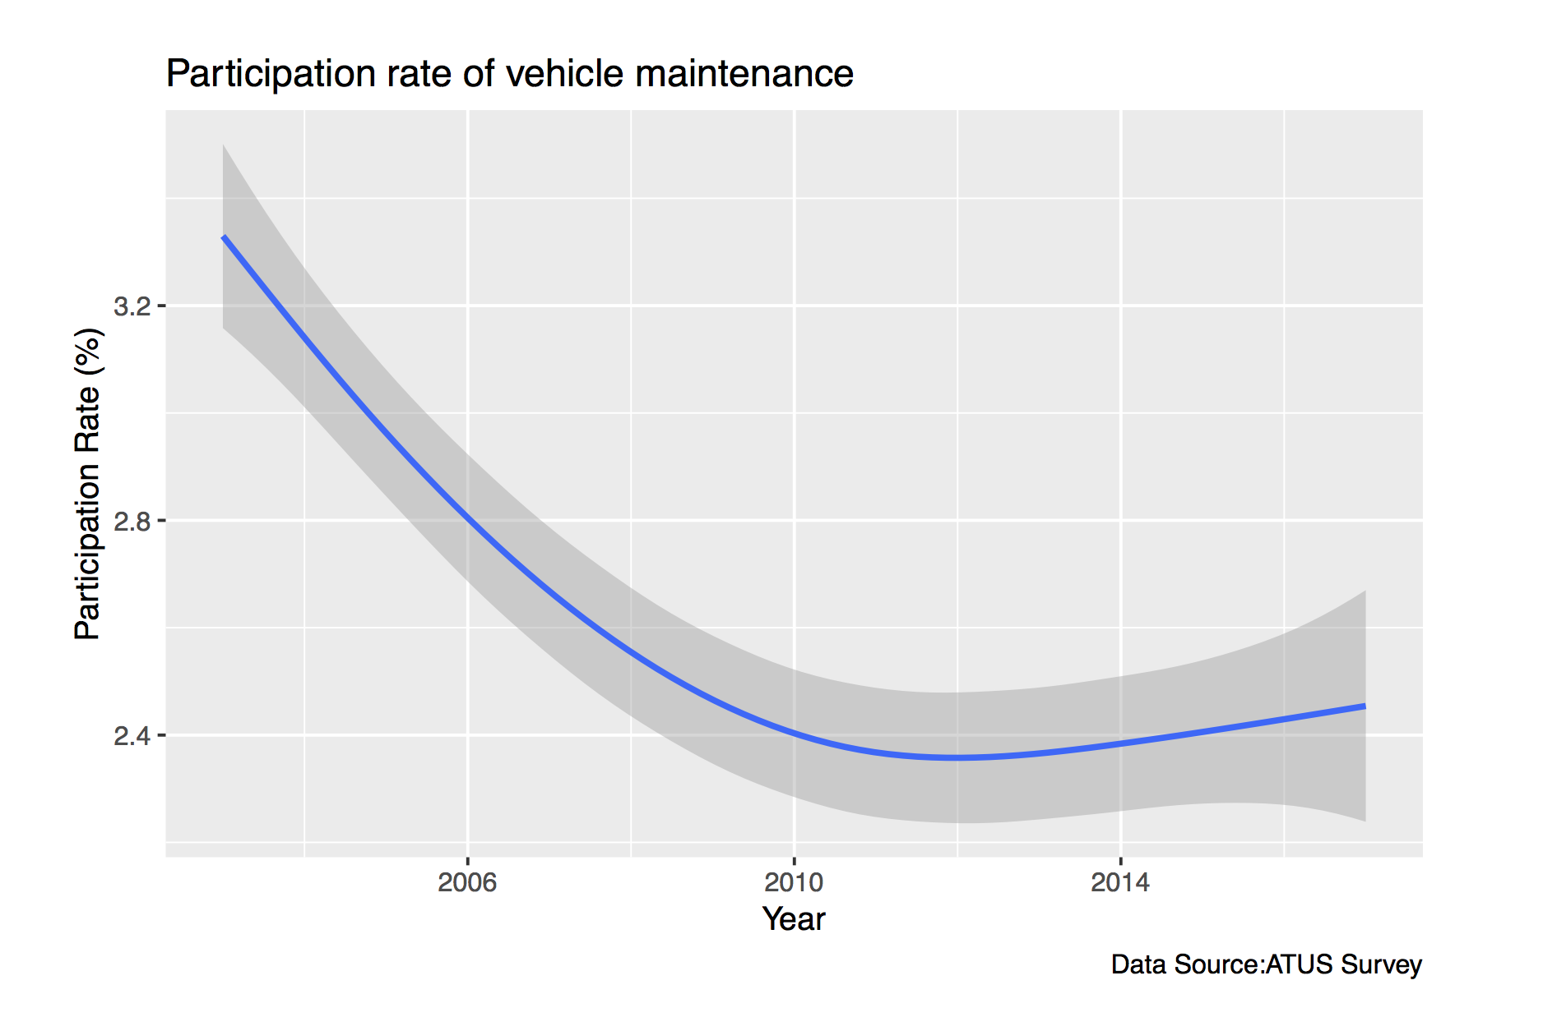
House Maintenance and Vehicle Maintenance
The participation rate was too low to warrant deeper analysis.
Whilst the findings represented that there existed a separation in gender, the participation rates of around 3% for both reflected that these were more uncommon activities.
It was decided that there was not enough data to reflect the time spent on these activities in a suitable linear model.

Slide 10
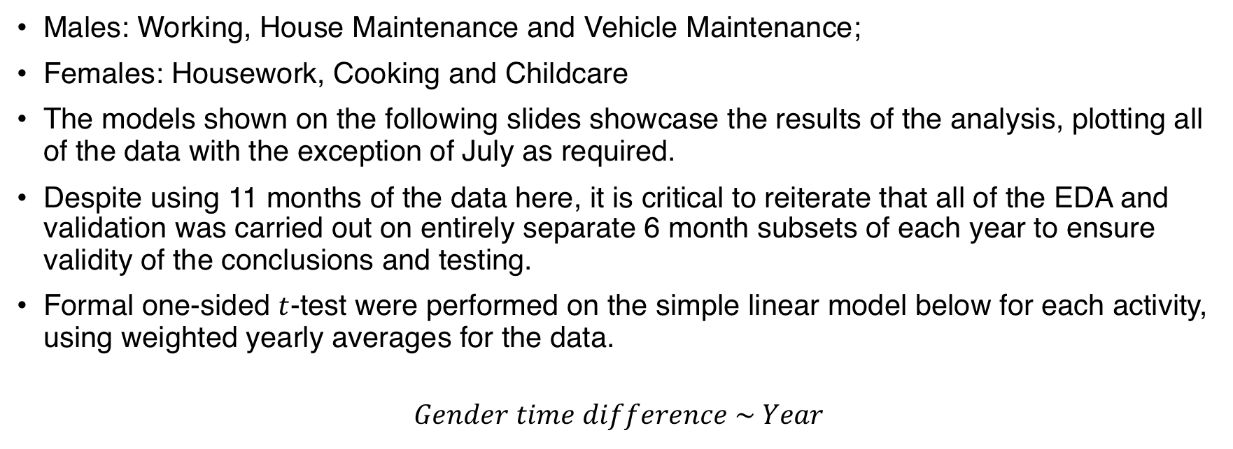
Validation
Males: Working, House Maintenance and Vehicle Maintenance;
Females: Housework, Cooking and Childcare
The models shown on the following slides showcase the results of the analysis, plotting all of the data with the exception of July as required.
Despite using 11 months of the data here, it is critical to reiterate that all of the EDA and validation was carried out on entirely separate 6 month subsets of each year to ensure validity of the conclusions and testing.
Formal one-sided $t$-test were performed on the simple linear model below for each activity, using weighted yearly averages for the data.
$$Gender time difference \sim Year$$

Slide 11
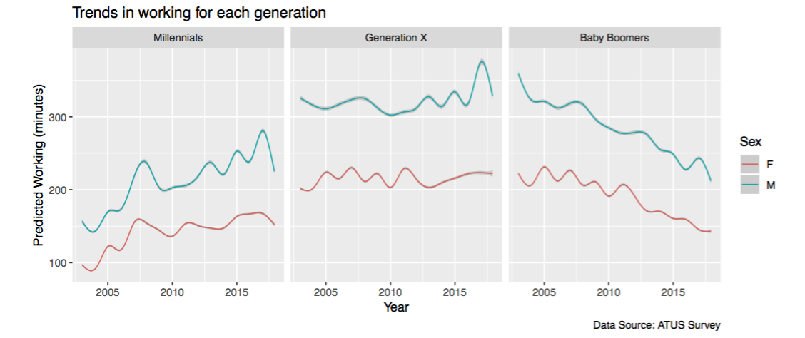
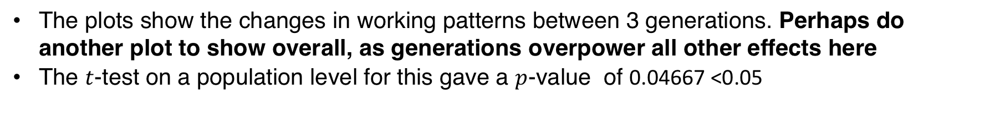
Validation – Working
The Silent Generation have been excluded from these plots as the youngest of this generation would be 65 by 2010 which is retirement age.
The plots show the changes in working patterns between 3 generations. Perhaps do another plot to show overall, as generations overpower all other effects here
The $t$-test on a population level for this gave a $p$-value of 0.04667 <0.05

Slide 12
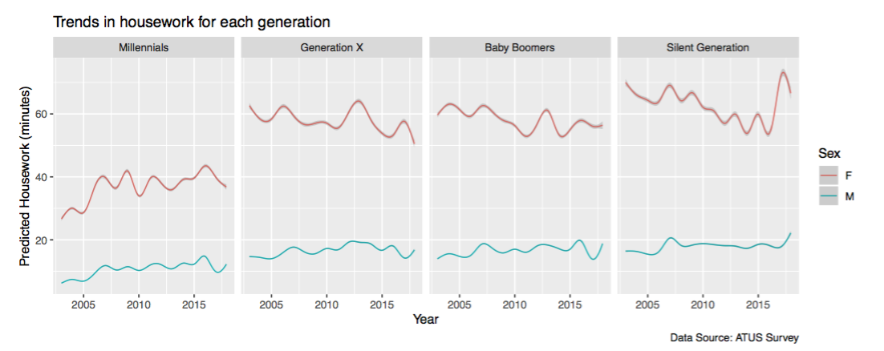
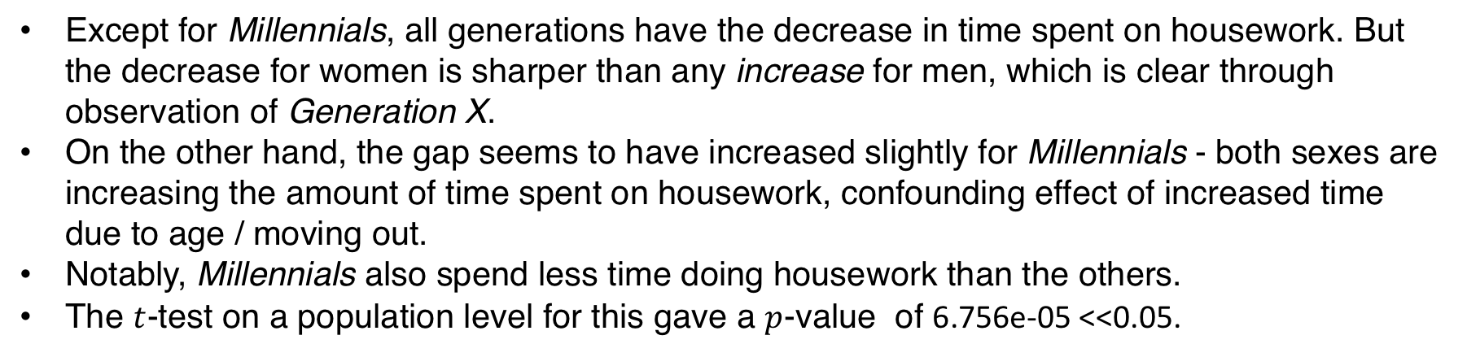
Validation – Housework
Except for Millennials, all generations have the decrease in time spent on housework. But the decrease for women is sharper than any increase for men, which is clear through observation of Generation X.
On the other hand, the gap seems to have increased slightly for Millennials - both sexes are increasing the amount of time spent on housework, confounding effect of increased time due to age / moving out.
Notably, Millennials also spend less time doing housework than the others.
The $t$-test on a population level for this gave a $p$-value of 6.756e-05 <<0.05.

Slide 13
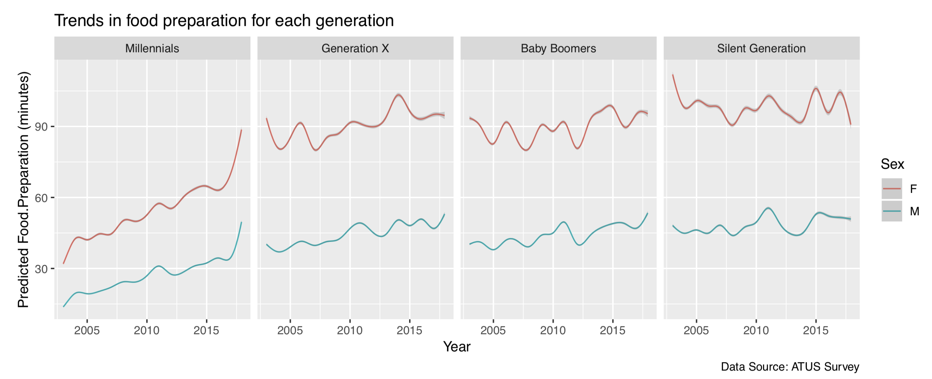
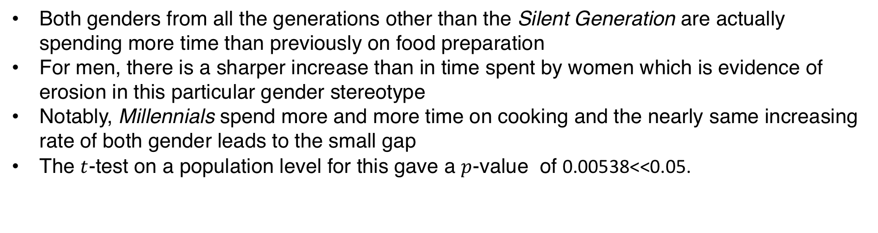
Validation – Cooking
Both genders from all the generations other than the Silent Generation are actually spending more time than previously on food preparation
For men, there is a sharper increase than in time spent by women which is evidence of erosion in this particular gender stereotype
Notably, Millennials spend more and more time on cooking and the nearly same increasing rate of both gender leads to the small gap
The $t$-test on a population level for this gave a $p$-value of 0.00538<<0.05.

Slide 14
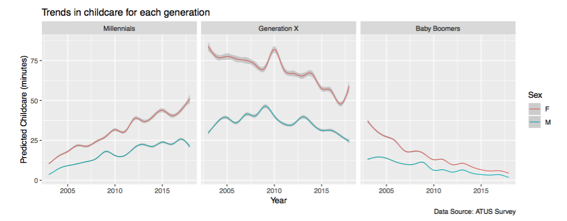
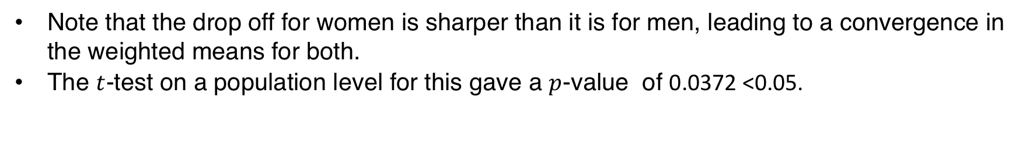
Validation – Childcare
Similarly to Working, the Silent Generation has been excluded as most of them are unlikely to have any household children of their own.
Note that the drop off for women is sharper than it is for men, leading to a convergence in the weighted means for both.
The $t$-test on a population level for this gave a $p$-value of 0.0372 <0.05.

Slide 15
Limitations of the Data
15 years is a relatively short period within which to observe long term trends
Sporadic subset sizes due to the filtering and sub-setting required
The reliance on people to remember the way in which they spend their time
(i.e. They could forget smaller tasks and focus on more memorable or time-
consuming ones)
Data was only collected for a person’s activities in the last 24 hours (think of an answer to this if they ask us how we would have done it better)

Slide 16
References
[1] “ATUS datasets.” https://www.bls.gov/tus/datafiles_0317.htm.
[2] Bureau of Labor Statistics, “The american time use survey.” https://www.bls.gov/tus/, 2017.
[3] T. Parsons, “Age and sex in the social structure of the united states,” American Sociological Review, vol. 7, no. 5, pp. 604–616, 1942 [Online]. Available: http://www.jstor.org/stable/2085686
[4] “Millennials projected to overtake baby boomers as america’s largest generation.” http://www. pewresearch.org/fact-tank/2018/03/01/millennials-overtake-baby-boomers/.

Slide 17
Any Questions?

