Slide 1
How Americans’ Time-Use Patterns Have Changed From 2003 to 2017
GROUP JULY

Slide 2
Introduction
The dataset [1] is based on the research of the American Time Use Survey [2] from 2003 to 2017, containing 431 different activities which are grouped into 17 categories.
Aim: To identify some of the biggest changes and possible reasons for them
Approaches:
EDA
Explore the data using just the even numbered months
Validation
Formal hypothesis tests on the initial beliefs from the EDA using the odd numbered months
Summary plots of findings

Slide 3
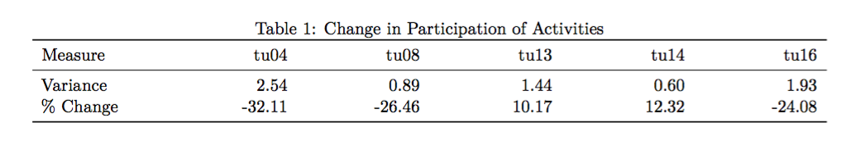
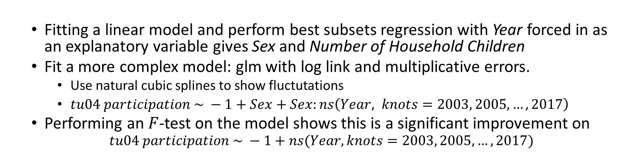
Observation 1: Caring for & Helping Non-HH Members (tu04)
EDA:
Activities with % change larger than 10% and variance greater than 0.5.
Fitting a linear model and perform best subsets regression with Year forced in as an explanatory variable gives Sex and Number of Household Children
Fit a more complex model: glm with log link and multiplicative errors.
Use natural cubic splines to show fluctutations
$tu04 participation \sim −1+Sex+Sex:ns\left(Year, knots=2003, 2005, …, 2017\right)$
Performing an $F$-test on the model shows this is a significant improvement on $tu04 participation \sim −1+ns(Year,knots=2003, 2005, …, 2017)$

Slide 4
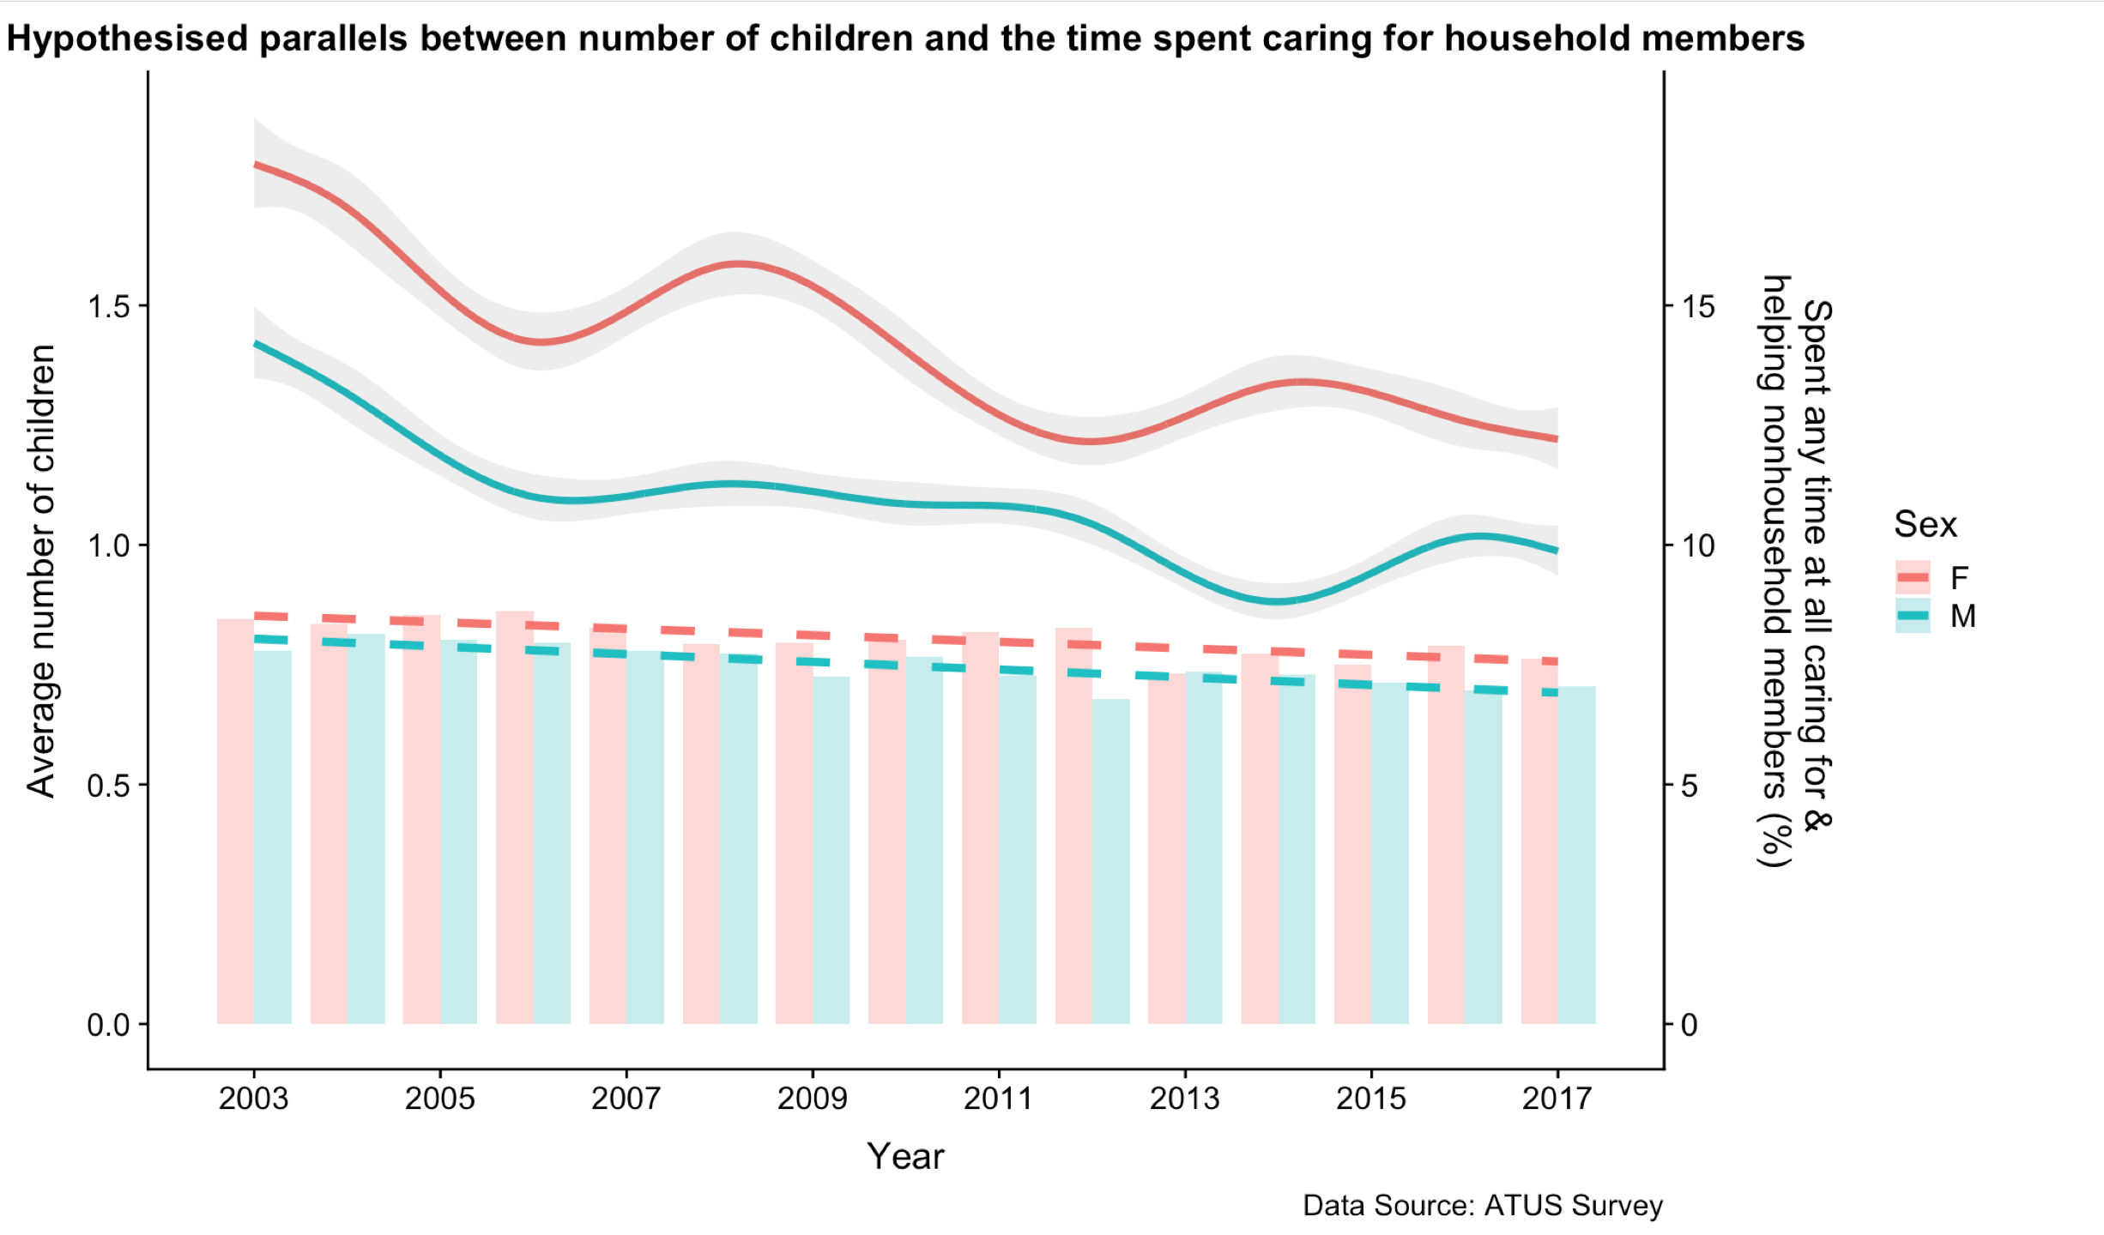
The plot is built on the training data and indicates that over the period, the participation in tu04 has decreased for both men and women.
An informal one-sided $t$-test on a linear model simplification of the glm, without splines, gives a $p$-value of 5.7e-09
Changes in the average number of household children initially seem to follow the trend in tu04 participation. However if check the correlations between them, the link is fairly weak (0.65 for Men and 0.49 for Women).

Slide 5
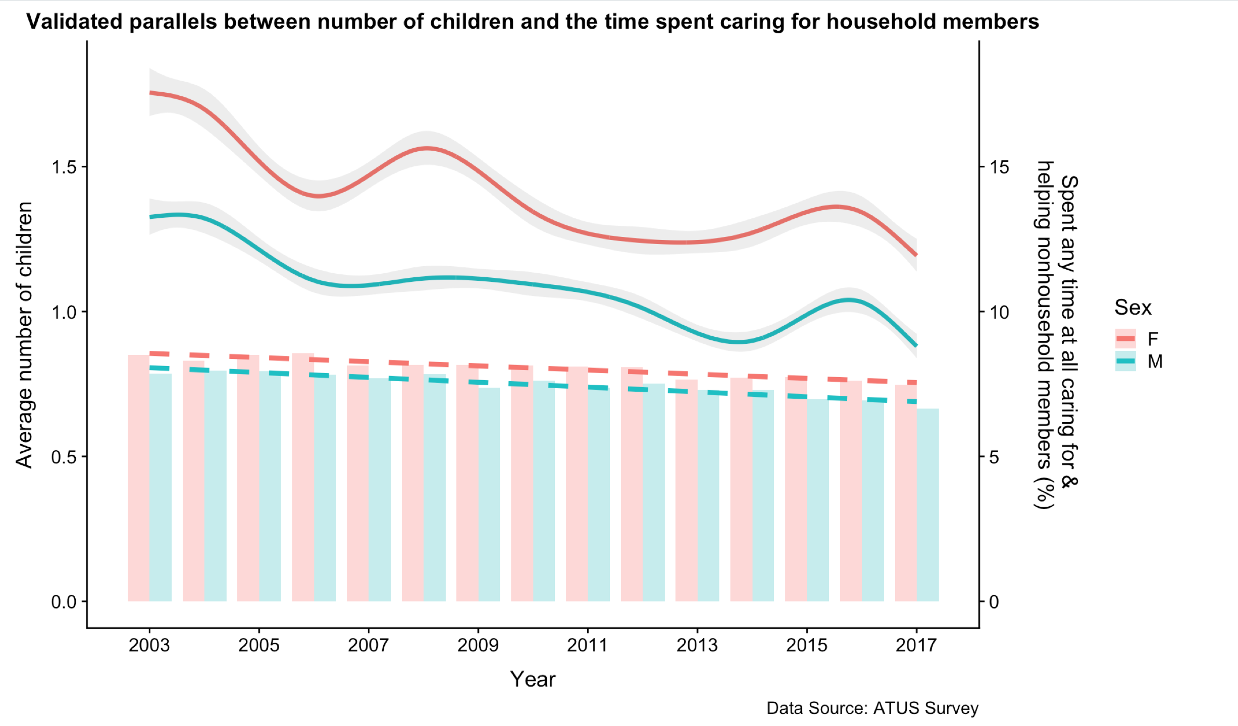
Validation:
Including or excluding the number of household kids in the linear model with Sex and Year and t-test would both give a p-value which is less than 0.05. It is enough to conclude that both gender tend to join less in the activity through these 15 years.
Besides, there seems to be a link between the number of household kids and the participation percentage. The right plot shows changes using a fitting model on all the data, only excluding those responses taken in July for each year.

Slide 6
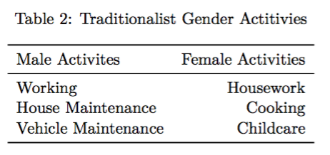
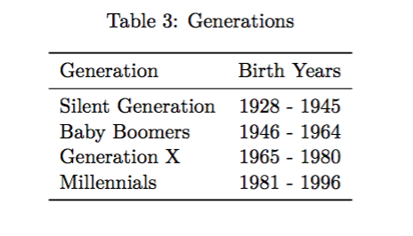

Fluctuation 2: The Time Spent on Traditionally Gendered Activities as Gender Roles have Broken Down?
The division between genders in terms of roles and responsibilities is always a major news topic.
(such as ‘#MeToo’ and ‘Times Up’.)
This report would focus on the long-term changes in time use for different sexes.
Table 2 is a simplified version of Talcott Parsons’ [3] study on gender roles.
Table 3 shows how to break down the respondents into different generation groups [4].

Slide 7
Validation:
Males: Working, House Maintenance and Vehicle Maintenance;
Females: Housework, Cooking and Childcare
The following models showcase the results of the analysis plotting all of the data with the exception of July as required.
Despite using 11 months of the data here, it is critical to reiterate that all of the EDA and validation was carried out on entirely separate 6 month subsets of each year to ensure validity of the conclusions and testing.

Slide 8
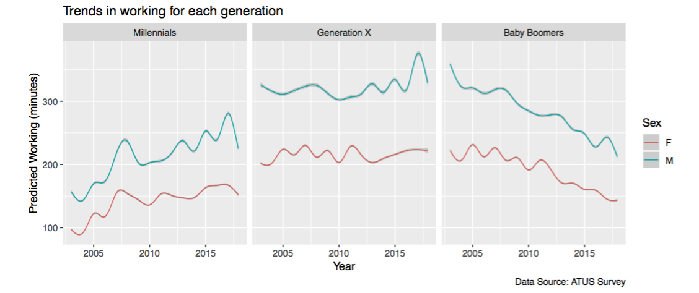
Validation – Males – Working
The Silent Generation have been excluded from these plots as the youngest of this generation would be 65 by 2010 which is retirement age.
The plots show the changes in working patterns between 3 generations.
A slight contraction. It is clear that working hours follow a fairly standard trajectory, peaking for people in their middle ages.
Millennials have seen a steady increase in their time spent working as would be expected for; the genders seem to have a much smaller gap when compared with Generation X though, which is testament to part of the hypothesis made above regarding progressive social norms propagating through younger generations.

Slide 9
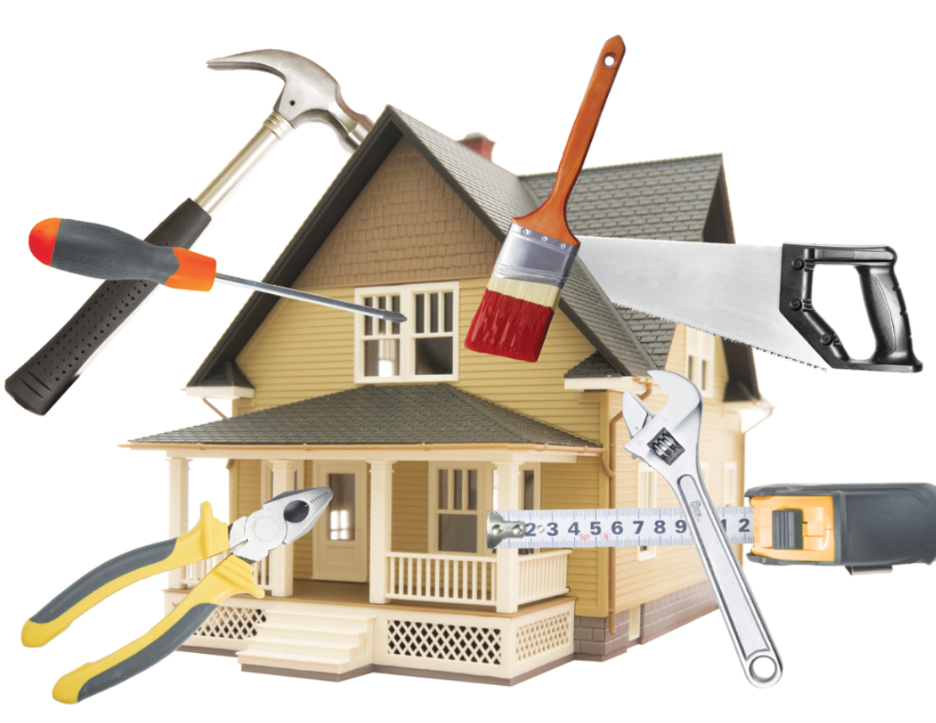

Validation – Males – House Maintenance and Vehicle Maintenance
The participation rate was too low to warrant deeper analysis.
Whilst the findings represented that there existed a separation in gender, the participation rates of around 3% for both reflected that these were more uncommon activities.
It was decided that there was not enough data to reflect the time spent on these activities in a suitable linear model.

Slide 10
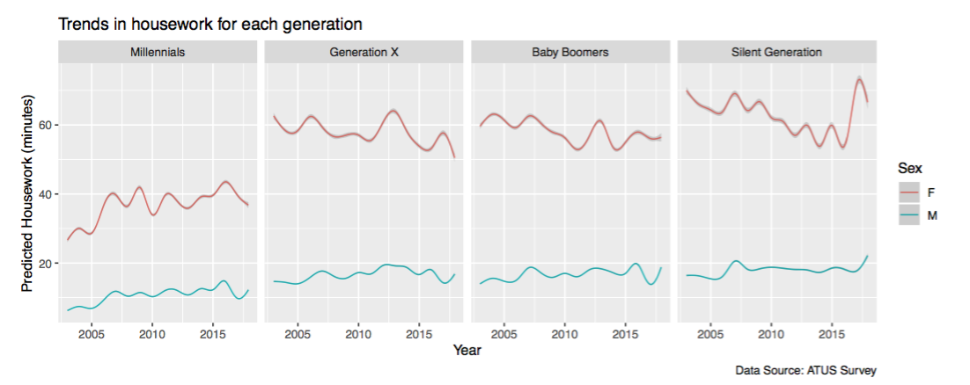
Validation – Females – Housework
Except for Millennials, all generations have the decrease in time spent on housework. But the decrease for women is sharper than the increase for men, which is clearly in Generation X.
On the other hand, the gap seems to have increased slightly for Millennials - both sexes are increasing the amount of time spent on housework.
Notably, Millennials also spend less time doing housework than the others.

Slide 11
Validation – Females – Cooking
Very similar trend to Housework;
The difference is that for Baby Boomers and Generation X, women are actually spending more time than previously. For men, the sharper increase shows that they seem to be more normalized to prepare food.
Notably, Millennials spend more and more time on cooking and the nearly same increasing rate of both gender leads to the small gap.

Slide 12
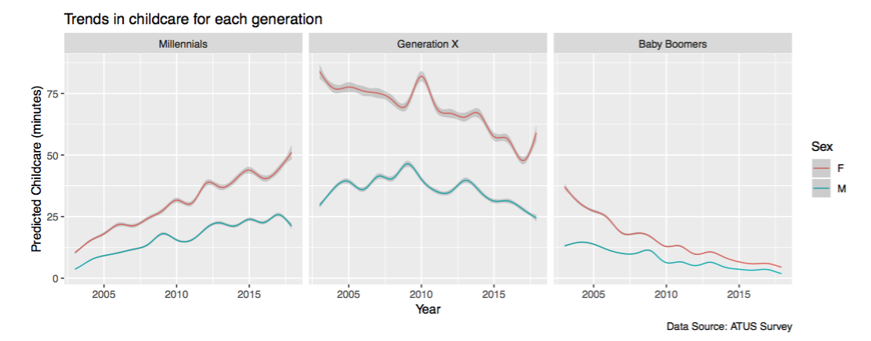
Validation – Females – Childcare
Similarly like Working, the Silent Generation has been excluded as most of them are unlikely to have any household children of their own.
It is unlikely that many people within these generations would have children (age less than 18) living with them at this age (in fact checking the data confirms that only 9% met this criteria in 2017). That’s why Baby Boomers and the Silent Generation show nearly nothing.
Note that the drop off for women is sharper than it is for men, leading to a convergence in the weighted means for both.

Slide 13
Limitation of the Data
The length of the period, 15 years is a short amount of time to observe trends among such a large population.
Data had to first be subsetted or transformed as no immediate trends were visible at the surface, this led to sporadic subset size and get down to the demographics that were desirable to investigate (like Vehicle and House Maintenance).
The reliance on people to remember the way in which they spend their time.
(i.e. They could forget smaller tasks and focus on more memorable or time-
consuming ones.)
It is exacerbated due to data only being collected for the previous 24 hours.

Slide 14
Any Question?

Slide 15
Reference
[1] “ATUS datasets.” https://www.bls.gov/tus/datafiles_0317.htm.
[2] Bureau of Labor Statistics, “The american time use survey.” https://www.bls.gov/tus/, 2017.
[3] T. Parsons, “Age and sex in the social structure of the united states,” American Sociological Review, vol. 7, no. 5, pp. 604–616, 1942 [Online]. Available: http://www.jstor.org/stable/2085686
[4] “Millennials projected to overtake baby boomers as america’s largest generation.” http://www. pewresearch.org/fact-tank/2018/03/01/millennials-overtake-baby-boomers/.

