Slide 1

1 The Foundations: Logic and Proofs
1.1 Propositional Logic
1.2 Applications of Propositional Logic 1.3 Propositional Equivalences 1.4 Predicates and Quantifiers 1.5 Nested Quantifiers 1.6 Rules of Inference 1.7 Introduction to Proofs 1.8 Proof Methods and Strategy

Slide 2
Section Summary
Tautologies, Contradictions, and Contingencies.
Logical Equivalence
Important Logical Equivalences
Showing Logical Equivalence
Normal Forms
Disjunctive Normal Form
Conjunctive Normal Form
Propositional Satisfiability
The n-Queens Problem
Sudoku Example

Slide 3
Tautologies 永真式
Topic #1.1 – Propositional Logic: Equivalences
A tautology is a compound proposition that is true no matter what the truth values of its atomic propositions are!
Ex. p ∨ ¬p [What is its truth table?]
p | ¬p | p∨¬p
T | F | T
F | T | T

Slide 4
Contradictions 永假式
Topic #1.1 – Propositional Logic: Equivalences
A contradiction is a compound proposition that is false no matter what the truth values of its atomic propositions are!
Ex. p ∧ ¬p [Truth table?]
p | ¬p | p∧¬p
T | F | F
F | T | F

Slide 5
What’s left besides Tautologies and Contradictions
Topic #1.1 – Propositional Logic: Equivalences
All other props. are contingencies (可满足式)
i.e., in the truth tables,
Some rows give T, others give F

Slide 6
Tautologies, Contradictions, and Contingencies
A tautology is a proposition which is always true.
Example: p ∨¬p
A contradiction is a proposition which is always false.
Example: p ∧¬p
A contingency is a proposition which is neither a tautology nor a contradiction, such as p
P | ¬p | p ∨¬p | p ∧¬p
T | F | T | F
F | T | T | F

Slide 7
Which of these are tautologies?
p→ (q → p)
p→ (¬p → p)
(q → p) → (p → q)
(q → p) ∨ (p → q)
(p → (q → r)) → (q → (p → r))
Please prove your claims, using truth tables. (Hint: Ask what assignment of truth values to p,q, and r would falsify each formula).

Slide 8
Which of these are tautologies?
p→ (q → p) Tautologous
p→ (¬p → p) Tautologous
(q → p) → (p → q) Contingent
(q → p) ∨ (p → q) Tautologous
(p → (q → r)) → (q → (p → r)) Tautologous
Notes:
1,2,4,5 are known as “`paradoxes’ of the material implication”, because they contrast with implication in ordinary language

Slide 9
Section Summary
Tautologies, Contradictions, and Contingencies.
Logical Equivalence
Important Logical Equivalences
Showing Logical Equivalence
Normal Forms
Disjunctive Normal Form
Conjunctive Normal Form
Propositional Satisfiability
The n-Queens Problem
Sudoku Example

Slide 10

Logical Equivalence等值式
Topic #1.1 – Propositional Logic: Equivalences
Given two props. p and q, how many propositional formulas can we get ?
How many truth tables can we get from propositional formulas with two props. p and q ?
unlimited formulas
$$2^{2^{2}}=16$$

Slide 11
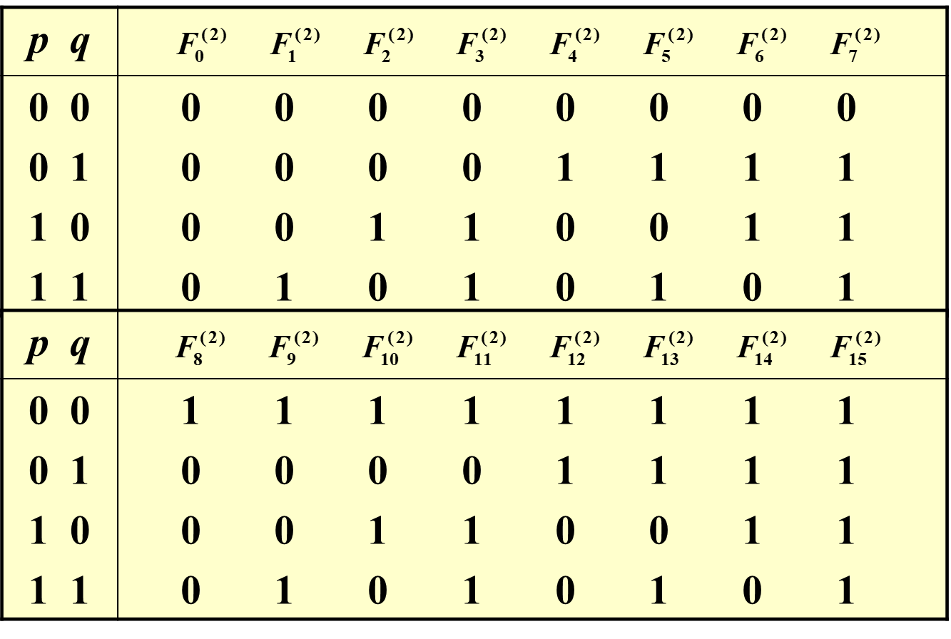
Logical Equivalence 等值式
Topic #1.1 – Propositional Logic: Equivalences
Truth table p→q, ¬p∨q, (¬p∨q)∨(¬(p→q)∧q)

Slide 12
Logical Equivalence 等值式
Topic #1.1 – Propositional Logic: Equivalences
Compound proposition A is logically equivalent to compound proposition B, written A⇔B, IFF
A and B contain the same truth
values in all rows of their truth
tables

Slide 13
Propositional Equivalence
Topic #1.1 – Propositional Logic: Equivalences
Two syntactically (i.e., textually) different compound propositions may be semantically identical (i.e., have the same meaning). We call them logically equivalent. (逻辑等值)
Notation: … ⇔ …

Slide 14
Proving Equivalence via Truth Tables
Ex. Prove that p∨q ⇔ ¬(¬p ∧ ¬q).
F
T
T
T
F
T
T
F
F
T
T
F
T
F
T
T
F
F
F
T

Slide 15
Equivalence Laws
Topic #1.1 – Propositional Logic: Equivalences
Similar to arithmetic identities in algebra, but for propositional equivalences instead.
They provide a pattern or template that can be used to match all or part of a much more complicated proposition and to find an equivalence for it.
Abbreviation: T stands for an arbitrary tautology; F an arbitrary contradiction

Slide 16
Logical Equivalences 逻辑等值式
P ∧ T ⇔ P, P ∨ F ⇔ P Identity（同一律）
P ∨ T ⇔ T , P ∧ F ⇔ F
Domination（零律）
P ∨ P ⇔ P , P ∧ P ⇔ P
Idempotency（等幂律）

Slide 17
Logical Equivalences
¬(¬P)) ⇔ P Double negation（双重否定律）
P ∨ Q ⇔ Q ∨ P P ∧ Q ⇔ Q ∧ P Commutativity（交换律）
(P ∨ Q) ∨ R ⇔ P ∨ (Q ∨ R) (P ∧ Q) ∧ R ⇔ P ∧ (Q ∧ R) Associativity（结合律）

Slide 18
Logical Equivalences
P ∧ (Q ∨ R) ⇔(P ∧ Q) ∨ (P ∧ R) P ∨ (Q ∧ R) ⇔ (P ∨ Q) ∧ (P ∨ R) Distributivity（分配律）
¬(P ∧ Q)⇔ ¬P ∨¬Q ¬(P ∨ Q)⇔ ¬P ∧¬Q DeMorgan’s laws（德·摩根律）

Slide 19
Logical Equivalences
P → Q ⇔ ¬P ∨Q Implication（蕴涵等值式）
P ∨ ¬P ⇔ T Tautology（排中律）
P ∧ ¬P ⇔ F Contradiction（矛盾律）
(P → Q) ∧ (Q → P) ⇔ (P ↔ Q) Equivalence （等价等值式）
(P → Q) ∧ (P → ¬Q) ⇔ ¬P Absurdity ( 归谬论 )

Slide 20
Logical Equivalences
(P → Q) ⇔ (¬Q → ¬P) Contrapositive（蕴涵逆反式）
P ∨ (P ∧ Q) ⇔ P P ∧ (P ∨ Q) ⇔ P Absorption（吸收律）
(P ∧ Q) → R ⇔ P → (Q → R) Exportation（输出律）

Slide 21
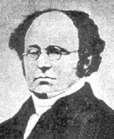
More Equivalence Laws
Topic #1.1 – Propositional Logic: Equivalences
De Morgan’s: ¬(p∧q) ⇔ ¬p ∨ ¬q ¬(p∨q) ⇔ ¬p ∧ ¬q
德·摩根律扩展：
¬(p∧q ∨r ∧ ¬ s) ⇔ ¬p ∨ ¬q ∧ ¬r ∨ s
Augustus De Morgan (1806-1871)

Slide 22
Defining Operators via Equivalences
Using equivalences, we can define operators in terms of other operators.
Exclusive or: p⊕q ⇔ (p∨q)∧¬(p∧q) p⊕q ⇔ (p∧¬q)∨(q∧¬p)

Slide 23
Tautologies revisited
We’ve introduced the notion of a tautology using the example p ∨ ¬p
Now, you know more operators, so can formulate many more tautologies, e.g., (p∨q) ↔ ¬(¬p ∧ ¬q) (p→q) ↔ (¬q → ¬ p), and so on

Slide 24
What is the difference between ↔ and ⇔ ?
A ⇔ B says that no assignment of truth values to A and B can make A ↔ B false
So, A ⇔ B can only hold between well-chosen compound A and B. For example, p∨q ⇔ ¬(¬p ∧ ¬q).

Slide 25
EXAMPLE 4
Show that the propositions p∨(q∧r) and (p∨q)∧(p∨r) are logically equivalent. This is the distributive law of disjunction over conjunction.

Slide 26
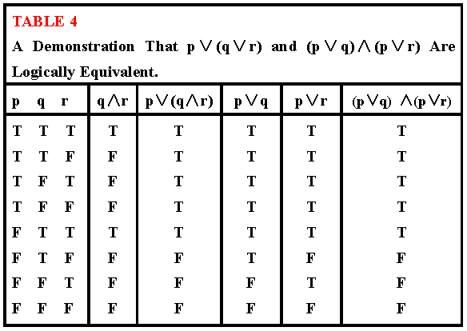
Table 4

Slide 27
置换规则
给定公式A，它的所有子公式为A₁, A₂,…,A_{n}, 设A_{i} ⇔ B_{i}, 用B_{i}置换A_{i，}所得公式为B，则 A⇔ B。
例：求证：
(P →( Q →R) ⇔ P →( ¬ Q ∨ R)为永真式
已 知 ( Q →R) ⇔ ( ¬ Q ∨ R)
用(¬Q ∨ R)置换原式中的(Q →R)

Slide 28


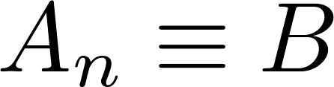
Constructing New Logical Equivalences
We can show that two expressions are logically equivalent by developing a series of logically equivalent statements.
To prove that we produce a series of equivalences beginning with A and ending with B.
Keep in mind that whenever a proposition (represented by a propositional variable) occurs in the equivalences listed earlier, it may be replaced by an arbitrarily complex compound proposition.

Slide 29
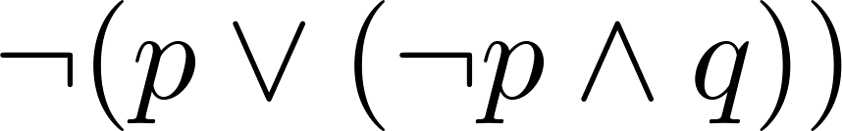
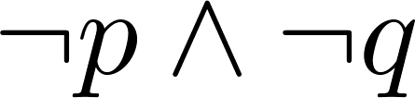
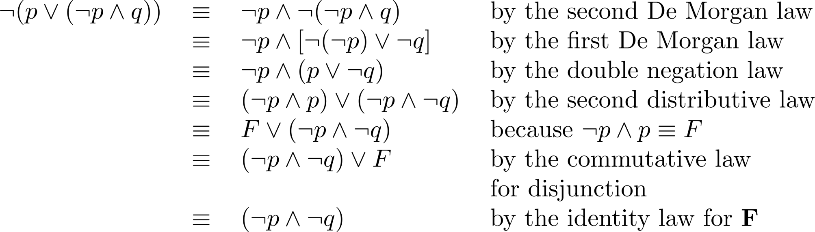
Equivalence Proofs
Example: Show that
is logically equivalent to
Solution:

Slide 30
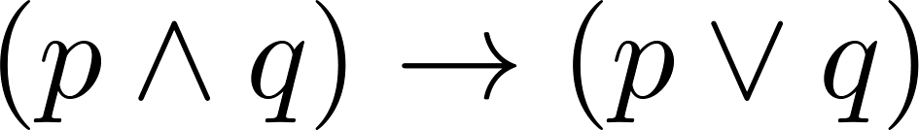
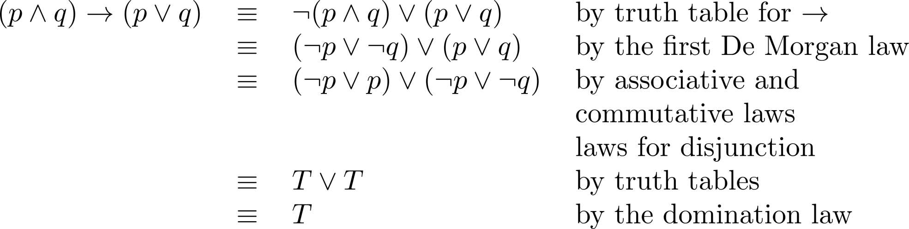
Equivalence Proofs
Example: Show that
is a tautology.
Solution:

Slide 31
An Example Problem
Topic #1.1 – Propositional Logic: Equivalences
Check using a symbolic derivation whether (p ∧ ¬q) → (p ⊕ r) ⇔ ¬p ∨ q ∨ ¬r.
(p ∧ ¬q) → (p ⊕ r) [Expand definition of →]
⇔ ¬(p ∧ ¬q) ∨ (p ⊕ r) [Expand defn. of ⊕]
⇔ ¬(p ∧ ¬q) ∨ ((p ∨ r) ∧ ¬(p ∧ r))
[DeMorgan’s Law]
⇔ (¬p ∨ q) ∨ ((p ∨ r) ∧ ¬(p ∧ r))
cont.

Slide 32
Example Continued...
Topic #1.1 – Propositional Logic: Equivalences
(¬p ∨ q) ∨ ((p ∨ r) ∧ ¬(p ∧ r)) ⇔ [∨ commutes]
⇔ (q ∨ ¬p) ∨ ((p ∨ r) ∧ ¬(p ∧ r)) [∨ is associative]
⇔ q ∨ (¬p ∨ ((p ∨ r) ∧ ¬(p ∧ r))) [distrib. ∨ over ∧]
⇔ q ∨ (((¬p ∨ (p ∨ r)) ∧ (¬p ∨ ¬(p ∧ r)))
[assoc.] ⇔ q ∨ (((¬p ∨ p) ∨ r) ∧ (¬p ∨ ¬(p ∧ r)))
[trivial taut.] ⇔ q ∨ ((T ∨ r) ∧ (¬p ∨ ¬(p ∧ r)))
[domination] ⇔ q ∨ (T ∧ (¬p ∨ ¬(p ∧ r)))
[identity] ⇔ q ∨ (¬p ∨ ¬(p ∧ r)) ⇔ cont.

Slide 33
End of Long Example
Topic #1.1 – Propositional Logic: Equivalences
q ∨ (¬p ∨ ¬(p ∧ r))
[DeMorgan’s] ⇔ q ∨ (¬p ∨ (¬p ∨ ¬r))
[Assoc.] ⇔ q ∨ ((¬p ∨ ¬p) ∨ ¬r)
[Idempotent] ⇔ q ∨ (¬p ∨ ¬r)
[Assoc.] ⇔ (q ∨ ¬p) ∨ ¬r
[Commut.] ⇔ ¬p ∨ q ∨ ¬r
Q.E.D. (quod erat demonstrandum)
Q.E.D.是拉丁片语「quod erat demonstrandum」（这被证明了）的缩写。
(Which was to be shown.)

Slide 34
Logically Equivalent
Two compound propositions p and q are logically equivalent if p↔q is a tautology.
We write this as p⇔q or as p≡q where p and q are compound propositions.
Two compound propositions p and q are equivalent if and only if the columns in a truth table giving their truth values agree.
This truth table show ¬p ∨ q is equivalent to p → q.
p | q | ¬p | ¬p ∨ q | p→ q
T | T | F | T | T
T | F | F | F | F
F | T | T | T | T
F | F | T | T | T

Slide 35
Application
Please simplify the following program
If A ∧ B then
If B ∨ C then
XXX
Else
YYY
End
Else
If A ∧ C then
YYY
Else
XXX
End
End
The condition for executing code segment XXX is:
((A∧B) ∧ (B ∨ C) ) ∨ (¬( A∧B) ∧ ¬(A∧C))
⇔ ¬(A ∧ ¬B ∧ C）
The condition for executing code segment YYY is:
((A∧B) ∧ ¬ (B ∨ C) )∨ (¬(A∧B) ∧ (A∧C))
⇔ A ∧ ¬B ∧ C
If A∧ ¬B∧C then
YYY
Else
XXX
End

Slide 36
Application
Please solve the following problem using the methods from Logical Equivalences.
A、B、C、D participate in the 100-meter race，four audience X、Y、Z predicate the result as follows before the competition.
X：C ranks the first place，B ranks the second place.
Y：C ranks the second place，D ranks the third place.
Z：A ranks the second place，D ranks the fourth place.
After the competition, we discover that each of the four audiences is right for half of their predication, so what is the real ranking？
Let p_{i} , q_{i} , r_{i} , s_{i} denote that A、B、C、D be the No. i in the final ranking, respectively
( r₁ ∧ ¬q₂) ∨ (¬r₁ ∧ q₂) ⇔1
( r₂ ∧ ¬s₃) ∨ (¬r₂ ∧ s₃) ⇔1
( p₂ ∧ ¬s₄) ∨ (¬p₂ ∧ s₄) ⇔1

Slide 37
By 1) and 2),
1 ⇔ (( r₁∧¬q₂) ∨ (¬r₁∧q₂) ) ∧ (( r₂∧¬s₃) ∨ (¬r₂∧s₃))
⇔ (r₁ ∧¬q₂ ∧ r₂ ∧ ¬s₃) ∨(r₁ ∧ ¬q₂ ∧ ¬r₂ ∧ s₃)
∨ (¬r₁ ∧ q₂ ∧ r₂ ∧ ¬s₃) ∨ (¬r₁ ∧ q₂ ∧ ¬r₂ ∧ s₃)
⇔ (r₁ ∧ ¬q₂ ∧ ¬r₂ ∧ s₃)∨ (¬r₁ ∧ q₂ ∧ ¬r₂ ∧ s₃) ⇔ 1
Combining the above argument with 3),
1 ⇔ ((r₁ ∧ ¬q₂ ∧ ¬r₂ ∧ s₃)∨ (¬r₁ ∧ q₂ ∧ ¬r₂ ∧ s₃))
∧(( p₂ ∧ ¬s₄) ∨ (¬p₂ ∧ s₄))
⇔ (r₁ ∧ ¬q₂ ∧ ¬r₂ ∧ s₃ ∧ p₂ ∧ ¬s₄)
∨ (r₁ ∧ ¬q₂ ∧ ¬r₂ ∧ s₃ ∧ ¬p₂ ∧ s₄)
∨ (¬r₁ ∧ q₂ ∧ ¬r₂ ∧ s₃ ∧ p₂ ∧ ¬s₄)
∨ (¬r₁ ∧ q₂ ∧ ¬r₂ ∧ s₃ ∧ ¬p₂ ∧ s₄)
⇔ (r₁ ∧¬q₂ ∧ ¬r₂ ∧ s₃ ∧ p₂ ∧ ¬s₄) ⇔ 1
Finally：
C: the first
A: the second
D: the third
B: the fourth

Slide 38

For you to think about:

Slide 39
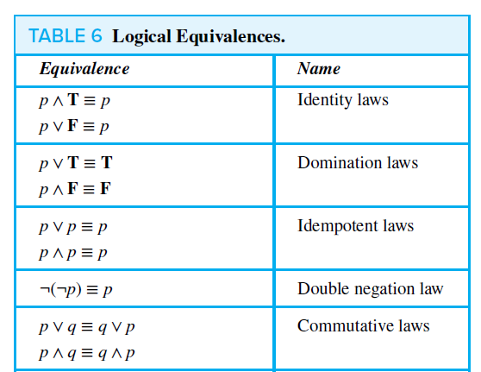
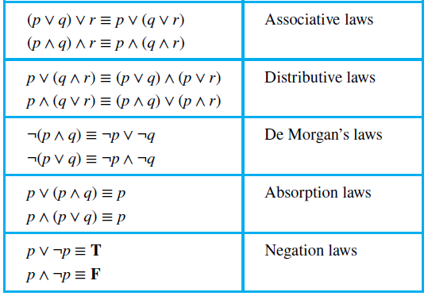
Key Logical Equivalences

Slide 40
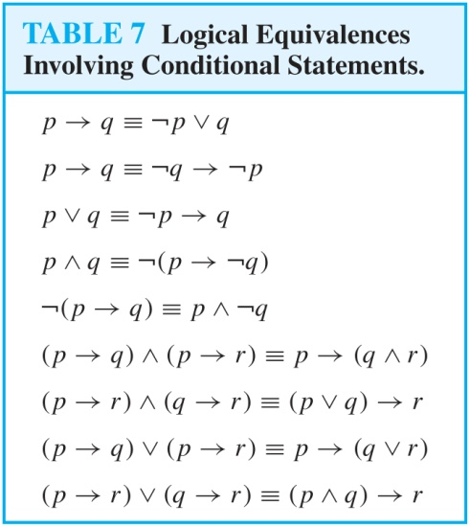
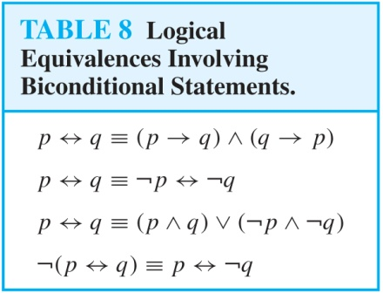
More Logical Equivalences

Slide 41
Section Summary
Tautologies, Contradictions, and Contingencies.
Logical Equivalence
Important Logical Equivalences
Showing Logical Equivalence
Normal Forms
Disjunctive Normal Form
Conjunctive Normal Form
Propositional Satisfiability
The n-Queens Problem
Sudoku Example

Slide 42
简单析取式,简单合取式
仅有限个命题变项或其否定构成的析取式称为简单析取式,仅有限个命题变项或其否定构成的合取式称为简单合取式.
简单析取式: p∨q, ┐p∨q, ┐p∨┐q
简单合取式: p∧q, ┐p∧q, ┐p∧┐q
一个简单析取式为重言式,当且仅当含有一个命题变项及其否定.
一个简单合取式为矛盾式,当且仅当含有一个命题变项及其否定.

Slide 43
析取范式,合取范式
仅由有限个简单合取式构成的析取式称为析取范式.
A⬄A1∨A2∨A3….., Ai为简单合取式
一个析取范式为矛盾式,当且仅当含有的每个简单合取式为假.
仅由有限个简单析取式构成的合取式称为合取范式.
A⬄A1 ∧ A2 ∧ A3….., Ai为简单析取式
一个合取范式为重言式,当且仅当含有的每个析取式为真.
任何析取范式的对偶是合取范式.
A=(p∧ ┐q ∧r) ∨(┐ p ∧ q) ∨(q ∧ ┐ q)
A*=(p∨┐q ∨r) ∧(┐ p ∨ q) ∧(q ∨ ┐ q)

Slide 44
求范式的步骤
定理 范式存在定理
任何命题公式都存在着与之等值的析取范式与合取范式.
求公式的范式的步骤：
(1) 消去公式中的→, ↔（若存在）
A→B⇔¬A∨B
A↔B⇔(¬A∨B)∧(A∨¬B)
(2) 否定联结词¬的内移或消去
¬ ¬A⇔ A
¬(A∨B)⇔¬A∧¬B
¬(A∧B)⇔¬A∨¬B
(3) 使用分配律
A∨(B∧C) ⇔ (A∨B)∧(A∨C) 求合取范式
A∧(B∨C) ⇔ (A∧B)∨(A∧C) 求析取范式

Slide 45
求范式的步骤
消去对{┐,∧,∨}多余的联结词;
否定号的消去或内移;
利用分配律;
求((p∨q) →r) →p的合取范式和析取范式
((p∨q) →r) →p⬄ (┐ (p∨q) ∨r) →p) ⬄┐ (┐ (p∨q) ∨r) ∨ p⬄ ((p∨q) ∧┐r) ∨ p ⬄ (p∨q ∨ p) ∧(┐r ∨ p) (合取范式) ⬄ (p∨q) ∧(┐r ∨ p) (合取范式)
((p∨q) →r) →p ⬄ (┐ (p∨q) ∨r) →p ⬄ ((p∨q) ∧┐r) ∨ p ⬄ (p ∧┐r )∨(q ∧┐r) ∨ p (析取范式) ⬄ (q ∧┐r) ∨ p (析取范式)

Slide 46
极小项
在含有n个命题的简单合取式中,若每个命题变项与其否定不同时存在,而两者之一出现且出现一次,且第i个命题变项或其否定出现在从左起的第i位上(若命题变项无角标,按字典序排序),这样的简单合取式称为极小项
极小项
对应的赋值
十进制数
记法
¬P∧¬Q∧¬R
000
0
m₀₀₀或m₀
¬P∧¬Q∧R
001
1
m₀₀₁或m₁
¬P∧Q∧¬R
010
2
m₀₁₀或m₂
¬P∧Q∧R
011
3
m₀₁₁或m₃
P∧¬Q∧¬R
100
4
m₁₀₀或m₄
P∧¬Q∧R
101
5
m₁₀₁或m₅
P∧Q∧¬R
110
6
m₁₁₀或m₆
P∧Q∧R
111
7
m₁₁₁或m₇
例：n=3, 命题变项为 p, q, r 时，极小项：
p ∧ q, ¬p ∧¬q, ¬p ∧ q ∧r, p ∧ ¬q ∧¬r

Slide 47
主析取范式
设命题公式A中含有n个命题变项,如果A的析取范式中的简单合取式全是极小项,则A称为主析取范式.
例: n=3, 命题变项为 p, q, r 时，
(¬p ∧ ¬q ∧ r )∨(¬p ∧ q ∧ r ) ⇔ m₁∨m₃

Slide 48
主析取范式
求主析取范式的步骤
设公式 A 含命题变项 p₁, p₂, …, p_{n}
(1) 求 A 的析取范式 A′ = B₁∨ B₂∨ … ∨ B_{s}, 其中B_{j}是简单合取式, j=1,2, … ,s
(2) 若某个B_{j} 既不含p_{i}, 又不含¬p_{i}, 则将B_{j} 展开成
B_{j} ⇔ B_{j} ∧ (p_{i} ∨ ¬p_{i}) ⇔ (B_{j} ∧ p_{i})∨(B_{j} ∧ ¬p_{i})
重复这个过程, 直到所有简单合取式都是长度为n的极小项为止
(3) 消去重复出现的极小项, 即用m_{i}代替m_{i}∨m_{i}
(4) 将极小项按下标从小到大排列

Slide 49
例题
求¬(p→q)∨¬r 的主析取范式
解 (1) ¬(p→q)∨¬r ⇔ (p∧¬q)∨¬r
p∧¬q ⇔ (p∧¬q)∧1
⇔ (p∧¬q)∧(¬r∨r)
⇔ (p∧¬q∧¬r)∨(p∧¬q∧r)
⇔ m₄∨m₅
¬r ⇔ (¬p∨p)∧(¬q∨q)∧¬r
⇔ (¬p∧¬q∧¬r)∨(¬p∧q∧¬r)∨(p∧¬q∧¬r)∨(p∧q∧¬r)
⇔ m₀∨ m₂∨ m₄∨ m₆
得 ¬(p→q)∨¬r ⇔ m₀∨ m₂∨ m₄ ∨m₅ ∨ m₆

Slide 50
例题
求((p∨q)→r) →p的主析取范式
((p∨q)→r) →p
⬄┐((p∨q)→r)∨p
⬄┐(┐(p∨q)∨r)∨p
⬄((p∨q)∧┐r)∨p⬄(p∧┐r)∨(q∧┐r)∨p
⬄(p∧q∧┐r)∨(p∧┐q∧┐r)∨(p∧q∧┐r)∨(┐p∧q∧┐r)
∨(p∧q∧r)∨(p∧┐q∧r)∨(p∧q∧┐r)∨(p∧┐q∧┐r)
⬄(p∧q∧┐r)∨(p∧┐q∧┐r)∨(┐p∧q∧┐r)∨(p∧q∧r)∨(p∧┐q∧r)
⬄m6 ∨ m4 ∨ m2 ∨m7 ∨m5

Slide 51
定理
任何一个命题公式均存在一个与之等值的主析取范式，而且是唯一的。
证明：（主析取范式唯一）
假设命题公式 A 等值于两个不同的主析取范式B 和C，则B⇔C. 由于B 和C 是不同的主析取范式，不妨设极小项m_{i}出现在B 中，而没有出现在C 中，于是下标 i 对应的二进制为B 的成真赋值，C 的成假赋值，这与B⇔C 矛盾。

Slide 52
主合取范式
定义 极大项
在含有n个命题变项的简单析取式中，若每个命题变项与其否定有且仅有一个出现一次，则称这样的简单析取式为极大项.
例： n=3, 命题变项为 p, q, r 时，极大项：
¬p ∨ ¬q, p ∨ q, p ∨ ¬q ∨ ¬r, ¬p ∨ q ∨ r
设命题公式A中含有n个命题变项,如果A的合取范式中的简单合取式全是极大项,则A称为主合取范式.

Slide 53
极小项和极大项
极小项 | 极大项
公式 | 成真 赋值 | 名称 | 公式 | 成假 赋值 | 名称
¬p ∧¬q ∧¬r ¬p ∧¬q ∧ r ¬p ∧ q ∧¬r ¬p ∧ q ∧ r p ∧ ¬q ∧ ¬r p ∧ ¬q ∧ r p ∧ q ∧¬r p ∧ q ∧ r | 0 0 0 0 0 1 0 1 0 0 1 1 1 0 0 1 0 1 1 1 0 1 1 1 | m₀ m₁ m₂ m₃ m₄ m₅ m₆ m₇ | p ∨ q ∨ r p ∨ q ∨¬r p ∨ ¬q ∨ r p ∨ ¬q ∨¬r ¬p ∨ q ∨ r ¬p ∨ q ∨¬r ¬p ∨ ¬q ∨ r ¬p ∨ ¬q ∨¬r | 0 0 0 0 0 1 0 1 0 0 1 1 1 0 0 1 0 1 1 1 0 1 1 1 | M₀ M₁ M₂ M₃ M₄ M₅ M₆ M₇

Slide 54
主合取范式
求主合取范式的步骤
设公式 A 含命题变项 p₁, p₂, …, p_{n}
(1) 求A的合取范式A′=B₁∧B₂∧ … ∧B_{s}, 其中B_{j}是简单析取式,
j=1,2, … ,s
(2) 若某个B_{j}既不含p_{i}, 又不含¬p_{i}, 则将B_{j}展开成
B_{j} ⇔ B_{j}∨(p_{i}∧¬p_{i}) ⇔ (B_{j}∨p_{i})∧(B_{j}∨¬p_{i})
重复这个过程, 直到所有简单析取式都是长度为n的极大项为止
(3) 消去重复出现的极大项, 即用M_{i}代替M_{i}∧M_{i}
(4) 将极大项按下标从小到大排列

Slide 55
例题
求¬(p→q)∨¬r 的主合取范式
解 ¬(p→q)∨¬r ⇔ (p∨¬r)∧(¬q∨¬r)
p∨¬r ⇔ p∨0∨¬r
⇔ p∨(q∧¬q)∨¬r
⇔ (p∨q∨¬r)∧(p∨¬q∨¬r)
⇔ M₁∧M₃
¬q∨¬r ⇔ (p∧¬p)∨¬q∨¬r
⇔ (p∨¬q∨¬r)∧(¬p∨¬q∨¬r)
⇔ M₃∧M₇
得 ¬(p→q)∨¬r ⇔ M₁∧M₃∧M₇

Slide 56
主析取范式的用途
判断两个命题公式是否等值;
判断命题公式的类型;
求命题公式的成真和成假赋值；

Slide 57
主析取范式的用途
判断两个公式是否等值
例 用主析取范式判断下述两个公式是否等值：
⑴ p→(q→r) 与 (p∧q)→r
⑵ p→(q→r) 与 (p→q)→r
解 p→(q→r) = m₀∨m₁∨m₂∨m₃∨ m₄∨m₅∨ m₇
(p∧q)→r = m₀∨m₁∨m₂∨m₃∨ m₄∨m₅∨ m₇
(p→q)→r = m₁∨m₃∨ m₄∨m₅∨ m₇
故⑴中的两公式等值，而⑵的不等值.

Slide 58
主析取范式的用途
(2) 判断公式的类型
设A含n个命题变项，则
A为重言式⇔A的主析取范式含2^{n}个极小项
⇔A的主合取范式为 T.
A为矛盾式⇔ A的主析取范式为 F
⇔ A的主合取范式含2^{n}个极大项
A为非重言式的可满足式
⇔A的主析取范式中至少含一个且不含全部极小项
⇔A的主合取范式中至少含一个且不含全部极大项

Slide 59
主析取范式的用途
(3) 求公式的成真赋值和成假赋值
例如: (p→¬q)→r ⇔ m₁∨m₃∨m₅∨ m₆∨m₇
其成真赋值为 001, 011, 101, 110, 111
其余的赋值 000, 010, 100为成假赋值
类似地，由主合取范式也可立即求出成假赋值
和成真赋值.

Slide 60
Normal or Canonical Forms(范式）
Unique representations of a proposition
Examples:
Construct a simple proposition of two variables which is true only when
P is true and Q is false:
P ∧¬Q
P is true and Q is true:
P ∧Q
P is true and Q is false or P is true and Q is true:
(P ∧¬Q) ∨(P ∧Q)

Slide 61
Normal or Canonical Forms
A disjunction of conjunctions where
every variable or its negation is represented once in each conjunction （合取式） (a minterm)
each minterms appears only once

Slide 62
Disjunctive Normal Form (DNF)（析取范式）
Important in switching theory, simplification in the design of circuits.
Method: To find the minterms of the DNF.
Use the rows of the truth table where the proposition is 1 or True
If a zero appears under a variable, use the negation of the propositional variable in the minterm
If a one appears, use the propositional variable.

Slide 63
Example
Find the DNF of (P ∨Q) → ¬R
P Q R (P ∨Q) → ¬R
0 0 0 1
0 0 1 1
0 1 0 1
0 1 1 0
1 0 0 1
1 0 1 0
1 1 0 1
1 1 1 0

Slide 64
Example
There are 5 cases where the proposition is true, hence 5 minterms. Rows 1,2,3, 5 and 7 produce the following disjunction of minterms:
(P ∨Q) → ¬R
⇔(¬P ∧¬Q∧¬R) ∨(¬P ∧¬Q∧ R)∨ (¬P ∧Q∧¬R) ∨(P ∧¬Q∧¬R) ∨(P ∧Q∧¬R)
Note that you get a Conjunctive Normal Form (CNF)（合取范式） if you negate a DNF and use DeMorgan’s Laws.

Slide 65
Section Summary
Tautologies, Contradictions, and Contingencies.
Logical Equivalence
Important Logical Equivalences
Showing Logical Equivalence
Normal Forms
Disjunctive Normal Form
Conjunctive Normal Form
Propositional Satisfiability
The n-Queens Problem
Sudoku Example

Slide 66
Propositional Satisfiability
A compound proposition is satisfiable if there is an assignment of truth values to its variables that make it true.
When no such assignments exist, the compound proposition is unsatisfiable.

Slide 67
Questions on Propositional Satisfiability
Example: Determine the satisfiability of the following compound propositions:
Solution: Satisfiable. Assign T to p, q, and r.
Solution: Satisfiable. Assign T to p and F to q.
Solution: Not satisfiable. Check each possible assignment of truth values to the propositional variables and none will make the proposition true.

Slide 68
Notation
Needed for the next example.

Slide 69
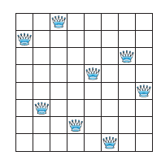
EXAMPLE 10
The n-Queens Problem The n-queens problem asks for a placement of n queens on an n × n chessboard so that no queen can attack another queen. This means that no two queens can be placed in the same row, in the same column, or on the same diagonal

Slide 70






Every row contains at least one queen:
There is at most one queen in each row
No column contains more than one queen
No diagonal contains two queens
(i,k))
Using this and other approaches, the number of ways n queens can be placed on a chessboard so that no queen can attack another has been computed for n ≤ 27. When n = 8 there are 92 such placements, while for n = 16 this number grows to 14,772,512.

Slide 71
P(1,1) | P(1,2) | P(1,3) | P(1,4)
P(2,1) | P(2,2) | P(2,3) | P(2,4)
P(3,1) | P(3,2) | P(3,3) | P(3,4)
P(4,1) | P(4,2) | P(4,3) | P(4,4)

Slide 72
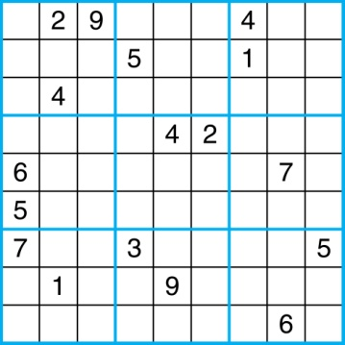
Sudoku
A Sudoku puzzle is represented by a 9×9 grid made up of nine 3×3 subgrids, known as blocks. Some of the 81 cells of the puzzle are assigned one of the numbers 1,2, …, 9.
The puzzle is solved by assigning numbers to each blank cell so that every row, column and block contains each of the nine possible numbers.
Example

Slide 73
Encoding as a Satisfiability Problem
Let p(i,j,n) denote the proposition that is true when the number n is in the cell in the ith row and the jth column.
There are 9×9 × 9 = 729 such propositions.
In the sample puzzle p(5,1,6) is true, but p(5,j,6) is false for j = 2,3,…9

Slide 74
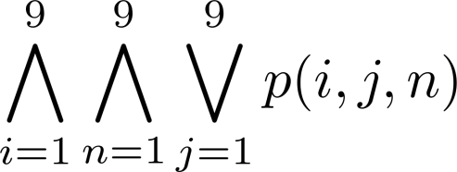
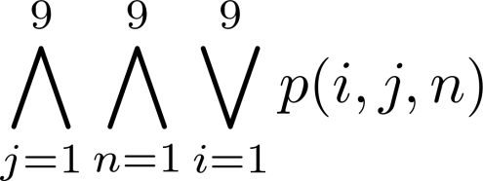
Encoding (cont)
For each cell with a given value, assert p(i,j,n), when the cell in row i and column j has the given value.
Assert that every row contains every number.
Assert that every column contains every number.

Slide 75
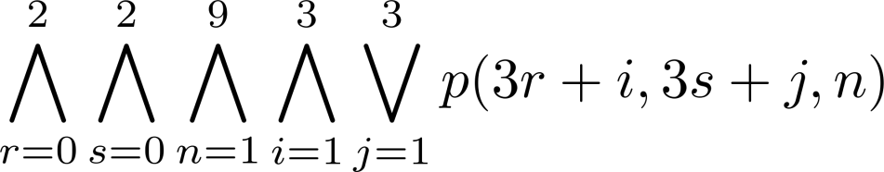
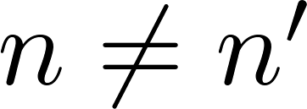
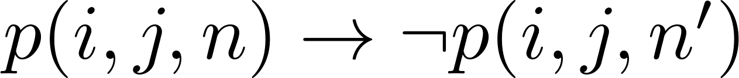
Encoding (cont)
Assert that each of the 3 x 3 blocks contain every number.
(this is tricky - ideas from chapter 4 help)
Assert that no cell contains more than one number. Take the conjunction over all values of n, n’, i, and j, where each variable ranges from 1 to 9 and ,
of

Slide 76
Solving Satisfiability Problems
To solve a Sudoku puzzle, we need to find an assignment of truth values to the 729 variables of the form p(i,j,n) that makes the conjunction of the assertions true. Those variables that are assigned T yield a solution to the puzzle.
A truth table can always be used to determine the satisfiability of a compound proposition. But this is too complex even for modern computers for large problems.

Slide 77
Homework
§1.3 – 8, 11 a) b), 12 b),
28, 33, 35,
66 a) b).
Find the Disjunctive Normal Form of
¬(p→q)∨¬r
§Due date: 2023.03.12

