Slide 1

1 The Foundations: Logic and Proofs
1.1 Propositional Logic
1.2 Applications of Propositional Logic 1.3 Propositional Equivalences 1.4 Predicates and Quantifiers 1.5 Nested Quantifiers 1.6 Rules of Inference 1.7 Introduction to Proofs 1.8 Proof Methods and Strategy

Slide 2
1.7 Introduction to Proofs 定理证明方法
1.7.1 Introduction
1.7.2 Some Terminology
1.7.3 Understanding How Theorems Are Stated
1.7.4 Methods of Proving Theorems
1.7.5 Direct Proofs
1.7.6 Proof by Contraposition
1.7.7 Proofs by Contradiction
1.7.8 Mistakes in Proofs

Slide 3
Introduction to Proofs
In this chapter we move from formal proofs of theorems toward more informal proofs.
The arguments we introduced in Section 1.6 to show that statements involving propositions and quantified statements are true were formal proofs, where all steps were supplied, and the rules for each step in the argument were given.
In practice, the proofs of theorems designed for human consumption are almost always informal proofs, where more than one rule of inference may be used in each step, where steps may be skipped, where the axioms being assumed and the rules of inference used are not explicitly stated.
Notes:
Of course, when one is proving things about a mathematical model of the real world, one must always recognize the risk that the postulates that are supposed to connect the premises of the model with the real world may fail to be true.

Slide 4
Proof Terminology 术语
Theorem 定理
A statement that has been proven to be true.
Axioms, postulates, hypotheses, premises 公理 假定 假设 前提
Assumptions (often unproven) defining the structures about which we are reasoning.
Rules of inference 推理规则
Patterns of logically valid deductions from hypotheses to conclusions.
Notes:
Axioms are statements that are taken as true that serve to define the very structures we are reasoning about.
Postulates are assumptions stating that some characteristic of an applied mathematical model corresponds to some truth about the real world or some situation being modeled.
Hypotheses are statements that are temporarily adopted as being true, for purposes of proving the consequences they would have if they were true, leading to possible falsification of the hypothesis if a predicted consequence turns out to be false. Usually a hypothesis is offered as a way of explaining a known consequence. Hypotheses are not necessarily believed or disbelieved except in the context of the scenario being explored.
Premises are statements that the reasoner adopts as true so he can see what the consequences would be. Like hypotheses, they may or may not be believed.
Conjectures are statements that are proposed to be logical consequences of other statements, and that may be strongly believed to be such, but that have not yet been proven.
Lemmas are relatively uninteresting statements that are proved on the way to proving an actual theorem of interest.
Doctrine
Ideology

Slide 5
More Proof Terminology
Lemma 引理- A minor theorem used as a stepping-stone to proving a major theorem.
Corollary 推论- A minor theorem proved as an easy consequence of a major theorem.
Conjecture 猜想- A statement whose truth value has not been proven. (A conjecture may be widely believed to be true, regardless.)
Theory 理论– The set of all theorems that can be proven from a given set of axioms.

Slide 6
Graphical Visualization
A Particular Theory
A proof
The Axioms of the Theory
Various Theorems
Notes:
中国各族人民将继续在中国共产党领导下，在马克思列宁主义、毛泽东思想、邓小平理论、“三个代表”重要思想、科学发展观、习近平新时代中国特色社会主义思想指引下，坚持人民民主专政，坚持社会主义道路，坚持改革开放，不断完善社会主义的各项制度，发展社会主义市场经济，发展社会主义民主，健全社会主义法治，贯彻新发展理念，自力更生，艰苦奋斗，逐步实现工业、农业、国防和科学技术的现代化，推动物质文明、政治文明、精神文明、社会文明、生态文明协调发展，把我国建设成为富强民主文明和谐美丽的社会主义现代化强国，实现中华民族伟大复兴。
中国共产党以马克思列宁主义、毛泽东思想、邓小平理论、“三个代表”重要思想、科学发展观、习近平新时代中国特色社会主义思想作为自己的行动指南。
The Communist Party of China uses Marxism-Leninism, Mao Zedong Thought, Deng Xiaoping Theory, the Theory of Three Represents, the Scientific Outlook on Development, and Xi Jinping Thought on Socialism with Chinese Characteristics for a New Era as its guides to action.

Slide 7
1.7 Introduction to Proofs 定理证明方法
1、直接证明 / direct proof:
P → Q
2、间接证明 / indirect proof :
P → Q ⇔ ¬ Q → ¬ P
3、空证明 / vacuous proof:
P → Q 其中 P为 F
4、平凡证明 / trivial proof：
P → Q 其中 Q 为T
5、反证法 / proof of contradiction：
P
¬ P ⇒ S ∧ ¬ S

Slide 8
Proof Methods for Implications
For proving implications p → q, we have:
Direct proof: Assume p is true, and prove q.
Indirect proof: Assume ¬q, and prove ¬p.
(proof by contraposition :¬q →¬p )
Vacuous proof: Prove ¬p by itself.
Trivial proof: Prove q by itself.
Proof by Contradiction: Assume ¬p, and prove both q and ¬q for some proposition q.

Slide 9
Direct Proof Example
Definition: An integer n is called odd iff n=2k+1 for some integer k; n is even iff n=2k for some k.
Theorem: (For all numbers n) If n is an odd integer, then n² is an odd integer.
Proof: If n is odd, then n = 2k+1 for some integer k. Thus, n² = (2k+1)² = 4k² + 4k + 1 = 2(2k² + 2k) + 1. Therefore n² is of the form 2j + 1 (with j the integer 2k² + 2k), thus n² is odd. □
Notes:
The statement that every integer is either odd or even can actually be proven from simpler axioms, the Peano axioms of arithmetic. However, for

Slide 10
Indirect Proof Example Proof by Contraposition
Theorem: (For all integers n) If 3n+2 is odd, then n is odd.
Proof: Suppose that the conclusion is false, i.e., that n is even. Then n=2k for some integer k. Then 3n+2 = 3(2k)+2 = 6k+2 = 2(3k+1). Thus 3n+2 is even, because it equals 2j for integer j = 3k+1. So 3n+2 is not odd. We have shown that
¬(n is odd)→¬(3n+2 is odd),
thus its contrapositive (3n+2 is odd) → (n is odd)
is also true. □

Slide 11
Vacuous Proof Example
Theorem: (For all n) If n is both odd and even, then n² = n + n.
Proof: The statement “n is both odd and even” is necessarily false, since no number can be both odd and even. So, the theorem is vacuously true. □

Slide 12
Trivial Proof Example
Theorem: (For integers n) If n is the sum of two prime numbers, then either n is odd or n is even.
Proof: Any integer n is either odd or even. So the conclusion of the implication is true regardless of the truth of the antecedent. Thus the implication is true trivially. □

Slide 13
Proof by Contradiction
A method for proving p.
Assume ¬p, and prove both q and ¬q for some proposition q. (Can be anything!)
Thus ¬p→ (q ∧ ¬q)
(q ∧ ¬q) is a trivial contradiction, equal to F
Thus ¬p→F, which is only true if ¬p=F
Thus p is true.

Slide 14
Proof by Contradiction Example
Theorem: is irrational.
Proof: Assume were rational. This means there are integers i,j with no common divisors such that = i/j.
Squaring both sides, 2 = i²/j², so 2j² = i². So i² is even; thus i is even.
Let i=2k. So 2j² = (2k)² = 4k². Dividing both sides by 2, j² = 2k². Thus j² is even, so j is even.
But then i and j have a common divisor, namely 2, so we have a contradiction. □

Slide 15
Common Fallacies
A fallacy is an inference rule or other proof method that is not logically valid.
A fallacy may yield a false conclusion!
Fallacy of affirming the conclusion:
“p→q is true, and q is true, so p must be true.” (No, because F→T is true.)
Fallacy of denying the hypothesis:
“p→q is true, and p is false, so q must be false.” (No, again because F→T is true.)
Notes:
It’s easy for each fallacy to give a counter-example showing why it is not valid.

Slide 16
What is wrong with this?
Prove that 1 = 2
Solution: Step 5. a - b = 0 by the premise and division by 0 is undefined.

Slide 17
Circular Reasoning
The fallacy of (explicitly or implicitly) assuming the very statement you are trying to prove in the course of its proof.
Example:
Prove if n² is even, then an integer n is even.
Attempted proof: “Assume n² is even. Then n²=2k for some integer k. Dividing both sides by n gives n = (2k)/n = 2(k/n). So there is an integer j (namely k/n) such that n=2j. Therefore n is even.”
Circular reasoning is used in this proof. Where?
Begs the question: How do you show that j=k/n=n/2 is an integer, without first assuming that n is even?
Notes:
The given statement is implicitly universal: FORALL integers n, n is even if n-squared is even.
Note that although the statement we are trying to prove is true, our proof of it is invalid. It does not give a clear, valid path to the conclusion.

Slide 18
Review: Proof Methods So Far
Direct, indirect, vacuous, and trivial proofs of statements of the form p→q.
Proof by contradiction of any statements.
Next: more proof methods and strategy

Slide 19
1 The Foundations: Logic and Proofs
1.1 Propositional Logic
1.2 Applications of Propositional Logic 1.3 Propositional Equivalences 1.4 Predicates and Quantifiers 1.5 Nested Quantifiers 1.6 Rules of Inference 1.7 Introduction to Proofs 1.8 Proof Methods and Strategy

Slide 20
1.8 Proof Methods and Strategy
1.8.1 Introduction
1.8.2 Exhaustive Proof and Proof by Cases
1.8.3 Existence Proofs
1.8.4 Uniqueness Proofs
1.8.5 Proof Strategies
1.8.6 Looking for Counterexamples
1.8.7 Proof Strategy in Action
1.8.8 Tilings
1.8.9 The Role of Open Problems
1.8.10 Additional Proof Methods

Slide 21
Overview
In 1.7, we already saw:
Several types of proofs of implications p→q:
Vacuous, Trivial, Direct, Indirect
Some methods of proving general statements p:
proof by contradiction.
In this module, we will see examples of:
Forward vs. backward reasoning.
Types of existence proofs:
Constructive vs. Nonconstructive.
Proof by cases.
Adapting existing proofs.
Turning conjectures into proofs.

Slide 22
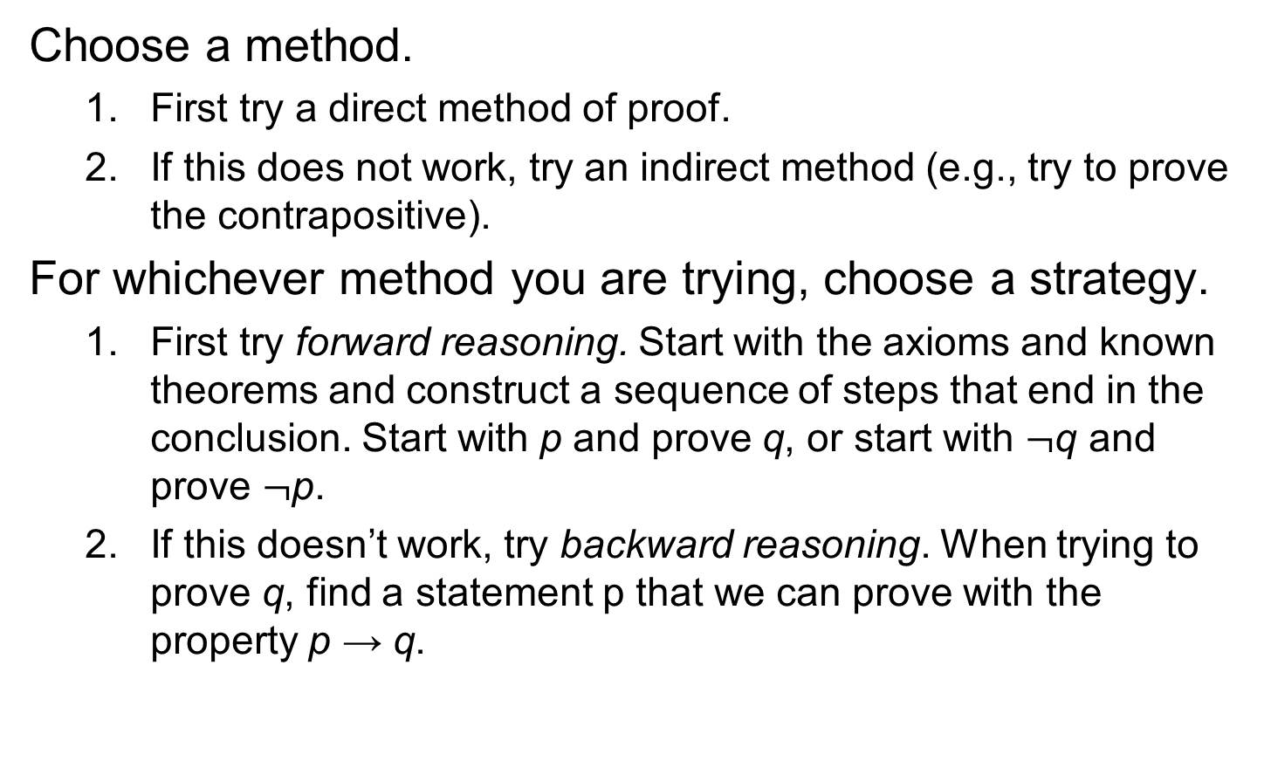
Proof Strategies for proving p → q

Slide 23
Forward Reasoning
Have premises p, and want to prove q.
Find a s₁ such that p→s₁
Then, find an s₂ such that s₁→s₂.
And hope to eventually get to an s_{n} such that s_{n}→q.
The problem with this method is…
It can be tough to see the path looking from p.

Slide 24
Backward Reasoning
It can often be easier to see the very same path if you just start looking from the conclusion q instead…
That is, first find an s₋₁ such that s₋₁→q.
Then, find an s₋₂ such that s₋₂→s₋₁, and so on…
Working back to an s_{−n} such that p→s_{−n.}
Note we still are using modus ponens to propagate truth forwards down the chain from p to s_{−n} to … to s₁ to q!
We are finding the chain backwards, but applying it forwards.
This is not quite the same thing as an indirect proof…
In that, we would use modus tollens and ¬q to prove ¬s₋₁, etc.
However, it is similar.

Slide 25
Backward Reasoning Example
Theorem: ∀a>0,b>0,a≠b: (a+b)/2 > (ab)^{1/2}.
Proof:
Notice it is not obvious how to go from the premises a>0, b>0, a≠b directly forward to the conclusion (a+b)/2 > (ab)^{1/2}.
So, let’s work backwards from the conclusion, (a+b)/2 > (ab)^{1/2} !

Slide 26
Steps of Example
(a+b)/2 > (ab)^{1/2} ⇔ (squaring both sides)
This preserves the “>” since both sides are positive.
(a+b)²/4 > ab ⇔ (multiplying through by 4)
(a+b)² > 4ab ⇔ (squaring a+b)
a²+2ab+b² > 4ab ⇔ (subtracting out 4ab)
a²−2ab+b² > 0 ⇔ (factoring left side)
(a−b)² > 0
Now, since a≠b, (a−b)≠0, thus (a−b)²>0, and we can work our way back along the chain of steps…

Slide 27
“Forwardized” version of Example
Theorem: ∀a>0,b>0,a≠b: (a+b)/2 > (ab)^{1/2}.
Proof. If Since a≠b, (a−b)≠0. Thus, (a−b)²>0, i.e., a²−2ab+b² > 0. Adding 4ab to both sides, a²+2ab+b² > 4ab. Factoring the left side, we have (a+b)² > 4ab, so (a+b)²/4 > ab. Since ab is positive, we can take the square root of both sides and get (a+b)/2 > (ab)^{1/2}. ■
This is just a simple proof proceeding directly from premises to conclusion, but if you don’t realize how it was obtained, it looks “magical.”
A common student reaction: “But how did you know to pick 4ab out of thin air, to add to both sides?”
Answer: By working backwards from the conclusion!

Slide 28
Stone Game Example
Game rules:
There are 15 stones in a pile. Two players take turns removing either 1, 2, or 3 stones. Whoever takes the last stone wins.
Theorem: There is a strategy for the first player that guarantees him a win.
How do we prove this? Constructive proof…
Looks complicated… How do we pick out the winning strategy from among all possible strategies?
Work backwards from the endgame!

Slide 29
Working Backwards in the Game
Player 1 wins if it is Player 2’s turn and there are no stones…
P1 can arrange this if it is his turn, and there are 1, 2, or 3 stones…
This will be true as long as player 2 had 4 stones on his turn…
And so on…
Player 1 | Player 2
 | 0
1, 2, 3
 | 4
5, 6, 7
 | 8
9, 10, 11
 | 12
13, 14, 15

Slide 30
“Forwardized” version
Theorem. Whoever moves first can always force a win.
Proof. Player 1 can remove 3 stones, leaving 12. After player 2 moves, there will then be either 11, 10, or 9 stones left. In any of these cases, player 1 can then reduce the number of stones to 8. Then, player 2 will reduce the number to 7, 6, or 5. Then, player 1 can reduce the number to 4. Then, player 2 must reduce them to 3, 2, or 1. Player 1 then removes the remaining stones and wins.

Slide 31
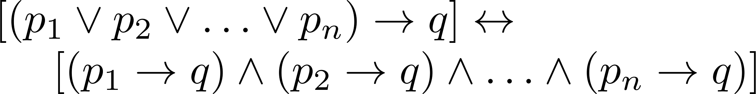

Proof by Cases
To prove a conditional statement of the form:
Use the tautology
Each of the implications is a case.

Slide 32
Proof by Cases
Example:
Let a @ b = max{a, b} = a
if a ≥ b, otherwise a @ b = max{a, b} = b.
Show that for all real numbers a, b, c
(a @b) @ c = a @ (b @ c)
(This means the operation @ is associative.)
Proof: Let a, b, and c be arbitrary real numbers.
Then one of the following 6 cases must hold.
a ≥ b ≥ c
a ≥ c ≥ b
b ≥ a ≥c
b ≥ c ≥a
c ≥ a ≥ b
c ≥ b ≥ a

Slide 33
Proof by Cases
Case 1: a ≥ b ≥ c
(a @ b) = a, a @ c = a, b @ c = b
Hence (a @ b) @ c = a = a @ (b @ c)
Therefore the equality holds for the first case.
A complete proof requires that the equality be shown to hold for all 6 cases. But the proofs of the remaining cases are similar. Try them.

Slide 34
Without Loss of Generality
Example: Show that if x and y are integers and both x∙y and x+y are even, then both x and y are even.
Proof: Use a proof by contraposition. Suppose x and y are not both even. Then, one or both are odd. Without loss of generality, assume that x is odd. Then x = 2m + 1 for some integer m.
Case 1: y is even. Then y = 2n for some integer n, so x + y = (2m + 1) + 2n = 2(m + n) + 1 is odd.
Case 2: y is odd. Then y = 2n + 1 for some integer n, so x ∙ y = (2m + 1) (2n + 1) = 2(2m ∙ n +m + n) + 1 is odd.
We only cover the case where x is odd because the case where y is odd is similar. The use phrase without loss of generality (WLOG) indicates this.

Slide 35
Proof by Examples?
A universal statement can never be proven by using examples, unless the universe can be validly reduced to only finitely many examples, and your proof covers all of them!
Theorem: ¬∃x,y∈Z: x²+3y² = 8.
Proof: If |x|≥3 or |y|≥2 then x²+3y² >8. This leaves x²∈{0,1,4} and 3y²∈{0,3}. The largest pair sum to 4+3 = 7 < 8.

Slide 36
Proving Existentials
A proof of a statement of the form ∃x P(x) is called an existence proof.
If the proof demonstrates how to actually find or construct a specific element a such that P(a) is true, then it is a constructive proof.
Otherwise, it is nonconstructive.

Slide 37
Constructive Existence Proof
Theorem: There exists a positive integer n that is the sum of two perfect cubes in two different ways:
equal to j³ + k³ and l³ + m³ where j, k, l, m are positive integers, and {j,k} ≠ {l,m}
Proof: Consider n = 1729, j = 9, k = 10, l = 1, m = 12. Now just check that the equalities hold.

Slide 38
Another Constructive Existence Proof
Theorem: For any integer n>0, there exists a sequence of n consecutive composite integers.
Same statement in predicate logic: ∀n>0 ∃x ∀i (1≤i≤n)→(x+i is composite)
Proof follows on next slide…

Slide 39
The proof...
Given n>0, let x = (n + 1)! + 1.
Let i ≥ 1 and i ≤ n, and consider x+i.
Note x+i = (n + 1)! + (i + 1).
Note (i+1)|(n+1)!, since 2 ≤ i+1 ≤ n+1.
Also (i+1)|(i+1). So, (i+1)|(x+i).
∴ x+i is composite.
∴ ∀n ∃x ∀1≤i≤n : x+i is composite. Q.E.D.
Notes:
Need number theory for this example. At least, need the definitions of factorial “!”, and divides notation “|”.

Slide 40
Nonconstructive Existence Proof
Theorem: “There are infinitely many prime numbers.”
Any finite set of numbers must contain a maximal element, so we can prove the theorem if we can just show that there is no largest prime number.
i.e., show that for any prime number, there is a larger number that is also prime.
More generally: For any number, ∃ a larger prime.
Formally: Show ∀n ∃p>n : p is prime.

Slide 41
The proof, using proof by cases...
Given n>0, prove there is a prime p>n.
Consider x = n!+1. Since x>1, we know (x is prime)∨(x is composite).
Case 1: x is prime. Obviously x>n, so let p=x and we’re done.
Case 2: x has a prime factor p. But if p≤n, then x mod p = 1. So p>n, and we’re done.

Slide 42
Adapting Existing Proofs
Theorem: There are infinitely many primes of the form 4k+3, where k∈N.
Recall we proved there are infinitely many primes because if p₁,…,p_{n} were all the primes, then (∏p_{i})+1 must be prime or have a prime factor greater than p_{n}, ⇒ contradiction!
Proof: Similarly, suppose q₁,…,q_{n} lists all primes of the form 4k+3,
and analogously consider Q = 4(∏q_{i})+3.
Unfortunately, since q₁ = 3 is possible, 3|Q and so Q does have a prime factor among the q_{i}, so this doesn’t work!
So instead, consider Q = 4(∏q_{i})−1 = 4(∏q_{i}−1)+3. This has the right form, and has no q_{i} as a factor since ∀i: Q ≡ q_{i} −1 (mod q_{i}).
Notes:
35假设只有有限形如4k+3的素数，即q1,q2,…,qn，其中q1=3,q2=7,等等。令Q=4q1q2…qn-1。注意Q是形如4k+3的数(其中k=q1q2…qn-1)。如果Q是素数，那么我们找到了一个所要求的素数，它的形式与所列的那些数不同。如果Q不是素数，那么Q至少有一个素因子不在q1,q2,…,qn中，因为当Q被qj除时，余数为qj-1,qj-1≠0。由于所有奇素数要么形如4k+1要么4k+3，并且形如4k+1的素数的积也是这种形式(因为(4k+1)(4m+1)=4(4km+k+m)+1)，一定存在形如4k+3的Q的因子，它不同于我们所列的素数。

Slide 43
Conjecture and Proof
We know that some numbers of the form 2^{p}−1 are prime when p is prime.
These are called the Mersenne primes.
Can we prove the inverse, that a^{n}−1 is composite whenever either a>2, or (a=2 but n is composite)?
All we need is to find a factor greater than 1.
Note a^{n}−1 factors into (a−1)(a^{n−1}+…+a+1).
When a>2, (a−1)>1, and so we have a factor.
When n is composite, ∃r,s>1: n=rs. Thus, given a=2, a^{n} = 2^{n} = 2^{rs} = (2^{r})^{s}, and since r>1, 2^{r} > 2 so 2^{n} − 1 = b^{s}−1 with b = 2^{r} > 2, which now fits the first case.

Slide 44
Conjecture & Counterexamples
Conjecture: ∀ integers n>0, n²−n+41 is prime.
Hm, let’s see if we can find any counter-examples:
1²−1+41 = 41 (prime)
2²−2+41 = 4−2+41 = 43 (prime)
3²−3+41 = 9−3+41 = 47 (prime) Looking good so far!!
Can we conclude after showing that it checks out in, say, 20 or 30 cases, that the conjecture must be true?
NEVER NEVER NEVER NEVER NEVER!
Of course, 41²−41+41 is divisible by 41!!

Slide 45
Even Great Mathematicians Can Propose False Conjectures!
Euler conjectured that for n>2, the sum of n−1 n^{th} powers of positive integers is not an nth power.
Remained true for all cases checked for 200 years, but no proof was found.
Finally, in 1966, someone noticed that 27⁵ + 84⁵ + 110⁵ + 133⁵ = 144⁵.
Larger counter-examples have also been found for n=4, but none for n>5 yet.

Slide 46
Fermat’s “Last Theorem”
Theorem: x^{n}+y^{n}=z^{n} has no solutions in integers xyz ≠ 0 with integer n>2.
In the 1600s, Fermat famously claimed in a marginal note that he had a “wondrous proof” of the theorem.
But unfortunately, if he had one, he never published it!
The theorem remained a publicly unproven conjecture for the next ~400 years!
Finally, a proof that requires hundreds of pages of advanced mathematics was found by Wiles at Princeton in 1990.
It took him 10 years of work to find it!
Challenge: Find a short, simple proof of Fermat’s last theorem, and you will become instantly famous!

Slide 47
An Open Problem
The 3x + 1 Conjecture: Let T be the transformation that sends an even integer x to x/2 and an odd integer x to 3x + 1. For all positive integers x, when we repeatedly apply the transformation T, we will eventually reach the integer 1.
For example, starting with x = 13:
T(13) = 3∙13 + 1 = 40, T(40) = 40/2 = 20, T(20) = 20/2 = 10,
T(10) = 10/2 = 5, T(5) = 3∙5 + 1 = 16,T(16) = 16/2 = 8,
T(8) = 8/2 = 4, T(4) = 4/2 = 2, T(2) = 2/2 = 1
The conjecture has been verified using computers up to 5.6 ∙ 10¹³ .

Slide 48
Some Open Conjectures
Conjecture (Goldbach’s Conjecture) Every integer n≥2 is exactly the average of some two primes.
∀n≥2 ∃ primes p,q: n=(p+q)/2.
Conjecture: There are infinitely many primes of the form n²+1, where n∈Z.
Conjecture: (Twin Prime Conjecture) There are infinitely pairs of primes of the form (p, p+2).
Conjecture: (The Hailstone Problem) If h(x) = x/2 when x is even, and 3x+1 when x is odd, then ∀x∈N ∃n∈N h^{n}(x) = 1 (where the superscript denotes composition of h with itself n times).
Prove any of these, and you can probably have a lifetime career sitting around doing pure mathematics…

Slide 49
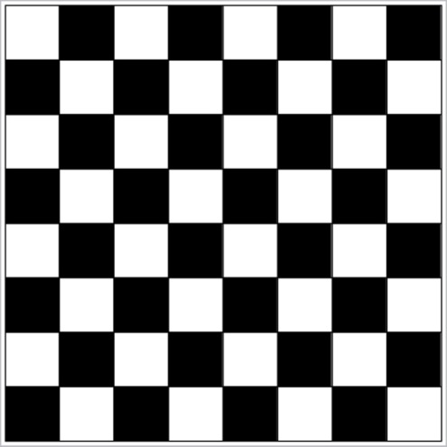
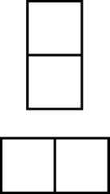
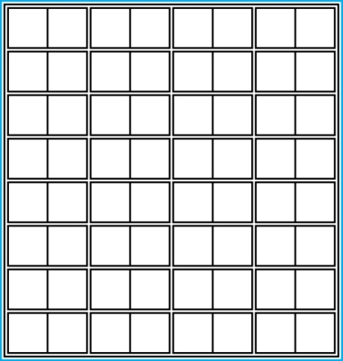
Proof and Disproof: Tilings
Example 1: Can we tile the standard checkerboard using dominos?
Solution: Yes! One example provides a constructive existence proof.
Two Dominoes
The Standard Checkerboard
One Possible Solution

Slide 50
Tilings
Example 2: Can we tile a checkerboard obtained by removing one of the four corner squares of a standard checkerboard?
Solution:
Our checkerboard has 64 − 1 = 63 squares.
Since each domino has two squares, a board with a tiling must have an even number of squares.
The number 63 is not even.
We have a contradiction.

Slide 51
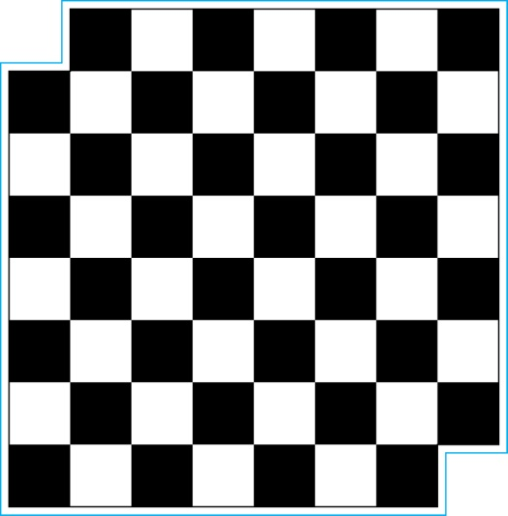
Tilings
Example 3: Can we tile a board obtained by removing both the upper left and the lower right squares of a standard checkerboard?
Nonstandard Checkerboard
Dominoes

Slide 52
Tilings
Solution:
There are 62 squares in this board.
To tile it we need 31 dominos.
Key fact: Each domino covers one black and one white square.
Therefore the tiling covers 31 black squares and 31 white squares.
Our board has either 30 black squares and 32 white squares or 32 black squares and 30 white squares.
Contradiction!

Slide 53
Additional Proof Methods
Later we will see many other proof methods:
Mathematical induction, which is a useful method for proving statements of the form ∀n P(n), where the domain consists of all positive integers.
Structural induction, which can be used to prove such results about recursively defined sets.
Cantor diagonalization is used to prove results about the size of infinite sets.
Combinatorial proofs use counting arguments.

Slide 54
Homework
1.7: 8, 18, 20
1.8: 6, 7,12, 32
Due date : 2024.03.26

