Slide 1
Boolean Algebra 布尔代数
Chapter 12

Slide 2
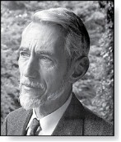
Chapter Summary
Boolean Functions
Representing Boolean Functions
Logic Gates
Minimization of Circuits
Claude Shannon (1916 - 2001)

Slide 3
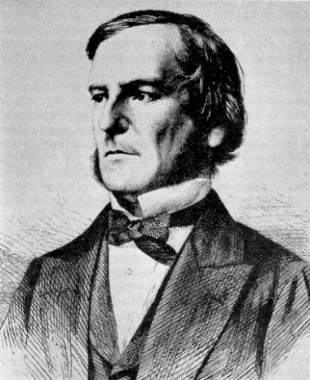

乔治·布尔（George Boole）
1815年11月2日－1864年12月8日.
英格兰数学家和哲学家，数理逻辑学先驱.
1854年出版《The Laws of Thought》（思维的
定律), 介绍了现在以他的名字命名的布尔代数.
克劳德·艾尔伍德·香农（Claude Elwood Shannon）
1916年4月30日—2001年2月24日，美国数学家、密码学家，信息论创始人.
1937年完成硕士论文，1938年正式出版《A Symbolic Analysis of Relay and Switching Circuits 》（继电路和开关电路的符号分析），将布尔代数应用于电子领域，能够构建并解决任何逻辑和数值关系，被誉为“有史以来最重要的硕士论文之一”.
1948年发表划时代论文《A Mathematical Theory of
Communication 》（通信的数学理论）, 创立信息论.
1949年发表《Communication Theory of Secrecy
Systems》（保密系统的通信理论）.

Slide 4
Boolean Functions 布尔函数
Section 12.1

Slide 5
Section Summary 1
Introduction to Boolean Algebra
Boolean Expressions and Boolean Functions
Identities of Boolean Algebra
Duality
The Abstract Definition of a Boolean Algebra

Slide 6
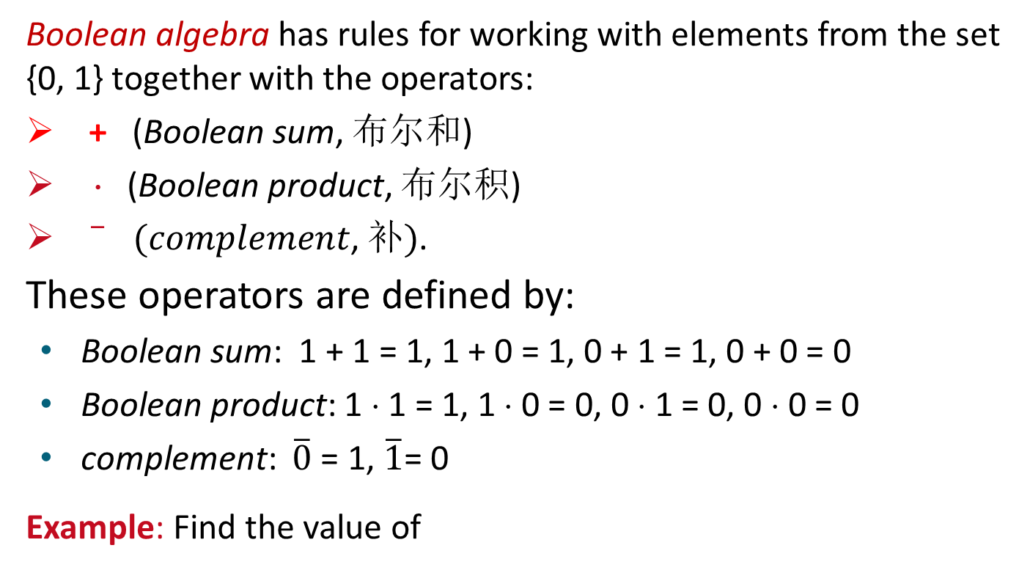
Introduction to Boolean Algebra
Boolean algebra has rules for working with elements from the set {0, 1} together with the operators:
+ (Boolean sum, 布尔和)
⋅ (Boolean product, 布尔积)
$\overline{ } (complement\text{, }补)$.
These operators are defined by:
Boolean sum: 1 + 1 = 1, 1 + 0 = 1, 0 + 1 = 1, 0 + 0 = 0
Boolean product: 1 ⋅ 1 = 1, 1 ⋅ 0 = 0, 0 ⋅ 1 = 0, 0 ⋅ 0 = 0
complement: $\overline{0}$ = 1, $\overline{1}$= 0
Example: Find the value of
Solution :

Slide 7


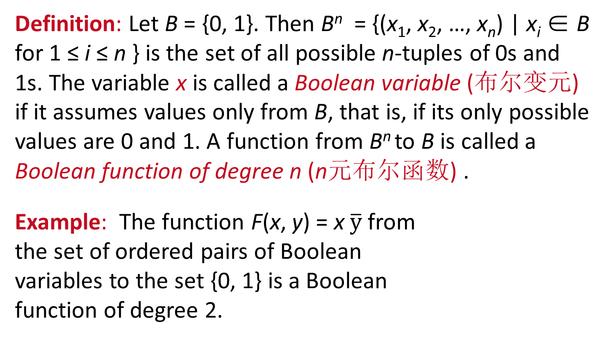
Boolean Expressions and Boolean Functions 1
Definition: Let B = {0, 1}. Then B^{n} = {(x₁, x₂, …, x_{n}) | x_{i} ∈ B for 1 ≤ i ≤ n } is the set of all possible n-tuples of 0s and 1s. The variable x is called a Boolean variable (布尔变元) if it assumes values only from B, that is, if its only possible values are 0 and 1. A function from B^{n} to B is called a Boolean function of degree n (n元布尔函数) .
Example: The function F(x, y) = x $\overline{y}$ from the set of ordered pairs of Boolean variables to the set {0, 1} is a Boolean function of degree 2.
TABLE 1
x | y | F(x, y)
1 1 0 0 | 1 0 1 0 | 1 0 0 1

Slide 8
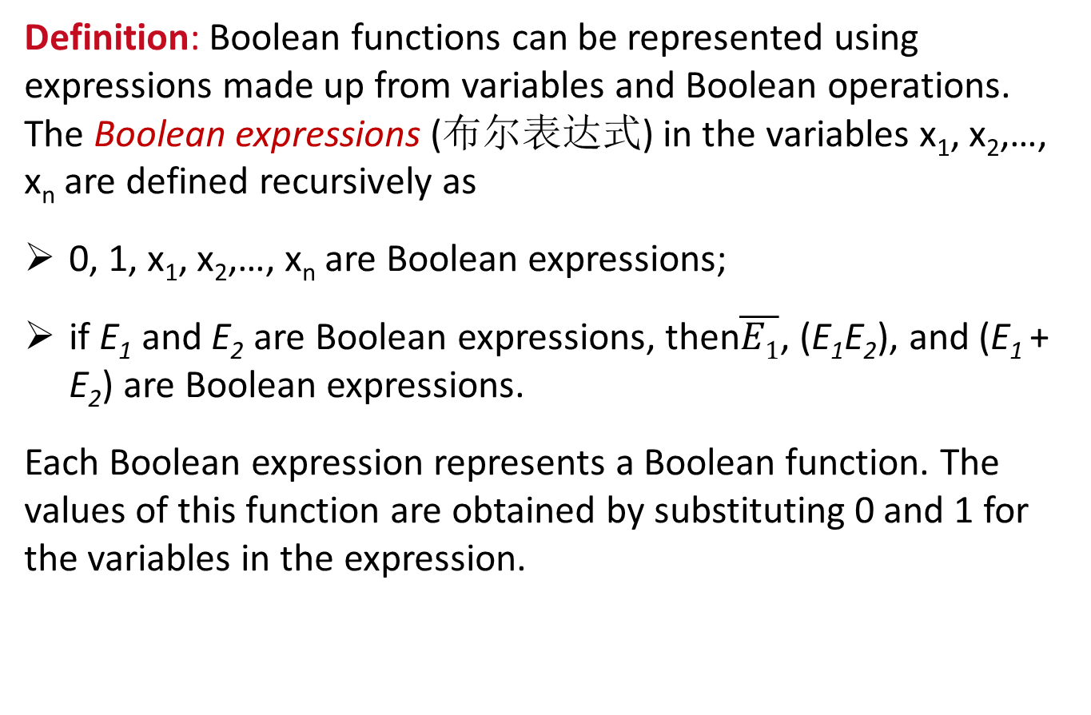
Boolean Expressions and Boolean Functions 1
Definition: Boolean functions can be represented using expressions made up from variables and Boolean operations. The Boolean expressions (布尔表达式) in the variables x₁, x₂,…, x_{n} are defined recursively as
0, 1, x₁, x₂,…, x_{n} are Boolean expressions;
if E₁ and E₂ are Boolean expressions, then$\overline{E1}$, (E₁E₂), and (E₁ + E₂) are Boolean expressions.
Each Boolean expression represents a Boolean function. The values of this function are obtained by substituting 0 and 1 for the variables in the expression.

Slide 9
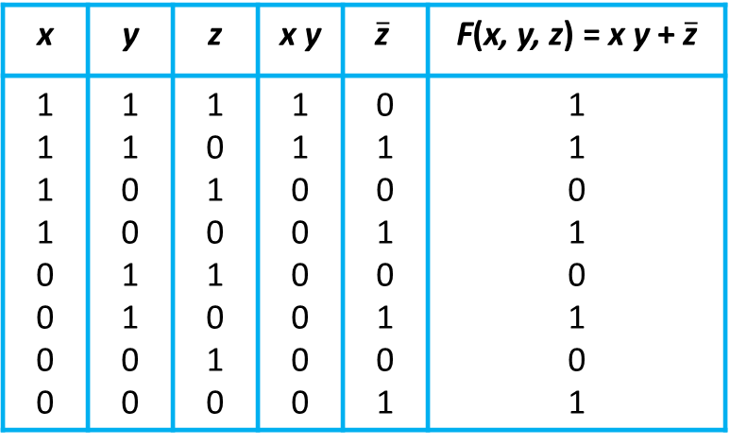
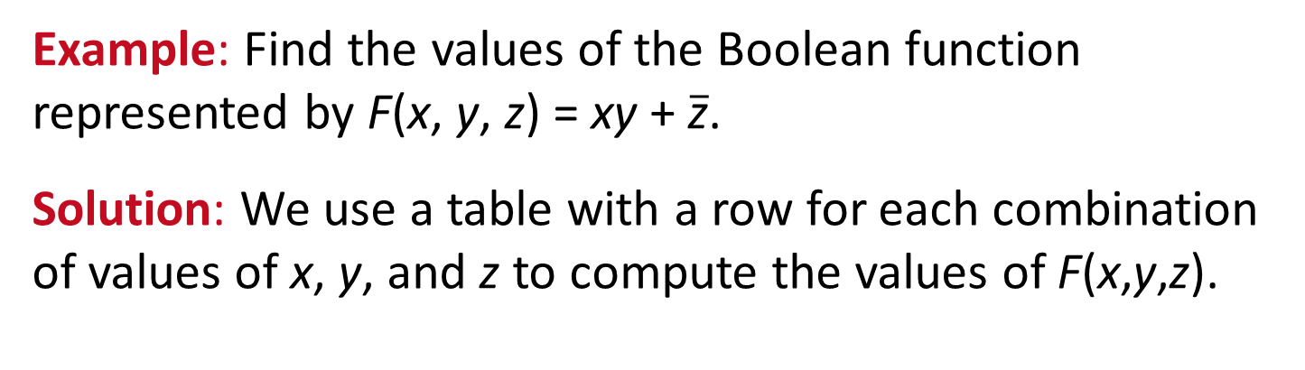
Boolean Expressions and Boolean Functions 2
Example: Find the values of the Boolean function represented by F(x, y, z) = xy + $\overline{\text{z}}$.
Solution: We use a table with a row for each combination of values of x, y, and z to compute the values of F(x,y,z).
TABLE 2
x | y | z | x y | $$\overline{\text{z}}$$ | F(x, y, z) = x y + $\overline{\text{z}}$
1 1 1 1 0 0 0 0 | 1 1 0 0 1 1 0 0 | 1 0 1 0 1 0 1 0 | 1 1 0 0 0 0 0 0 | 0 1 0 1 0 1 0 1 | 1 1 0 1 0 1 0 1

Slide 10

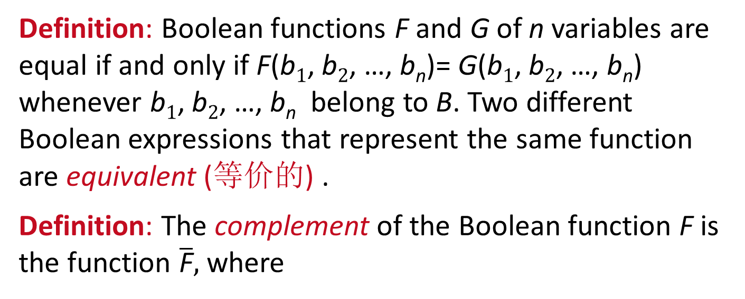
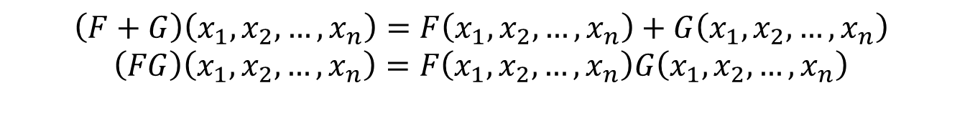
Boolean Expressions and Boolean Functions 3
Definition: Boolean functions F and G of n variables are equal if and only if F(b₁, b₂, …, b_{n})= G(b₁, b₂, …, b_{n}) whenever b₁, b₂, …, b_{n} belong to B. Two different Boolean expressions that represent the same function are equivalent (等价的) .
Definition: The complement of the Boolean function F is the function $\overline{\text{F}},$ where
$$\overline{F} \left(x_{1},x_{2},…,x_{n}\right)= \overline{F\left(x_{1},x_{2},…,x_{n}\right)}.$$
Definition: Let F and G be Boolean functions of degree n. The Boolean sum F + G and the Boolean product FG are defined by
$$\left(F+G\right)\left(x_{1},x_{2},…,x_{n}\right)=F\left(x_{1},x_{2},…,x_{n}\right)+G\left(x_{1},x_{2},…,x_{n}\right) \\ \left(FG\right)\left(x_{1},x_{2},…,x_{n}\right)=F\left(x_{1},x_{2},…,x_{n}\right)G\left(x_{1},x_{2},…,x_{n}\right)$$

Slide 11
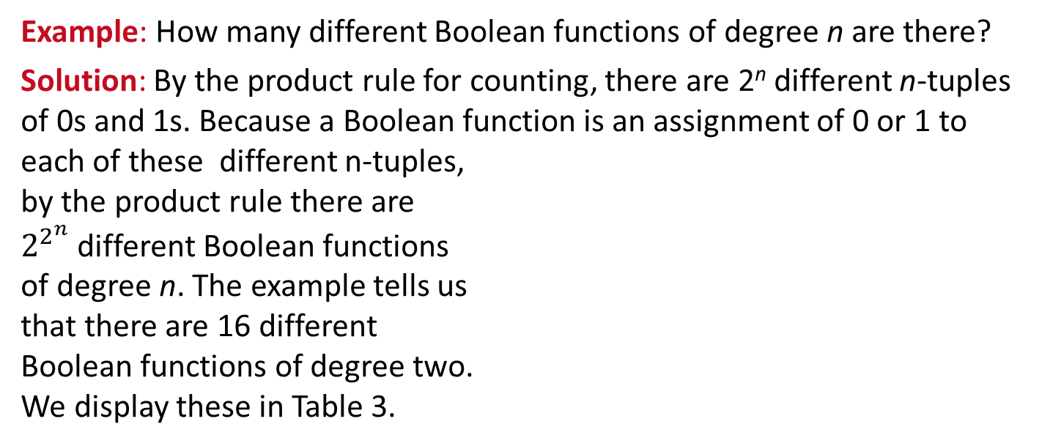
Boolean Functions
Example: How many different Boolean functions of degree n are there?
Solution: By the product rule for counting, there are 2^{n} different n-tuples of 0s and 1s. Because a Boolean function is an assignment of 0 or 1 to each of these different n-tuples, by the product rule there are $2^{2^{n}}$ different Boolean functions of degree n. The example tells us that there are 16 different Boolean functions of degree two. We display these in Table 3.
TABLE 4 The Number of Boolean Functions of Degree n.
Degree | Number
1 2 3 4 5 6 | 4 16 256 65,536 4,294,967,296 18,446,744,073,709,551,616
TABLE 3 The 16 Boolean Functions of Degree Two.
x | y | F₁ | F₂ | F₃ | F₄ | F₅ | F₆ | F₇ | F₈ | F₉ | F₁₀ | F₁₁ | F₁₂ | F₁₃ | F₁₄ | F₁₅ | F₁₆
1 1 0 0 | 1 0 1 0 | 1 1 1 1 | 1 1 1 0 | 1 1 0 1 | 1 1 0 0 | 1 0 1 1 | 1 0 1 0 | 1 0 0 1 | 1 0 0 0 | 0 1 1 1 | 0 1 1 0 | 0 1 0 1 | 0 1 0 0 | 0 0 1 1 | 0 0 1 0 | 0 0 0 1 | 0 0 0 0

Slide 12


Identities of Boolean Algebra 布尔恒等式
TABLE 5 Boolean Identities.
Each identity can be proved using a table.
All identities in Table 5, except for the first and the last two come in pairs. Each element of the pair is the dual of the other (obtained by switching Boolean sums and Boolean products and 0’s and 1’s.
The Boolean identities correspond to the identities of propositional logic (Section 1.3) and the set identities (Section 2.2).
Identity | Name
 | Law of the double complement
 | Idempotent laws
 | Identity laws
 | Domination laws
 | Commutative laws
 | Associative laws
 | Distributive laws
 | De Morgan’s laws
 | Absorption laws
 | Unit property
 | Zero property
$$x+\left(y+z\right)=\left(x+y\right)+z \\ x\left(yz\right)=\left(xy\right)z$$
$$x+yz=\left(x+y\right)\left(x+z\right) \\ x\left(y+z\right)=xy+xz$$

Slide 13
Identities of Boolean Algebra 布尔恒等式
Example: Show that the distributive law x(y + z) = xy + xz is valid.
Solution: We show that both sides of this identity always take the same value by constructing this table.
TABLE 6 Verifying One of the Distributive Laws.
x | y | z | y+z | xy | xz | x(y + z) | xy + xz
1 1 1 1 0 0 0 0 | 1 1 0 0 1 1 0 0 | 1 0 1 0 1 0 1 0 | 1 1 1 0 1 1 1 0 | 1 1 0 0 0 0 0 0 | 1 0 1 0 0 0 0 0 | 1 1 1 0 0 0 0 0 | 1 1 1 0 0 0 0 0

Slide 14
Identities of Boolean Algebra 布尔恒等式
Example: Translate the distributive law x + yz = (x + y)(x + z) in Table 5 into a logical equivalence.
Solution: Here we will change the Boolean variables x, y, and z into the propositional variables p, q, and r. Then,
p ∨ (q ∧ r) ≡ (p ∨ q) ∧ (p ∨ r).

Slide 15
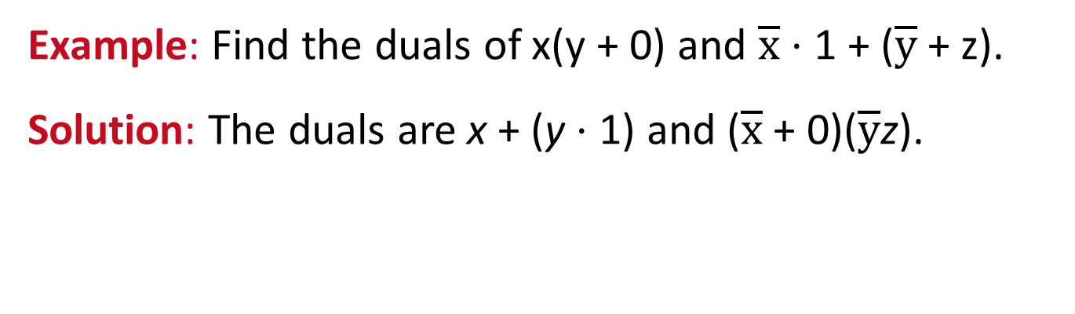
Duality 对偶性
Definition: The dual (对偶式) of a Boolean expression is obtained by interchanging Boolean sums and Boolean products and interchanging 0s and 1s.
Example: Find the duals of x(y + 0) and $\overline{x}$ ⋅ 1 + ($\overline{y}$ + z).
Solution: The duals are x + (y ⋅ 1) and ($\overline{x}$ + 0)($\overline{y}$z).

Slide 16
Duality 对偶性
An identity between functions represented by Boolean expressions remains valid when the duals of both sides of the identity are taken. This result, called the duality principle (对偶性原理), is useful for obtaining new identities.
Example: Construct an identity from the absorption law x(x + y) = x by taking duals.
Solution: Taking the duals of both sides of this identity produces the identity x + xy = x, which is also called an absorption law and is shown in Table 5.

Slide 17
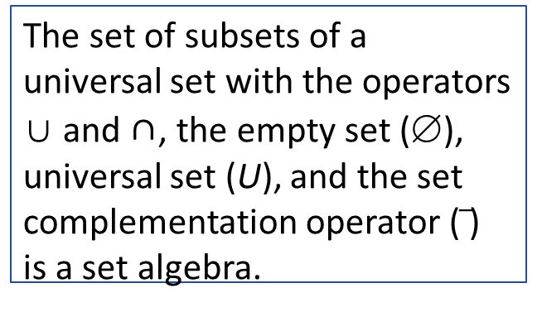
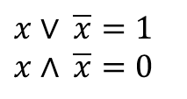
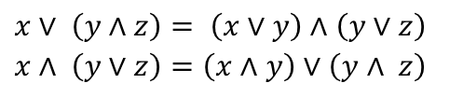
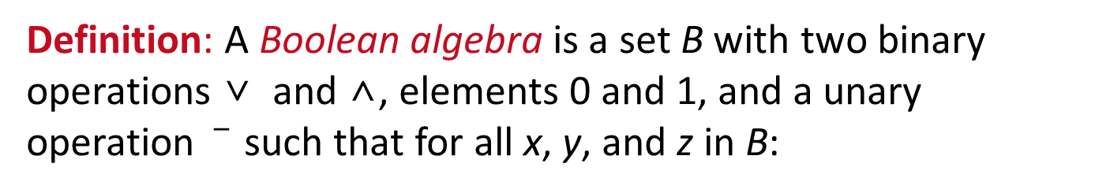
Formal Definition of a Boolean Algebra
Definition: A Boolean algebra is a set B with two binary operations ∨ and ∧, elements 0 and 1, and a unary operation such that for all x, y, and z in B:
The set of propositional variables with the operators ∧ and ∨, elements T and F, and the negation operator ¬ is a Boolean algebra.
identity laws
$$x∨ \overline{x}=1 \\ x∧ \overline{x}=0$$
complement laws
associative laws
The set of subsets of a universal set with the operators ∪ and ∩, the empty set (∅), universal set (U), and the set complementation operator ( ) is a set algebra.
commutative laws
$$\begin{matrix}x∨ \left(y∧z\right)= \left(x∨y\right)∧\left(y∨z\right) \\ x∧ \left(y∨z\right)=\left(x∧y\right)∨\left(y∧ z\right)\end{matrix}$$
distributive laws

Slide 18
Representing Boolean Functions
Section 12.2

Slide 19
Section Summary 2
Sum-of-Products Expansions
Functional Completeness

Slide 20
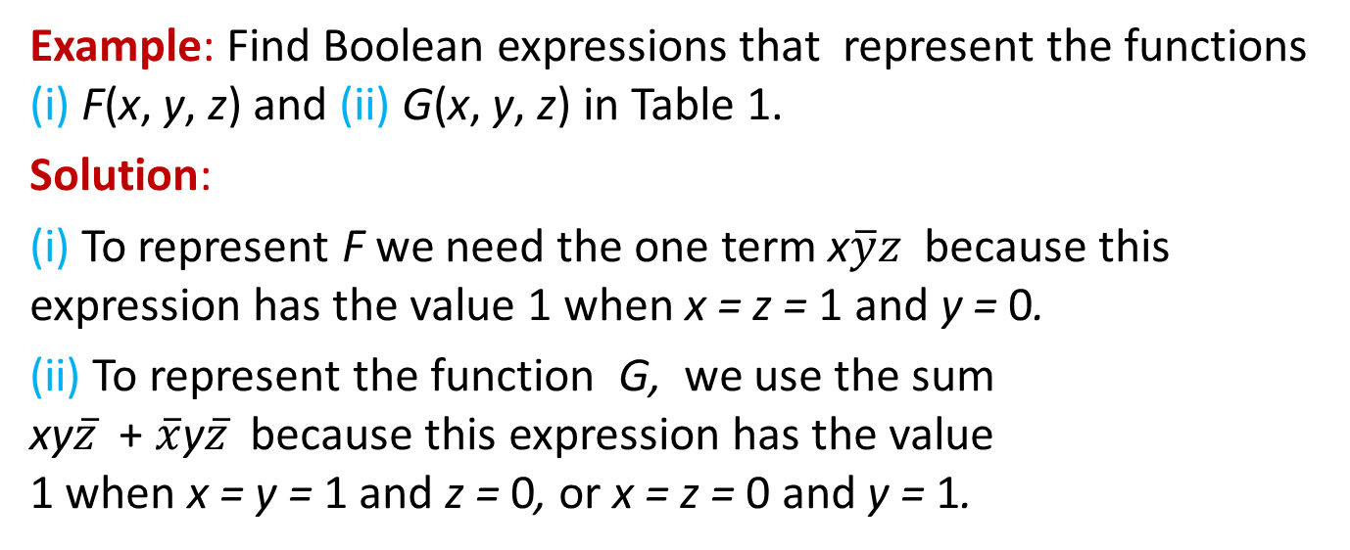
Sum-of-Products Expansion 1 积之和展开式
Example: Find Boolean expressions that represent the functions (i) F(x, y, z) and (ii) G(x, y, z) in Table 1.
Solution:
(i) To represent F we need the one term x$\overline{y}z$ because this expression has the value 1 when x = z = 1 and y = 0.
(ii) To represent the function G, we use the sum xy$\overline{z}$ + $\overline{x}$y$\overline{z}$ because this expression has the value 1 when x = y = 1 and z = 0, or x = z = 0 and y = 1.
TABLE 1
x | y | z | F | G
1 1 1 1 0 0 0 0 | 1 1 0 0 1 1 0 0 | 1 0 1 0 1 0 1 0 | 0 0 1 0 0 0 0 0 | 0 1 0 0 0 1 0 0
The general principle is that each combination of values of the variables for which the function has the value 1 requires a term in the Boolean sum that is the Boolean product of the variables or their complements.

Slide 21
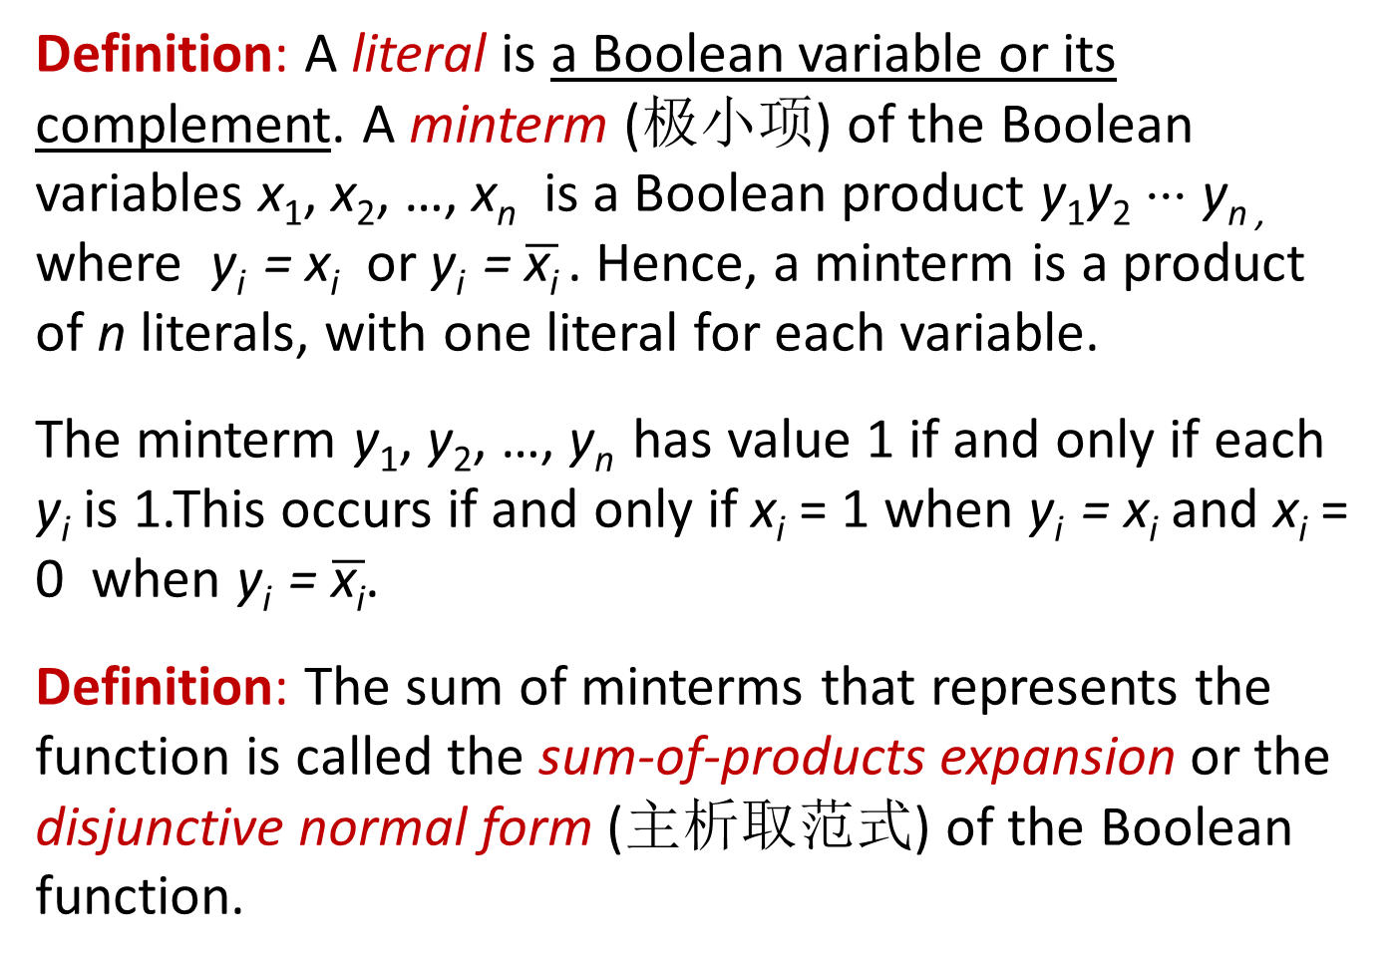
Sum-of-Products Expansion 2
Definition: A literal is a Boolean variable or its complement. A minterm (极小项) of the Boolean variables x₁, x₂, …, x_{n} is a Boolean product y₁y₂ ⋅⋅⋅ y_{n ,} where y_{i} = x_{i} or y_{i} = $\overline{\text{x}\text{i}}$ . Hence, a minterm is a product of n literals, with one literal for each variable.
The minterm y₁, y₂, …, y_{n} has value 1 if and only if each y_{i} is 1.This occurs if and only if x_{i} = 1 when y_{i} = x_{i} and x_{i} = 0 when y_{i} = $\overline{\text{x}\text{i}}$.
Definition: The sum of minterms that represents the function is called the sum-of-products expansion or the disjunctive normal form (主析取范式) of the Boolean function.

Slide 22
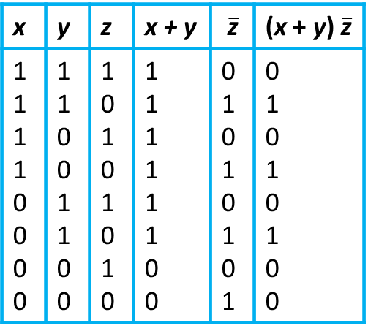
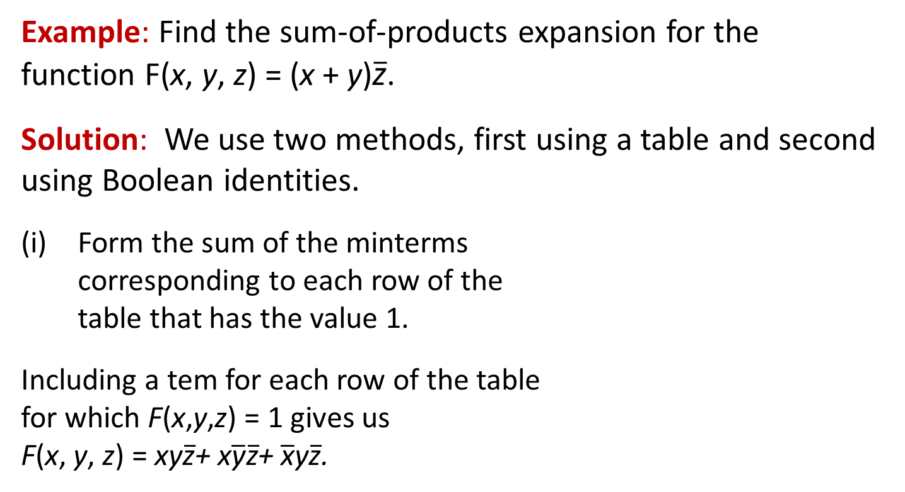
Sum-of-Products Expansion 3
Example: Find the sum-of-products expansion for the function F(x, y, z) = (x + y)$\overline{\text{z}}$.
Solution: We use two methods, first using a table and second using Boolean identities.
Form the sum of the minterms corresponding to each row of the table that has the value 1.
Including a tem for each row of the table for which F(x,y,z) = 1 gives us F(x, y, z) = xy$\overline{\text{z}}$+ x$\overline{\text{y}}\overline{\text{z}}$+ $\overline{\text{x}}$y$\overline{\text{z}}$.
TABLE 2
x | y | z | x + y | $$\overline{\text{z}}$$ | (x + y) $\overline{\text{z}}$
1 1 1 1 0 0 0 0 | 1 1 0 0 1 1 0 0 | 1 0 1 0 1 0 1 0 | 1 1 1 1 1 1 0 0 | 0 1 0 1 0 1 0 1 | 0 1 0 1 0 1 0 0

Slide 23
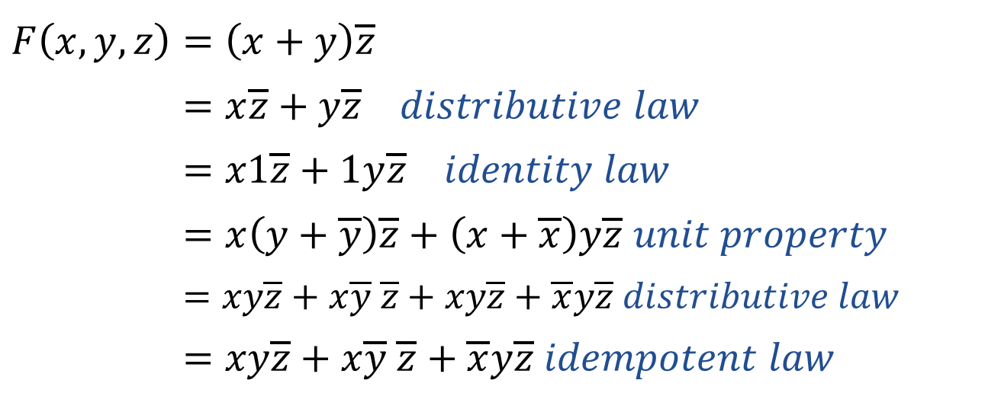
Sum-of-Products Expansion 4
We now use Boolean identities to find the disjunctive normal form of F(x, y, z):
$$F\left(x,y,z\right)=\left(x+y\right)\overline{z} \\ =x\overline{z}+y\overline{z} distributive law \\ =x1\overline{z}+1y\overline{z} identity law \\ =x\left(y+\overline{y}\right)\overline{z}+\left(x+\overline{x}\right)y\overline{z} unit property \\ =xy\overline{z}+x\overline{y} \overline{z}+xy\overline{z}+\overline{x}y\overline{z} distributive law \\ =xy\overline{z}+x\overline{y} \overline{z}+\overline{x}y\overline{z} idempotent law$$

Slide 24
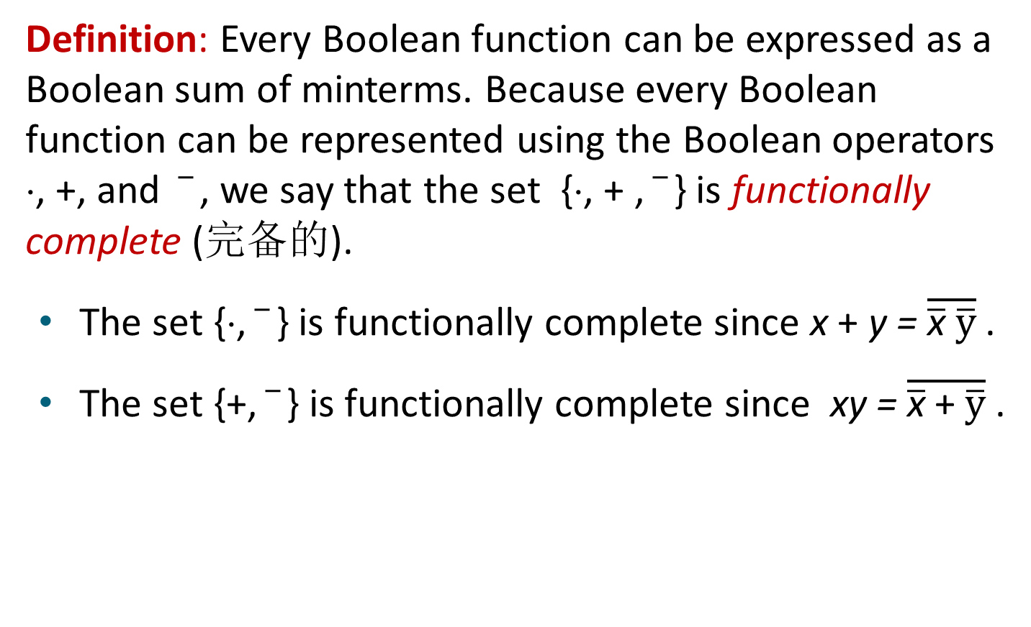
Functional Completeness 函数完备性
Definition: Every Boolean function can be expressed as a Boolean sum of minterms. Because every Boolean function can be represented using the Boolean operators ⋅, +, and , we say that the set {⋅, + , } is functionally complete (完备的).
The set {⋅, } is functionally complete since x + y = $\overline{\overline{\text{x}} \overline{y}}$ .
The set {+, } is functionally complete since xy = $\overline{\overline{\text{x}} \text{+} \overline{y}}$ .

Slide 25
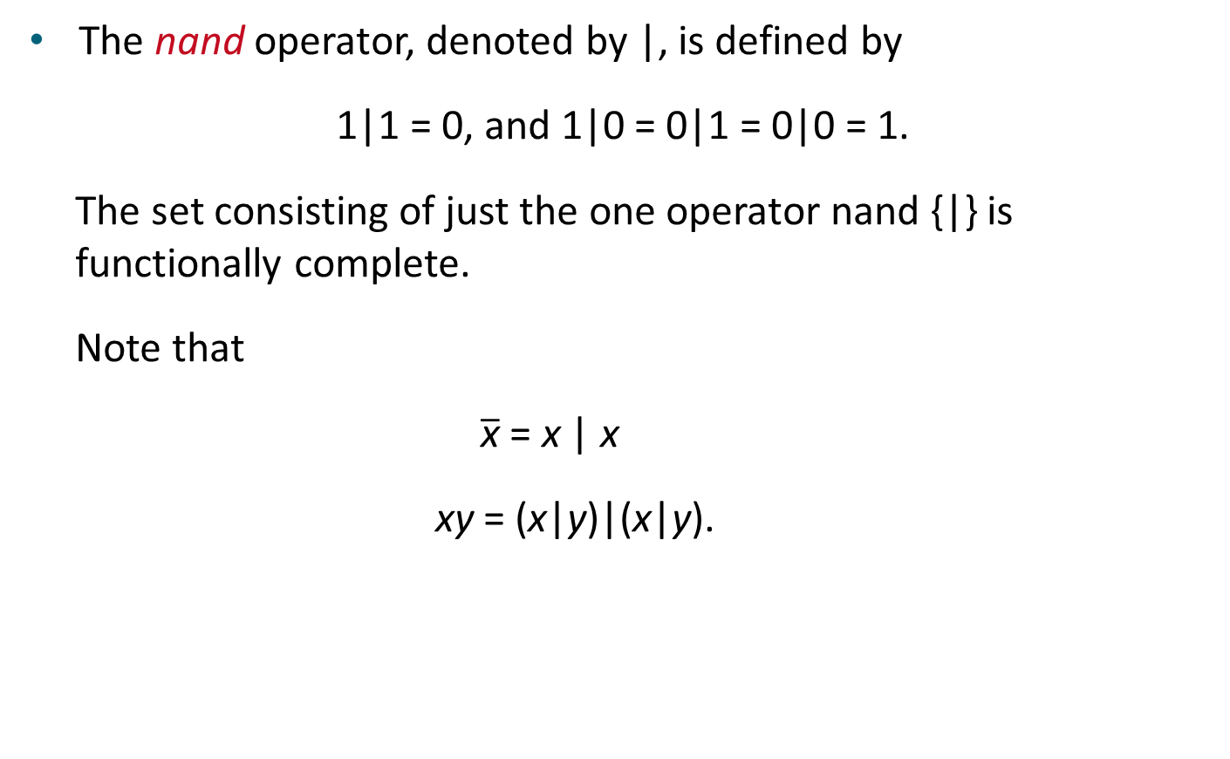
Functional Completeness 函数完备性
The nand operator, denoted by |, is defined by
1|1 = 0, and 1|0 = 0|1 = 0|0 = 1.
The set consisting of just the one operator nand {|} is functionally complete.
Note that
$\overline{\text{x}}$ = x | x
xy = (x|y)|(x|y).

Slide 26
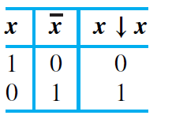
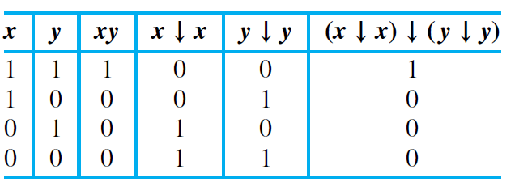
Functional Completeness 函数完备性
The nor operator, denoted by ↓, is defined by
0 ↓ 0 = 1, and 1 ↓ 0 = 0 ↓ 1 = 1 ↓ 1 = 0.
The set consisting of just the one operator nor {↓} is functionally complete.

Slide 27
Logic Gates
Section 12.3

Slide 28
Section Summary 3
Logic Gates
Combinations of Gates
Examples of Circuits

Slide 29


Logic Gates 逻辑门
We construct circuits using gates, which take as input the values of two or more Boolean variables and produce one or more bits as output, and inverters, which take the value of a Boolean variable as input and produce the complement of this value as output.
(反相器)
(或门)
(与门)

Slide 30
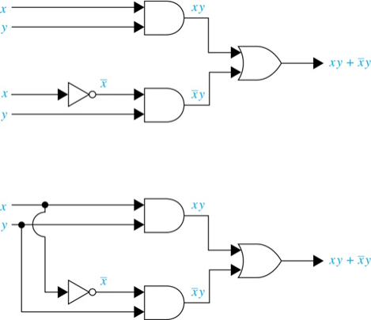
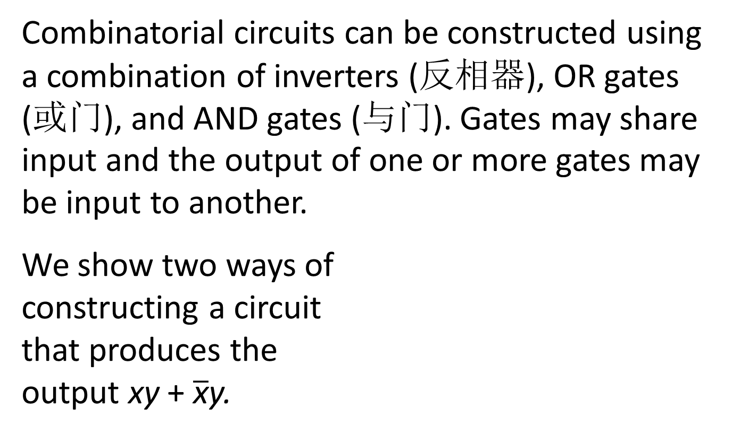
Combinations of Gates
Combinatorial circuits can be constructed using a combination of inverters (反相器), OR gates (或门), and AND gates (与门). Gates may share input and the output of one or more gates may be input to another.
We show two ways of constructing a circuit that produces the output xy + $\overline{\text{x}}$y.

Slide 31
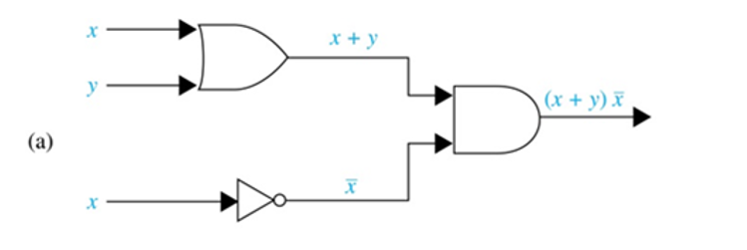
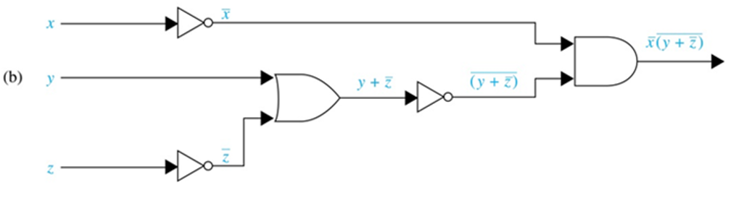
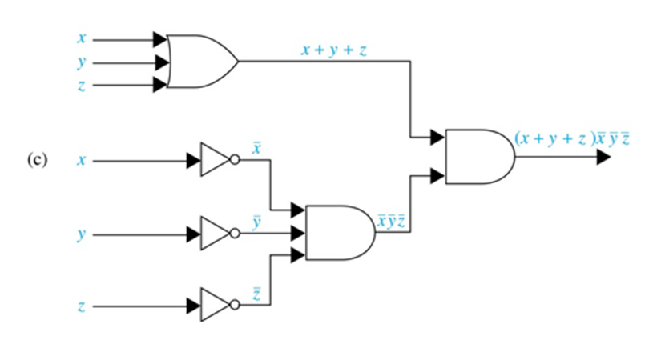
Combinations of Gates 2
Example: Construct circuits that produce these outputs

Slide 32
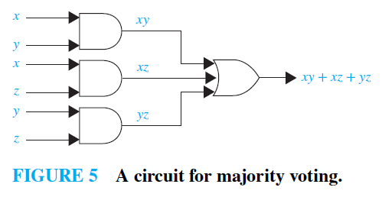
Combinations of Gates 3
Example: A committee of three individuals decides issues for an organization. Each individual votes either yes or no for each proposal that arises. A proposal is passed if it receives at least two yes votes. Design a circuit that determines whether a proposal passes.
Solution: We use x, y, z to denote three individuals, then the Boolean function that has these output values is xy + xz + yz.

Slide 33
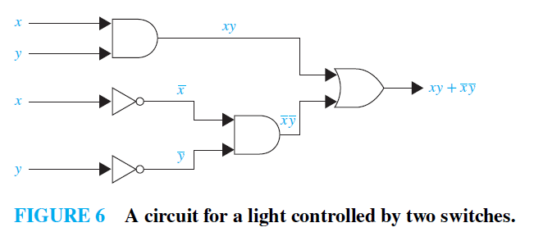
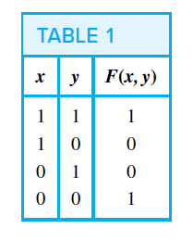
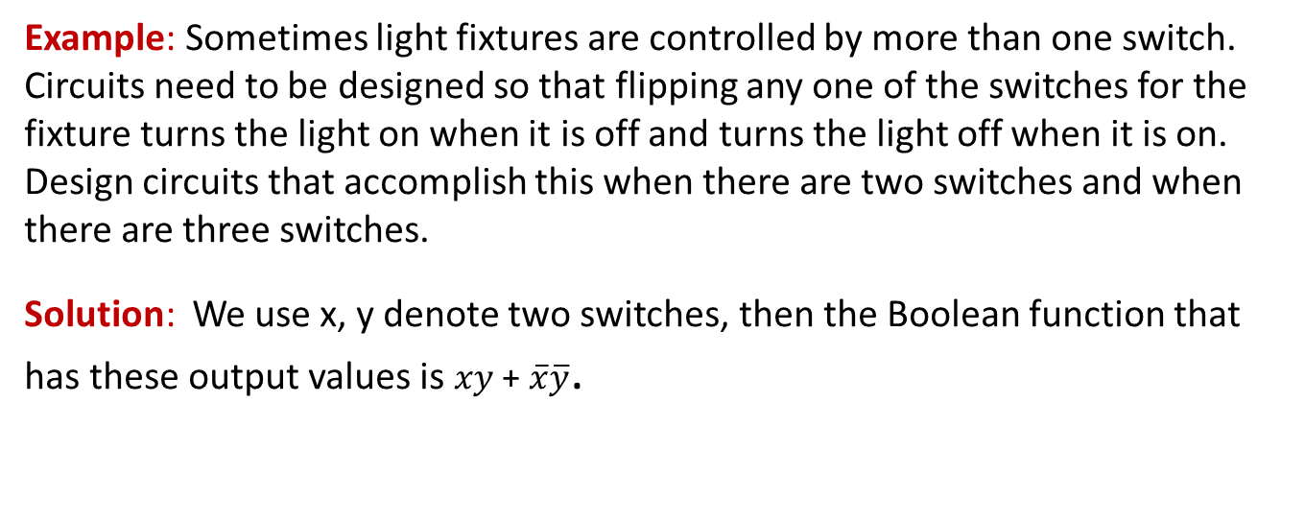
Combinations of Gates 4
Example: Sometimes light fixtures are controlled by more than one switch. Circuits need to be designed so that flipping any one of the switches for the fixture turns the light on when it is off and turns the light off when it is on. Design circuits that accomplish this when there are two switches and when there are three switches.
Solution: We use x, y denote two switches, then the Boolean function that has these output values is $xy$ + $\overline{x}\overline{y}$.

Slide 34
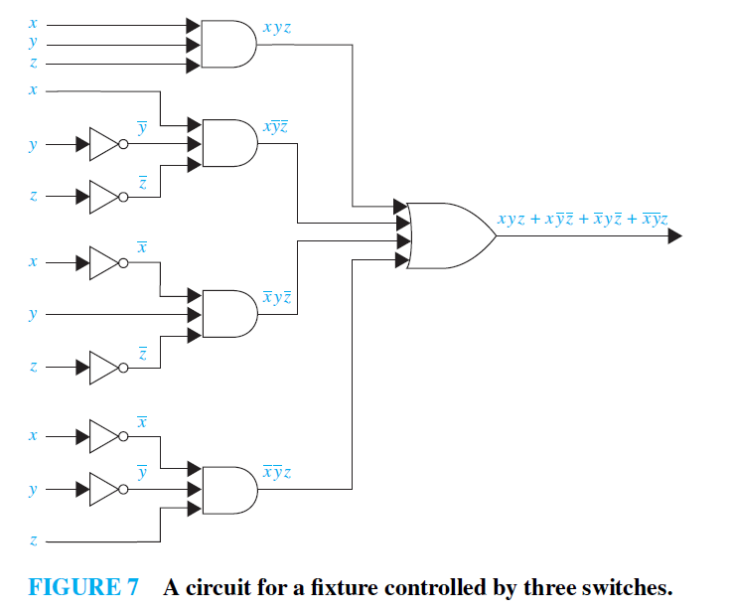
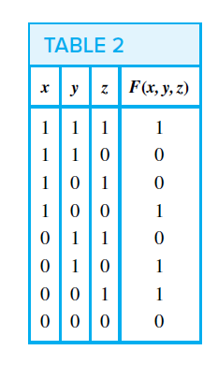

Combinations of Gates 4
Solution: We use x, y, z denote three switches, then the Boolean function that has these output values is $xyz+x\overline{y}\overline{z}+\overline{x}y\overline{z}+\overline{x}\overline{y}z$.

Slide 35
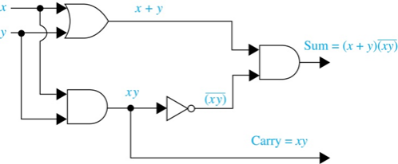

Adders 加法器
Logic circuits can be used to add two positive integers from their binary expansions.
The first step is to build a half adder (半加法器) that adds two bits, but which does not accept a carry (进位) from a previous addition.
Since the circuit has more than one output, it is a multiple output circuit (多重输出电路) .
TABLE 3 Input and Output for the Half Adder.
c = xy
s= $x\overline{y}$ + $\overline{x}y$ = (x + y)$\overline{\text{(}\text{xy}\text{)}}$.
Input |  | Output
x | y | s | c
1 1 0 0 | 1 0 1 0 | 0 1 1 0 | 1 0 0 0

Slide 36
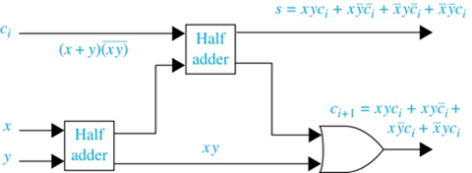
Adders 加法器
A full adder (全加法器) is used to compute the sum bit and the carry bit when two bits and a carry are added.
TABLE 3 Input and Output for the Full Adder.
Input | Input |  | Output
x | y | c_{i} | s | c_{i + 1}
1 1 1 1 0 0 0 0 | 1 1 0 0 1 1 0 0 | 1 0 1 0 1 0 1 0 | 1 0 0 1 0 1 1 0 | 1 1 1 0 1 0 0 0

Slide 37
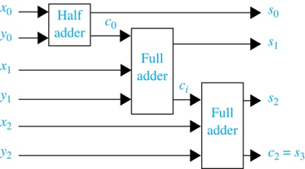
Adders 加法器
A half adder and multiple full adders can be used to produce the sum of n bit integers.
Example: Here is a circuit to compute the sum of two three-bit integers.

Slide 38
Minimization of Circuits 电路极小化
The efficiency of a combinational circuit depends on the number and arrangement of its gates. The process of designing a combinational circuit begins with the table specifying the output for each combination of input values.
We can always use the sum-of-products expansion of a circuit to find a set of logic gates that will implement this circuit. However, the sum-of-products expansion may contain many more terms than are necessary.
Terms in a sum-of-products expansion that differ in just one variable, so that in one term this variable occurs and in the other term the complement of this variable occurs, can be combined.

Slide 39
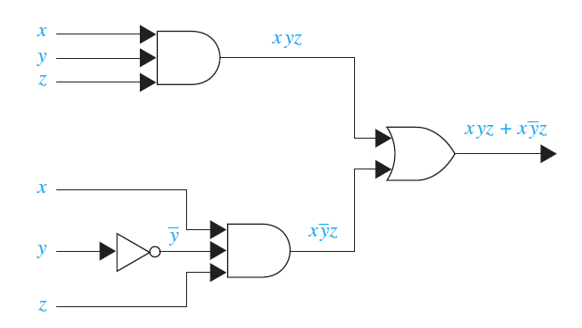



Minimization of Circuits 电路极小化
Example: Consider the circuit that has output 1 if and only if (x = y = z = 1) or (x = z = 1 and y = 0).
Solution: The sum-of-products expansion of this circuit is
xyz + x$\overline{y}$z.
The two products differ in exactly one variable y. They can be combined as
xyz + x$\overline{y}$z = (y + $\overline{y}$)(xz)
= 1 ⋅ (xz)
= xz.

Slide 40
Karnaugh Maps 卡诺图
There is a graphical method to reduce the number of terms in a Boolean expression representing a circuit, called a Karnaugh map or K-map, which can be used to find terms to combine for Boolean functions involving a relatively small number of variables.
The method we will describe was introduced by Maurice Karnaugh in 1953. His method is based on earlier work by E.W. Veitch. (This method is usually applied only when the function involves six or fewer variables.)
K-maps give us a visual method for simplifying sum-of-products expansions. However, they are not suited for mechanizing this process.

Slide 41
The Quine–MCCluskey Method 奎因-莫可拉斯基方法
The Quine–McCluskey method is such a procedure. It can be used for Boolean functions in any number of variables, It was developed in the 1950s by W. V. Quine and E. J. McCluskey.
Basically, the Quine–McCluskey method consists of two parts. The first part finds those terms that are candidates for inclusion in a minimal expansion as a Boolean sum of Boolean products. The second part determines which of these terms to actually use.

Slide 42
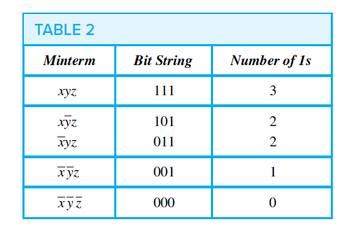
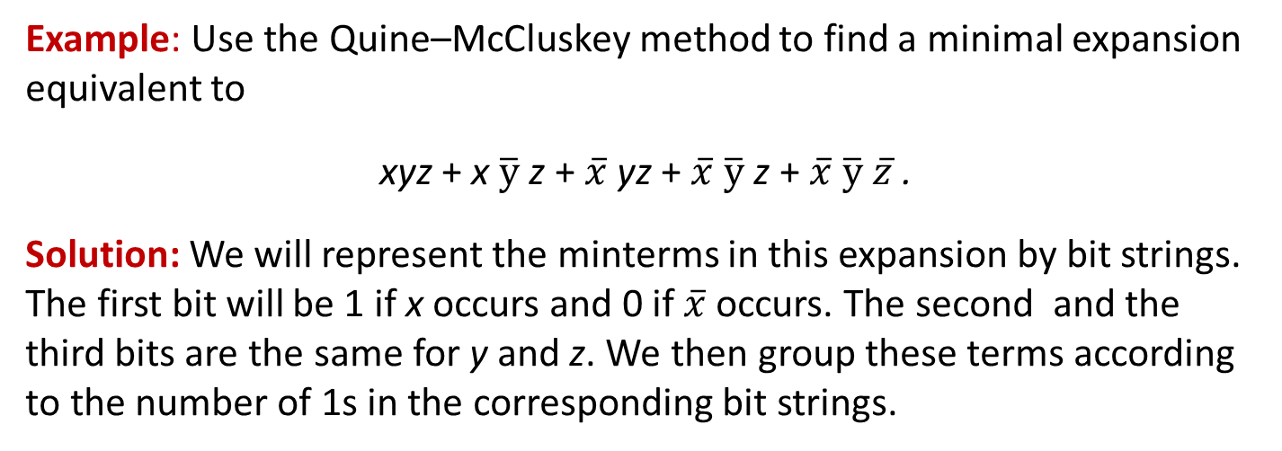
The Quine–MCCluskey Method 奎因-莫可拉斯基方法
Example: Use the Quine–McCluskey method to find a minimal expansion equivalent to
xyz + x $\overline{y}$ z + $\overline{x}$yz + $\overline{x}$ $\overline{y}$ z + $\overline{x}$ $\overline{y}$ $\overline{z}$.
Solution: We will represent the minterms in this expansion by bit strings. The first bit will be 1 if x occurs and 0 if $\overline{x}$ occurs. The second and the third bits are the same for y and z. We then group these terms according to the number of 1s in the corresponding bit strings.

Slide 43
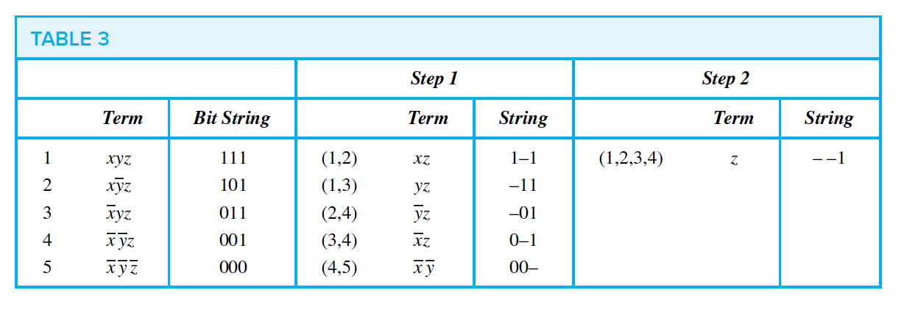
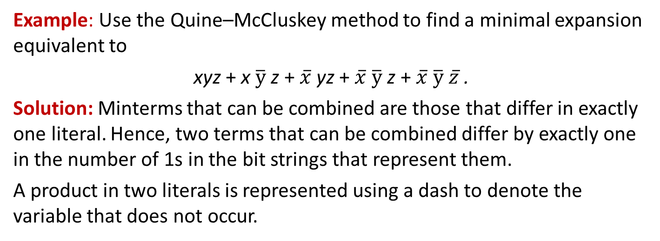
The Quine–MCCluskey Method 奎因-莫可拉斯基方法
Example: Use the Quine–McCluskey method to find a minimal expansion equivalent to
xyz + x $\overline{y}$ z + $\overline{x}$yz + $\overline{x}$ $\overline{y}$ z + $\overline{x}$ $\overline{y}$ $\overline{z}$.
Solution: Minterms that can be combined are those that differ in exactly one literal. Hence, two terms that can be combined differ by exactly one in the number of 1s in the bit strings that represent them.
A product in two literals is represented using a dash to denote the variable that does not occur.

Slide 44
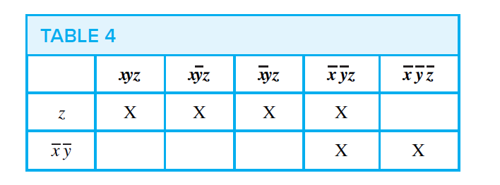
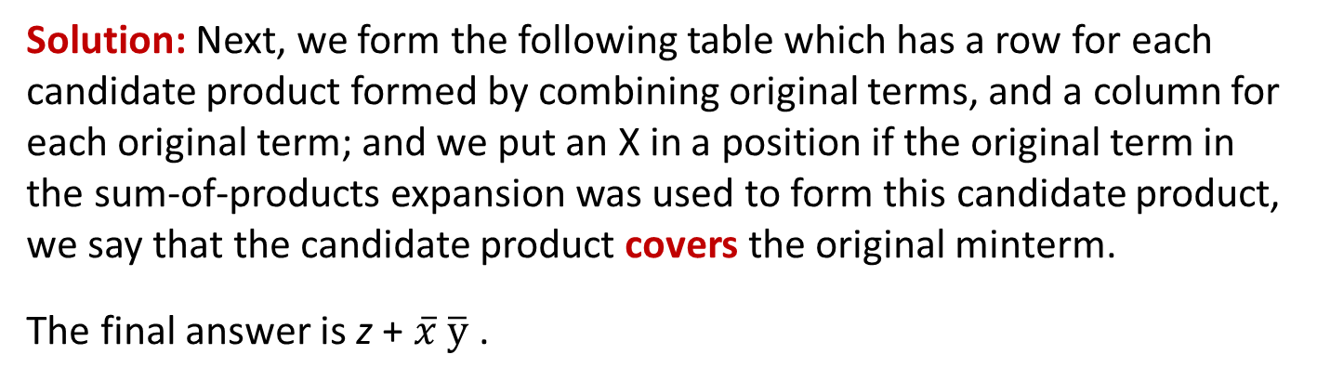
The Quine–MCCluskey Method 奎因-莫可拉斯基方法
Solution: Next, we form the following table which has a row for each candidate product formed by combining original terms, and a column for each original term; and we put an X in a position if the original term in the sum-of-products expansion was used to form this candidate product, we say that the candidate product covers the original minterm.
The final answer is z + $\overline{x}$ $\overline{y}$ .

Slide 45
The Quine–MCCluskey Method 奎因-莫可拉斯基方法
The Quine–McCluskey method uses this sequence of steps to simplify a sum-of-products expression.
1. Express each minterm in n variables by a bit string of length n with a 1 in the ith position if xi occurs and a 0 in this position if xi occurs.
2. Group the bit strings according to the number of 1s in them.
3. Determine all products in n − 1 variables that can be formed by taking the Boolean sum of minterms in the expansion. Minterms that can be combined are represented by bit strings that differ in exactly one position. Represent these products in n − 1 variables with strings that have a 1 in the ith position if xi occurs in the product, a 0 in this position if xi occurs, and a dash in this position if there is no literal involving xi in the product.

Slide 46
The Quine–MCCluskey Method 奎因-莫可拉斯基方法
4. Determine all products in n − 2 variables that can be formed by taking the Boolean sum of the products in n − 1 variables found in the previous step. Products in n − 1 variables that can be combined are represented by bit strings that have a dash in the same position and differ in exactly one position.
5. Continue combining Boolean products into products in fewer variables as long as possible.
6. Find all the Boolean products that arose that were not used to form a Boolean product in one fewer literal.
7. Find the smallest set of these Boolean products such that the sum of these products represents the Boolean function. This is done by forming a table showing which minterms are covered by which products. Every minterm must be covered by at least one product.

Slide 47
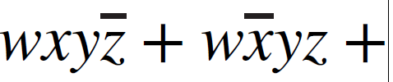
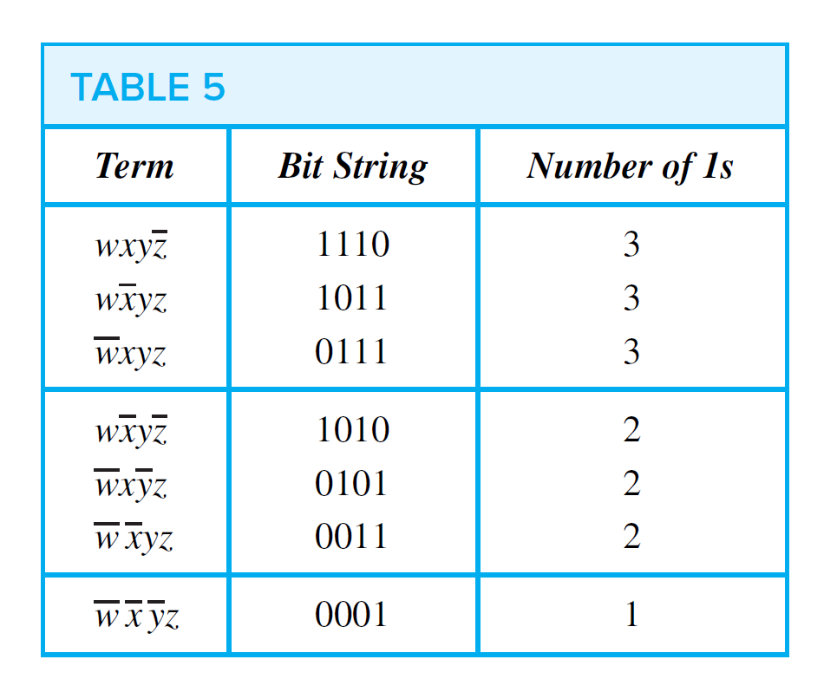
The Quine–MCCluskey Method 奎因-莫可拉斯基方法
Example: Use the Quine–McCluskey method to simplify the sum-of-products expansion
Solution:

Slide 48

The Quine–MCCluskey Method 奎因-莫可拉斯基方法
Example: Use the Quine–McCluskey method to simplify the sum-of-products expansion
Solution:

Slide 49

The Quine–MCCluskey Method 奎因-莫可拉斯基方法
Example: Use the Quine–McCluskey method to simplify the sum-of-products expansion
Solution:

Slide 50
Homework
§12.1 6 c), 13, 21, 28 d)
§12.2 3 a) b), 14 c), 15 b), 12 §12.3 5, 6 c), 7, 10, 11
Due date : 2024.6.4

