Slide 1
2 Basic Structures: Sets, Functions, Sequences, Sums and Matrices
2.1 Sets
2.2 Set Operations
2.3 Functions
2.4 Sequences and Summations
2.5 Cardinality of Sets
2.6 Matrices

Slide 2
Introduction to Set Theory 集合论(§2.1)
A set is a new type of structure, representing an unordered collection (group, plurality) of zero or more distinct (different) objects.
Set theory deals with operations between, relations among, and statements about sets.
Sets are ubiquitous in computer software systems.
All of mathematics can be defined in terms of some form of set theory (using predicate logic).

Slide 3
Basic notations for sets
For sets, we’ll use variables S, T, U, …
Roster method: we can denote a set S in writing by listing all of its elements in curly braces:
{a, b, c} is the set of whatever 3 objects are denoted by a, b, c.
Set builder notation: For any proposition P(x) over any universe of discourse,
{x | P(x)} is the set of all x such that P(x).
Notes:
Read {a, b, c} as “the set whose elements are a, b, and c” or just “the set a, b, c”.

Slide 4
Example
The set V of all vowels in English alphabet can be written as V={a,e,i,o,u}.
Speech sounds are generally divided into vowels and consonants.
The set O of odd positive integers less than 10 can be expressed by O={1,3,5,7,9}.
The set of positive integers less than 100 can be denoted by {1,2,3,…,99}.

Slide 5
Basic properties of sets
Sets are inherently unordered:
No matter what objects a, b, and c denote, {a, b, c} = {a, c, b} = {b, a, c} = {b, c, a} = {c, a, b} = {c, b, a}.
All elements are distinct (unequal); multiple listings make no difference!
If a=b, then {a, b, c} = {a, c} = {b, c} = {a, a, b, a, b, c, c, c, c}.
This set contains (at most) 2 elements!

Slide 6
Definition of Set Equality 集合相等
Two sets are declared to be equal if and only if they contain exactly the same elements.
In particular, it does not matter how the set is defined or denoted.
For example:
The set {1, 2, 3, 4}
= {x | x is an integer where x>0 and x<5 }
= {x | x is a positive integer whose square is >0 and <25}

Slide 7
Infinite Sets 无限集
Conceptually, sets may be infinite (i.e., not finite, without end, unending).
Symbols for some special infinite sets: N = {0, 1, 2, …} The Natural numbers. Z = {…, -2, -1, 0, 1, 2, …} The Zntegers. R = The “Real” numbers, such as 374.1828471929498181917281943125…
“Blackboard Bold” or double-struck font (ℕ,ℤ,ℝ) is also often used for these special number sets.
Infinite sets come in different sizes!
Notes:
vowels

Slide 8
Basic Set Relations: Member of (成员)
x∈S (“x is in S”) is the proposition that object x is an ∈lement or member of set S.
e.g. 3∈N, “a”∈{x | x is a letter of the alphabet}
Can define set equality in terms of ∈ relation: ∀S,T: S=T ↔ (∀x: x∈S ↔ x∈T) “Two sets are equal iff they have all the same members.”
x∉S :≡ ¬(x∈S) “x is not in S”

Slide 9
The Empty Set 空集
∅ (“null”, “the empty set”) is the unique set that contains no elements whatsoever.
∅ = {} = {x | False}
No matter the domain of discourse, we have the axiom ¬∃x: x∈∅.

Slide 10
Subset 子集
S⊆T (“S is a subset of T”) means that every element of S is also an element of T.
S⊆T ⇔ ∀x (x∈S → x∈T)
∅⊆S, S⊆S.
Notes:
Note also that FORALL x P(x)->Q(x) can also be understood as meaning “{x|P(x)} is a subset of {x|Q{x}}”. This can help you understand the meaning of implication. For example, if I say, “if a student has a drivers license, then he is over 16,” this is the same as saying “the set of students with drivers licenses is a subset of the set of students who are over 16”, or “every student with a drivers license is over 16.” If no students in the universe of discourse have drivers licenses, then the antecedent is always false, or in other words the set of students with drivers licenses is just the empty set, which is of course a member of every set, and so the statement is vacuously true. Alternatively, if every student in the universe of discourse is over 16, then the consequent is always true, that is, the set of students who are over 16 is the entire universe of discourse, and so every set of students in the u.d. is necessarily a subset of the set of students who are over 16, and so the statement is trivially true. The statement is only false if there exists a student with a drivers license in the u.d. who is under 16 (perhaps the license is fake or from a foreign country), in which case, the set of students with drivers licenses is *not* a subset of the under-16 students.

Slide 11
Proper (Strict) Subsets 真子集
S⊂T (“S is a proper subset of T”) means that S⊆T but .
Example: {1,2} ⊂ {1,2,3}
S
T
Venn Diagram equivalent of S⊂T
Notes:
We may also say, “S is a strict subset of T”, or “S is strictly a subset of T” to mean the same thing.

Slide 12
Sets Can be Objects, Too!
The objects that are elements of a set may themselves be sets.
E.g. let S={x | x ⊆ {1,2,3}} then S={∅, {1}, {2}, {3}, {1,2}, {1,3}, {2,3}, {1,2,3}}
Note that 1 ≠ {1} ≠ {{1}} !!!!
Very
Important!
Notes:
In general, any kind of object or structure, whether simple or complex, can be a member of a set. In particular, sets themselves (being structures) can be members of sets.
If you don’t understand the distinction between 1, {1}, {{1}}, you’ll make endless silly mistakes. 1 is a number, the number one. {1} is NOT A NUMBER AT ALL! It is a COMPLETELY DIFFERENT TYPE OF OBJECT! Namely, it is a set. What kind of set? It is a singleton set, by which we mean a set that contains exactly one element. In this case, its element happens to be the number 1. Now, what is {{1}}? It is also a set, and also a singleton set, but it is a COMPLETELY DIFFERENT TYPE of singleton set. To see this, notice that {1} is a set of numbers, whereas {{1}} is not a set of numbers at all! It is a SET OF SETS. Its single element is not a number at all, but is a SET. Namely, the set {1}. In other words, {{1}} is the singleton set whose member is the singleton set whose member is 1. Whereas, {1} is just the singleton set whose member is 1. And, 1 is just 1. All of these are distinct objects and you’ve got to learn to keep them separate! Otherwise, you’ll never have a chance of understanding data types in programming languages. For example, in most languages, we can have an array of numbers, or an array of arrays of numbers, etc. These are all completely different types of objects and can never be compatible with each other.

Slide 13
Cardinality and Finiteness 基数
|S| (read “the cardinality of S”) is a measure of how many different elements S has.
e.g., |∅|=0, |{1,2,3}| = 3, |{a,b}| = 2, |{{1,2,3},{4,5}}| = ____
If there are exactly n distinct elements in S where n is a nonnegative integer, we say that S is a finite set. Otherwise, we say S is infinite set.
What are some infinite sets we’ve seen?
2
N
Z
R

Slide 14
The Power Set (幂集) Operation
The power set P(S) of a set S is the set of all subsets of S. P(S) :≡ {x | x⊆S}.
E.g. P({a,b}) = {∅, {a}, {b}, {a,b}}.
Sometimes P(S) is written 2^{S}. Note that for finite S, |P(S)| = 2^{|S|}.
It turns out ∀S:|P(S)|>|S|, e.g. |P(N)| > |N|.
Notes:
We’ll get to different sizes of infinite sets later, in the module on functions.

Slide 15
Review: Set Notations So Far
Variable objects x, y, z; sets S, T, U.
Literal set {a, b, c} and set-builder {x | P(x)}.
∈ relational operator, and the empty set ∅.
Set relations =, ⊆, ⊇, ⊂, ⊃, ⊄, etc.
Venn diagrams.
Cardinality |S| and infinite sets N, Z, R.
Power sets P(S).

Slide 16
Ordered n-tuples 有序n元组
These are like sets, except that duplicates matter, and the order makes a difference. Ordered pairs 序偶
For n∈N, an ordered n-tuple or a sequence or list of length n is written (a₁, a₂, …, a_{n}). Its first element is a₁, etc.
Note that (1, 2) ≠ (2, 1) ≠ (2, 1, 1).
Empty sequence, singlets, pairs, triples, quadruples, quintuples, …, n-tuples.
Contrast with sets’ {}
Notes:
Sometimes people also define “bags”, which are unordered collections in which duplicates matter. If you have a bag of coins, they are in no particular order, but it matters how many coins of each type you have.

Slide 17
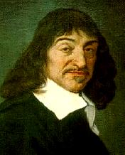
Cartesian Products of Sets 笛卡尔集
For sets A, B, their Cartesian product A×B :≡ {(a, b) | a∈A ∧ b∈B }.
E.g. {a,b}×{1,2} = {(a,1),(a,2),(b,1),(b,2)}
Note that for finite A, B, |A×B|=|A||B|.
Note that the Cartesian product is not commutative: i.e., ¬∀AB: A×B=B×A.
Extends to A₁ × A₂ × … × A_{n}...
René Descartes (1596-1650)
Notes:
Usually AxBxC is defined as {(a,b,c) | a is in A and b is in B and c is in C}.

Slide 18
Definition of relations
Let A and B be two sets. A binary relation R from A to B is a subset of A × B.
Note that the order of the two sets matters.
More generally, let A₁, A₂, ..., A_{n} be n sets. An n-ary relation R on these sets is a subset of A₁ × A₂ × ... × A_{n}.
The sets A_{i} are known as the domains of the relation, and n as its degree
Again, the order of the domains matters.

Slide 19
Review of §2.1
Sets S, T, U… Special sets N, Z, R.
Set notations {a,b,...}, {x|P(x)}…
Set relation operators x∈S, S⊆T, S⊇T, S=T, S⊂T, S⊃T. (These form propositions.)
Finite vs. infinite sets.
Set operations |S|, P(S), S×T.

Slide 20
Start §2.2: 集合运算The Union Operator 并集
For sets A, B, their∪nion A∪B is the set containing all elements that are either in A, or (“∨”) in B (or, of course, in both).
Formally, ∀A,B: A∪B = {x | x∈A ∨ x∈B}.
Note that A∪B is a superset of both A and B (in fact, it is the smallest such superset): ∀A, B: (A∪B ⊇ A) ∧ (A∪B ⊇ B)

Slide 21
Union Examples
{a,b,c}∪{2,3} = {a,b,c,2,3}
{2,3,5}∪{3,5,7} = {2,3,5,3,5,7} ={2,3,5,7}
Required Form
2
5
3
7

Slide 22
The Intersection Operator 交集
For sets A, B, their intersection A∩B is the set containing all elements that are simultaneously in A and (“∧”) in B.
Formally, ∀A,B: A∩B={x | x∈A ∧ x∈B}.
Note that A∩B is a subset of both A and B (in fact it is the largest such subset): ∀A, B: (A∩B ⊆ A) ∧ (A∩B ⊆ B)

Slide 23
Intersection Examples
∅
{a,b,c}∩{2,3} = ___
{2,4,6}∩{3,4,5} = ______
{4}
3
2
4
6
5

Slide 24
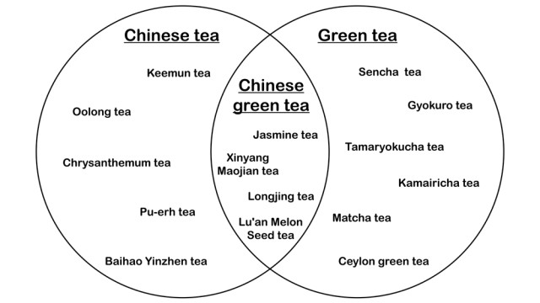
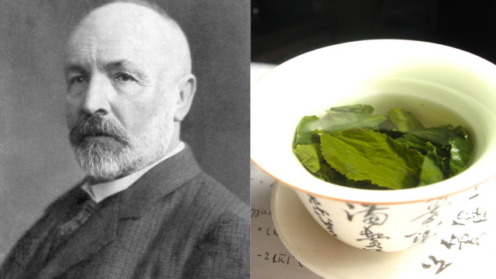
A Venn diagram showing a union of the Chinese tea set and the Green tea set. At the intersection of these sets are different types of Chinese green tea.
Notes:
keemun tea
Oolong tea
Chrysanthemum tea
pu-erh tea
baihao yinzhen tea
jasmine tea
xinyang maojian tea
longjing tea
sencha tea
gyokuro tea
tamaryokucha tea
kamairicha tea
matcha tea
ceylon grean tea

Slide 25
Disjointedness 互斥
Two sets A, B are called disjoint (i.e., unjoined) iff their intersection is empty. (A∩B=∅)
Example: the set of even integers is disjoint with the set of odd integers.

Slide 26
Inclusion-Exclusion Principle 容斥原理
How many elements are in A∪B? |A∪B| = |A| + |B| − |A∩B|
Example: How many students are on our class email list? Consider set E = I ∪ M, I = {s | s turned in an information sheet} M = {s | s sent the TAs their email address}
Some students did both! |E| = |I∪M| = |I| + |M| − |I∩M|
Notes:
We will see this basic counting principle again when we talk about combinatorics.

Slide 27
Set Difference 差集
For sets A, B, the difference of A and B, written A−B, is the set of all elements that are in A but not B. Formally: A − B :≡ {x | x∈A ∧ x∉B} = {x | ¬(x∈A → x∈B) }
Also called: The complement of B with respect to A.
Notes:
NOT (x in A -> x in B) = NOT (x not in A or x in B) (defn. of implies) = x in A AND x not in B (DeMorgan’s law).

Slide 28
Set Difference Examples
{1,2,3,4,5,6} − {2,3,5,7,9,11} = ___________
Z − N = {… , −1, 0, 1, 2, … } − {0, 1, … } = {x | x is an integer but not a nat. #} = {x | x is a negative integer} = {… , −3, −2, −1}
{1,4,6}

Slide 29
Set Difference - Venn Diagram
A−B is what’s left after B “takes a bite out of A”
Chomp!
Set A−B
Set A
Set B

Slide 30
Set Complements 补集
The universe of discourse can itself be considered a set, call it U.
When the context clearly defines U, we say that for any set A⊆U, the complement of A, written , is the complement of A w.r.t. U, i.e., it is U−A.
E.g., If U=N,

Slide 31
More on Set Complements
An equivalent definition, when U is clear:
A
U
Notes:
Note that set difference and complement do not relate to each other like arithmetic difference and negative. In arithmetic, we know that a-b = -(b-a). But in sets, A-B is not generally the same as the complement of B-A.

Slide 32
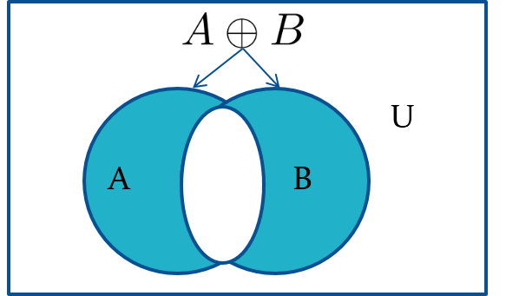
Symmetric Difference (optional)
Definition: The symmetric difference of A and B, denoted by
is the set
Example:
U = {0,1,2,3,4,5,6,7,8,9,10}
A = {1,2,3,4,5} B ={4,5,6,7,8}
What is
Solution: {1,2,3,6,7,8}
Venn Diagram

Slide 33
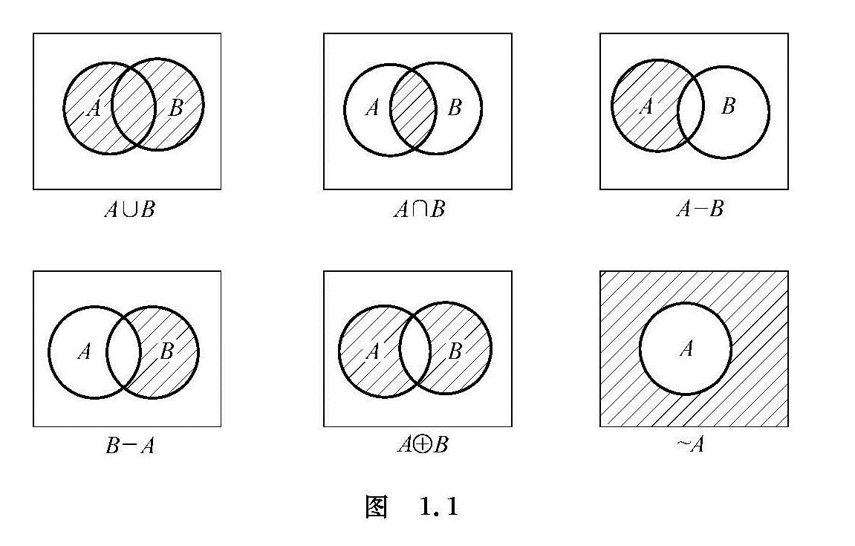
Venn Diagram

Slide 34
Set Identities
Identity laws
Domination laws
Idempotent laws
Complementation law

Slide 35
Set Identities 2
Commutative laws
Associative laws
Distributive laws

Slide 36
Set Identities 3
De Morgan’s laws
Absorption laws
Complement laws

Slide 37
DeMorgan’s Law for Sets
Exactly analogous to (and provable from) DeMorgan’s Law for propositions.

Slide 38
Proving Set Identities
Different ways to prove set identities:
Prove that each set (side of the identity) is a subset of the other.
Use set builder notation and propositional logic.
Membership Tables: Verify that elements in the same combination of sets always either belong or do not belong to the same side of the identity. Use 1 to indicate it is in the set and a 0 to indicate that it is not

Slide 39
Proof of Second De Morgan Law 1
Example: Prove that
Solution: We prove this identity by showing that:

Slide 40
Proof of Second De Morgan Law 2
These steps show that:

Slide 41
Proof of Second De Morgan Law 3
These steps show that:

Slide 42

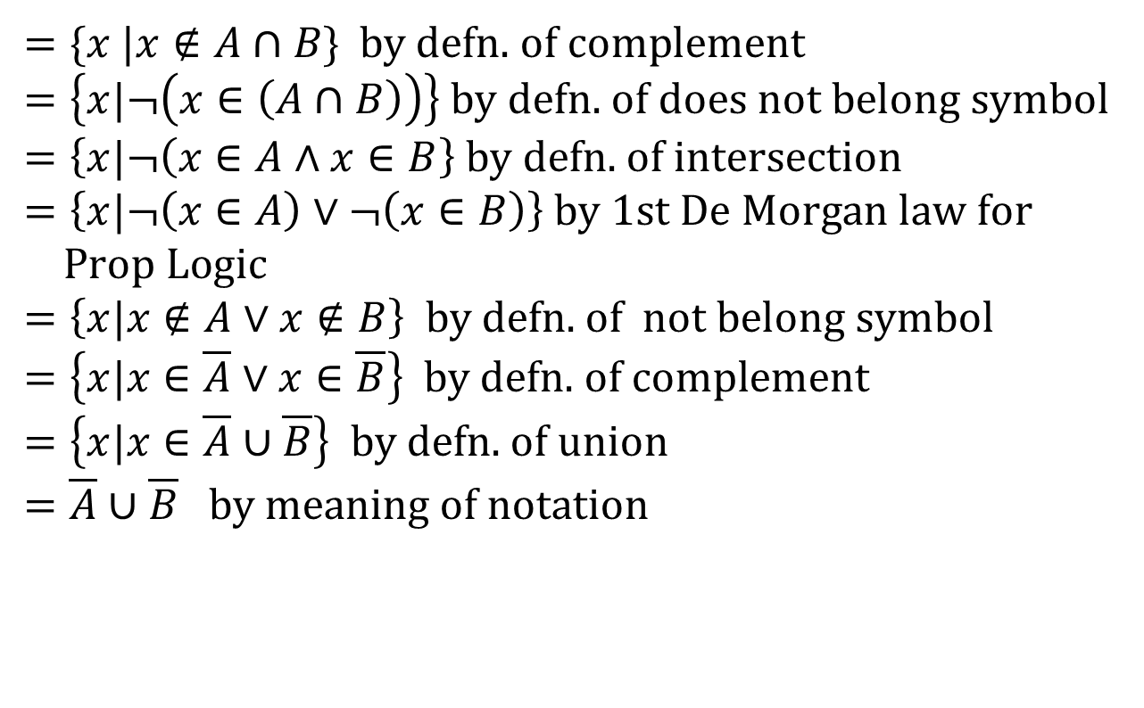
Set-Builder Notation: Second De Morgan Law
$$\overline{A∩B}$$
$$=\{x |x∉A∩B \} \text{by} \text{defn}\text{. }\text{of} \text{complement} \\ =\left\{x|¬\left(x∈\left(A∩B\right)\right)\right\} \text{by} \text{defn}\text{. }\text{of} \text{does} \text{not} \text{belong} \text{symbol} \\ =\left\{x|¬\left(x∈A∧x∈B\right.\right\} \text{by} \text{defn}\text{. }\text{of} \text{intersection} \\ =\left\{x|¬\left(x∈A\right)∨¬\left(x∈B\right)\right\} \text{by}\text{ 1}\text{st} \text{De} \text{Morgan} \text{law} \text{for} \\ \text{Prop} \text{Logic} \\ =\left\{x|x∉A∨x∉B\right\} \text{by} \text{defn}\text{. }\text{of} \text{not} \text{belong} \text{symbol} \\ =\left\{x|x∈\overline{A}∨x∈\overline{B}\right\} \text{by} \text{defn}\text{. }\text{of} \text{complement} \\ =\left\{x|x∈\overline{A}∪\overline{B}\right\} \text{by} \text{defn}\text{. }\text{of} \text{union} \\ =\overline{A}∪\overline{B} \text{by} \text{meaning} \text{of} \text{notation}$$

Slide 43
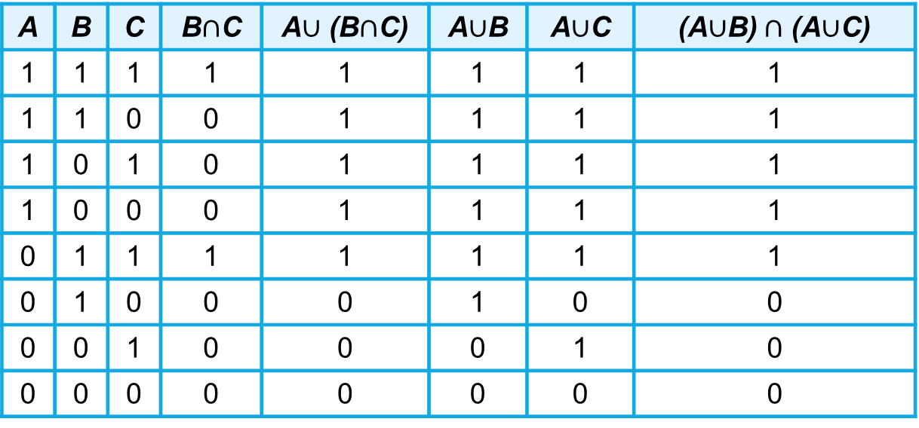
Membership Table
Example: Construct a membership table to show that the distributive law holds.
Solution:
A | B | C | B$∩$C | A$∪$ (B$∩$C) | A$∪$B | A$∪$C | (A$∪$B)$∩$ (A$∪$C)
1 | 1 | 1 | 1 | 1 | 1 | 1 | 1
1 | 1 | 0 | 0 | 1 | 1 | 1 | 1
1 | 0 | 1 | 0 | 1 | 1 | 1 | 1
1 | 0 | 0 | 0 | 1 | 1 | 1 | 1
0 | 1 | 1 | 1 | 1 | 1 | 1 | 1
0 | 1 | 0 | 0 | 0 | 1 | 0 | 0
0 | 0 | 1 | 0 | 0 | 0 | 1 | 0
0 | 0 | 0 | 0 | 0 | 0 | 0 | 0

Slide 44
Review of §2.1-2.2
Sets S, T, U… Special sets N, Z, R.
Set notations {a,b,...}, {x|P(x)}…
Relations x∈S, S⊆T, S⊇T, S=T, S⊂T, S⊃T.
Operations |S|, P(S), ×, ∪, ∩, −,
Set equality proof techniques:
Mutual subsets.
Derivation using logical equivalences.

Slide 45
Generalized Unions & Intersections
Since union & intersection are commutative and associative, we can extend them from operating on ordered pairs of sets (A,B) to operating on sequences of sets (A₁,…,A_{n}), or even on unordered sets of sets, X={A | P(A)}.

Slide 46

Generalized Union
Binary union operator: A∪B
n-ary union: A∪A₂∪…∪A_{n} :≡ ((…((A₁∪ A₂) ∪…)∪ A_{n}) (grouping & order is irrelevant)
“Big U” notation:
$$\bigcup_{i=1}^{n}{A_{i}}$$

Slide 47

Generalized Intersection
Binary intersection operator: A∩B
n-ary intersection: A₁∩A₂∩…∩A_{n}≡((…((A₁∩A₂)∩…)∩A_{n}) (grouping & order is irrelevant)
“Big Arch” notation:
$$\bigcap_{i=1}^{n}{A_{i}}$$

Slide 48
Representations
A frequent theme of this course will be methods of representing one discrete structure using another discrete structure of a different type.
E.g., one can represent natural numbers as
Sets: 0:≡∅, 1:≡{0}, 2:≡{0,1}, 3:≡{0,1,2}, …
Bit strings: 0:≡0, 1:≡1, 2:≡10, 3:≡11, 4:≡100, …

Slide 49
Representing Sets with Bit Strings
For an enumerable u.d. U with ordering x₁, x₂, …, represent a finite set S⊆U as the finite bit string B=b₁b₂…b_{n} where ∀i: x_{i}∈S ↔ (i<n ∧ b_{i}=1).
E.g. U=N, S={2,3,5,7,11}, B=001101010001.
In this representation, the set operators “∪”, “∩”, “‾ ” are implemented directly by bitwise OR, AND, NOT!
Notes:
So, for example, on a 64-bit processor, using just a single machine-language instruction you can calculate the union or intersection of two sets out of a universe of discourse having up to 64 elements. This leads to an extremely fast way of doing complicated calculations on small sets. It is not a good method for large, sparsely populated sets, because searching the bit string to find which bits are “1” can take a long time.

Slide 50
EXAMPLE 20 ：The bit strings for the sets {1, 2, 3, 4, 5} and {1, 3, 5, 7, 9} are 11 1110 0000 and 10 1010 1010, respectively. Use bit strings to find the union and intersection of these sets.
Solution: The bit string for the union of these sets is
11 1110 0000 ∨ 10 1010 1010 = 11 1110 1010,
which corresponds to the set {1, 2, 3, 4, 5, 7, 9}.
The bit string for the intersection of these sets is
11 1110 0000 ∧ 10 1010 1010 = 10 1010 0000,
which corresponds to the set {1, 3, 5}.

Slide 51
Homework
2.1 19, 27, 29
2.2 4, 14, 20, 29, 37
Due date : 2024.03.26

