Slide 1
Functions
Section 2.3

Slide 2
Section Summary
Definition of a Function.
Domain, Codomain
Image, Preimage
Injection, Surjection, Bijection
Inverse Function
Function Composition
Graphing Functions
Floor, Ceiling, Factorial
Partial Functions

Slide 3
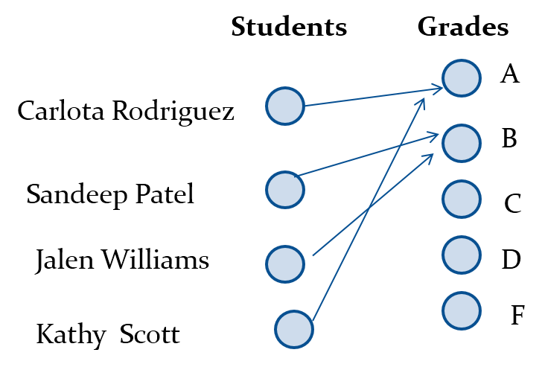
Functions 函数
Definition: Let A and B be nonempty sets. A function f from A to B, denoted f: A → B is an assignment of each element of A to exactly one element of B. We write f(a) = b if b is the unique element of B assigned by the function f to the element a of A.
Functions are sometimes called mappings or transformations.

Slide 4
Functions 函数
A function f: A → B can also be defined as a subset of A×B (a relation). This subset is restricted to be a relation where no two elements of the relation have the same first element.
Specifically, a function f from A to B contains one, and only one ordered pair (a, b) for every element a∈ A.
and

Slide 5
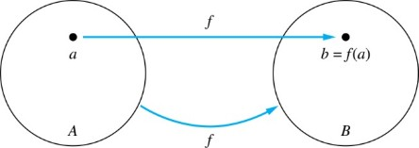
Functions 函数
Given a function f: A → B:
We say f maps A to B or f is a mapping from A to B.
A is called the domain (定义域) of f.
B is called the codomain (陪域) of f.
If f(a) = b,
then b is called the image (像) of a under f.
a is called the preimage (原像) of b.
The range of f is the set of all images of points in A under f. We denote it by f(A).
Two functions are equal when they have the same domain, the same codomain and map each element of the domain to the same element of the codomain.

Slide 6
Representing Functions
Functions may be specified in different ways:
An explicit statement of the assignment. Students and grades example.
A formula.
A computer program.
A Java program that when given an integer n, produces the nth Fibonacci Number (covered in the next section and also in Chapter 5).

Slide 7
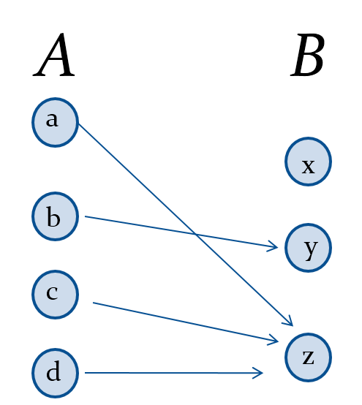
Questions
f(a) = ?
z
The image of d is ?
z
The domain of f is ?
A
The codomain of f is ?
B
The preimage of y is ?
b
f(A) = ?
{y,z}
The preimage(s) of z is (are) ?
{a,c,d}

Slide 8
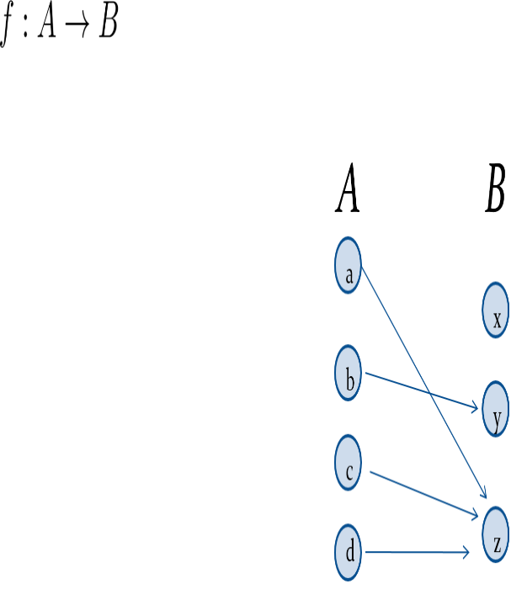
Question on Functions and Sets
If
and S is a subset of A, then
f {a,b,c,} is ?
{y,z}
f {c,d} is ?
{z}

Slide 9
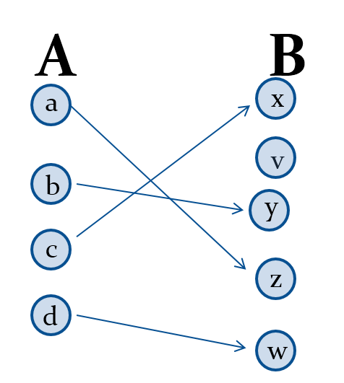

Injections 单射函数
Definition: A function f is said to be one-to-one , or injective, if and only if f(a) = f(b) implies that a = b for all a and b in the domain of f. A function is said to be an injection if it is one-to-one.

Slide 10
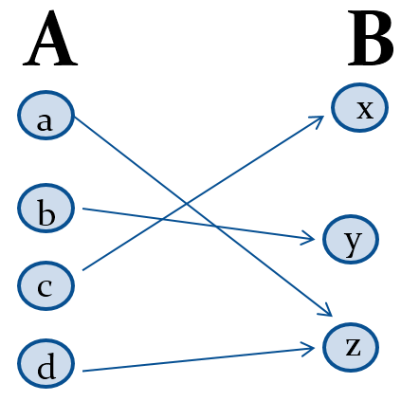
Surjections 满射函数
Definition: A function f from A to B is called onto or surjective, if and only if for every element
there is an element
with
A function f is called a surjection if it is onto.

Slide 11
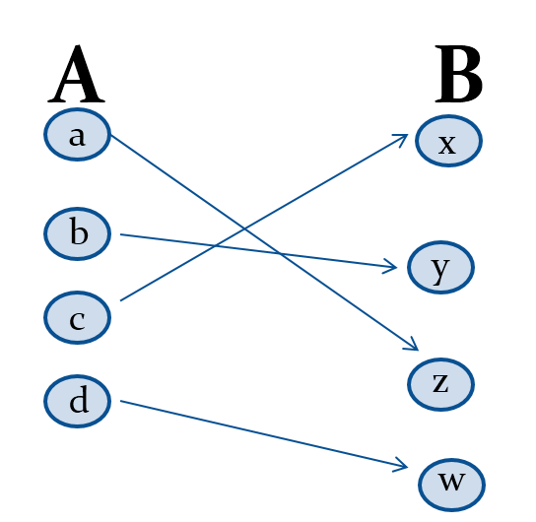
Bijections 双射函数
Definition: A function f is a one-to-one correspondence, or a bijection if it is both one-to-one and onto (surjective and injective).

Slide 12
Showing that f is one-to-one or onto 1
Suppose that f : A → B.
To show that f is injective Show that if f (x) = f (y) for arbitrary x, y ∈ A, then x = y.
To show that f is not injective Find particular elements x, y ∈ A such that x ≠ y and f (x) = f (y).
To show that f is surjective Consider an arbitrary element y ∈ B and find an element x ∈ A such that f (x) = y.
To show that f is not surjective Find a particular y ∈ B such that f (x) ≠ y for all x ∈ A.

Slide 13
Showing that f is one-to-one or onto 2
Example 1: Let f be the function from {a,b,c,d} to {1,2,3} defined by f(a) = 3, f(b) = 2, f(c) = 1, and f(d) = 3. Is f an onto function?
Solution: Yes, f is onto since all three elements of the codomain are images of elements in the domain. If the codomain were changed to {1,2,3,4}, f would not be onto.
Example 2: Is the function f(x) = x² from the set of integers to the set of integers onto?
Solution: No, f is not onto because there is no integer x with x² = −1, for example.

Slide 14
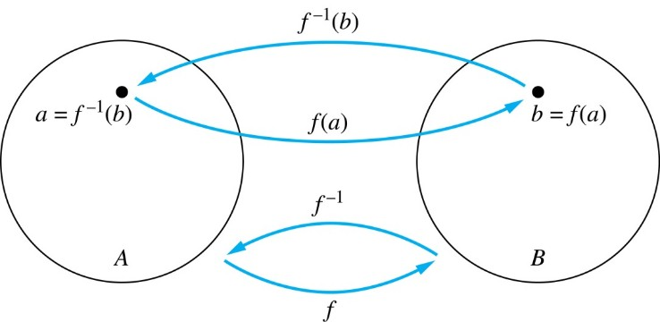
Inverse Functions 反函数
Definition: Let f be a bijection from A to B. Then the inverse of f, denoted
is the function from
B to A defined as
No inverse exists unless f is a bijection. Why?

Slide 15
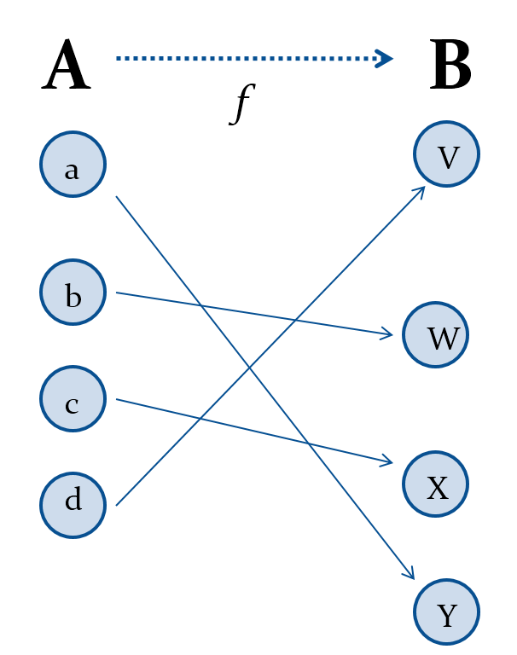
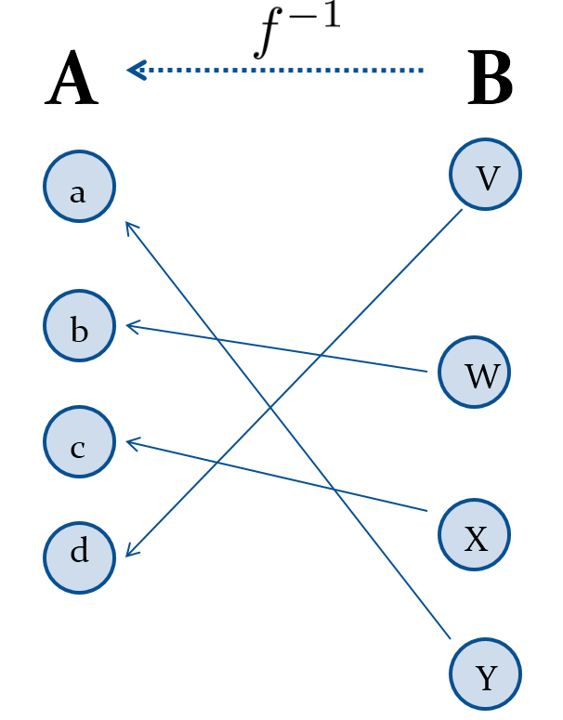
Inverse Functions

Slide 16
Questions
Example 1: Let f be the function from {a,b,c} to {1,2,3} such that f(a) = 2, f(b) = 3, and f(c) = 1. Is f invertible and if so what is its inverse?
Solution: The function f is invertible because it is a one-to-one correspondence. The inverse function f⁻¹ reverses the correspondence given by f, so f⁻¹ (1) = c, f⁻¹ (2) = a, and f⁻¹ (3) = b.

Slide 17
Questions
Example 2: Let f: Z → Z be such that f(x) = x + 1. Is f invertible, and if so, what is its inverse?
Solution: The function f is invertible because it is a one-to-one correspondence. The inverse function f⁻¹ reverses the correspondence so f⁻¹ (y) = y −1.

Slide 18
Questions
Example 3: Let f: R → R be such that
Is f invertible, and if so, what is its inverse?
Solution: The function f is not invertible because it is not one-to-one.

Slide 19
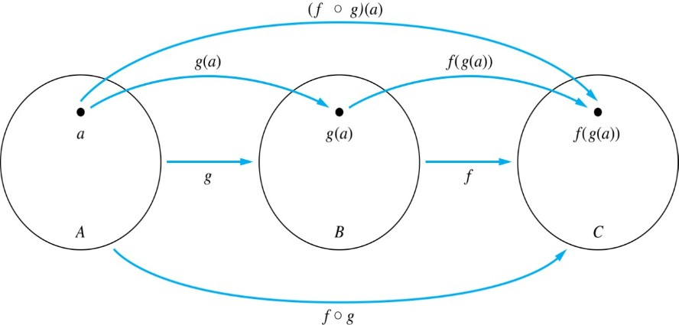
Composition 复合函数
Definition: Let f: B→C, g: A→B. The composition of f with g, denoted
is the function from A to C defined by

Slide 20
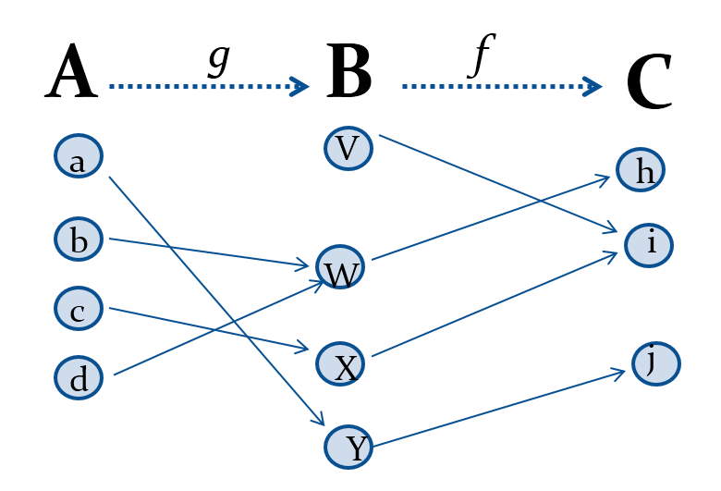
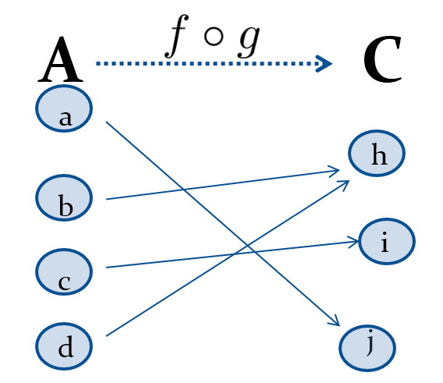
Composition 复合函数

Slide 21
Composition 复合函数
Example 1: If

Slide 22
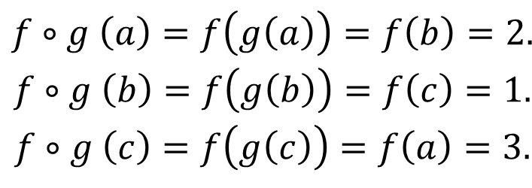
Composition Questions
Example 2: Let g be the function from the set {a,b,c} to itself such that g(a) = b, g(b) = c, and g(c) = a. Let f be the function from the set {a,b,c} to the set {1,2,3} such that f(a) = 3, f(b) = 2, and f(c) = 1.
What is the composition of f and g, and what is the composition of g and f.
Solution: The composition f∘g is defined by
$$\begin{matrix}f∘g \left(a\right)=f\left(g\left(a\right)\right)=f\left(b\right)=2. \\ f∘g \left(b\right)=f\left(g\left(b\right)\right)=f\left(c\right)=1. \\ f∘g \left(c\right)=f\left(g\left(c\right)\right)=f\left(a\right)=3.\end{matrix}$$
Note that g∘ f is not defined, because the range of f is not a subset of the domain of g.

Slide 23
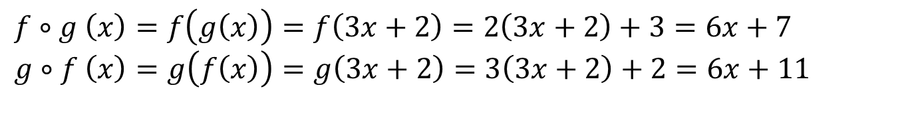
Composition Questions
Example 2: Let f and g be functions from the set of integers to the set of integers defined by
What is the composition of f and g, and also the composition of g and f ?
Solution:
$$f∘g \left(x\right)=f\left(g\left(x\right)\right)=f\left(3x+2\right)=2\left(3x+2\right)+3=6x+7 \\ g∘f \left(x\right)=g\left(f\left(x\right)\right)=g\left(3x+2\right)=3\left(3x+2\right)+2=6x+11$$

Slide 24
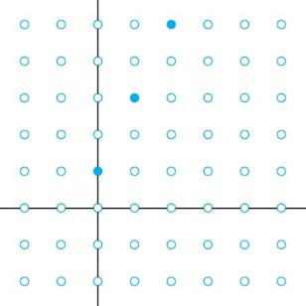
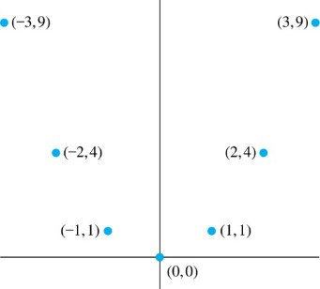
Graphs of Functions
Let f be a function from the set A to the set B. The graph of the function f is the set of ordered pairs
Graph of f(n) = 2n + 1 from Z to Z
Graph of f(x) = x² from Z to Z

Slide 25
Some Important Functions
The floor function, denoted
is the largest integer less than or equal to x.
The ceiling function, denoted
is the smallest integer greater than or equal to x
Example:

Slide 26
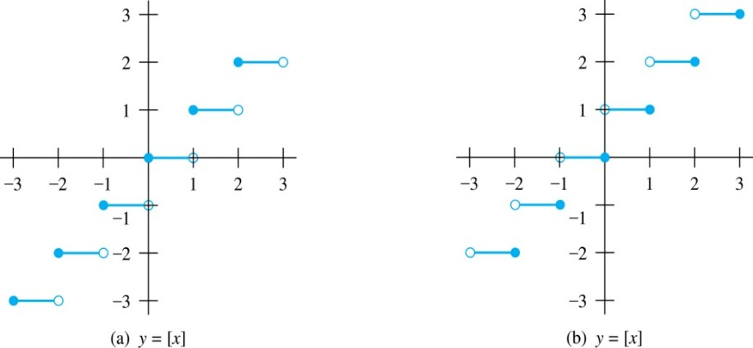
Floor and Ceiling Functions
Graph of (a) Floor and (b) Ceiling Functions

Slide 27
Floor and Ceiling Functions
TABLE 1 Useful Properties of the Floor and Ceiling Functions. (n is an integer, x is a real number)

Slide 28
Proving Properties of Functions
Example: Prove that x is a real number, then ⌊2x⌋= ⌊x⌋ + ⌊x + 1/2⌋
Solution: Let x = n + ε, where n is an integer and 0 ≤ ε< 1.
Case 1: ε < ½
2x = 2n + 2ε and ⌊2x⌋ = 2n, since 0 ≤ 2ε< 1.
⌊x + 1/2⌋ = n, since x + ½ = n + (1/2 + ε ) and 0 ≤ ½ +ε < 1.
Hence, ⌊2x⌋ = 2n and ⌊x⌋ + ⌊x + 1/2⌋ = n + n = 2n.
Case 2: ε ≥ ½
2x = 2n + 2ε = (2n + 1) +(2ε − 1) and ⌊2x⌋ =2n + 1, since 0 ≤ 2 ε − 1< 1.
⌊x + 1/2⌋ = ⌊ n + (1/2 + ε)⌋ = ⌊ n + 1 + (ε – 1/2)⌋ = n + 1 since 0 ≤ ε − 1/2< 1.
Hence, ⌊2x⌋ = 2n + 1 and ⌊x⌋ + ⌊x + 1/2⌋ = n + (n + 1) = 2n + 1.

Slide 29
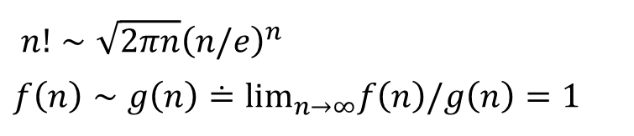
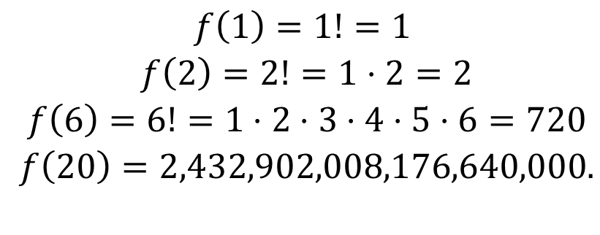
Factorial Function 阶乘函数
Definition: f: N → Z⁺ , denoted by f(n) = n! is the product of the first n positive integers when n is a nonnegative integer.
$$f\left(n\right)=1⋅2⋅⋅⋅ \left(n–1\right)⋅n, f\left(0\right)=0!=1$$
Stirling’s Formula:
Examples:
$$n!∼\sqrt{2πn}{\left(n/e\right)}^{n} \\ f\left(n\right)∼g\left(n\right)≐lim_{n→∞}f\left(n\right)/g\left(n\right)=1$$
$$\begin{matrix}f\left(1\right)=1!=1 \\ f\left(2\right)=2!=1⋅2=2 \\ f\left(6\right)=6!=1⋅2⋅3⋅4⋅5⋅6=720 \\ f\left(20\right)=2,432,902,008,176,640,000.\end{matrix}$$

Slide 30
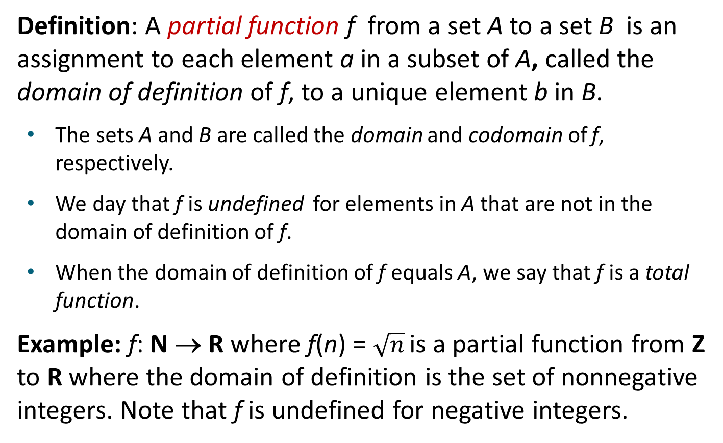
Partial Functions
Definition: A partial function f from a set A to a set B is an assignment to each element a in a subset of A, called the domain of definition of f, to a unique element b in B.
The sets A and B are called the domain and codomain of f, respectively.
We day that f is undefined for elements in A that are not in the domain of definition of f.
When the domain of definition of f equals A, we say that f is a total function.
Example: f: N → R where f(n) = $\sqrt{n}$ is a partial function from Z to R where the domain of definition is the set of nonnegative integers. Note that f is undefined for negative integers.

Slide 31
Sequences and Summations
Section 2.4

Slide 32
Section Summary
Sequences.
Examples: Geometric Progression, Arithmetic Progression
Recurrence Relations
Example: Fibonacci Sequence
Summations
Special Integer Sequences

Slide 33
Introduction
Sequences are ordered lists of elements.
1, 2, 3, 5, 8
1, 3, 9, 27, 81, …….
Sequences arise throughout mathematics, computer science, and in many other disciplines, ranging from botany to music.
We will introduce the terminology to represent sequences and sums of the terms in the sequences.

Slide 34
Sequences 序列
Definition: A sequence is a function from a subset of the integers (usually either the set {0, 1, 2, 3, 4, …..} or {1, 2, 3, 4, ….}) to a set S.
The notation a_{n} is used to denote the image of the integer n. We can think of a_{n} as the equivalent of f(n) where f is a function from {0,1,2,…..} to S. We call a_{n} a term of the sequence.

Slide 35
Sequences 序列
Example: Consider the sequence {a_{n}} where

Slide 36

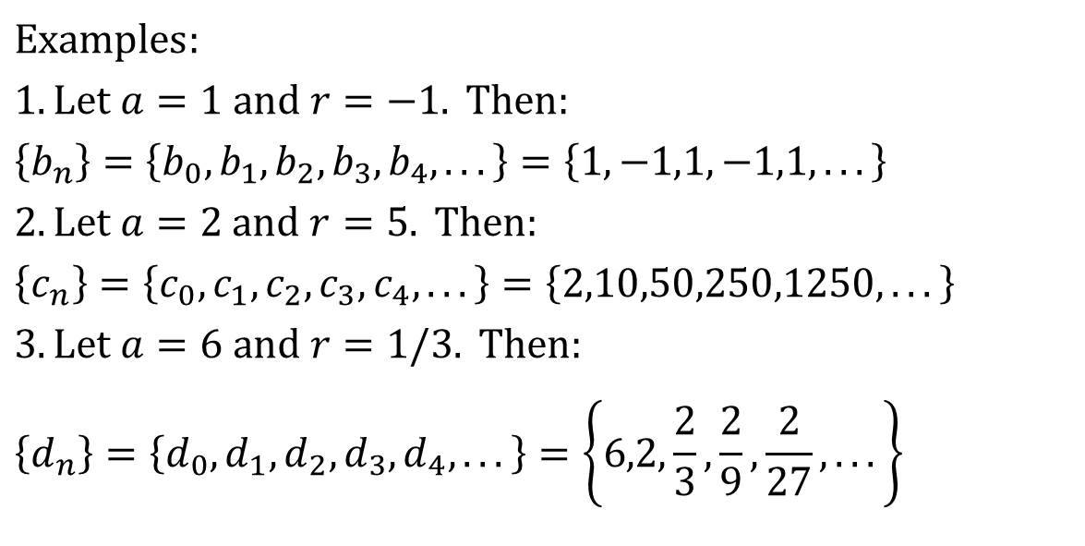
Geometric Progression 几何级数
Definition: A geometric progression is a sequence of the form:
$$a,ar^{1},ar^{2},…,ar^{n},…$$
where the initial term a and the common ratio r are real numbers.
$$Examples: \\ 1.\text{Let} a=1 \text{and} r=−1. \text{Then}: \\ \left\{b_{n}\right\}=\left\{b_{0},b_{1},b_{2},b_{3},b_{4},...\right\}=\left\{1,−1,1,−1,1,...\right\} \\ 2.\text{Let} a=2 \text{and} r=5. \text{Then}: \\ \left\{c_{n}\right\}=\left\{c_{0},c_{1},c_{2},c_{3},c_{4},...\right\}=\left\{2,10,50,250,1250,...\right\} \\ 3.\text{Let} a=6 \text{and} r=1/3. \text{Then}: \\ \left\{d_{n}\right\}=\left\{d_{0},d_{1},d_{2},d_{3},d_{4},...\right\}=\left\{6,2,\frac{2}{3},\frac{2}{9},\frac{2}{27},...\right\}$$

Slide 37
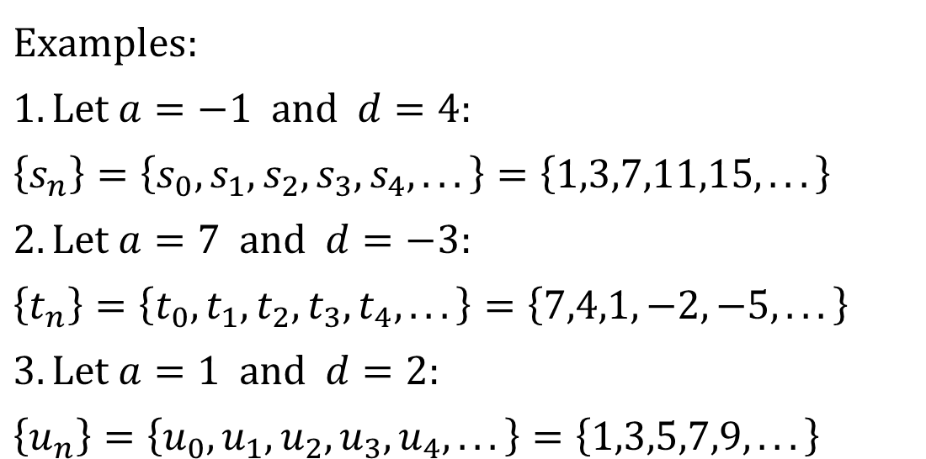
Arithmetic Progression 算数级数
Definition: A arithmetic progression is a sequence of the form:
where the initial term a and the common difference d are real numbers.
$$Examples: \\ 1.\text{Let} a=−1 \text{and} d=4: \\ \left\{s_{n}\right\}=\left\{s_{0},s_{1},s_{2},s_{3},s_{4},...\right\}=\left\{1,3,7,11,15,...\right\} \\ 2.\text{Let} a=7 \text{and} d=−3: \\ \left\{t_{n}\right\}=\left\{t_{0},t_{1},t_{2},t_{3},t_{4},...\right\}=\left\{7,4,1,−2,−5,...\right\} \\ 3.\text{Let} a=1 \text{and} d=2: \\ \left\{u_{n}\right\}=\left\{u_{0},u_{1},u_{2},u_{3},u_{4},...\right\}=\left\{1,3,5,7,9,...\right\}$$

Slide 38
Strings
Definition: A string is a finite sequence of characters from a finite set (an alphabet).
Sequences of characters or bits are important in computer science.
The empty string is represented by λ.
The string abcde has length 5.

Slide 39
Recurrence Relations 递推关系
Definition: A recurrence relation for the sequence {a_{n}} is an equation that expresses a_{n} in terms of one or more of the previous terms of the sequence, namely, a₀, a₁, …, a_{n−1}, for all integers n with n ≥ n₀, where n₀ is a nonnegative integer.
A sequence is called a solution of a recurrence relation if its terms satisfy the recurrence relation.
The initial conditions for a sequence specify the terms that precede the first term where the recurrence relation takes effect.

Slide 40
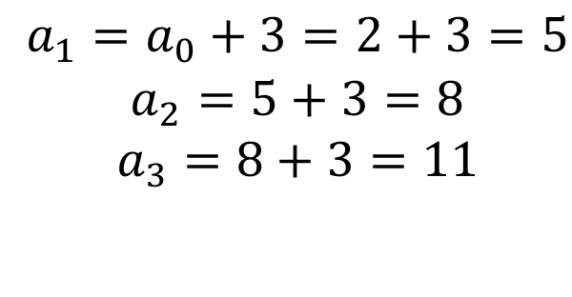
Questions about Recurrence Relations 1
Example 1: Let {a_{n}} be a sequence that satisfies the recurrence relation a_{n} = a_{n−1} + 3 for n = 1,2,3,4,…. and suppose that a₀ = 2. What are a₁ , a₂ and a₃?
[Here a₀ = 2 is the initial condition.]
Solution: We see from the recurrence relation that
$$\begin{matrix} a_{1}=a_{0}+3=2+3=5 \\ a_{2}=5+3=8 \\ a_{3}=8+3=11\end{matrix}$$

Slide 41
Questions about Recurrence Relations 2
Example 2: Let {a_{n}} be a sequence that satisfies the recurrence relation a_{n} = a_{n-1} – a_{n-2} for n = 2,3,4,…. and suppose that a₀ = 3 and a₁ = 5. What are a₂ and a₃?
[Here the initial conditions are a₀ = 3 and a₁ = 5. ]
Solution: We see from the recurrence relation that

Slide 42
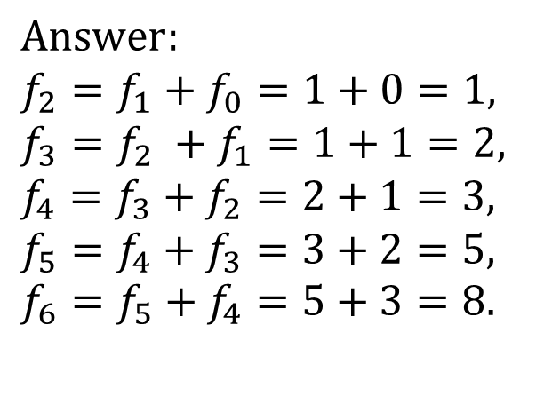
Fibonacci Sequence 斐波那契数列
Definition: Define the Fibonacci sequence, f₀ ,f₁ ,f₂,…, by:
Initial Conditions: f₀ = 0, f₁ = 1
Recurrence Relation: f_{n} = f_{n−1} + f_{n−2}
Example: Find f₂ ,f₃ ,f₄ , f₅ and f₆ .
$$Answer: \\ f_{2}=f_{1}+f_{0}=1+0=1, \\ f_{3}=f_{2} +f_{1}=1+1=2, \\ f_{4}=f_{3}+f_{2}=2+1=3, \\ f_{5}=f_{4}+f_{3}=3+2=5, \\ f_{6}=f_{5}+f_{4}=5+3=8.$$

Slide 43
Solving Recurrence Relations
Finding a formula for the nth term of the sequence generated by a recurrence relation is called solving the recurrence relation.
Such a formula is called a closed formula.
Various methods for solving recurrence relations will be covered in Chapter 8 where recurrence relations will be studied in greater depth.
Here we illustrate by example the method of iteration in which we need to guess the formula. The guess can be proved correct by the method of induction (Chapter 5).

Slide 44
Iterative Solution Example
Method 1: Working upward, forward substitution Let {a_{n}} be a sequence that satisfies the recurrence relation a_{n} = a_{n−1} + 3 for n = 2,3,4,…. and suppose that a₁ = 2.
a₂ = 2 + 3
a₃ = (2 + 3) + 3 = 2 + 3 ∙ 2
a₄ = (2 + 2 ∙ 3) + 3 = 2 + 3 ∙ 3
.
.
. a_{n} = a_{n-1} + 3 = (2 + 3 ∙ (n – 2)) + 3 = 2 + 3(n − 1)

Slide 45
Iterative Solution Example
Method 2: Working downward, backward substitution Let {a_{n}} be a sequence that satisfies the recurrence relation a_{n} = a_{n−1} + 3 for n = 2,3,4,…. and suppose that a₁ = 2.
a_{n} = a_{n-1} + 3
= (a_{n-2} + 3) + 3 = a_{n-2} + 3 ∙ 2
= (a_{n-3} + 3 )+ 3 ∙ 2 = a_{n-3} + 3 ∙ 3
.
.
.
= a₂ + 3(n − 2) = (a₁ + 3) + 3(n − 2) = 2 + 3(n − 1)

Slide 46
Financial Application
Example: Suppose that a person deposits $10,000.00 in a savings account at a bank yielding 11% per year with interest compounded annually. How much will be in the account after n years?
Let P_{n} denote the amount in the account after n years. P_{n} satisfies the following recurrence relation:
P_{n} = P_{n−1} + 0.11P_{n−1} = (1.11) P_{n−1}
with the initial condition P₀ = 10,000

Slide 47
Financial Application
P_{n} = P_{n−1} + 0.11P_{n−1} = (1.11) P_{n−1}
with the initial condition P₀ = 10,000
Solution: Forward Substitution
P₁ = (1.11)P₀
P₂ = (1.11)P₁ = (1.11)²P₀
P₃ = (1.11)P₂ = (1.11)³P₀
:
P_{n} = (1.11)P_{n−1} = (1.11)^{n}P₀ = (1.11)^{n} 10,000
P_{n} = (1.11)^{n} 10,000 (Can prove by induction, covered in Chapter 5)
P₃₀ = (1.11)³⁰ 10,000 = $228,992.97

Slide 48
Special Integer Sequences
Given a few terms of a sequence, try to identify the sequence. Conjecture a formula, recurrence relation, or some other rule.
Some questions to ask?
Are there repeated terms of the same value?
Can you obtain a term from the previous term by adding an amount or multiplying by an amount?
Can you obtain a term by combining the previous terms in some way?
Are they cycles among the terms?
Do the terms match those of a well known sequence?

Slide 49
Questions on Special Integer Sequences
Example 1: Find formulae for the sequences with the following first five terms: 1, ½, ¼, 1/8, 1/16
Solution: Note that the denominators are powers of 2. The sequence with a_{n} = 1/2^{n} is a possible match. This is a geometric progression with a = 1 and r = ½.
Example 2: Consider 1,3,5,7,9
Solution: Note that each term is obtained by adding 2 to the previous term. A possible formula is a_{n} = 2n + 1. This is an arithmetic progression with a =1 and d = 2.
Example 3: 1, -1, 1, -1,1
Solution: The terms alternate between 1 and -1. A possible sequence is a_{n} = (−1)^{n} . This is a geometric progression with a = 1 and r = −1.

Slide 50
Questions on Special Integer Sequences
TABLE 1 Some Useful Sequences.
nth Term | First 10 Terms
n² n³ n⁴ f_{n} 2^{n} 3^{n} n! | 1, 4, 9, 16, 25, 36, 49, 64, 81, 100,… 1, 8, 27, 64, 125, 216, 343, 512, 729, 1000,… 1, 16, 81, 256, 625, 1296, 2401, 4096, 6561, 10000,… 1, 1, 2, 3, 5, 8, 13, 21, 34, 55, 89,… 2, 4, 8, 16, 32, 64, 128, 256, 512, 1024,… 3, 9, 27, 81, 243, 729, 2187, 6561, 19683, 59049,… 1, 2, 6, 24, 120, 720, 5040, 40320, 362880, 3628800,…

Slide 51
Guessing Sequences
Example: Conjecture a simple formula for a_{n} if the first 10 terms of the sequence {a_{n}} are 1, 7, 25, 79, 241, 727, 2185, 6559, 19681, 59047.
Solution: Note the ratio of each term to the previous approximates 3. So now compare with the sequence 3^{n} . We notice that the nth term is 2 less than the corresponding power of 3. So a good conjecture is that a_{n} = 3^{n} − 2.

Slide 52
Integer Sequences
Integer sequences appear in a wide range of contexts. Later we will see the sequence of prime numbers (Chapter 4), the number of ways to order n discrete objects (Chapter 6), the number of moves needed to solve the Tower of Hanoi puzzle with n disks (Chapter 8), and the number of rabbits on an island after n months (Chapter 8).
Integer sequences are useful in many fields such as biology, engineering, chemistry and physics.
On-Line Encyclopedia of Integer Sequences (OESIS) contains over 200,000 sequences. Began by Neil Stone in the 1960s (printed form). Now found at http://oeis.org/Spuzzle.html

Slide 53
Integer Sequences
Here are three interesting sequences to try from the OESIS site. To solve each puzzle, find a rule that determines the terms of the sequence.
Guess the rules for forming for the following sequences:
2, 3, 3, 5, 10, 13, 39, 43, 172, 177, ...
Hint: Think of adding and multiplying by numbers to generate this sequence.
0, 0, 0, 0, 4, 9, 5, 1, 1, 0, 55, ...
Hint: Think of the English names for the numbers representing the position in the sequence and the Roman Numerals for the same number.
2, 4, 6, 30, 32, 34, 36, 40, 42, 44, 46, ...
Hint: Think of the English names for numbers, and whether or not they have the letter ‘e.’
The answers and many more can be found at http://oeis.org/Spuzzle.html

Slide 54
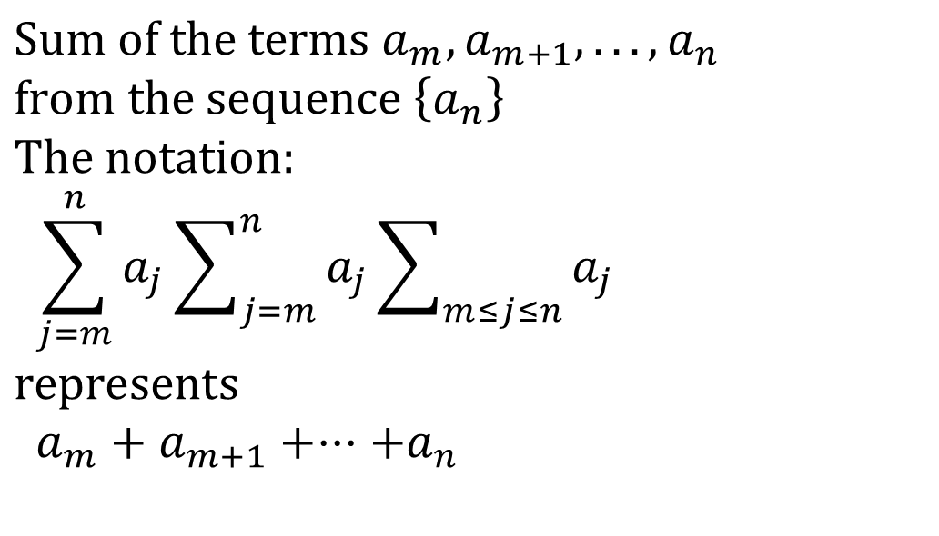
Summations
$$\text{Sum} \text{of} \text{the} \text{terms} a_{m},a_{m+1},...,a_{n} \\ \text{from} \text{the} \text{sequence} \left\{a_{n}\right\} \\ \text{The} \text{notation}\text{:} \\ \sum_{j=m}^{n}{a_{j}}\sum_{j=m}^{n}{a_{j}}\sum_{m≤j≤n}{a_{j}} \\ \text{represents} \\ a_{m}+a_{m+1}+⋅⋅⋅+a_{n}$$
The variable j is called the index of summation. It runs through all the integers starting with its lower limit m and ending with its upper limit n.

Slide 55
Summations

Slide 56
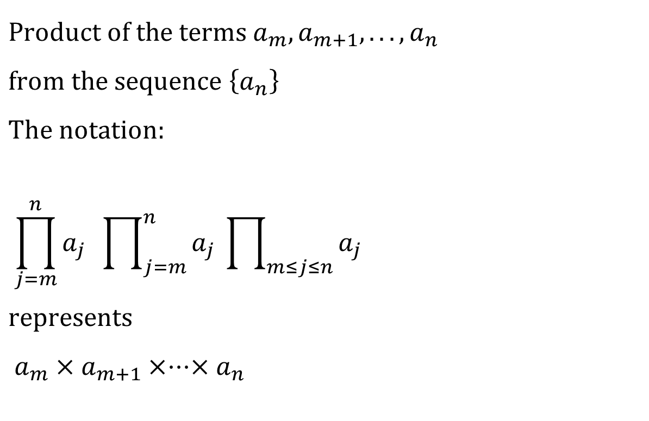
Product Notation
$$\text{Product} \text{of} \text{the} \text{terms} a_{m},a_{m+1},...,a_{n} \\ \text{from} \text{the} \text{sequence} \left\{a_{n}\right\} \\ \text{The} \text{notation}\text{:} \\ \prod_{j=m}^{n}{a_{j}} \prod_{j=m}^{n}{a_{j}} \prod_{m≤j≤n}{a_{j}} \\ \text{represents} \\ a_{m}×a_{m+1}×⋅⋅⋅×a_{n}$$

Slide 57
Geometric Series 1
Sums of terms of geometric progressions
Proof: Let
To compute S_{n} , first multiply both sides of the equality by r and then manipulate the resulting sum as follows:

Slide 58
Geometric Series
From previous slide.
Shifting the index of summation with k = j + 1.
Removing k = n + 1 term and adding k = 0 term.
Substituting S for summation formula
if r ≠1
if r = 1

Slide 59
Some Useful Summation Formulae
TABLE 2 Some Useful Summation Formulae.
Sum | Closed From
Geometric Series: We just proved this.
Later we will prove some of these by induction.
Proof in text (requires calculus)

Slide 60
Homework
§2.3 8, 20, 24, 33
§2.4 16, 26, 30, 34
Due date : 2024.03.26

