Slide 1
Chapter 3: Algorithms

Slide 2
Chapter Summary
Algorithms
Example Algorithms
Algorithmic Paradigms
Growth of Functions
Big-O and other Notation
Complexity of Algorithms

Slide 3
Section Summary 1
Properties of Algorithms
Algorithms for Searching and Sorting
Greedy Algorithms

Slide 4
Problems and Algorithms
Problems: In many domains there are key general problems that ask for output with specific properties when given valid input.
Notation: The first step is to precisely state the problem, using the appropriate structures to specify the input and the desired output.
Algorithm: We then solve the general problem by specifying the steps of a procedure that takes a valid input and produces the desired output. This procedure is called an algorithm.

Slide 5
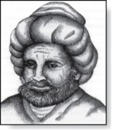
Algorithms
Abu Ja’far Mohammed Ibin Musa Al-Khowarizmi
(780-850)
Definition: An algorithm is a finite set of precise instructions for performing a computation or for solving a problem.
Example: Describe an algorithm for finding the maximum value in a finite sequence of integers.
Solution: Perform the following steps:
Set the temporary maximum equal to the first integer in the sequence.
Compare the next integer in the sequence to the temporary maximum.
If it is larger than the temporary maximum, set the temporary maximum equal to this integer.
Repeat the previous step if there are more integers. If not, stop.
When the algorithm terminates, the temporary maximum is the largest integer in the sequence.

Slide 6
Specifying Algorithms
pseudocode :Algorithms can be specified in different ways. Their steps can be described in English or in pseudocode (伪代码). Pseudocode is an intermediate step between an English language description of the steps and a coding of these steps using a programming language.
C++ and Java as a pseudocode : The form of pseudocode we use is specified in Appendix 3. It uses some of the structures found in popular languages such as C++ and Java.

Slide 7
Properties of Algorithms
Input: An algorithm has input values from a specified set.
Output: From the input values, the algorithm produces the output values from a specified set. The output values are the solution.
Correctness: An algorithm should produce the correct output values for each set of input values.
Finiteness: An algorithm should produce the output after a finite number of steps for any input.
Effectiveness: It must be possible to perform each step of the algorithm correctly and in a finite amount of time.
Generality: The algorithm should work for all problems of the desired form.

Slide 8
Finding the Maximum Element in a Finite Sequence
The algorithm in pseudocode:
Pseudocode
procedure max (a₁, a₂, …., a_{n}: integers)
max := a₁
for i := 2 to n
if max < a_{i} then max := a_{i}
return max{max is the largest element}
Does this algorithm have all the properties listed on the previous slide?

Slide 9
Some Example Algorithm Problems
Three classes of problems will be studied in this section.
Searching Problems: finding the position of a particular element in a list.【搜索问题】
Sorting problems: putting the elements of a list into increasing order.【排序问题】
Optimization Problems: determining the optimal value (maximum or minimum) of a particular quantity over all possible inputs.【优化问题】

Slide 10
Section Summary 1
Properties of Algorithms
Algorithms for Searching and Sorting
Greedy Algorithms

Slide 11
Searching Problems
Definition: The general searching problem is to locate an element x in the list of distinct elements a₁, a₂, ..., a_{n}, or determine that it is not in the list.
Solution: The solution to a searching problem is the location of the term in the list that equals x (that is, i is the solution if x = a_{i}) or 0 if x is not in the list.

Slide 12
Linear Search Algorithm
The linear search algorithm locates an item in a list by examining elements in the sequence one at a time, starting at the beginning.
First compare x with a₁. If they are equal, return the position 1.
If not, try a₂. If x = a₂, return the position 2.
Keep going, and if no match is found when the entire list is scanned, return 0.
Pseudocode
procedure linear search(x: integer, a₁, a₂, …, a_{n}: distinct integers)
i := 1
while (i ≤ n and x ≠ a_{i})
i := i + 1
if i ≤ n then location := i
else location := 0
return location{location is the subscript of the term that equals x, or is 0 if x is not found}

Slide 13
Binary Search 二分搜索
Assume the input is a list of items in increasing order.
The algorithm begins by comparing the element to be found with the middle element.
If the middle element is lower, the search proceeds with the upper half of the list.
If it is not lower, the search proceeds with the lower half of the list (through the middle position).
Repeat this process until we have a list of size 1.
If the element we are looking for is equal to the element in the list, the position is returned.
Otherwise, 0 is returned to indicate that the element was not found.
In Section 3.3, we show that the binary search algorithm is much more efficient than linear search.
procedure binary search(x: integer, a₁,a₂,…, a_{n}: increasing integers)
i := 1 {i is the left endpoint of interval}
j := n {j is right endpoint of interval}
while i < j
m := ⌊(i + j)/2⌋
if x > a_{m} then
i := m + 1
else
j := m
if x = a_{i} then location := i
else location := 0
return location{location is the
subscript i of the term a_{i} equal to
x, or 0 if x is not found}

Slide 14
Binary Search
Example: The steps taken by a binary search for 19 in the list:
1 2 3 5 6 7 8 10 12 13 15 16 18 19 20 22
The list has 16 elements, so the midpoint is 8. The value in the 8th position is 10. Since 19 > 10, further search is restricted to positions 9 through 16.
1 2 3 5 6 7 8 10 12 13 15 16 18 19 20 22
The midpoint of the list (positions 9 through 16) is now the 12th position with a value of 16. Since 19 > 16, further search is restricted to the 13th position and above.
1 2 3 5 6 7 8 10 12 13 15 16 18 19 20 22
The midpoint of the current list is now the 14th position with a value of 19. Since 19 ≯ 19, further search is restricted to the portion from the 13th through the 14th positions .
1 2 3 5 6 7 8 10 12 13 15 16 18 19 20 22
The midpoint of the current list is now the 13th position with a value of 18. Since 19> 18, search is restricted to the portion from the 14th position through the 14th.
1 2 3 5 6 7 8 10 12 13 15 16 18 19 20 22
Now the list has a single element and the loop ends. Since 19=19, the location 14 is returned.

Slide 15
Sorting
Definition: To sort the elements of a list is to put them in increasing order (numerical order, alphabetic, and so on).

Slide 16
Bubble Sort 冒泡排序
Bubble sort makes multiple passes through a list. Every pair of elements that are found to be out of order are interchanged.
procedure bubblesort(a₁,…,a_{n}: real numbers with n ≥ 2)
for i := 1 to n− 1
for j := 1 to n − i
if a_{j} >a_{j+1} then interchange a_{j} and a_{j+1；}
{a₁,…, a_{n} is now in increasing order}

Slide 17
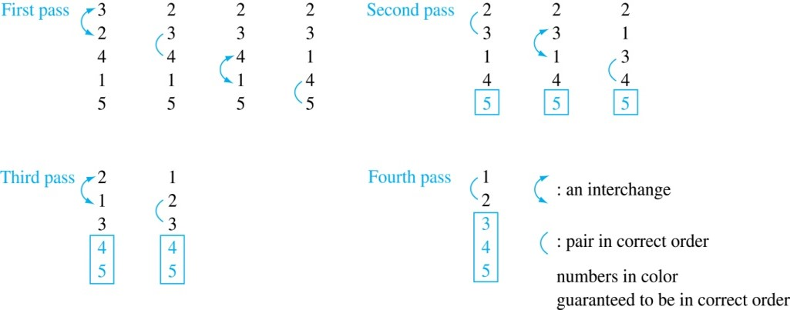
Bubble Sort Example
Example: Show the steps of bubble sort with 3 2 4 1 5

Slide 18
Insertion Sort 插入排序
Insertion sort begins with the 2nd element. It compares the 2nd element with the 1st and puts it before the first if it is not larger.
Next the 3rd element is put into the correct position among the first 3 elements.
In each subsequent pass, the n+1st element is put into its correct position among the first n+1 elements.
Linear search is used to find the correct position.
procedure insertion sort
(a₁, … , a_{n}: real numbers with n ≥ 2)
for j := 2 to n
i := 1
while a_{j} > a_{i}
i := i + 1
m := a_{j}
for k := 0 to j − i − 1
a_{j-k} := a_{j-k-1}
a_{i} := m
{Now a₁,…,a_{n} is in increasing order}

Slide 19
Insertion Sort 2
Example: Show all the steps of insertion sort with the input: 3 2 4 1 5
2 3 4 1 5 (first two positions are interchanged)
2 3 4 1 5 (third element remains in its position)
1 2 3 4 5 (fourth is placed at beginning)
1 2 3 4 5 (fifth element remains in its position)

Slide 20
Section Summary 1
Properties of Algorithms
Algorithms for Searching and Sorting
Greedy Algorithms

Slide 21
Greedy Algorithms 贪婪算法
Optimization problems: minimize or maximize some parameter over all possible inputs. Optimization problems can often be solved using a greedy algorithm.
Greedy algorithm: which makes the “best” choice at each step. Making the “best choice” at each step does not necessarily produce an optimal solution to the overall problem, but in many instances, it does.
Optimal solution: after specifying what the “best choice” at each step is, we try to prove that this approach always produces an optimal solution, or find a counterexample to show that it does not.

Slide 22
Greedy Algorithms: Making Change
Example: Design a greedy algorithm for making change (in U.S. money) of n cents with the following coins: quarters (25 cents), dimes (10 cents), nickels (5 cents), and pennies (1 cent) , using the least total number of coins. 【求最少硬币数】
Idea: At each step choose the coin with the largest possible value that does not exceed the amount of change left.
If n = 67 cents, first choose a quarter leaving 67−25 = 42 cents. Then choose another quarter leaving 42 −25 = 17 cents
Then choose 1 dime, leaving 17 − 10 = 7 cents.
Choose 1 nickel, leaving 7 – 5 = 2 cents.
Choose a penny, leaving one cent. Choose another penny leaving 0 cents.

Slide 23
Greedy Change-Making Algorithm
Solution: Greedy change-making algorithm for n cents. The algorithm works with any coin denominations c₁, c₂, …,c_{r} .
procedure change(c₁, c₂, …, c_{r}: values of coins, where c₁> c₂> … > c_{r} ; n: a positive integer)
for i := 1 to r
d_{i} := 0 [d_{i} counts the coins of denomination c_{i}]
while n ≥ c_{i}
d_{i} := d_{i} + 1 [add a coin of denomination c_{i}]
n = n - c_{i}
[d_{i} counts the coins c_{i}]
For the example of U.S. currency, we may have quarters, dimes, nickels and pennies, with c₁ = 25, c₂ = 10, c₃ = 5, and c₄ = 1.
The optimality can be proved!

Slide 24
Greedy Algorithm-Counterexample
But if we allow only quarters (25 cents), dimes (10 cents), and pennies (1 cent), the algorithm no longer produces the minimum number of coins.
Counterexample: Consider the example of 31 cents. The optimal number of coins is 4, i.e., 3 dimes and 1 penny. What does the algorithm output?(25+1+1+1+1+1+1=31)

Slide 25
Greedy Scheduling 1
Example: We have a group of proposed talks with start and end times. Construct a greedy algorithm to schedule as many as possible in a lecture hall.
How should we make the “best choice” at each step of the algorithm? That is, which talk do we pick ?
starts earliest
shortest
ends earliest

Slide 26
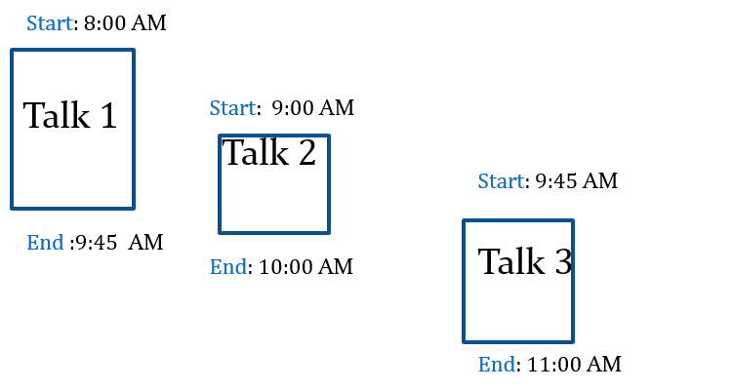
Counterexample-Greedy Scheduling
Picking the shortest talk doesn’t work.
Can you find a counterexample here?
But picking the one that ends soonest does work. The algorithm is specified on the next page.

Slide 27
Greedy Scheduling algorithm
Solution: At each step, choose the talks with the earliest ending time among the talks compatible with those selected.
procedure schedule(s₁ ≤ s₂ ≤ … ≤ s_{n} : start times, e₁ ≤ e₂ ≤ … ≤ e_{n} : end times)
sort talks by finish time and reorder so that e₁ ≤ e₂ ≤ … ≤ e_{n}
S := ∅
for j := 1 to n
if talk j is compatible with S then
S := S ∪{talk j}
return S [ S is the set of talks scheduled]

Slide 28
The Growth of Functions
Section 3.2

Slide 29
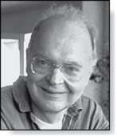
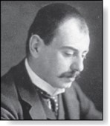
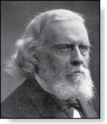
Section Summary
Donald E. Knuth
(Born 1938)
Big-O Notation
Big-O Estimates for Important Functions
Big-Omega and Big-Theta Notation
Edmund Landau
(1877-1938)
Paul Gustav Heinrich Bachmann
(1837-1920)

Slide 30
Big-O Notation 1
Definition: Let f and g be functions from the set of integers or the set of real numbers to the set of real numbers. We say that f(x) is O(g(x)) if there are constants C and k such that
whenever x > k. (illustration on next slide)
This is read as “f(x) is big-O of g(x)” or “g asymptotically dominates f.”
Witnesses (凭证): the constants C and k are called witnesses to the relationship f(x) is O(g(x))

Slide 31
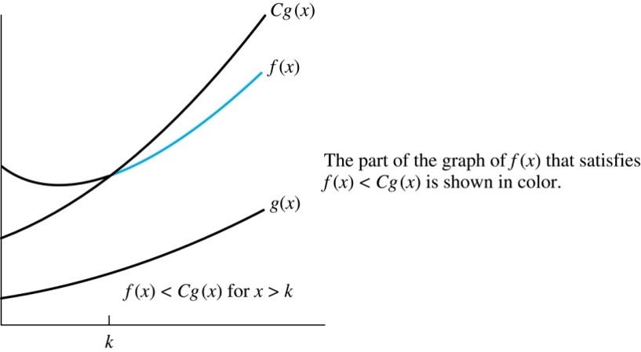
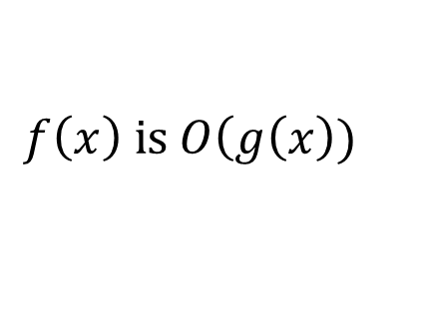
Illustration of Big-O Notation 1
$$f\left(x\right) \text{is} O\left(g\right.\left(x\right))$$

Slide 32

Using the Definition of Big-O Notation 1
Example: Show that is .
Solution: Since when x > 1, x < x² and 1 < x²
$f\left(x\right)=$ $x^{2}+2x+1$
$$0≤x^{2}+2x+1≤x^{2}+2x^{2}+x^{2}=4x^{2}$$
Can take C = 4 and k = 1 as witnesses to show that (see graph on next slide)
Alternatively, when x > 2, we have 2x ≤ x² and 1 < x². Hence, when x > 2.
Can take C = 3 and k = 2 as witnesses instead.

Slide 33
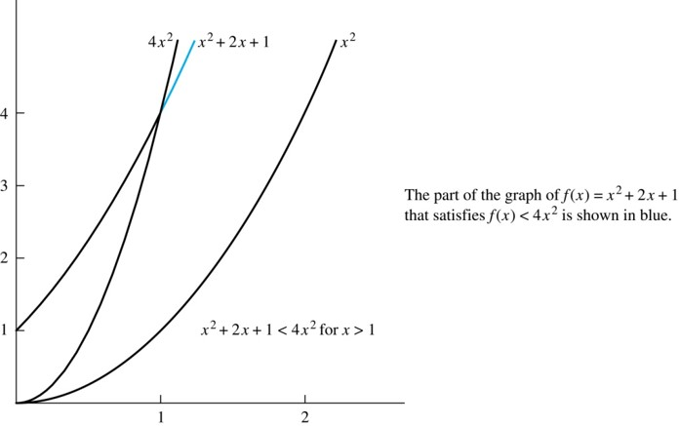
Illustration of Big-O Notation 2

Slide 34
Big-O Notation 2
For we have We say that the two functions are of the same order.
and h(x) is larger than g(x) for all positive real
numbers, then
Note that if
for x > k and if
for all x, then
if x > k. Hence,
For many applications, the goal is to select the function g(x) in O(g(x)) as small as possible (up to multiplication by a constant, of course).

Slide 35
Using the Definition of Big-O Notation 2
Example: Show that 7x² is O(x³).
Solution: When x > 7, 7x² < x³. Take C =1 and k = 7 as witnesses to establish that 7x² is O(x³).
Counterexample: Show that n² is not O(n).
Solution: Suppose there are constants C and k for which n² ≤ Cn, whenever n > k. Then (by dividing both sides of n² ≤ Cn) by n, then n ≤ C must hold for all n > k. A contradiction!

Slide 36
Section Summary
Donald E. Knuth
(Born 1938)
Big-O Notation
Big-O Estimates for Important Functions
Big-Omega and Big-Theta Notation
Edmund Landau
(1877-1938)
Paul Gustav Heinrich Bachmann
(1837-1920)

Slide 37
Big-O Estimates for Polynomials
Example: Let
are real numbers with a_{n} ≠0. Then f(x) is O(x^{n}).
Proof:
Take
and k = 1. Then f(x) is O(x^{n}).
The leading term a_{n}x^{n} of a polynomial dominates its growth.

Slide 38
Big-O Estimates for Some Important Functions
Example: Use big-O notation to estimate the sum of the first n positive integers.
Solution:
Example: Use big-O notation to estimate the factorial function
Solution:

Slide 39
Big-O Estimates for Some Important Functions
Example: Use big-O notation to estimate log n!
Solution: Given that
then
Hence, log(n!) is O(n∙log(n)) taking C = 1 and k = 1.

Slide 40
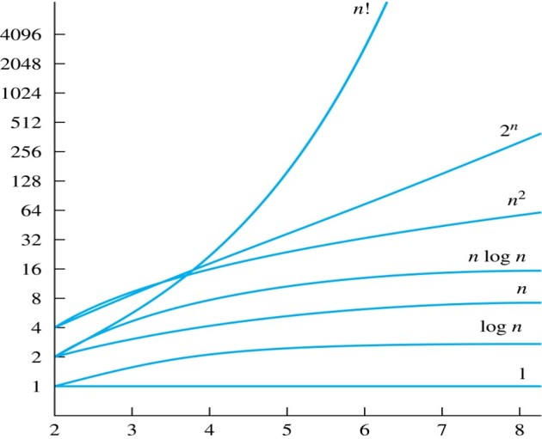
Display of Growth of Functions
Note the difference in behavior of functions as n gets larger

Slide 41
Useful Big-O Estimates Involving Logarithms, Powers, and Exponents
If d > c > 1, then
n^{c} is O(n^{d}), but n^{d} is not O(n^{c}).
If b > 1 and c and d are positive, then
(log_{b} n)^{c} is O(n^{d}), but n^{d} is not O((log_{b} n)^{c}).
If b > 1 and d is positive, then
n^{d} is O(b^{n}), but b^{n} is not O(n^{d}).
If c > b > 1, then
b^{n} is O(c^{n}), but c^{n} is not O(b^{n}).

Slide 42
Combinations of Functions 1
If f₁ (x) is O(g₁(x)) and f₂ (x) is O(g₂(x)) then
( f₁ + f₂ )(x) is O(max(|g₁(x) |,|g₂(x) |)).
See next slide for proof
If f₁ (x) and f₂ (x) are both O(g(x)) then
( f₁ + f₂ )(x) is O(g(x)).
See text for argument
If f₁ (x) is O(g₁(x)) and f₂ (x) is O(g₂(x)) then
( f₁ f₂ )(x) is O(g₁(x)g₂(x)).
See text for argument

Slide 43
Combinations of Functions 2
By the definition of big-O notation, there are constants C₁,C₂ ,k₁,k₂ such that
Therefore
whenever x > k, where k = max(k₁,k₂).

Slide 44
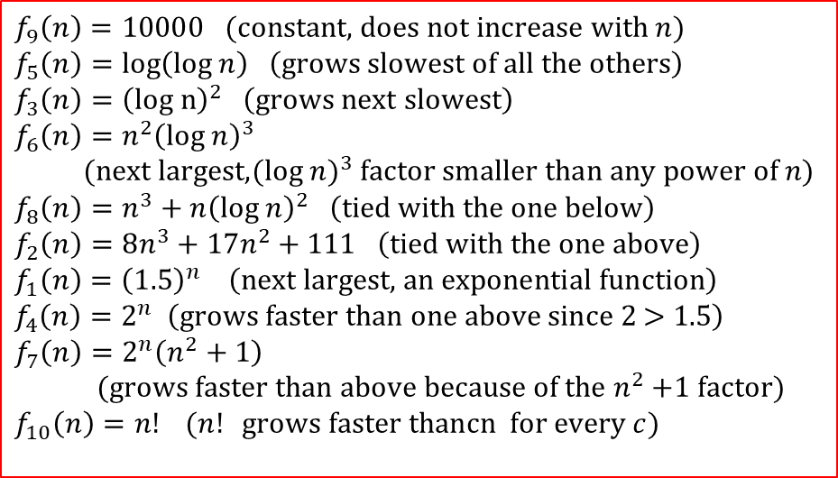
Ordering Functions by Order of Growth
Put the functions below in order so that each function is big-O of the next function on the list.
We solve this exercise by successively finding the function that grows slowest among all those left on the list.
$$f_{9}\left(n\right)=10000 (\text{constant}\text{, }\text{does} \text{not} \text{increase} \text{with} n) \\ f_{5}\left(n\right)=\text{log}\left(\text{log} n\right) \left(\text{grows} \text{slowest} \text{of} \text{all} \text{the} \text{others}\right) \\ f_{3}\left(n\right)={\left(\text{log} \text{n}\right)}^{2} \left(\text{grows} \text{next} \text{slowest}\right) \\ f_{6}\left(n\right)=n^{2}{\left(\text{log} n\right)}^{3}$$
$(\text{next} \text{largest}\text{,}(\text{log} n)^{3} \text{factor} \text{smaller} \text{than} \text{any} \text{power} \text{of} n)$ $$f_{8}\left(n\right)=n^{3}+n{\left(\text{log} n\right)}^{2} \left(\text{tied} \text{with} \text{the} \text{one} \text{below}\right)$$
$$f_{2}\left(n\right)=8n^{3}+17n^{2}+111 \left(\text{tied} \text{with} \text{the} \text{one} \text{above}\right) \\ f_{1}\left(n\right)={\left(1.5\right)}^{n} \left(\text{next} \text{largest}\text{, }\text{an} \text{exponential} \text{function}\right) \\ f_{4}\left(n\right)=2^{n} \left(\text{grows} \text{faster} \text{than} \text{one} \text{above} \text{since}\text{ 2 > 1.5}\right) \\ f_{7}\left(n\right)=2^{n}\left(n^{2}+1\right)$$
$(\text{grows} \text{faster} \text{than} \text{above} \text{because} \text{of} \text{the} n^{2}\text{ +1 }\text{factor})$ $$f_{10}\left(n\right)=n! (n! \text{grows} \text{faster} \text{thancn} \text{for} \text{every} c)$$

Slide 45
Section Summary
Donald E. Knuth
(Born 1938)
Big-O Notation
Big-O Estimates for Important Functions
Big-Omega and Big-Theta Notation
Edmund Landau
(1877-1938)
Paul Gustav Heinrich Bachmann
(1837-1920)

Slide 46
Big-Omega Notation 1
Definition: Let f and g be functions from the set of integers or the set of real numbers to the set of real numbers. We say that if there are constants C and k such that
Ω is the upper case version of the lower case Greek letter ω
when x > k.
We say that “f(x) is big-Omega of g(x).”
Big-O gives an upper bound on the growth of a function, while Big-Omega gives a lower bound. Big-Omega tells us that a function grows at least as fast as another.

Slide 47
Big-Omega Notation 2
Example: Show that
Solution:
positive real numbers x.
Is it also the case that
x³≤ 1*（8 x³ +5 x² +7), taking C=1 and k=1 (x≥1).

Slide 48
Big-Theta Notation 1
Θ is the upper case version of the lower case Greek letter θ.
Definition: Let f and g be functions from the set of integers or the set of real numbers to the set of real numbers. The function
We say that “f(x) is big-Theta of g(x)” and also that “f(x) is of order g(x)” and also that “f(x) and g(x) are of the same order.”
and k such that C₁g(x) < f(x) < C₂ g(x) if x > k. This follows from the definitions of big-O and big-Omega.
if and only if there exists constants C₁ , C₂

Slide 49
Big-Theta Notation 2
Example: Show that the sum of the first n positive integers is Θ(n²).
Solution:
We have already shown that f(n)=n*(1+n)/2 is O(n²).
To show that f(n) is Ω(n²), we need a positive constant C such that f(n) > Cn² for sufficiently large n. Summing only the terms greater than n/2 we obtain the inequality
Taking C =¼, f(n) > Cn² for all positive integers n. Hence, f(n) is Ω(n²), and we can conclude that f(n) is Θ(n²).

Slide 50
Big-Theta Notation 3
Example: Show that Solution:【根据定义】

Slide 51
Big-Theta Notation 4
When
it must also be the case that
Note that
if and only if it is the cases
Sometimes writers are careless and write as if big-O notation has the same meaning as big-Theta.

Slide 52

Big-Theta Estimates for Polynomials
Theorem: Let
are real numbers with a_{n} ≠0.
Then f(x) is of order x^{n} (or Θ(x^{n})).
(The proof is an exercise.)
Example:
The polynomial
is order of x⁵ (or Θ(x⁵)).
The polynomial
$$f\left(x\right)=8x^{199}+7x^{100}+x^{99}+5x^{2}+25$$
is order of x¹⁹⁹ (or Θ(x¹⁹⁹) ).

Slide 53
Complexity of Algorithms
Section 3.3

Slide 54
Section Summary
Time Complexity
Worst-Case Complexity
Understanding the Complexity of Algorithms

Slide 55
The Complexity of Algorithms 1
How efficient: Given an algorithm, how efficient is this algorithm for solving a problem given input of a particular size? To answer this question, we ask:【算法复杂度】
How much time does this algorithm use to solve a problem?
How much computer memory does this algorithm use to solve a problem?
time complexity 【时间复杂度】: When we analyze the time the algorithm uses to solve the problem given input of a particular size, we are studying the time complexity of the algorithm.
space complexity 【空间复杂度】: When we analyze the computer memory the algorithm uses to solve the problem given input of a particular size, we are studying the space complexity of the algorithm.

Slide 56
The Complexity of Algorithms 2
time complexity big-O :We will measure time complexity in terms of the number of operations an algorithm uses and we will use big-O and big-Theta notation to estimate the time complexity.
ignore hardware and software: We ignore implementation details (including the data structures used and both the hardware and software platforms) because it is extremely complicated to consider them.

Slide 57
Time Complexity
worst-case time complexity :We will focus on the worst-case time complexity of an algorithm. This provides an upper bound on the number of operations an algorithm uses to solve a problem with input of a particular size.
average case time complexity :It is usually much more difficult to determine the average case time complexity of an algorithm. This is the average number of operations an algorithm uses to solve a problem over all inputs of a particular size.

Slide 58
Complexity Analysis of Algorithms
Example: Describe the time complexity of the algorithm for finding the maximum element in a finite sequence.
procedure max(a₁, a₂, …., a_{n}: integers)
max := a₁
for i := 2 to n
if max < a_{i} then max := a_{i}
return max{max is the largest element}
Solution: Count the number of comparisons.
The max < a_{i} comparison is made n − 1 times.
Each time i is incremented, a test is made to see if i ≤ n.
One last comparison determines that i > n.
Exactly 2(n − 1) + 1 = 2n − 1 comparisons are made.
Hence, the time complexity of the algorithm is Θ(n).

Slide 59
Section Summary
Time Complexity
Worst-Case Complexity
Understanding the Complexity of Algorithms

Slide 60
Worst-Case Complexity of Linear Search
Example: Determine the time complexity of the linear search algorithm.
procedure linear search( x : integer,
a₁, a₂, …, a_{n}: distinct integers)
i := 1
while (i ≤ n and x ≠ a_{i})
i := i + 1
if i ≤ n then location := i
else location := 0
return location{location is the subscript of the term that equals x, or is 0 if x is not found}
Solution: Count the number of comparisons.
At each step two comparisons are made; i ≤ n and x ≠ a_{i} .
To end the loop, one comparison i ≤ n is made.
After the loop, one more i ≤ n comparison is made.
If x = a_{i} , 2i + 1 comparisons are used. If x is not on the list, 2n + 1 comparisons are made and then an additional comparison is used to exit the loop. So, in the worst case 2n + 2 comparisons are made. Hence, the complexity is Θ(n).

Slide 61
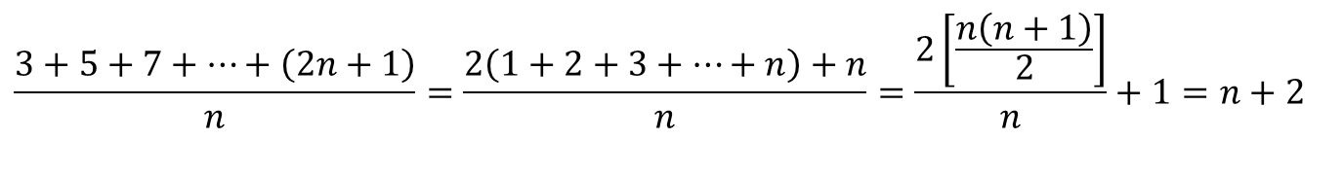
Average-Case Complexity of Linear Search
Example: Describe the average case performance of the linear search algorithm. (Although usually it is very difficult to determine average-case complexity, it is easy for linear search.)
Solution: Assume the element is in the list and that the possible positions are equally likely. By the argument on the previous slide, if x = a_{i} , the number of comparisons is 2i + 1.
$$\frac{3+5+7+…+\left(2n+1\right)}{n}=\frac{2\left(1+2+3+…+n\right)+n}{n}=\frac{2\left[\frac{n\left(n+1\right)}{2}\right]}{n}+1=n+2$$
Hence, the average-case complexity of linear search is Θ(n).

Slide 62
Worst-Case Complexity of Binary Search
Example: Describe the time complexity of binary search in terms of the number of comparisons used.
procedure binary search(x: integer, a₁,a₂,…, a_{n}: increasing integers)
i := 1 {i is the left endpoint of interval}
j := n {j is right endpoint of interval}
while i < j
m := ⌊(i + j)/2⌋
if x > a_{m} then i := m + 1
else j := m
if x = a_{i} then location := i
else location := 0
return location{location is the subscript i of the term a_{i} equal to x, or 0 if x is not found}
Solution: Assume (for simplicity) n = 2^{k} elements. Note that k = log n.
Two comparisons are made at each stage; i < j, and x > a_{m} .
At the first iteration the size of the list is 2^{k} and after the first iteration it is 2^{k-1}. Then 2^{k-2} and so on until the size of the list is 2¹ = 2.
At the last step, a comparison tells us that the size of the list is the size is 2⁰ = 1 and the element is compared with the single remaining element.
Hence, at most 2k + 2 = 2 log n + 2 comparisons are made.
Therefore, the time complexity is Θ (log n), better than linear search.

Slide 63
Worst-Case Complexity of Bubble Sort
Example: What is the worst-case complexity of bubble sort in terms of the number of comparisons made?
procedure bubblesort (a₁,…,a_{n}: real numbers with n ≥ 2)
for i := 1 to n− 1
for j := 1 to n − i
if a_{j} >a_{j+1} then interchange a_{j} and a_{j+1}
{a₁,…, a_{n} is now in increasing order}
Solution: A sequence of n−1 passes is made through the list. On each pass n − i comparisons are made.
The worst-case complexity of bubble sort is Θ(n²) since

Slide 64
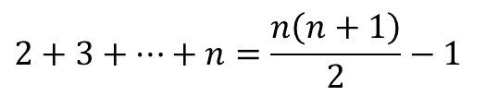
Worst-Case Complexity of Insertion Sort
Example: What is the worst-case complexity of insertion sort in terms of the number of comparisons made?
procedure insertion sort (a₁,…,a_{n}:
real numbers with n ≥ 2)
for j := 2 to n
i := 1
while a_{j} > a_{i}
i := i + 1
m := a_{j}
for k := 0 to j − i − 1
a_{j-k} := a_{j-k-1}
a_{i} := m
Solution: The total number of comparisons are
$$2+3+⋯+n=\frac{n\left(n+1\right)}{2}−1$$
Therefore the complexity is Θ(n²).

Slide 65
Section Summary
Time Complexity
Worst-Case Complexity
Understanding the Complexity of Algorithms

Slide 66
Understanding the Complexity of Algorithms 1
TABLE 1 Commonly Used Terminology for the Complexity of Algorithms.
Complexity | Terminology
Θ(1) | Constant complexity
Θ(log n) | Logarithmic complexity
Θ(n) | Linear complexity
Θ(n log n) | Linearithmic complexity
Θ(n^{b}) | Polynomial complexity
Θ(b^{n}), where b > 1 | Exponential complexity
Θ(n!) | Factorial complexity

Slide 67
Understanding the Complexity of Algorithms 2
TABLE 2 The Computer Time Used by Algorithms.
Problem Size |  |  | Bit Operations Used
n | 𝐥𝐨𝐠 n | n | n 𝐥𝐨𝐠 n | n² | 2^{n} | n!
Times of more than 10¹⁰⁰ years are indicated with an *.

Slide 68
Complexity of Problems
Tractable Problem: There exists a polynomial time algorithm to solve this problem. These problems are said to belong to the Class P.
Intractable Problem: There does not exist a polynomial time algorithm to solve this problem. 【指数或阶乘级时间复杂度】
Unsolvable Problem : No algorithm exists to solve this problem, e.g., halting problem.【停机问题】
Class NP: Solution can be checked in polynomial time. But no polynomial time algorithm has been found for finding a solution to problems in this class. 【N-皇后问题】
NP Complete Class: If you find a polynomial time algorithm for one member of the class, it can be used to solve all the problems in the class. 【穷举问题】

Slide 69
Homework
§3.1 4, 27, 51 §3.2 25, 34 §3.3 2, 3
Due date : 2024.04.02

